Slide 1
Improving the SND Online System
Rebecca Osar
Supervisor: Federico Cindolo

Slide 2
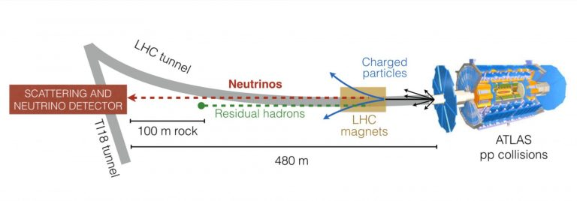
Scattering and Neutrino Detector (SND)
New apparatus located 480m from the Atlas collision site
Detects and identifies all three neutrino flavors

Slide 3
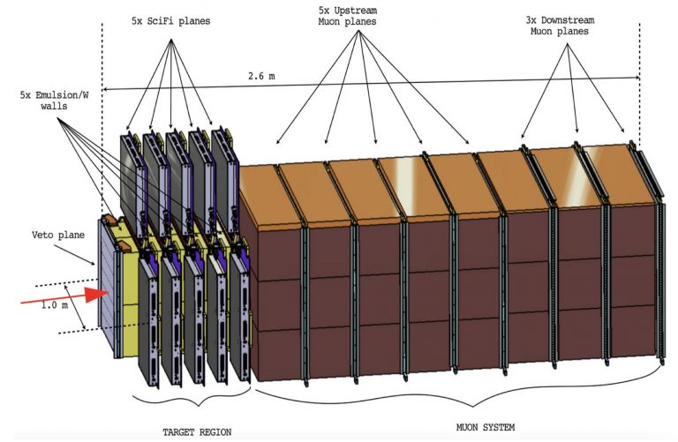
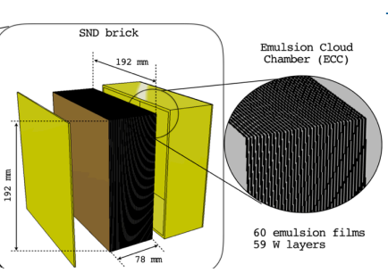
Scattering and Neutrino Detector (SND)
Detector Setup Emulsion Target

Slide 4
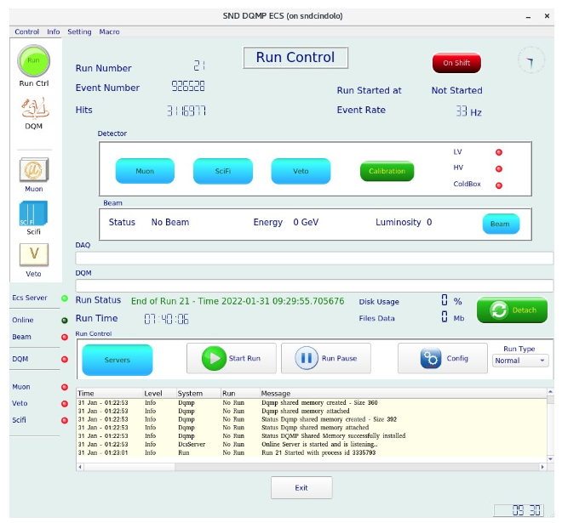
The Monitor System
Monitors detector elements and data quality
Initiates response protocols
Notifies shifters if a problem occurs
Electronic Control System (ECS) GUI

Slide 5
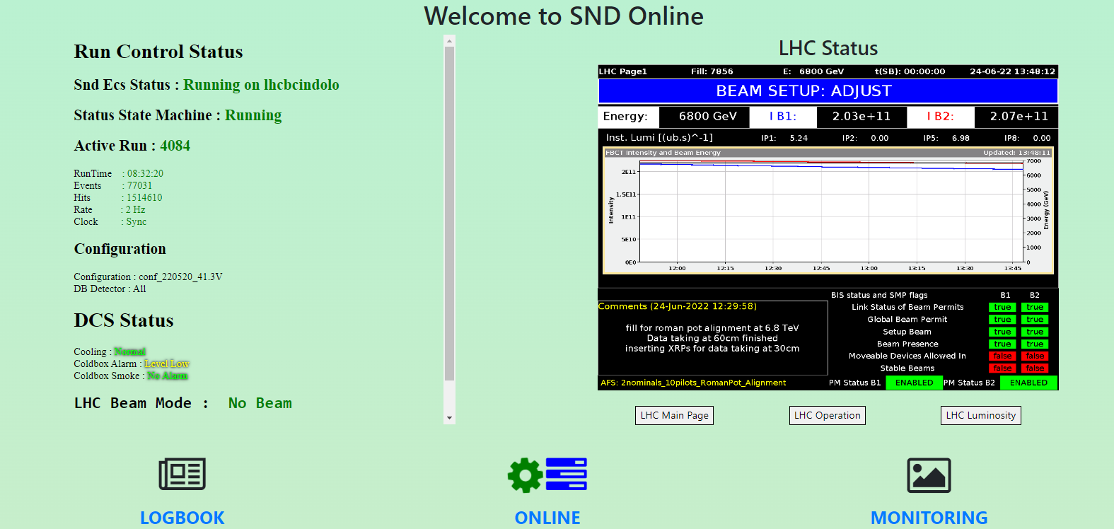
SND Online
Updates in real time :)

Slide 6
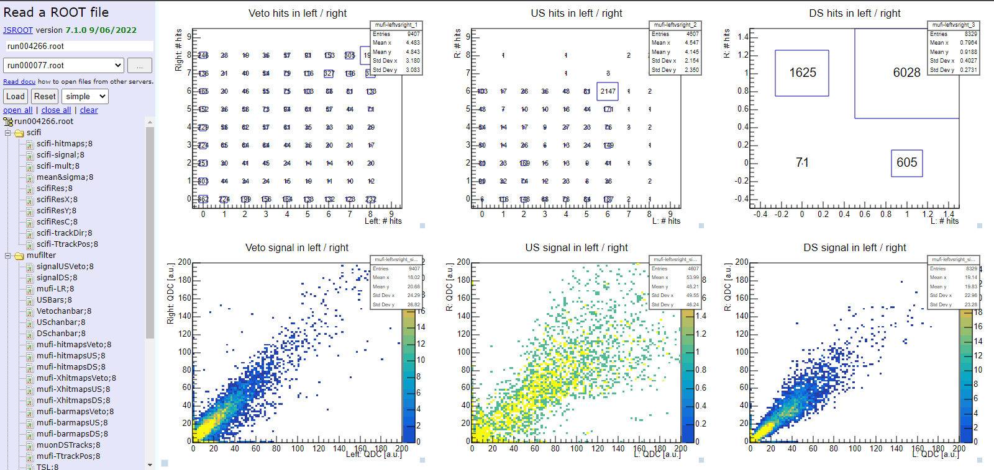
SND Online - Monitoring
Choose a run
Choose detector histograms to view

Slide 7
My Project Goals:
Write histograms with real-time analysis to the SND webpage
  luminosity
  background
  event rate
Implement data quality monitoring in the ECS GUI
Help assemble emulsion walls for the replacement in late July
Help develop emulsion films from current runs

Slide 8
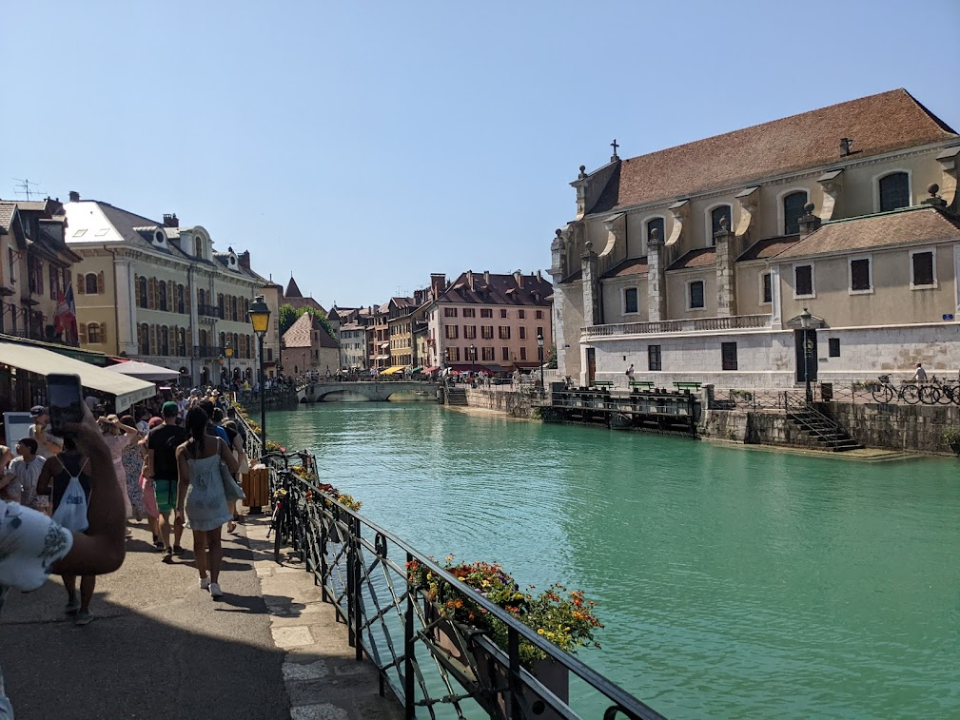
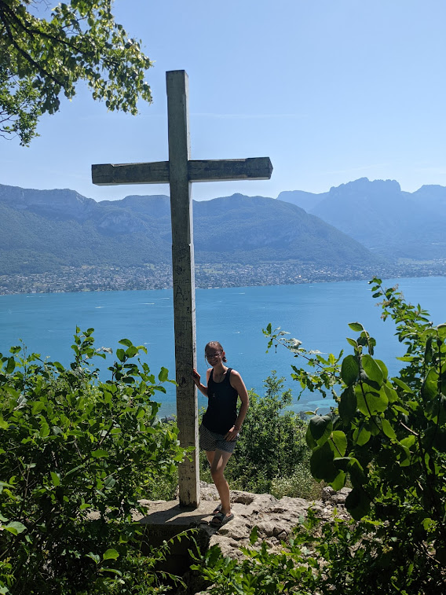
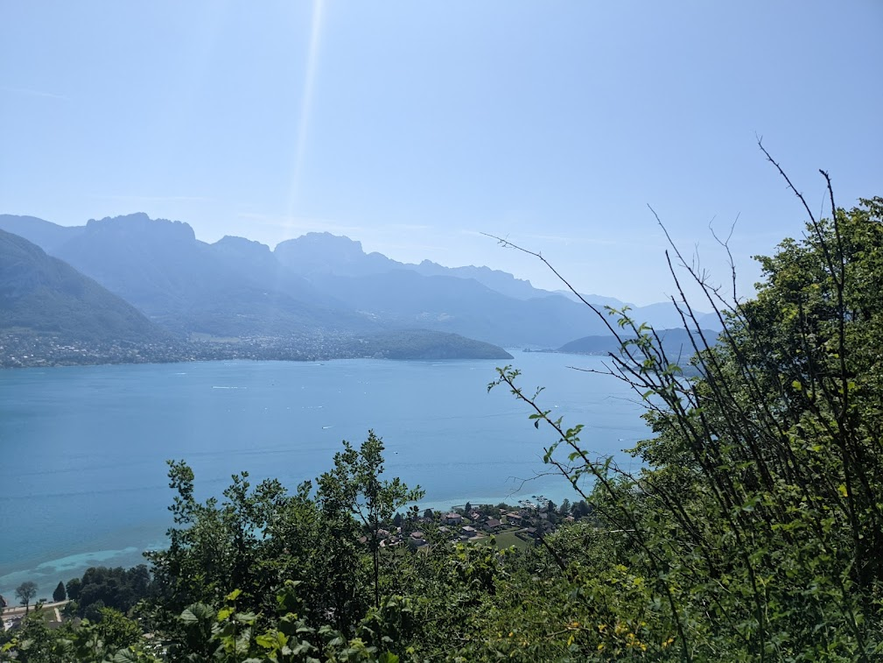
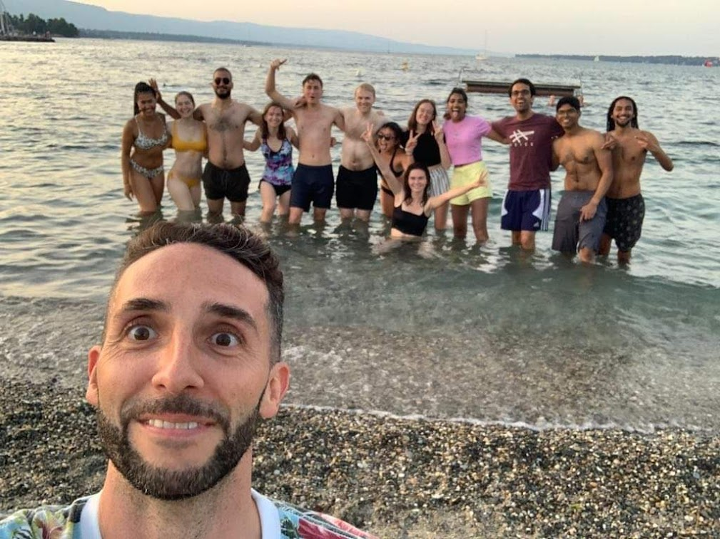
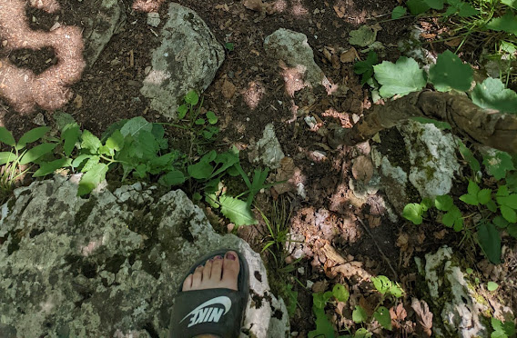
~Excursions~

Slide 9
Questions?

