Slide 1
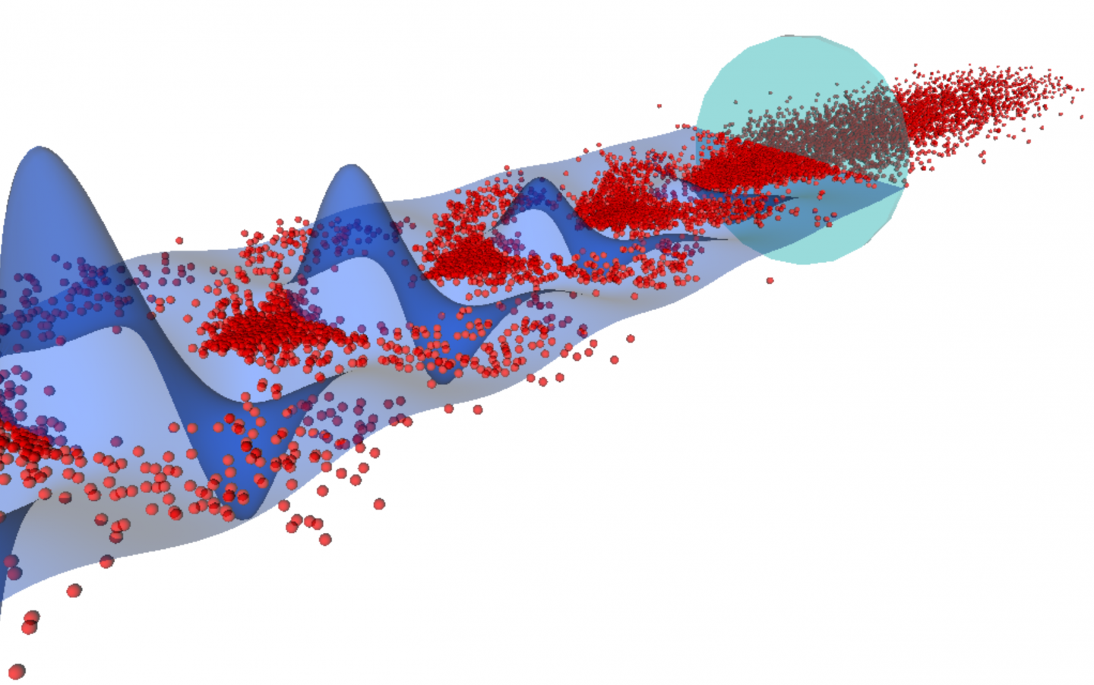

Adiabatic Focusing in Low Density Plasmas in AWAKE
University of Michigan CERN REU
Morgan Cole - University of California, Berkeley
Supervisors: Livio Verra & Edda Gschwendtner

Slide 2
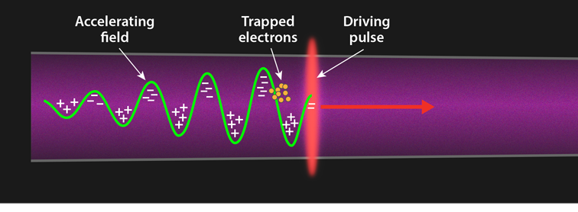
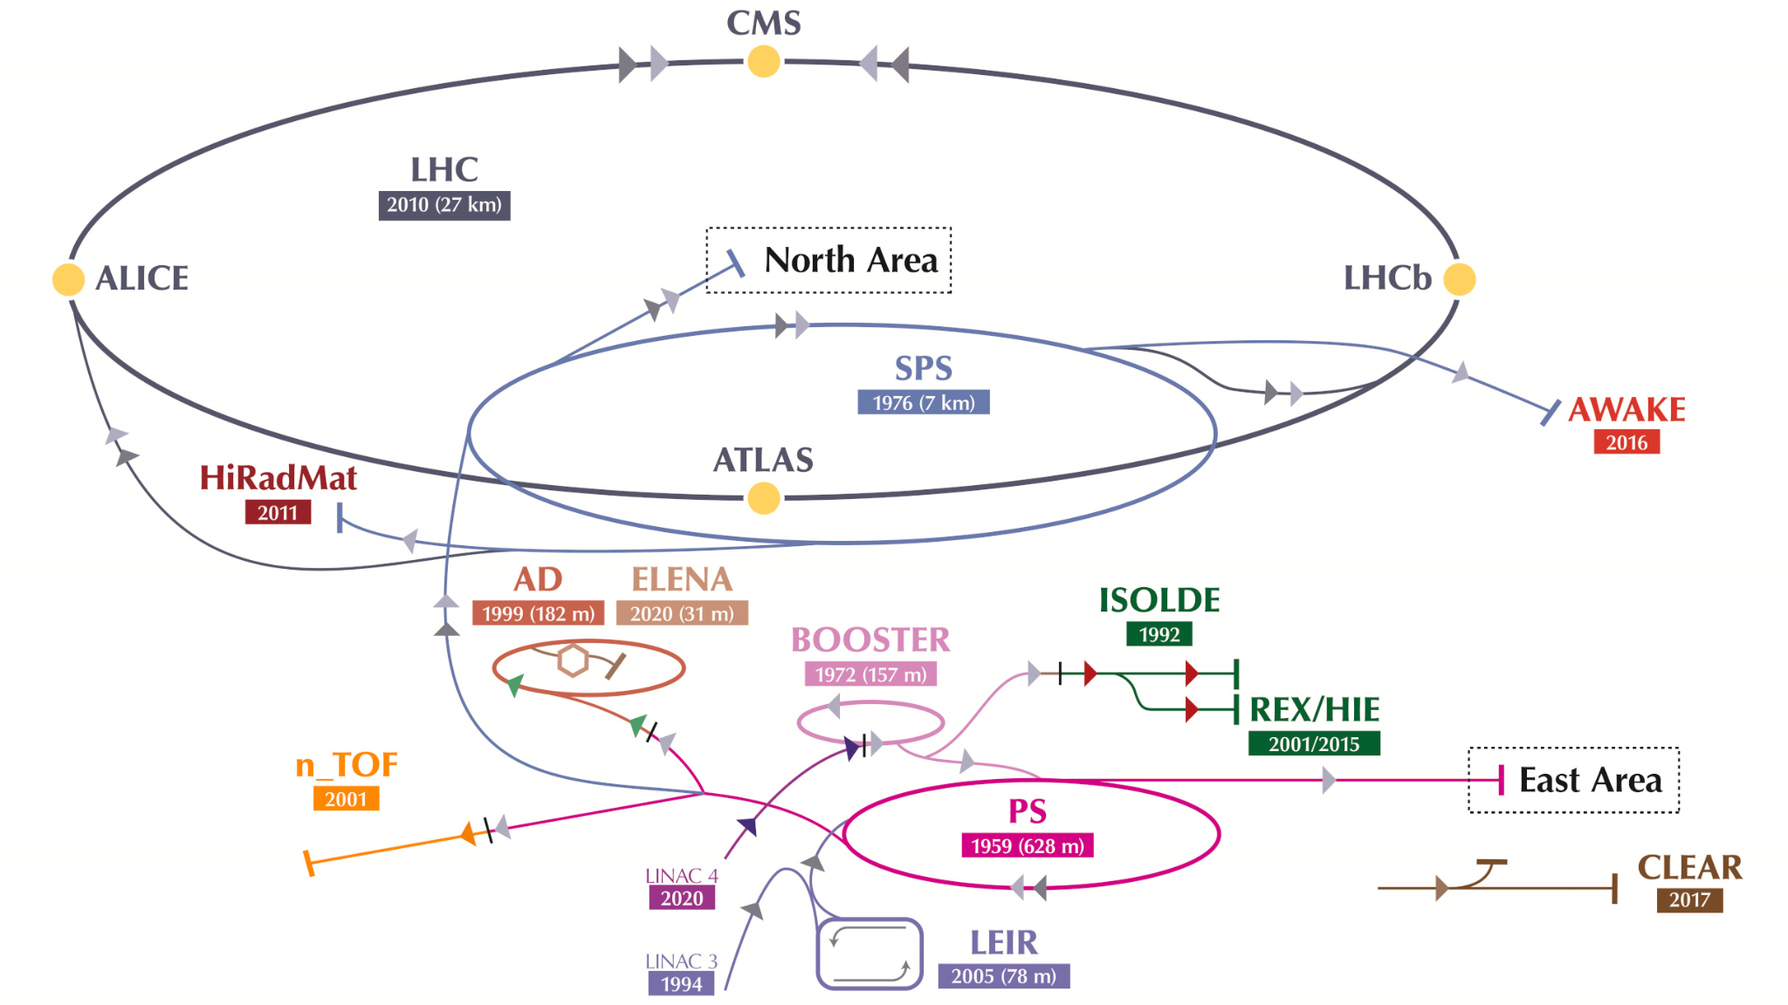
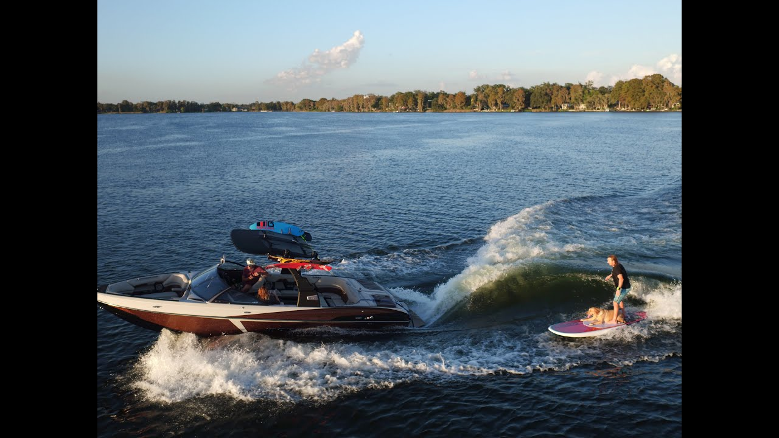
What is AWAKE?
Advanced WAKEfield Experiment
Plasma field (water), driving bunch of protons (boat), witness electron bunch (surfer)
APS/Alan Stonebraker

Slide 3

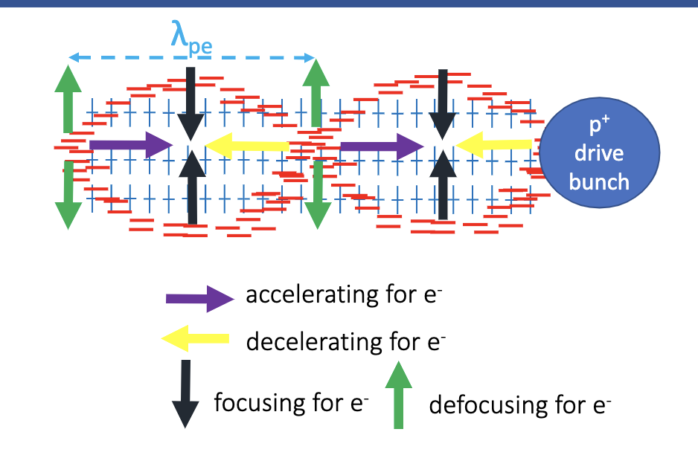
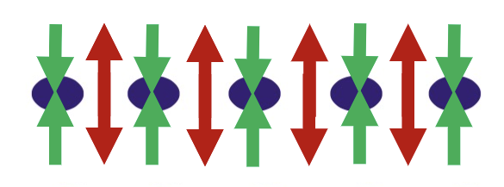
Self-Modulation Instability
Plasma wave focusing & defocusing regions
High-density plasma → SMI (micro-bunches)
Proton Bunch - No plasma
SMI - High-density plasma

Slide 4
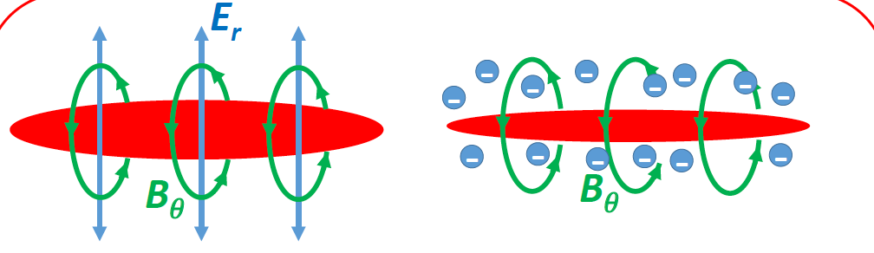
Adiabatic Focusing
Dominant effect in low density plasma
Proton beam “focuses itself” with magnetic field

Slide 5
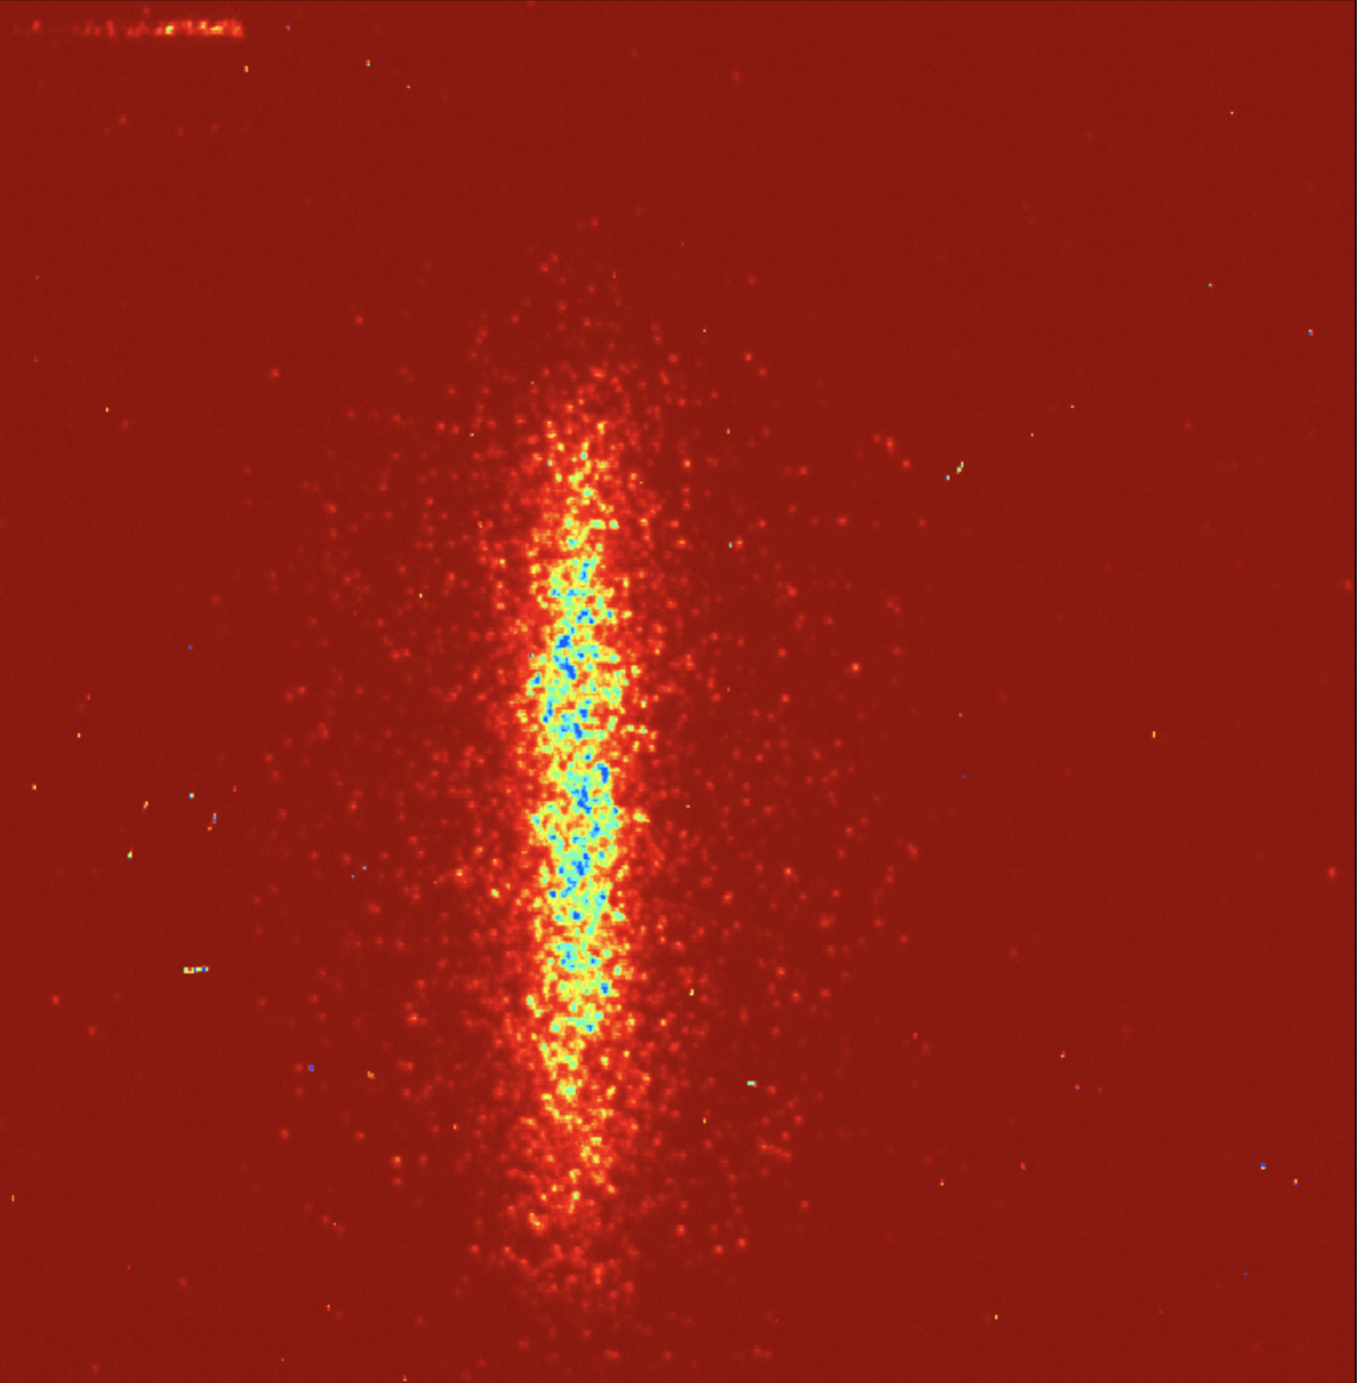
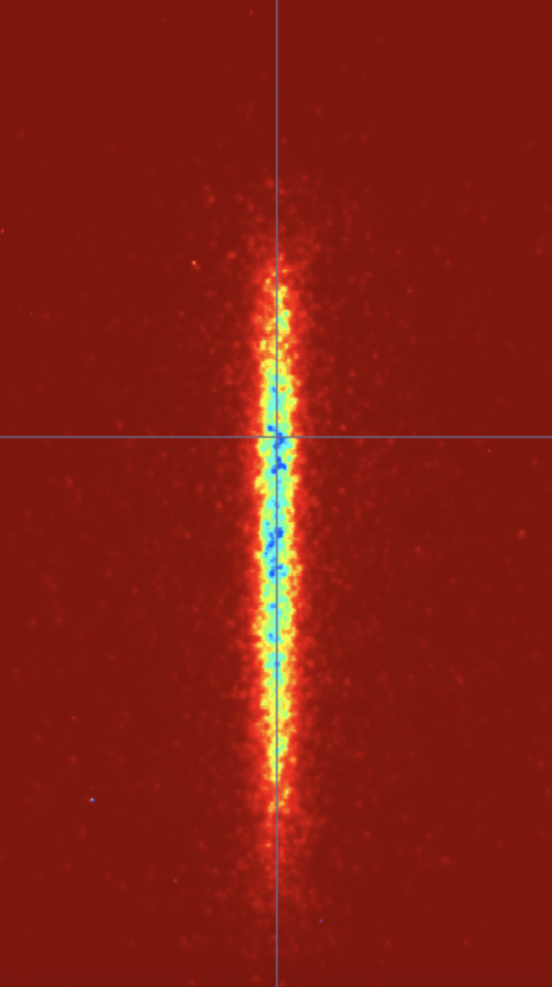
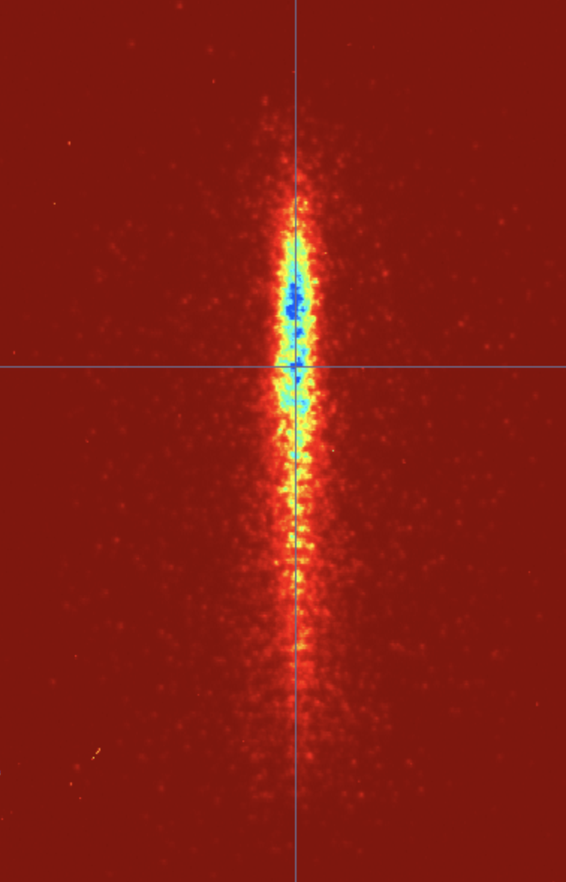
Plans for Upcoming Experiment
Time-averaged streak camera images of proton bunch
Increasing Plasma Density
No plasma
w/Plasma
Self Modulation

Slide 6
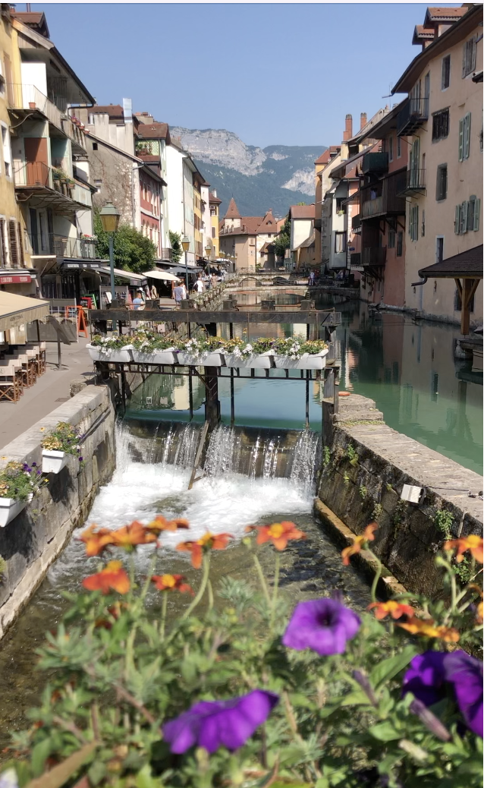
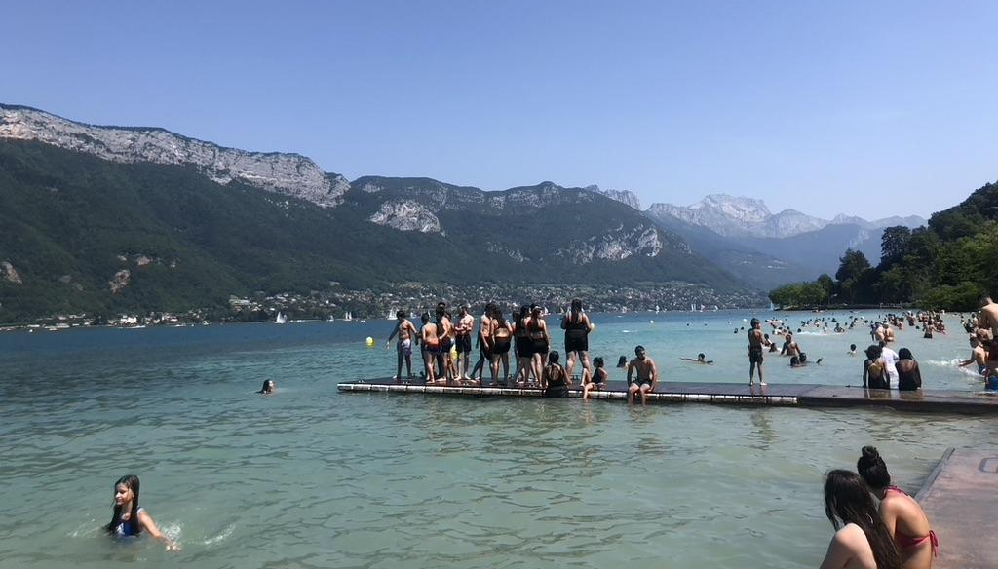
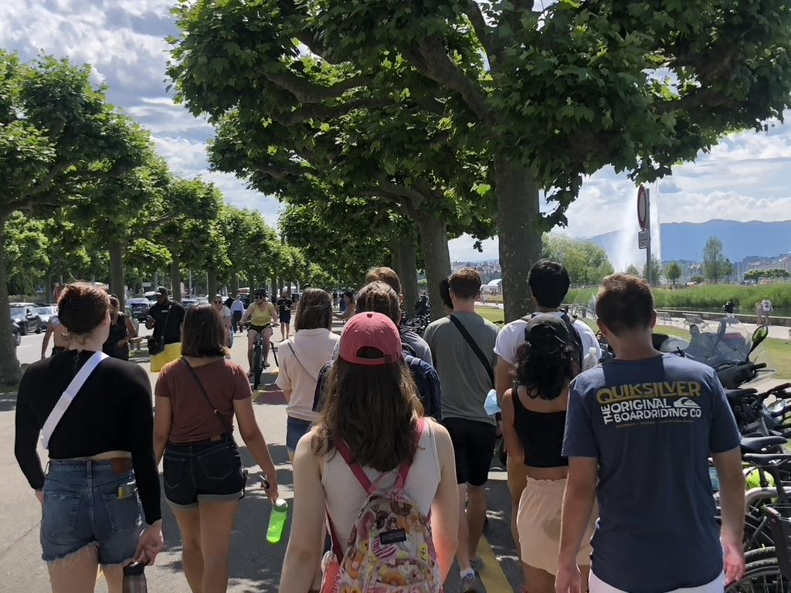
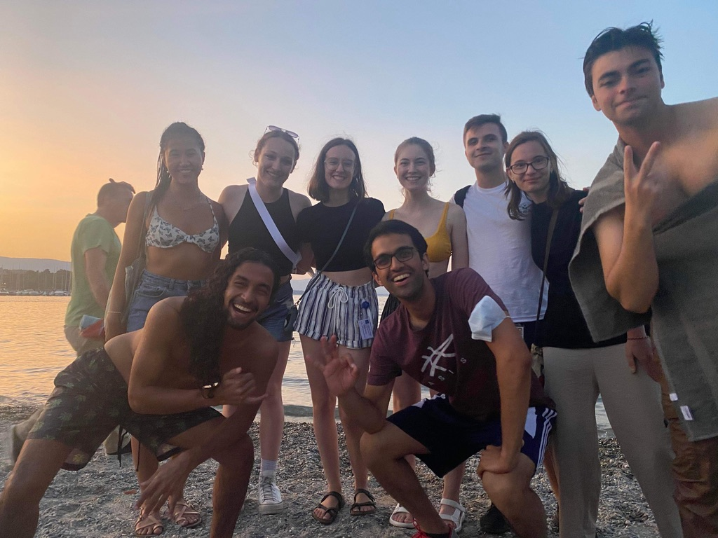
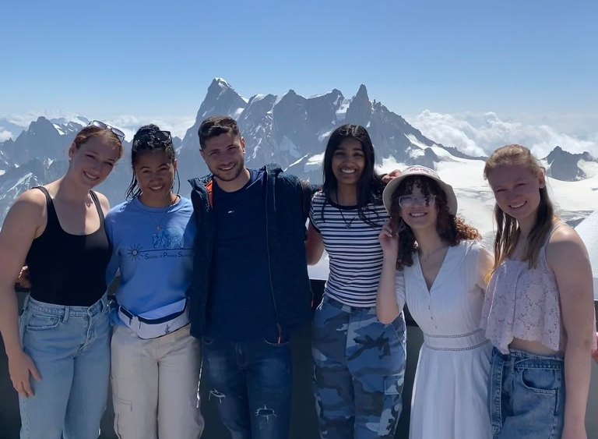
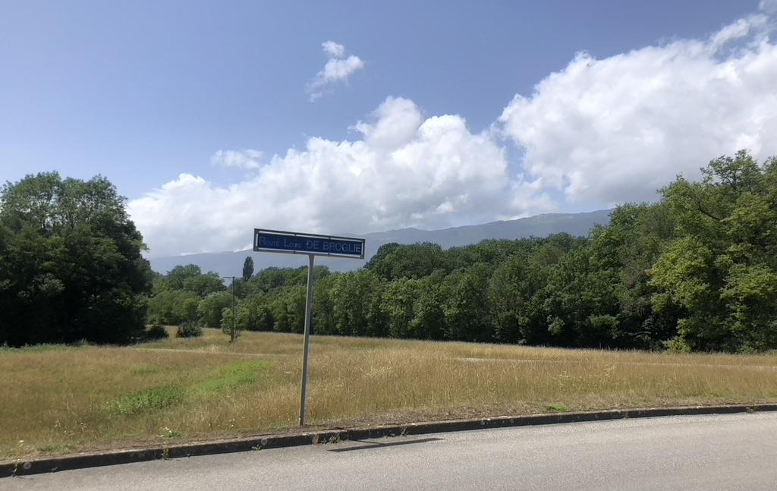
Pictures :)

