Slide 1
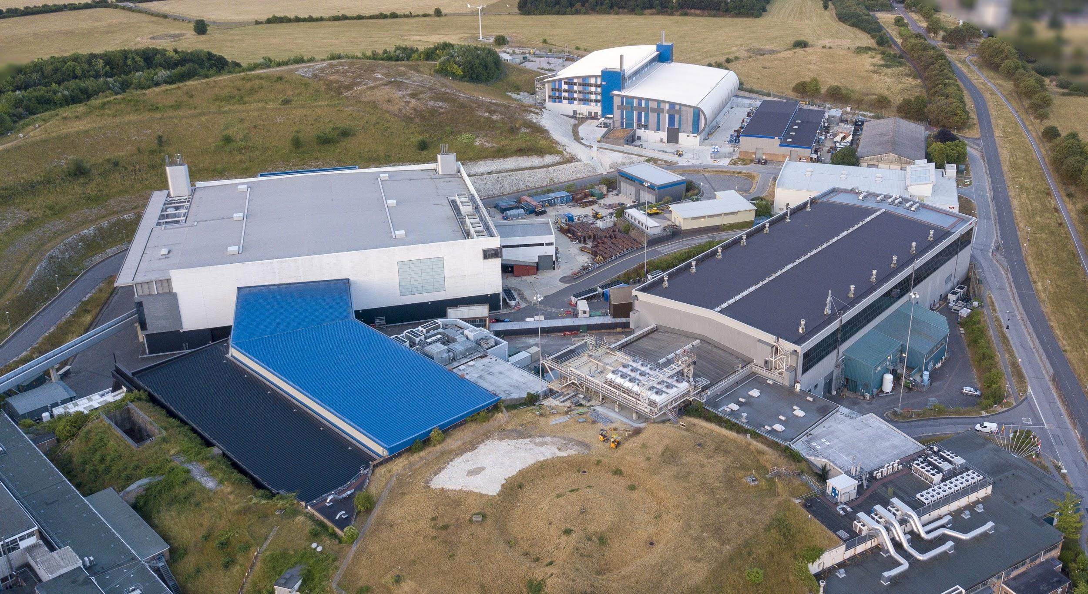


Notes:
To edit the background image, select ‘Format’ from the PowerPoint menu and ‘Slide Background’ from the drop-down menu. Within the new list of options that appears on the right of the screen, select the ‘File’ button under ‘Insert picture from’ and select your image from your file browser. Please remove or amend the image credit if you are using a different image to the one provided.

Slide 2



EPICS Transition
at the ISIS Accelerators
Ivan Finch
What we use now,
Where we’re going,
How we’re going to get there
Notes:
Remember to point out that ISIS Instrumentation Controls (Freddie and Kathryn) are already on EPICS, and we are belatedly following

Slide 3

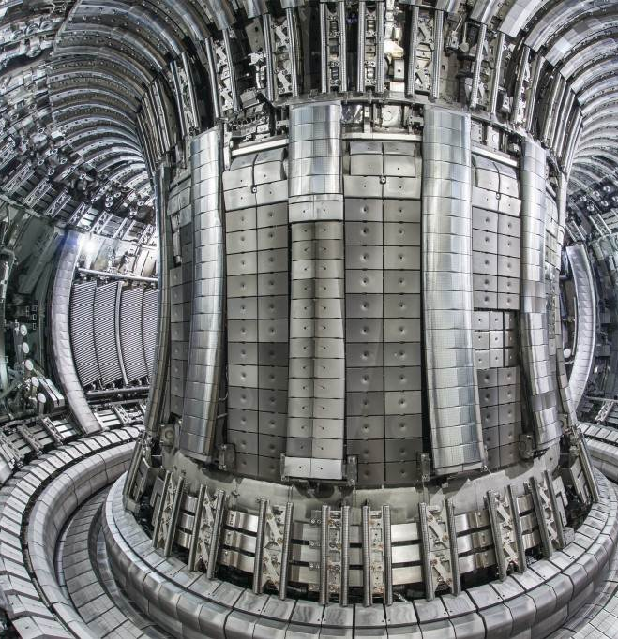
Collaborations
First-time meeting the wider EPICS Community and asking for help was at Cadarache / ITER 2019!
Received valuable advice – foremost having a good naming convention document and sticking to it
EPICS Oxfordshire is running again – ISIS, Diamond, CLF, and CCFE. But last also involved Daresbury. Next planned for Jan / Feb; if interested let me know!
© ITER Organisation
Notes:
Don't want to offend the Fritz-Haber-Institut or Canadian Light Source;
CCFE = Culham Centre for Fusion Energy

Slide 4


What We Use Now
Our existing hardware and software

Slide 5
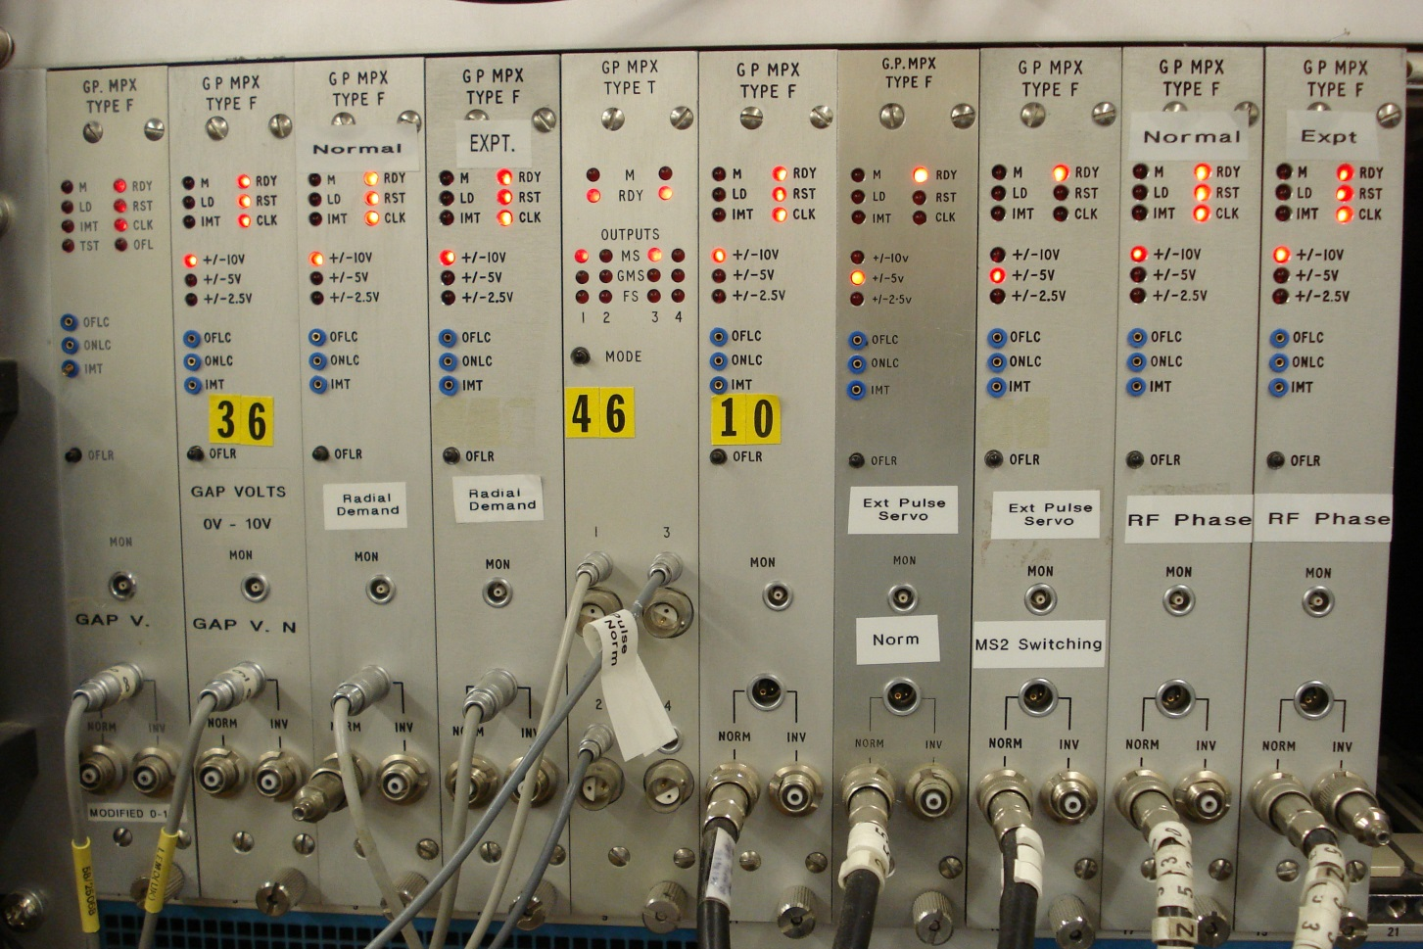
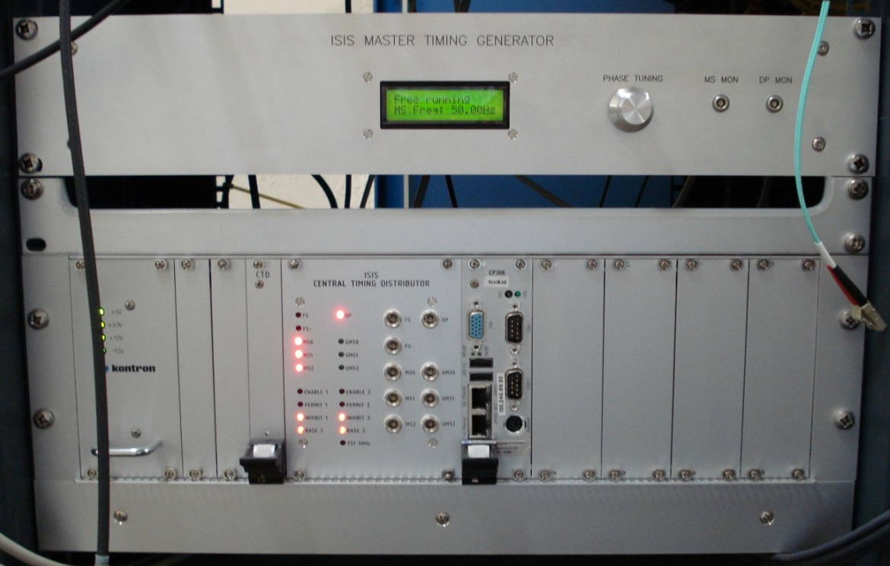
Heterogenous Hardware
There are three generations of hardware (MPX, STE, and CPS) developed in-house and managed by the controls group. We still have a small amount of controls hardware (MPX crates) from the 1980s.
The largest set of hardware the controls system interfaces with is our CPS systems.
As well as these systems we need to interface with a variety of PLCs via FINS and Modbus, and soon CIP. Also National Instruments PXI crates and other more exotic hardware.
Notes:
MPX is a relative of the CAMAC crates used at Cern in the ‘70s. STE and CPS systems are industrial PC chases (standard backplanes) running custom cards.

Slide 6
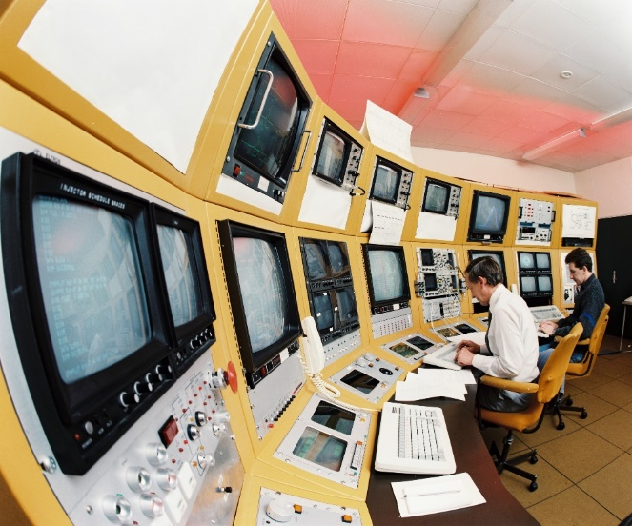
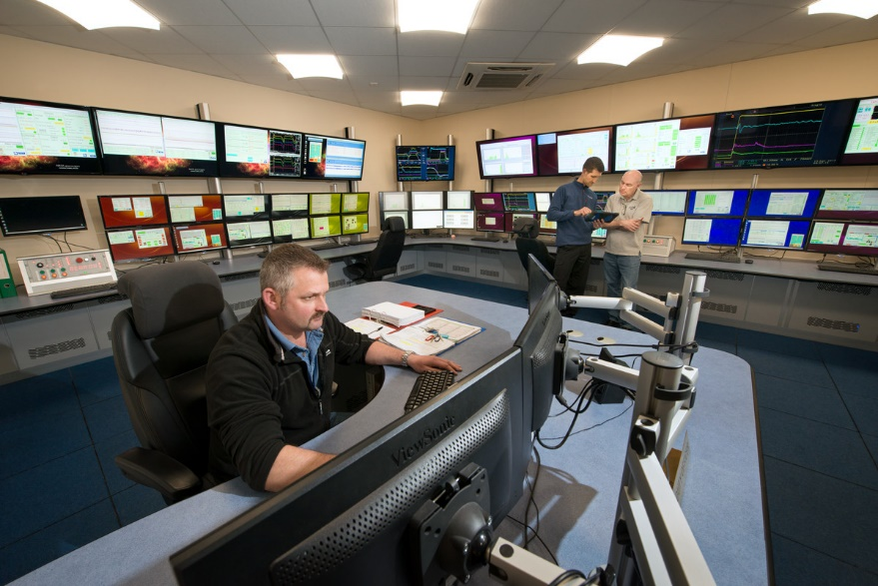
Vsystem at ISIS
EPICS will be our third control system.
Currently we use the proprietary closed-source Vsystem control system, which is a complete package including alarm handler and logging. We have customised this system with our own MQTT interface, data archiving, and web-based alarm viewer.
The only other accelerator site that uses Vsystem is ATLAS at Argonne.
Notes:
First control system was Babbage / Graces which used touchscreens
First control system is Graces Babbage. We've also been through operating system and processor architecture changes.
Vsystem is a "cousin" to EPICS, came form LANL in the 80s. Bad blood.
The Argonne Tandem Linac Accelerator System (ATLAS) is the world’s first superconducting linear accelerator for heavy ions at energies in the vicinity of the Coulomb barrier.

Slide 7
Where We’re Going
What our implementation of EPICS will look like

Slide 8
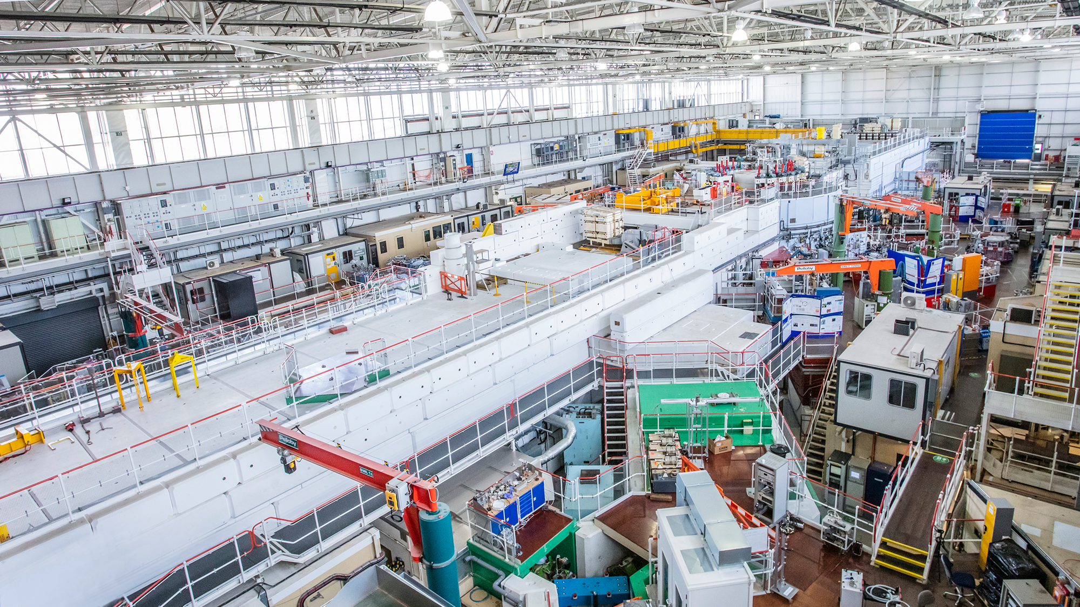

Transition Decisions
Made
favour PVAccess over Channel Access
prefer IOCs (or equivalents) in containers on centrally managed servers
Phoebus for user interaction
Deferred
selection of technology for archiving of PVs
selection of alarm handler software
Opportunistic
Allow obsolescence to take care of old hardware
Fortunate
Already a dedicated controls network
Notes:
Somewhat deliberately we have modelled ourselves after how I understand ESS to work, and less deliberately like Diamond, and entirely accidentally very differently from ISIS Instrumentation.

Slide 9
How We’re Getting There
The transition from Vsystem to EPICS

Slide 10
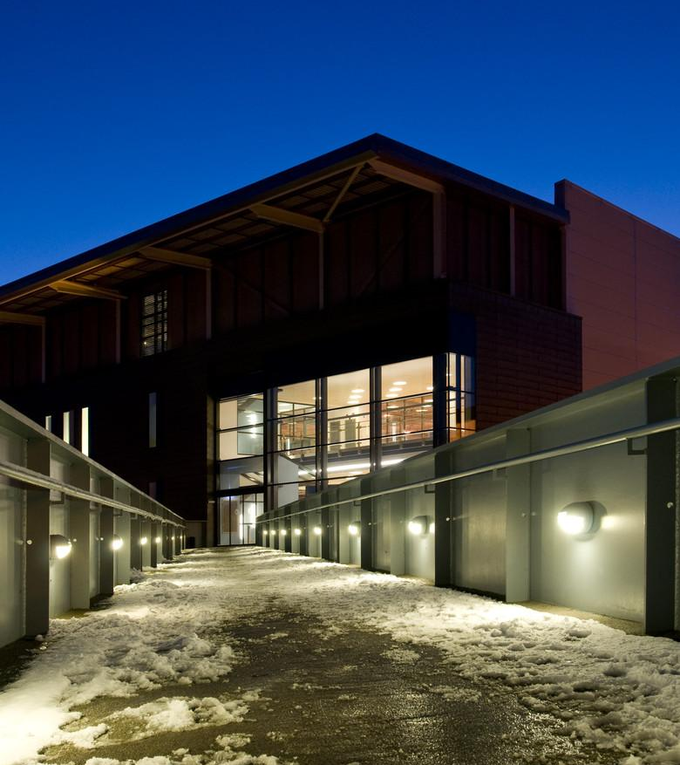
Hardware Interfaces
First from-scratch IOCs developed to interface with Omron PLCs via the CIP protocol
We have tested community developed EPICS IOCs interfacing with:
FINS (used for existing target station Omron PLCs)
MODBUS (used by synchrotron RF and other users)
Proprietary XML format used by our CPS & PXI crates
We will not be interfacing MPX and STE directly to EPICS, instead supporting to obsolescence through PVEcho
Notes:
Mention that Basil is the best person to talk to about all this. He will be giving a lightning talk on the interface to new Omron PLCs

Slide 11
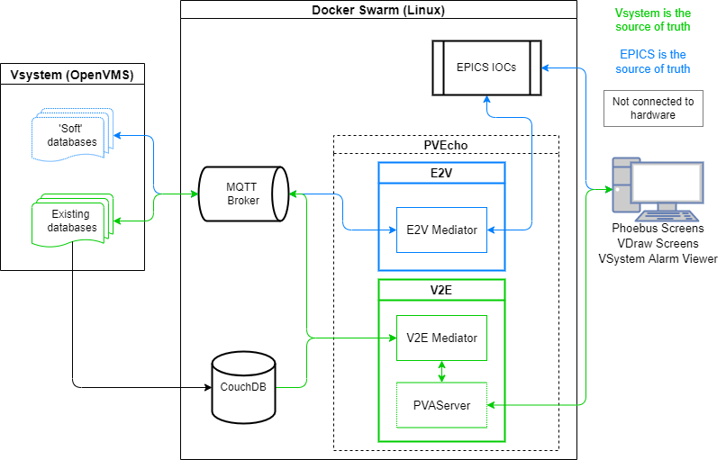
PVEcho – Bridge between EPICS and Vsystem
~10k Lines of Code (Python), of which ~7.5k LOCs are unit and integration tests
Supporting systems include Vsystem events driven Python code, Mosquitto (MQTT broker), CouchDB, etc.
Deployed and working since Dec 2021, but still under development
Notes:
Don’t go into technical details – Kathryn has a lightning talk
Example of improvements: IO errors, making more robust, improving metadata update speed

Slide 12
Screens Conversion (vcdParser)
Vsystem control screens are saved in a binary file format (VCD files). The format of these VCD files was unknown, but through experimentation the file format has been decoded.
EPICS has a variety of GUI tools, but most development is concentrated in CS Studio (used in ISIS Experiment Controls) and Phoebus (closely related). We have selected Phoebus. Phoebus uses XML files which may largely be understood by inspection.
We have written a program, vcdParser, which automatically converts Vsystem control screens into Phoebus control screens.

Slide 13
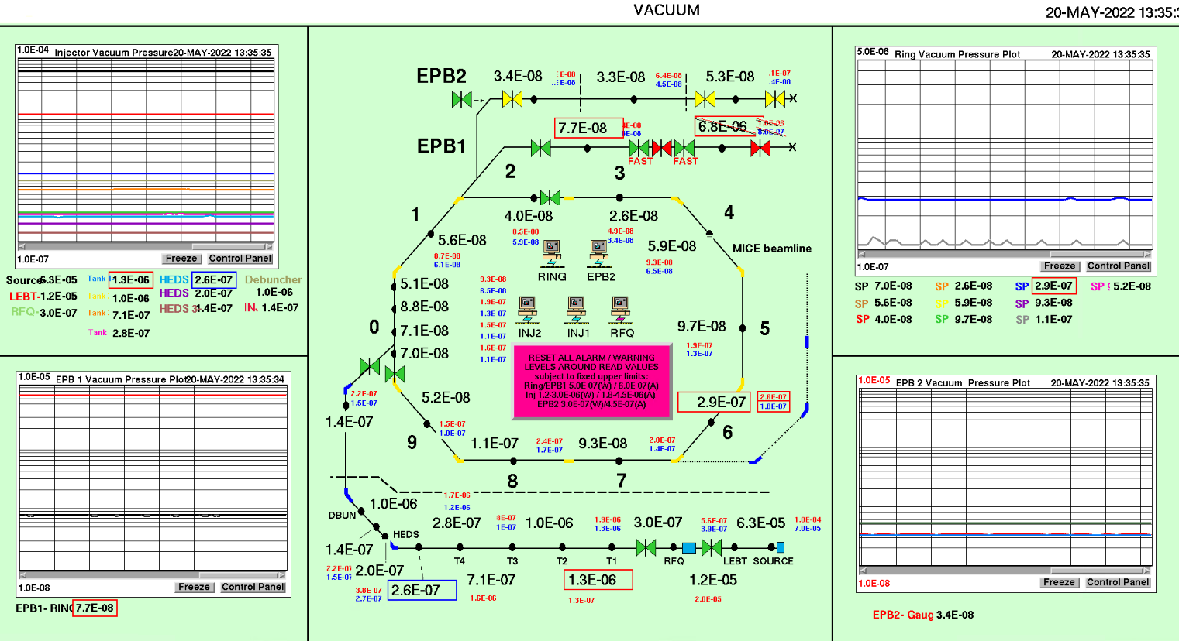
Screens Conversion – Vsystem Original

Slide 14
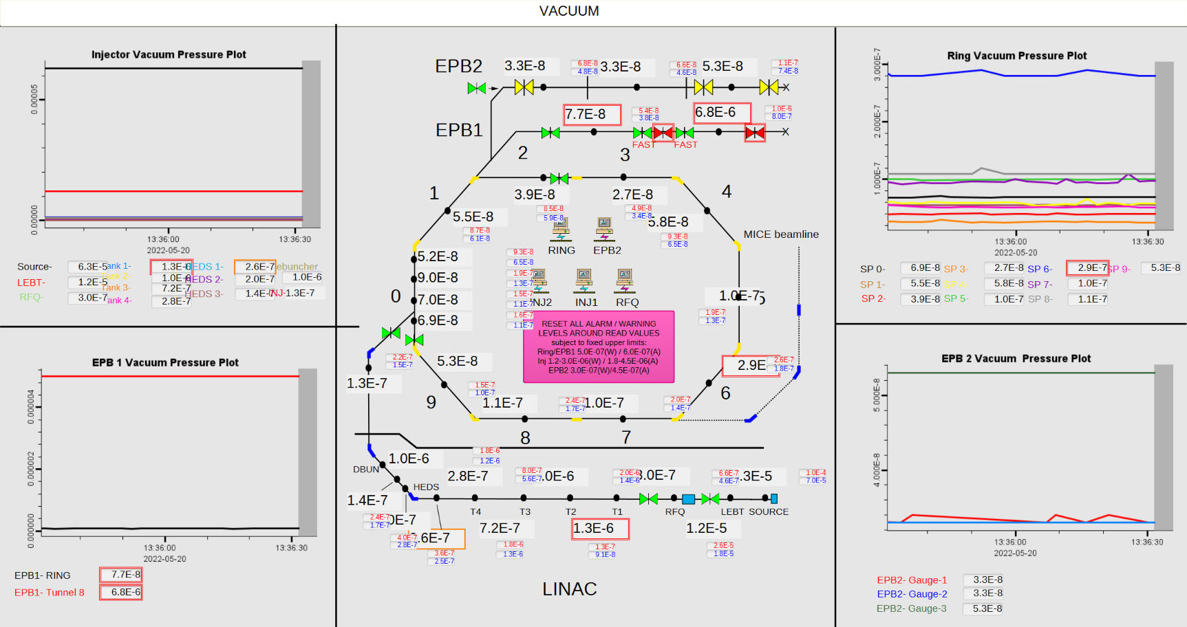
Automatically Converted Screen (VCDParser)

Slide 15
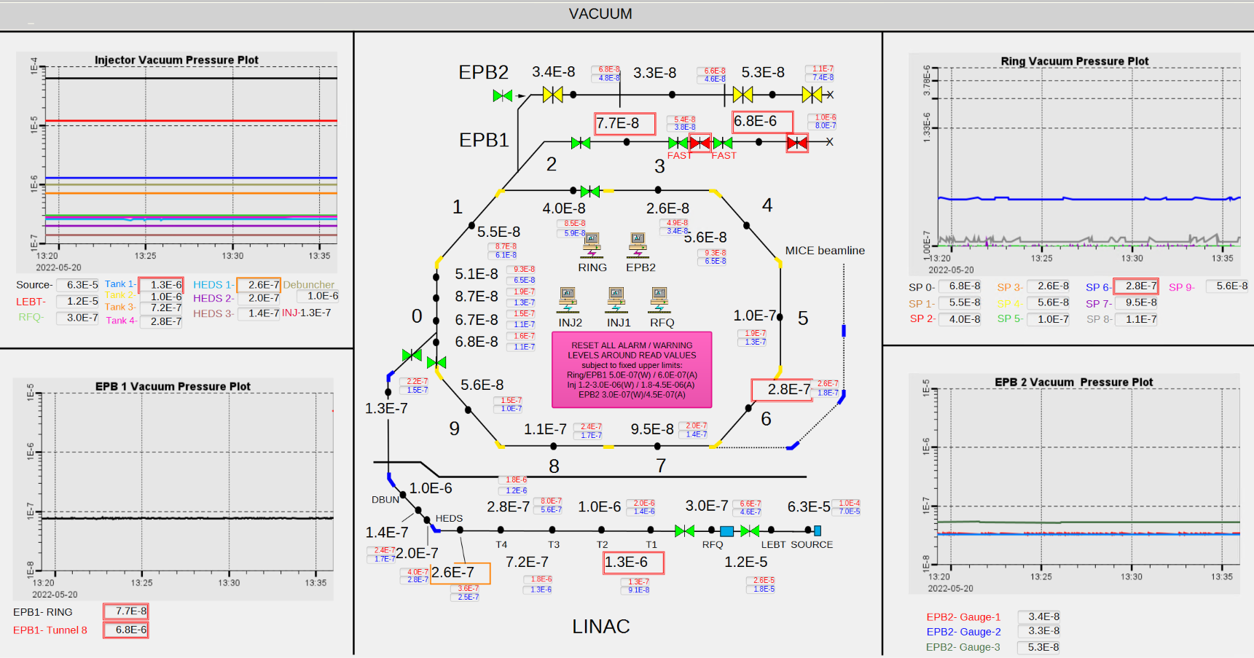
Manually Corrected Screen (data from pvecho)
Notes:
Have an actual live demo?

Slide 16
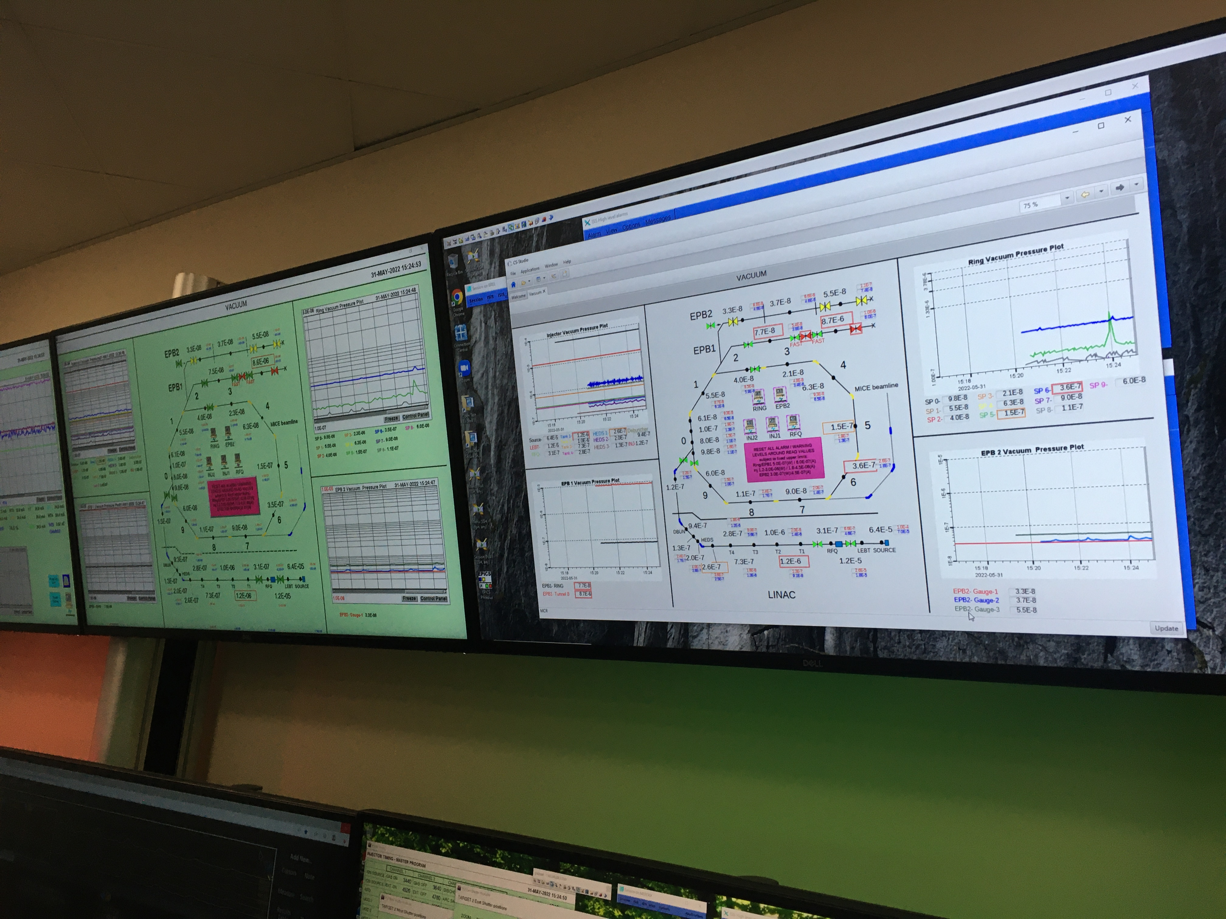
Screen in ISIS MCR
Successfully running since February 2022.
Deployment designed to build user confidence, gather feedback from MCR crew, and develop experience in controls team.
It has highlighted a number of issues that must be resolved before we can continue deployment of converted screens, especially keeping manual tweaks as the converter improves.
Notes:
Mention Sarah Medley
We have hit some snags, none major, but you only have one chance to make a good impression. (Example of being unable to quit full-screen.)
Sarah asked me to mention she’s the one gathering the feedback.
Next up TS1 screens

Slide 17
But first… EPICS
Not everything is a slow transition from our existing systems
Notes:
The abstract pattern can be removed or repositioned if required. Be careful to ‘Send to Back’ so that it does not obscure any important information.

Slide 18
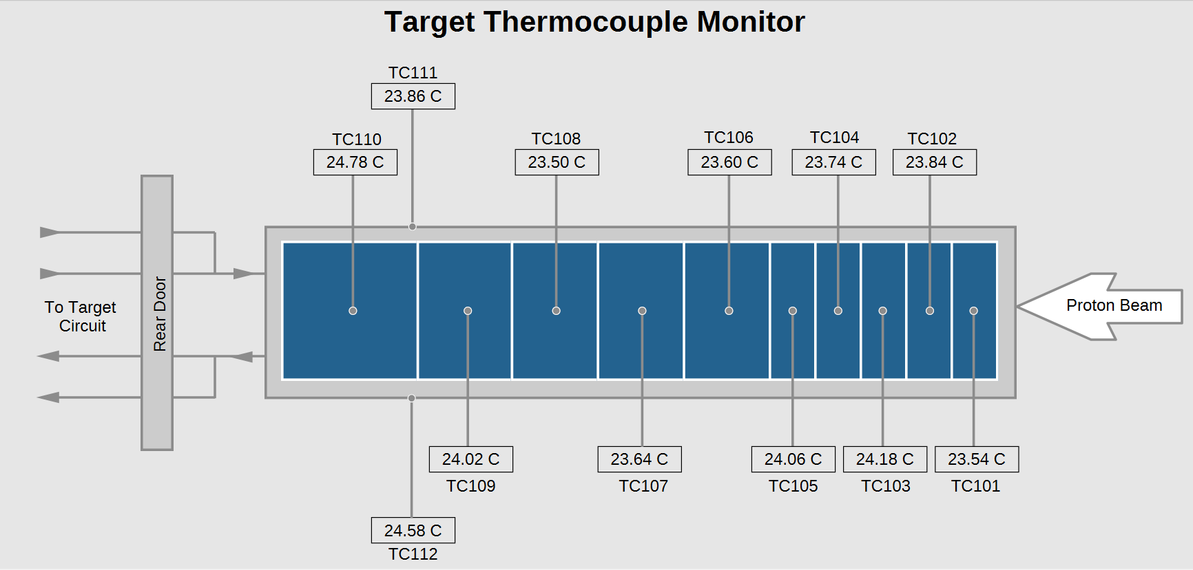
Target Station 1 – EPICS end-to-end
ISIS has two target stations which produce neutrons for our beamlines. Target Station 1 (TS1) has operated since the mid-80s and has undergone a major refit.
All PLCS have been replaced with new Omron PLCs using the CIP protocol
EPICS IOCs (actually PvaPy) and Phoebus control screens

Slide 19
PVEcho – Bridge between EPICS and Vsystem
Feed alarms from EPICS to Vsystem so that we need only run one alarm handler in the MCR
Values from EPICS into Vsystem to allow us to reuse existing applications (specifically the halo steering)
Allow us to reuse our existing archiving solutions

Slide 20
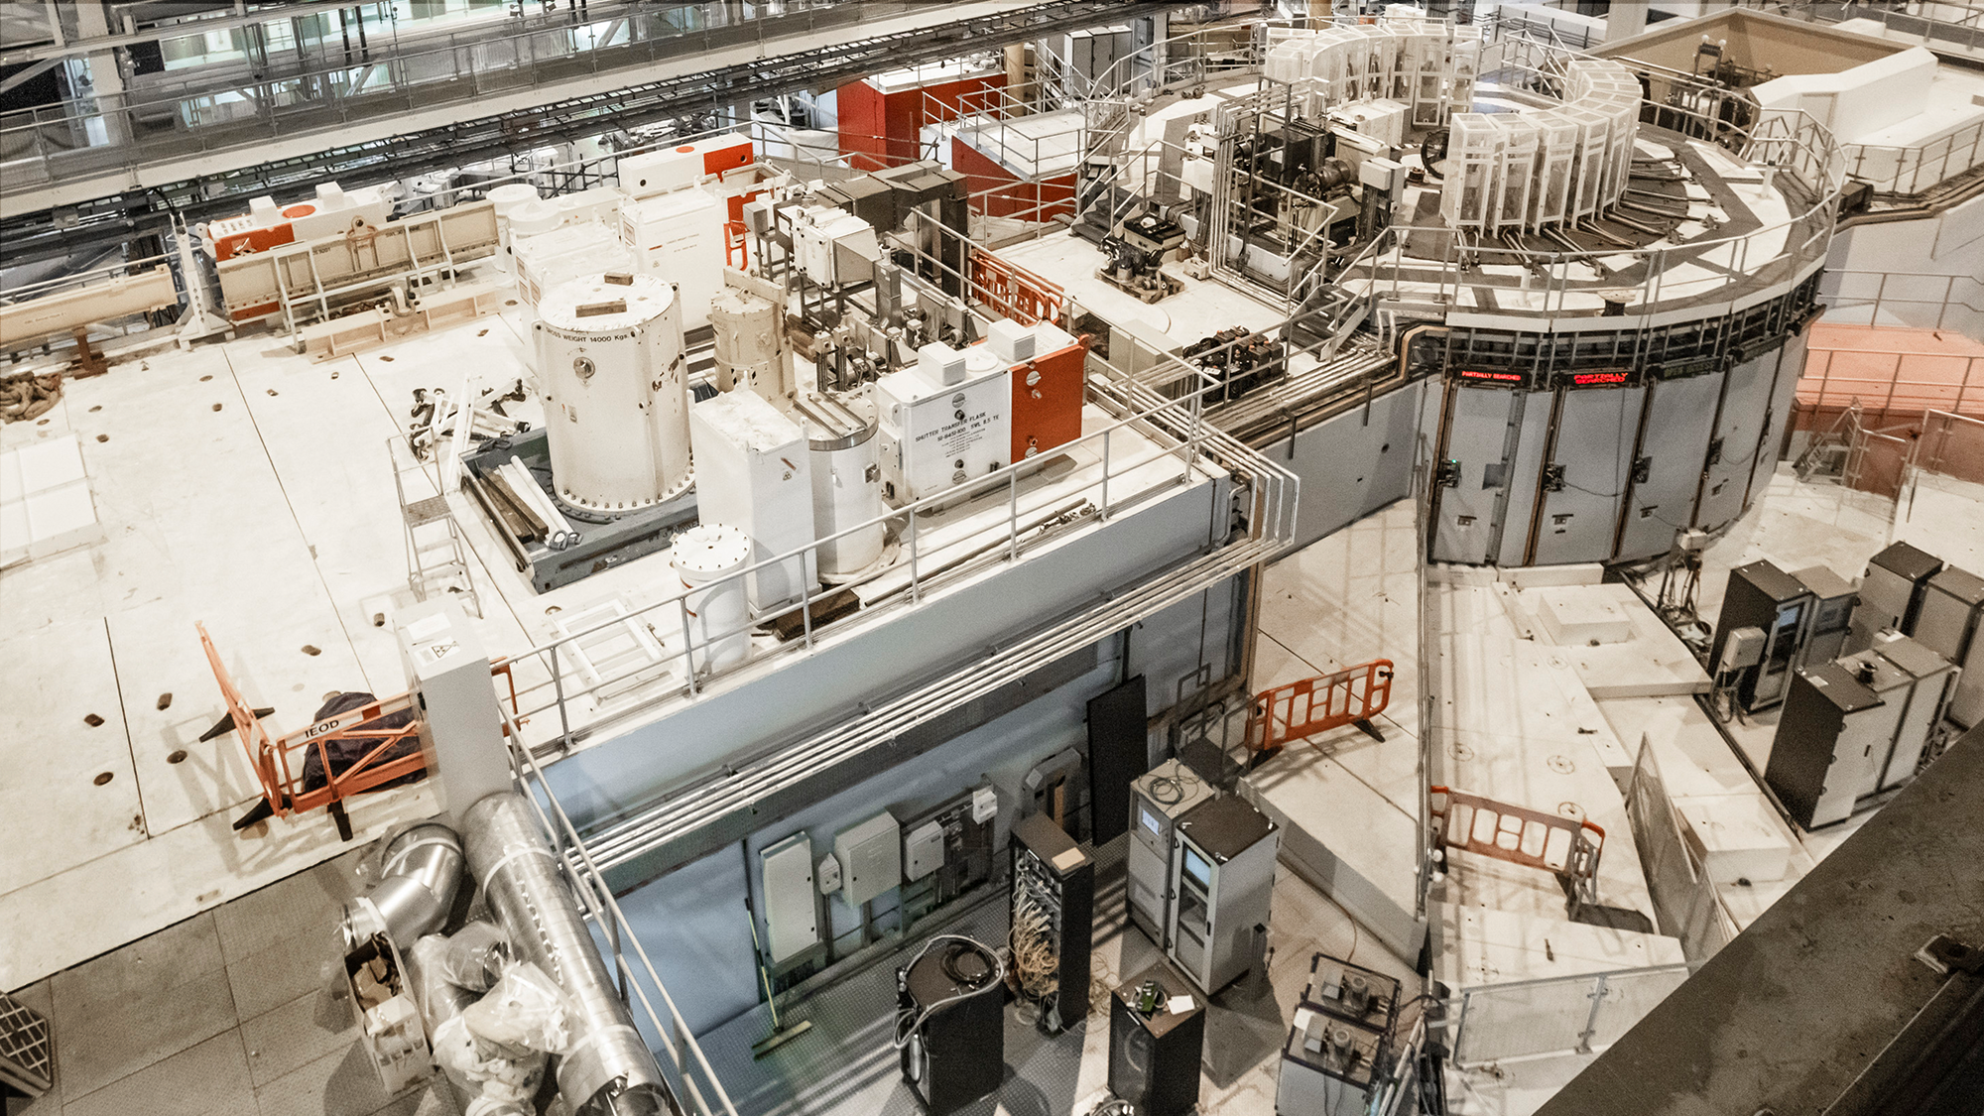
Challenges
Docker development on Windows with PVAcess
Deploying, customising, and standardising Phoebus
Archiving continuity and choices, unexpected features of the Archiver Appliance
Mismatches between Vsystem and EPICS
Doing things differently, e.g. our CIP and CPS IOCs
Our own lack of experience!

Slide 21




Slide 22





isis.stfc.ac.uk
@ISISNeutronMuon
STFC

