Slide 1

EPICS Module for Beckhoff ADS Protocol
jernej.varlec@cosylab.com
Notes:
This is the scientific Title Slide: use this slide for all scientific presentations

Slide 2
Who am I?
Working with Cosylab for a couple of years now
Collaborating on EPICS and Beckhoff projects
I’ve been tasked with porting our original ADS device support to Autoparam

Slide 3
What is ADS?
TCP based communication protocol developed by Beckhoff
Devices communicate via message router
Used internally in a TwinCAT system (e.g., HMI)
Libraries for external clients
Not to be confused with EtherCAT

Slide 4
Cosylab’s ADS device support
Developed a couple of years ago
So far, only used by our customers
We decided we want to publish it as open source

Slide 5
Why do we think it is useful
Very fast because of sum reads
Beckhoff example:
  Single reads: 4k variables with 2ms protocol time = 8000 ms to scan all variables
  Sum reads: 4k variables with 2m protocol time = 20 ms to scan all variables
Our tests:
  Stable reading 10,000 variables when using periodic scan rates

Slide 6
Performance numbers
These numbers are for 1k – 10k ai records and 500 variables per ADS transaction.
  PLC cycle time is 10ms.
  PLC variables are LREAL
Updates were stable at all scan rates.
Interrupt scan rate averages:
  1k records: 10ms
  2.5k records: 50ms
  5k records: 326ms
  10k records: 1362ms

Slide 7
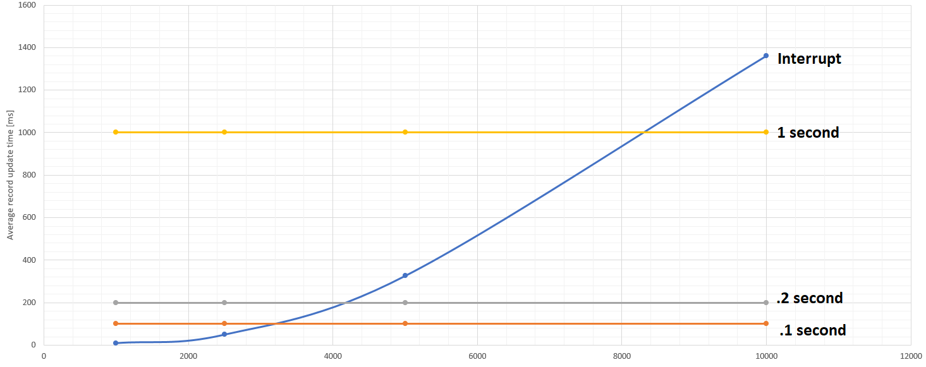

Slide 8
How do we use it
It’s based on AutoparamDriver
Reason structure:
  DataType NumElements Read/Write AdsPort VariableName
Example:
  field(INP, "@asyn(test 0 0) BOOL R P=PLC_TC3 V=SomeStruct.switchStatus")
  field(OUT, "@asyn(test 0 0) USINT[] N=10 W P=851 V=SomeStruct.ucharTest”)
  field(INP, "@asynMask(test 0 0xFFFF 0) UINT_digi R P=851 V=SomeStruct.mbbid")

Slide 9
Potential limitations EPICS developers should be aware of
Maximum of 2048 kB of data per transfer
Recommended maximum of 500 variables per transfer
  This is recommended by Beckhoff
  Value can be changed

Slide 10

Where can you get it?
https://epics.cosylab.com

Slide 11
Thank you

