Slide 1
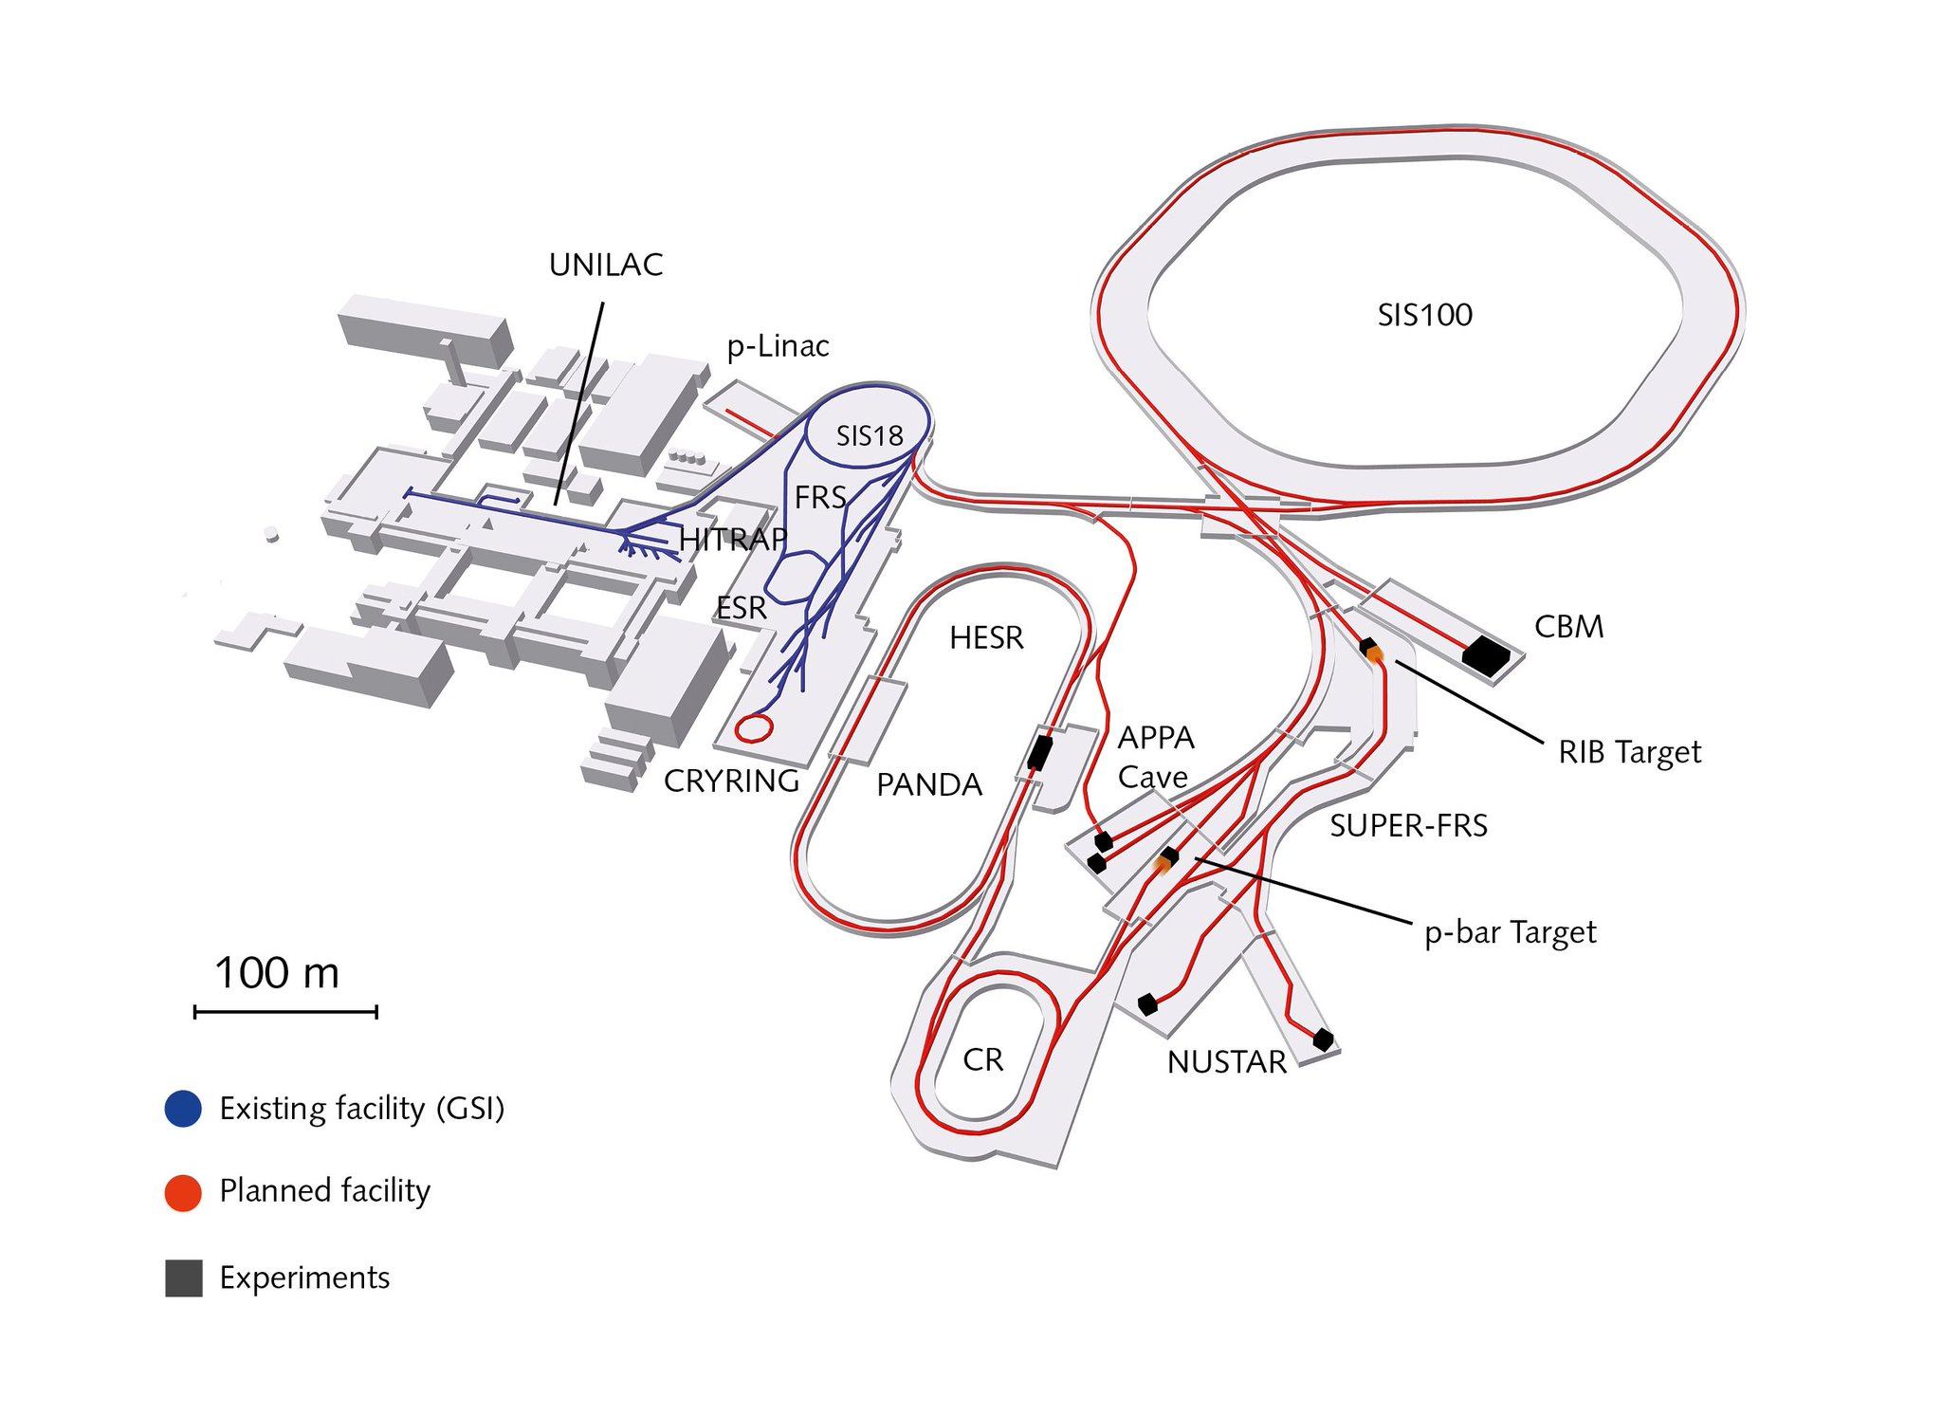


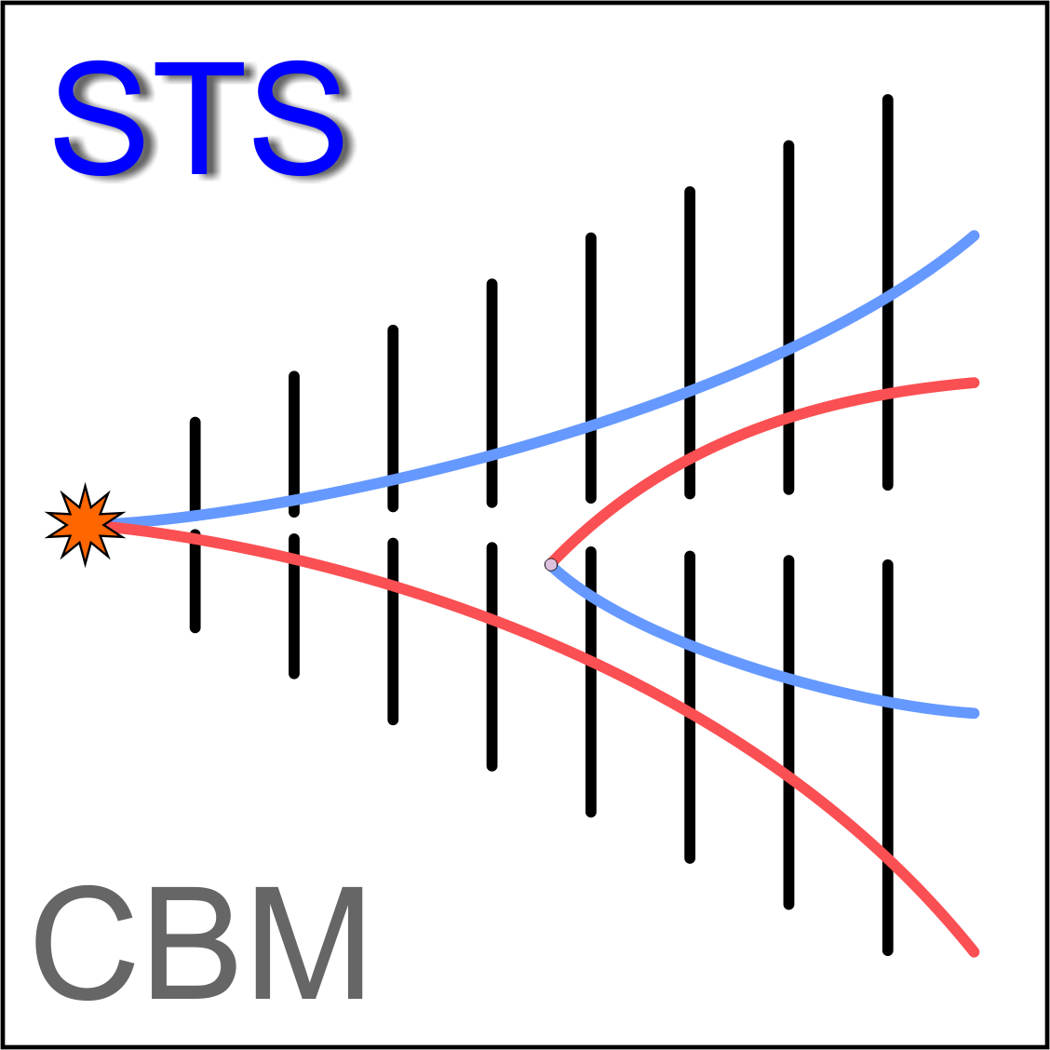

Containerized EPICS-based Detector Control System for the mini-Compressed Baryonic Matter (mCBM) experiment
Marcel Bajdel^{1,2}, Florian Feldbauer³, Peter Zumbruch¹
¹ GSI Helmholtz Centre for Heavy Ion Research, Darmstadt, Germany, ² Goethe-Universität Frankfurt am Main
³ Ruhr-Universität Bochum

Slide 2
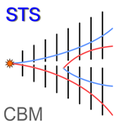
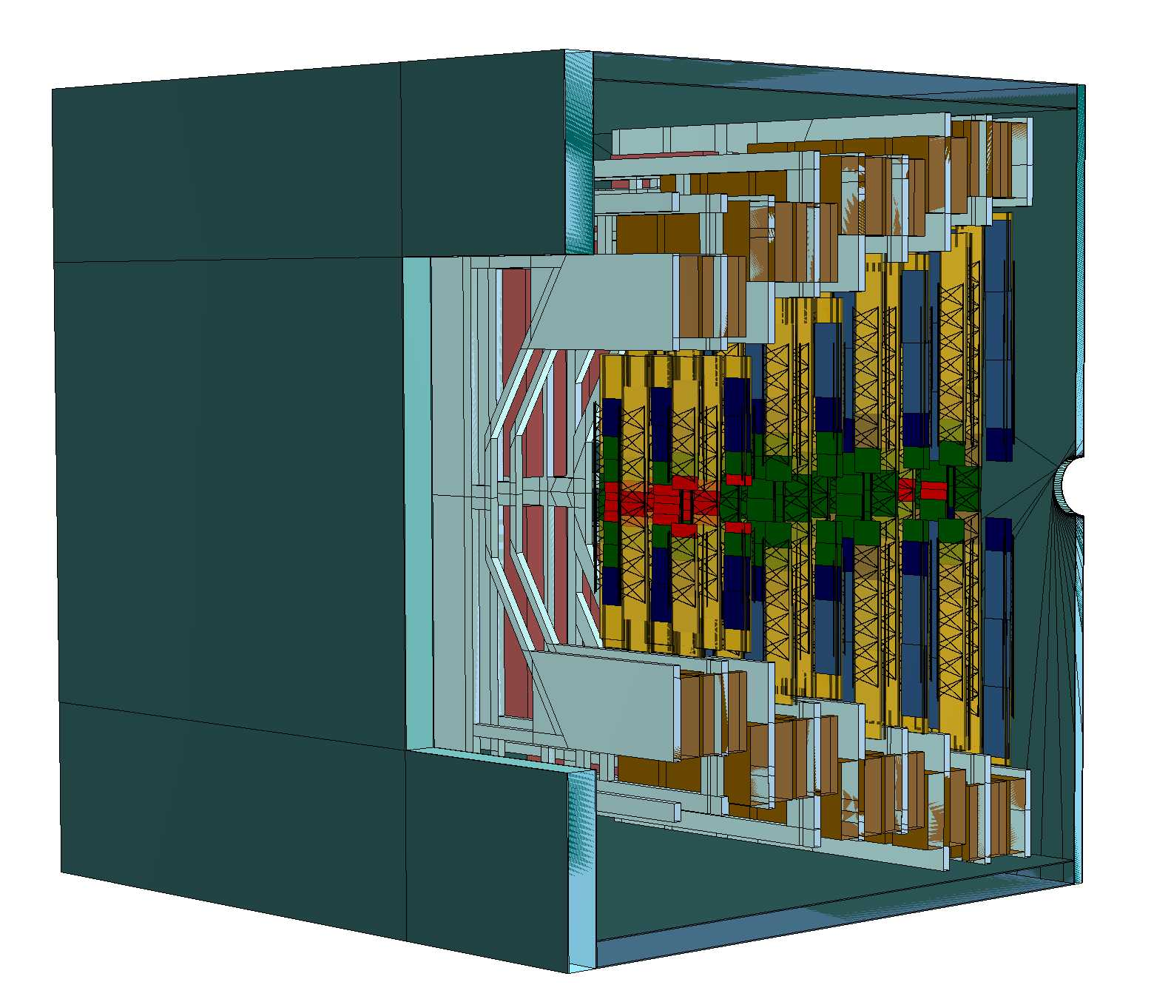
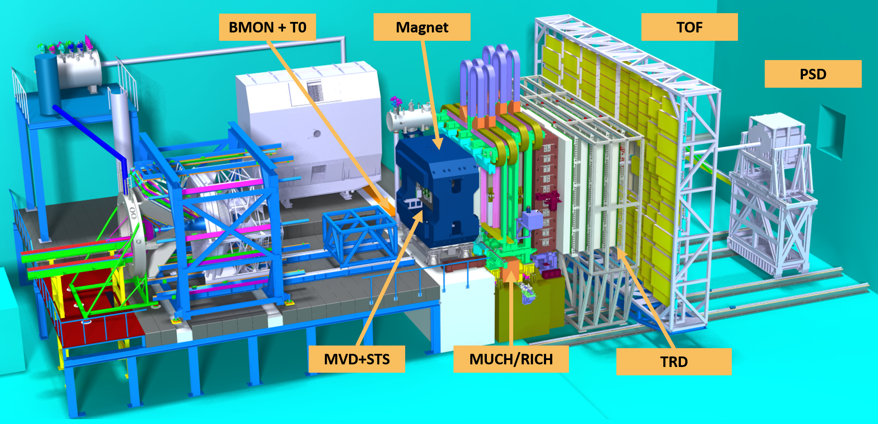
mSTS as the DCS pathfinder for the STS
Silicon Tracking System (STS) – 876 modules
The Compressed Baryonic Matter (CBM) Experiment
(up to 500 000 PVs)

Slide 3
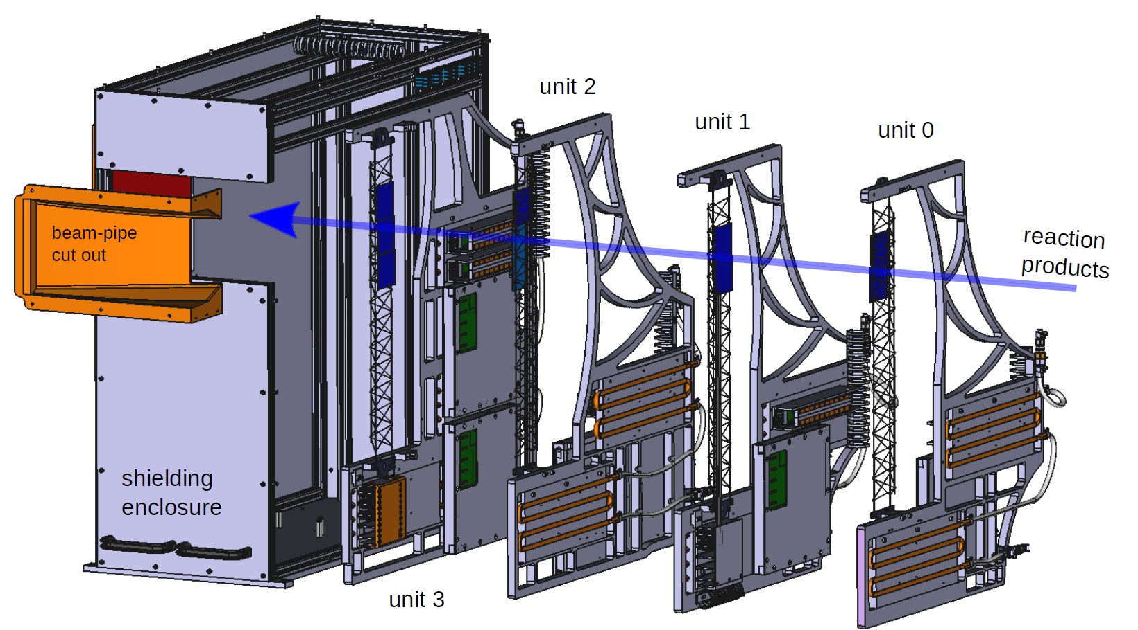
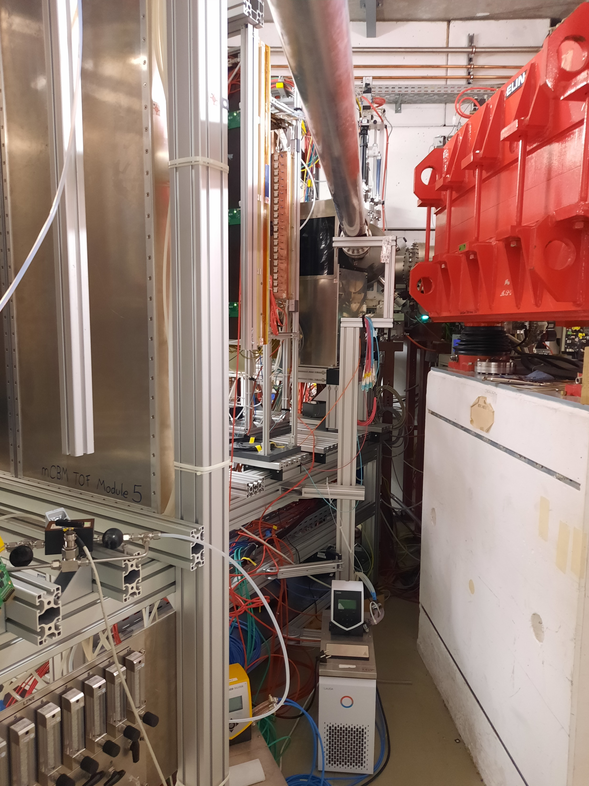
mSTS as the DCS pathfinder for the STS
mini – STS - 11 modules
mini – CBM Experiment
About 5000 PVs

Slide 4
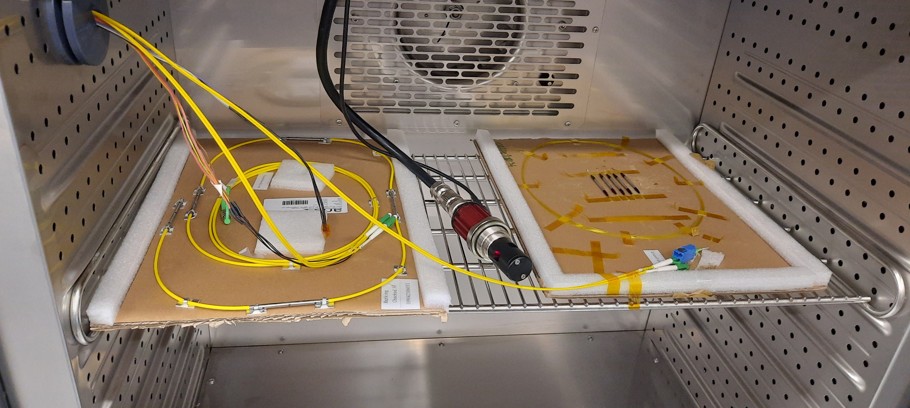
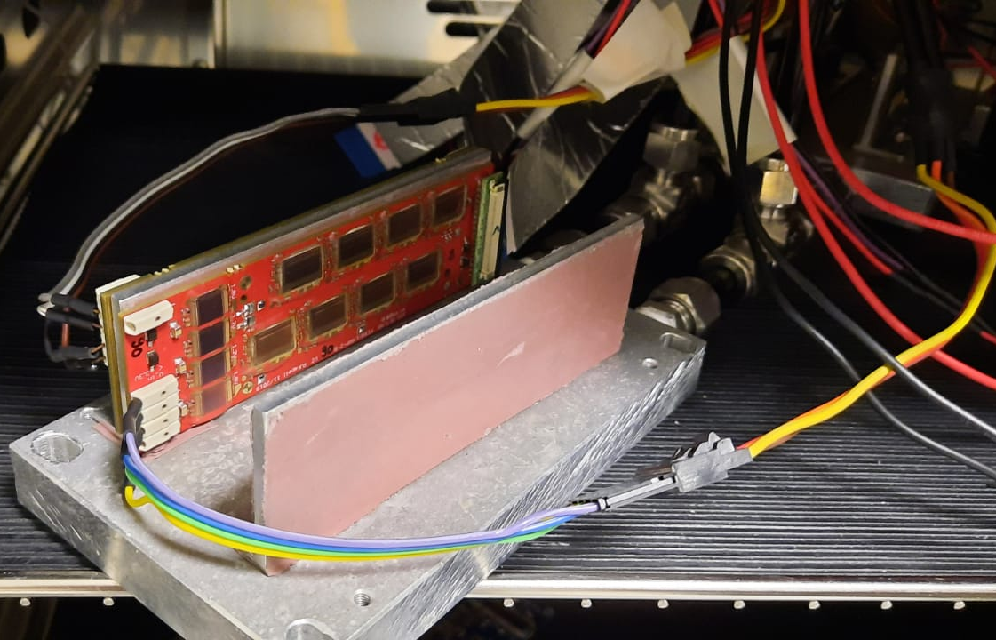
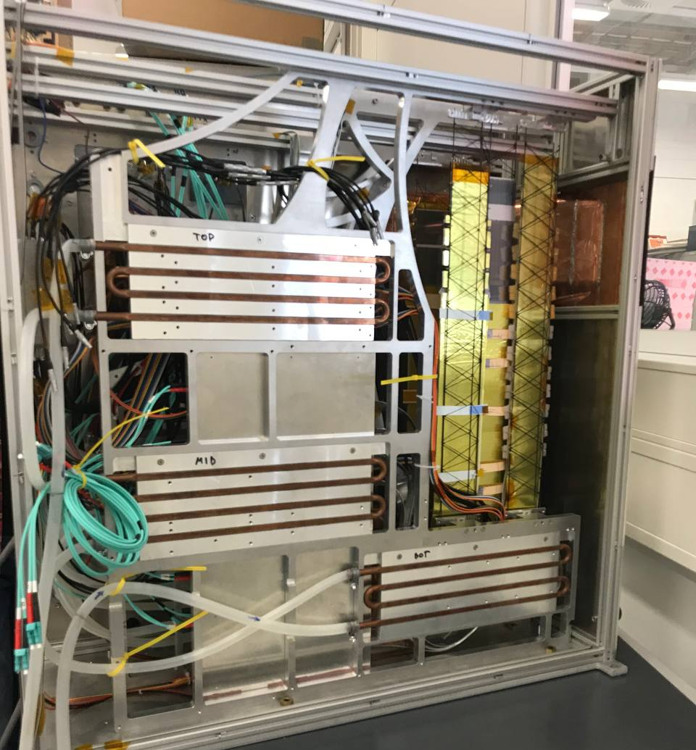
Objectives
Requirements:
Easy and fast to implement and maintain
cross-platform compatible (mostly Unix based machines)
easily scalable EPICS related applications stack
RH + T Fiber Optic Sensors testing (100 PVs)
Readout and Thermal cycling of the Front-End Boards and detector modules (up to 1000PVs)
Many small setups/medium setups
The mSTS (up to 5000 PVs)

Slide 5
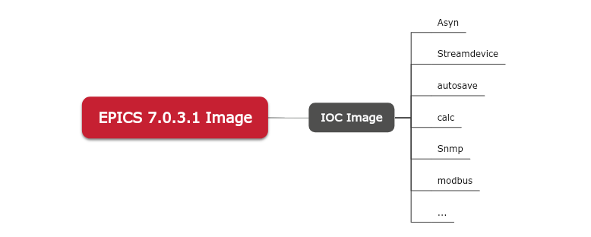
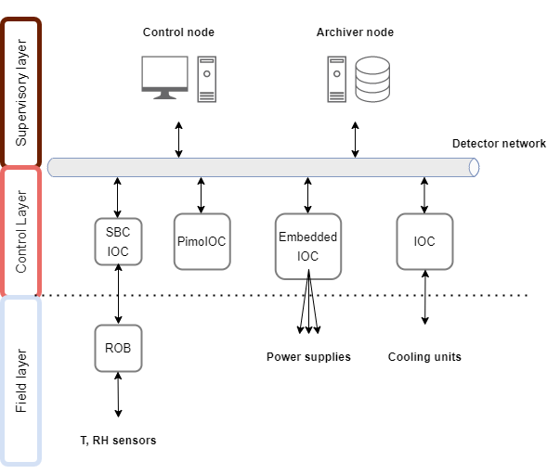
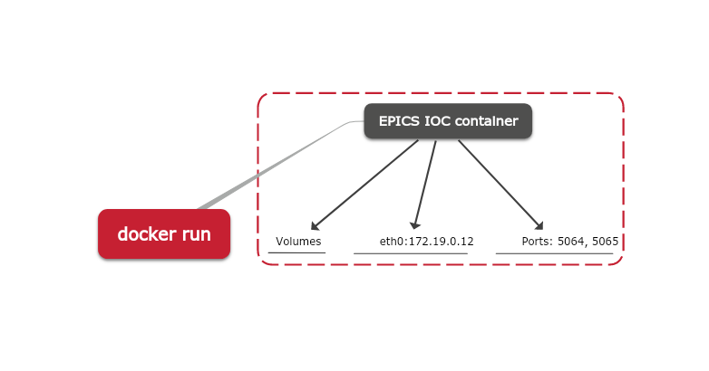
Architecture
Hardware and bus specific changes:
Custom st.cmd
Protocol file (if needed)
Database
Other…
mSTS architecture

Slide 6

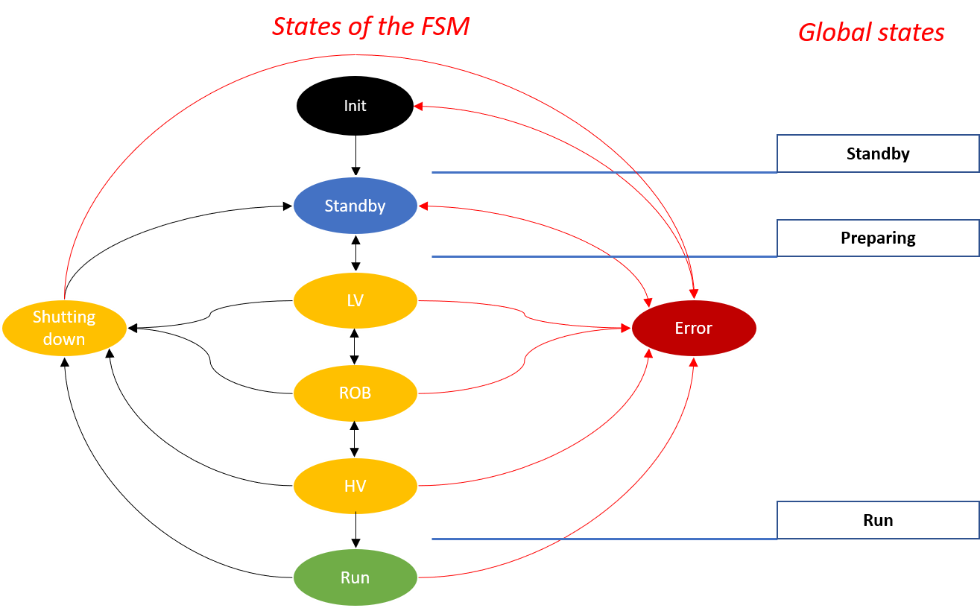


Detector Control System
Compose your services
Quick and easy configuration – proper yml file configuration to connect containers
Single host deployment
High productivity
User-defined volumes to store data and ensure persistency
Restart mechanisms
Alarm Server
Elasticsearch
Redis DB
Kibana
Alarm Logger
Kafka
Archiver
Phoebus
Sequencer
Jupyter
Zookeeper
IOCs
Software interlock to prohibit operation if the ambient temperature is too close to the dew point

Slide 7
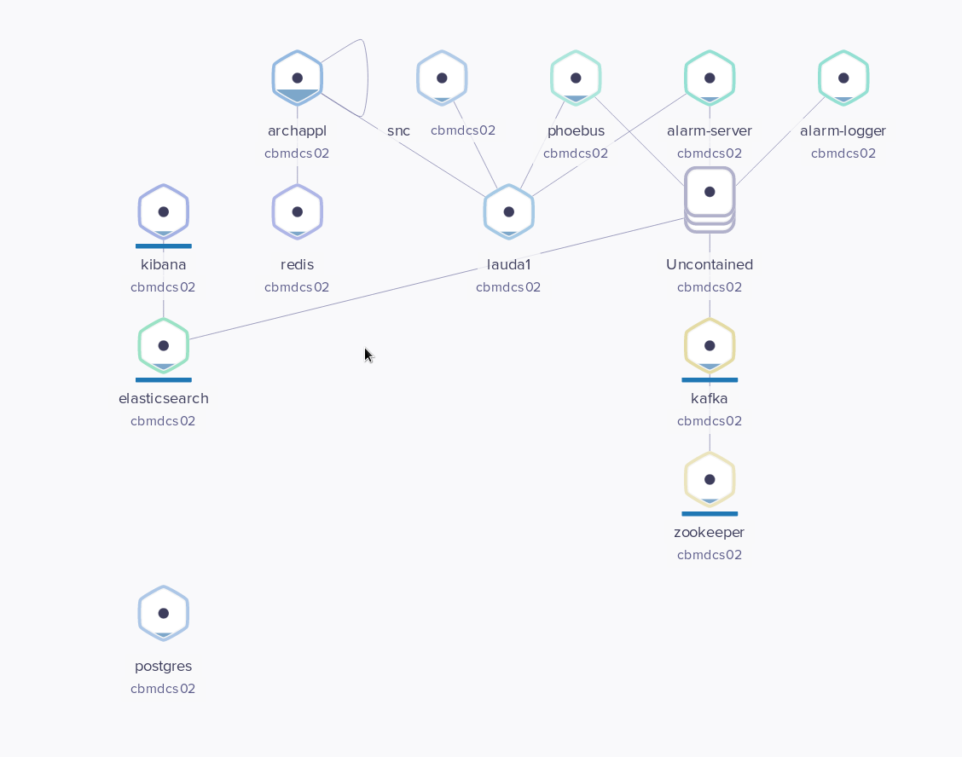

Monitoring and outlook
Containers monitoring:
Weavescope - Access, Control, Metrics, Metadata, Automatic topologies and intelligent grouping
IOC monitoring:
Pimo IOC (ping monitor) - scripts for regular checking via ping the network status of DCS related network devices
IOC heartbeat
Outlook:
Full orchestration for the entire CBM experiment

