Slide 1

Using document templates to structure inputs and autogenerate database
tilen.zagar@cosylab.com
Notes:
This is the scientific Title Slide: use this slide for all scientific presentations

Slide 2
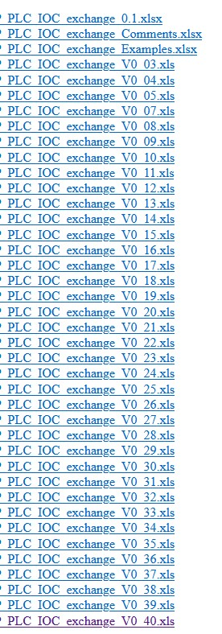
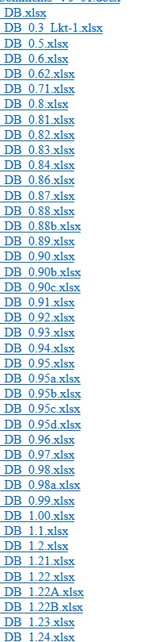
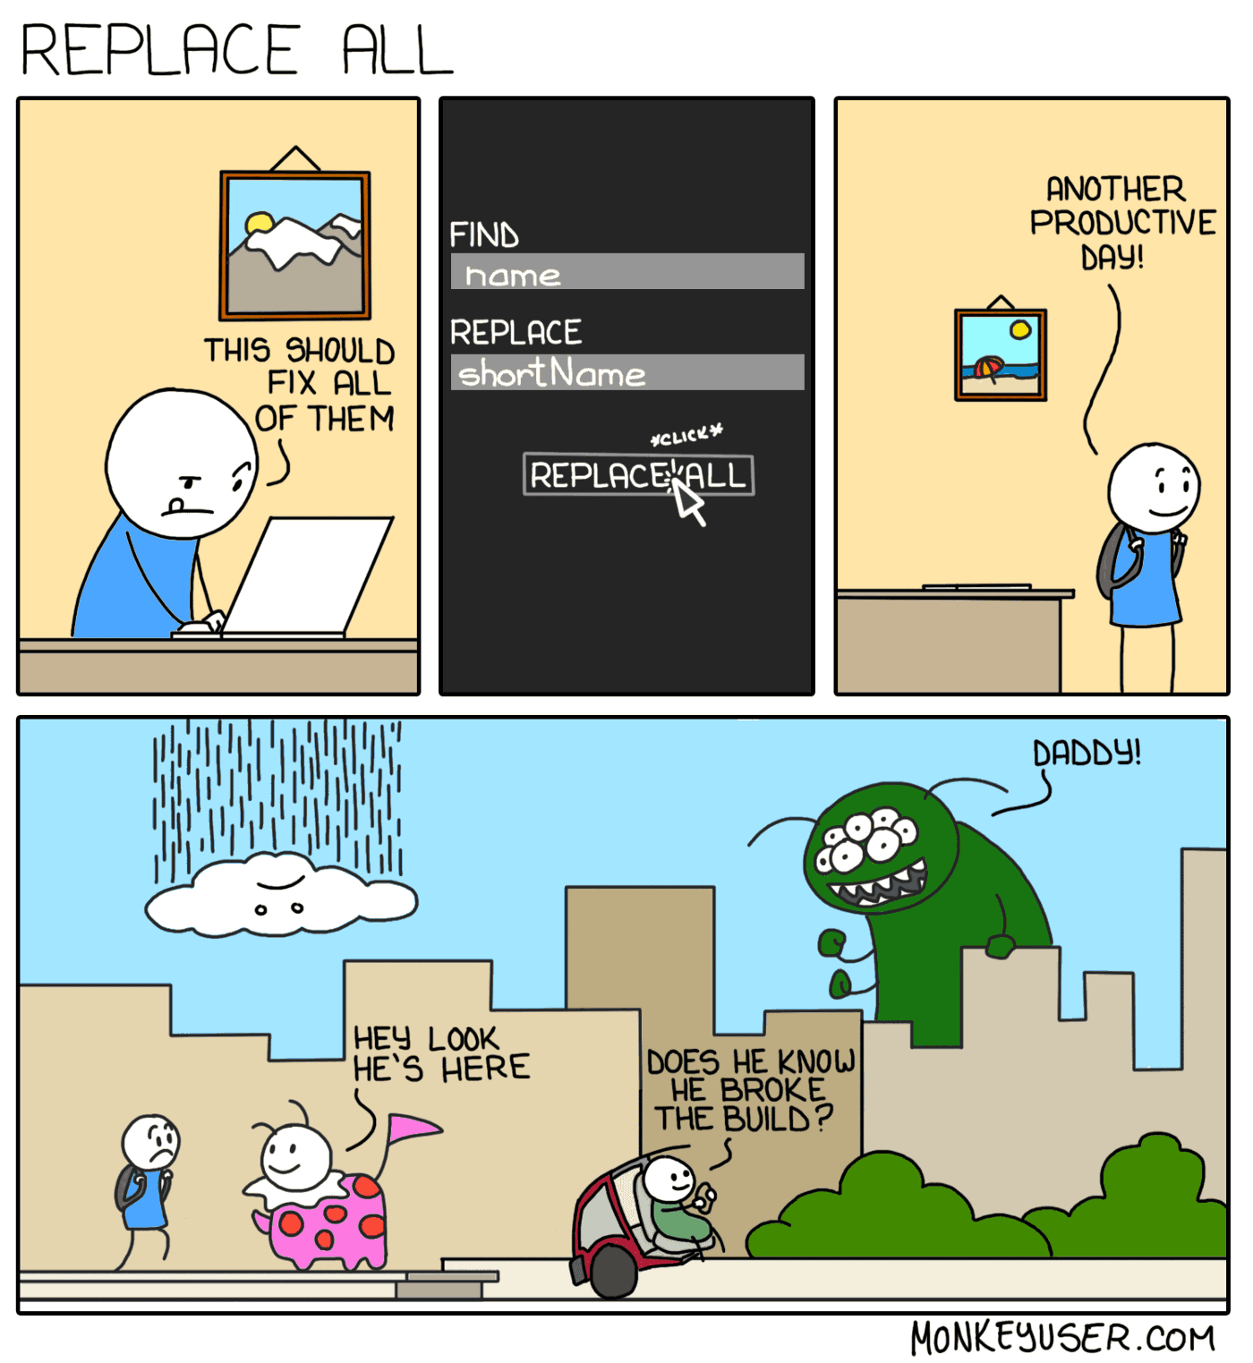
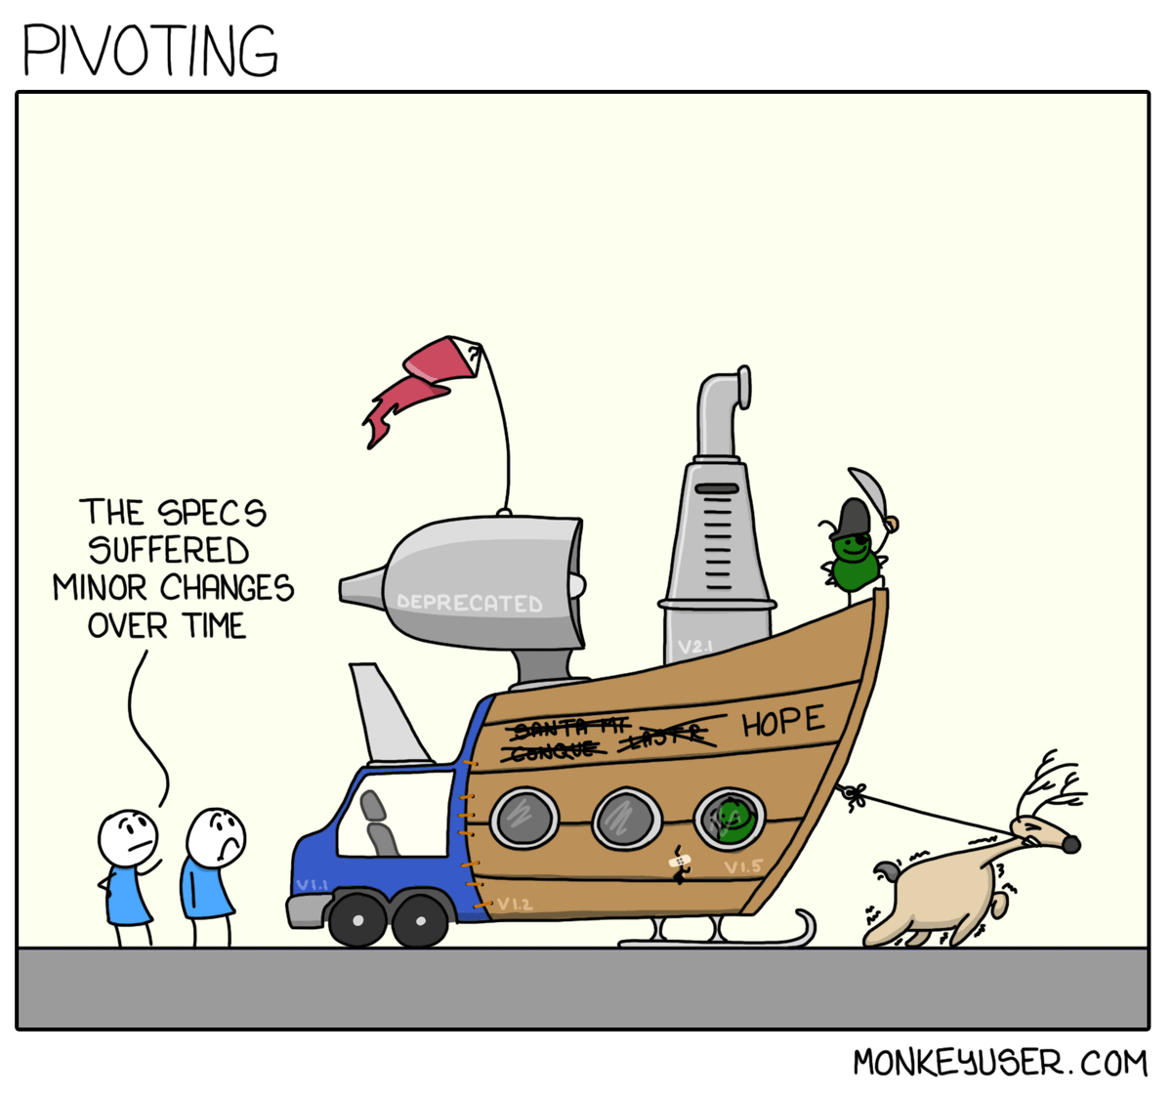
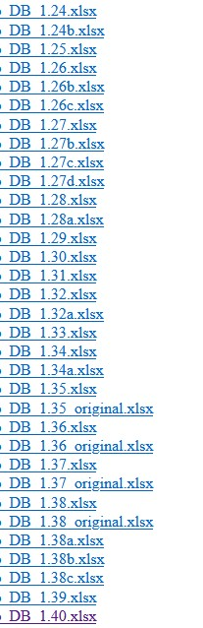
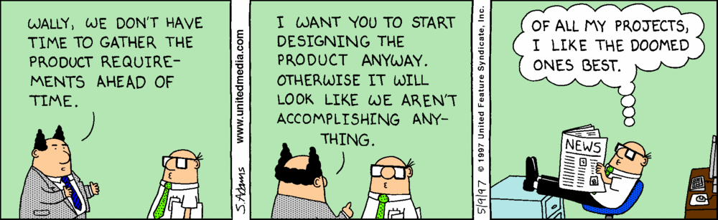
Challenges of developing (control system) software?

Slide 3
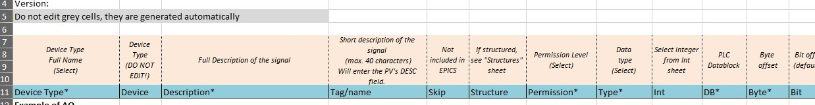
Our approach: structure, guidance and automation
Identify stakeholders / domain experts and agree about roles / expectations
Milestones with dates for each step – helps to keep the goal in mind
Help beyond just the scope of “coding”, but …
… know your audience!
Automate “everything”!

Slide 4
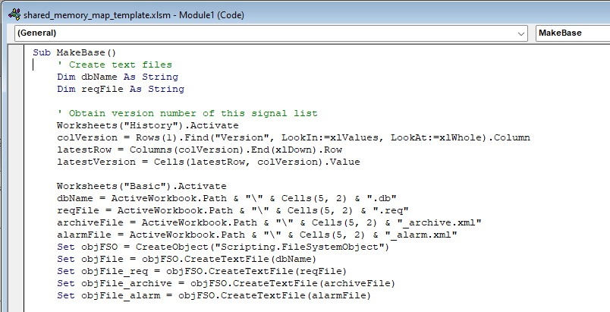
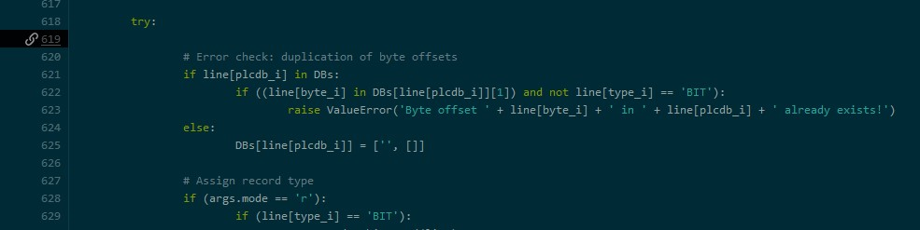
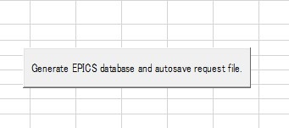

Tools are already out there
No need to reinvent the wheel
  We tried Visual Basic …
  … and we stick to Python ☺

Slide 5
Project in numbers
Almost 50 versions after the “final” version of signals :D
9000 variables / records
Scripts to generate and error check database, archiver and alarm server configuration took 10% of effort
In half year we managed to define interfaces, implement all the business logic required on the EPICS level, prepare IOC app, create GUIs, configure central services …

Slide 6
Why are we doing it?
  Single interface / document between field experts and control system engineers
  Clear roles and expectations
  One input, multiple outputs in a single, automated step – saves a lot of time
  Added features: error checking, statistic …
  “To err is human”, so if no human is involved = “no” errors in the database

Slide 7
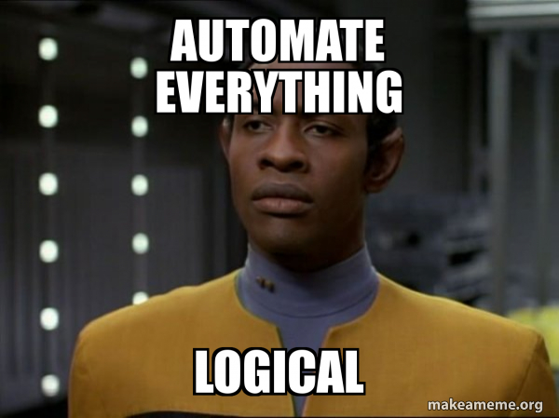
Rules, structure and automate where possible
Rules, structure and

Slide 8
Thank you

