Slide 1
Phoebusgen & PV Info
Two new community projects for high level controls
2022 EPICS Collaboration Meeting
Tynan Ford

Slide 2
phoebusgen

Slide 3
Background
ALS has used EDM for many years. About 60% of ALS EDM screens are auto generated from Matlab
  For historical reasons, some GUI information is stored in Matlab instead of PVs
  Physicists can enable/disable equipment in Matlab and have screens update automatically
  Makes engineering screen development easy
With the move from EDM to Phoebus, a similar solution was needed to generate Phoebus screens

Slide 4
Solution: phoebusgen
Python module to create CS Studio Phoebus widgets
  pip install phoebusgen
38 widgets fully supported (all properties available)
  3 widgets partially supported (X/Y Plot, Image, Stripchart)
https://github.com/als-epics/phoebusgen
  Available on Github. Contributions/suggestions welcome
  Docs: https://als-epics.github.io/phoebusgen

Slide 5
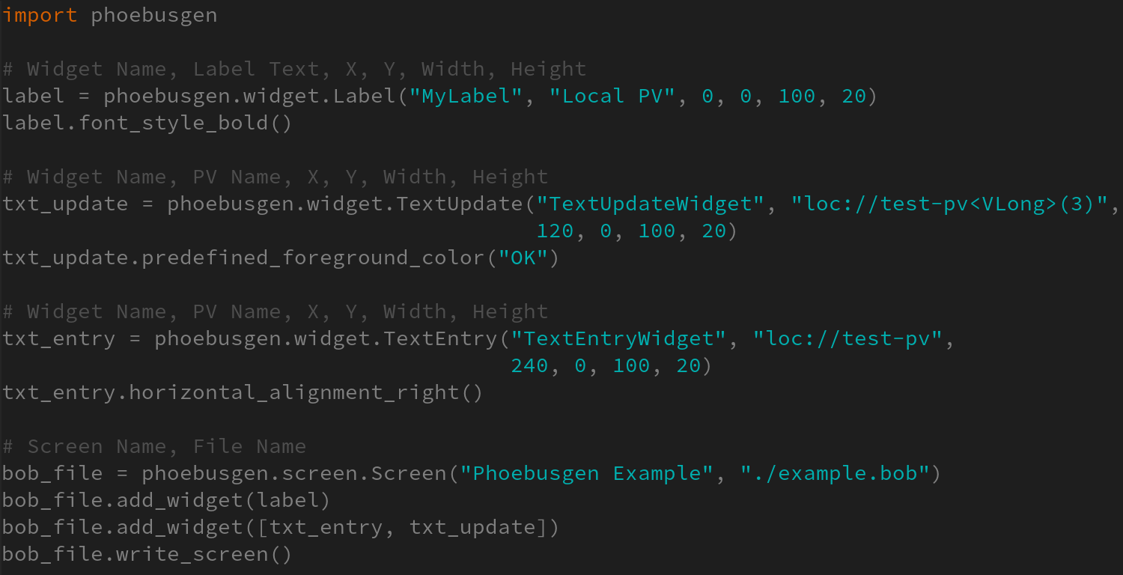

Slide 6
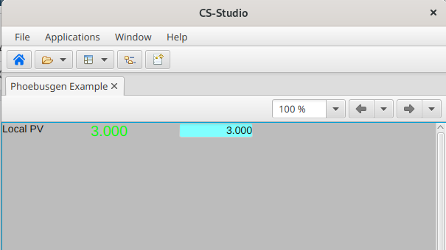
Resulting Screen

Slide 7
PV Info

Slide 8
Background
ALS previously used MySQL for PV directory service
Web front-end was created to query PVs, plot archived data, view live PV data, etc.
  MySQL, PHP EPICS extension
Users are very fond of this application and it is very useful for quick debugging or for those who might not have CS Studio installed

Slide 9
New PV Info
ALS is moving to use Channel Finder, which means a new version of PV Info is needed
Updated PV Info uses ReactJS
Interacts with:
  EPICS Channel Finder
  PV Web Socket (PVWS)
  Archiver Appliance Web Viewer
Site specific configuration available in .env file
https://github.com/channelFinder/pvinfo

Slide 10
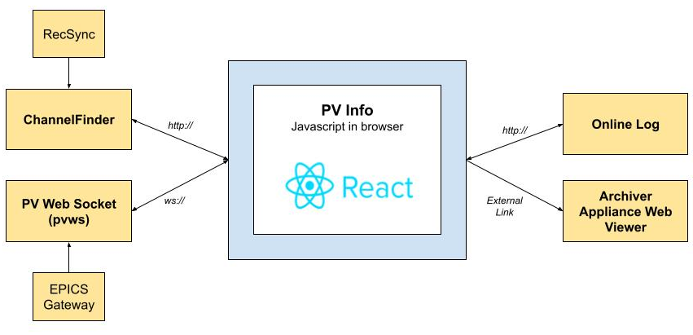
Architecture
Note: Only Channel Finder is required

Slide 11
Current Status
ALS version is diverged from community version on Github
  Working to get ALS configured to use community version
  Working to fully support different channel finder configurations and variable number of CF properties/tags
Would like to hear feedback from others who try to use it
  Do site specific settings fit your use case?
  Anything to make the app more generic? Any other useful integrations?

Slide 12
Demo

Slide 13
Questions?

