Slide 1
Diamond Control Systems Status and plans for the Diamond-II upgrade
EPICS Collaboration Meeting, September 2022
Ulrik Pedersen
Head of Beamline Controls, Diamond Light Source

Slide 2
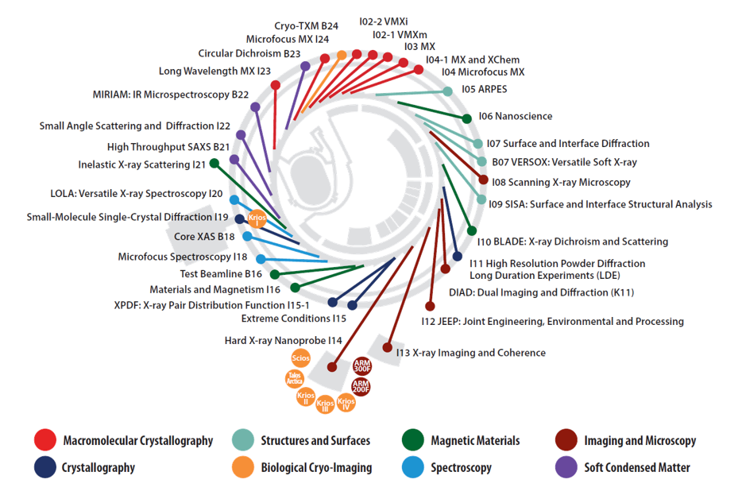

Diamond Light Source Facility
Operational Since 2007
3rd Gen. Storage Ring
  3GeV
  0.8mA to 300mA
33 beamlines
  >33 end-stations

Slide 3
DLS Control Systems Today
Currently based on EPICS R3.14.12
  PVAccess adopted in a few areas – primarily to transfer area detector data
IOC target platforms
  VME/VxWorks: 430
  RHEL7 Linux soft-iocs: 1568
  Windows soft-iocs: 55
Display managers:
  EDM: initially deployed everywhere
  CSS: Machine operator screens have been transferred from EDM + around 5 beamlines
Build System anno. 2006
  A dedicated build server and build user
    Production file system (NFS) is read-only to all except the build server/user
  Gitlab DVCS – tags used to identify releases
  Homegrown Bash scripts automate the build processes
  Engineer in-the-loop to deploy new versions on the machine/beamline

Slide 4
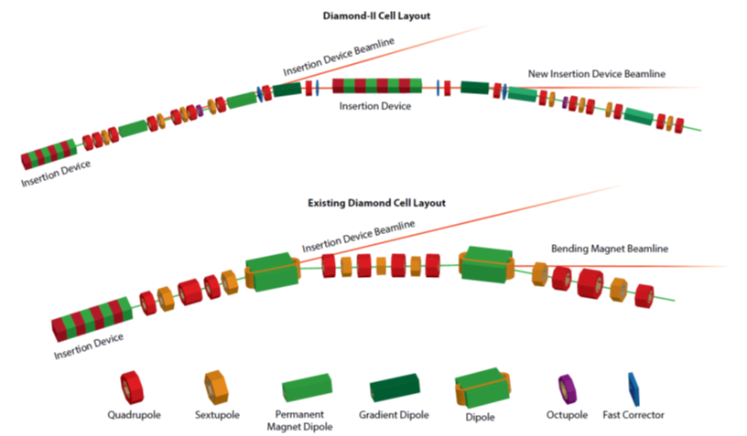
Diamond-II Facility Upgrade Project
Replacing the entire accelerator!
Benefits
  Low Emittance
  Increased Capacity
  Higher Energy
All bending magnet beamlines turn into insertion device beamlines

Slide 5
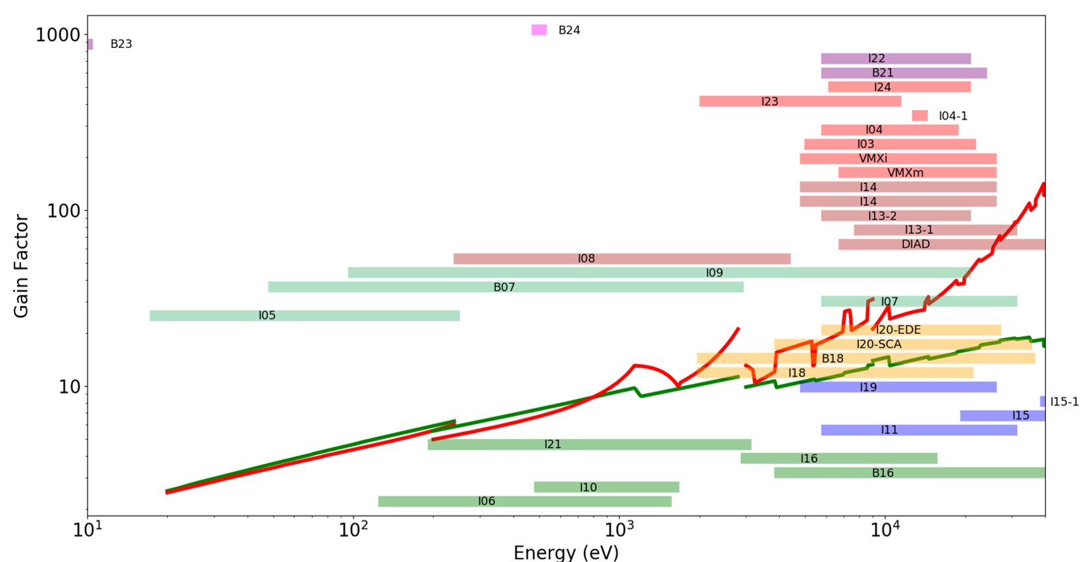
Diamond-II Brightness Gain
Exploit the improvements in photon-beam properties
  Coherence
  Brightness
Increased brightness means
  Lower exposure time, higher detector framerate
  Faster scans
  Higher degree of scan synchronization

Slide 6
Diamond-II Programme
New Accelerator
  But re-use many Controls components: VME I/O
Beamline Programme:
  Critical Beamline Upgrades
    Necessary changes to just work with the new machine (more Pb!)
  5 new “Flagship Beamlines”
    New world-class beamlines, taking full advantage of the new machine
  Competitive Beamline Upgrades
    Upgrades to exploit the improvement to the beam

Slide 7
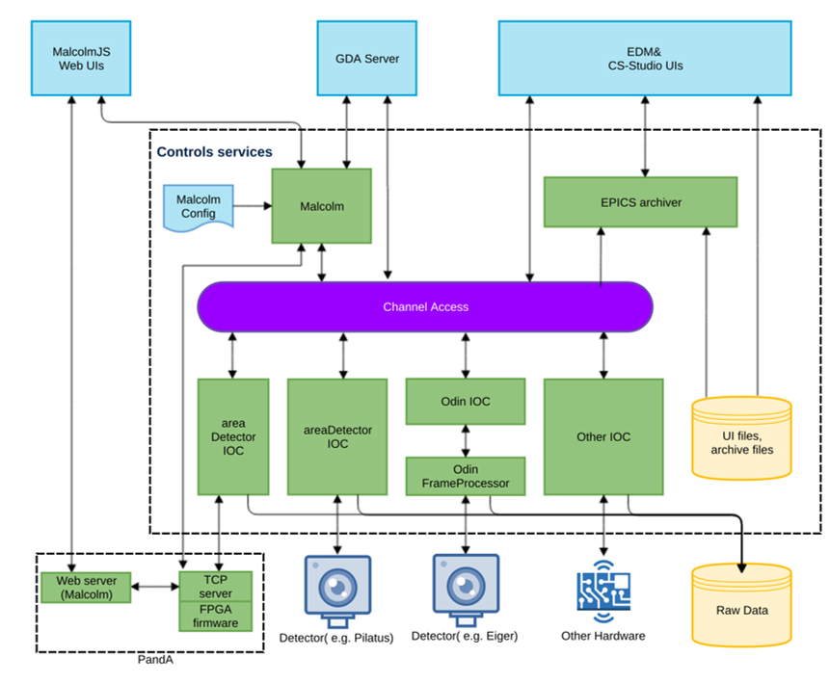
Diamond-II Control Systems Updates
EPICS Controls Systems are a part of a deep software stack
The entire stack is up for review and modernization
Opportunities to address obsolescence

Slide 8
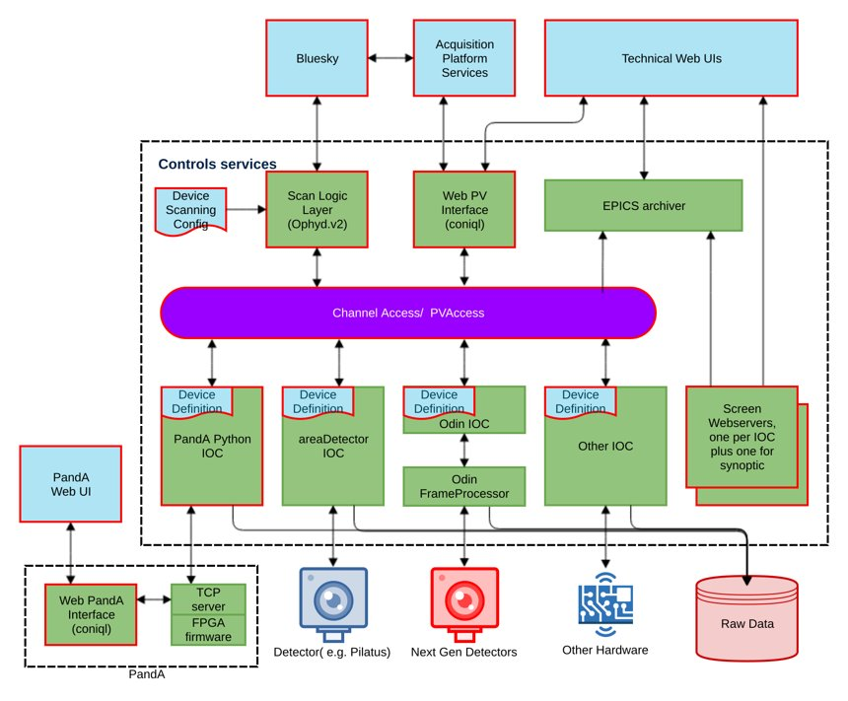
Diamond-II Control Systems Updates
Service-based architecture
  All services built and deployed in containers on Kubernetes
Adopting BlueSky and Ophyd
  Replacing parts of GDA
  Extending Ophyd with Malcolm functionality (Ophyd v2)
Adopting EPICS7
Obsolete VxWorks systems
  Replace VME hardware with EtherCat and soft-IOCs where possible
  Adopt RTEMS and port existing VxWorks IOCs
Browser-based Web UIs
  React-based frontend
  Runtime PV access via GraphQL
  Screens designed in Phoebus .bob format

Slide 9

Diamond-II: When? How much???
Plans and budgets…
  Funding: approx. £500M over 8 years
  Full Business Case (FBC) submitted to government towards end of 2022
  Approvals expected 2023…
  Around £81M has been approved for first phase
Planning an 18-month downtime/dark period around 2026
  Critical Upgrades and 3 new Flagship Beamlines before dark period
  2 Flagship Beamlines after dark period
  Keep all most beamlines operational until dark period

Slide 10
Thank you for listening
Any questions?

