Slide 1
Training sessions on CERN financial processes:
Part 1 CET tool - hands-on and practice
Julie Falcon FAP/ACC, Estelle Carneiro FAP/ACC and Luigi Scibile TE/HDO

Slide 2
Content/Organisation
Introduction
Overview of CET for a typical section and important milestones in the financial processes.
CET basic usage:
  CET desktop
  Consultation of an ORDER
  Transaction by cost center
  Totals by cost center
  Consultation of a BUDGET CODE
  Consultation of a CONTRACT
  Consultation of a sale invoice: RFF transactions
  Report creation
Questions, Answers and Hands-on

Slide 3
Introduction
The first part concerns the use of the CET tool: the basic usage and the specific usage for a Section Leader (your budget, your commitments, your revenues, etc).
The second part concerns the TE department budget processes on a financial year: the DPO office (Valeria Perez Reale and Macarena Gonzalez Torres) will present the budget processes and how to prepare and follow your budget envelope as SL (CET and APT as tools).
This session is organised by Luigi Scibile TE/HDO (your link person), Julie Falcon and Estelle Carneiro FAP/ACC.

Slide 4
Overview of CET for a typical section
My favourite -> Totals by cost centers
Why?
  It contains all the information you will need to discuss with your GL and with the DPO office.
  It is a dashboard/overview for all your budget/accounts.
  It allows to drill down a cost center (budget code) and jump to the transactions.
  It provides you with the same view of what the others see of your budget/accounts.

Slide 5
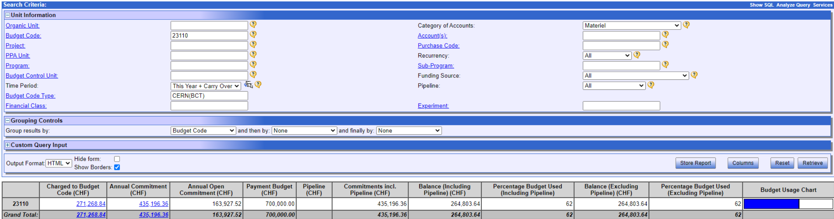
Overview of Totals by cost centers

Slide 6
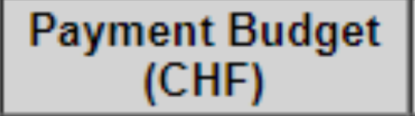
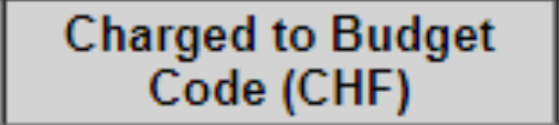
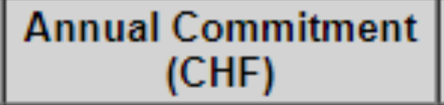
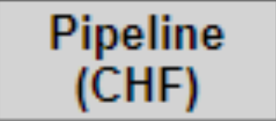
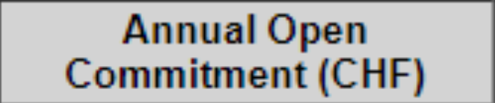
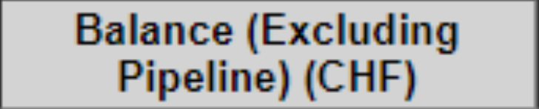
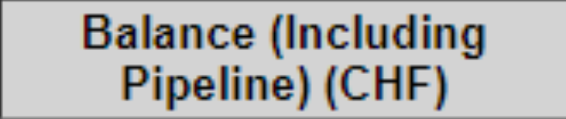
Overview of Totals by cost centers
THIS IS YOUR BUDGET
THIS IS the amount CHARGED against your budget
(amount debited from your budget code and no longer in your accout)
Decreasing importance
THIS IS WHAT you have already ORDERED (difficult to UNDO)
THIS IS WHAT is in the process TO BE ORDERED
THESE are derived from the previous

Slide 7
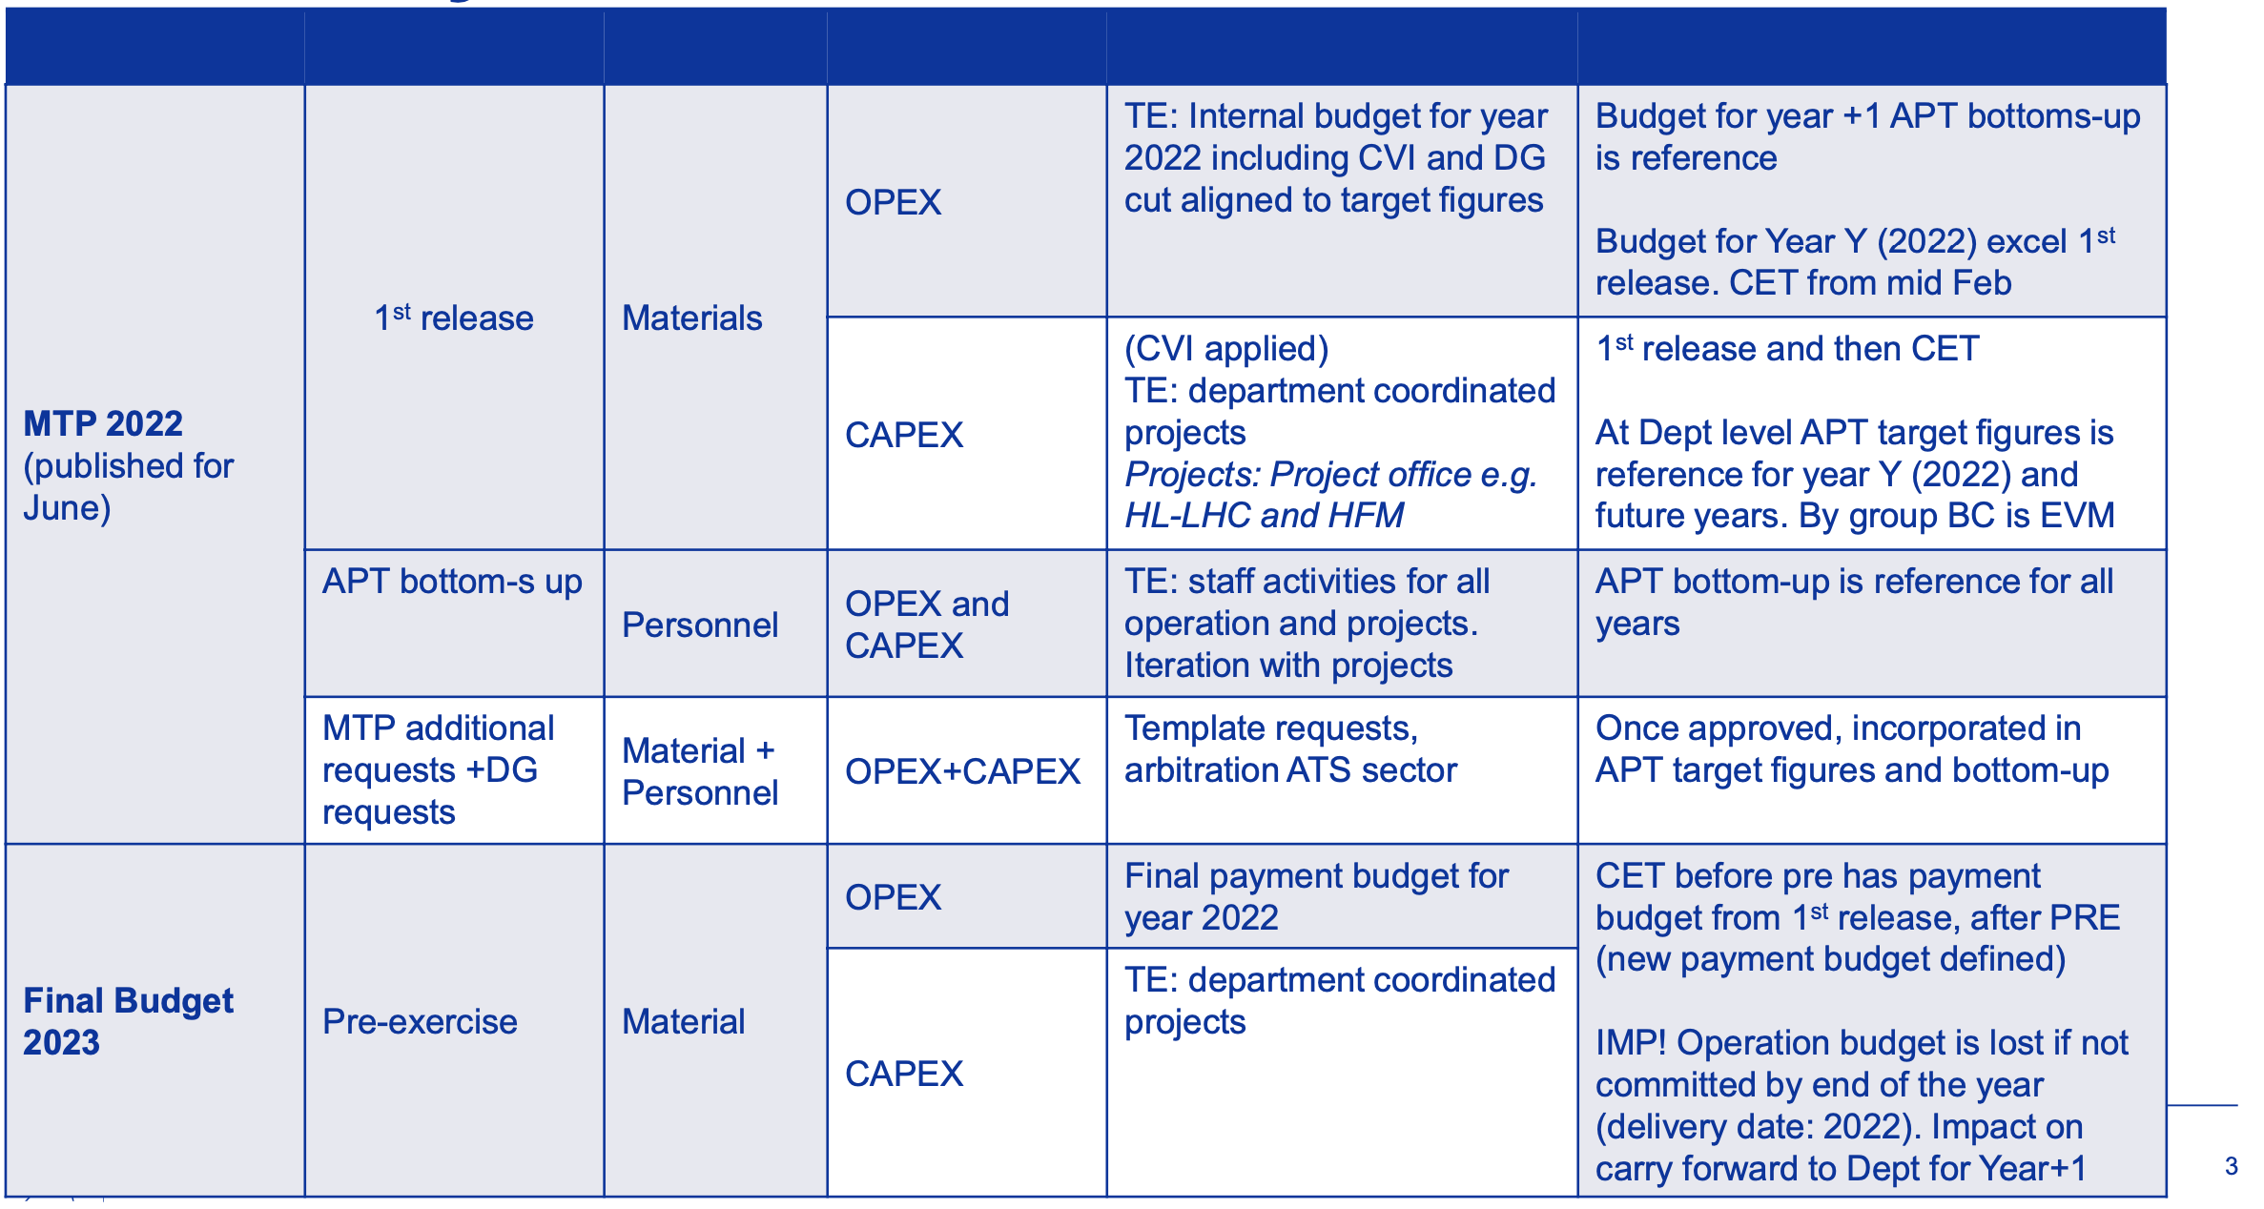
Important milestones for financial processes
Table, courtesy of V. Perez Reale, sent by TE DPO office after TE Retreat this February.
Why are these important?
There is no other budget than the one defined in CET
During the Pre-Exercixe, you need to know what is in CET to take decisions.
2021
2022
2023
Year n-1
Year n
Year n+1

Slide 8
CET basic usage
Moving to the presentation by Julie and Estelle.

Slide 9
Question, Answers and hands-on

Slide 10
Thank you for your attention and participation!
If you need further assistance, please do not hesitate to contact me.

