Slide 1
Introduction to CET for TE section leaders
Julie Falcon (FAP-ACC-GA), Estelle Carneiro (FAP-ACC-GA), Meriem Chniba (DDPO HSE)
21/06/2022

Slide 2
General information

Slide 3
CET training - perspectives
Basics, in CERN catalogue, happen 3 to 4 times per year
Basics will become an e-learning training (currently working on recording modules)
Advanced training to be developed and added to the catalogue

Slide 4
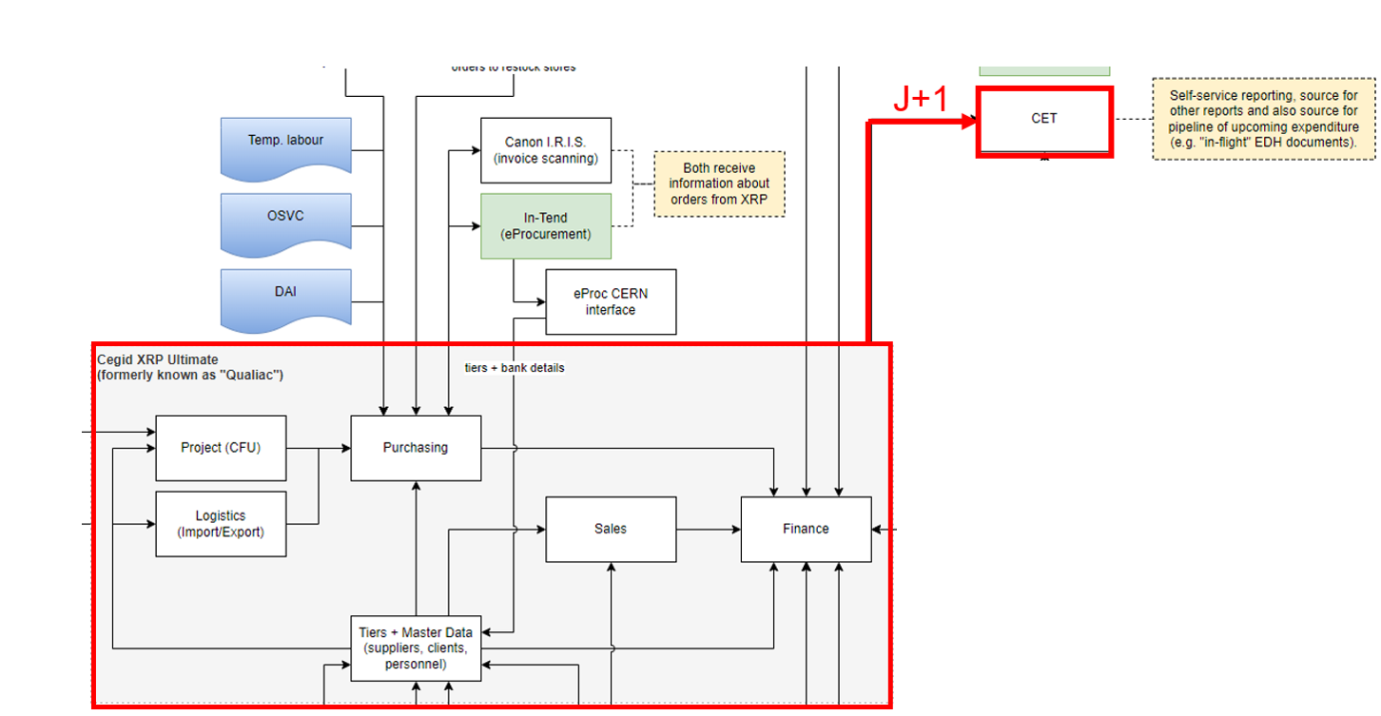
CET: CERN Expenditure Tracking
Application accessible via https://cet.cern.ch (preferably browsers like Google Chrome or Edge for hyperlinks functioning correctly)
  The CERN Expenditure Tracking application provides a reporting solution for CERN's expenditure tracking needs.
  The data is extracted from other applications and consolidated on a nightly basis for read-only consultation.
  It allows a budget follow-up at different levels like single order, budget code, contract, or organic unit.

Slide 5
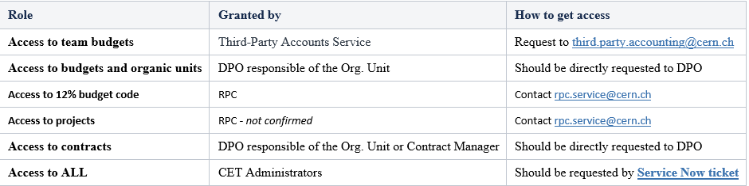
Access rights
Accessibility is driven by the CET Role which is granted to the user.
Access to DAI will automatically give access to orders without a CET role.
How to request specific access ?

Slide 6

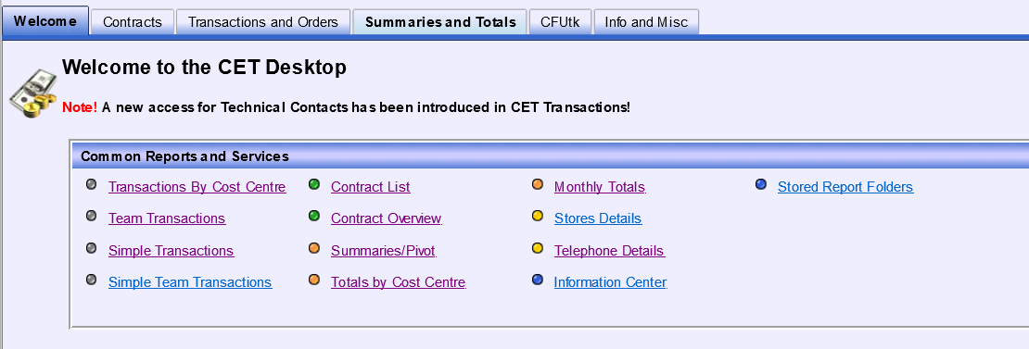
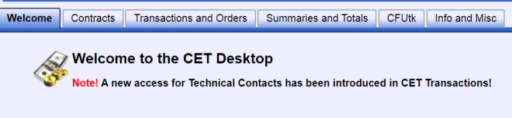
CET Desktop : Personnalisable
Welcome page
Management of menus(create/delete/add links or groups)
Management of tabs and groups (Welcome page)

Slide 7
Consultation of an ORDER in CET

Slide 8
Order life cycle
Need Identification
Supply Identification
Order
Reception service/ material
Invoicing
Order Closed
Validation
Yes
No
Correction/ Rejection
Your role as a technical contact

Slide 9
Order Status
Status before 30 / Pipeline : Order is under approval (EDH approval workflow)
Status 30 : Order sent to supplier (commitment exists and starts appearing in CET)
Status 58 : Order received (goods) totally or partially, RECEP doc validated by Tech. contact → reception is manually accrued on a quarterly basis(charged on your budget code, on your order)
Status 60 : Order received (goods) totally or partially, RECEP doc validated by Tech. contact → reception is automatically accrued on a daily basis(charged on your budget code, on your order)
Status 72 : Invoice received and attached to the order
Status 91 : Invoice validated for payment, charged on your budget code, on your order
Status 95 : Order deleted

Slide 10
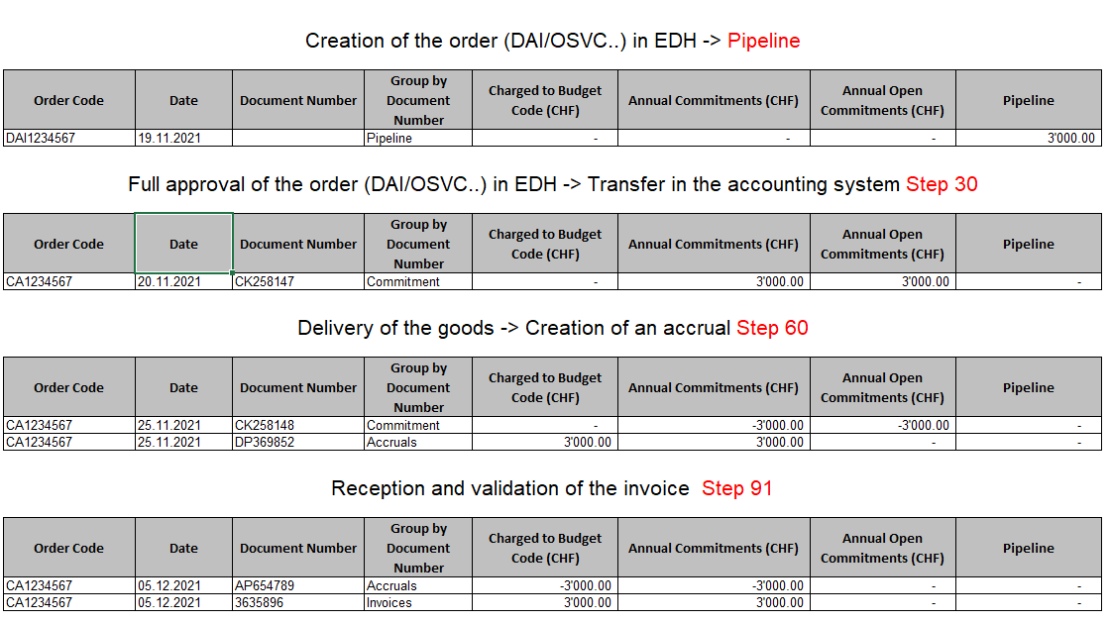
Annual commitment = Charged to Budget Code + Annual Open commitment

Slide 11
Order follow-up
As a technical contact of an order :
  Follow up the order from the creation to reception
  Transfer invoices to accounts-payable if received directly
  Accounts Payable may send you a RECEP document to agree on the quantities received and the conformity with the order.
  Can indicate via the RECEP document if no more invoices are expected, so Accounts Payable can close the order.
  Inform your DPO/DDPO (who will contact General Accounting) if the order needs to be closed.

Slide 12
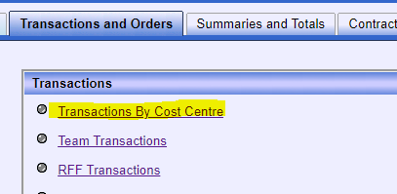
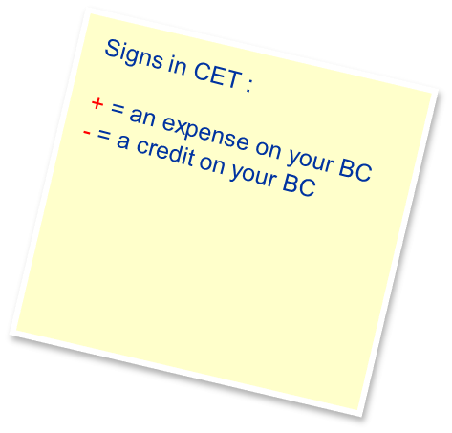
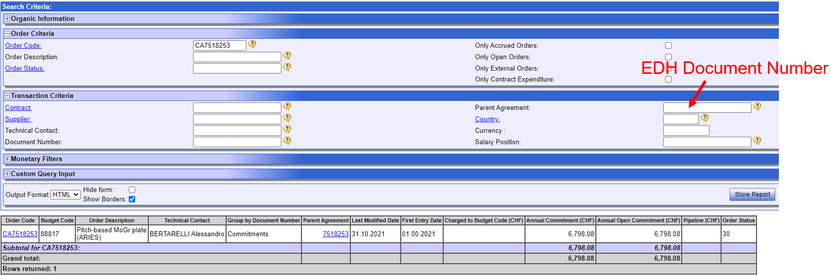
Transaction by cost center
View with Default Columns (select via COLUMNS button)
Order committed :
NB : The year of delivery date indicated in the order lines in EDH will trigger the accounting date of the open commitment.
If there are different dates on different lines, everything will be recorded at the earliest mentioned date.

Slide 13
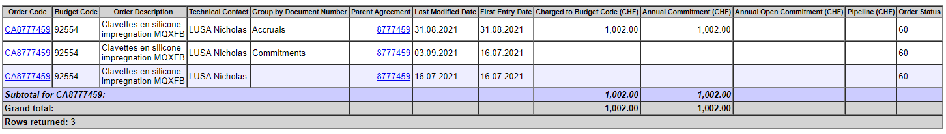
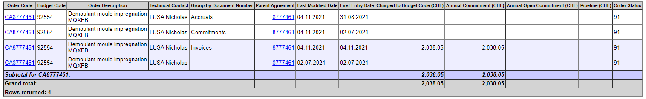
Order accrued at the basis of the reception :
Order invoiced :
NB : If the invoice or accrual is only partial, both lines Invoices or Accruals and Commitments will show an amount.

Slide 14
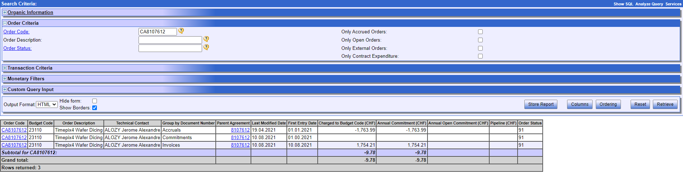
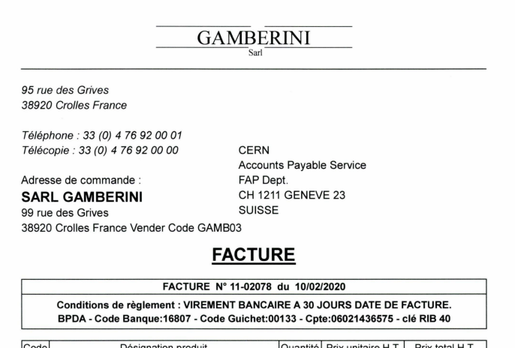
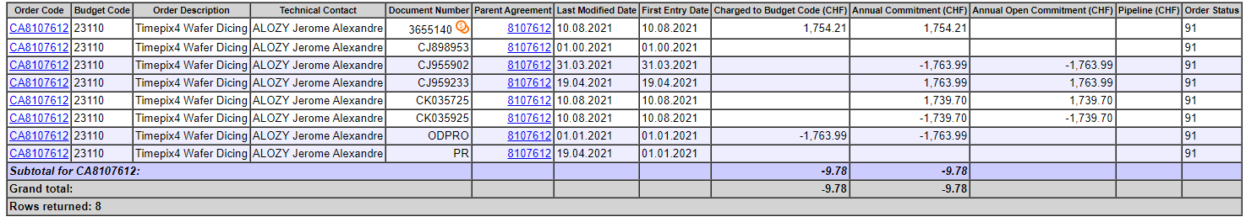
Transaction by cost center
In «Columns», if you unselect «Group By Document Number» and select «Document Number», you will have
access to the supplier invoice

Slide 15
Consultation of a CONTRACT in CET

Slide 16

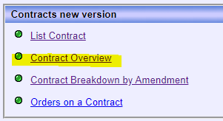
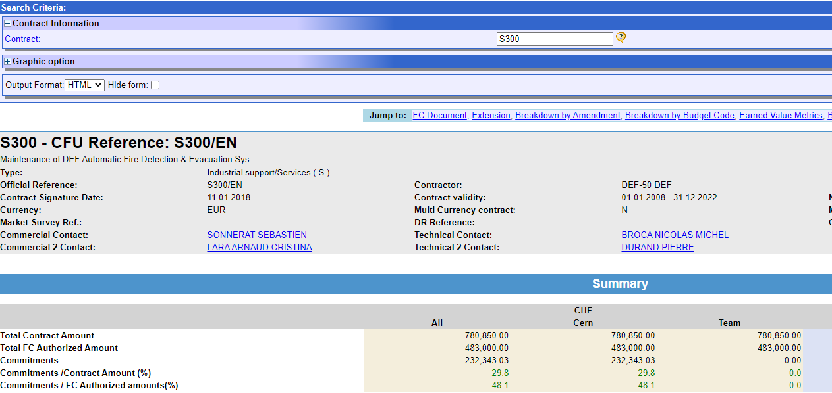
Contracts
Financial data

Slide 17

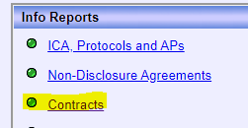
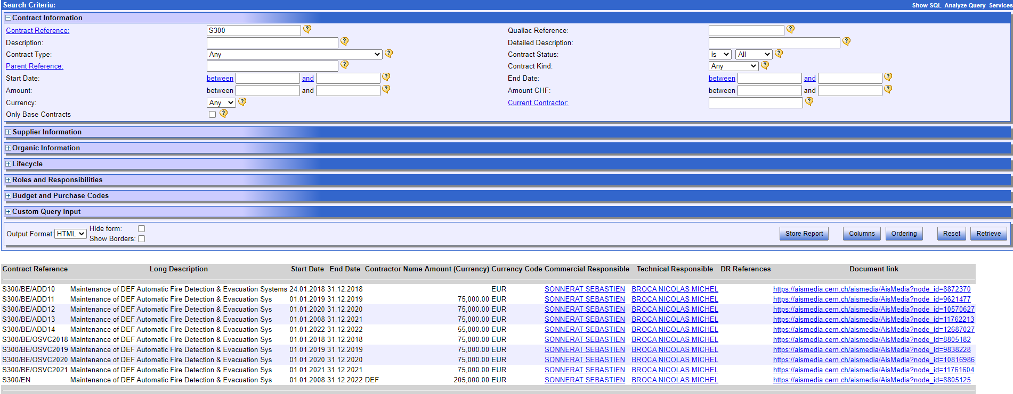
CFUtk
General information
Possibility to search by Technical Contact, Supplier, Amount

Slide 18
Consultation of a BUDGET CODE in CET

Slide 19
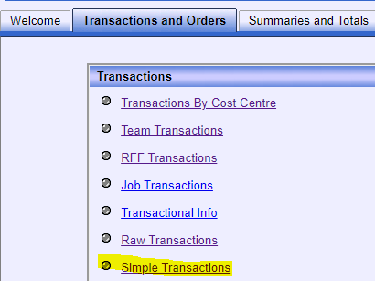
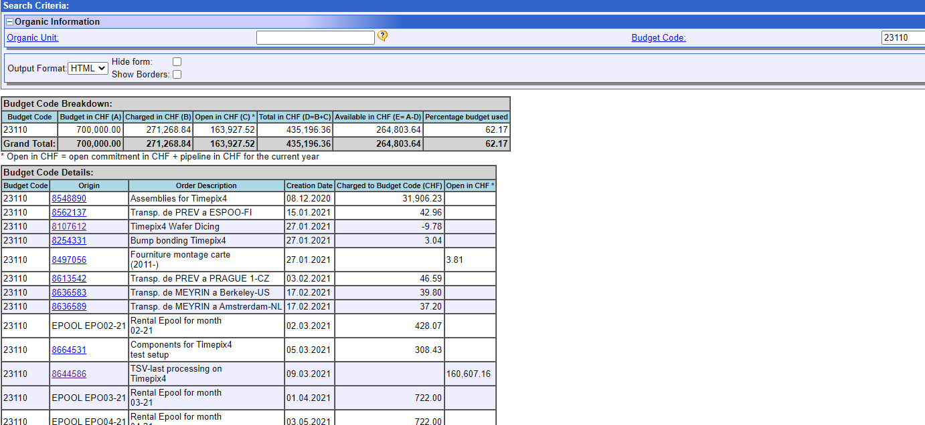
Simple transactions (static)

Slide 20
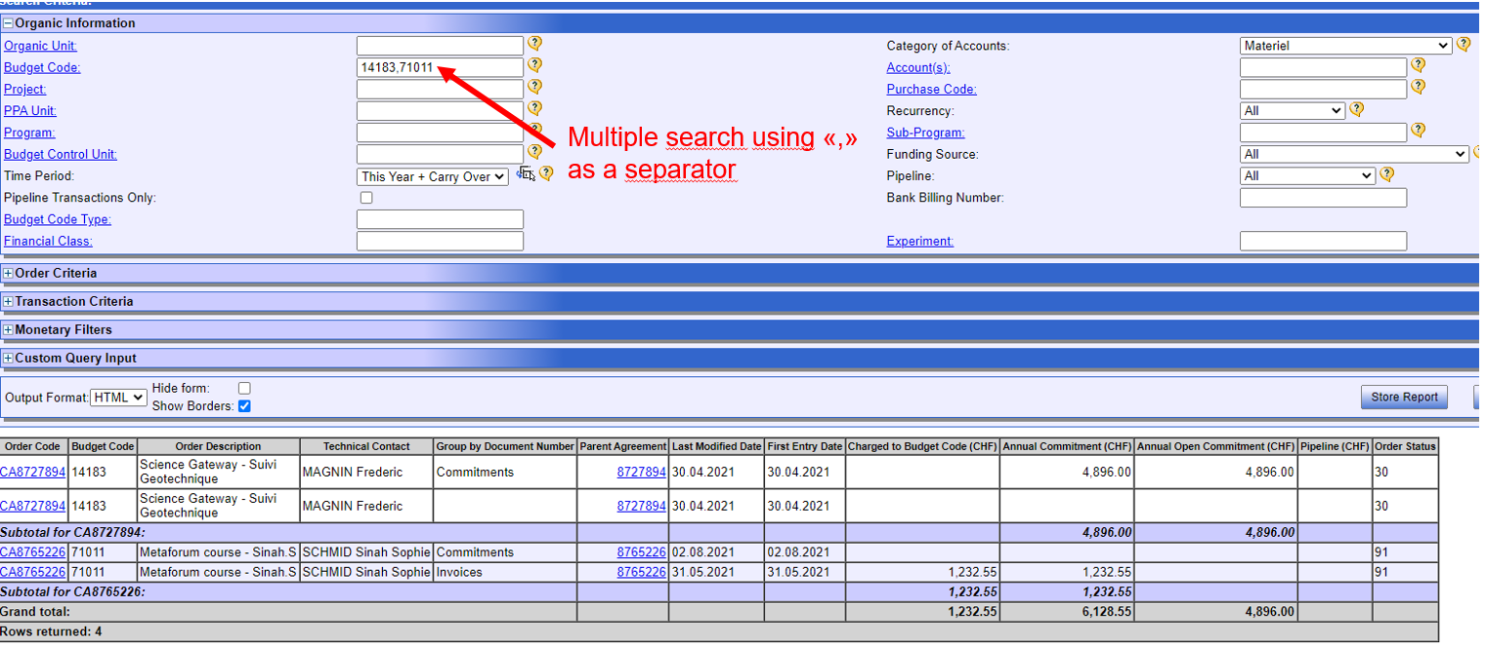
Transaction by Cost Center

Slide 21
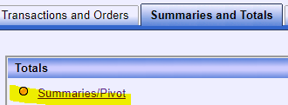
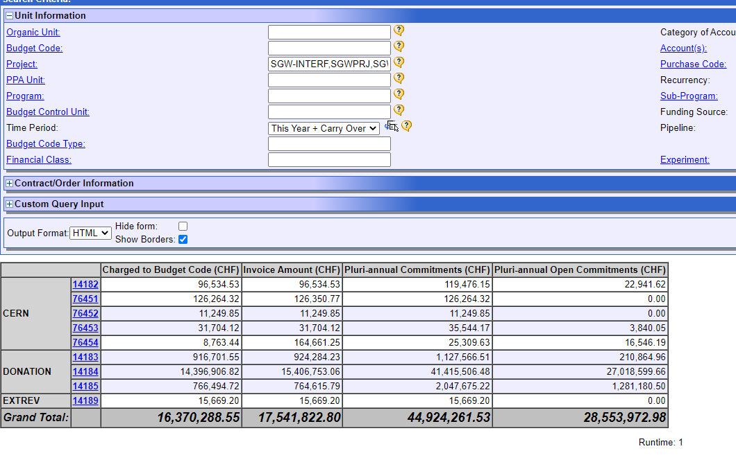

Summaries/Pivot
Summaries can be organized by row and columns via the Grouping Layout button.

Slide 22
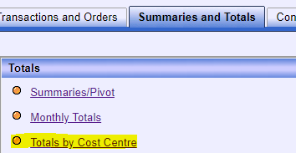
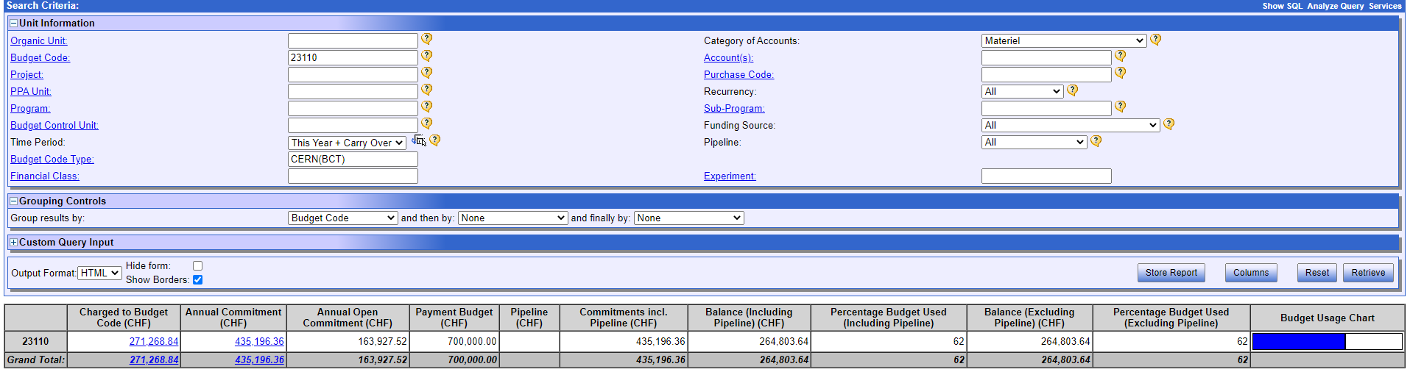
Total By cost Center

Slide 23
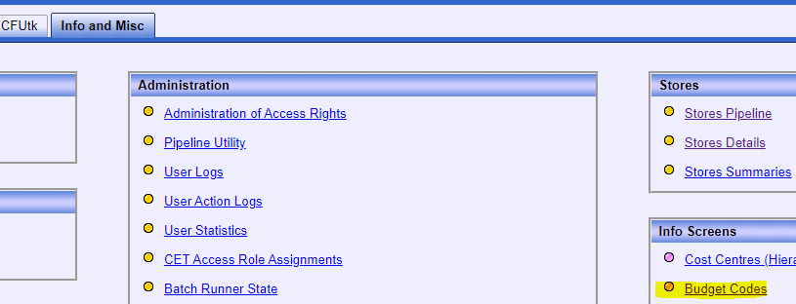
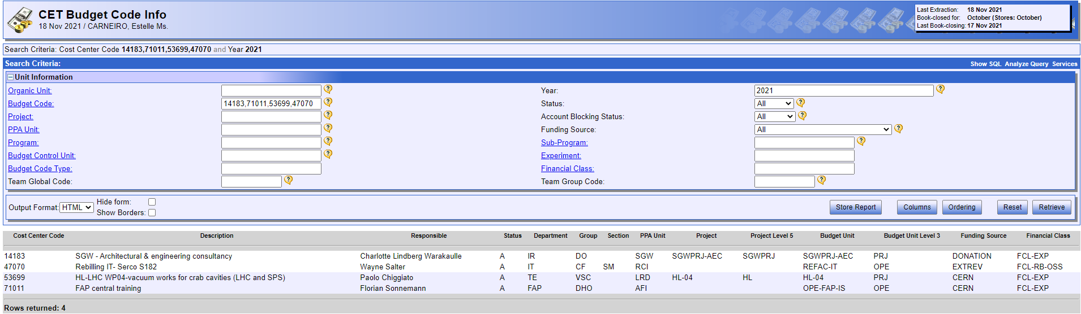
Info and Misc / Budget Codes

Slide 24
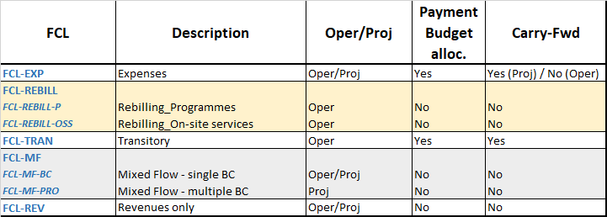
Financial classes for budget codes

Slide 25
Financial classes for budget codes (definitions)
FCL-EXP : Used to record expenses within the limits of an authorized budget. This FCL shall be the default when a BC is created and is the most widely used at CERN. Can be used either for operational or project activities.
FCL-REV : Revenue budget codes cover all inflows of external (non-CERN) funds other than those specifically identified in FCL-REBILL or FCL-MF. The use of these funds is governed mainly by the CERN budget and MTP, although not in all cases. The related budget allocations are made by FAP-RPC.
FCL-MF : Shall allow both revenue and expenses to be managed and monitored on the same BC. Balance is expected to be 0 at the end of the accounting period/activity. Subject to the following criteria :
  The source of funds must be external
  CERN is the coordinator or reponsible for the mgt of the activity
  The activity is time-limited and non-recurrent (project or project-like)
  The Mixed-Flow BC must be useful to the Project Leader for the financial management of his/her Project (i.e. expenses will need to relate to the revenues);
  The activity is executed on the CERN premises except for conferences, workshops & scientific meetings;
  A written agreement (e.g. Partnership / R&D agreement, MoU, Collaboration agreement…) must be drawn-up by CERN and subject to prior approval by FAP.
FCL-REBILL : Shall be opened specifically for the booking of the on-site operational expenses, which shall be recovered through periodic invoicing of a third-party (balance=0).

Slide 26
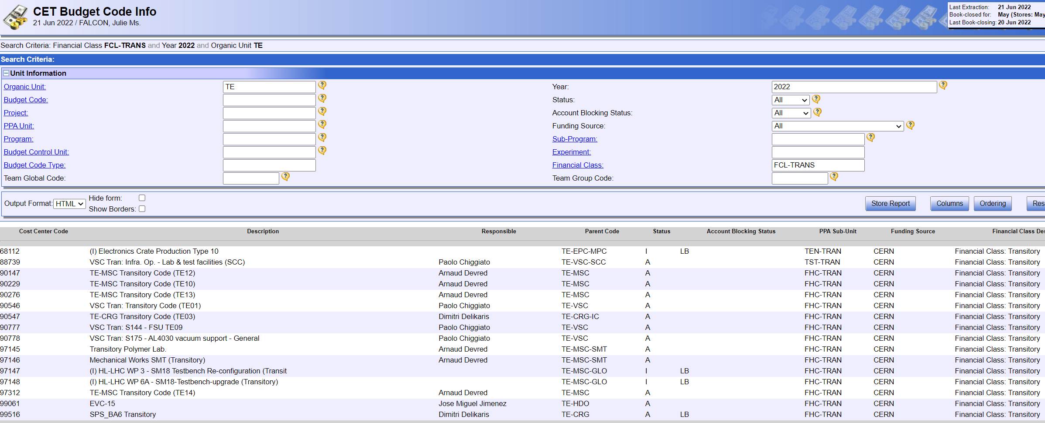
Financial classes for budget codes (transitory)
FCL-TRANS : Used to book expenses (invoicing of internal services) that shall be recharged internally to other BCs, through an automatic (e.g. GESMAR, BAAN), manual (e.g. TID) or accounting process. Depending on the invoicing model of the activity, overheads or margins can be applied. At the end of the accounting year, this is not expected that the expenses are exactly covered by the recharging (balance <> 0) in all cases. As most of the transitory BCs are used on a multi-annual basis, and can have irregular cash-flow profiles, the carry-fwd mechanism shall be implemented.

Slide 27
Consultation of a sale invoice in CET

Slide 28
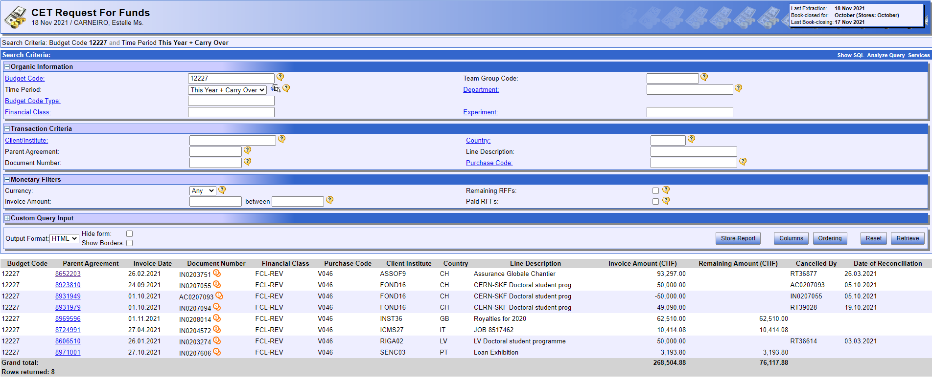
RFF (Request For Funds) transactions

Slide 29
Report Creation

Slide 30
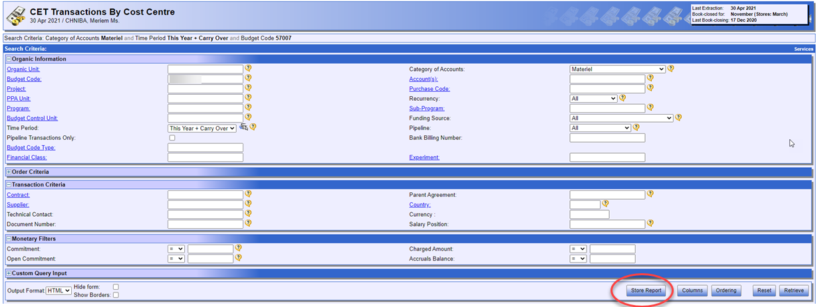
Possibility to register the layout of a report that you need on a recurrent basis:
1

Slide 31
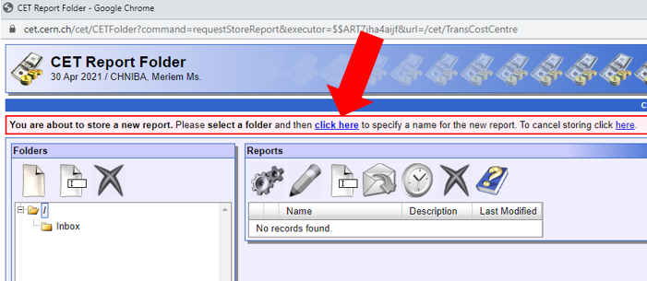
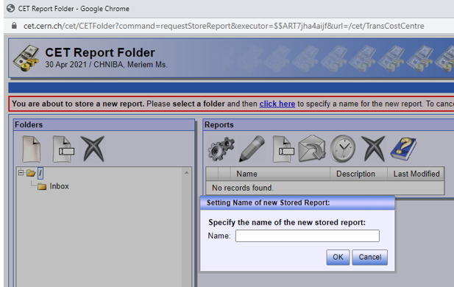
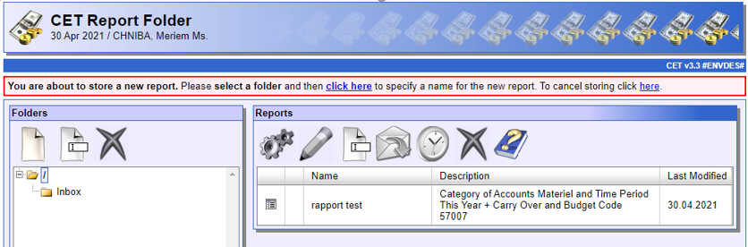
2
3

Slide 32
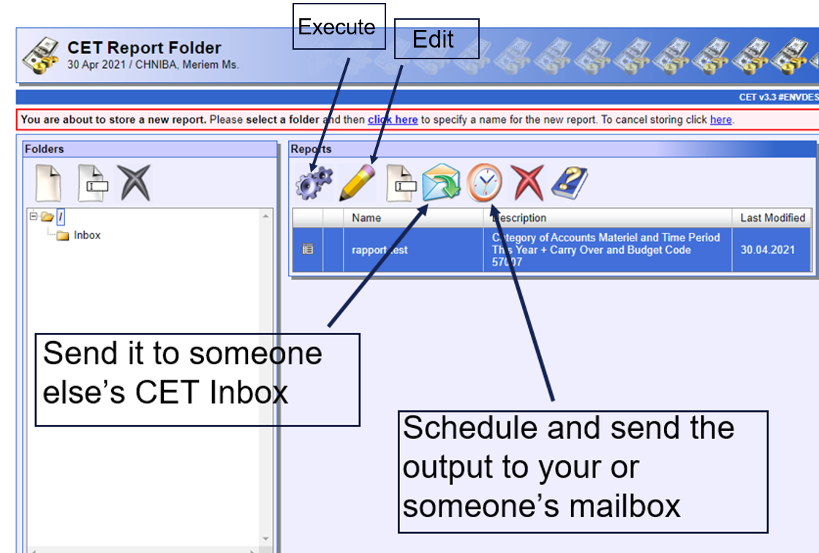

Slide 33
Useful Contacts
Close orders, move commitments, further info on CET, etc. :
general.accounting@cern.ch
Supplier Invoices:
Accounts-payable@cern.ch
Client Invoices:
Accounts.receivable@cern.ch
Third party accounts:
Third.party.accounting@cern.ch
Any budget related or other specific questions:
→ your DPO/DDPO, and eventually rpc.service@cern.ch

Slide 34
Thank you for your attention
Questions ?

Slide 36
Back-up slides

Slide 37
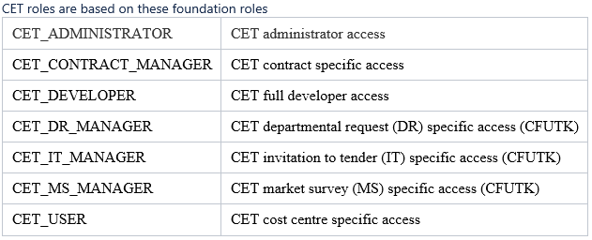
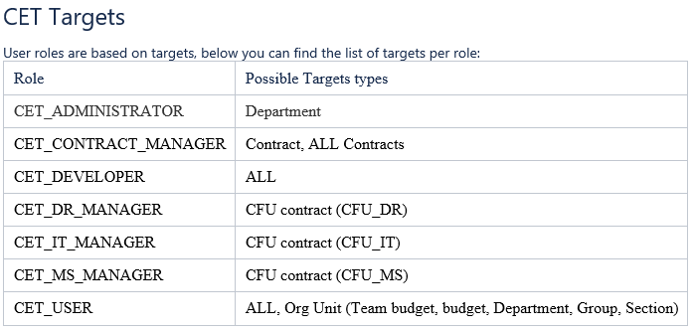
Access rights

Slide 38
Reminder of the end / beginning of the year planning and budgeting processes (1): carry-forward M
Materials
  for projects: automatic
  for operation: only in the limit of committed amounts
    Specific treatment for transitory and externally funded codes (including MFBC)
    BAAN orders not delivered on 31st December will be included
    Done on the programme level
  for consolidation:
    during PRE, the same rules as for projects apply
    after book closing, only in the limit of the committed amounts

Slide 39
Reminder of the end / beginning of the year planning and budgeting processes (2): carry-forward P
Personnel
  Staff: in general terms none, during PRE:
    A small portion of unspent staff budget (maximum 2 FTEs, minimum 0.5 FTEs) can be used to finance a fellow, with the following «conversion rate»: 1 staff FTE = 1 fellow FTE plus 110 kCHF/year on average
    Exceptional re-profiling made for ATS Sector – agreement that further unspent budget, if any, will NOT be used for Fellows
    As from next year, overspent budget will have to be absorbed by the Departments concerned (either MtoP or decrease of FTEs for future years)
  Fellows: uncommitted budget can be subject to a carry-forward of max 5% DGP determined by comparing the standard cost to the allocated budget.
      Overcommitment to be (ideally) covered by MtoP before the end of the year, otherwise negative carry-forward of the full amount
      Please pay attention to externally funded fellows

