Slide 1

LHC High Luminosity Upgrade plans
(including introduction to FP7 Hi-Lumi Design Study)
Lucio Rossi
CERN
sLHC-PP Public events @ CERN 8 March 2011

Slide 2
Content
Scope of HL-LHC
Main technologies
  sLHC as key step toward high luminosity
HiLumi LHC, an FP7 Design Study
  A global collaboration

Slide 3
How the lumi might evolve in LHC
Prudent assumptions, of September 2010:
Better than expected LHC behaviour is not yet integrated.
It is assumed to saturate at design luminosity of 1.e34. Today we may assume 1.7-2 e34 !
The new shutdown plan (approved 31 January 2011) not yet integrated (shutdown in 2013)
Better performance may push the integrated lumi to 300 fb⁻¹ before 2020.

Slide 4
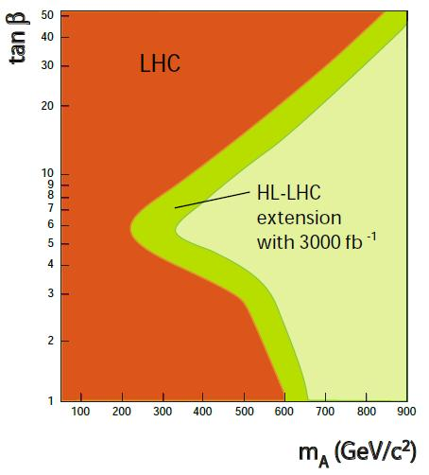
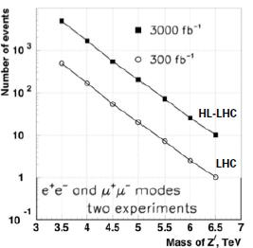
(some of the) Phyics motivation
In particular, operation at higher luminosity as foreseen by HL-LHC has three main purposes:
Perform more accurate measurements on the new particles discovered in the LHC.
Observe rare processes, whether predicted by the Standard Model (SM) or by the new physics scenarios unveiled by the LHC, which have rates below the sensitivity of the current phase.
Extend the exploration of the energy frontier, therefore extending the discovery reach, by probing the very rare events where most of the proton momentum is concentrated in a single quark or gluon.
300 fb⁻¹

Slide 5
The goal
The main objective of HL-LHC is to implement a hardware configuration and a set of beam parameters that will allow the LHC to reach the following targets:
A peak luminosity of 5×10³⁴ cm⁻²s⁻¹ with levelling, allowing:
An integrated luminosity of 250 fb⁻¹ per year, enabling the goal of 3000 fb⁻¹ twelve years after the upgrade. This luminosity is more than ten times the luminosity reach of the first 10 years of the LHC lifetime.
allow design for lower peak L, less pile up
less peak heat deposition ( a factor 2 may be the diff

Slide 6
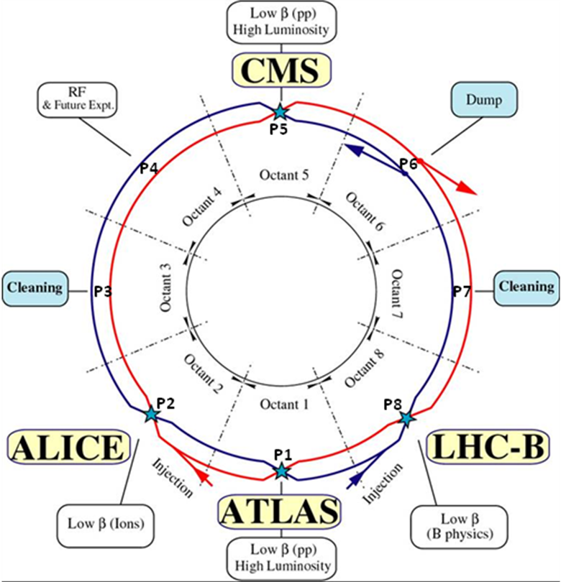
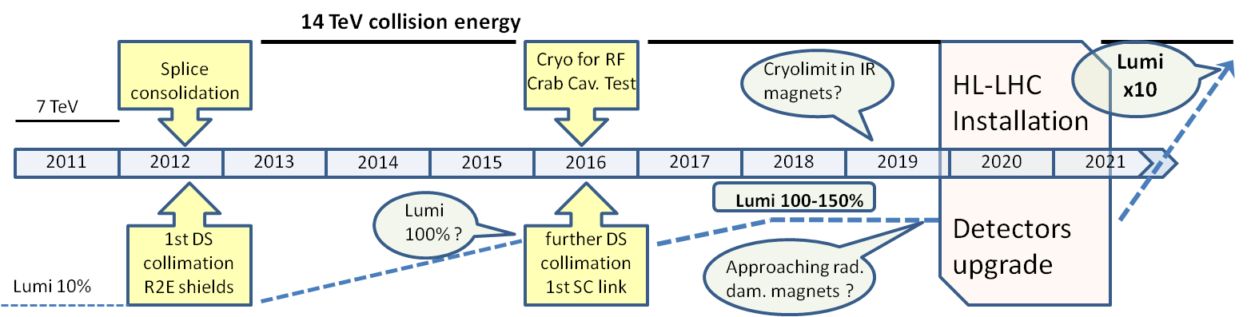
The path toward high lumi
From Chamonix 2011:
Integrate also LHCb and Alice in the upgrade picture (so far there were not)
The shutdown scheme is to be shifted of one year : a resource loaded plan under preparation

Slide 7
What is new from last year
Phase 1 upgrade (of which sLHC has been an important pillar) have evidenced the difficulty to go to β* sensibly smaller than LHC.
Necessity to go beyond a change of the IR (inner triplet quads+ D1)
Necessity of levelling and of means to beat the geometric reduction factor

Slide 8
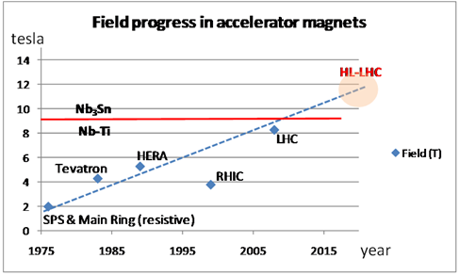
Squeezing the beam
High Field SC Magnets
13 T, 150 mm aperture Quads for the inner triplet
  LHC: 8 T, 70 mm.
  sLHC-PP: 8.5 T 120 mm
More focus strength, β* as low as 15 cm (55 cm in LHC). In sam scjeme even β* down to 7.5 cm are considered
Dipole separators capable of 6-8 T with 150-180 mm aperture (LHC: 1.8 T, 70 mm)

Slide 9

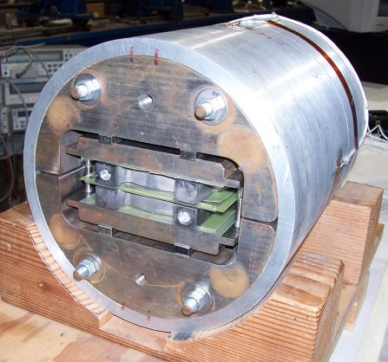
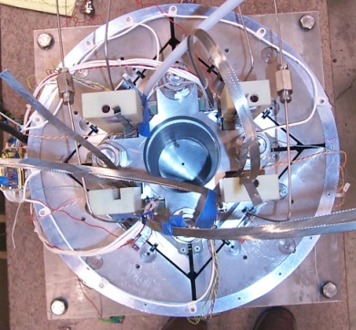
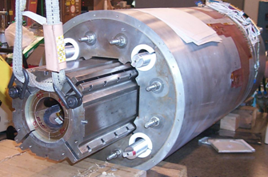
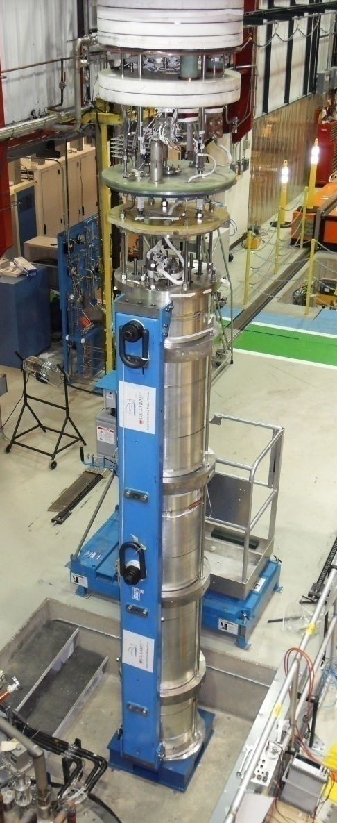
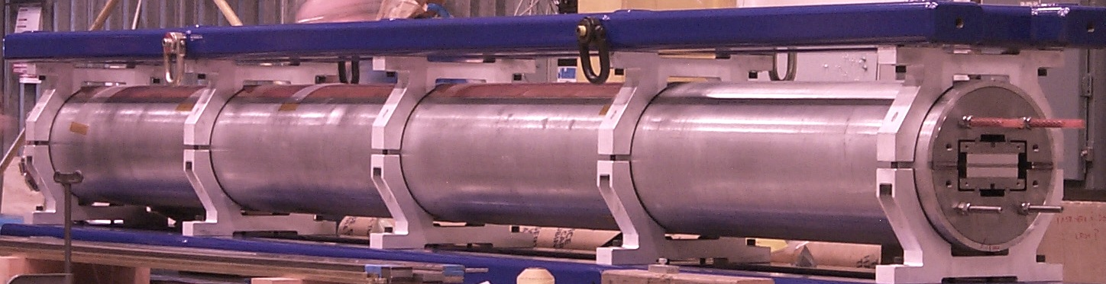
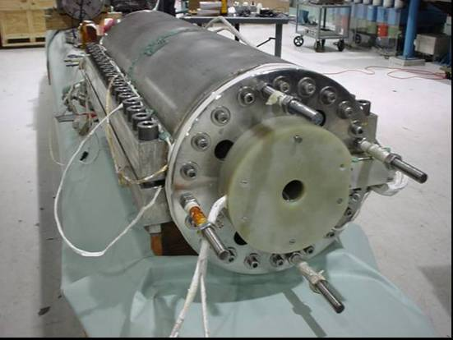
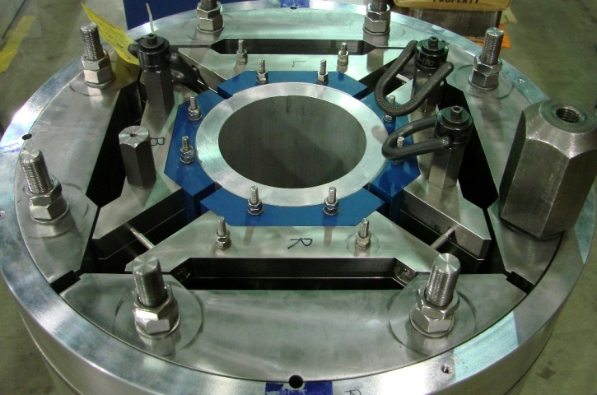
LARP Magnets
SM
SQ
TQS
LQS-4m
LR
TQC
HQ

Slide 10

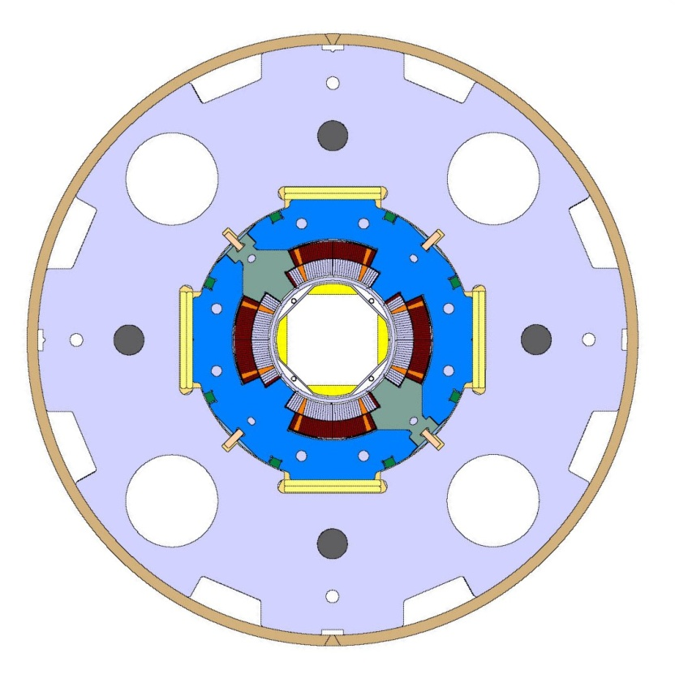
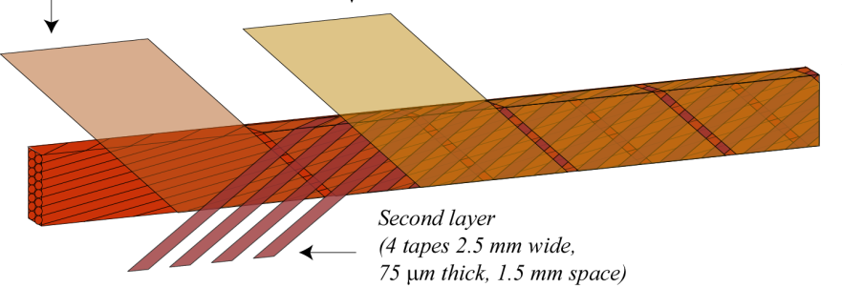
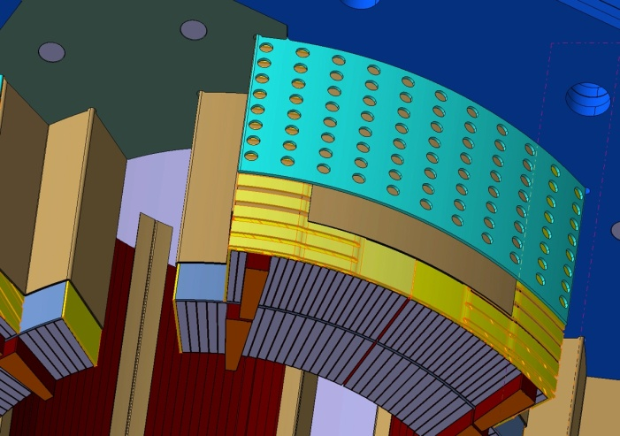
Direct benefit from sLHC program: improved Nb-Ti technolgy
Favorite scheme of HL-LHC requires new Nb-Ti more pushed wrt to present LHC for the matching sections: larger aperture (85-90 mm, wrt LHC 56/70 mm)
Higher heat deposition will demand use of the new insulation scheme

Slide 11
crab crossing restores bunch overlap
F. Zimmermann CC09
θ_{c}
RF crab cavity deflects head and tail in opposite direction so that collision is effectively “head on” for luminosity and tune shift
bunch centroids still cross at an angle (easy separation)
1st proposed in 1988, in operation at KEKB since 2007 → world record luminosity!

Slide 12
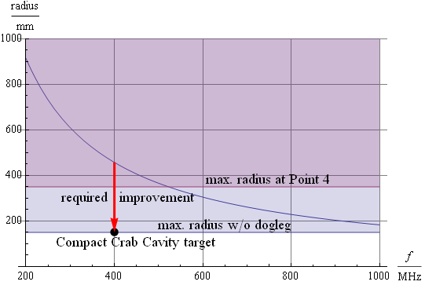
Improve beam overlap
SC RF Crab cavities
Crab cavities to rotate the beam and colliding with good overlap
Providing « easy » way for levelling
Necessary to fully profit of the low β*
Very demanding phase control (better than 0.001°) and protection
Very compact design
40-80 MV (16 MV in LHC)

Slide 13
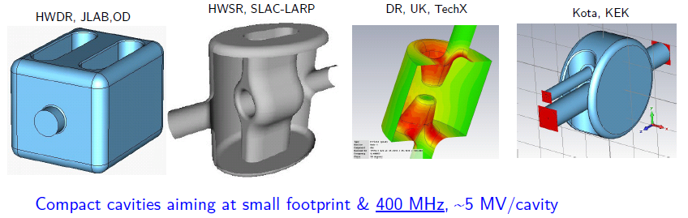
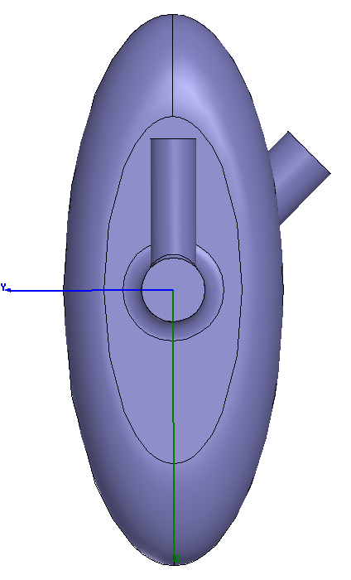
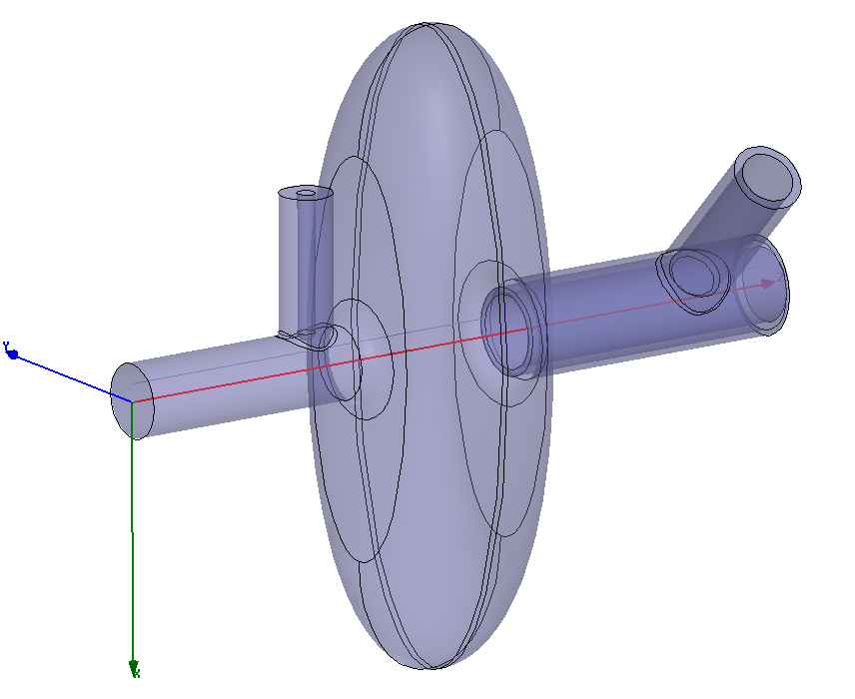
Compact 400 MHz
(see 4th LHC CC workshop)
Technical space for He tank, etc..
All these 400 MHz can fit into the standard 194 mm LHC beam separation with cavities in a common cryostat (but not easy…)
LHC
pipe1
LHC
pipe2
New idea for a very compact elliptical 800 MHz
194 mm

Slide 14
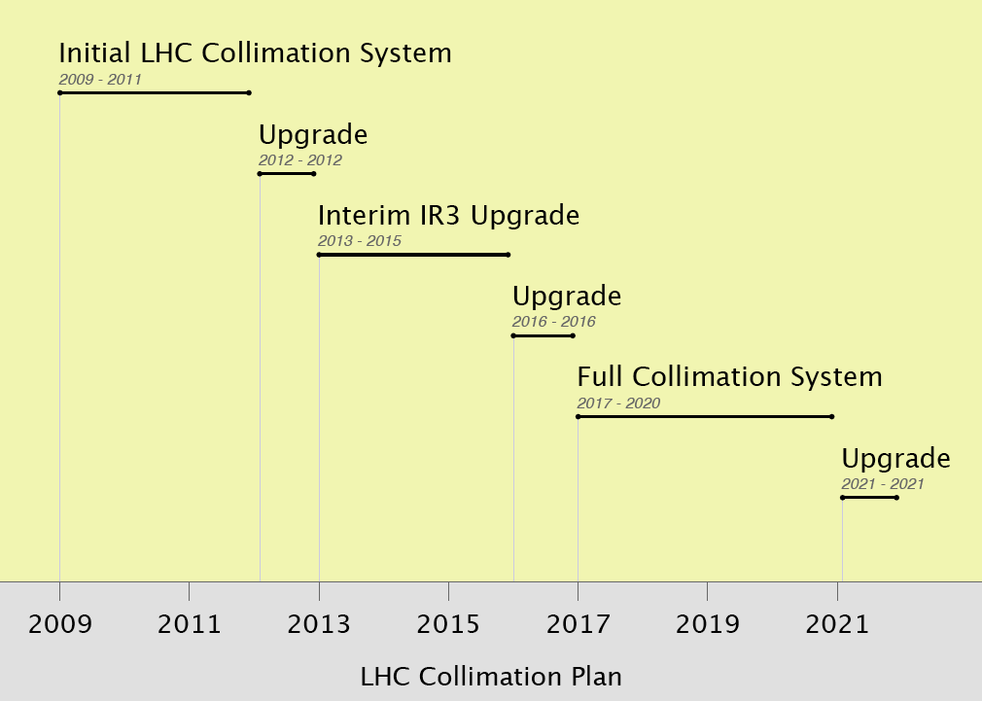
≤ 50% I_{nom} @ 3.5 TeV
β* ≈ 2m
HL-LHC WP5:
Upgrades as required for HL-LHC upgrade
≤ 100% I_{nom} @ 7.0 TeV
β* ≈ 1m
≥ 160% I_{nom} at
7.0 TeV
β* ≈ 55cm

Slide 15
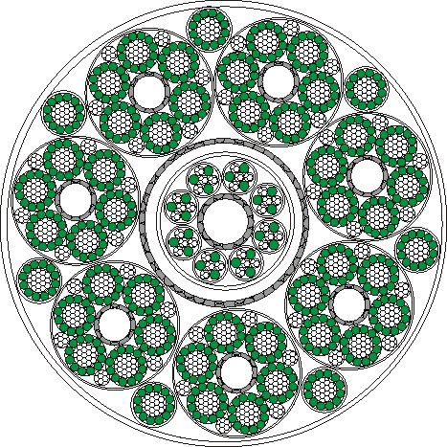
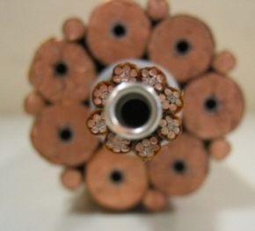
Removal of Electrical Power Converter (200kA-5 kV SC cable, 100 m height)
Φ = 62 mm
MgB2
(or other HTS)
7 × 14 kA, 7 × 3 kA and 8 × 0.6 kA cables – Itot∼120 kA @ 30 K
Also DFs with current leads removed to surface
Definitive solution to R2E problem
Make room for shielding unmovable electronics
Make much easier maintnance and application ALARA

Slide 16
Technical reasons for the upgrade
(or at least for important improve)
The zone of the triplets will wear out
  Radiation damage limit
  Hardware and shielding that has not been really optimized for very high radiation
    Better and increased shielding of the triplet and other elements
    Better design (absorbers, TAS) also for background
    Removing power supply, longer lines, necessity of a re-layout
  Necessity to increase to heat removal capacity
    Restoring cooling capacity in IR5 Left and decouple RF from Magnets 2016-17
    Local removal (inside triplet) and transport away
    Cooling capacity
    Cooling sectorization (compelte decoupling of IR form arc: this will allow more budget for e-clouds, 25 ns will may re-favourite)

Slide 17
example HL-LHC parameters, β*=15 cm
parameter | symbol | nom. | nom.* | HL crab | HL sb + lrc | HL 50+lrc
protons per bunch | N_{b} [10¹¹] | 1.15 | 1.7 | 1.78 | 2.16 | 3.77
bunch spacing | Δt [ns] | 25 | 50 | 25 | 25 | 50
beam current | I [A] | 0.58 | 0.43 | 0.91 | 1.09 | 0.95
longitudinal profile |  | Gauss | Gauss | Gauss | Gauss | Gauss
rms bunch length | σ_{z} [cm] | 7.55 | 7.55 | 7.55 | 5.0 | 7.55
beta* at IP1&5 | β∗ [m] | 0.55 | 0.55 | 0.15 | 0.15 | 0.15
full crossing angle | θ_{c} [μrad] | 285 | 285 | (508-622) | 508 | 508
Piwinski parameter | φ=θ_{c}σ_{z}/(2*σ_{x}*) | 0.65 | 0.65 | 0.0 | 1.42 | 2.14
tune shift | ΔQ_{tot} | 0.009 | 0.0136 | 0.011 | 0.008 | 0.010
potential pk luminosity | L [10³⁴ cm⁻²s⁻¹] | 1 | 1.1 | 10.6 | 9.0 | 10.1
events per #ing |  | 19 | 40 | 95 | 95 | 189
effective lifetime | τ_{eff} [h] | 44.9 | 30 | 13.9 | 16.8 | 14.7
run or level time | t_{run,level} [h] | 15.2 | 12.2 | 4.35 | 4.29 | 4.34
e-c heat SEY=1.2 | P [W/m] | 0.2 | 0.1 | 0.4 | 0.6 | 0.3
SR+IC heat 4.6-20 K | P_{SR+IC} [W/m] | 0.32 | 0.30 | 0.62 | 1.30 | 1.08
IBS ε rise time (z, x) | τ_{IBS,z/x} [h] | 59, 102 | 40, 69 | 38, 66 | 8, 33 | 18, 31
annual luminosity | L_{int}[fb⁻¹] | 57 | 58 | 300 | 300 | 300

Slide 18
Luminosity vs. β* in the Xing plane (with hour-glass effect) for different values of β* in the other plane: nominal emittance and bunch length, ultimate intensity, no crab-cavity
Example of flat optics:
β* =30 cm in the crossing-plane
β* = σ_{z} =7.5 cm in the other plane
Θ_{c} = 10σ in the plane of biggest β*
→ Peak lumi ~5.6 10³⁴cm ⁻²s ^{– 1}
0.16cm
“Equivalent” round optics:
β* =15 cm in both planes
Θ_{c} = 10σ
→ Peak lumi ~3.5 10³⁴cm ⁻²s ^{– 1}
0.40cm
1.0cm
7.5cm
16cm
40cm
NEW scheme ATS: see next slides
S. Fartoukh, sLHC-PR0049 & LMC 21/07/2010
R. D. Maria, S. Fartoukh, sLHC-PR0050 & LMC 21/07/2010
100cm
Case of round beam optics
The “virtual” performance of the two optics is equivalent with crab-cavity (~8-9E34),
In all cases the two options requires to push β* well beyond the Phase I limit of 30 cm. …Nb3Sn can only improve the situation by ~25%, not more!

Slide 19
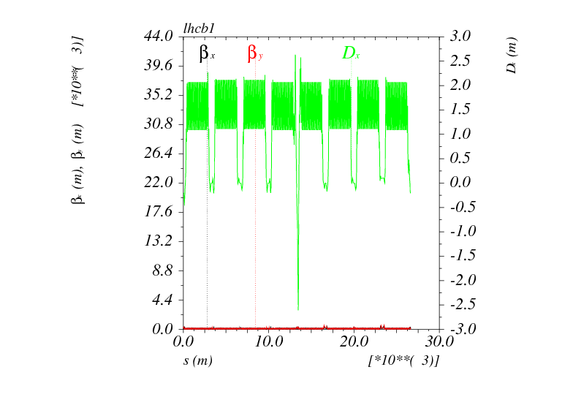
Injection optics: β* = 14 m in IR1 and IR5
Nominal β_{arc} (180m) in s45/56/81/12

Slide 20

Pre-squeezed optics: β* = 60 cm in IR1 and IR5: “1111”
Similar to the nominal LHC
Nominal β_{arc} (180m) in s45/56/81/12

Slide 21
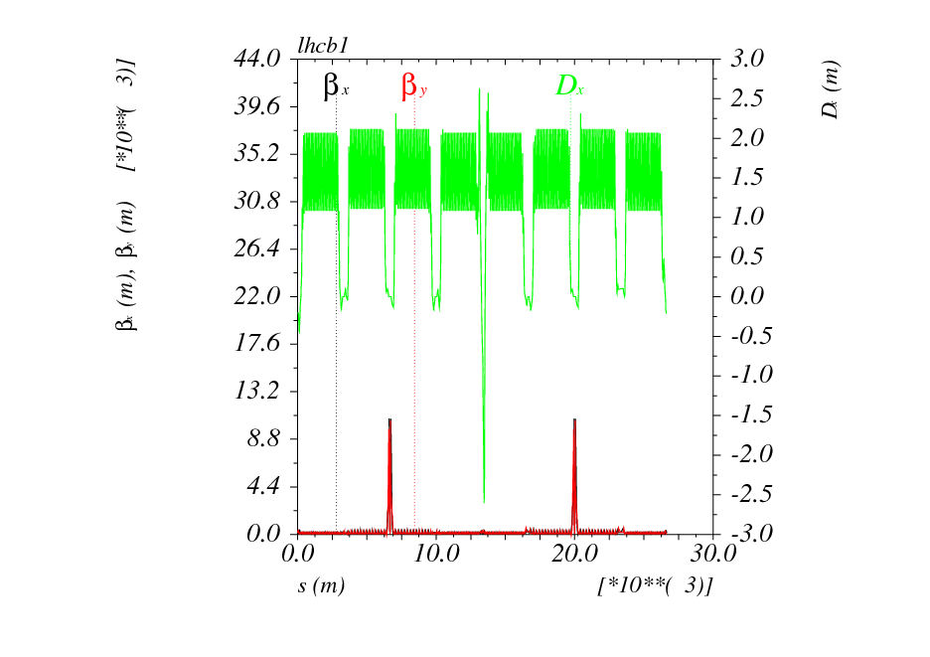
Intermediate squeezed optics: β* = 30 cm in IR1 and IR5: “2222”
Similar to Phase I
(but with much more flexibility)
β_{arc} increased by a factor of 2 in s45/56/81/12

Slide 22
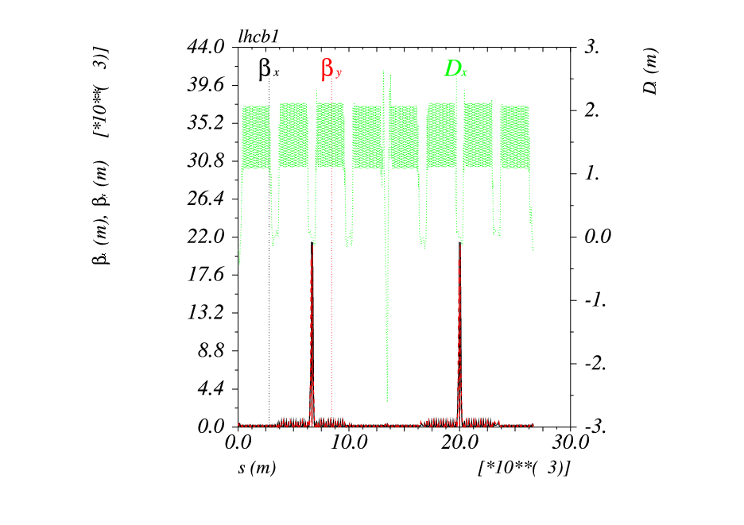
Squeezed optics (round): β* = 15 cm in IR1 and IR5: “4444”
HL-LHC with round optics
(preferable with crabs)
β_{arc} increased by a factor of 4 in s45/56/81/12

Slide 23
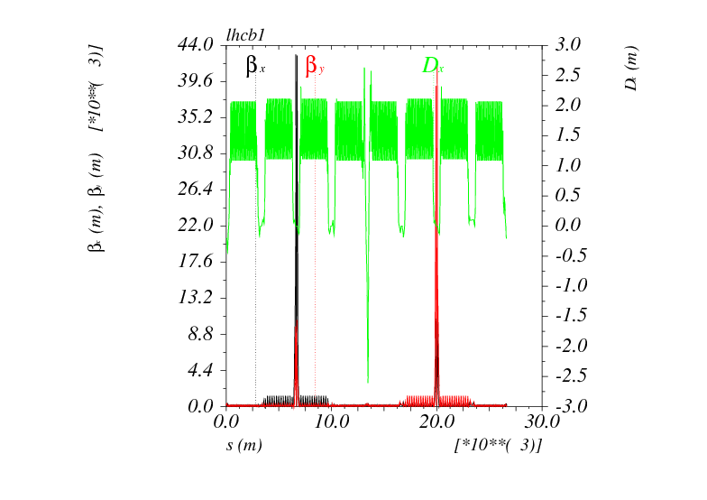
Squeezed optics (flat): β*_{x/y} = 7.5/30 cm alternated in IR1 and IR5: “8228”
HL-LHC with flat optics
(back-up w/o crabs)
β_{arc} increased by a factor of 2 or 8 in s45/56/81/12
depending on the β* aspect ratio in IP1 and IP5

Slide 24
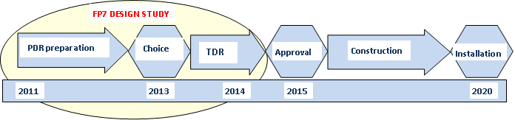
Structure of the project HL-LHC and the HiLumi FP7 Design Study

Slide 25
Large participation application 25 Nov 2010

Slide 26
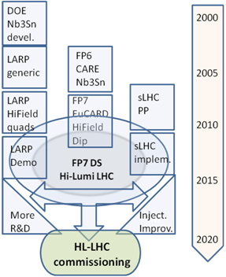
HiLumi is the focal point of 20 years of converging International collaboration
The collaboration wiht US on LHC upgrade started during the construction of LHC
EU programs have been instrumental in federating all EU efforts
With Hi-Lumi the coordination makes a step further: from coordinated R&D to a common project
CERN is not anymore the unique owner, rather is the motor and cathalizer of a wider effort.
Managed like a large detector collaboration (with CERN in special position as operator of LHC)

Slide 27
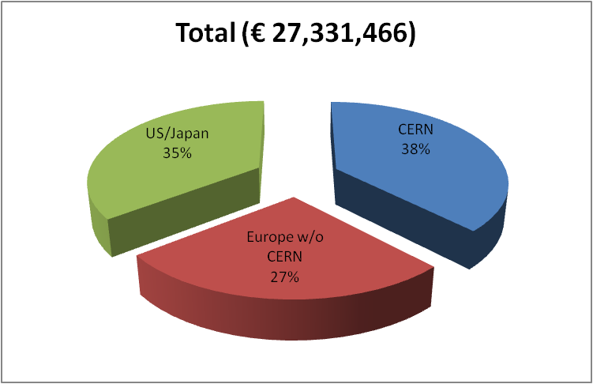
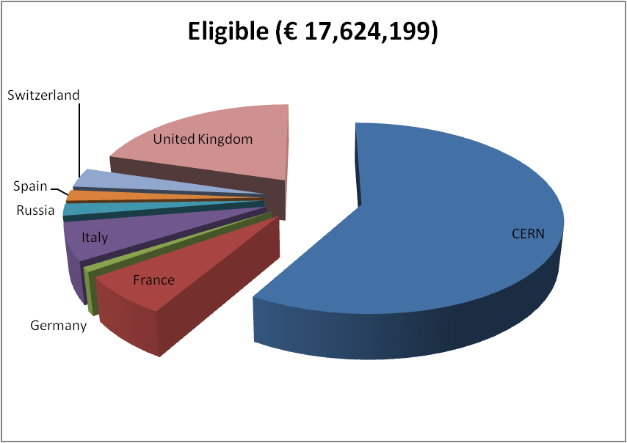
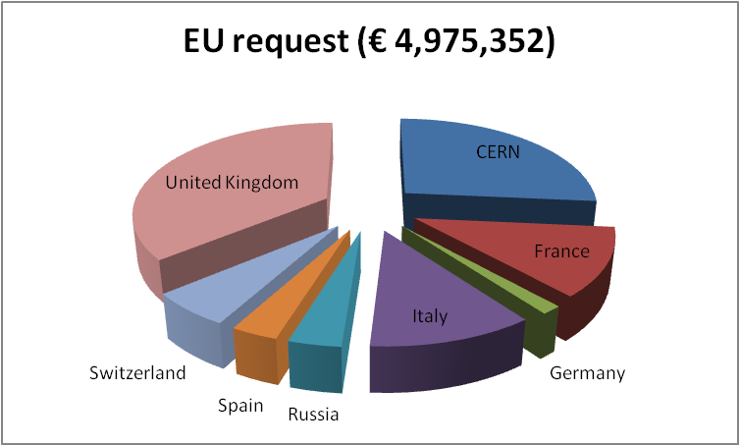
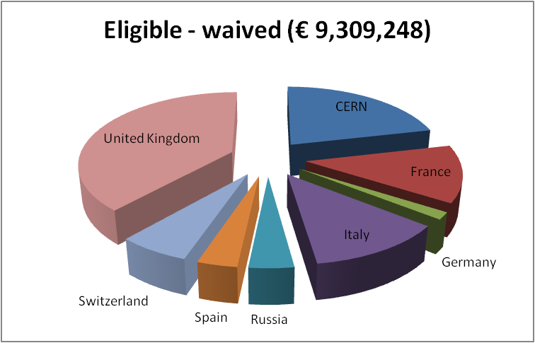
Budget FP7 HiLumi
CERN waives all technical works:
LHC is core program.
Only kept the CERN cost for managem.
Only EU research area
Waiving effect
50%
85% of CERN gen. mngt

Slide 28
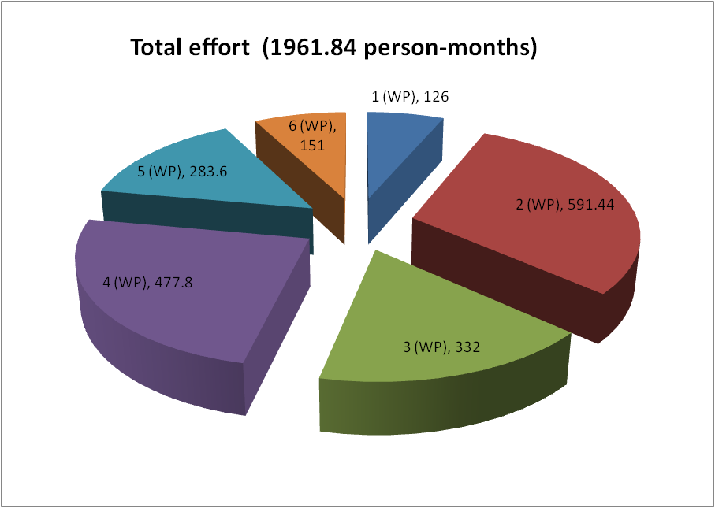
Budget cont.
Personnel for HiLumi by WP
Manag and Tech. Coord. (6%)
Acc. Physics and beam
Magnets for IR
Crab Cavities
Collimators
Sc links
Estimated cost for the the whole HL-LHC over 10 years in M€

Slide 29

Conclusion
HL-LHC project is starting, forming a large international collaboration
HL-LHC has a flexible plan: however the development of the main hardware is –almost – traced
HL-LHC builts on the strength and expertise of sLHC
  For the injectors (that will deliver the needed beam)
  For the beam studies (fundamental understanding the limitation of Phase 1)
  For the pushed Nb-Ti technologies for magnets:
    Essential for Matching Section magnets
    Important back-up solution for the low-β magnets
  For the radiation studies, safety aspect and management tools.

