Slide 1

PLANS FOR THE UPGRADE OF THE LHC INJECTORS
R. Garoby for the LIU Project Team
8/03/2011
This project has received funding from the European Community's Seventh Framework Programme (FP7/2007-2013) under the Grant Agreement nº212114

Slide 2
Outline
Introduction
Needs of the “High Luminosity LHC”
Plans for the injectors’upgrade
Summary

Slide 3
Introduction

Slide 4
CERN Scientific Strategy
Based on the experience gained diagnosing and repairing the LHC in 2008 and 2009 the following decisions have been taken in 2010 and formalized in the CERN Medium Term Plan 2011-2015:
LHC will operate until ~2030. Experiments expect to accumulate ~3000 fb⁻¹.
During its last decade of operation, the LHC shall aim at a useful average luminosity of 5 10³⁴ cm⁻²s⁻¹.
The upgrade of the LHC itself for High Luminosity shall be implemented in ~2020,
The injectors shall be adapted to meet reliably the performance required by the High Luminosity LHC for as long as it operates (2030).

Slide 5

Organization
WP2: Management tools
WP5: Radioprotection
WP6: NbTi Wide Aperture Quadrupole
Two projects have been created on January 1, 2011 for studying and implementing the High Luminosity Upgrade of the LHC:
“HL-LHC” for the LHC itself
“This new study combines all work related to the provision of a peak luminosity of five times the design luminosity of the LHC (i.e. 5x10³⁴ cm⁻²s⁻¹) and with an enhanced luminosity lifetime by “luminosity leveling””.
“LHC Injectors Upgrade” (LIU) for the injector complex
“The LHC Injectors Upgrade should plan for delivering reliably to the LHC the beams required for reaching the goals of the HL-LHC. This includes LINAC4, the PS booster, the PS, the SPS, as well as the heavy ion chain.”
R and D for a Super conducting Proton Linac is pursued as an option for future potential application
WP2: Management tools
WP5: Radioprotection
WP7.1: H⁻ ion source
WP7: H⁻ ion source § pulsed SC RF

Slide 6
Needs of the
“High Luminosity LHC”

Slide 7
Analysis
Most important characteristics:
Luminosity
Integrated Luminosity = x
Time
LHC requirements on its injectors
Number of protons per bunch (“intensity”),
Number of bunches (distance between bunches),
Bunch emittances (“size”)
+ minimum time between data taking periods
Consequence for the injectors
The LHC imposed brightness must be present from the lowest energy because brightness is (at best) conserved in a cascade of proton accelerators (Liouville’s theorem).
Severe constraint at low energy because of space charge tune spread ΔQ_{SC}
Need for high availability (reliability) and flexibility
(proportional to
number of events)
Duration of data taking
(N_{b}/ε_{X,Y} is called
“beam brightness”)
Detailed specifications to be established with HL-LHC Project

Slide 8
HL-LHC beam characteristics
Scenarios for increasing the LHC luminosity
(Preliminary but typical!)
Nominal luminosity (10³⁴ cm⁻²s⁻¹) reached with:
  75 ns spacing, 1.7 10¹¹ p/b, emittances = 2.7 μrad, β*=0.55 m
  or 50 ns spacing, 1.7 10¹¹ p/b, nominal emittances (3.75 μrad), β*=0.55 m
2 x nominal luminosity reached with:
  50 ns spacing, 2.3 10¹¹ p/b, nominal emittances, β*=0.55 m
  or 25 ns spacing, 1.15 10¹¹ p/b, emittances = 1.9 μrad, β*=0.55 m
3 x nominal luminosity reached with:
  25 ns spacing, 1.7 10¹¹ p/b, emittances = 2.7 μrad, β*=0.55 m
6 x nominal luminosity reached with:
  25 ns spacing, 1.7 10¹¹ p/b, emittances = 1.9 μrad, β*=0.3 m

Slide 9
Comparison with present injectors performance
From R. Steerenberg
 | Expected Beam Characteristics at SPS exit in 2011 |  |  |  | HL-LHC (tentative) requirements
 | Ip / bunch | ɛ_{h} and ɛ_{v} | ɛ_{longit} | nb | Ip / bunch | ɛ_{h} and ɛ_{v} | Peak
 | [x10¹¹] | [mm ∙ mrad] | [eVs] | bunches | [x10¹¹] | [mm ∙ mrad] | Luminosity
 |  | 1σ, norm. |  |  |  | 1σ, norm. | [x10³⁴ cm⁻²s⁻¹]
LHC25 (DB) | 1.15 | 3.6 | 0.7 | 1 - 4 x 72 | 1.7 | 1.9 | 6 (β*=0.3 m)
LHC50 (SB) | 1.45 | 3.5 | ≤ 0.8 | 1 - 4 x 36 | 2.3 | 3.5 | 2 (β*=0.55 m)
LHC50 (DB) | 1.15 (?) | 1.5 (?) | ≤ 0.8 | 1 - 4 x 36
LHC75 (SB) | 1.2 | 2 | ≤ 0.8 | 1 - 4 x 24 | 1.7 | 2.7 | 1 (β*=0.55 m)
LHC75 (DB) | 1.2 (?) | 1 (?) | ≤ 0.8 | 1 – 4 x 24
LHC150 (SB) | 1.1 | < 2.5 (1.6) | ≤ 0.8 | 1 - 4 x 12
Final requirements will depend upon experience with LHC and progress with technological developments. Clear trends:
  Intensity per bunch ≥ ultimate (1.7 10¹¹ p/b)
  Transverse emittances << nominal (3.75 mm.mrad)
  Interesting potential of 50 ns bunch spacing, but likely preference for 25 ns for highest luminosity (except if strong limitation e.g. because of e-clouds)

Slide 10
Plans for the Injectors’ Upgrade

Slide 11
Goals § Means
To increase performance
Brightness ä
Increase injection energy in the PSB from 50 to 160 MeV, Linac4 (160 MeV H⁻) to replace Linac2 (50 MeV H⁺)
Increase injection energy in the PS from 1.4 to 2 GeV, increasing the field in the PSB magnets, replacing power supply and changing transfer equipment
Upgrade the PSB , PS and SPS to make them capable to accelerate and manipulate a higher brightness beam (feedbacks, cures against electron clouds, hardware modifications to reduce impedance…)
To increase reliability and lifetime (until ~2030!)
(tightly interleaved with consolidation)
Upgrade/replace ageing equipment (power supplies, magnets, RF…)
Procure spares
Improve radioprotection measures (shielding, ventilation…)

Slide 12
Linac4 [1/6]
3 MeV
50 MeV
102 MeV
160 MeV
H⁻ source
RFQ
chopper
DTL
CCDTL
PIMS
PSB
~ 80 m
H⁻ charge exchange injection in the PSB
Ion species H⁻
Output Energy 160 MeV
Bunch Frequency 352.2 MHz
Max. Rep. Rate 2 Hz
Max. Beam Pulse Length 1.2 ms
Max. Beam Duty Cycle 0.24 %
Chopper Beam-on Factor 65 %
Chopping scheme:
222 transmitted /133 empty buckets
Source current 80 mA
RFQ output current 70 mA
Linac pulse current 40 mA
N. particles per pulse 1.0 × 10¹⁴
Transverse emittance 0.4 π mm mrad
160/50 MeV ⇒ factor 2 in βγ²) → doubled brightness in the PSB
Chopping at low energy to ease longitudinal capture and reduce beam loss in PSB.

Slide 13
Linac4 [2/6]
Milestones
End CE works: December 2010
Infrastructure: 2011
Installation: 2011-2012
Commissioning: 2013 till Q1-2014
Modifications PSB: Q1-2014
PSB commissioning: Q2-2014
Operation: Q3-2014

Slide 14
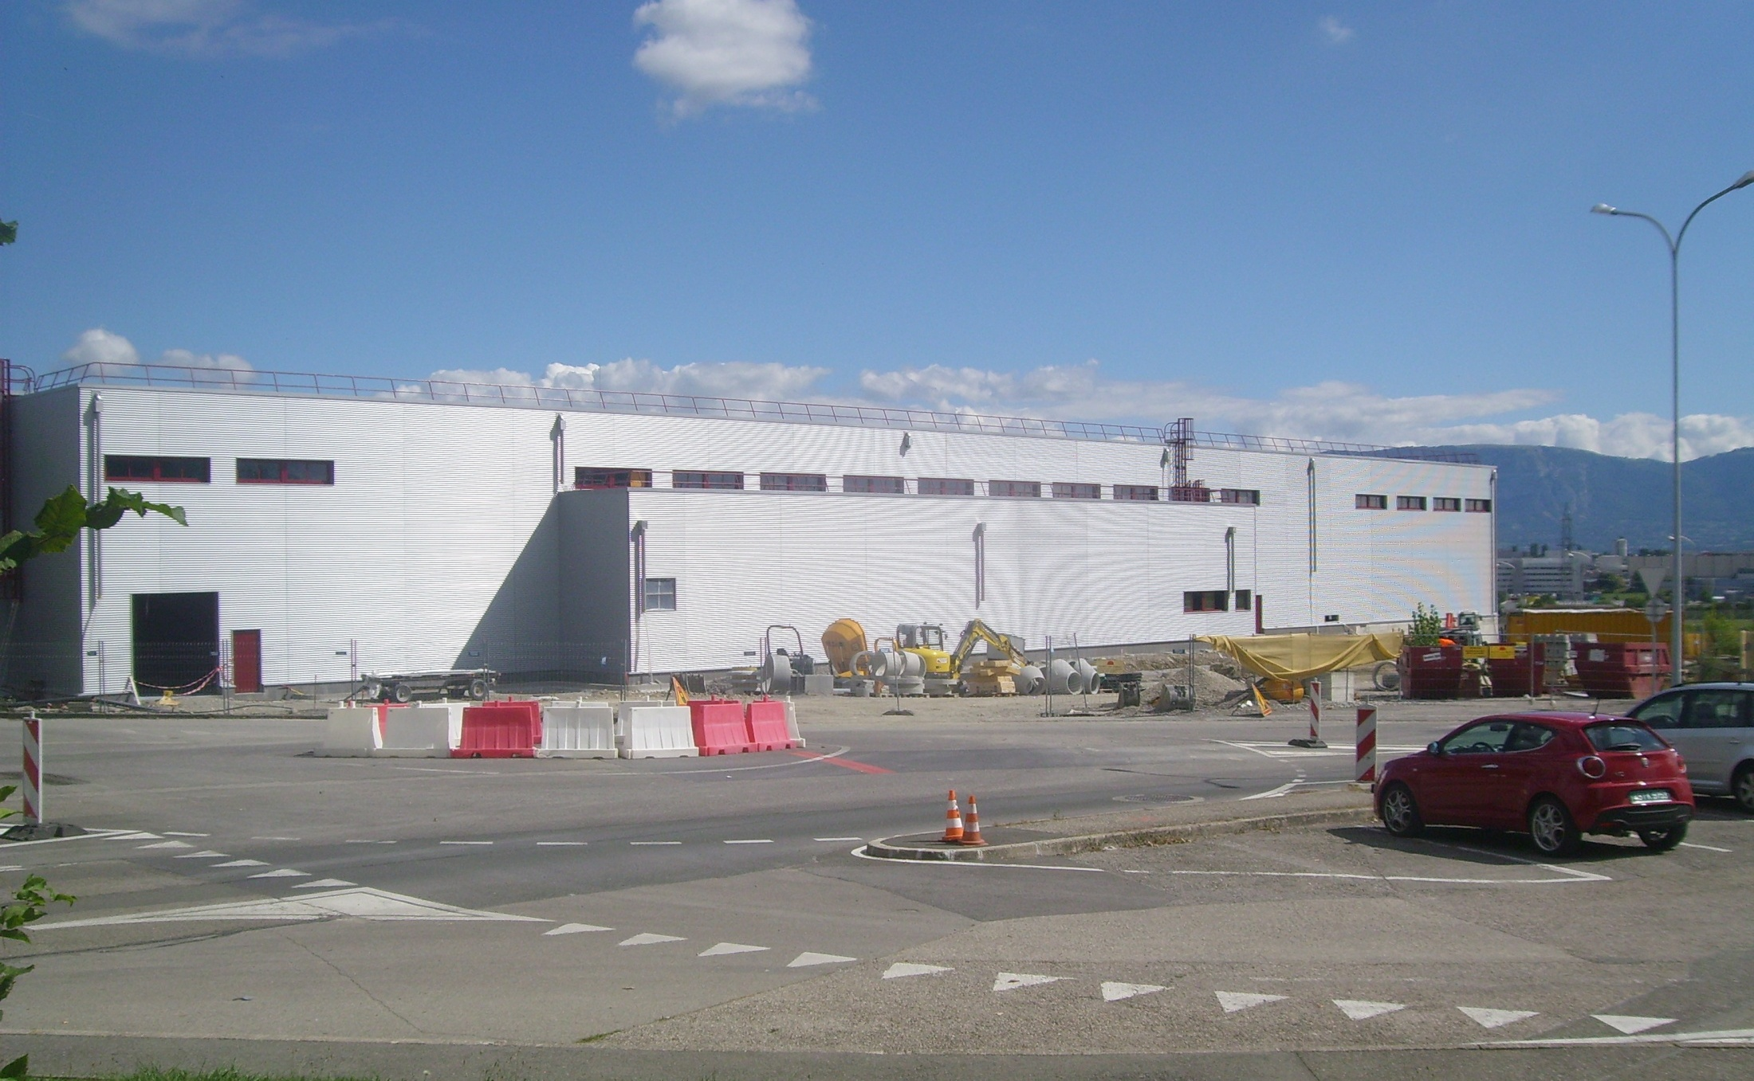
Linac4 [3/6]
Building completion in October 2010
Notes:
I will assume that the why is well know – zooming into the commissioning phase

Slide 15
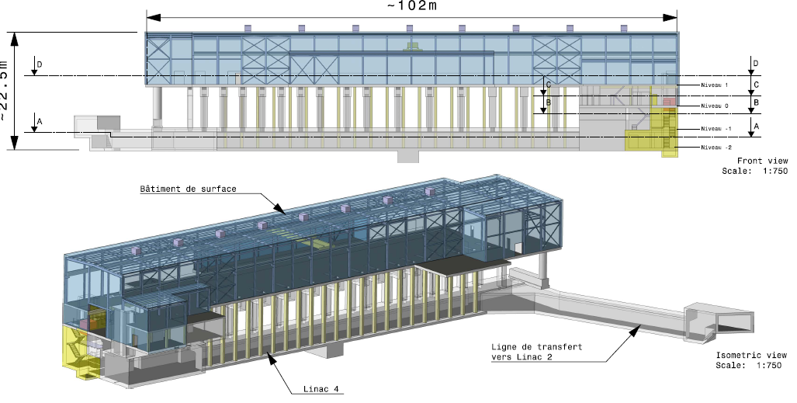
Linac4 [4/6]
Building completion in October 2010
ground
Design of building started in December 2006.
Overall floor surface of Linac4 installations = 3’305 m2 (over 4 levels)
Completion in October 2010

Slide 16
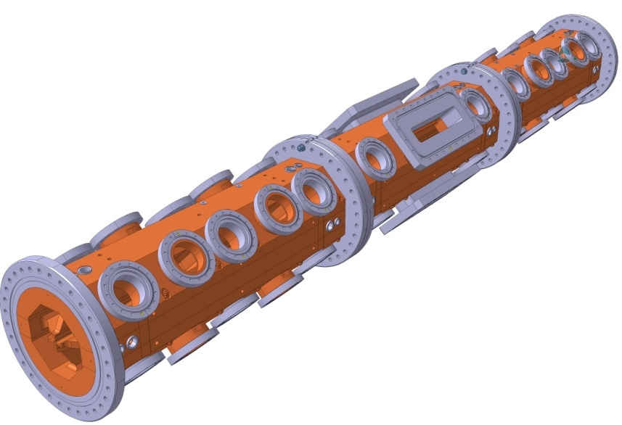
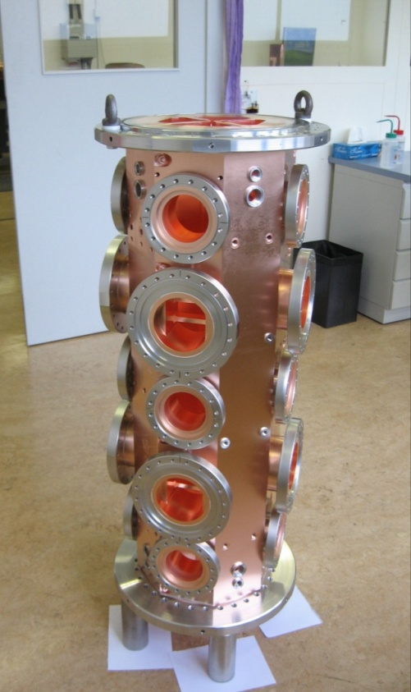
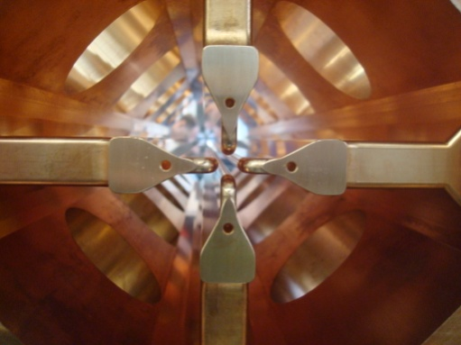
Linac4 [5/6]
RFQ
Energy 3 MeV (below radiation threshold)
Length 3m, 3 section of 1 m each.
Brazed 4-vane design. Simplified shape and cooling (max. duty of 10%).
Collaboration with CEA Saclay (in charge of thermal simulations and of RF design, measurement and tuning).
Construction entirely done at CERN: machining, metrology, brazing (horizontal).
Status: Module #1 completed (2 brazing steps), Module #2 ready for brazing, Module #3 under machining.
RFQ ready for RF tests in June 2011.
module #1

Slide 17
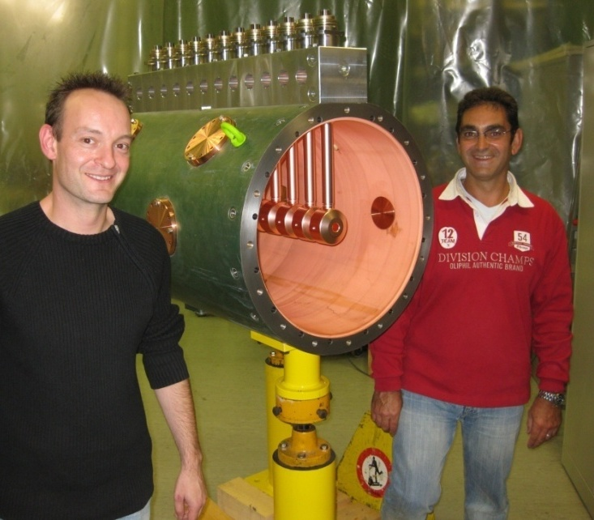
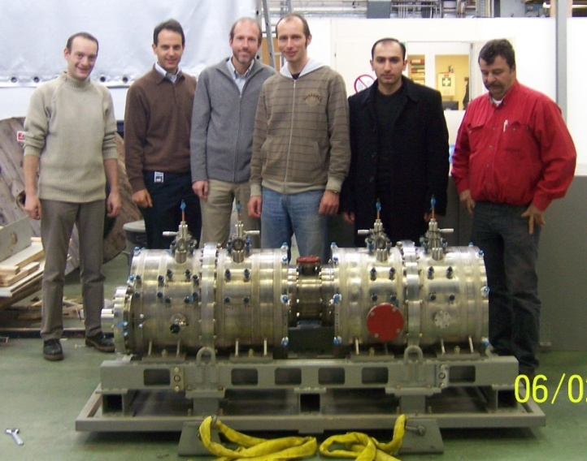
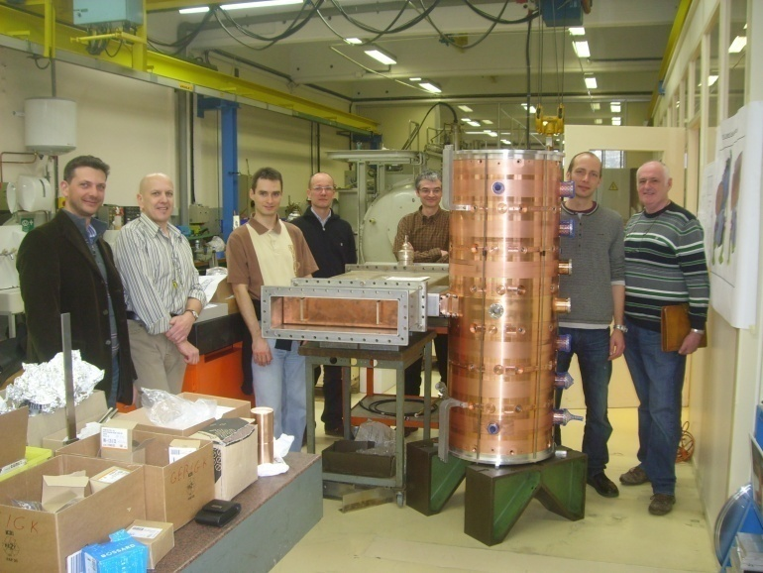
Linac4 [6/6]
Accelerating structures
Three structures of new design:
DTL (Drift Tube Linac): complete revision of mechanical design w.r.t. other projects.
CCDTL (Cell-Coupled DTL): new structure, first time used in an accelerator.
PIMS (Pi-Mode Structure): new structure, first time used in a proton machine.
DTL prototype, 2009
CCDTL prototype, 2008
R&D since 2003.
Prototypes built (and tested at high RF power) for the three structures.
Construction starting in 2010.
PIMS prototype, 2010

Slide 18
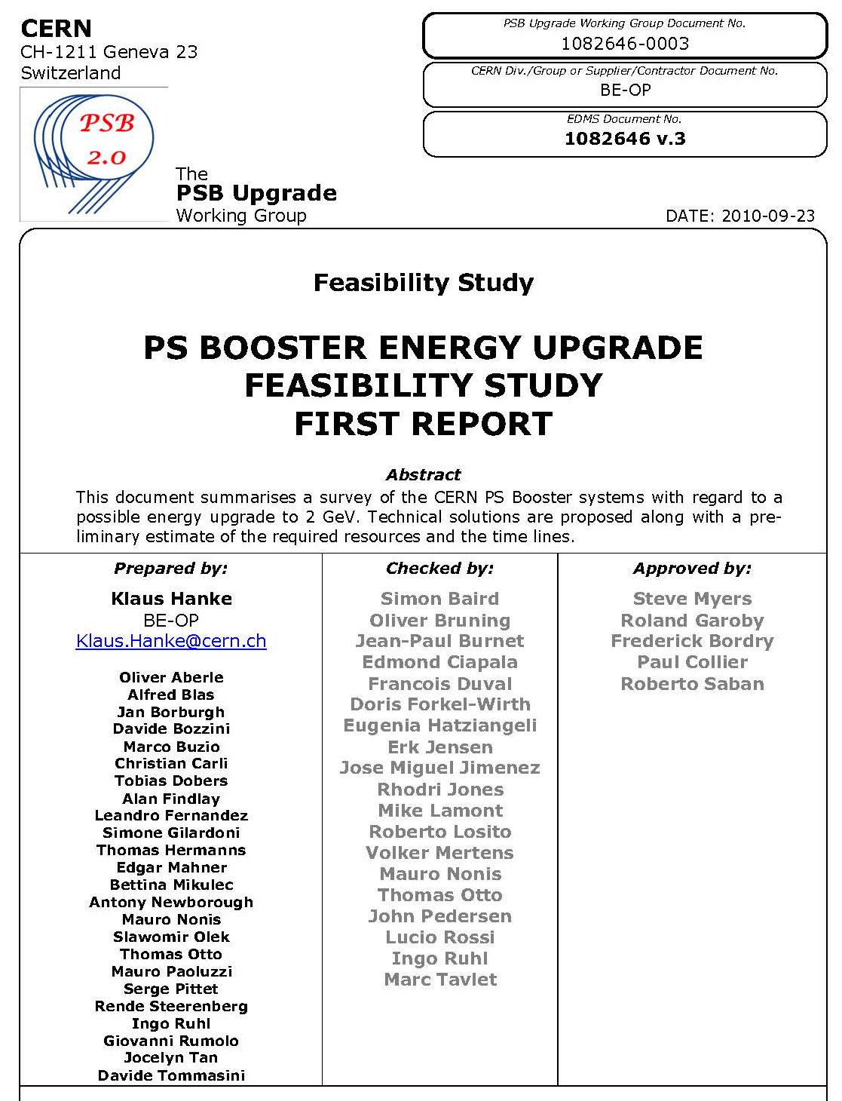
PSB Energy Increase § Consolidation [1/3]
From K. Hanke
Outcome of the Task Force created after the LHC Workshop in 2010 for studying and costing the increase of the PSB to PS transfer energy above 1.4 GeV.
Task Force members
document released

Slide 19
PSB Energy Increase § Consolidation [2/3]
From K. Hanke
Subjects
(material cost in kCHF)
Magnets | 3445
Magnetic Measurements | 111
RF (High power and Low Level) | 14320
Beam Intercepting Devices | 700
Power Converters | 21100
Vacuum System | 100
Beam Instrumentation | 67
Commissioning | 50
Extraction, Transfer, Injection | 5763
Controls | 116
Electrical Systems | 1700
Cooling & Ventilation | 5500
Radio-Protection | 0
Transport and Handling | 680
Survey | 50
Total Project | 53702

Slide 20
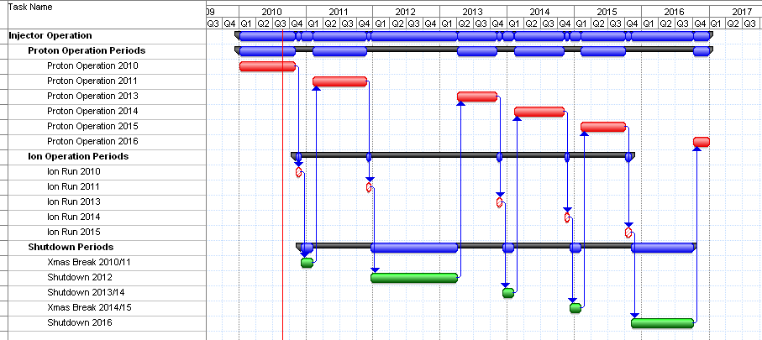
PSB Energy Increase § Consolidation [3/3]
From K. Hanke
Estimated total cost:
53.752 MCHF
(Consolidation: 27.320 MCHF
Upgrade: 26.432 MCHF)
one year of intense work
different options studied; baseline scenario chosen
an upgrade of the PSB from 1.4 GeV to 2.0 GeV is technically feasible
a realistic estimate of budget and time lines has been made; the upgrade can be completed by 2016
the budget has been entered in the MTP according to the estimate (consol. and upgrade)
ready for preparing TDR, pending evaluation of alternative scenarios and management decision

Slide 21
RCS option
Tentative RCS parameters
C. Carli
Energy range | 160 MeV to 2 GeV
Circumference | (200/7) π m ≈ 89.76 m
Repetition rate | ~10 Hz
RF voltage | 60 kV
Harmonics | h = 2 or 3
Frequency range | 3.48 MHz (h=2 at injection) to 9.5 MHz (h=3 at ejection)
Beam parameters for LHC (for lower emittances scale down intensity accordingly) | Intensity: up to 12×2.7 10¹¹ protons/cycle Transv. emittance: ε*_{rms} ≈ 2.5 μm Long. emittance: ε_{l} < 12×0.27 eVs (determined by acceptance for most cases)
Lattice | FODO with 15 cells and 3 periods, 4 cells in arc, straight with one cell
Tunes | 4 < Q_{H,V} < 5
Relativistic gamma at transition | ~4
Bending magnet filling factor | 56 %
Maximum magnetic field | 1.16 T
Benefits:
Competitive cost wrt PSB consolidation and upgrade (?)
Reliability (new hardware / modern design)
Commissioning decoupled from physics operation
Limited risk: Linac2 + PSB can remain available for a few years as back-up.

Slide 22
PS Upgrade Needs
From S. Gilardoni
Issues:
Hardware for injection at 2 GeV: studied by the Task Force on «PSB energy upgrade » preliminary solutions found
Blow-up and instabilities in the transverse phase planes:
  Dilution after injection oscillations due to mis-steering
  Laslett tune shift due to space charge (even if < |0.3|)
  → Blow-up of first batch waiting for the second batch injection
  Head-tail instability at low energy
  TMCI close to transition
  e-clouds effects on high energy flat-top
Blow-up and instabilities in the longitudinal phase plane:
  Transient beam loading effects especially at low voltage during gymnastics
  Coupled bunch instabilities due to cavities impedances (reminder: 5 different RF systems in the PS for a total of 22 cavities)

Slide 23
PS Upgrades
[non-RF]
System | Elements | Impact | Comments
Injection elements | Injection septum Injection bumpers Eventual extra kicker | High | 2 GeV operation. Promising design exists already. Includes power converters, magnets and control system.
Low energy correctors | 100 horizontal correctors 30 vertical correctors | Low | 2 GeV operation. Will be tested in MDs. Includes power converters, magnets and control system.
Low energy skew quadrupoles | 45 magnets | High | 2 GeV operation. Will be tested in MDs Used to damp HEADTAIL instability. Includes power converters, magnets and control system.
Low energy quadrupoles | 40 magnets | Low | 2 GeV operation. Will be tested in MDs. Includes power converters and magnets and control system. PFW could be used.
Transverse damper | Power part of existing system | Medium | Would be necessary if too large ripple of injection kicker. Used also to damp the HEADTAIL instability.
e-cloud attenuation system | Chamber coating or electrode Installation | Not clear yet | Studies to asses if limiting factor or not. Includes new e-cloud detectors.
Instrumentation | BWS, BCT, Orbit system, profile monitors. | Not clear yet | Revise the current performances to tests if comply with upgraded LHC beams.
Improved shielding on top of route Goward and on top of SMH16 | Shielding elements |  | Required for PS non-LHC operation. Needed also for 1.4 GeV operation.

Slide 24
PS RF Upgrades
Priority | Item | When
[1] | New coupled-bunch FB | 2012
2 | Dedicated kicker cavity | 2015-2020
10 MHz
[1] | 1-turn delay FB | 2011
1 | Renovate FB amplifiers | 2011-2015 (?)
1 | Slow phase loops around each cavity | 2013-2014
2 | New power amplifier (1 tube/gap) | 2014-2018 (?)
20 MHz
1 | 1-turn delay FB | 2012
2 | Slow phase loops around each cavity | 2012
40 MHz
[1] | Automatic tuning system | 2011
1 | 1-turn delay FB | 2012
2 | New feedback amplifier in grooves | 2014
2 | Slow phase loops around each cavity | 2012
3 | Study more voltage per cavity | 2013
3 | New power supplies | 2014-
80 MHz
1 | 1-turn delay FB | 2012
1 | Automatic tuning system - PLC, prot./ions switching | 2011-2012
2 | Slow phase loops around each cavity | 2012
2 | New feedback amplifier in grooves | 2014
2 | Fast ferrite tuner | 2016
3 | Study more voltage per cavity | 2013
3 | New power supplies | 2014-
3 | Extra 80 MHz cavity | ???
Crude planning. Some items may only be implemented after 2017.
Ongoing work is indicated with a bracket on priorities.
Priorities may change depending upon the outcome of the studies

Slide 25
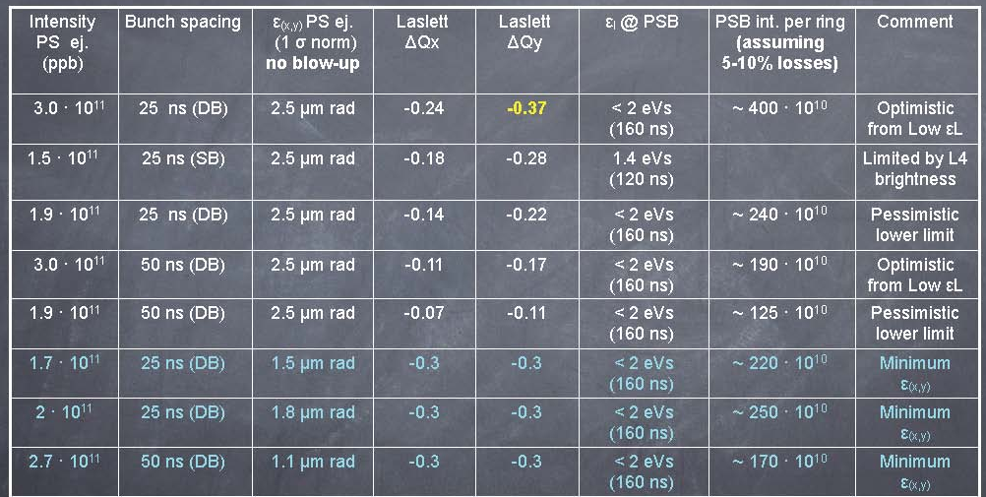
PS Performance Potential
From S. Gilardoni
Preliminary extrapolations with Linac4
Stretched
Realistic
Stretched
Realistic
Stretched
Need further studies and MDs to improve these estimates:
  Longitudinal phase plane: impact of beam loading and possible cures,
  Transverse phase planes: blow-up rate with high space charge, e-clouds effects
  Radio protection (especially if other users attempt to profit from a higher PS intensity)
  Specifications of feedbacks and analysis of feasibility

Slide 26
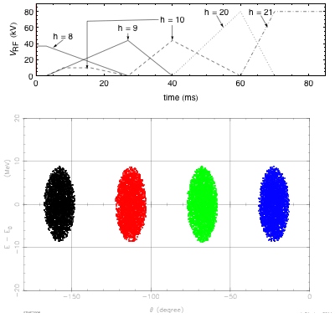
PS Gymnastics Upgrade
Alternative RF gymnastics using all PSB rings
From C. Carli
Scheme yielding 64 bunches per PS batch
  Brightness increase: 1.5
  Reasonable complexity of RF gymnastics
Scheme yielding 48 bunches per PS batch
  Brightness increase compared to present situation: 2
  Complex RF gymnastics with many batch compression steps
Any compression scheme can be combined with a PSB energy upgrade
Tests can proceed immediately with double batch transfer from the PSB at 1.4 GeV and lead to delivering beyond ultimate 25 ns bunch trains to the SPS before the end of 2012 (although at the cost of significant MD time and efforts from the PS LLRF team).

Slide 27
Status of SPS Studies
E. Shaposhnikova
Main lessons/results from 2010
Nominal 25 ns beam in good shape: low beam losses (5%) even with low ξ_{v} = 0.1
Ultimate (injected) beam - needs studies
  25 ns: large losses and emittances, instabilities
  50 ns: 15% losses, 1.5x10¹¹/bunch at 450 GeV/c in 4 batches
TMCI threshold is at ultimate intensity (low ξ). Ultimate single bunch accelerated to 450 GeV/c with low loss and ξ_{v}, but with some emittance blow-up. More problems for small injected emittances.
New low γ_{t} optics: promising results for beam stability and brightness
Limitations for dedicated LHC filling/MD: MKE, MKP, MKDH3 heating/outgassing
MDs issues: transverse emittance measurements, time allocation, data analysis

Slide 28
Electron clouds in the SPS
J.M. Jimenez
  High bunch intensity, and/or Small emittances (LHC requirements)
  are impossible in the SPS at short bunch spacing because of electron clouds generating:
  pressure rise: beam gas scattering, dose rates to tunnel and components
  beam instabilities: transverse emittance blow-up and single bunch vertical instability
Possible actions
Suppression: Clearing electrodes
  Aperture, impedance, full-scale feasibility, lifetime, quads, LSS, cabling, powering, etc.
Mitigations
  a-C coatings
    Lifetime, stability with venting, outgassing rates, in-situ coating, LSS.
  Scrubbing runs
    Feasibility and margin, MD time
(Potential) Cure
  Wide band feedback systems
    High speed digitization and digital treatment
Simulations
  e-cloud budget, stability expected, emittance growth, impedance from electrodes, effectiveness of wide band feedback, etc.
  If we rely on beam scrubbing in the LHC why not in the SPS?

Slide 29
SPS Hardware Upgrades
B. Goddard

Slide 30
SPS Performance Potential
E. Shaposhnikova
SPS Q&A
Intensity per bunch and emittance as a function of the distance between bunches today and after upgrade?
- before upgrades, single-bunch performance can probably be achieved with 50 & 75 ns beams (~3 μm emittances at ultimate intensity); hopefully less (2.5 μm ?) with low γ_{t} (RF voltage limit to be seen); > 4 μm for 25 ns (ultimate beam)
- after upgrades (200 MHz RF upgrade, e-cloud mitigation/cure, transverse impedance reduction, upgraded transverse feedback, etc.) the space charge limit could be attained (~2.5 μm with ultimate intensity for 50&25 ns beams)
What should be done for delivering smaller transverse emittances at ultimate current?
- more MDs with PS beams of very small transverse emittances
- need for improved beam instrumentation (trans. emittance measurement)
- low γ_{t} optics ?

Slide 31
Summary

Slide 32
Draft Planning
 | Linac4 | PS injector, PS and SPS | Beam characteristics at LHC injection
2011 - 2012 | Continuation of construction… | Beam studies § simulations Investigation of RCS option Hardware prototyping Design § construction of some equipment TDR | 25 ns, 1.15 10¹¹p/b, 3.5 mm.mrad 50 ns, 1.7 10¹¹p/b, ≤3.5 mm.mrad 75 ns, 1.2 10¹¹ p/b, ≤ 2 mm.mrad
2013 – Q2/2014 (Long Shutdown 1) | Linac4 beam commissioning Connection to PSB | PSB modification (H⁻ injection) PSB beam commissioning Modifications and installation of prototypes in PS and SPS
Q3/2014 - 2016 | Progressive increase of Linac4 beam current Progressive increase of PSB beam brightness | Beam studies Equipment design § construction | Improved beam from PSB Some improvement of PS beam Little gain for the SPS (pending SPS hardware upgrades)
2017 – Qx/2018 (Long Shutdown 2) |  | Installation in PS and SPS Beam commissioning
Qy/2018 –2020 |  |  | After ~1 year: All beam characteristics expected for the HL-LHC…
SPS limitation
PS limitation

Slide 33
Conclusions
Experience with beam in the LHC in 2011-2012 will help refine the beam characteristics required for HL-LHC.
Experience with beam in the injectors in 2011-2012 will help determine the precise upgrades required.
The SPS remains the limiting accelerator in the injector chain. The well-identified improvements shall be implemented as soon as possible to allow studying the other limitations.
The possibility to connect Linac4 to the PSB during the first long shutdown is worth being investigated, as well as the option to replace the PSB with an RCS.

Slide 34
THANK YOU
FOR YOUR ATTENTION!

