Slide 1
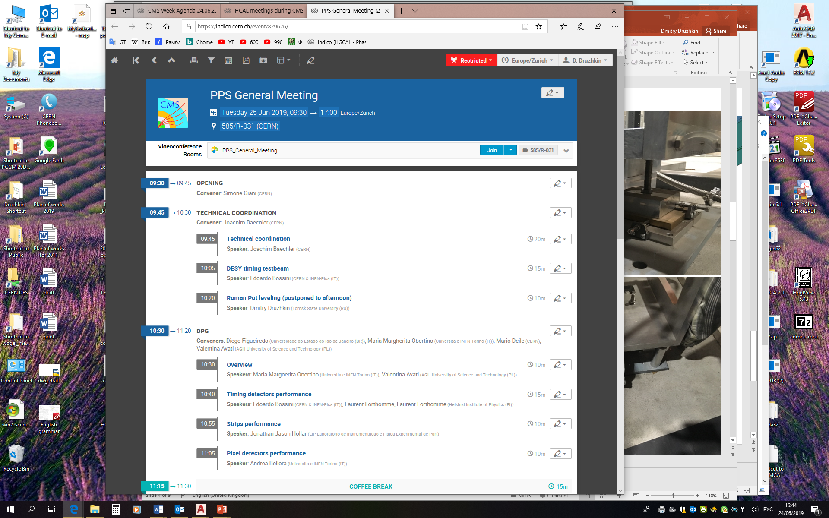
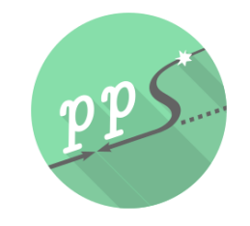
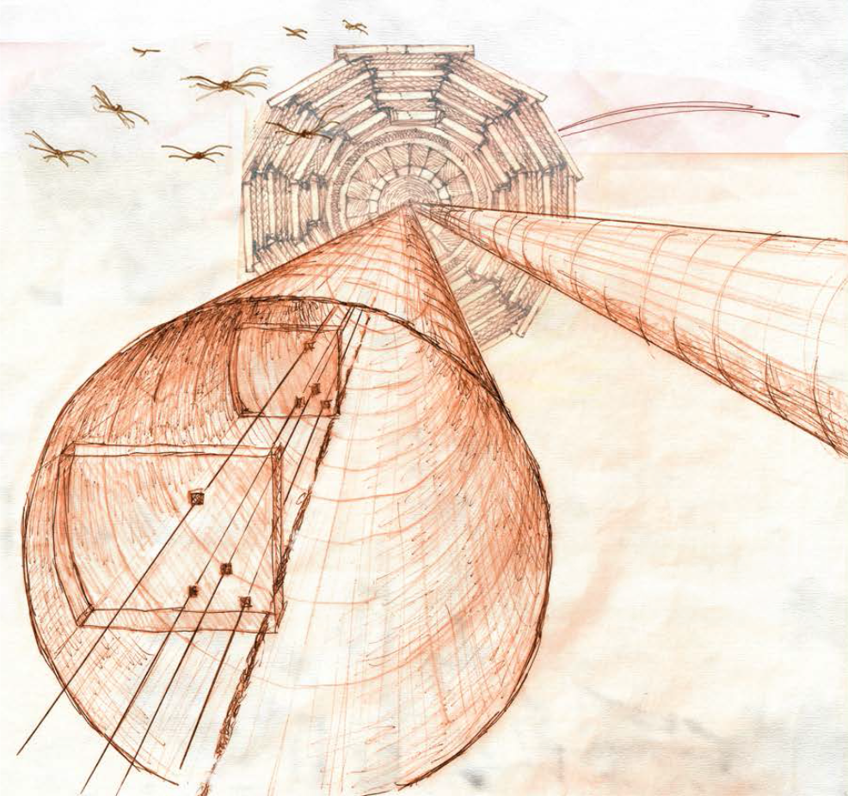
TREX
24.06.2022
The CMS Precision Proton Spectrometer at HL-LHC
D.Druzhkin, J.Baechler, M.Deile

Slide 2
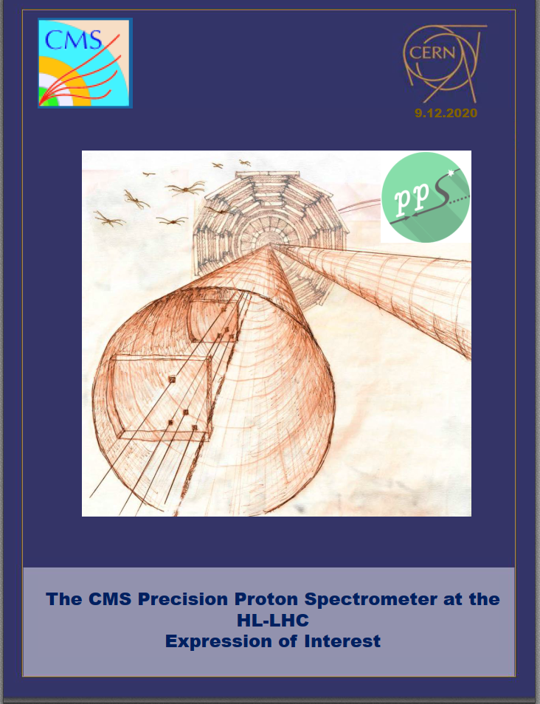
https://cds.cern.ch/record/2750358?ln=en (EoI)
LoI 2018
a priority
EoI 9.12.2020
ECR 1
tunnel
equipment
reusing
Doc.2
detectors;
sensors
(3D-Si, ETL, Diamond)
Doc.3
(420m)
postponed
The proposed PPS project for HL-LHC is based on the possibility of reusing existing Roman Pots and related equipment.
Available spare elements should be reviewed, discussed, revalidate and approved:
- RP station and horizontal units (Roman Pots);
- Housings with thin window;
- Support frames;
- Step motors (like collimators), THK gearing;
- Power, control and R/O Patch Panels;
- Cooling system (present cooling plant in USC55 or VORTEX ?);
- Vacuum system;
- Cabling, fibres, services (cooling, gas, vacuum pipes).

Slide 3
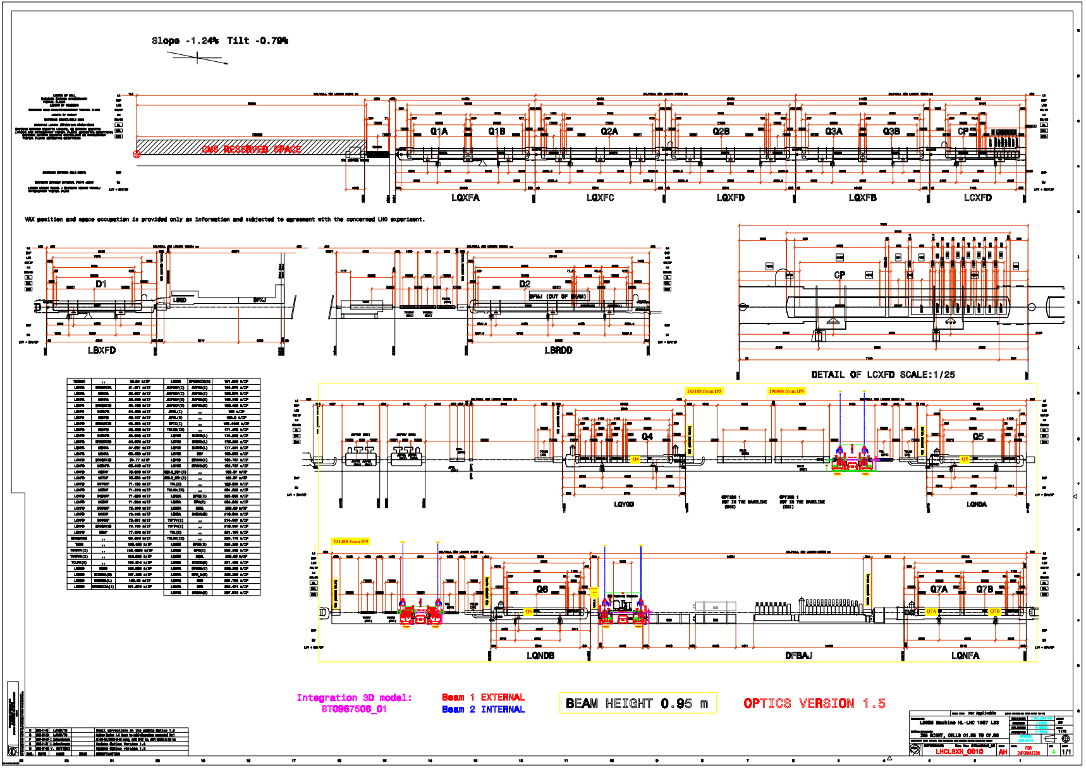
LSS5 layout, v.1.5 (LHCLSXH_0010)

Slide 4
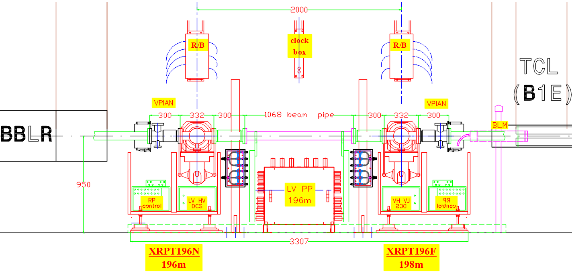
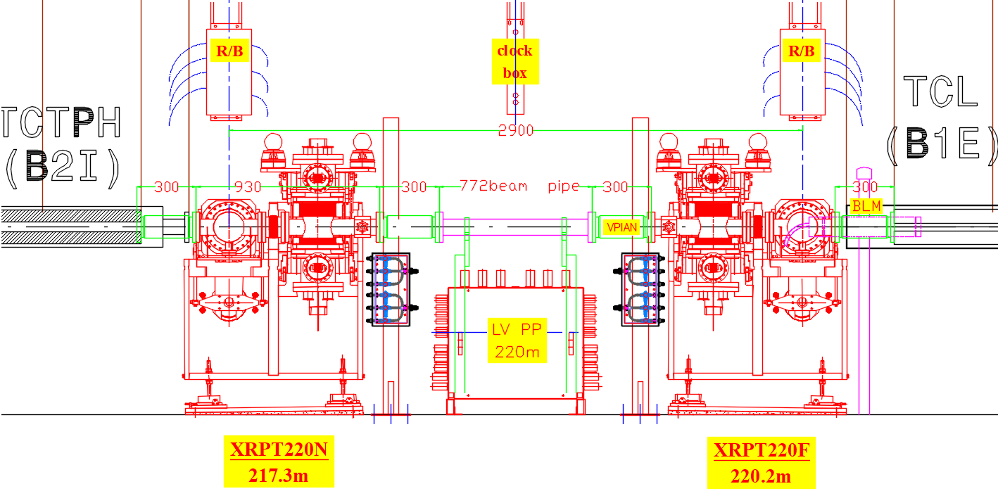
RP196m
XRP196N – 196m
and
XRP196F – 198m
The specific position and dimensions of PPs, cooling and gas lines can be adapted to the actual space available.
RP220m
XRP220N – 217.3m
and
XRP220F – 220.2m

Slide 5
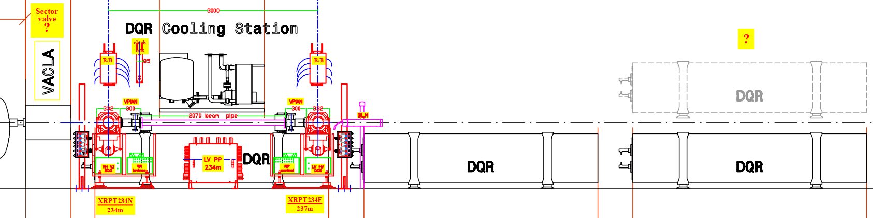
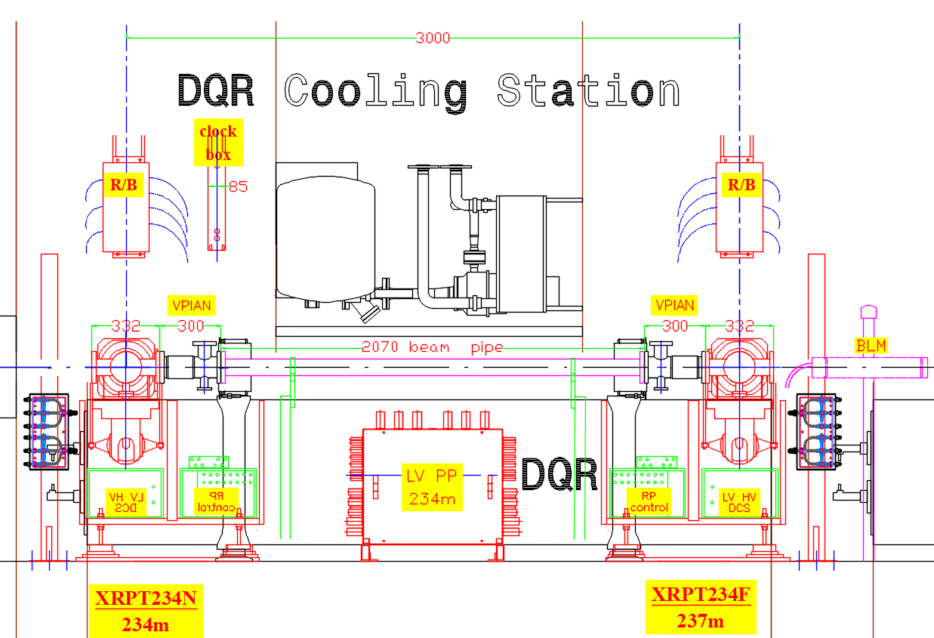
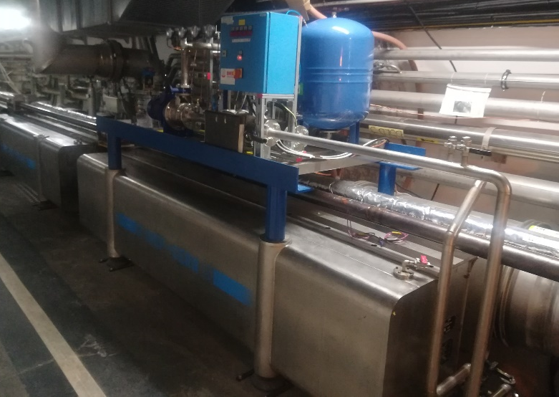
RP234m
XRP234N – 234m
and
XRP234F – 237m

Slide 6
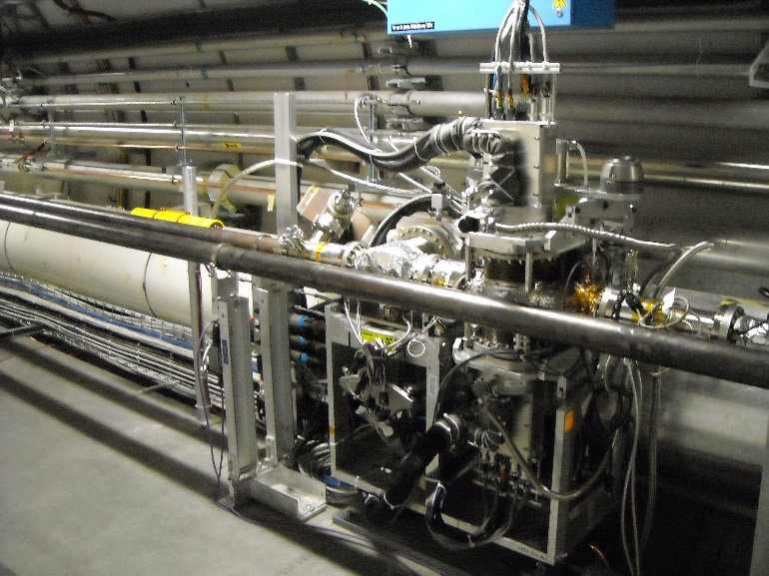
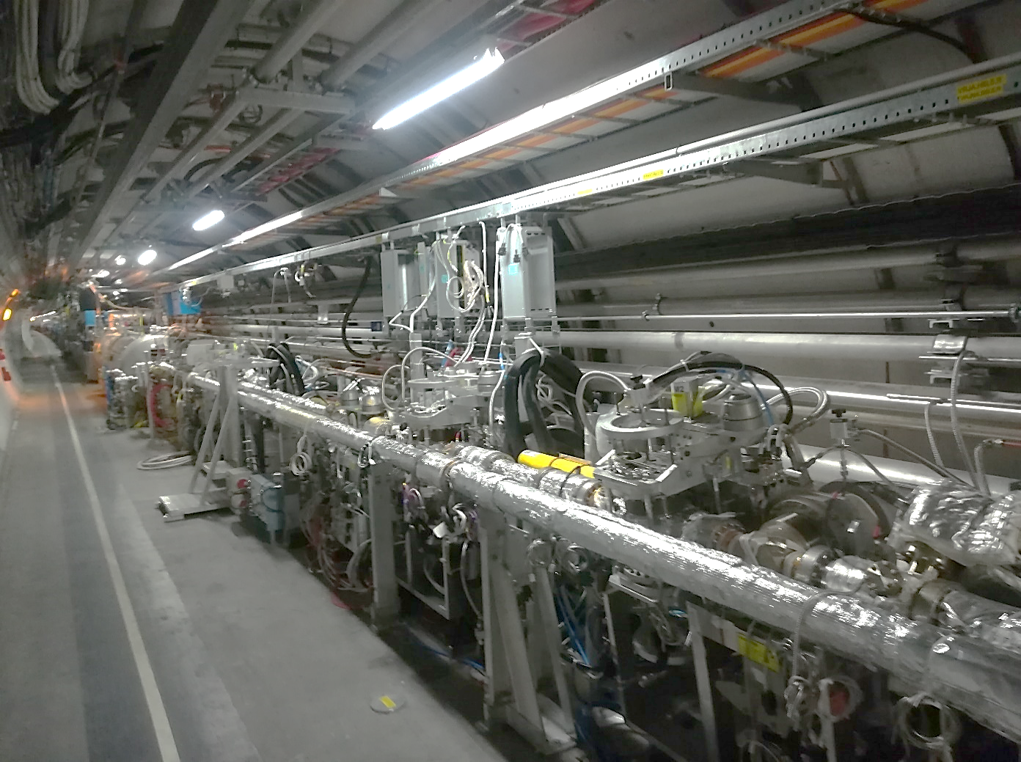
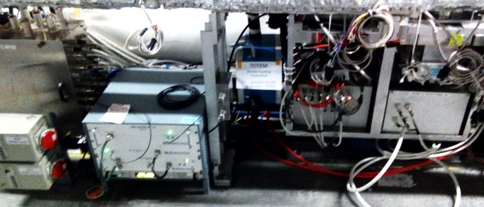
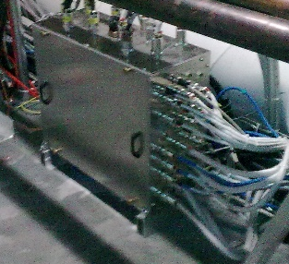
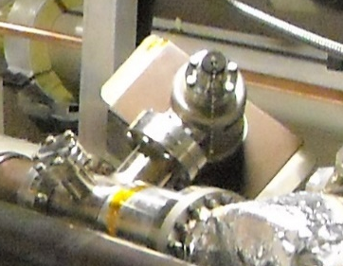
List of PPS equipment to be installed in the HL-LHC tunnel
Name of the system
Number
per sector
Total number
in LHC
Photo of eq.
Roman Pot station
Power PP
R/O PP
Clock PP
LVDT and motors PP
Cooling posts
Cooling gas C₃F₈ pipe/hoses/valves
Cooling water pipe/hoses
RP Vacuum line
BLM
Vacuum pump (VPIAN)
Connection bellows (with RF fingers) + VPIAN, BPM
6 12
3 6
3 or 6 6 or 12
3 6
6 12
4 8
3 6
? ?
12 24

Slide 7
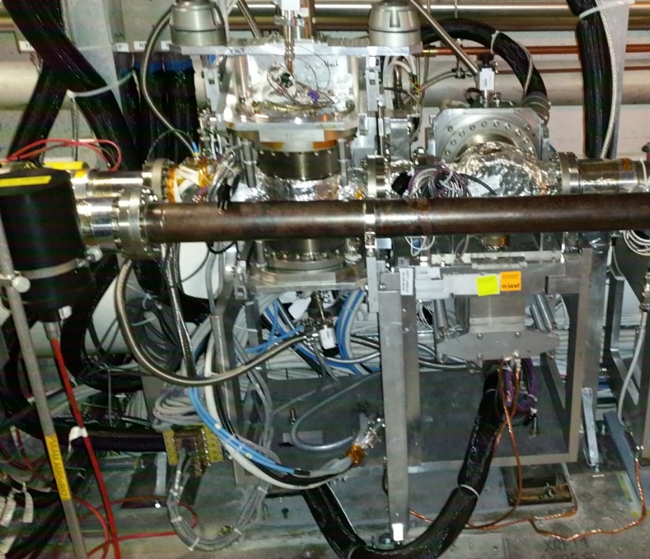
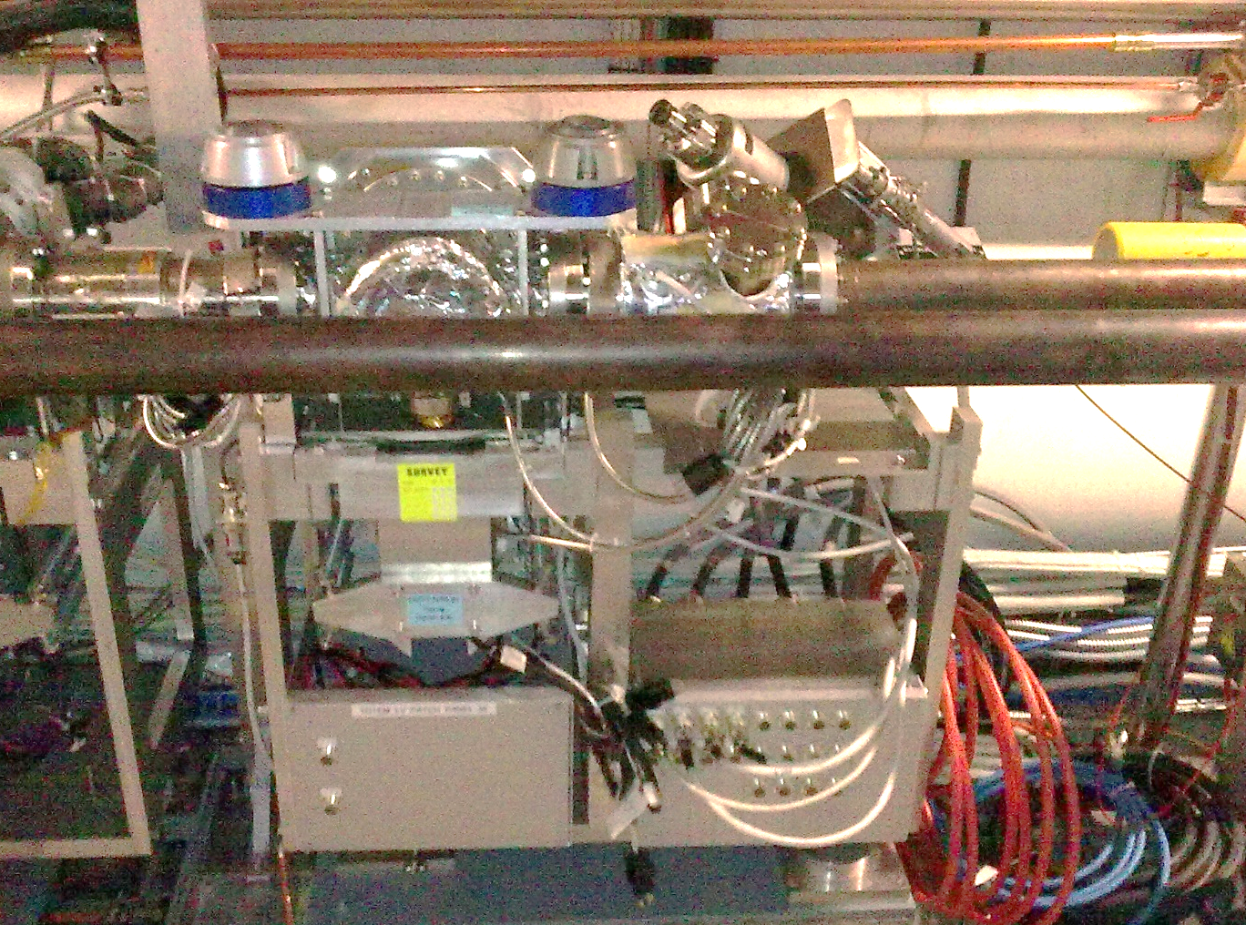
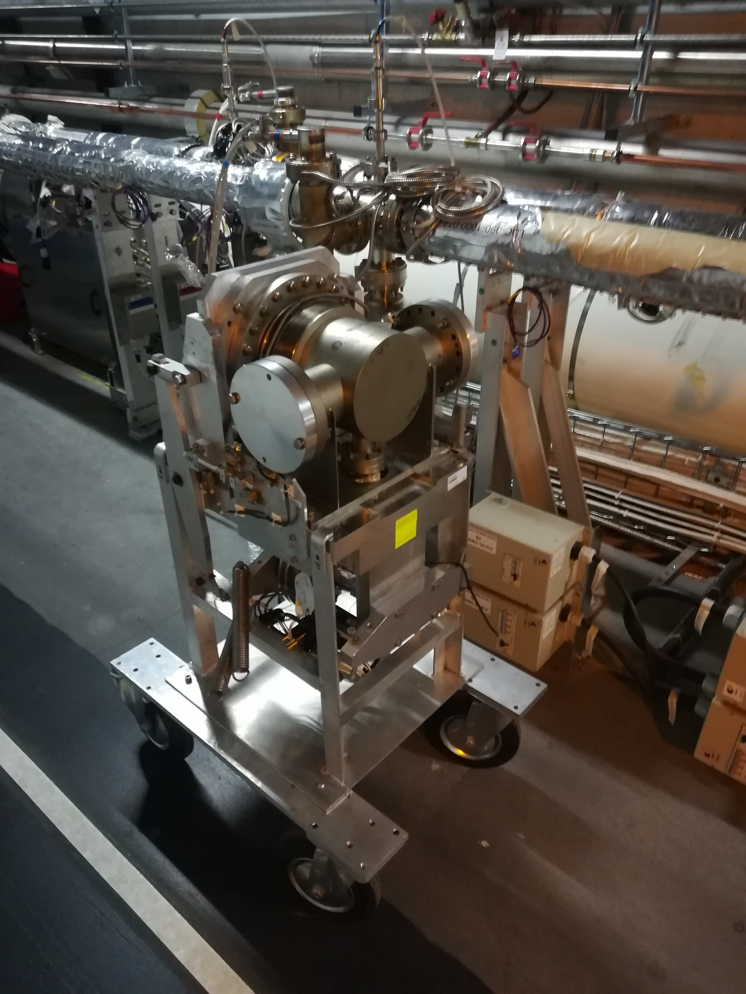
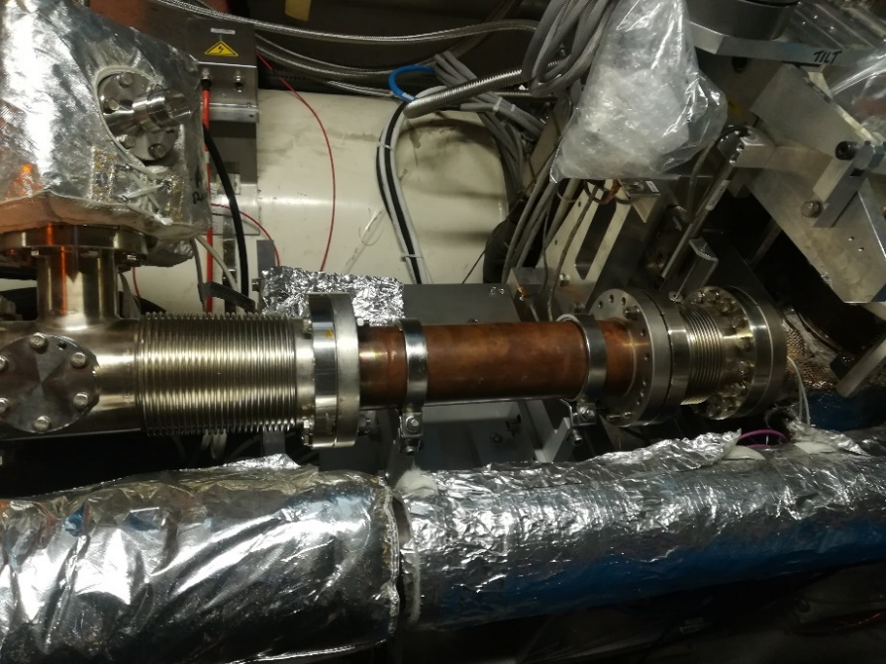
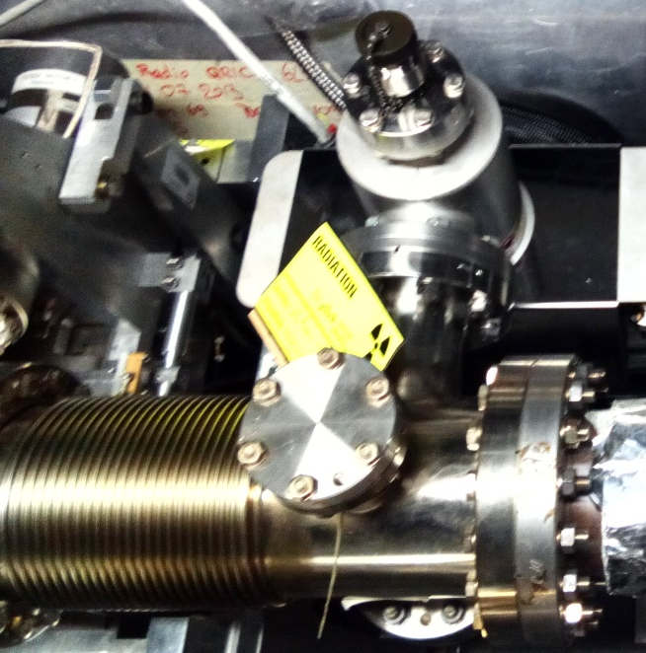
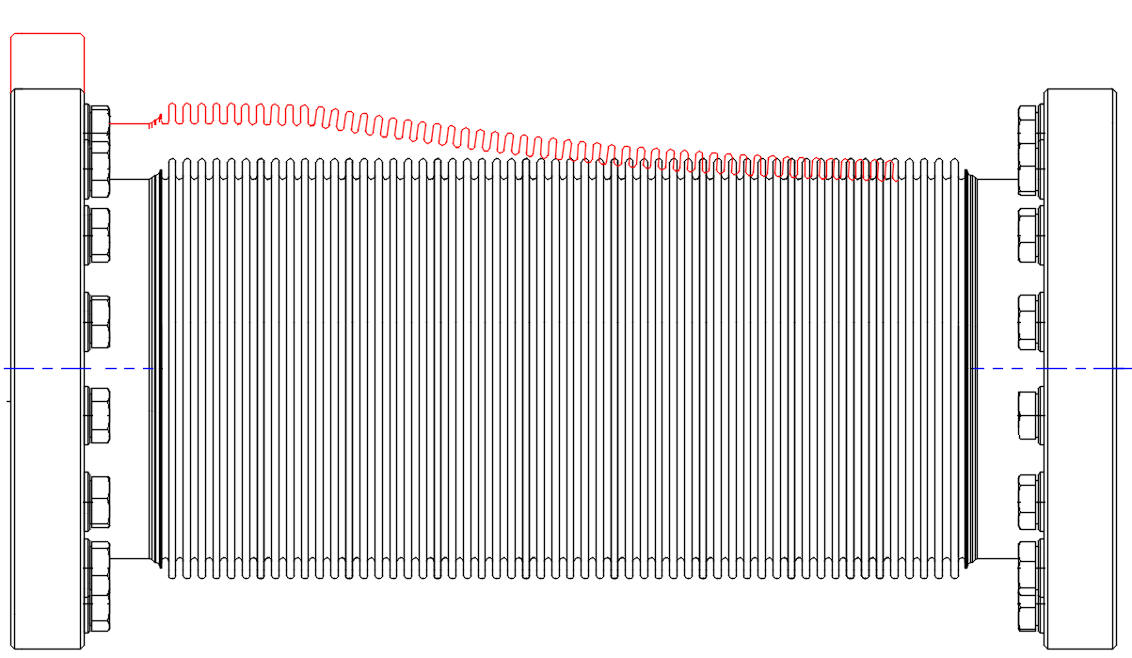
LHC infrastructure related to PPS Roman Pots (Run 2 and 3)
VGI (?)
Connection bellow 300mm
Bellow + VPIAN
Bellow + BPM ?

Slide 8
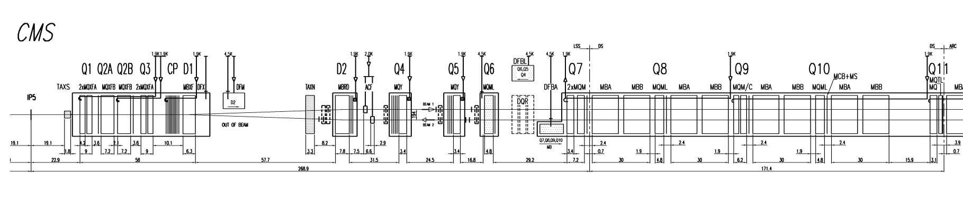
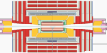
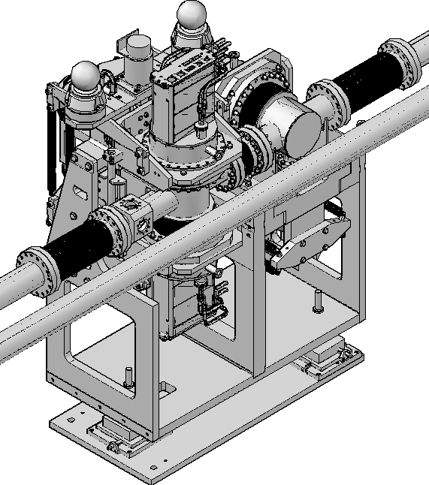
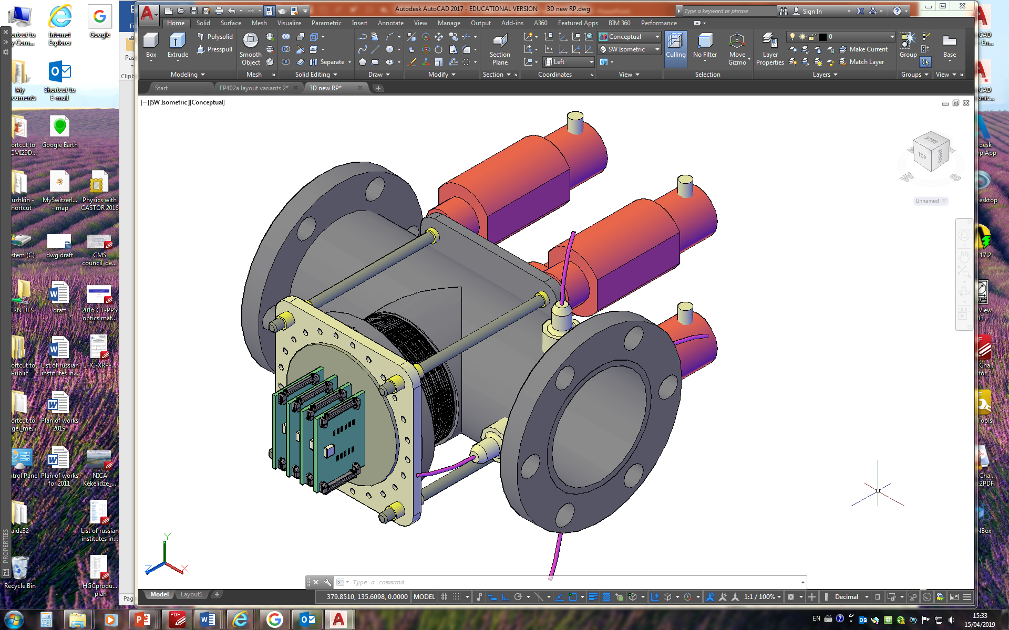
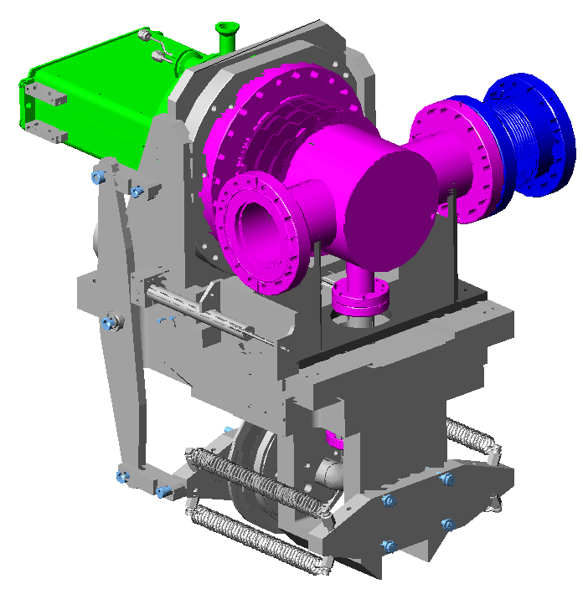
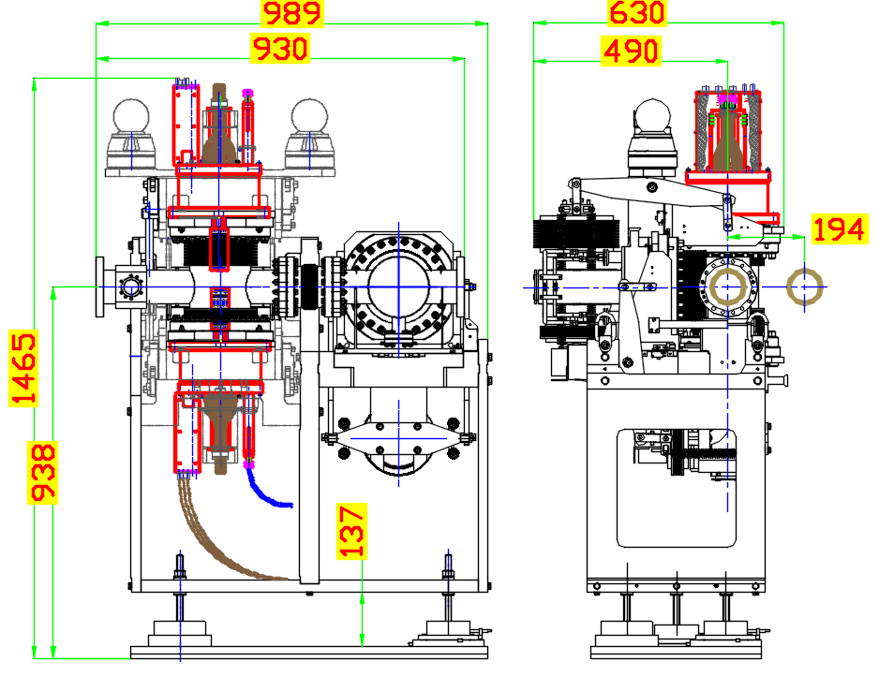
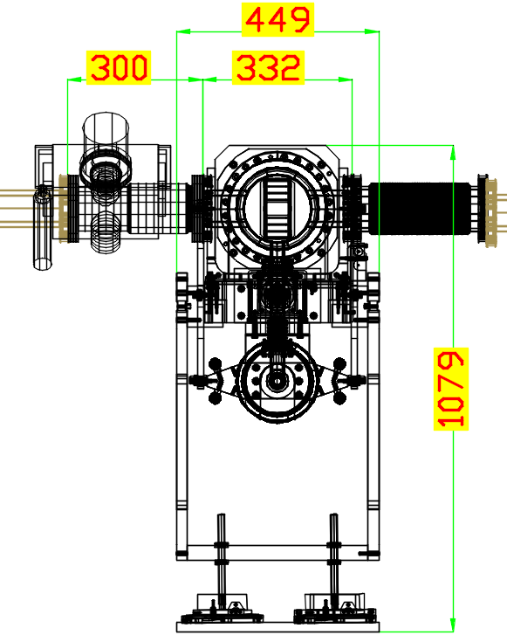
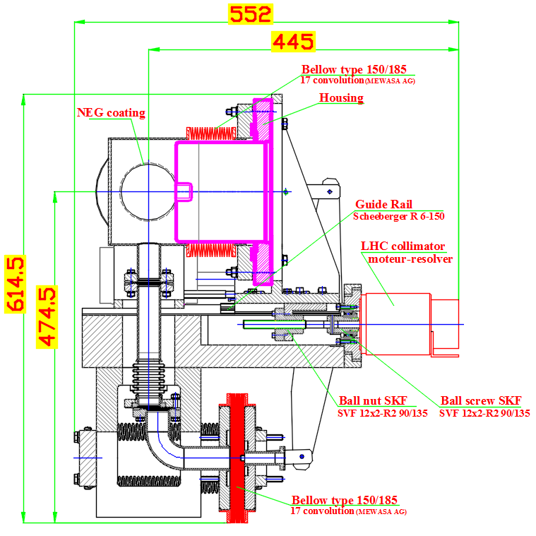
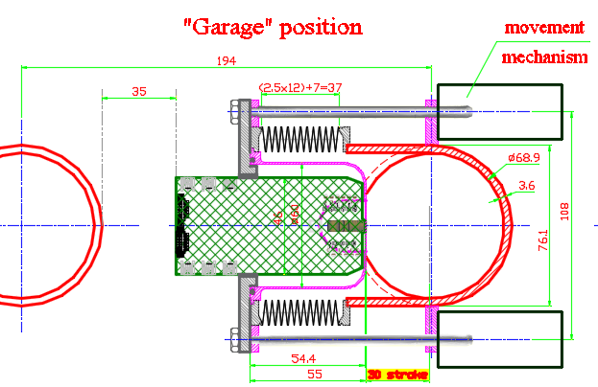
LSS5 at HL-LHC (post LS3)
220m
CMS
P.5
196m
234m
420m
available now
postponed
Triple RP station
Horizontal unit
new station (proposal)
Space on beam
Z_{RP}=930mm
Z_{Σ}=1530mm
Space on beam
Z_{RP}=332mm
Z_{Σ}=932mm
Space on beam
Z_{RP}=200mm
+BPM (?)
VPIAN
RP196m consists of two station at 196m (N) and 198m (F)
RP220m consists of two triple station at 217.3m (N) and 220.2m (F)
RP234m consists of two station at 234m (N) and 237m (F)
Must have at least 12 horizontal units with matching for optics housing
RP420m two station at (?)

Slide 9
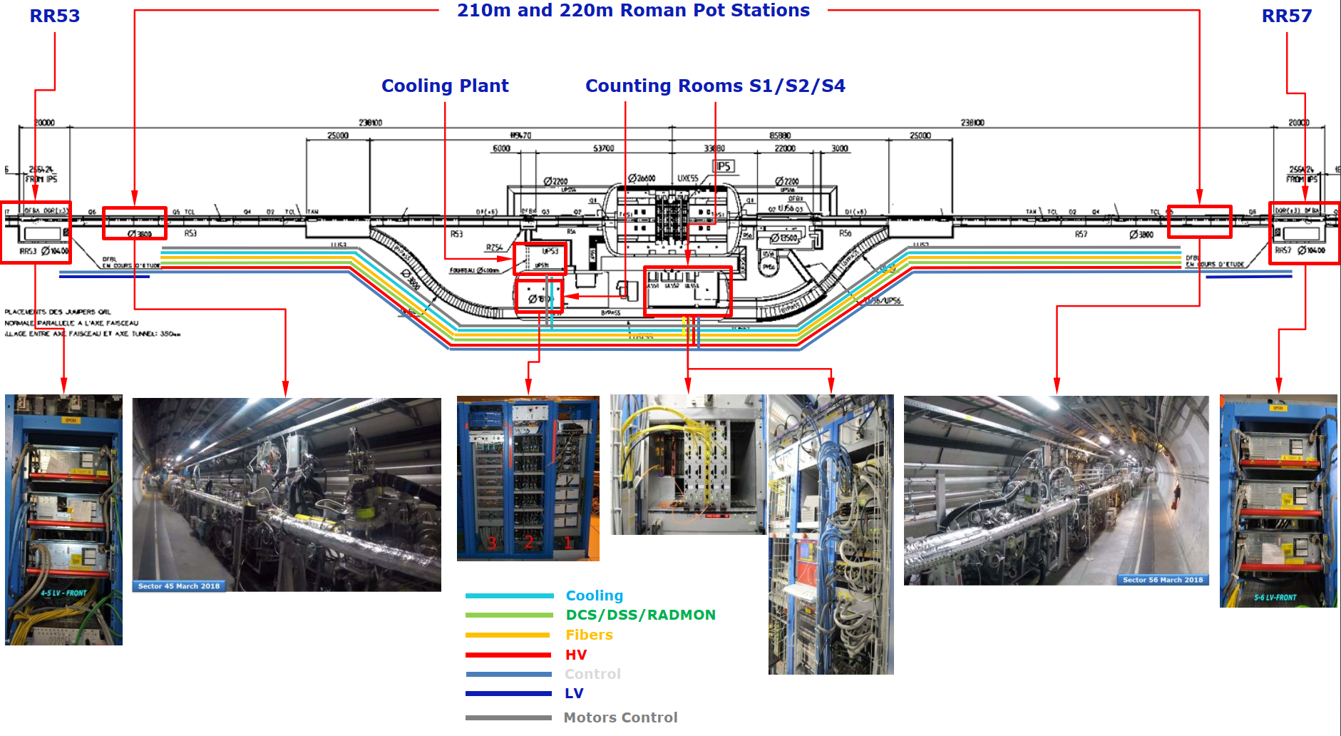
Roman Pot services lines (Run 2 and 3)
LHC tunnel
LHC tunnel
Alcove:
2 RACKs
(LV,
vacuum,
Control)
Alcove:
2 RACKs
(LV,
vacuum,
Control)
CMS USC55
G.Antchev

Slide 10
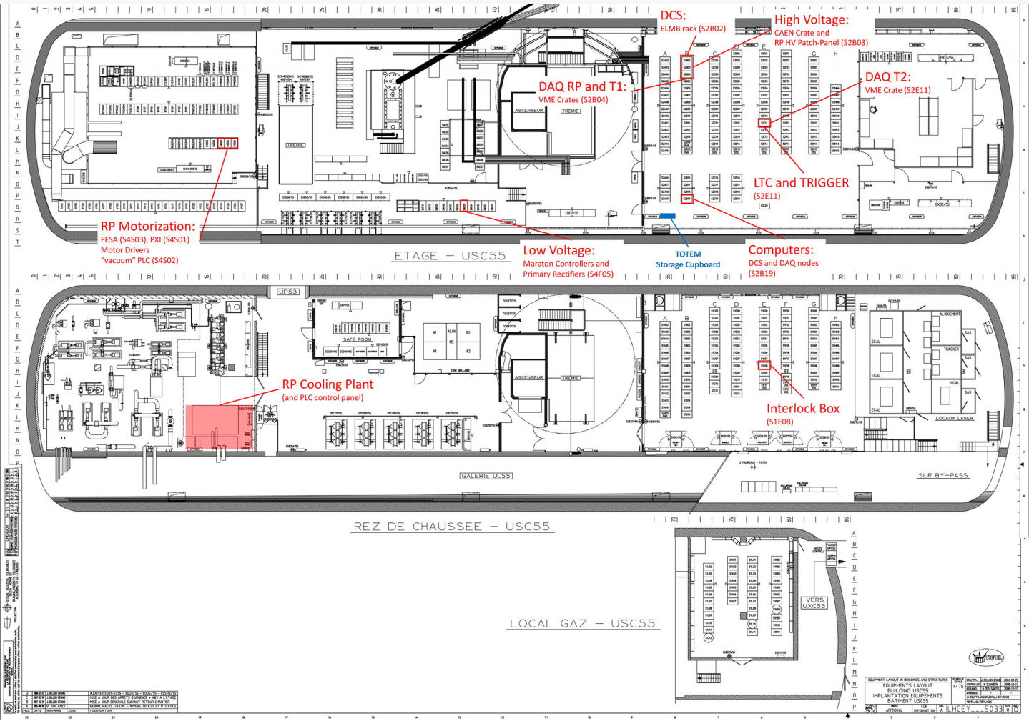
PPS - TOTEM equipment in CMS USC55 (Run 2 and 3)

Slide 11
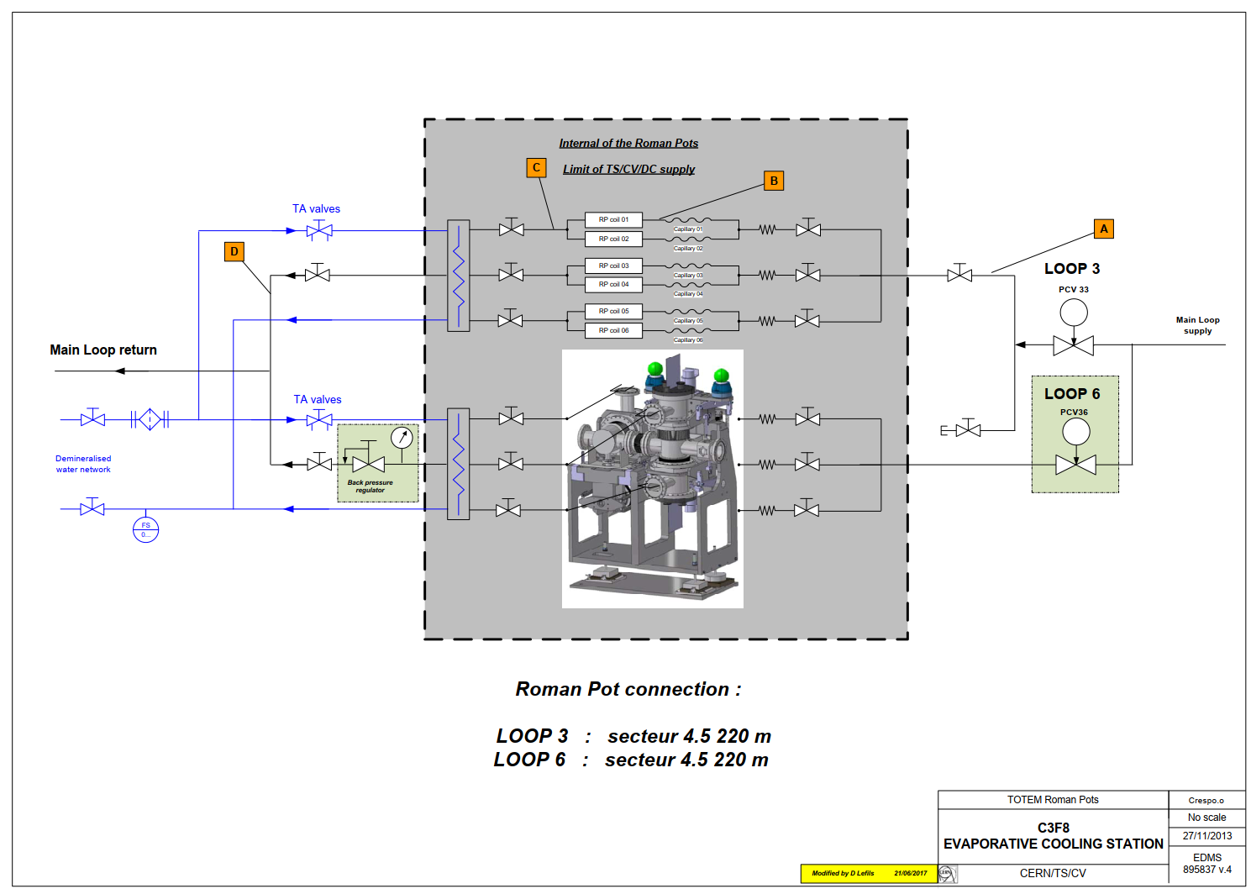
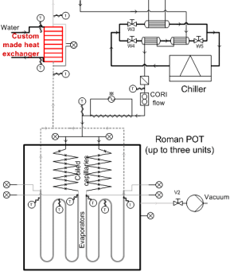
PPS - TOTEM cooling system (Run 2 and 3)

Slide 12
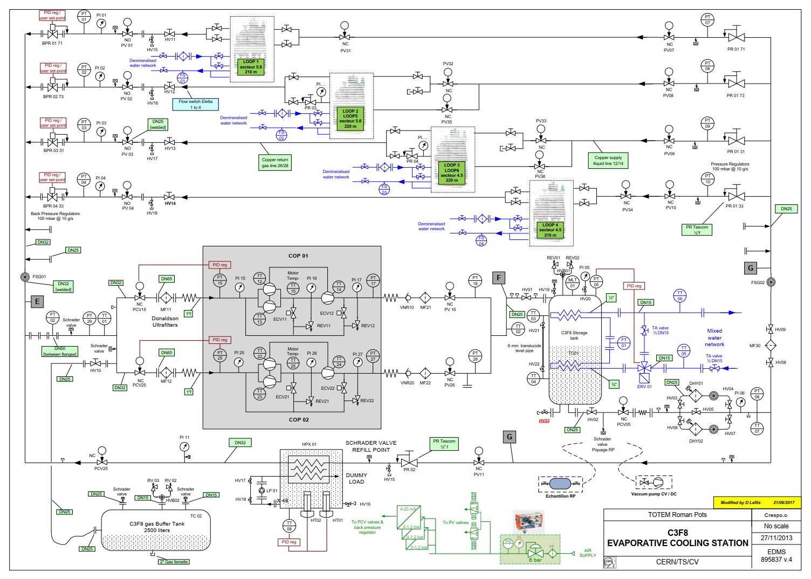

Slide 13
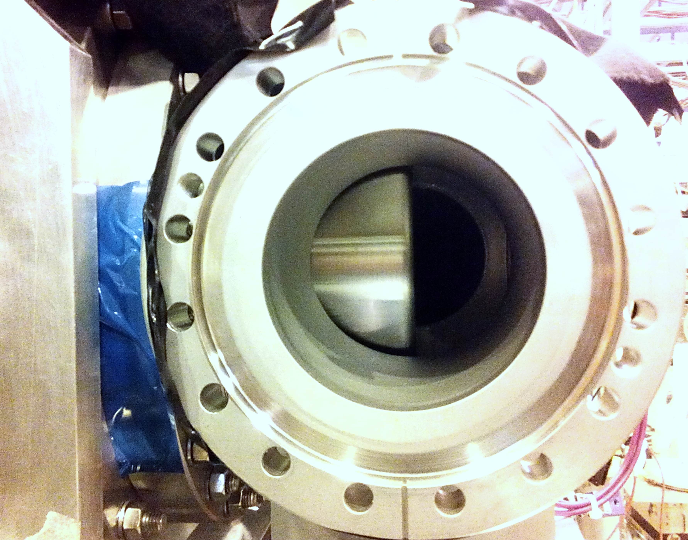
Backup slides

Slide 14
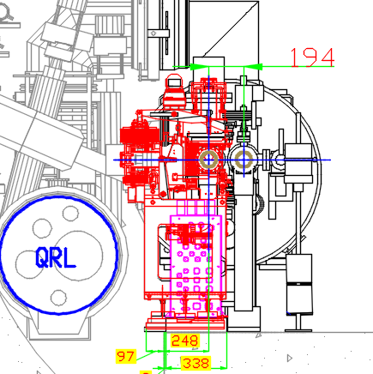
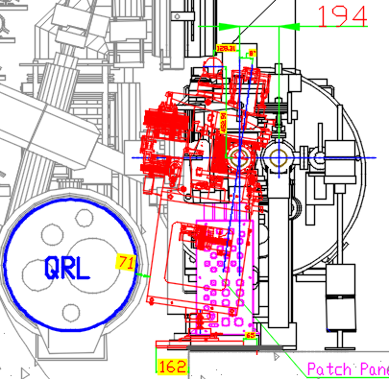
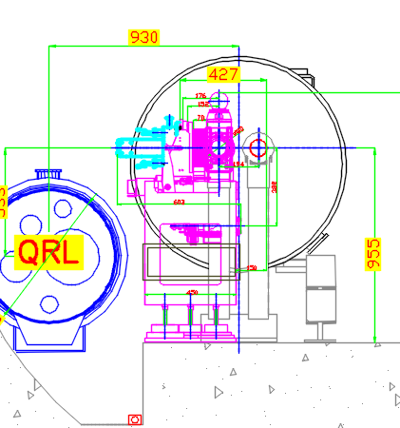
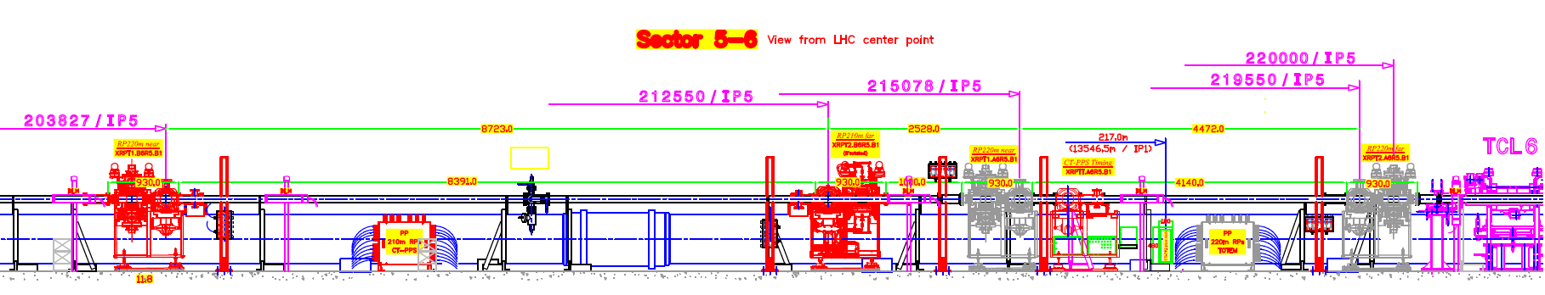
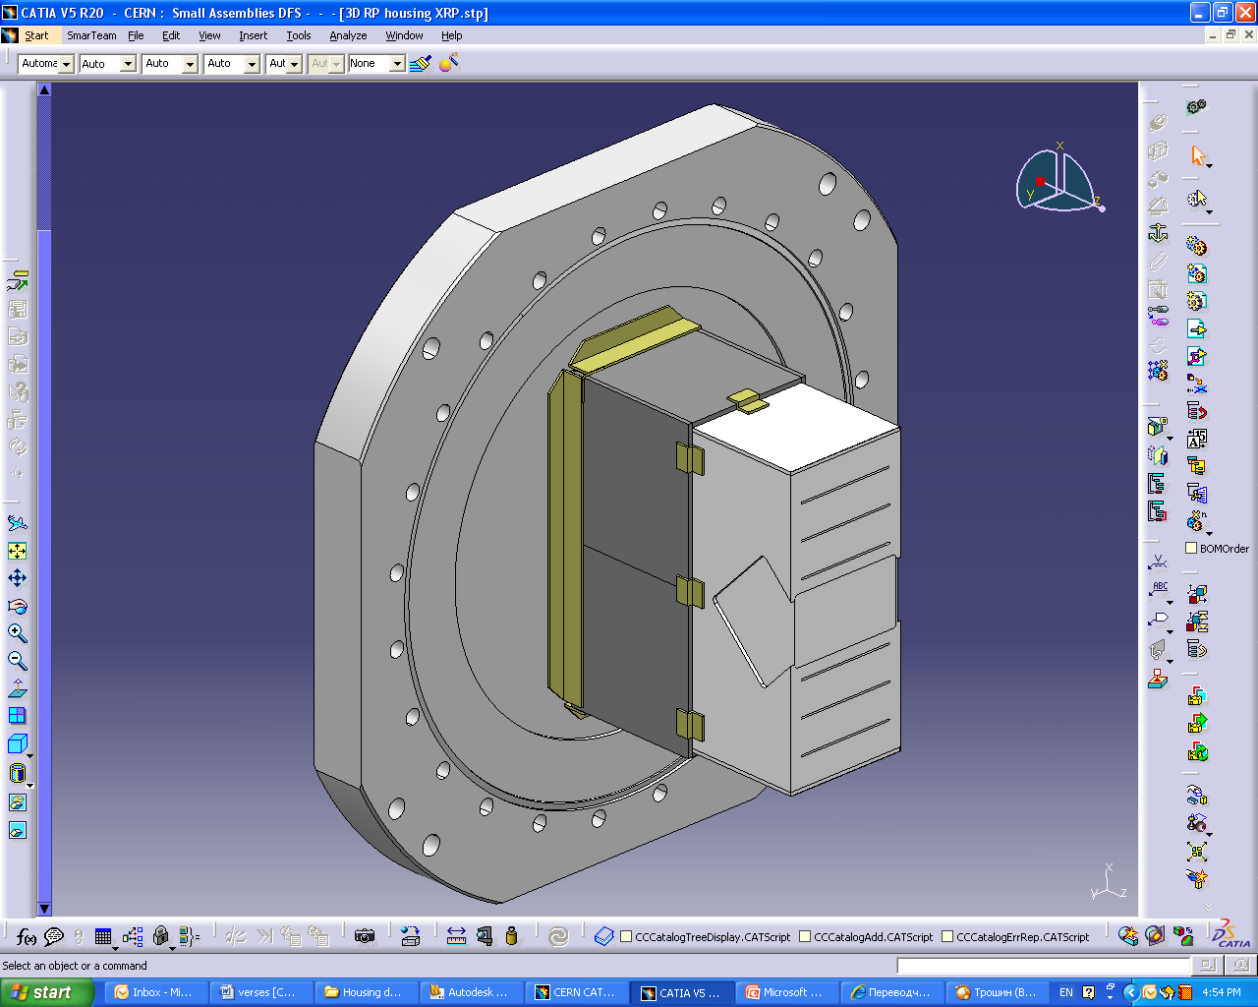
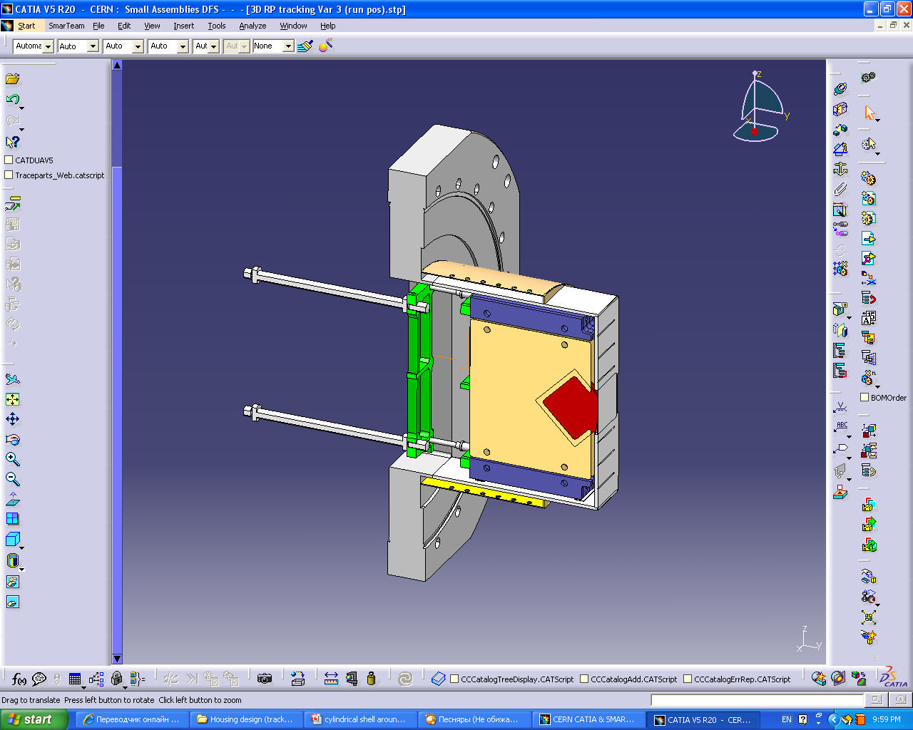
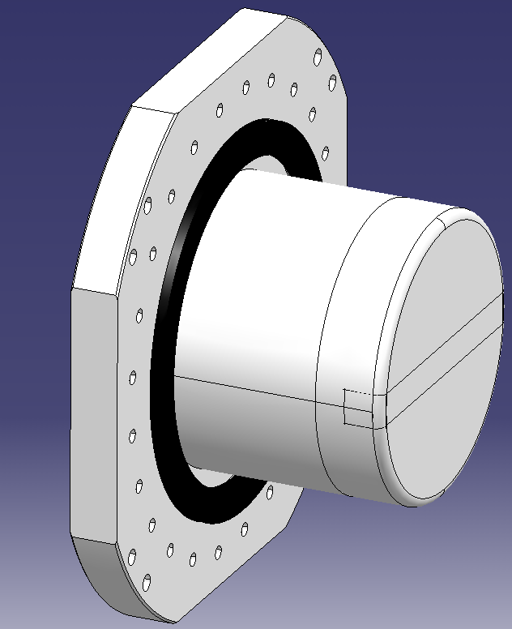
Present Run2-3 Roman Pot setup in the tunnel (LSS5)
RP210m near
RP210m far
(8°rotated)
PPS timing
(cylindrical)
Q6
Q5
IP5
8.7m
2m
0.6
3.8m
Present
rectangular
Detector inside the housing
Faraday cage, circular ferrite
Cylindrical shape,
circular ferrite
Faraday cage,
circular ferrite

Slide 15
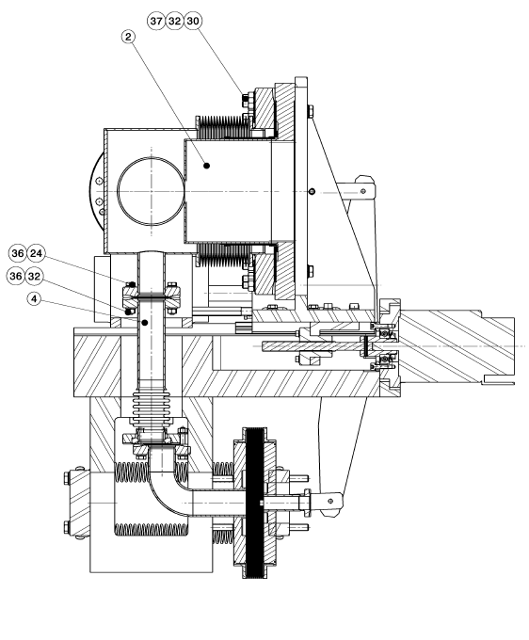
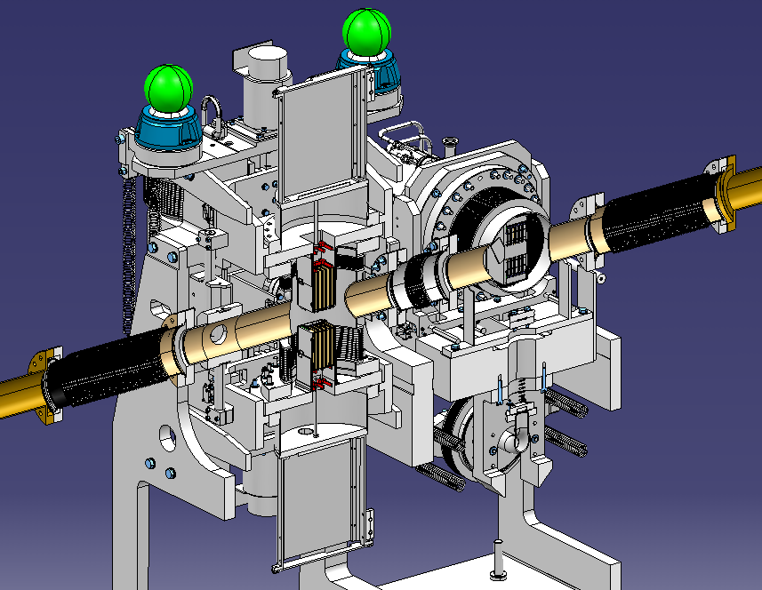
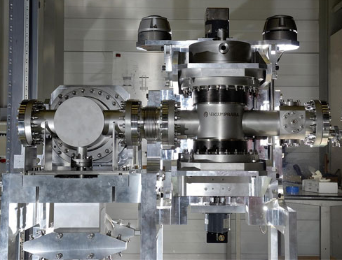
Mechanical structure of Roman Pot
Vacuum
bellow
Housing
for detector
Support
of detector
LHC Beam
pipe
PPS
detectorpackage
Two
vertical
RPs
Step
motor
Horizontal
RP
BPM
Sliding
mechanism
Vacuum
compensation system
Returnable springs
of safety system
The Housing separate the volumes of RP detector and LHC beam pipe. To minimize the amount of material versed by scattered protons, the thickness of the front wall is reduced to 150 µm around the
active sensor region. To exclude pressure on the thin wall, vacuum is also installed in detector volume.

Slide 16
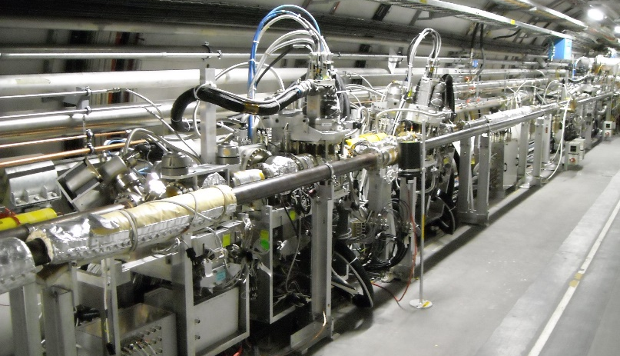
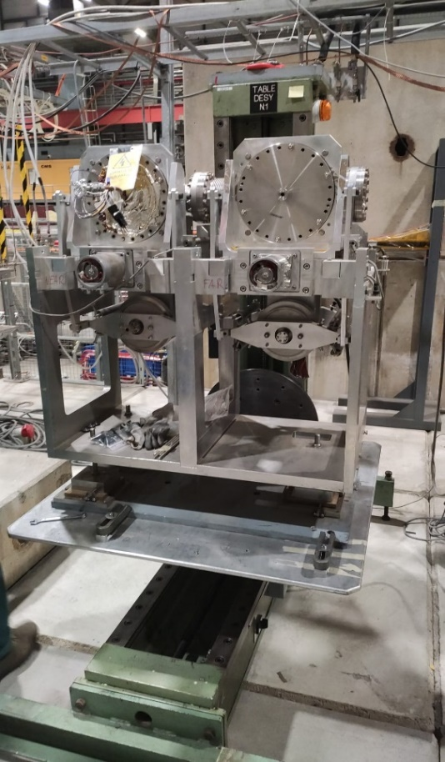
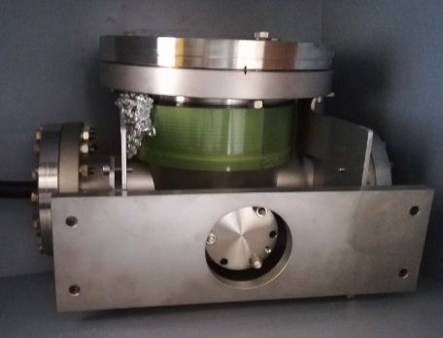
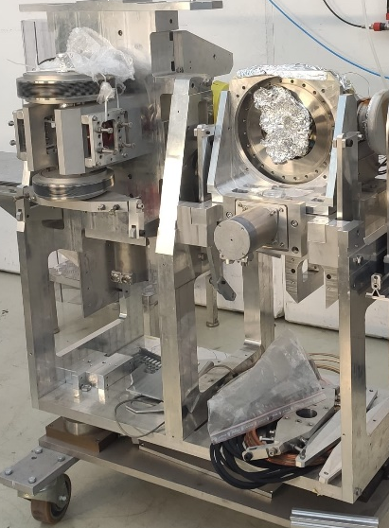


PPS - TOTEM units currently in use (Run1, 2, 3) + spare units
RP station in the tunnel
RP station in H8
Total: 8 triple station and 2 horizontal (now 6 + 4);
10 horizontal units; 2 cylinder. housing, 24 rectang.
2 horizontal units; one support frame;
1 cylindrical housing, 1 rec. housing (revalidate)
RP station
in CMS RP room
Components for horizontal unit in plastic boxes in B.226
1 triple
station
(1 horizontal
units;
2 rectangular
housings)
3 new VP vac. chambers
1 new cyl. housing
1 new horiz. unit
Availability: Numbers of RP station: 9 standard triple, plus 5 horizontal units (one tbc);
Total numbers of horizontal units: 14 (8 tunnel + 3 P.5 + 2 H8 + 1 B.226);
Number of detector housing: 26 rectangular; 4 cylindrical: 2 tunnel, 1 B226, 1 H8 (tbc)

Slide 17






Impedance study
The passage of the beam produces electromagnetic fields that interact with the vacuum chambers (beam pipe, roman pots, etc.) and can lead to:
- Bean energy loss
- Beam instabilities
- Excessive heating of the equipment
Impedance with RP at 1mm from the Beam
RP heating
Cylindrical or RF shield
Box design without RF shield
N.Minafra

