Slide 1
FGC4 PWM generation and voltage loop calculation dilemma

Slide 2
FGC4 requirements from power sections
The power converter groups presented the following requirements (in summery):
Power sections requirements:
Controls sections requirements:
Multi-V_loops
for modular converters (xPC)
Deported
ADCs (LPC)
Code re-usability
(SW & GW)
Remote
updates
V_loop
Logging (MPC)
Faster Inter I_loop communications (LPC)
No unsupported designs
ex. Picoblaze
Higher regulation performance (FPC & LPC)
Better deployment & maintenance
Component
procurement
F. Boattini,
Indico 1123297
J. M.Cravero,
Indico 1123297
S. Pittet,
Indico 1123297

Slide 3
Regulation requirements
Ben presented the requirements of the voltage loop in his presentation FGC4 Pre-Requisites Outcomes and conclusions
200kHz regulation rate voltage loop with ≈5µs group delay
4MHz regulation rate voltage loop for pulsed converters with ≈0.8µs group delay
2.5nS PWM granularity
3rd Generation
Thyristor | Analogue V LOOP | Digital V LOOP (DSP) | Digital V LOOP (FPGA)
TYPE 7 | CUTE | CANCUN 100 | DISCAP
15 Hz | 100 Hz | 1 kHz
200 Hz | 1 kHz | 10 kHz | 1 MHz
 | ≈120µs | ≈130µs | ≈1.5µs
200 Hz | 1 kHz¹ | 3 kHz | ≈40kHz
10 kHz |  | 100 kHz | 1 MHz
 |  | ≈10µs | ≈1.7µs
 |  | 50kHz | 100kHz
 |  | 3.3ns | 3.3ns
4th Generation
Thyristor | Analogue V LOOP | Digital V LOOP | Pulsed
 | Voltage Source | Switch Mode
15 Hz | ≥ 1 kHz | 5 kHz
200 Hz | 10 – 20 kHz | 50 kHz | 4 MHz
 | ≈5µs | ≈17µs | ≈0.8µs
200 Hz |  | 20 kHz
20 kHz |  | 200 kHz | 4 MHz
 |  | ≈5µs | ≈0.8µs
 |  | ≥ 250kHz | 400kHz
 |  | 2.5ns | 2.5ns
 | e.g.
Current Loop: | Bandwidth
 | Regulation Rate
 | M/C Group Delay
Voltage Loop: | Bandwidth
 | Regulation Rate
 | M/C Group Delay
 | Switching Frequency
 | PWM Granularity
RegFGC3 and Current loop in grey as not part of this discussion

Slide 4
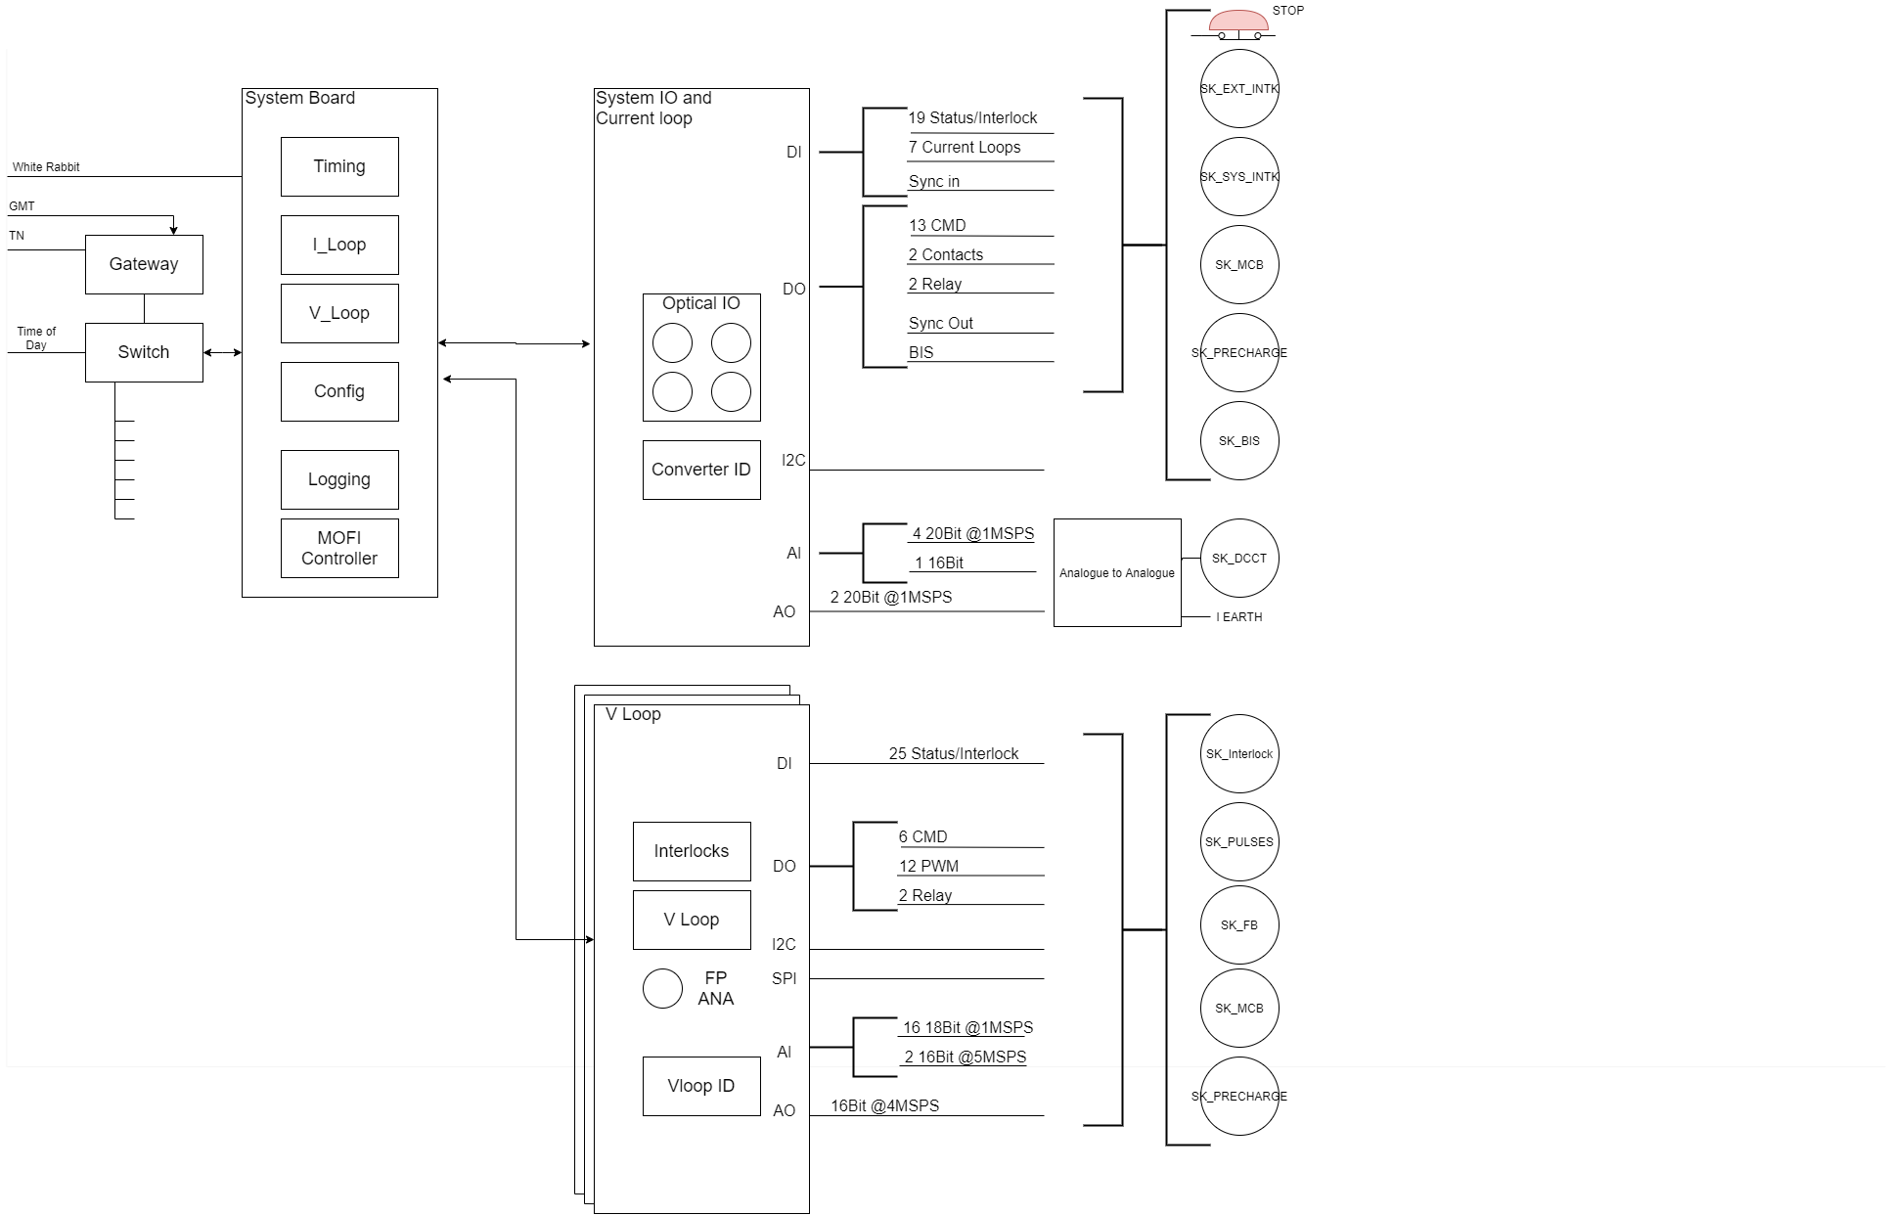
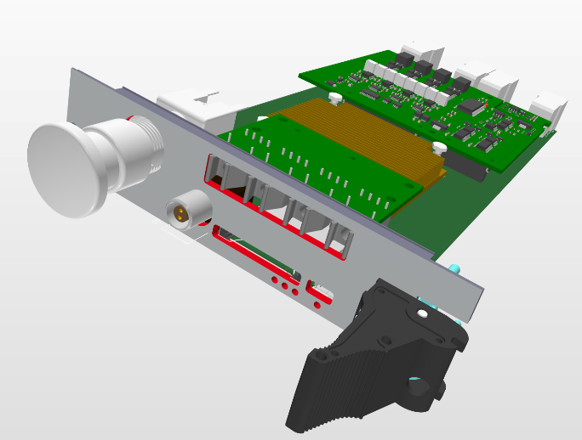
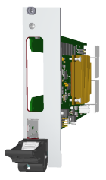
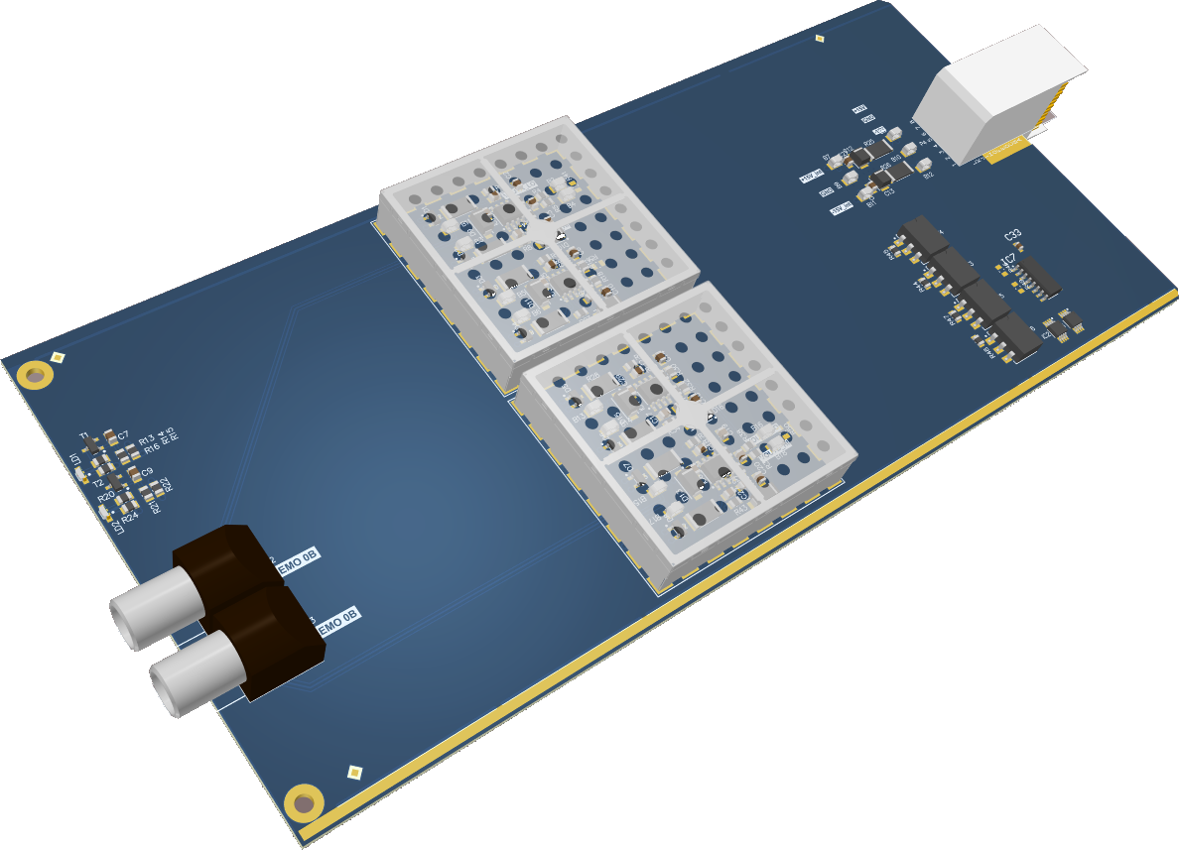
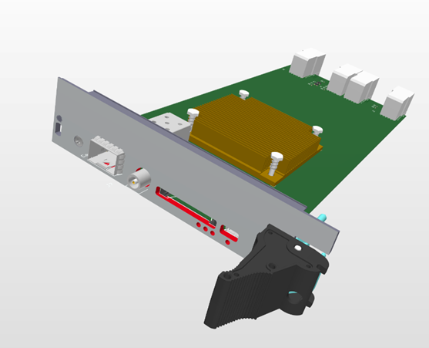
CCE architecture proposal

Slide 5
Why do CCS and CCE propose this?
<~200kHz, Regulating in the processor board allows:
Distributed Voltage Loops
Cross voltage source ADCs
Converter interleaving across separate voltage loops
Quality logging
On a slower processor CCS has already proved we can regulate CCLibs (much more complex than a voltage loop) to 273kHz no logging, 100kHz with logging. Iteration times of 3.4uS have been measured.
The link takes <1µS per direction. The round-trip time from the V loop board will be in the order of 5µS.
<4MHz, we adopt the Siramatrix approach and regulate in the FPGA this works in RegFGC3. Logging is sent back to the processor.
Scenario | Logging | Mean rate [kHz] | Slowest rate [kHz] | Slowest iteration [μs]
Idle | No | 284.7 | 273.2 | 3.66
Idle | Yes | 106.1 | 100.1 | 10.00
Direct | No | 261.2 | 253.8 | 3.94
Direct | Yes | 119.4 | 111.9 | 8.94
Taken from work by Dariusz Zielinski and Martin Cejp FGC4 Pre-Requisites Soc and Software cells for NXP and FPGA access removed for clarity as they are not relevant to this discussion.

Slide 6
PWM from FPGA
Requirement is for a 2.5nS step size in the PWM output.
This requires a 400MHz clock in the FPGA which we can proved. We should be able to provide a 800MHz clock.
This gives the following resolutions:

Slide 7
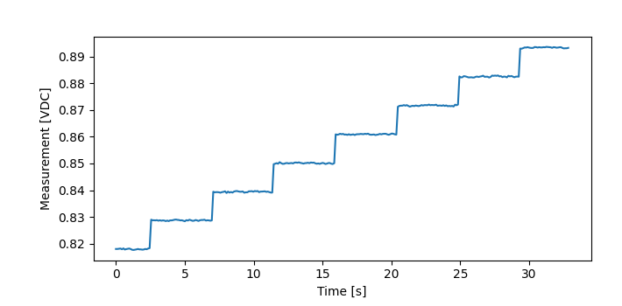
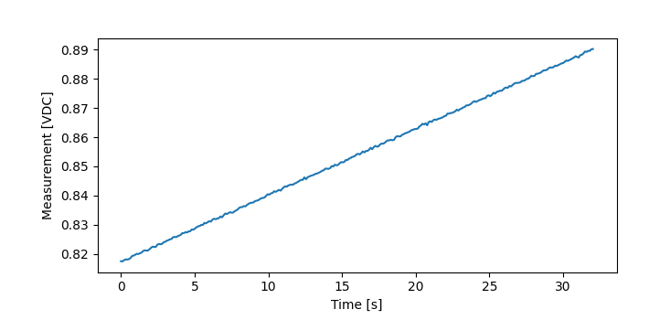
HRPWM
The RegFGC3 DSP has a HRPWM above 50kHz iteration rate this reduces the step size from 3.33nS to ~60pS
LPC completed some tests on a Cancun with the HRPWM disabled which showed that the fast current loop ensured linear ramp over a very long duration.
Tests were made on a Sirius converter and no difference was seen between enabling and disabling the HRPWM.
During the ramp phase the step sizes are larger than the resolution of step. During the flat top (or slow ramp) an averaging effect takes place.
Therefore, HRPWM is believed not to be needed.

Slide 8
Why do we not propose a DSP?
It limits or even prevents the distributed voltage loop approach (A Type 10 4P converter has 24PWM signals which are created by the DSP centrally then distributed on long wires to the sub modules)
The path for cross voltage source ADCs becomes longer and therefore slower and would not meet the requirements.
It is complex to interleave devices when they are not all driven by the same DSP
Introduces complexity and a bandwidth limit for logging of internal values (see present discussions with SVC, MPC etc.)
We do not need the HRPWM
Additional part to remote update
Additional tool chain and processor to learn and support
FPC solution becomes separate from LPC/MPC/HPC solution
}
Neither CCE or CCS have the resources to support this.

Slide 9
Question to answer
CCE and CCS propose that for voltage loops with regulation rates of:
<~200kHz, The voltage loop is calculated in a dedicated core of the processor of the system board and the PWM output is generated by an FPGA. That CCS developers and maintains a framework for regulation algorithms in this core. Competent programmers from xPC develop algorithms within this framework or CCS help can develop the algorithm from a specification or example. Loop tuning parameters and limits will be available to converter experts.
<4MHz, The voltage loop is calculated in the FPGA of the voltage loop board and the PWM/DAC output is generated by an FPGA. That CCE and FPC work together to specify, design and maintain this code. Loop tuning parameters and limits will be available to converter experts.

Slide 10

Conclusion
We believe that our proposal meets the requirements.
Distributed voltage loops
Logging
Digital V LOOP | Pulsed
Switch Mode
20 kHz
200 kHz | 4 MHz
≈5µs | ≈0.8µs
≥ 250kHz | 400kHz
2.5ns | 2.5ns
Voltage Loop: | Bandwidth
 | Regulation Rate
 | M/C Group Delay
 | Switching Frequency
 | PWM Granularity
CCE and CCS askes EPC to approve this proposal for FGC4.

