Slide 1
Status of WP6
P. Hernández
Universidad de Valencia & IFIC

Slide 2
WP6 work force
Spain CSIC: IFIC Valencia, IFT Madrid
Germany MPI: Heidelberg, Munich,
Italy INFN: Padova, Roma III, Napoli
UK: U. Durham
Names: Antush, Agarwalla, Barenboim, Bernabeu, Blennow, Coloma, Donini, Fernández-Martínez, Hernández, Huber, Li, Lindner, Long, López-Pavón, Maltoni, Mena, Mezzetto, Palomares-Ruiz, Pascoli, Peña-Garay, Orme, Ota, Rigolin, Rius, Schmidt, Schwetz, Winter, Wong …

Slide 3
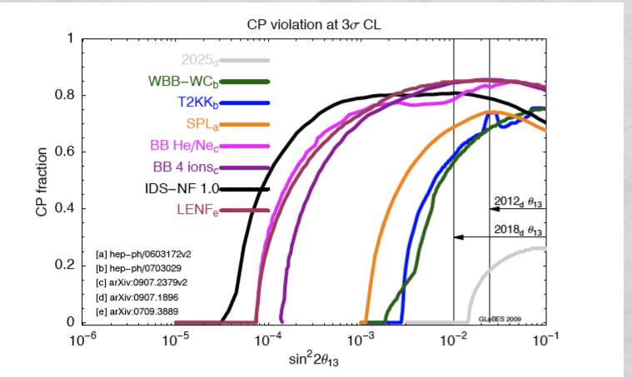

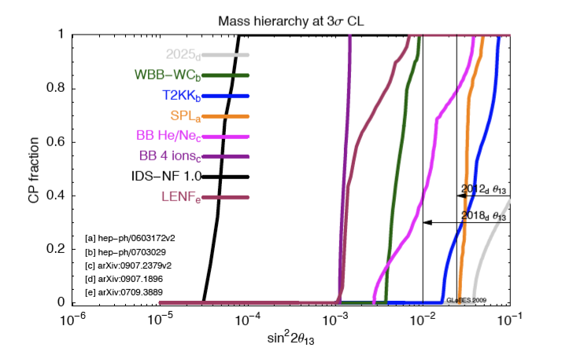
WP6 Tasks
Our Main Task: Optimization and comparison of facilities in terms of physics performance and hierarchy
WP6 2009 Yearly report: arXiv: 1005.3146, EURONU-WP6-10-19

Slide 4
WP6 Deliverables
Del. No. | Name | Nature | Delivery Date (proj.month) | Status
D4 | Review physics of baseline scenarios and optimization | R | 12
D9 | Interim report | R | 24 | in progress
D14 | Project Review Doc. | R | 36
✔

Slide 5
WP6 Deliverables
Del. No. | Name | Nature | Delivery Date (proj.month) | Status
D4 | Review physics of baseline scenarios and optimization | R | 12
D9 | Interim report | R | 24 | in progress
D14 | Project Review Doc. | R | 36
WP6 EURONU 2009 Yearly Report: arXiv: 1005.3146
✔
To appear shortly after this meeting:
WP6 EURONU 2nd year report
Basis for interim report

Slide 6

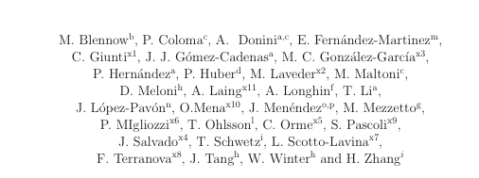
EURONU WP6 2010 yearly report
2nd year Milestones
+ Summary of other activities of WP6

Slide 7
WP6 Milestones
Del. No. | Name | Nature | Delivery Date (proj.month) | Status
6.1 | Update Physics Potential | R | 12
6.2 | Review Systematic Errors. Unified Treatment | R | 24 | in progress III
6.3 | Scenarios B, Li betabeam | R | 24 | in progress I
6.4 | Physics performance of all facilities with review of fluxes | R | 24 | in progress II
6.5 | Theoretical impact of future measurements in physics of flavour and choice of optimal scenario for all facilities | R | 36 | in progress IV
✔

Slide 8
In progress I
Scenarios for Li, B (vs He/Ne) betabeam
Compilation of all studies so far (reported to WP4)
Atmospheric and duty cycle restrictions
A. Donini’s Plenary Talk
Scenarios discussion WP6-WP4 tomorrow
Expected outcome: baseline scenario for betabeam fixed
-> summary in 2nd-year report

Slide 9
In progress II
Physics potential of all facilities with updated fluxes
Neutrino Factory: optimization revisited
S. Agarwalla’s Plenary Talk
Betabeam: optimization reviewed
A. Donini’s Plenary Talk
Need: agreement all WPs on scenarios & fluxes !
Comparison plots to be included in 2nd year WP6 report

Slide 10

In progress III …
Systematic errors… Unified treatment.
Example: A = normalization, x =
Add as many parameters as required by physics/detector.
GLOBES can do this

Slide 11
In progress III …
Systematic errors… Unified treatment.
Detector effects: energy dependent efficiencies and backg.

Slide 12
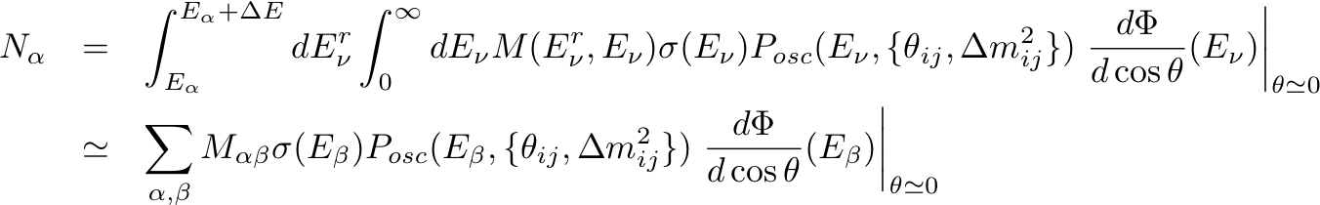
In progress III …
Systematic errors… Unified treatment.

Slide 13
In progress III …
Systematic errors… Unified treatment.
Migration matrices: ideally what we need to know about detector performance…
Burguet-Castell, et al Nucl. Phys. B695 (2004); B725 (2005)

Slide 14
In progress III …
Systematic errors… Unified treatment.
MM for signal and background events

Slide 15
In progress III …
Systematic errors… Unified treatment.
GLOBES joins the MM club
MM for signal and background events

Slide 16

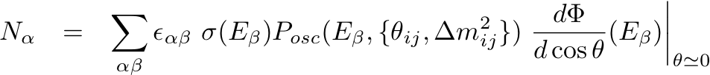
In progress III …
Systematic errors… Unified treatment.
Flux uncertainties: NF & BB
4 extra parameters to fit

Slide 17
In progress III …
Systematic errors… Unified treatment.
Oscillation probabilities: Earth matter density
Usually taken into account in the fit in phenomenological analyses

Slide 18

In progress III …
Systematic errors… Unified treatment.
If various channels contribute to the signal…
P. Coloma’s Plenary Talk

Slide 19
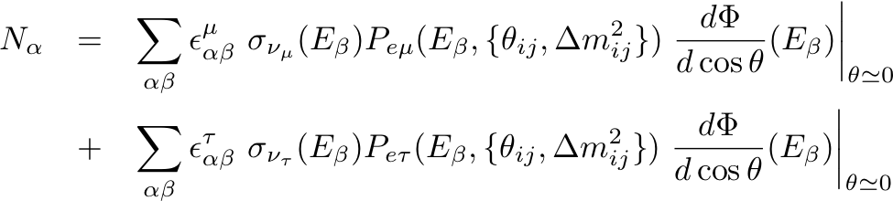
In progress III …
Systematic errors… Unified treatment.
If various channels contribute to the signal…
P. Coloma’s Plenary Talk

Slide 20
In progress III …
Systematic errors… Unified treatment.
Joint WP5-WP6 discussions going on
Cross sections and MMs: the hardest problem!
Not easy to disentangle detector and cross section in MM

Slide 21


In progress III …
Systematic errors… Unified treatment.

Slide 22
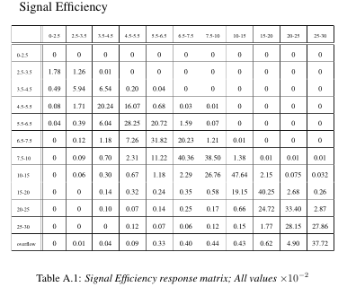


MIND MMs
A. Laing PhD Thesis

Slide 23
E reconstructed as if
n

Slide 24

QE Cross sections
p

Slide 25
DIS Cross sections
E_{ν} reconstructed from E_{l} and E_{h} and angles

Slide 26
QE Cross sections

Slide 27

QE Cross sections

Slide 28
In progress III …
Systematic errors… Unified treatment.
Inconsistent to use different to extract MMs and to do the analysis ?

Slide 29
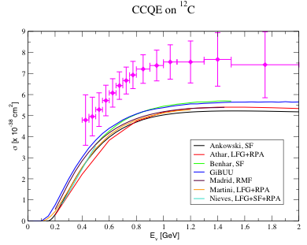
QE Cross Sections
Talk by L. Alvarez-Ruso WP5-WP6 Joint Parallel
State-of-the-art nuclear models cannot explain MiniBoone data…

Slide 30
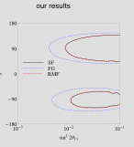
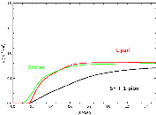
QE Cross Sections
Large impact on sensitivity for low γ beta beam
Talk by D. Meloni WP5-WP6 Joint Parallel
E. Fernández-Martinez, D. Meloni
EURONU-WP6-10-26

Slide 31
In progress III …
Systematic errors… Unified treatment.
Two very different types of errors on MMs
from cross section uncertainties
from detector inefficiencies
Goal is to identify the most relevant parameters of each type

Slide 32
In progress IV
Theoretical impact of future measurements in physics of flavour and choice of optimal scenario for all facilities.
Most popular among WP6 participants:
Non-standard neutrino interactions
S. Parke; J. López-Pavón WP6 parallel talks
Light sterile neutrinos
C. Giunti’s WP6 parallel talk
Also EURONU-WP6-10-14; EURONU-WP6-10-23;EURONU-WP6-10-24, EURONU-WP6-10-25

Slide 33
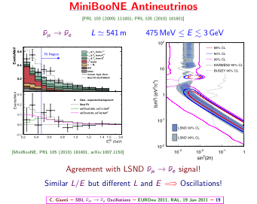
Revival of LSND by MiniBooNE

Slide 34
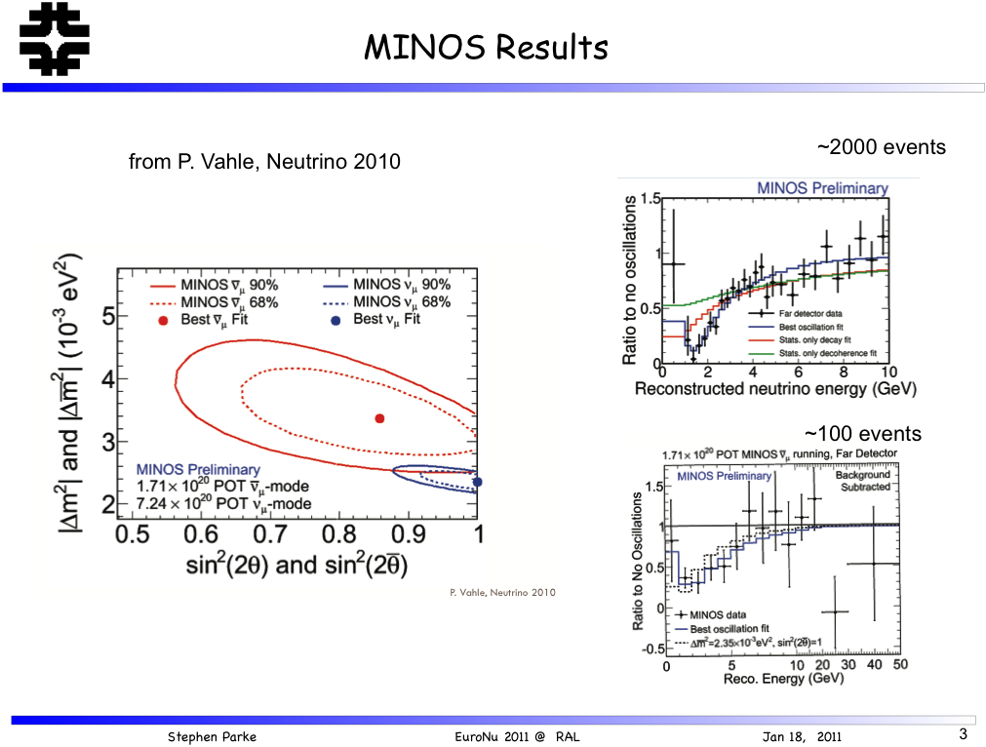
Revival by MINOS

Slide 35
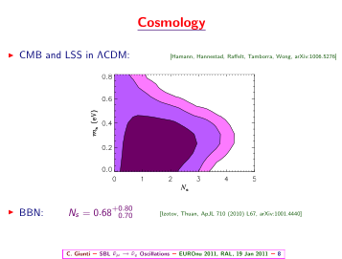
Revival by cosmology
Also M. C. González-García, M. Maltoni, J. Salvado, EURONU-WP6-10-22

Slide 36
NSI/Steriles ?
NSI for MINOS ? not easy to fit the data given other constraints
Steriles for LSND/MiniBooNe? tension between appearance vs disappearance, need additional CPT or NSI
Even if the simplest models do not work, they are worth exploring

Slide 37
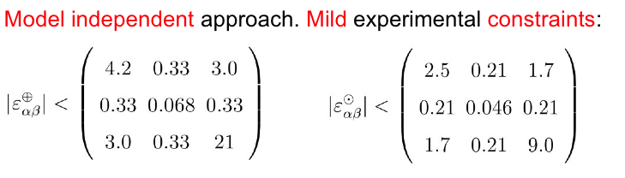
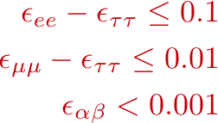
NF constraints on NSI
@NF
J.López-Pavón, Parallel Talk

Slide 38
Conclusions
Updated physics comparison expected soon in our yearly report (after scenario discussion with all WPs)
Systematic errors under discussion WP5-WP6
- Migration Matrices standard method (in GLOBES!)
- Need to disentangle systematic in cross sections/detector in MMs
- Clarification of discrepancies in cross sections

Slide 39
Conclusions
WP6 Activities:
Two theory workshops organized (large participation of the neutrino community):
Flavour physics in the era of precision neutrino experiments, Cosener’s House, June 8-10 June, 60 participants
Neutrino Theory, Models and Experimental perspectives,
CERN’s Theory Division, September 13-22 September, 56 participants
O(27) EURONU-WP6 reports (only 22 in the webpage)
analysis of present data, optimization/comparison, new physics searches…
Good coordination in summary report
Good communication with WP5 and improving WP3,WP4

