Slide 1
Status Update
EUROnu Costing
Outline
General remarks - reminder
Progress since last Annual Meeting – June 2010
Next steps - timeline
Ilias Efthymiopoulos – CERN
P. Bonnal, J. De Junghe, B. Daudin
EUROnu costing panel

Slide 2
General remarks - reminder
The cost estimate of the proposed facilities is a deliverable of the EUROnu project
Consistency throughout the document is the key issue!
Project: SB, BB, NF
Accelerator complex
Detector(s) [near, far]
PBS,
parameters list
Baseline
Physics
Performance
Optimization(?)
Cost estimate
resources/materials

Slide 3
General remarks - reminder
Getting a complete costing for the facility would be rather challenging
  Collective effort, needs engineers not only physicists!
We should present an objective cost estimate, i.e. what we estimate with today’s knowledge will be needed to build the facilities
  do not hide complications or unknowns → risk register
  demonstrate to possible funding agencies that a certain level of maturity in matters of costing is achieved
Apply confidentiality to the cost figures until the costing exercise is completed
Must establish a budget control to monitor the cost of the project if changes to the baseline are made
  Any cost increase must be justified
  Technical solutions should involve cost considerations

Slide 4
Progress since last Annual Meeting
Presentation and discussion in the IDS-NF meeting @RAL – September’10
  Costing section in IDS-NF IDR included; explain the adopted methodology leaving he numbers for the final document
  Work on PBS for NF
Work on the CERN costing tool to adopt it in our needs
  Handling of options and parallel PBSs or sections of PBSs
  Excel interface for massive data input
Costing documents available
  Guidelines for doing the costing – focused on NF, will be adopted to BB & SB
  Excel template
  Assumption Data Sheet
➩Available (next week) in EUROnu WG1 web

Slide 5
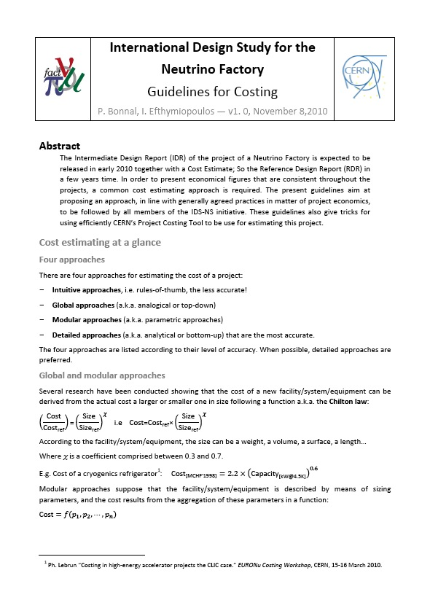
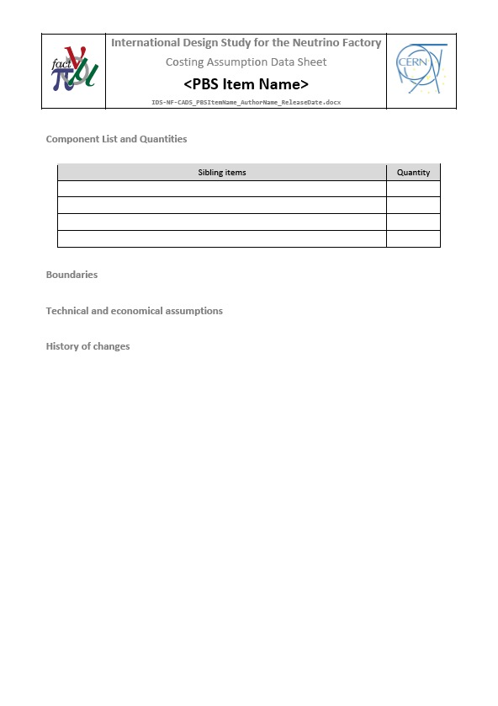
EUROnu costing – Documents
Guideline document
Assumption Data Sheet Template

Slide 6
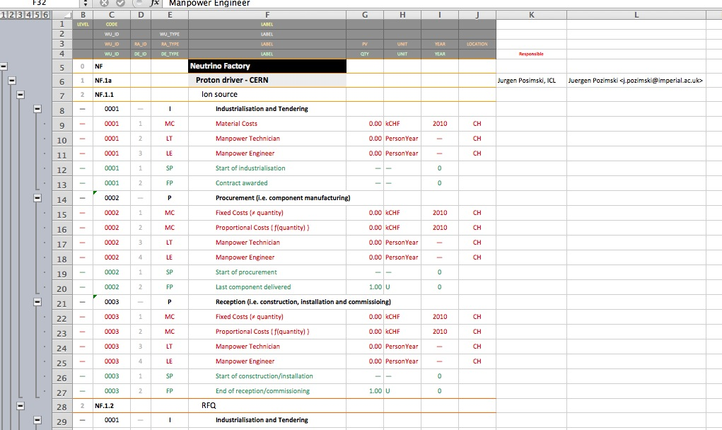
EUROnu costing – Documents
Excel Template

Slide 7
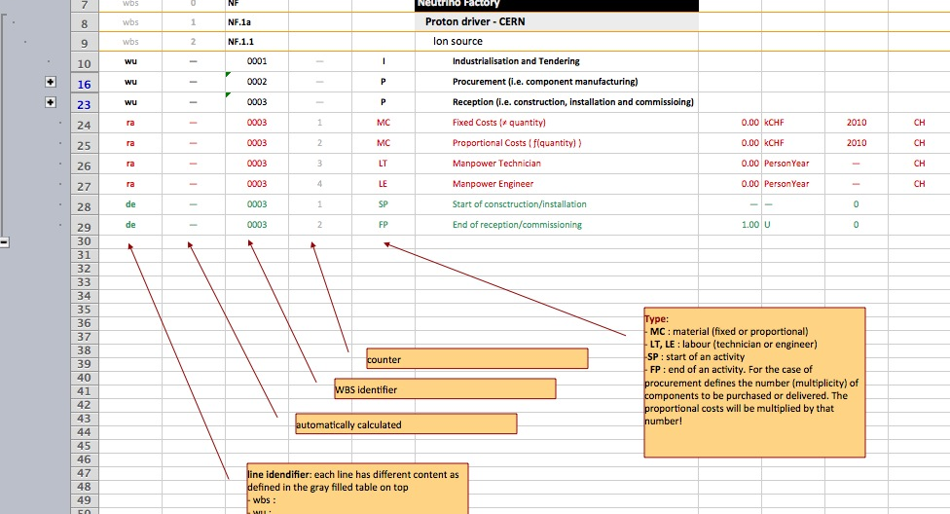
EUROnu costing – Documents
Excel Template
Help page

Slide 8
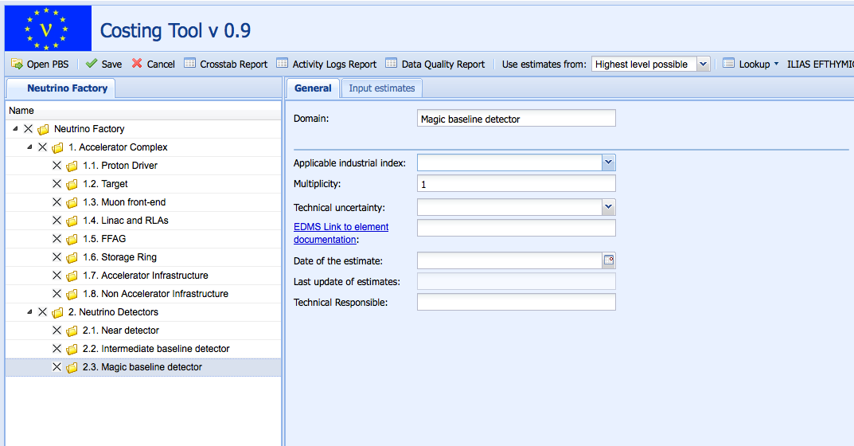
EUROnu costing – Costing Tool

Slide 9
EUROnu costing – Methodology
Establish the Project Breakdown Structure
  Describes the components of the baseline: sub-systems, sub-sub-systems etc.
  Use excel template file → load it to the Costing Tool
  Start with the baseline, leave options for later
For each of them, identify activities to perform – Work Breakdown Structure
  Include Engineering activities
    EMC studies, radiation hardness of equipment, accelerator & detector physics optimization,
    safety/environment engineering, risk analysis, commissioning, ramping-up, etc.
    Apply a global approach if not explicitly studied : +40% on material cost
  Do not include operation costs or dismantling costs
Try to evaluate costs associated to these activities, by all means
  Follow the proposed common rules
Identify the Cost Focal Points
  those responsible at the syb-system level to collect the cost information and maintain it in the costing tool → members of the Costing Panel

Slide 10
EUROnu costing – Methodology
At (sub-)system level
  If analytical approach possible:
    Detailed design + tendering + contracting / Manufacturing design + tooling procurement
    Raw material + manufacturing costs / Quality control + logistic
    Installation + pre-commissioning
  If not possible: global approach.
Create an Assumption Data Sheet
  Sourcing of the data/figures:
    Derived from previous projects
    Derived from analytical tool such as DFM/A…
    Quotes from manufacturers
  Monetary figure + currency + date + location
    E.g. 5 M US$ of 1997 ; Illinois USA
    300 k CHF of 2007 ; Geneva CH
Economical/financial factors taken care within the costing tool:
  location, FX, price escalation…

Slide 11
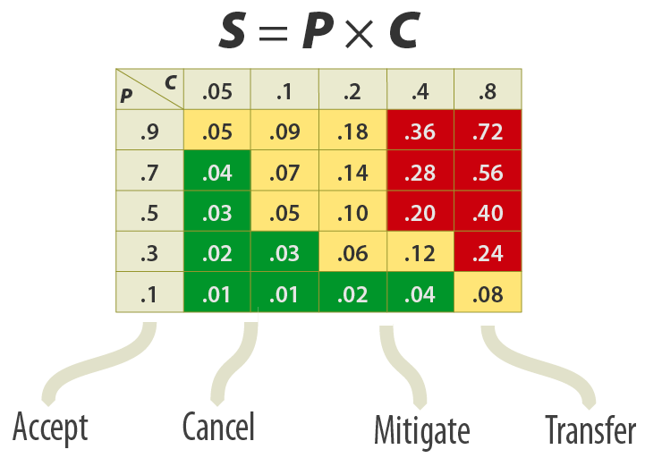
EUROnu costing – Methodology
Options : justify options in the project based on
  Expected improvements in technology
  Performance improvement that justifies the study
  Possible cost reduction
Cost aggregation by blended sub-system cost estimates
  And choice or options
Risk register where no technical solution is
available

Slide 12
EUROnu costing – Next steps
Costing panel
reps from each WP as cost contact persons
Include the CFP frm each sub-system
EUROnu MB
Tasks:
  Trained to use the costing tool
  Responsible for collecting information and cost update in the tool
Costing workshop
- Training
- Decide on costing strategy
June’10: EURONU annual meeting
- Costing session
- Review WBS
Nov/Dec 2010
March 2011 ????
2nd Costing workshop
- Complete WBS
- First global cost evaluation
March 2011
IDS/NF Interim Design Report
Dec 2011
Cost review workshop
- Review of cost estimates for each facility in view of the final report
CERN support
Project Office support: costing tool, consultancy, access to information and possibly experts

Slide 13
And then ……

