Slide 1
ECFA Neutrino Panel:

Slide 3
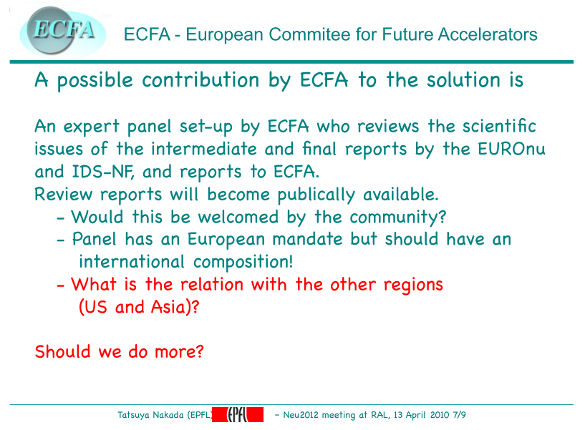

Slide 4
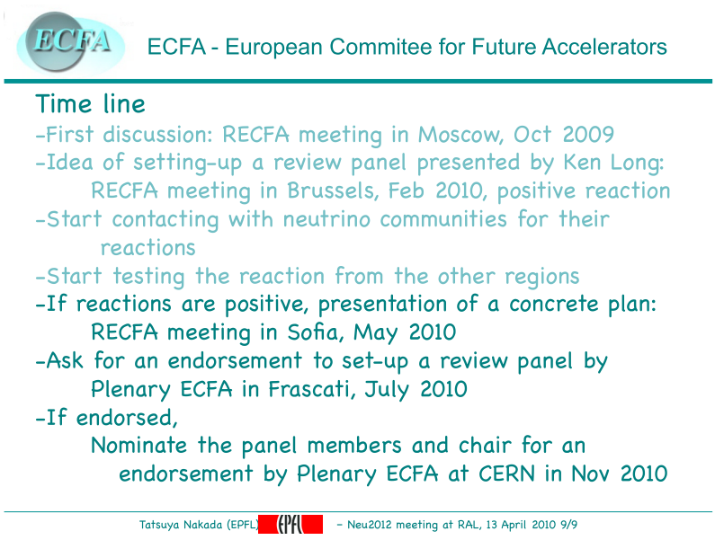

Slide 5
Community consultation; steps taken:
EUROnu:
  Concept explained to Management Board
    Welcomed proposed review panel
  Concept presented to delegates at EUROnu costing w/s, CERN, 15/16 March 2010:
    Positive reception
  Note:
    Formally, EUROnu reports to the Strategy Session of CERN Council:
      So, if the review of the IDR and EUROnu interim reports is deemed to be a success and the process moves on to the review of the RDR and the EUROnu final reports, it will be important that the review is included as part of the Strategy Session of CERN Council reporting process
IDS-NF
  Concept explained to Steering Group
    Proposed review panel was welcomed
      Comment:
        Ensure review panel is manifestly international
  Concept presented to IDS-NF plenary meeting, FNAL 08—10 April 2010
    Positive reception
Neu2012 (NA in EUCARD IA)
  Concept presented by T. Nakada to Neu2012 community
    Positive reception
Conclusion:
community welcomes proposed review panel.

Slide 6
Issues:
ECFA intention is that review panel shall be:
  International:
    European initiative; but international in scope and influence
  Composed of internationally recognised leaders in the field
Not sufficient for this to be the intention, nor sufficient even for it to be true in practice, unless:
  The international community recognises the panel as international and ‘heavy weight’
    i.e. essential that there be ‘buy in’ from:
      International neutrino community;
      ‘Stakeholders’:
        e.g. laboratory and funding-agency directors
    Implies:
      Care in establishing principle with stakeholders prior to launch of initiative
      Broad consultation to define composition of panel:
        Including appropriate cross membership (e.g. ICFA, ACFA, …)

Slide 7
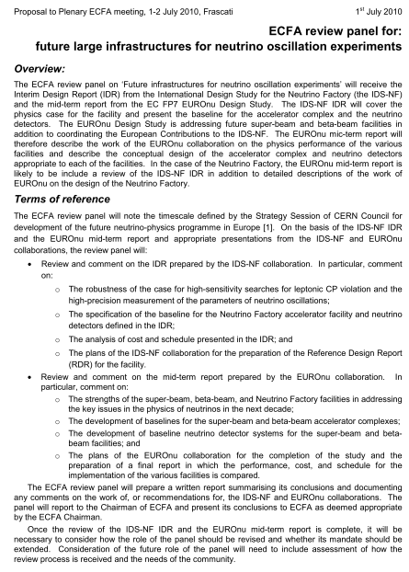
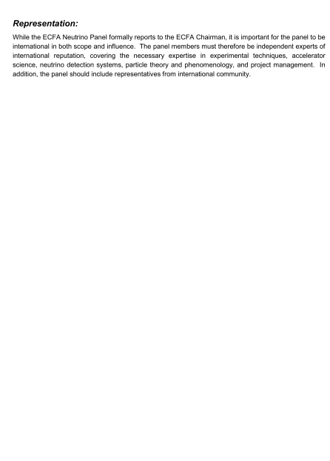

Slide 8
Steps taken since June 2010:
Nominations for panel members solicited from:
  ECFA members;
  Future accelerator-based neutrino community:
    Specifically via EUROnu Management Board, Nue2012 Workpackage managerss, and IDS-NF Steering Group
Extended discussion of nominees at R-ECFA meeting in Helsinki (October 2010) at which it was agreed that:
  The panel required expertise in neutrino experimentation, neutrino theory, and accelerator systems. Panel would be composed of three recognised experts in each of these categories, plus a chair person;
  The panel would be independent, i.e.:
    Those who would be authors of either the Interim Design Report (IDR) of the IDS-NF or the mid-term report of EUROnu would be deemed to be ineligible to serve on the panel; and
    Those who presently served the IDS-NF or EUROnu in an advisory capacity would be deemed ineligible to serve.

Slide 9
Composition of the panel:
Chair:
  Prof. Francis Halzen (US, Wisconsin)
Accelerator specialists:
  Terence Garvey (CH, PSI)
  David Findlay (UK, STFC/RAL)
  Philippe Lebrun (CERN)
Experimental physicists:
  Koichiro Nishikawa (JP, KEK)
  Patrick Decowski (NL. NIKHEF)
  Ewa Rondio (PL, NSI)
Theoretical physicists:
  Gianluigi Fogli (IT, INFN/Bari)
  Pepe Bernabeu (ES, Valencia IFIC)
  Jukka Maalampi (FI, Jyi)
Endorsed by
P-ECFA
25Nov11

Slide 10
ECFA review; timeline:
Date and venue:
  ECFA review will take place:
    In May
      Dates yet to be fixed
        Proponent Doodle poll at: http://doodle.com/9z7ixabrfm6kdiza
    At the Daresbury Laboratory
The following is a ‘best guess’:
  The meeting will take place over 2 days
  The Panel will request presentations in an open session
    Important for their to be an audience
  Panel’s feedback to us will come late May or in June

