Slide 1
CEDAR consolidation proposal
18th EABI-WG meeting
25th July, 2022
A. Lafuente

Slide 2
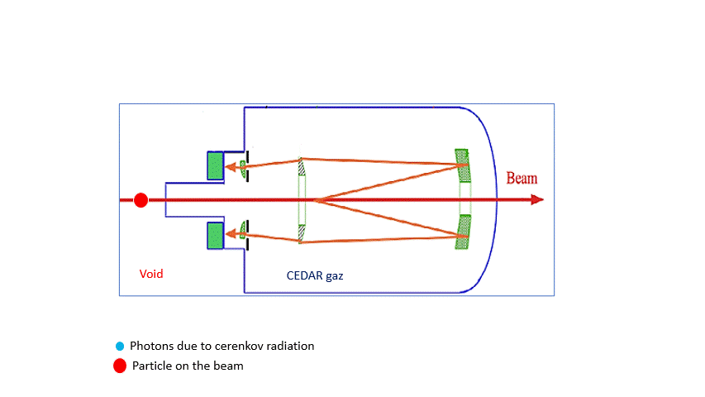
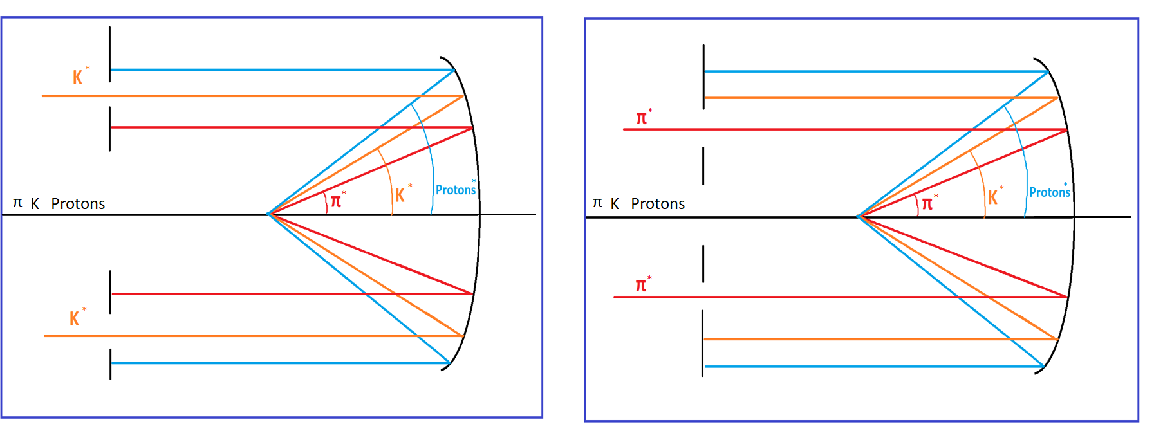
CEDAR counters are old detectors used for particle identification
CEDARs (Cerenkov Differential counter with Achromatic Ring Focus) were designed at CERN between 1975 and 1980 and use a highly performant optical system to identify a particle by detecting only the Cerenkov light emitted at a precise angle by beam particles of a specific rest mass
The light emission angle is directly related to the velocity of the particle and the refraction index of the gas
A diaphragm with an adjustable slit allows to filter light from unwanted particles
By tuning the pressure of the gas, we can then detect particles of a specific mass (and therefore of a specific type), while being blind to other particles
This is the principle of the two CEDARs (North and West) that allow tagging particles in different energy regimes

Slide 3
The proposed program is intertwined with NA62 CEDAR-H upgrade campaign
Designed and built more than 40 years ago their consolidation is now needed
No functional spares are available and only one CEDAR-W is left
This Consolidation Work Package (EDMS 2742855) describes the requests for:
  the two CEDARs used by Compass (XCED_N02, XCED_N20);
  the two used by NA61 (XCED_N03, XCED_W04);
  an additional CEDAR-W (e.g. XCED_N03) to cover increasing requests for H6;
  two spares, a North and a West (e.g. XCED_N01, XCED_N07)
The refurbishment of XCED_N06 onto a CEDAR-H filled with Hydrogen is described in a separate document (EDMS#2621859) but some synergies are expected
The project proposal is staged in two phases:
  Phase 1 has its own funding and it is aimed at ensuring a minimum level of reliability and availability for the coming years by completing the full consolidation of the one spare with two interchangeable set of optics
  In Phase 2, funded through NA-CONS, the remaining five operational CEDARs as well as the second spare would be consolidated

Slide 4
The consolidation campaign spans across different areas and equipment subsytems

Slide 5
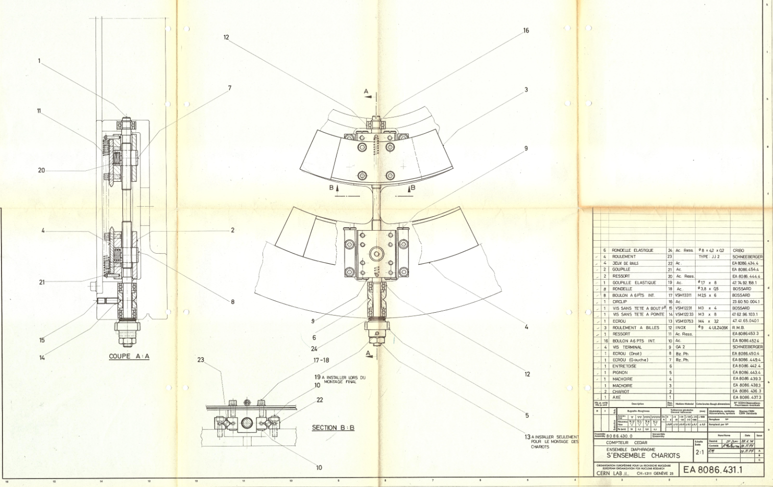
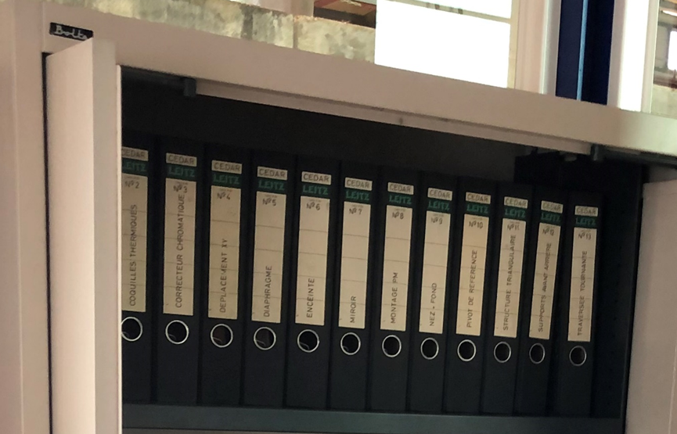
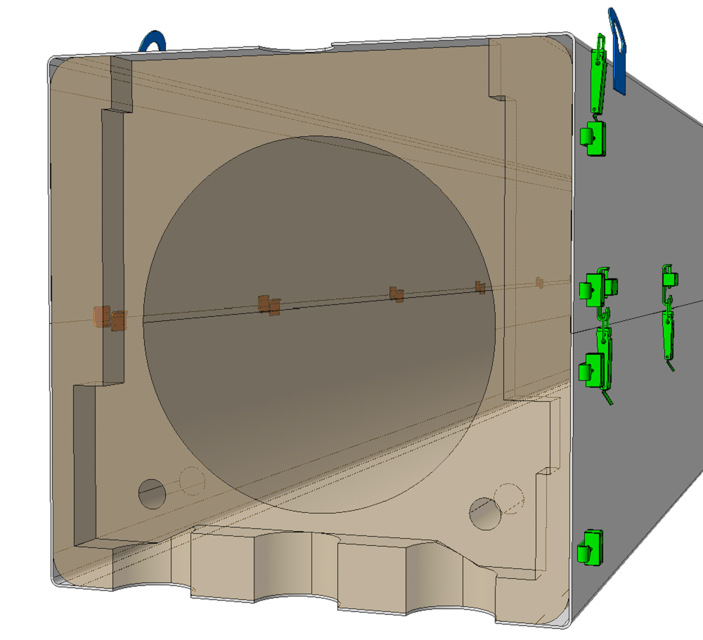
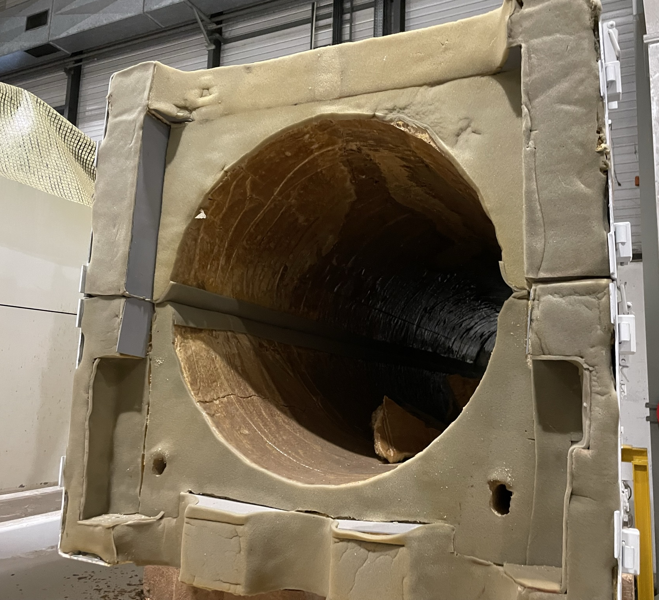
A consolidation of the documentation, that builds upon the one done for NA62, represents the starting point
Over 300 technical drawings concerning the CEDARs date from the 1970’s
They do not conform to current ISO standards and are only available on paper and/or in scanned form
It is therefore necessary to redo some 2D drawings as well as to provide 3D models if we want to be able to reproduce or modify a CEDAR
Some work has been already completed and as part of the CEDAR-H program for NA62
Resources request | 2021 | 2022 | 2023 | 2024 | 2025 | 2026 | 2027 | 2028 | 2029 | 2030
FSU drawings [kCHF] |  | 5 | 5

Slide 6
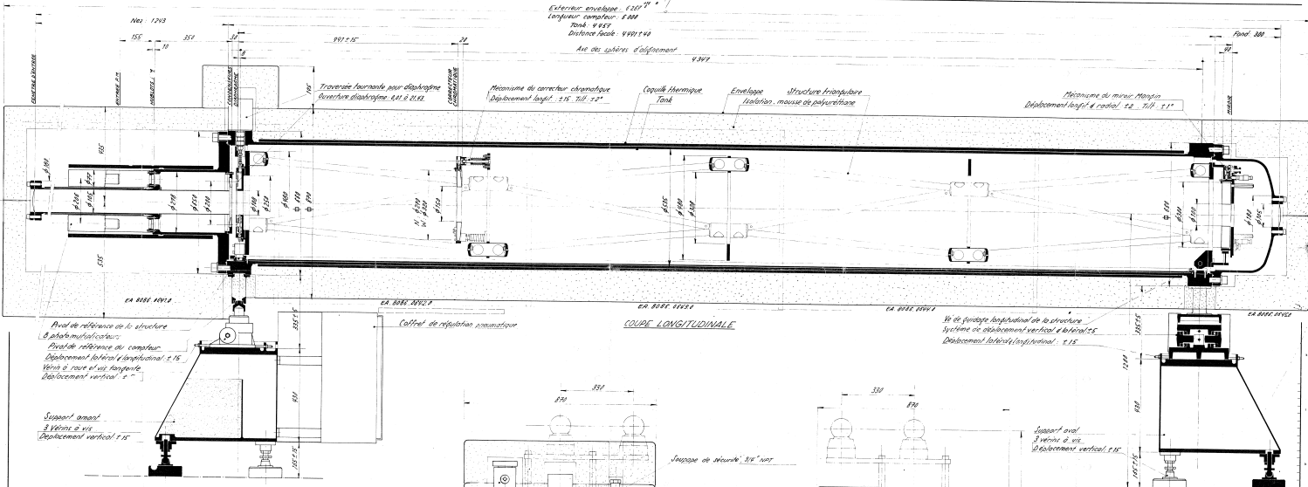
Tank seals, support motorization and controls will be replaced
The CEDAR optical system is inside a 6m-long pressure vessel that rests on a screw jack on the upstream side and a planimetric X-Y table on the downstream side to allow alignment with respect to the beamline
The additional spare plus the supports linked to the five operational CEDARs will follow during Phase II
Tanks and supports still meet the requirements but motorizations, sensors and controls require an uplift after 40 years of operation
All seals will be replaced by new Viton O-rings
Two spare sets of supports will be consolidated in Phase I mostly from existing inventory parts
Resources request | 2021 | 2022 | 2023 | 2024 | 2025 | 2026 | 2027 | 2028 | 2029 | 2030
Material Tank and supports [kCHF] |  |  | 5 |  |  |  |  | 17 | 17 | 17
FSU Tank and supports [kCHF] |  |  |  |  |  |  |  | 3 | 3 | 3

Slide 7
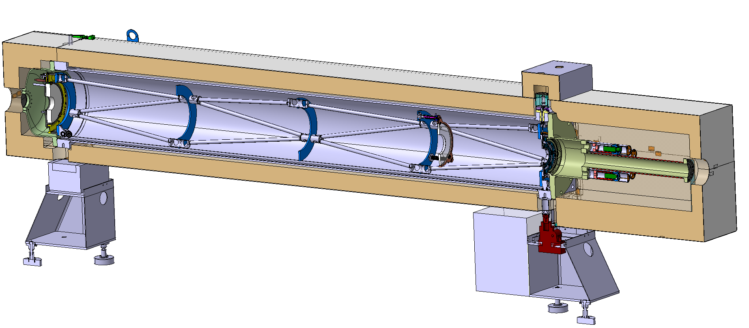
Optical elements will be produced from a new specification
The optical elements inside the counter comprise the Mangin mirror, the chromatic corrector, the diaphragm, 8 sets of condenser lenses and quartz windows
Work underway to understand if/how recently found blanks could be used for this purpose
A spare of each type (CEDAR-N and W) would be produced during Phase I and followed by an extra set of W-type in Phase II
Optical sets are adapted to different type of gases and physic regimes
They were made from high quality quartz blanks, polished to a PV SFE 80 nm and coated with MgF2 to minimise reflection at 300nm
New sets will be produced based on a newly developed specification and its performance compared with the original ones
Magnin mirror
Chromatic corrector
Diaphragm
Condenser lenses
Quartz windows
Resources request | 2021 | 2022 | 2023 | 2024 | 2025 | 2026 | 2027 | 2028 | 2029 | 2030
Material optical elements [kCHF] |  | 50 | 80 |  |  |  |  | 140

Slide 8
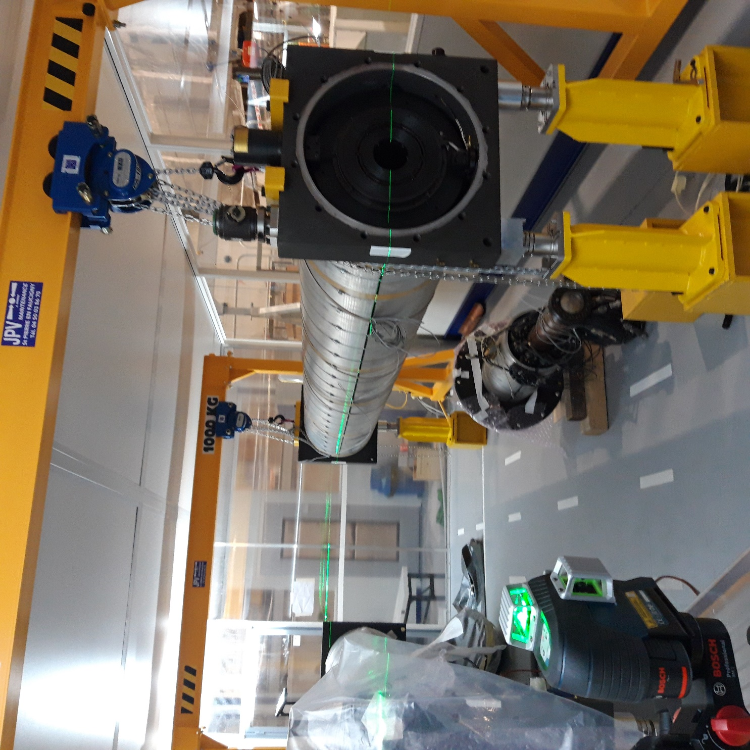
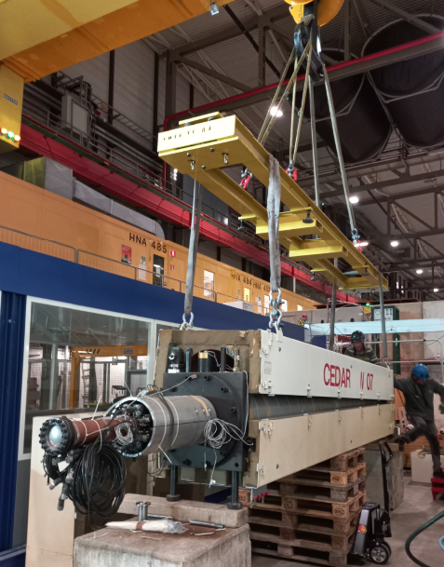
New optics will be validated in a testing campaign
The new optics will have to be tested in H6 and compared with the original set
The campaign will involve: taking two sets of optics for a CEDAR (an old one and a new one), mounting one of them in the counter, aligning them, and installing the detector in H6 beamline in EHN1 during a test beam period to finally run some alignment and pressures scans as well as detection efficiencies versus diaphragm slit apertures. They could then be compared after the procedure is repeated with the second set. FSU resources will be required for these campaigns.
Beam instrumentation, PMTs and data acquisition system from the BI group that will also provide some technical support
Support feet for the installation and alignment, gas supply and control infrastructure are already in place in PPE136
Resources request | 2021 | 2022 | 2023 | 2024 | 2025 | 2026 | 2027 | 2028 | 2029 | 2030
FSU CEDAR testing campaigns [kCHF] |  | 2 |  | 3 |  |  |  | 2 | 2 | 1

Slide 9
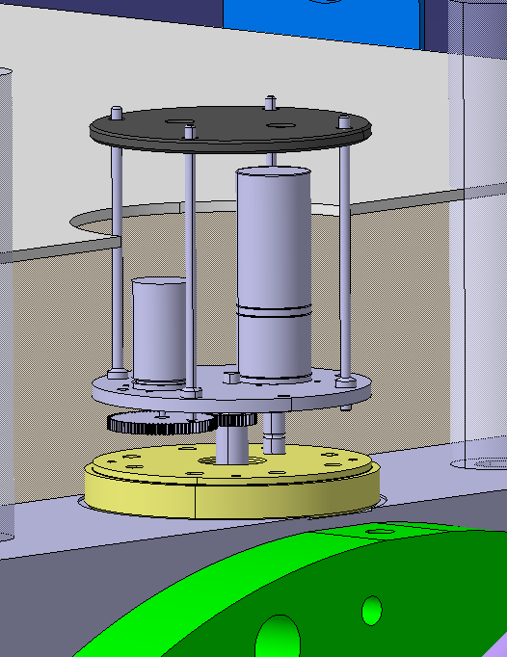
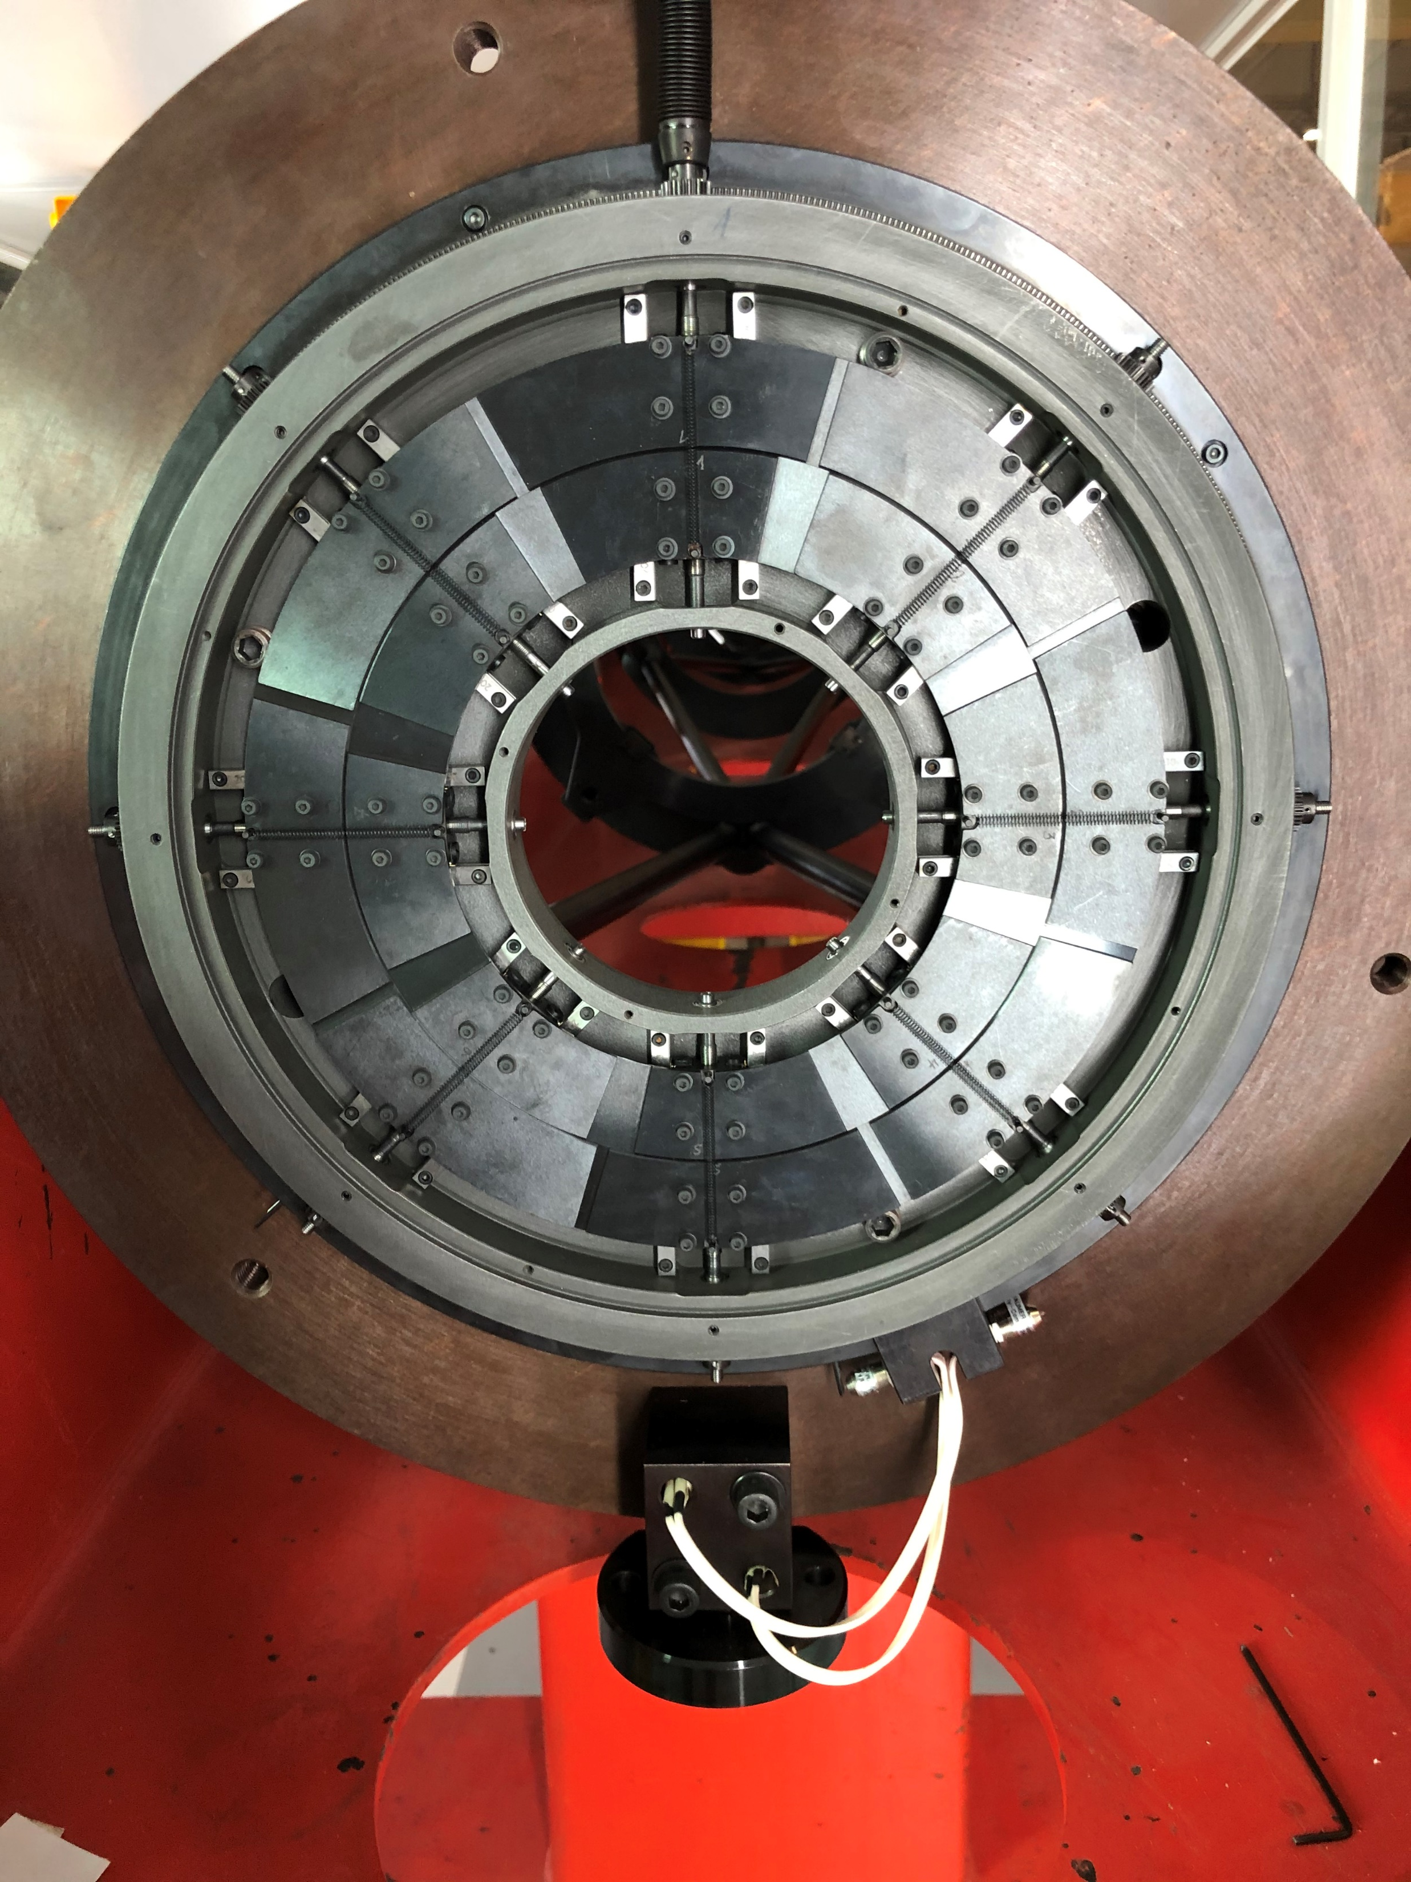
Diaphragm controls, motorization and sensors will be renewed
All the Cerenkov light is reflected by the mirror onto a ring-shaped diaphragm of 100 mm radius with adjustable aperture width that allows to filter light from unwanted particles
Recent problems with the aperture diaphragm control experienced in some of the CEDARs have evidenced the need to consolidate the all motorizations and sensors – of which some of the original ones have been now discontinued - by equivalent standard ones.
DC motor, potentiometer and end-switches will be replaced
Only the first spare would be completed during Phase I
Diaphragm control
Diaphragm
Resources request | 2021 | 2022 | 2023 | 2024 | 2025 | 2026 | 2027 | 2028 | 2029 | 2030
Material diaphragm controls [kCHF] |  | 2 | 3 |  |  |  |  | 5 | 5 | 5
Motor
Potentiometer
End Switches

Slide 10
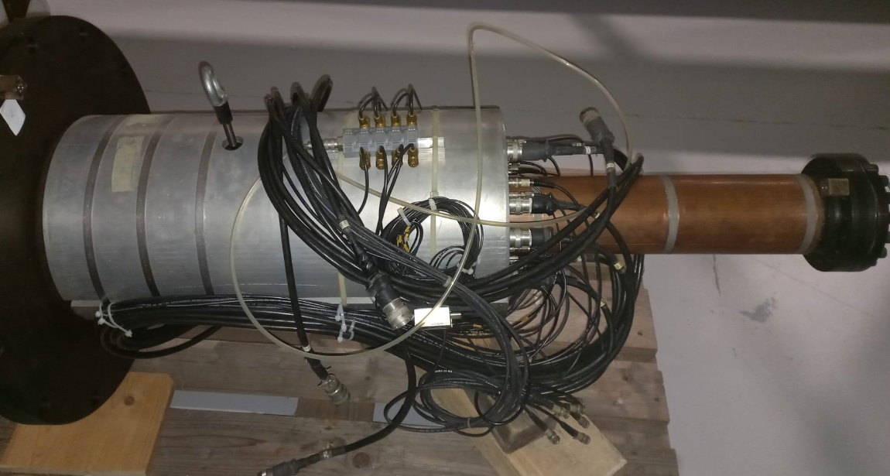
Photomultipliers and readout
The original Thorm EMI photomultipliers installed on the CEDARs are now over 40 years old and provisions should be made to replace them in the coming years
Some experiments such as Compass or NA62 have already consolidated or upgraded their light transmission system so similar work is due for the two remaining operational ones plus the new CEDAR-W and two spares
Finally, operational experience has also proved that, in order to properly power the Photomultipliers, new voltage dividers will be required to replace existing ones.
Resources for the consolidation of the CEDAR read-out have been allocated to renovate the control and acquisition electronics (SY-BI) and the CESAR Graphical User Interface (BE-CSS)
Only one spare would be completed in Phase I
Resources request | 2021 | 2022 | 2023 | 2024 | 2025 | 2026 | 2027 | 2028 | 2029 | 2030
Material PMTs [kCHF] |  |  | 15 |  |  |  |  | 30 | 30

Slide 11
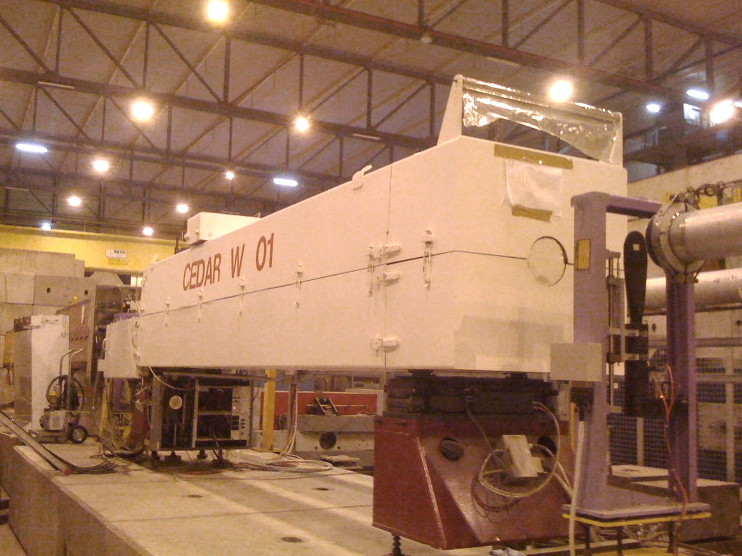
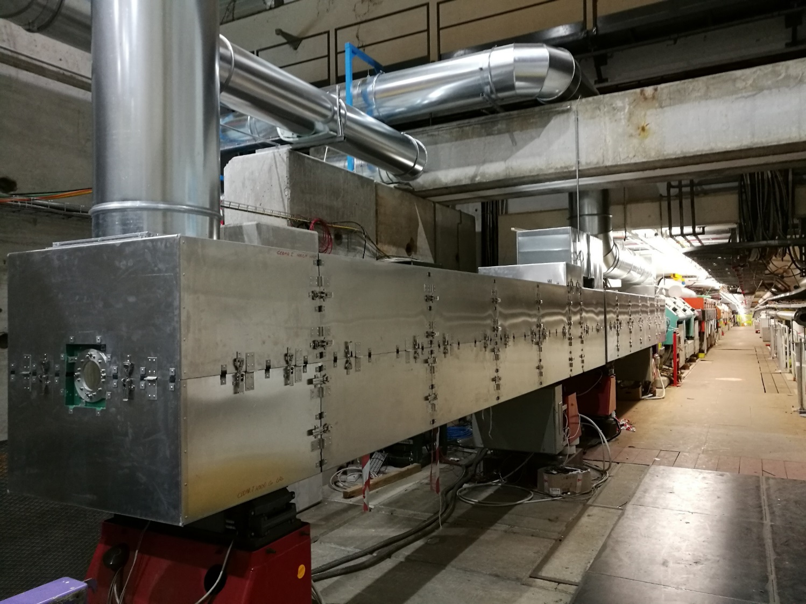
A thermal housing similar to that of COMPAS could be extended to all CEDARs
Stable temperature is key for a good separation efficiency
The original solution adopted for the thermal stabilisation of the CEDARs is based on a thick layer of polyurethane injected between the CEDAR tank and an external metallic box
This design has proven to fail meeting the requirements and is no longer compliant with CERN safety requirements
A new thermal housing based on high-performance Aerogel insulation like the one developed for the two in the COMPAS experiment but without active cooling could be extended to the remaining five detectors
Design work plus first thermal insulation for a prototype in Phase I would serve as pilot experience for the remaining four
Resources request | 2021 | 2022 | 2023 | 2024 | 2025 | 2026 | 2027 | 2028 | 2029 | 2030
Material thermal housing [kCHF] |  |  | 15 |  |  |  |  | 30 | 30
FSU thermal housing [kCHF] |  | 5 |  | 20 |  |  |  | 40 | 40

Slide 12
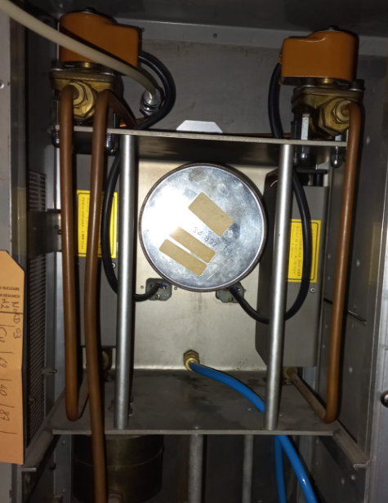
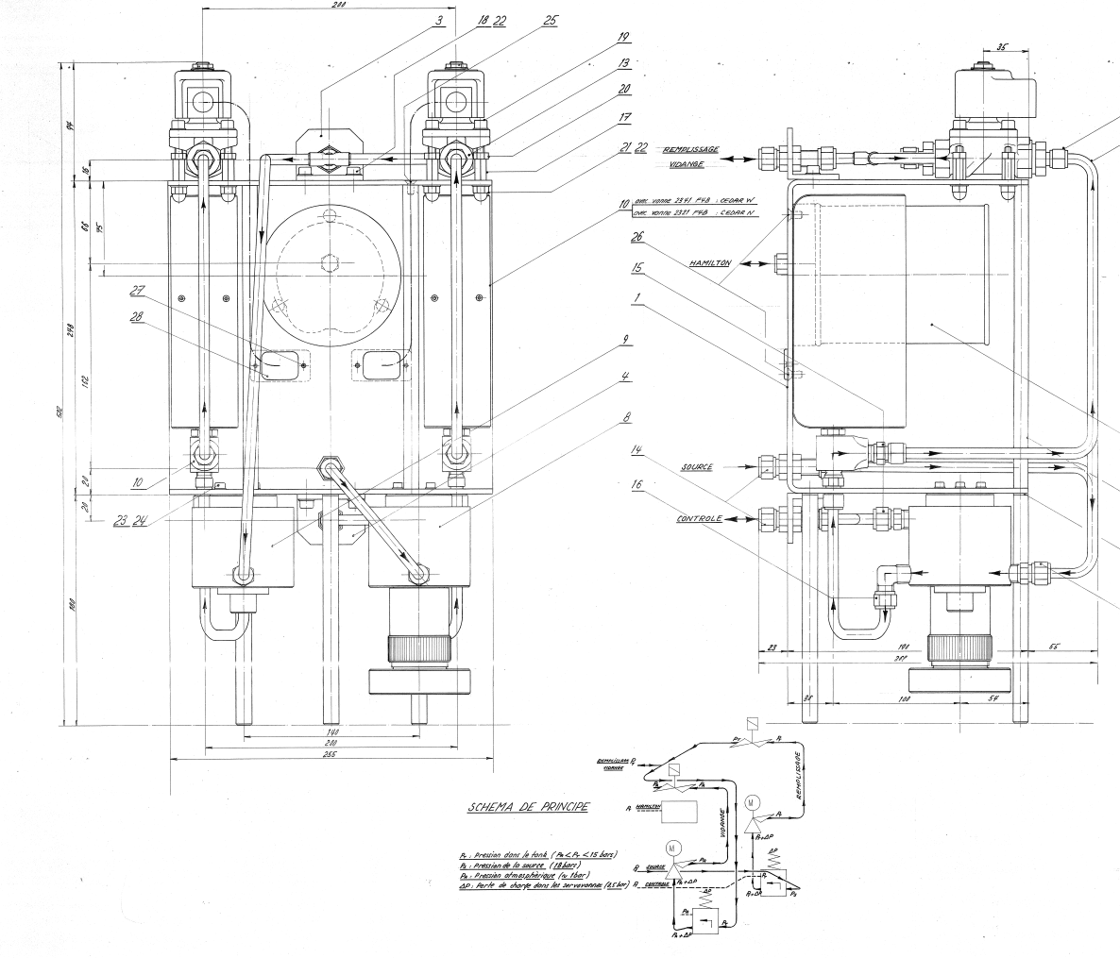
A gas control system based on modern standards could replace existing one
The gas systems for all the XCED detectors are obsolete. It is based on old and outdated technology that will need to be replaced
Foreseen solution is new gas panels and controls like the ones developed for the XCET for the Neutrino Platform or NA62 conforming with modern standards and compatible with larger-scale gas distribution consolidation of the North Area
Design work plus the first prototype would be executed in Phase I and followed by the remaining six in Phase II
Resources request | 2021 | 2022 | 2023 | 2024 | 2025 | 2026 | 2027 | 2028 | 2029 | 2030
Material Gas system [kCHF] |  |  |  | 20 |  |  |  | 40 | 40 | 40
FSU Gas system [kCHF] |  |  | 10

Slide 13
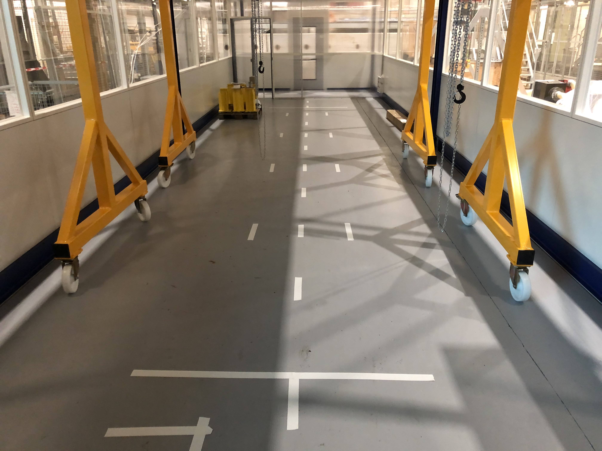
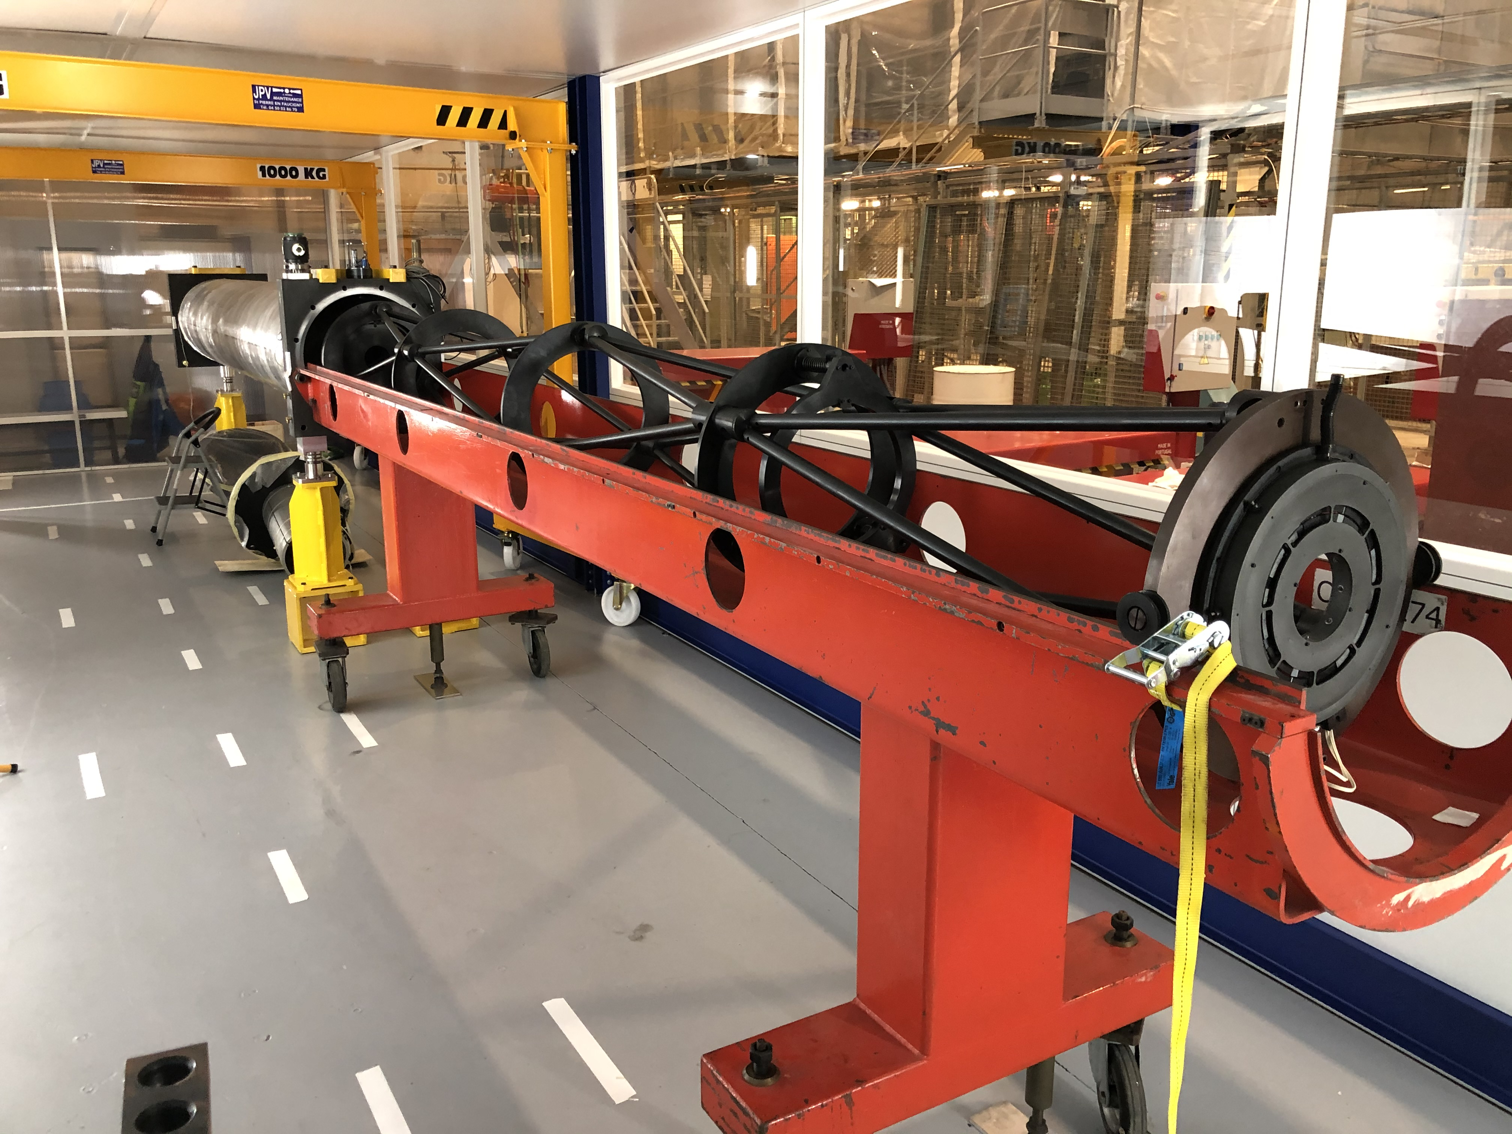
Grey room should be retrofitted in accordance with the scope of the program
The opening and replacement of the CEDAR optics will need to take place in a clean and controlled environment if the optical surface tolerances need to be preserved
A grey room has been set up in b.887 for this purpose and already used for the CEDAR-H of NA62 during 2020-2022
However, a major consolidation effort like the one described in this document will require some extra effort
A full test bench will be necessary to validate the new motor and controls for both diaphragm and feet. A minimum gas infrastructure will be also most likely needed for the design of the new gas panels and control systems and the room ventilation re-evaluated
Clean room garments as well as periodical cleaning services coherent with the overall consolidation strategy will be also needed
Resources request | 2021 | 2022 | 2023 | 2024 | 2025 | 2026 | 2027 | 2028 | 2029 | 2030
Grey room [kCHF] |  |  | 50 | 40
FSU grey room [kCHF] |  |  | 3 | 2 |  |  |  | 2 | 2 | 1

Slide 14
Grey room should be retrofitted in accordance with the scope of the program
A number of actions are proposed to consolidate the CEDAR counters, an important family of detectors used for the identification of particles in the secondary beams
This work package description focuses on the two CEDARs used by Compass and the two used by NA61 plus an additional CEDAR-W to cover increasing requests for H6, as well as two spares, a North and a West The proposed program is intertwined with two other efforts at CERN, namely, the production of a new CEDAR-H detector for NA62, and the consolidation of the North Experimental Area approved as of 2021.
The project is staged in two phases that run-in sync and partially share funding with those of NA-CONS, while also building upon the work done for the former
  In Phase I a spare CEDAR with an interchangeable set of optics will be produced to ensure minimum level of availability
  The request for NA-CONS concerns Phase 2, where the remaining five operational CEDARs as well as the second spare would be consolidated for a value of 545 kCHF. Compared to
compared to the 240kCHF of the original request EDMS 2206350
Requirement | 2020 | 2021 | 2022 | 2023 | 2024 | LS3 2025 2026 | 2027 | 2028 | 2029 | LS4 2030
Proposed installation schedule and duration |  |  | Complete CEDAR-N spare Set of optics for N and W spares 2 sets of feet |  |  |  |  | 2xCEDAR-W (spare and extra) | 2xCEDAR NA61 | 2xCEDAR Compass
Resources request | 2021 | 2022 | 2023 | 2024 | 2025 | 2026 | 2027 | 2028 | 2029 | 2030
TOTAL [kCHF] |  | 64 | 186 | 85 |  |  |  | 309 | 169 | 67

Slide 15

Thank you for your attention
Questions?

