Slide 1
Responsible Computing: the case of data privacy
Adam Smith
BU Computer Science/ECE/CDS
HDR Symposium Panel
October 25, 2022

Slide 2
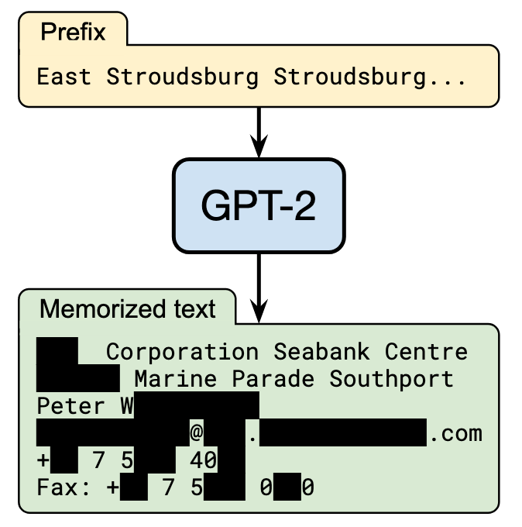
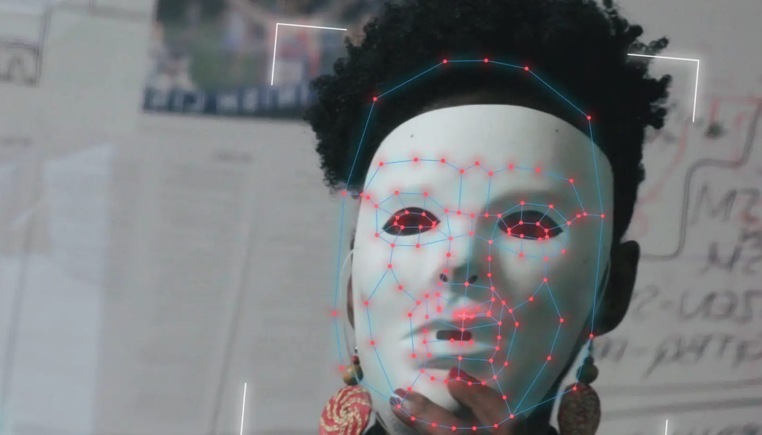

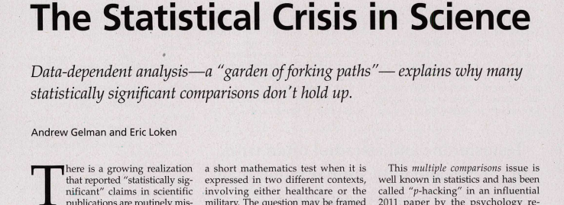
What is Responsible Computing?
“Gender Shades”: J. Buolamwini, T. Gebru. PMLR 81:77-91, 2018.
[Carlini et al. 20] Current language models memorize irrelevant information.
The “garden of forking paths”. Gelman and Loken, American Scientist, 2014
GDPR’s “Right to be Forgotten”
[Costeja González v. Google, 2014]
Notes:
What is responsible computing? Easiest to think in terms of failures

Slide 3
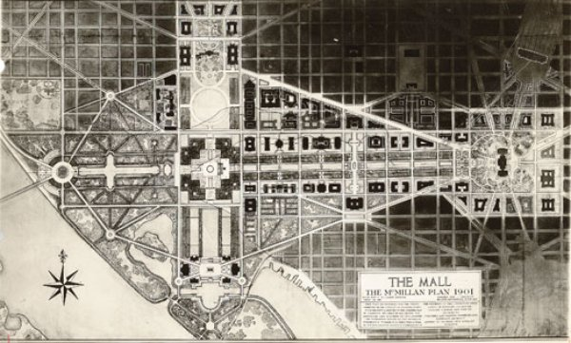
What is Responsible Computing?
Common thread:
Failure to engineer for the whole use case
true
while (system is evolving):
  Understand how data-driven systems operate in context
    How they affect people
  Formulate intermediate goals
  that align with final use
  Develop technical tools
https://thumbs-media.smithsonianmag.com/filer/brief-lenfant-2.jpg__600x0_q85_upscale.jpg

Slide 4

Privacy in Statistical Databases
Individuals
Researchers
queries
“Agency”
answers
Large collections of personal information
census data
medical/public health
social networks
education
system usage
Goal: Rigorous foundations and analysis
Accuracy
Privacy
Notes:
This talk is about mostly about privacy. Privacy can mean many things.
I’ll talk about privacy in statistical databases. A good example to have in mind is the problem faced by the Census.
Imagine you have a server or agency---say the US Census bureau---that collects data from many individuals, and would like to make that data available, to the extent possible, for analysis by researchers.
The census can’t just publish its data – it is bound to keep responses confidential.
Collections of personal information are now ubiquitous.
Benefits to society to mining and having access to this data,
especially in *aggregate*.
But what makes these data valuable is exactly what makes them sensitive, namely that they reveal many details about our lives.
So we really have a tension between two fundamental goals.

Slide 5
This talk
Why is privacy challenging?
  Memorization in machine learning
  [Brown, Bun, Feldman, S., Talwar 2021]
Differential Privacy [Dwork, McSherry, Nissim, S., 2006]
  “Privacy” as stability to small changes
  Widely studied and deployed

Slide 6
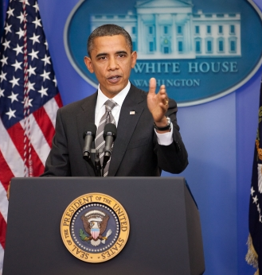
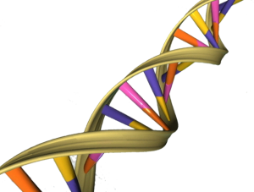
First attempt: Remove obvious identifiers
“AI recognizes blurred faces”
[McPherson Shokri Shmatikov ’16]
Name:
Ethnicity:
[Gymrek McGuire Golan
Halperin Erlich ’13]
[Pandurangan ‘14]
Everything is an identifier
Hospital A
Anonymize
Attacker
Hospital B
Anonymize
[Ganta Kasiviswanathan S ’08]
Images: whitehouse.gov, genesandhealth.org, medium.com

Slide 7
Is the problem granularity?
What if we only release aggregate information?
Statistics together may encode data
Example: Average salary before/after resignation
More generally:
Too many, “too accurate” statistics
reveal individual information
  Reconstruction attacks [Dinur Nissim 2003, …]
  Membership attacks [Homer et al, 2008, …]
  Memorization [this talk]
Cannot release everything everyone would want to know

Slide 8
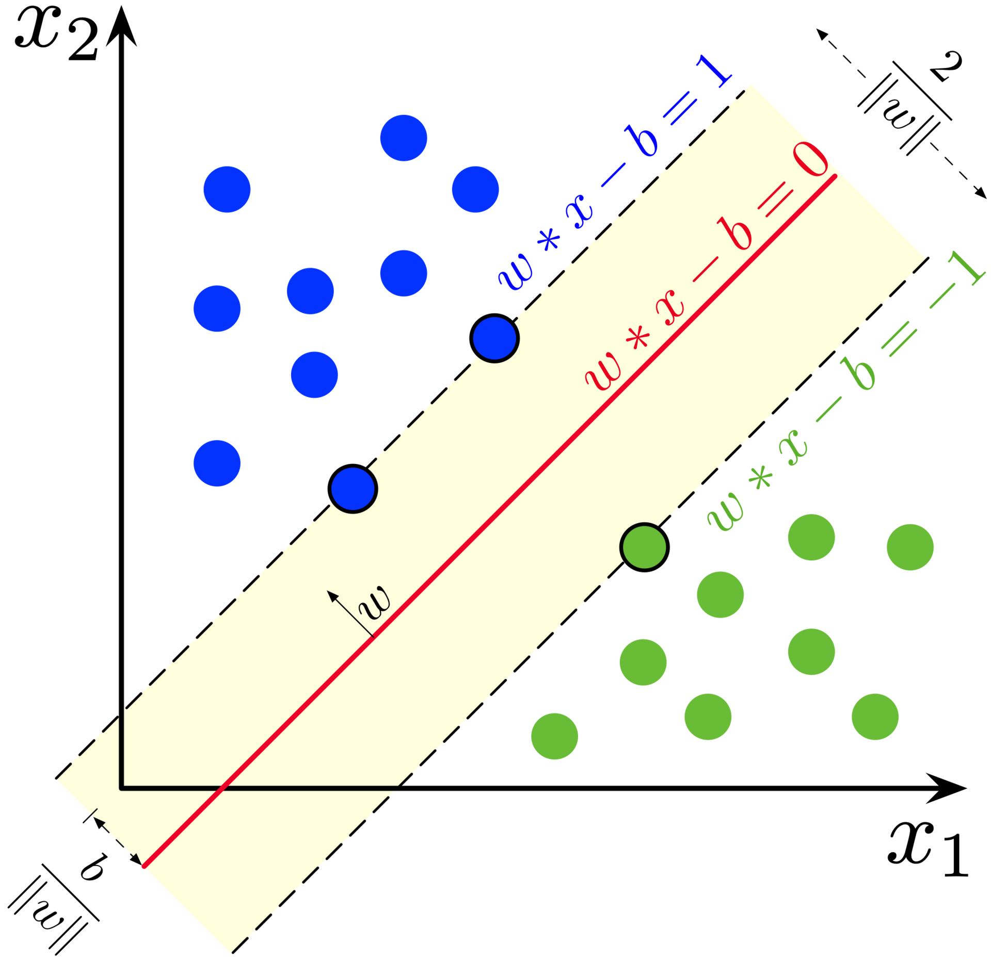
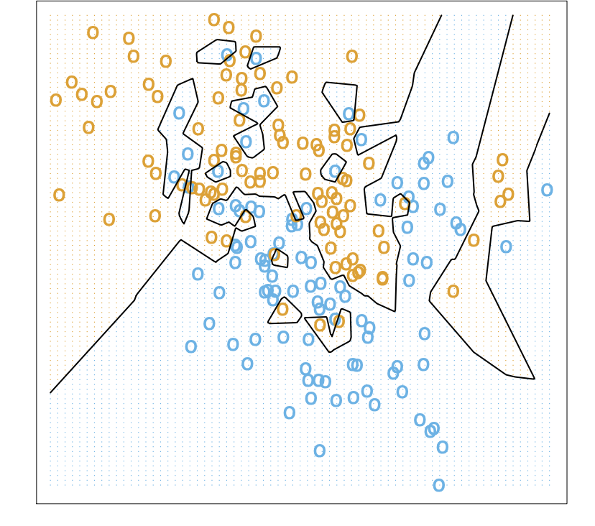
Memorization can be explicit…
Hastie, Tibshirani, and Friedman. The elements of statistical learning: data mining, inference, and prediction. Springer Science & Business Media, 2009.
Wikipedia, Support vector machine (20 August 2020)
Notes:
Now, memorization of training examples is often explicit and done by design
For instance, the natural description of a nearest-neighbor classifier is in fact the entire data set in the clear.
More complex models are also sometimes described in terms of data points. For example, the dual form of a support vector machine reveals several exact feature vectors, and its normal to present it in terms of those vectors.

Slide 9
… but commonly an unintended side effect
[Carlini et al. 20]
Current language models memorize irrelevant information.
Notes:
But research over the last few years has shown that memorization often happens unintentionally, as a side effect of specific strategies.
For example, Carlini et al. showed how current sentence completion models memorize exact phrases from their input texts, even when it’s a clear to a human—who has a little more context—that the phrases are irrelevant to general language understanding.
The phenomenon was illustrated by this well-known XKCD cartoon, in which a secret meeting of revolutionaries is discovered using Smart Compose.

Slide 10
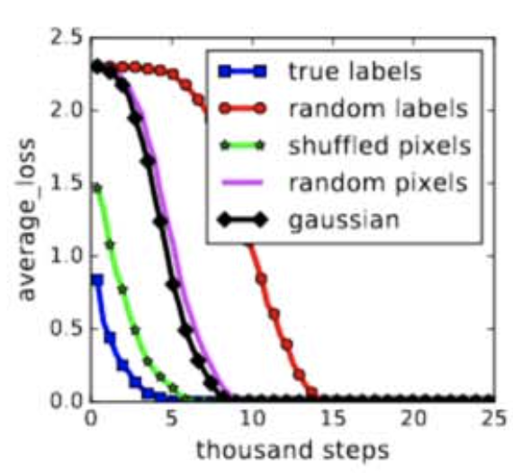
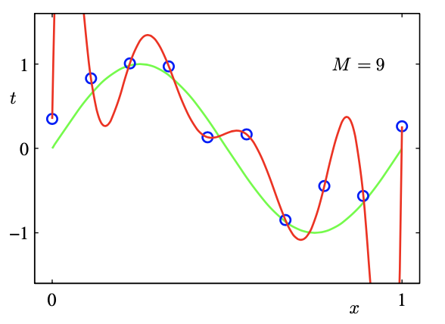
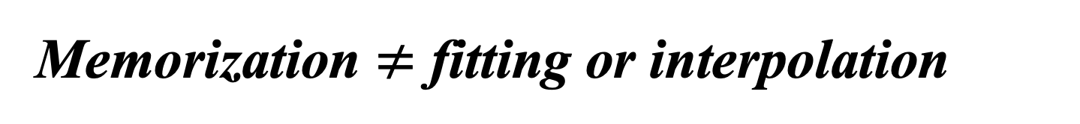
Memorization $≠$ fitting or interpolation
Data
Labels
Prior work: storing the labels you’ve seen
Zhang, Chiyuan, et al. "Understanding deep learning requires rethinking generalization." arXiv preprint arXiv:1611.03530 (2016)
Our work: memorizing examples
Christopher Bishop, “Pattern Recognition and Machine Learning,” 2006
Notes:
Related question that is better understood has to do with overfitting
Classic theory tells us that we should avoid overfitting to training data, since that will lead to bad generalization error
But we now know lots of settings where perfect fitting—where our model predicts all the training labels exactly—appears to be beneficial.
In fact, my collaborator Vitaly Feldman recently showed natural settings where perfect fitting is necessary for good performance regardless of the training algorithm.
In contrast, we look at settings where entire examples are memorized, even irrelevant details.

Slide 11


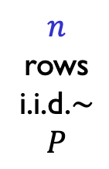


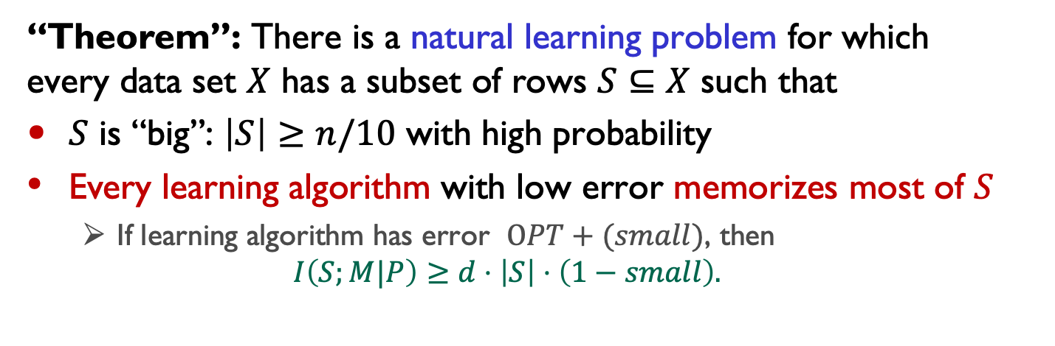

Memorization Can be Necessary
[Brown, Bun, Feldman, S, Talwar STOC 21]
Labels
test datum $Y$
$n$ rows
i.i.d.$∼P$
Data $X$
correct/incorrect
Learning Algorithm
Classifier $M$
$$S$$
$d$ bits/row
Special, vulnerable examples
“Theorem”: There is a natural learning problem for which
every data set $X$ has a subset of rows $S⊆X$ such that
$S$ is “big”: $\left|S\right|≥n/10$ with high probability
Every learning algorithm with low error memorizes most of $S$
  If learning algorithm has error $OPT+(small)$, then
  $I\left(S;M|P\right)≥d⋅\left|S\right|⋅\left(1−small\right).$
Notes:
Now, to really specify the result, we need to talk about what the learning algorithm knows.
If it knew a full description of the distribution P on labeled examples, then it could ignore the data entirely, and produce a classifier that reveals nothing about X.
What we give is a meta-distribution on P, such that
On one hand, S has lots of entropy even conditioned on a full description of P. That is, there is lots of irrelevant information in S
Every learning algorithm with low error must produce a classifier that reveals almost all of that information. This is true both for an uninformed attacker that doesn’t know P, and for one that already knows a complete description of P.
In other words, M stores everything about S even when much of that is ultimately not relevant.

Slide 12
Understanding good generalization
Common explanations for large models
Expressivity
Optimization is easier
Implicit regularization leads to good generalization
Large models store information whose usefulness isn’t yet “understood”
  Small subpopulations
  Adapting to new domains
Our results suggest an additional factor:

Slide 13
This talk
Why is privacy challenging?
  Memorization in machine learning
  [Brown, Bun, Feldman, S., Talwar 2021]
Differential Privacy [Dwork, McSherry, Nissim, S., 2006]
  “Privacy” as stability to small changes
  Widely studied and deployed

Slide 14
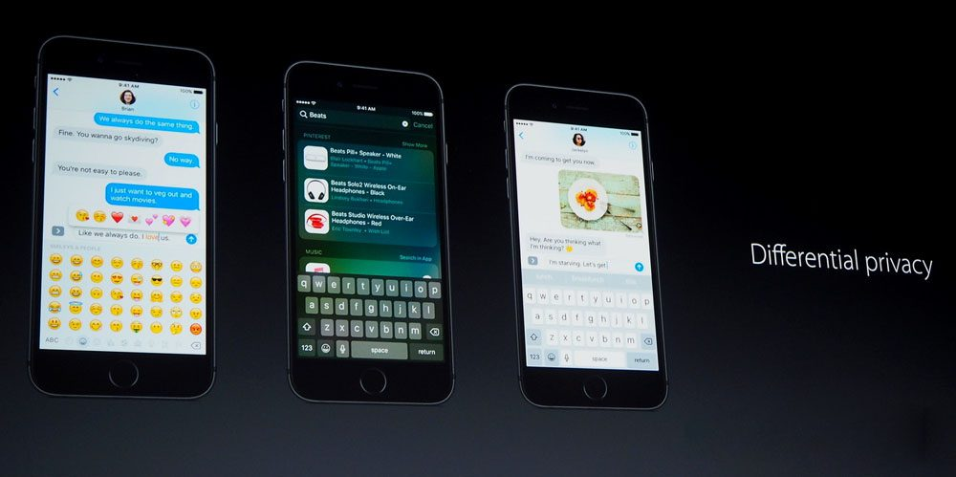

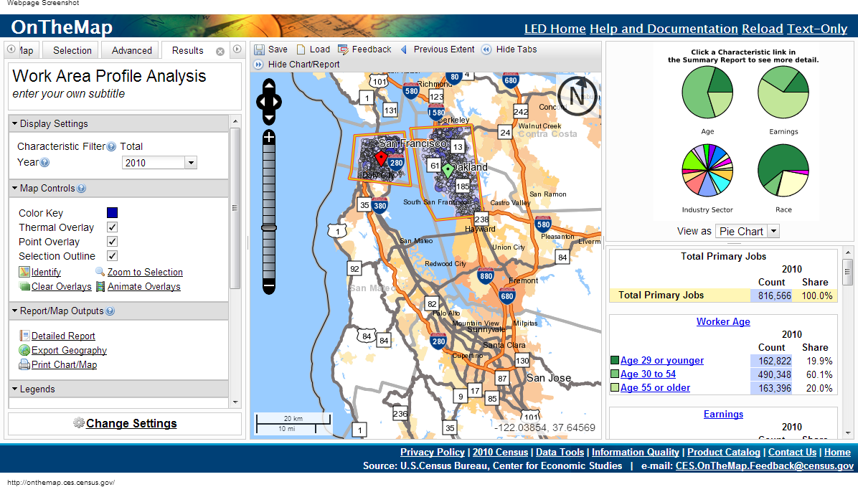
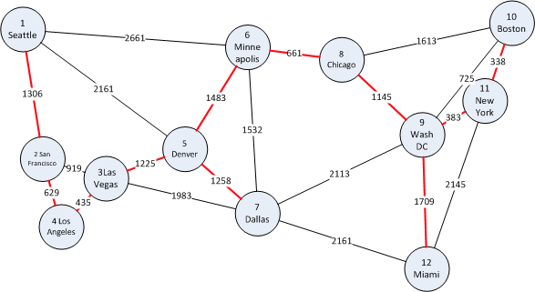
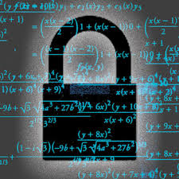
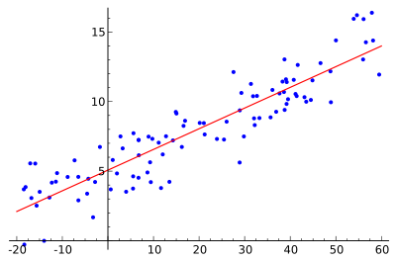
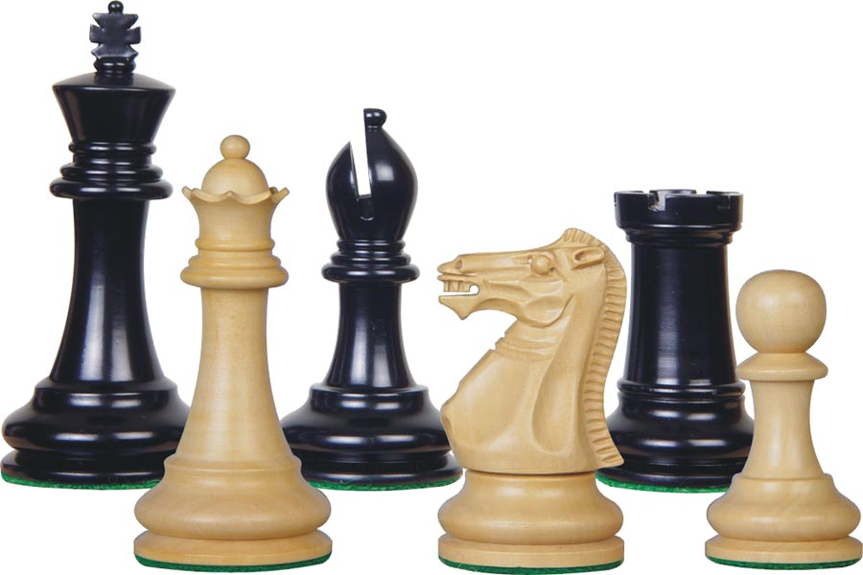
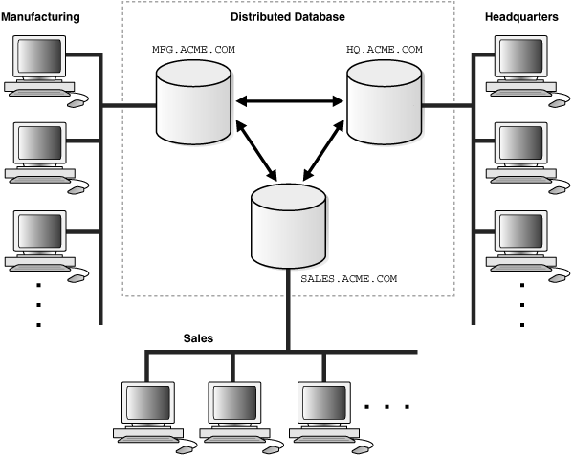
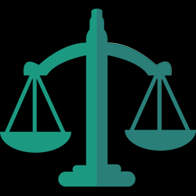
Differential Privacy [Dwork, McSherry, Nissim, S., 2006]
Many current deployments
Burgeoning field of research
Apple
Google
US Census
Crypto,
security
Statistics,
learning
Game theory,
economics
Databases,
programming
languages
Law,
policy
Algorithms

Slide 15

Differential Privacy [Dwork, McSherry, Nissim, S., 2006]
A
A(x)
A
A(x’)
local random coins
local random coins
A thought experiment
  Change one person’s data (or add or remove them)
  Will the distribution of outputs change much?
For any set of outcomes, about the same probability in both worlds

Slide 16

Research on differential privacy
Definitions
  Pinning down “privacy”
Algorithms: what can we compute privately?
  Fundamental techniques
  Specific applications
Attacks: “Cryptanalysis” for data privacy
  Impossibility results
Implications for other areas
  Interactive machine learning and statistical analysis
Notes:
One of the most striking aspects of a academic career is the feeling that “I can’t believe people actually pay me to do this”. So here are a few organizations that support my research.

Slide 17
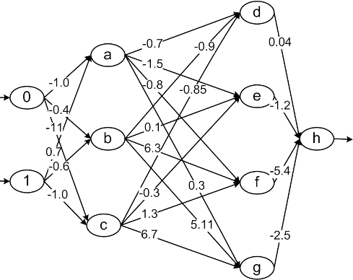

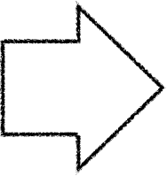




Frontier: Deep Learning with DP
McSherry Williams 09,
Chaudhuri, Song, Sarwate 13,
Bassily, S., Thakurta 2014,
Abadi et al 2016, …
Parameters
Sensitive Data
Deep Learning
Thought of as private now, but better to reason as if public
Revealed now, but should be hidden
Model
Example: https://github.com/tensorflow/privacy

Slide 18
Frontier: Deep Learning with DP
Main technique
Noisy SGD
Challenges
Tools for inference
  Constraints complicate
  interpretation
Computational advances
  How best to leverage huge advances in optimization?
  (Often privacy requires convergence)
Tighter analysis of privacy (and other) properties
General-purpose algorithms

Slide 19
What are we missing?
Technical principles for personal ownership of personal data
  What does it mean to control use?
Whom do privacy technologies empower?
  Big tech?
Painless processes for tech-policy dialogue
  (I don’t want to read your court opinions, and
  you don’t want to read my papers.)

