Slide 1

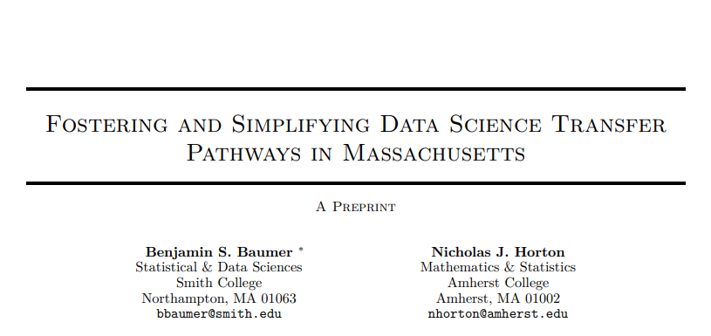
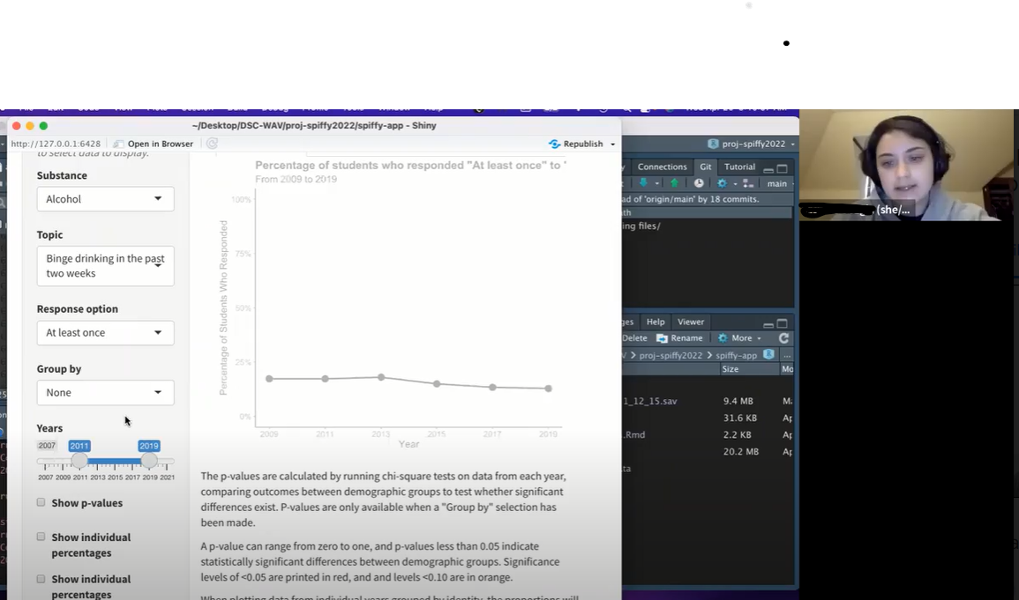
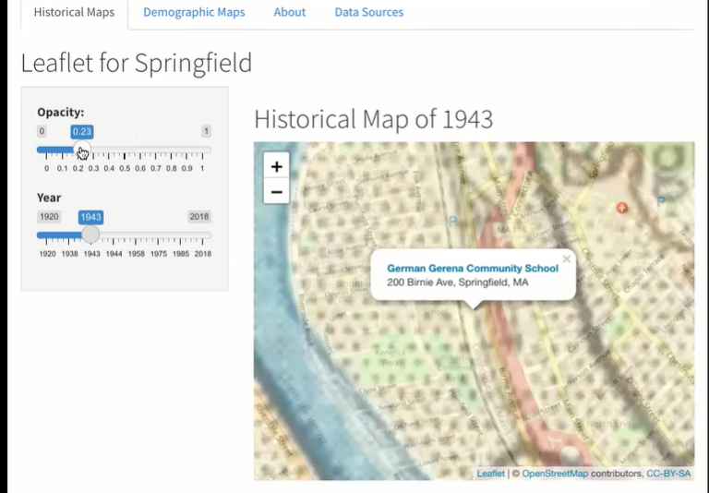
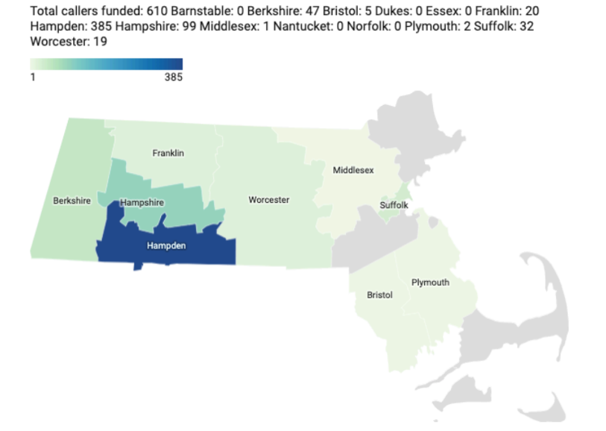
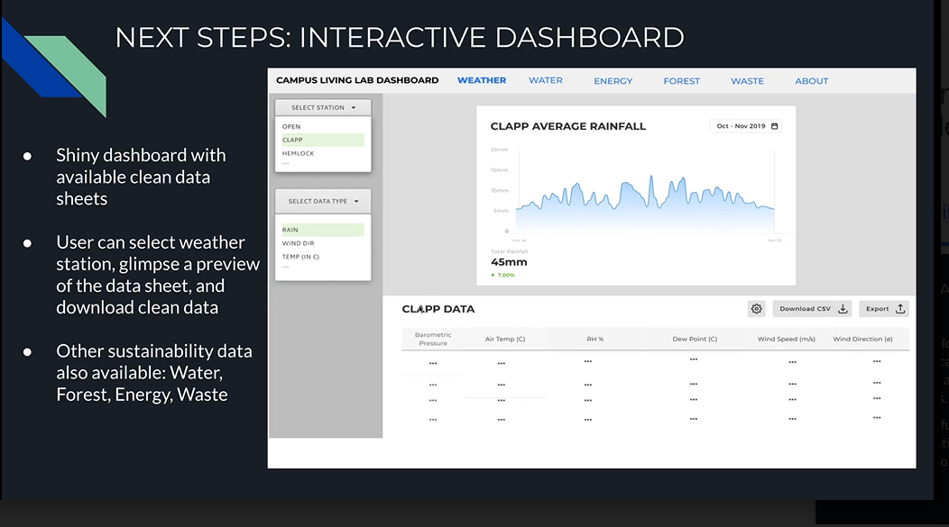
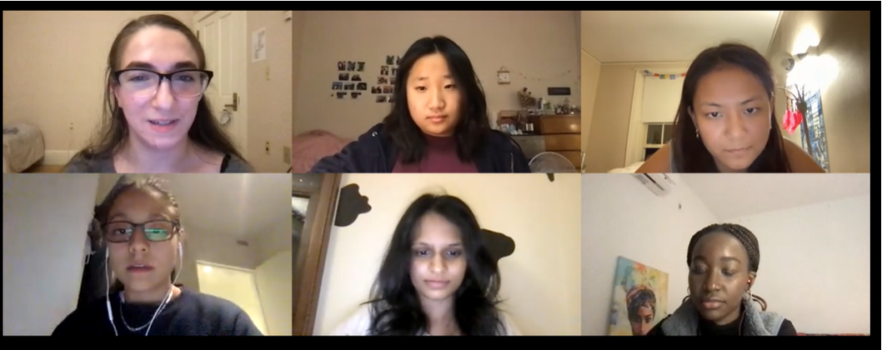


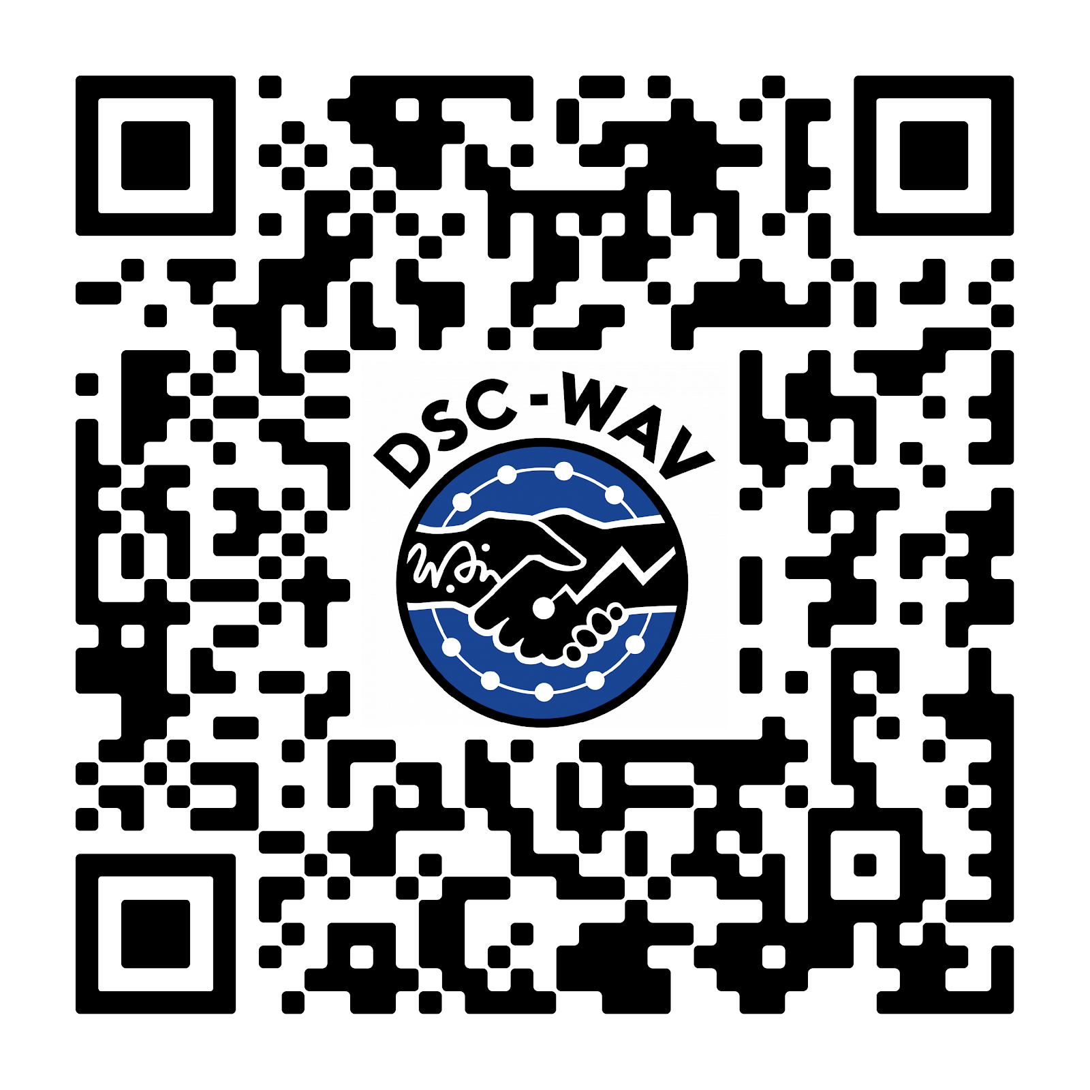
Goal #1
Students teams work with real clients to gain experience with collaboration, code review, version control, and communicating results of data science projects
Goal #2
Establish formal, transparent pathways in data science from community colleges to four-year programs, in order to diversify the data science workforce.
Data Science Corps: Wrangle, Analyze, Visualize – Experiential Learning in Local Community Organizations
Presenter: Valerie Barr, Bard College (co-PI), Principal Investigator: Benjamin S Baumer, Smith College
Co-Principal Investigators:
Nicholas J Horton, Amherst College; Randi L Garcia, Smith College; Jaime Davila, Hampshire College; Matthew Rattigan, University of Massachusetts, Amherst; Ileana Vasu, Holyoke Community College; Brian Candido, Springfield Technical Community College
Progress on Goal #1
Students learn and use:
Scrum methodology to foster collaboration, self governance, accountability, and process improvement.
Slack for transparent, asynchronous communication to foster inclusion.
GitHub protocols for committing and reviewing code, developing the understanding that code is “our code, not my code;” track team work using Issues or Kanban.
To run these teams:
Finding great community partners Ideally, partners have access to lots of data; a clear question or project related to the data; and a person on staff who both wants to work with a student team and has experience working with data themselves, to help shape the product and re-direct the effort if necessary.
Begin with a well-defined project We harness team energy & good intentions, support their productivity by cultivating an experience that lets them struggle—successfully – helping to envision a project outcome they can successfully accomplish.
Faculty need time to support these teams – more time than we anticipated. Faculty availability and involvement keeps students engaged.
Cohort 6 has just begun with three teams working at UMASS-Amherst, Bard College, Smith College, and Cohort 7 planning is underway.
Smith College is using this model to develop a course that would give
Progress on Goal #2
Defined pathways from community colleges to four-year programs in data science determine whether students in Massachusetts, who begin at community college, will have any access to the growing number of data science jobs in the United States
Only one MA public university has a data science bachelor degree program, and no community colleges have a transfer agreement into it. We are working to:
formalize one transfer agreement from a community college, establish a clear prototype that other schools could follow, clear pathway for any student
persuade the MA Board of Higher Education to include “data science” as a field of study transfer students can explore on the A2B website as a first step to broadening access to the field.
Existing community college faculty must be trained to teach data science courses
DSC-WAV offered professional development workshops (2021, 2022), preparing community college faculty to teach introductory data science
Community colleges do not yet offer an introductory data science course that is transferrable for credit equivalent to one taken at University of Massachusetts
Introduction to Data Science course being taught at Holyoke Community College by DSC-WAV workshop participant, with support from DSC-WAV grant.
Springfield Technical Community College is developing a data science program through its Computer Information Technology department. Several faculty workshop participants came from STCC.
Baumer and Horton authored a whitepaper for the MA Board of Higher Education outlining points of curricular friction, with recommendations for fostering and simplifying data science transfer pathways.
The DSC-WAV Data Science Symposium brought together public institution administrative leaders and faculty who could potentially open access to the field of data science.
Smith College is using this model to develop a course that would give students exposure to a variety of non-profit consulting roles for Fall 2023.
If we do not make diversity and inclusion a priority now, we will not have it in the future.
--Broadening Data Science Education (Rawlings-Goss et al. 2018)
This material is based upon work supported by the National Science Foundation under Grant Numbers HDR DSC 1924017, 1923388, 1923700, 1923934, and 1924032. Any opinions, findings, and conclusions or recommendations expressed in this material are those of the author(s) and do not necessarily reflect the views of the National Science Foundation.
Notes:
Notes:
In Powerpoint, click View > Guides
Keep text within gutter guides.
Author list: Don’t split names onto two lines (e.g., “Jimmy [break] Smith”). If that happens, use a new line, unless you need the space. Bold the first names of anybody who’s presenting in person.
Intro/methods/result: Do not drop below font size 28, but if you have extra space, jack up the font size until the space is full.
Do not use color in the sidebars except in graphs/figures. It’ll pull attention from the center and slow interpretation for passersby.

