Slide 1
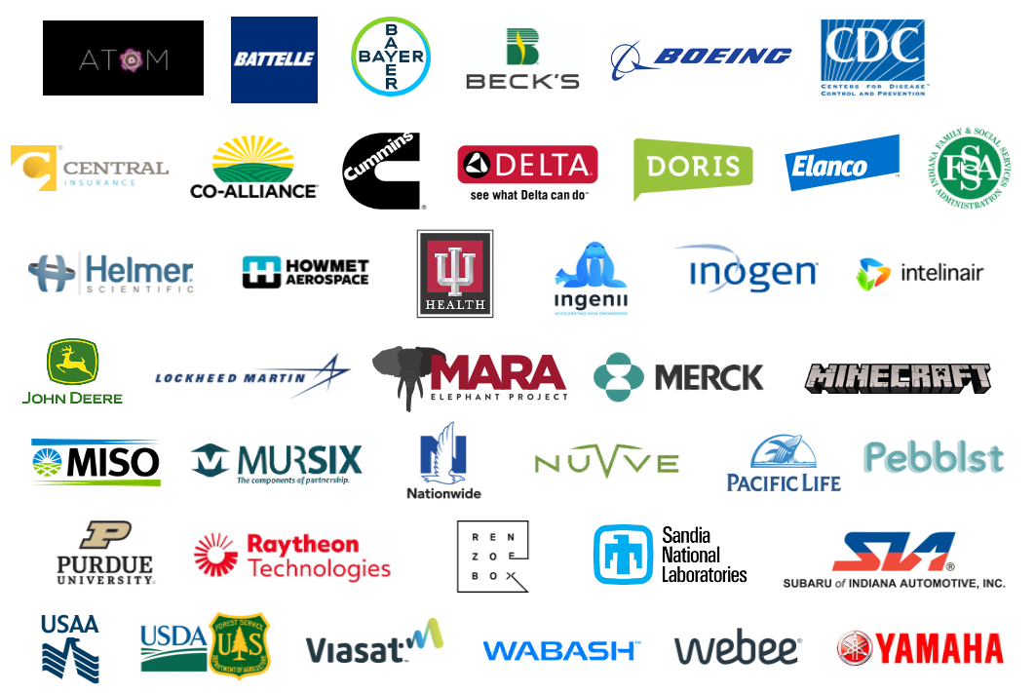
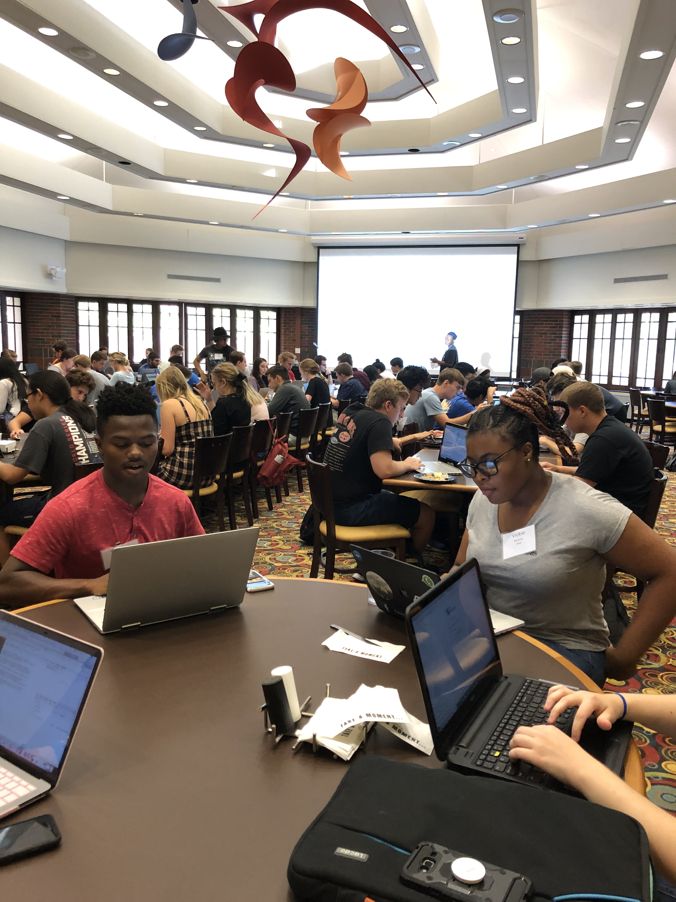
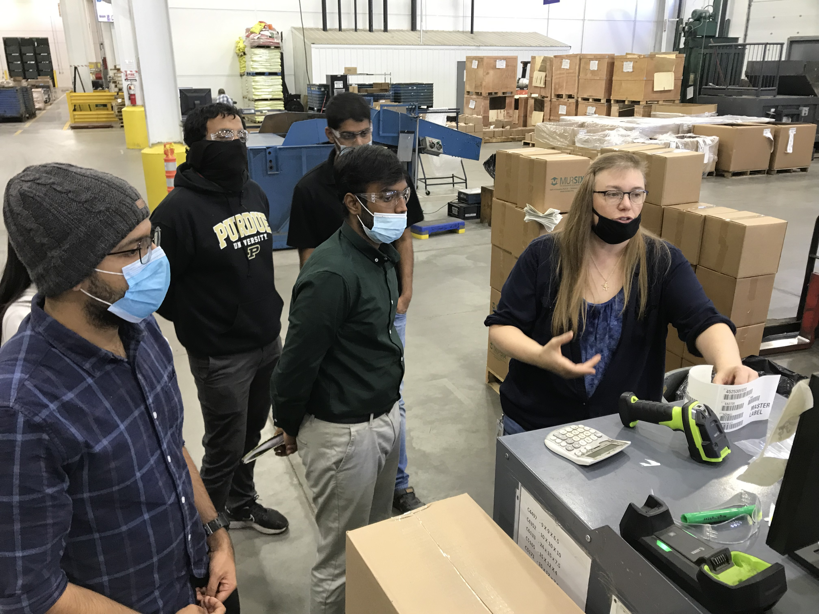
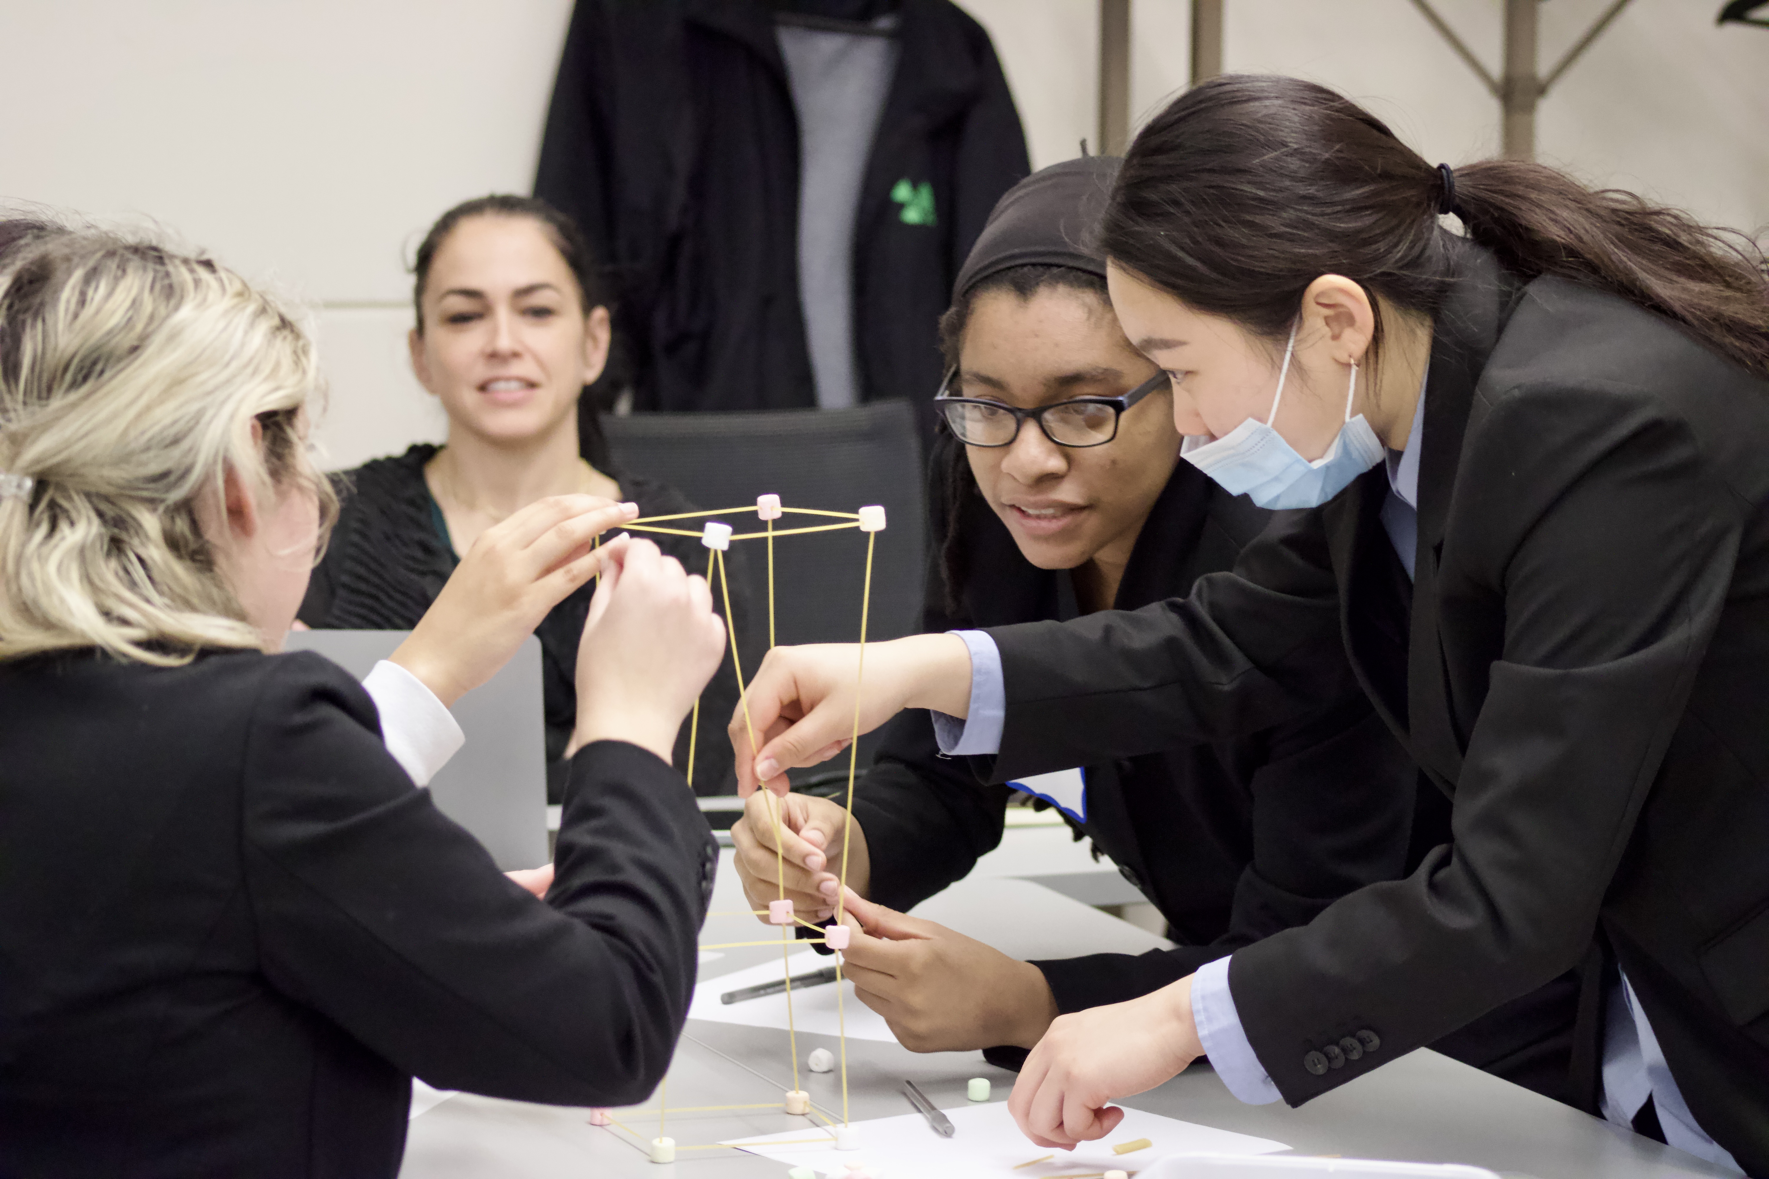
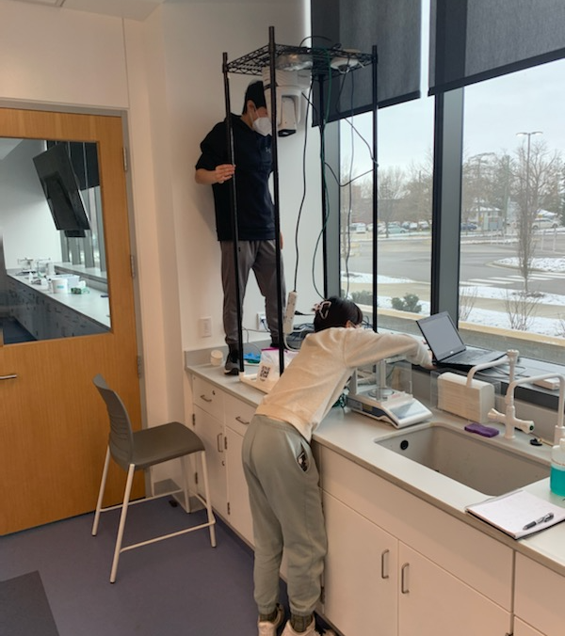
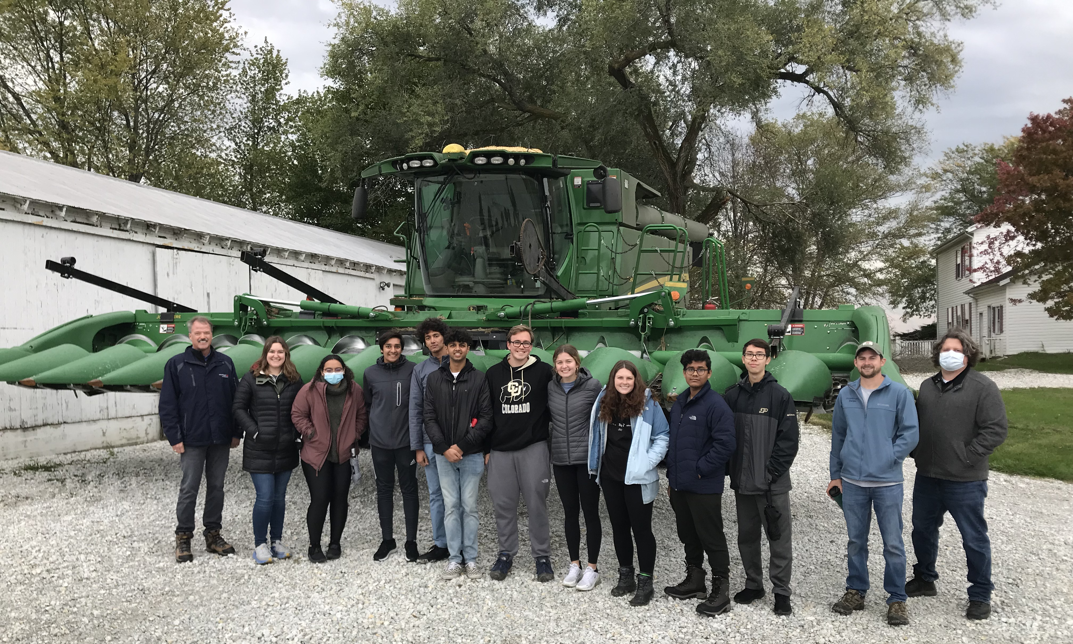
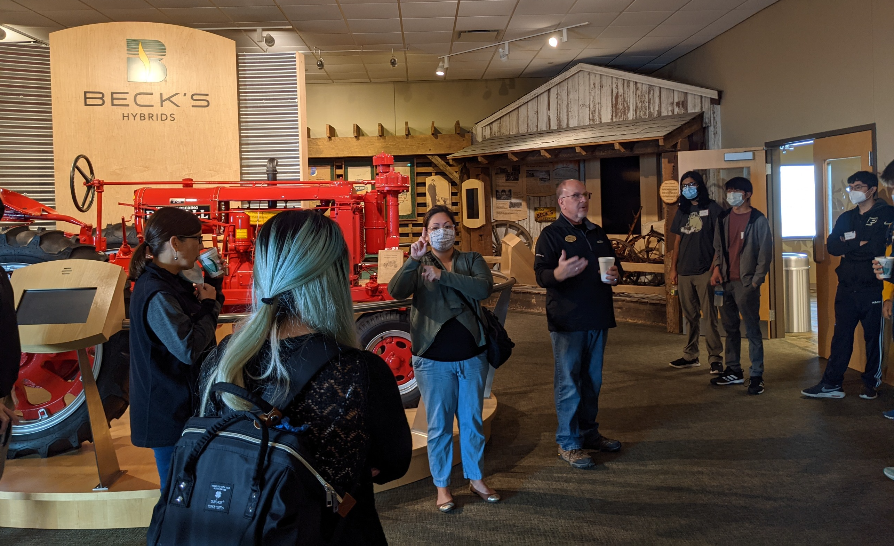
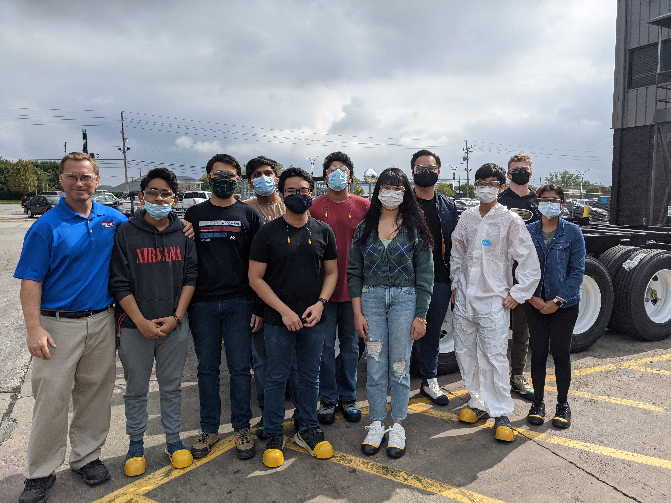
The Data Mine
Experiential Industry Practicums in Data Science
ABOUT THE DATA MINE
Corporate Partners
Residential, experiential learning community
Data Science for All
At West Lafayette Campus:
    133 majors represented
    30% female
    ~800 students in AY 2021-22
    ~1,300 students for AY 2022-23
        ~100 students at MSIs
        ~100 graduate students
    13 Learning Communities
Undergraduate and graduate students from all majors and computing backgrounds work in teams directly with partners in industry
Teams of 5-15 students collaborate on data intensive projects via experiential learning
    “We’re designing something our Corporate Partner will use! And we get to name it! It’s a unique opportunity and I am grateful for the experience of working on something [company] will likely use often.” ~student
Students are mentored by industry professionals during weekly team meetings
Teams are led by a paid team leader (typically an undergraduate student)
Students earn 3 credit hours per semester and spend 8-10 hours per week working on the projects
Projects last the entire academic year (August – May)
~70 projects in AY 2022-23 covering many domains:
    Digital agriculture
    Aerospace
    Manufacturing
    Life sciences
    Technology
    Finance
All projects conclude with a poster presentation at The Data Mine Corporate Partners Symposium: datamine.purdue.edu/symposium
“It’s literally like working with colleagues when working with you [students] – your ideas are so great, your thought processes are so wise.” ~Corporate Partner Mentor
SEMINAR (1 CREDIT)
1 credit hour per semester
8 levels (4 years)
All content in The Examples Book
    Publicly available at the-examples-book.com
R, Python, SQL, bash, HPC, TB of data
STUDENT QUOTES
“The research project with The Data Mine has no doubt been the highlight of my undergraduate career here at Purdue. ” ~senior
“One thing that has surprised me about the Data Mine Corporate Partners is how approachable everyone is. People are very knowledgeable and well informed. I can tell it’s a community that fosters growth and support; providing insight and understanding to the inner workings of an aerospace company.” ~student
“I had the chance to interact with multiple teammates, iterate over instances …, and develop testing mechanisms. …this project was a holistic learning experience for me.” ~student
The Data Mine Seminar (Fall 2019)
Students visit Mursix in Yorktown, IN
(Fall 2021)
Students during group interviews for TA positions
(Spring 2022)
Merck students set up video equipment (Spring 2022)
GRANTS
RESOURCES & MEDIA
$10 million Lilly Endowment grant for expansion within Indiana
$1.5 million NSF grant for MSI students nationwide
Additional Grants
  National Science Foundation (NSF) grants 0939370, 1246818, 2005632, 2118329, 2123321)
  Foundation for Food and Agriculture Research (FFAR) grant 534662
  National Institute of Food and Agriculture (NIFA) grants 2019-67032-29077 and 2020-70003-32299
  Sandia National Laboratories; Society Of Actuaries grant 19111857
  Cummins Inc. grants for the Indiana Digital Crossroads
Homepage: datamine.purdue.edu
Email: datamine@purdue.edu
The Examples Book: the-examples-book.com
Introducing The Data Mine video: https://youtu.be/R_kqpIMyhR4
Statewide Lilly Endowment grant in IN: www.purdue.edu/newsroom/releases/2021/Q2/purdue-to-launch-indiana-digital-crossroads-with-10-million-grant-from-lilly-endowment.html
NSF Grant for MSIs: https://beta.nsf.gov/science-matters/developing-21st-century-data-science-workforce
Halderman students visit local farm
(Fall 2021)
Students visit Beck’s Hybrids in Atlanta, IN
(Fall 2021)
Students visit Wabash in Lafayette, IN
(Fall 2021)
Notes:
3 iPads – video on repeat, The Examples Book, Symposium webpage for posters

