Slide 1
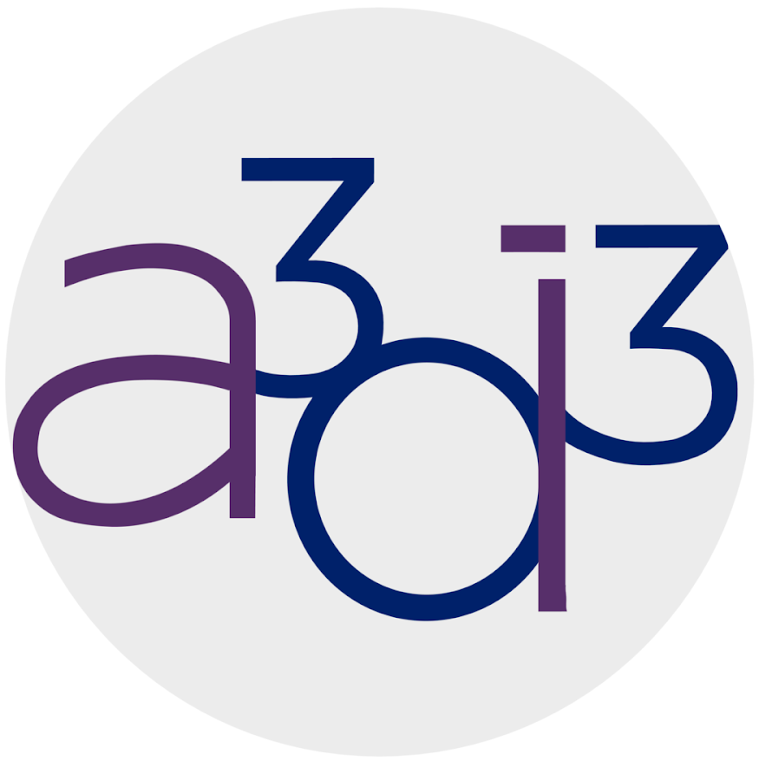
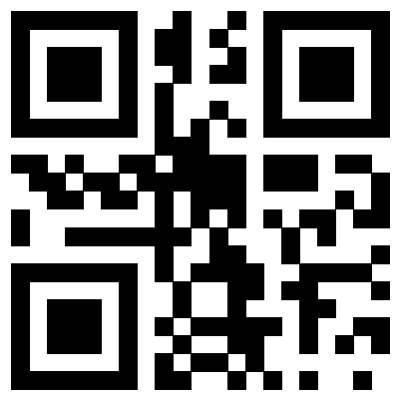
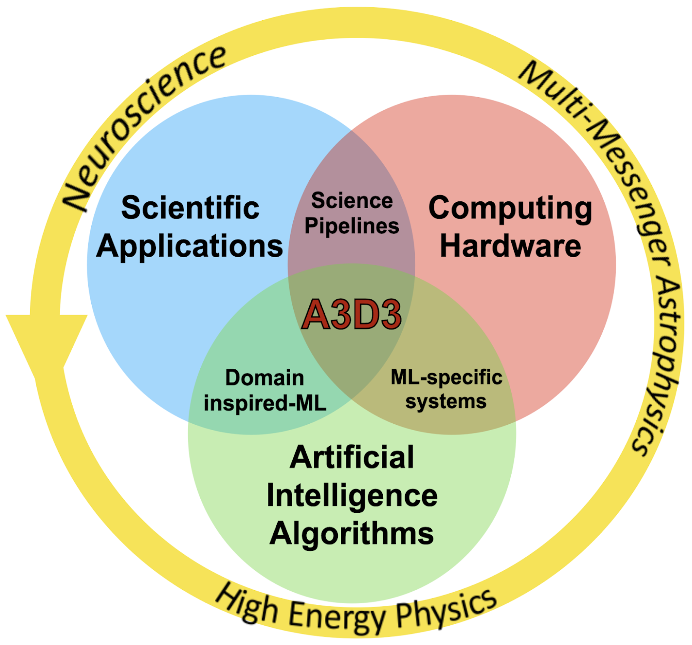
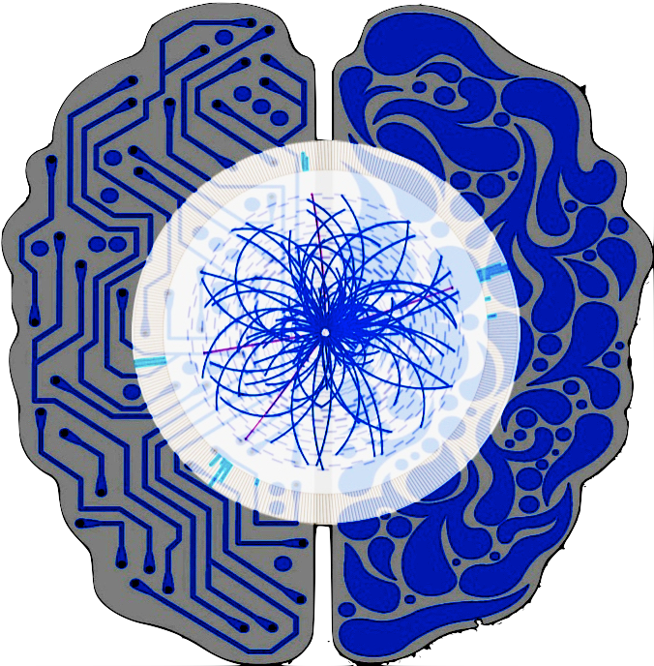
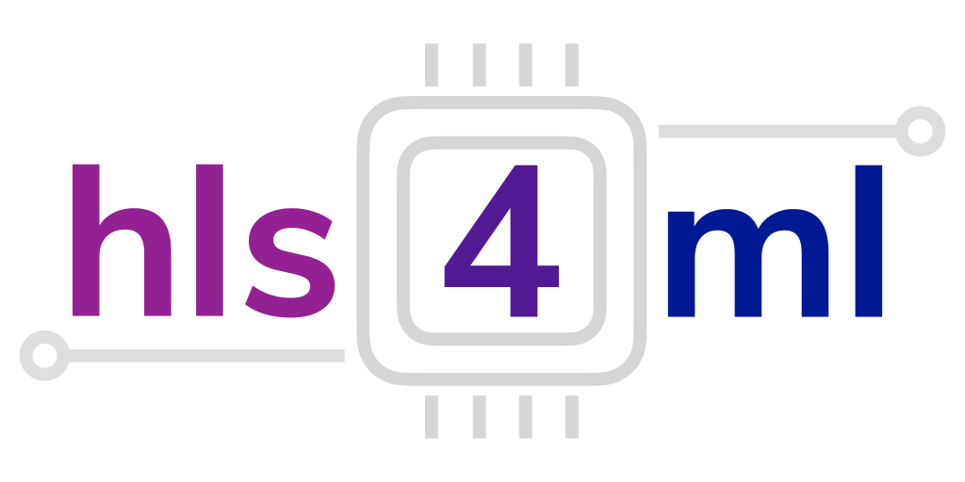









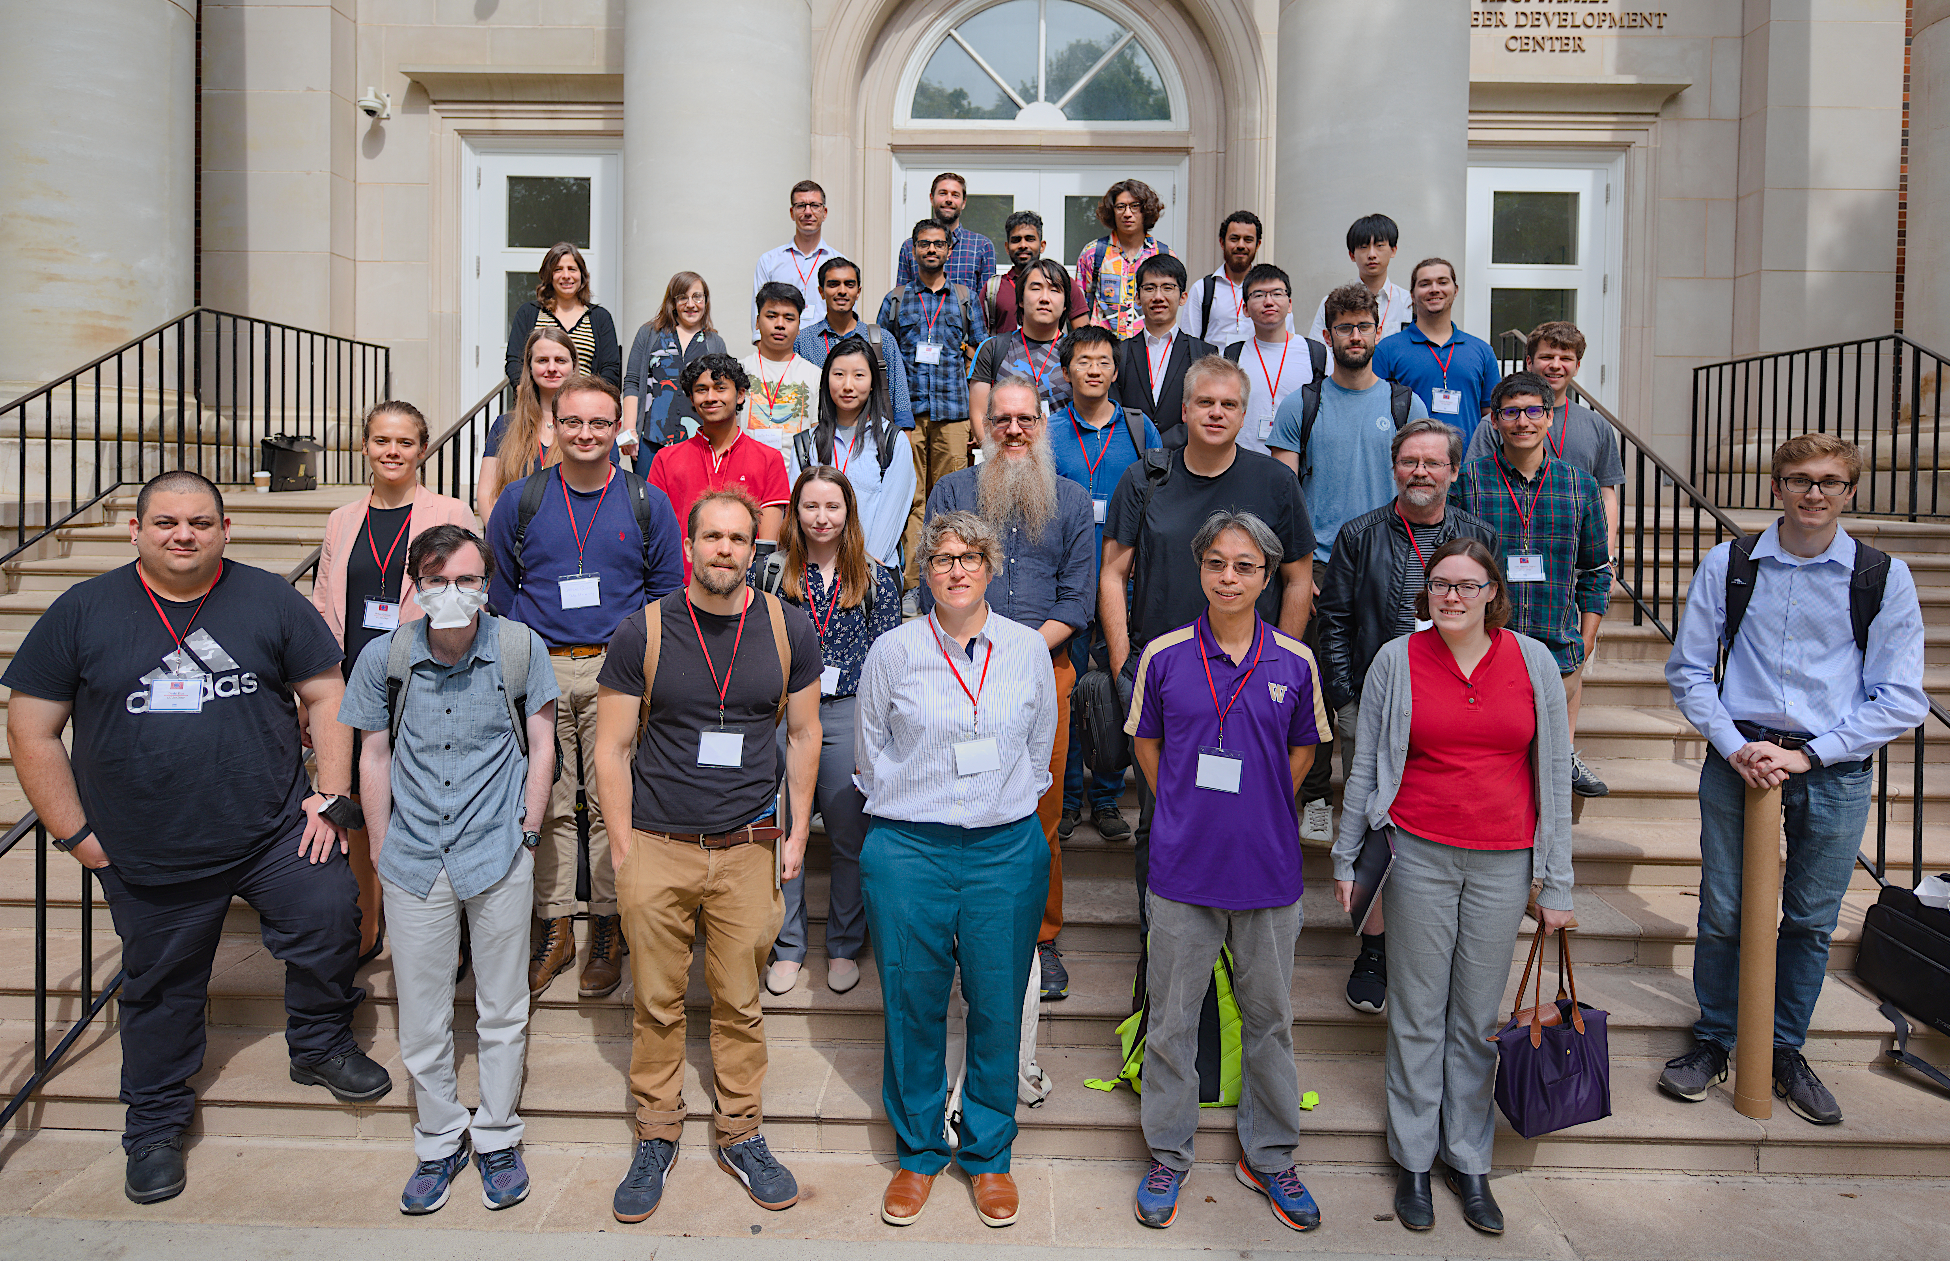
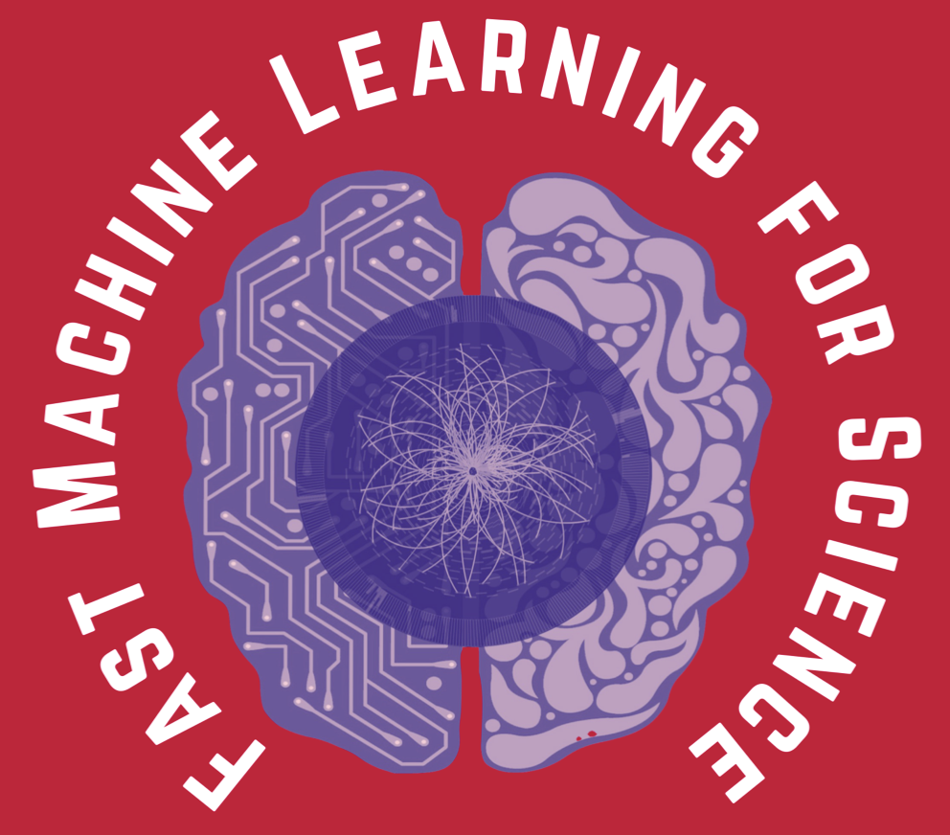
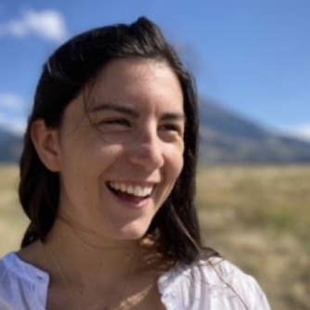
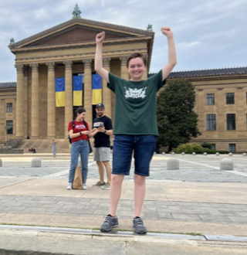

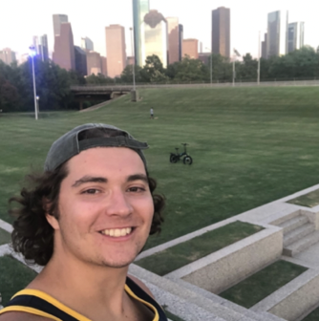
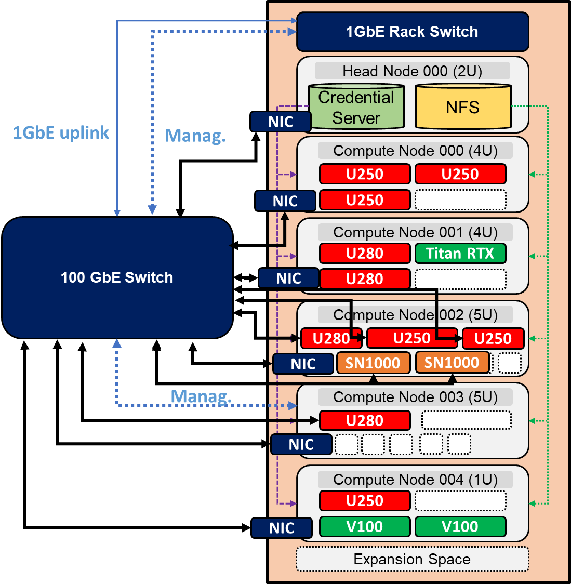

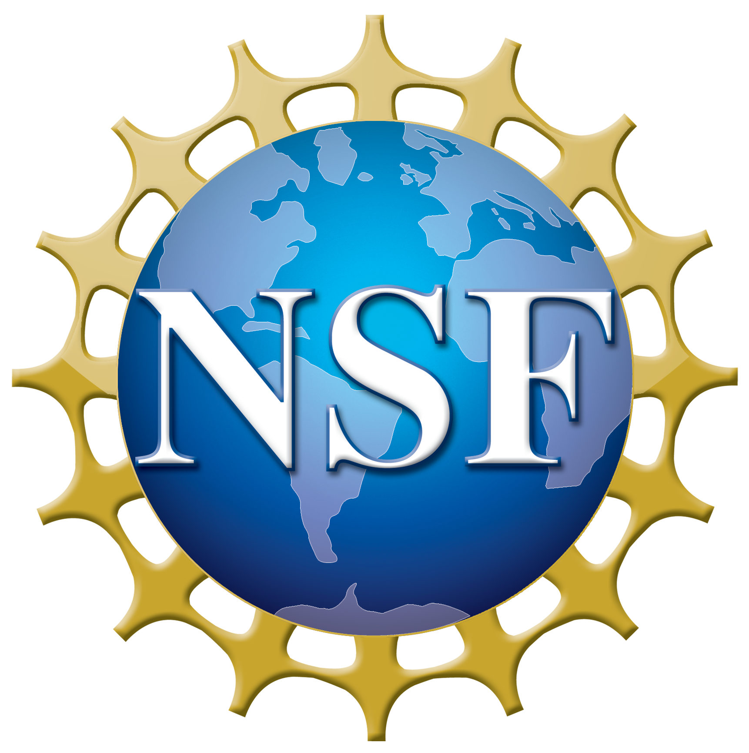
Community Engagement, Education, Outreach
Institutions: California Institute of Technology, University of California San Diego, Duke University, University of Illinois Urbana-Champaign, Massachusetts Institute of Technology, University of Minnesota Twin Cities, Purdue University, University of Washington Seattle, University of Wisconsin Madison
A3D3 Institute
Engagement & Outreach
Vision: to establish a tightly-coupled organization of domain scientists, computer scientists, and engineers that unite three core components that are essential to achieve real-time AI for data-driven discovery
A3D3¹ aims to be a nexus for exchanging new ideas, algorithms and tools between scientific domains, AI communities and industry partners for AI-Hardware co-design
Our efforts are strengthened by close collaboration with the Fast Machine Learning community² and open-source software ecosystem³
9 institutions, 17 senior personnel, 2 research scientists
10 postdocs, 15 graduates, 12 undergraduates, 4 postbacs
Our 2022 annual meeting⁴ was co-located with the FastML for Science workshop⁵
Postbaccalaurate Fellowships
A3D3 2022 Annual Meeting
2022
SMU
Program: One year fellowship to increase opportunities for women and other underrepresented groups in STEM
Postbac fellows are matched to a project and hosting institution based on preferences, availability and balance of areas within A3D3
Our members have been active in leading community white papers, such as
Applications and Techniques for Fast Machine Learning in Science⁶
Physics Community Needs, Tools, and Resources for Machine Learning⁷
Data Science and ML in Education⁸
Our postbac program is now in full swing, with four Year 1 fellows paired with mentors and performing cutting-edge research in our core domains of high-energy physics, multimessenger astronomy and neuroscience!
Monthly seminars with invited talks by domain scientists & CS/AI researchers (on YouTube!)
Cross-HDR activities to toward developing a coherent and sustainable HDR Ecosystem
Professional Development Activities include:
Industry Partnerships
Virtual orientation event including A3D3 introduction, industry experience and graduate school discussions
Quarterly “check-in” meetings
In-person mixer event and poster session held at the 2022 A3D3 annual meeting
Student-led activities such as a journal club in planning
Strong connection with industry leaders in AI hardware, HPCs, and cloud computing via integration with the Fast ML community and university research partnerships such as the AMD/Xilinx
HACC
The 2023-2024 postbac fellow call to be posted on AJO
We have presence with booths and fliers at affinity conferences such as SACNAS National Diversity in STEM and National Society of Black Physicists
Heterogeneous
Accelerated Compute Cluster (HACC) at UIUC
Training and Education
References
Training: A3D3 members involved in running hls4ml tutorials
Undergraduate research: Mentoring students in REU, SURF, …
@a3d3institute
[1] https://a3d3.ai
[2] https://fastmachinelearning.org
[3] https://github.com/fastmachinelearning
E.g. SURF project on fast inference for astronomy alert streams @ Caltech
[4] https://indico.cern.ch/event/1197118
[5] https://indico.cern.ch/event/1156222
Curriculum: 8 PIs developing courses involving A3D3 research!
Follow us!
[6] https://arxiv.org/abs/2110.13041
Shown at APS Data Science Education Community of Practice workshop
[7] https://arxiv.org/abs/2203.16255
@a3d3institute
[8] https://arxiv.org/abs/2207.09060
This project is supported by the National Science Foundation under Cooperative Agreement" OAC-2117997. Any opinions, findings, conclusions or recommendations expressed in this material are those of the authors and do not necessarily reflect the views of the National Science Foundation.

