Slide 1

NA Decabling

Slide 2


Power distribution
The main power distribution is coming from BA82 (EMD2: 18kV cable) to our EMT 211 / EBD2/A85
Safety power is coming from BE91 through BB81
Liquid Krypton + cryo Nitrogen system can’t afford power interruption

Slide 3
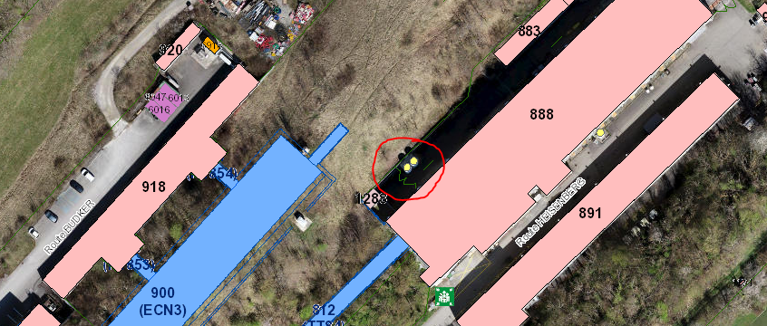
Cryo Krypton
The cooling source (including control cables) is located behind EHN2 and travelling in the TGs

Slide 4
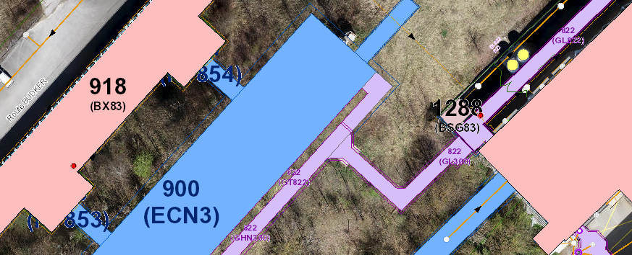
Patrol sectors
ECN3 sector is next to EHN2 sector (common sectorization doors)

Slide 5
Cooling & ventilation
Cooling circuit is travelling from ECN3 to EHN2
Including control cables???

Slide 6
Various
Several systems may have interactions with ECn3;
Experts should tell us….
- IT backbone
Level3 alarms (Fire, RP, ODH…)
Beam management

