Slide 1
IS04 vs IS03 as operational LINAC4 source from Jan2023
Alessandra Lombardi , Jean-Baptiste Lallement , Edgar Sargsyan, Giulia Bellodi, Francesco di Lorenzo, Mike o’Neil, Cristiano Mastrostefano and Sebastien Bertolo

Slide 2
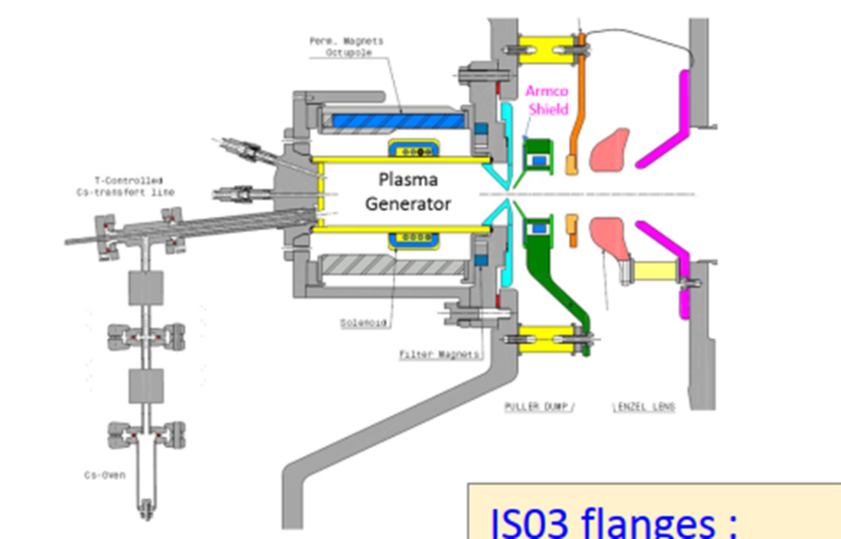
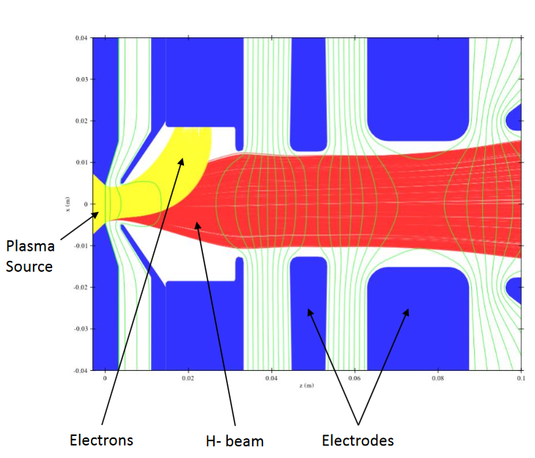
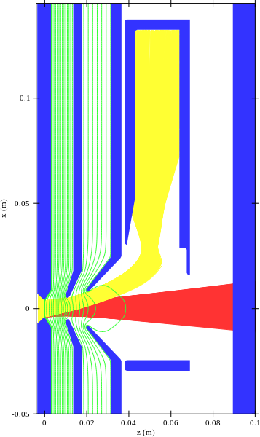
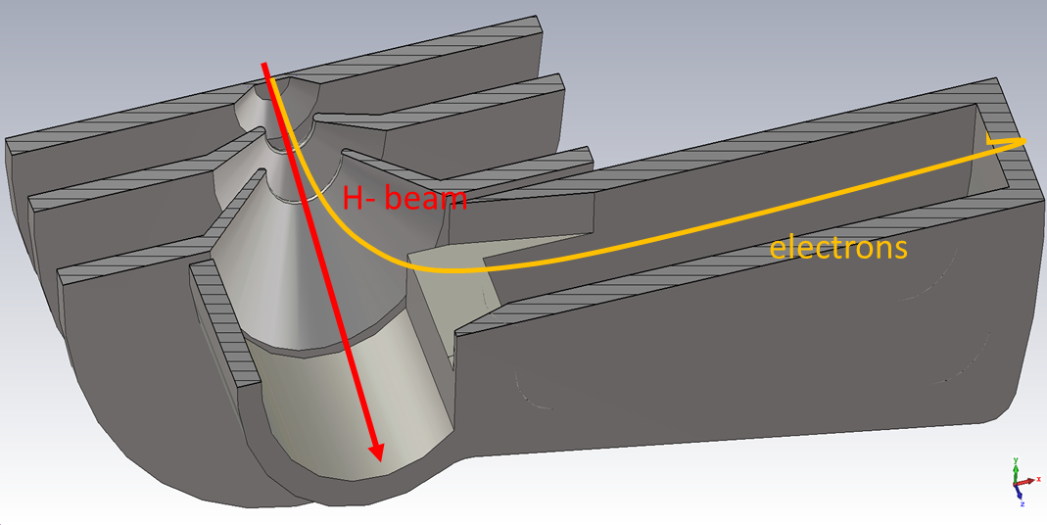
What’s new : IS03 vs. IS04
IS03 and ISO4 have identical plasma generators:
  Plasma chamber.
  RF system (amplifier and antenna).
  Gas injection system.
  Cesiation system.
IS03 and ISO4 have different
extractions and electron dumping schemes
ISO4 vs. IS03
Simplified design with only plasma, puller and ground electrodes :Eliminated puller-dump and Einzel lens causing emittance growth
6 cm shorter
Co-extracted 45 keV e⁻ onto a dedicated dump
IS03 – Dumping 10 keV e⁻
IS04 – Dumping 45 keV e⁻
-45 kV
-35 kV
0 kV
30 kV
0 kV
-45 kV
-22 kV
0 kV

Slide 3
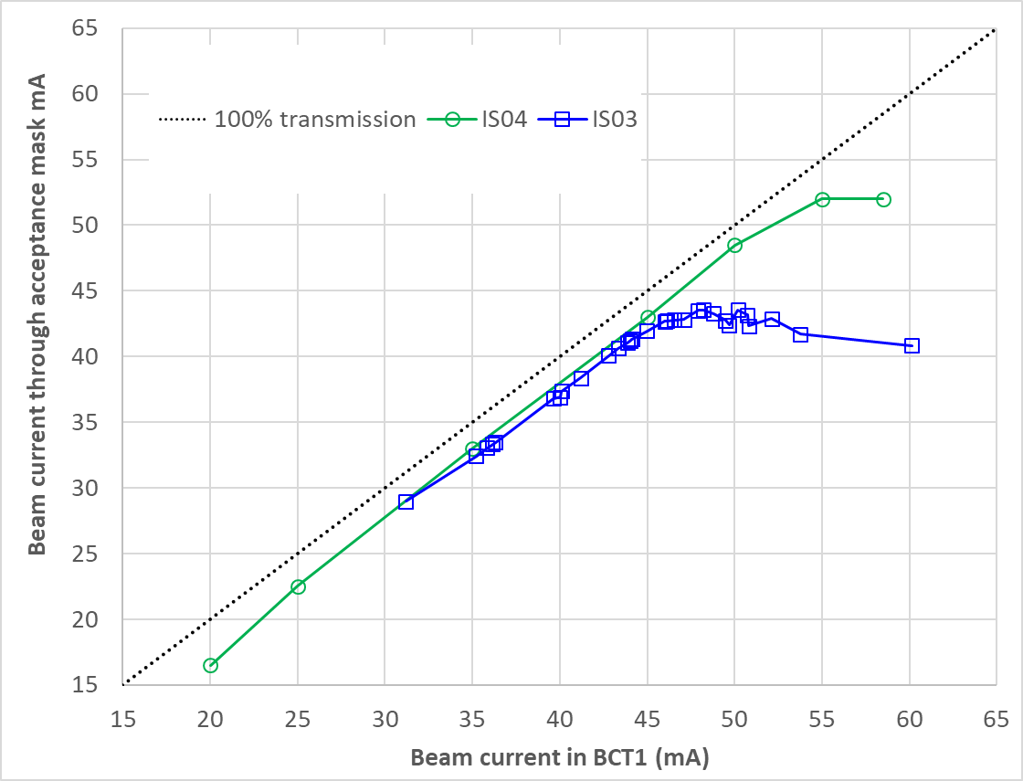
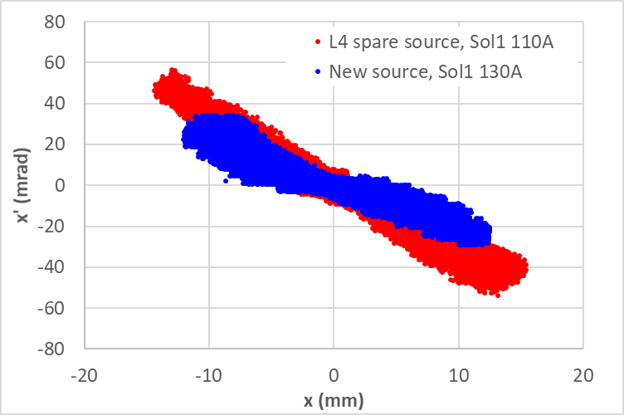
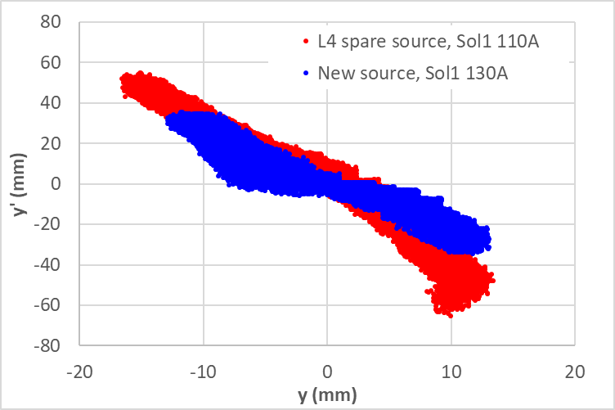
Not so different yet ….
With IS04 better quality beam at the test stand during 2021 (run for 20 weeks total)
Emittance at 35 mA | IS03 | IS04 | Δ (%)
XX’ norm. RMS emittance (π.mm.mrad) | 0.34 | 0.26 | -23.5
YY’ norm. RMS emittance (π.mm.mrad) | 0.40 | 0.32 | -20.0
Stability at 35 mA | IS03 | IS04 | factor
Sigma (%) over 24 h | 0.81% | 0.41% | 2
Sigma (%) over a week | 1.1% | 0.61% | 1.8

Slide 4
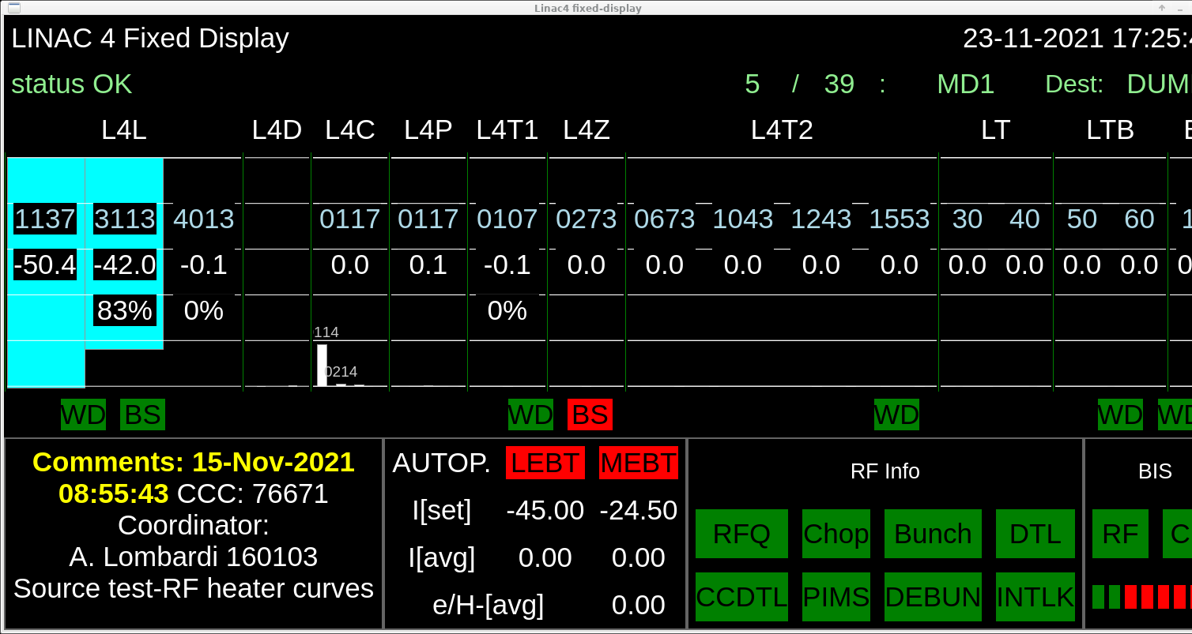
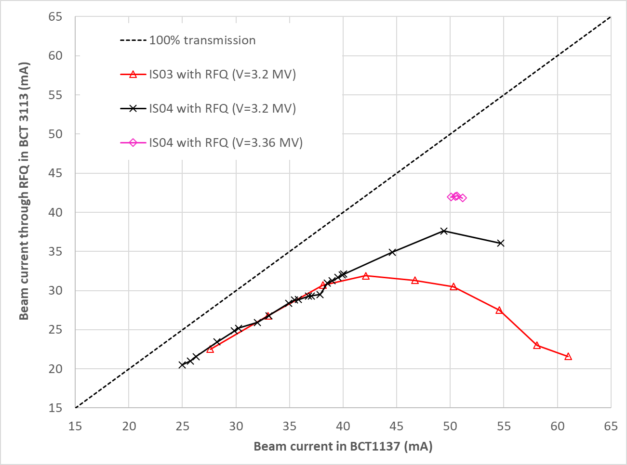
Confirmed at the LINAC4
19-23 November 2021
RFQ V=3.36 MV : 42 mA out of the RFQ
for 50.4 mA input – RECORD
In the operational range : equal transmission as IS03 (and potentially better with further optimization).
Above 40mA : superior transmission
RFQ V=3.2 MV (operational value) : Comparable performance for beam current <40 mA but considerably better above that

Slide 5
Reliability at the test stand (2022)
Started on 13/05, stopped on 10/06.
Mainly testing the electron dump reliability with 45 keV electrons.
Beam current 50 mA, e/H 0.8-1.4 (40-70 mA of electrons on dump).
Stability and reproducibility of beam intensity and emittance with autopilot.
Remove source after the test and inspect [to do].
Note: Reliability run time can be considered already from 21/04/2022, when this source started for the first time this year. Additionally, all run time from the last year should be considered too, as this is a cumulative process. The source has been operated for ~133 days in 2021 and ~50 days in 2022 (up to 10/06), which makes a total of ~183 days so far. No reliability issues were observed so far.

Slide 6
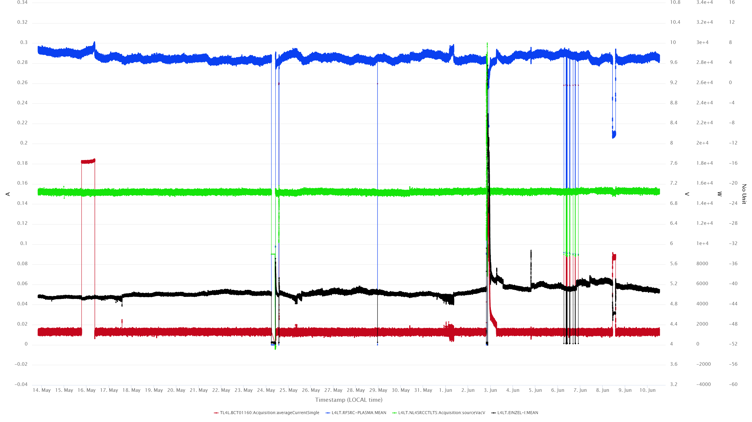
Unfiltered data
Compressed air cut on Meyrin site. Vacuum issues and consequently fault on all source systems. Cesiation partially lost; slow recovery until the next morning.
Emittance measurements with 35 mA beam to check reproducibility.
Timing triggers not received by the Parker valve and therefore not opening and pressure dropping. Timing repeater exchanged but could have also been a bad contact issue.
Stopped source to change Parker valve peak voltage duration from 250 us to 190 us. Increased GASSOLWIDTH accordingly.
Power cut due to fire alarm.
Solenoid 1 fault. No current on BCT but current on dump OK.
mA
* EINZEL=Dump

Slide 7
Statistics
Parameter | Mean | Standard deviation | 3STDEV/MEAN
H⁻ beam current on BCT01160 | 49.4 mA | 0.24 mA | 1.5%
e⁻ beam current on dump | 53.0 mA | 4.5 mA | 25.8%
Source vacuum gauge voltage | 7.042 V | 0.021 V | 0.9%
Source vacuum pressure* | 1.8E-5 mbar | 7.0E-7 mbar | 11.7%
Source RF forward power | 33673 W | 340 W | 3.03%
Source RF plasma power | 28524 W | 290 W | 3.05%
RF rack temperature | 23.4 °C | 2.4 °C | 30.8%
Source gas valve temperature | 21.6 °C | 0.83 °C | 11.5%
* Calculated from the source vacuum gauge voltage as P=2*10^{(0.817*U - 10.8)}

Slide 8
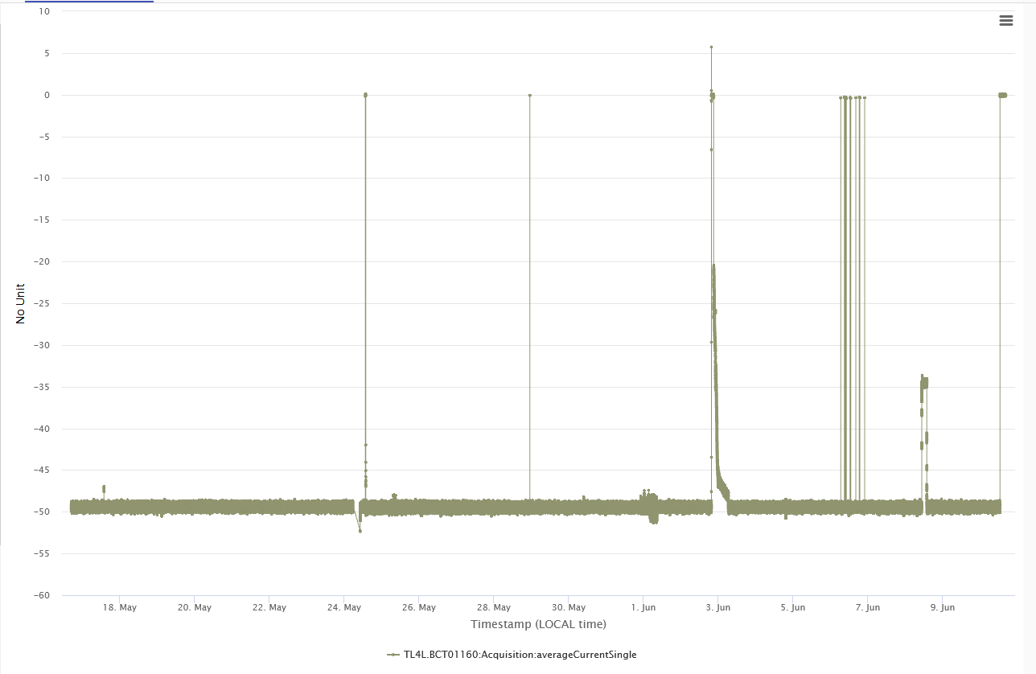
Beam stability (24/7 over 4 weeks)
No sparks in the extraction
No missed pulses
Excellent shot-to-shot stability

Slide 9
Inspection of the electron dump
After 133 days of operation (2021): no sign of damage
Plus 50 days of operation in 2022 : still to be inspected but no surprises anticipated.

Slide 10
Spares availability and testing
Foreseen to have 2 spares tested before end of 2022
  First spare is assembled and will be tested starting 8/8
  Second spare will be ready in September/October and tested there after

Slide 11
All modifications in the tunnel are backward compatible
1-2days to revert to IS03, if really needed. Time is comparable to changing a source to its spare.
Modifications:
  Power supply connections : connect 2 vs 3 power supplies + reconfiguration
  Take out Einzel Lens from BIS input
  Invert polarity of Solenoids
  Change reference settings for solenoids and steerers in the LEBT
  Redo the steering in the LINAC

Slide 12
operational and MD beam
 | Operational 2021-2022 (IS03) | Operational 2023 (IS04) | MD 2023 – linac and TL (IS04) | MD 2023 – linac +PSB (IS04)
Pulse length at the source | 900µs | 900µs | 900µs | 900µs
Pulse length after 3 MeV | 600µs | 600µs | 200-300µs | 300µs
Chopping factor | 65% | 65% | 44% | 65%
Peak current after the RFQ | 25mA | 25mA | 30-45 mA | Max 30mA
Average current along the pulse after chopping | 16mA | 16mA | 20mA (present operational limit ) | 20mA
Load on the 3 MeV dump | 3,4 10¹³ H- /sec | 3,4 10¹³ H- /sec | 3,2 10¹³ H- /sec | 2,0 10¹³ H- /sec
During MDs we use the chopping factor and the pulse length to respect the average current and the load on the 3 MeV dump

Slide 13
MD high intensity-
BI - instrumentation
  To be verified if attenuation to be added to BCT amplifiers. – ok up to 40 mA needs modification to go to 45 or higher. Check the options and planning only when/if it is approved to have MD higher than 40mA. Minimum : 1 month notice
  Pulse length for wire based measurements (SEMGrids, wirescanners, BSM) all to be reviewed for currents and optics settings to define acceptable pulse length.

Slide 14
Risks and Opportunities
Installation :
  all changes are backward compatible
Operational Beam :
  The beam from IS04 has been transported to 3 MeV and it has been successfully chopped in current range 20-50 mA
  The beam has not being transported down the LINAC and steering needs to be readjusted.
MD for higher intensity:
  This source allows for a higher intensity out of the RFQ (up to 42mA in test conditions, 38mA in nominal conditions vs 30mA of IS03). Limit on the source RF power should be updated so that this doesn’t happen accidentally
  MD to explore transmission and emittance of higher intensity beam can be done without disruption. With the current operational configuration an average current of 20mA along the linac should be respected (NB: “CAN be done” not “MUST be done”)

Slide 15
Summary : we propose to use IS04 as operational source from Jan 2023
IS04 has a simplified extraction system made of 3 electrodes instead of 5 and needing 2 power supplies (instead of3). This simplification has a positive effect on operation and also start-up. Conditioning the Einzel lens to the nominal voltage is often lengthy.
ISO4 has been tested thoroughly at the test stand and it has been tried at the LINAC4. Beam quality and reliability for operational beam is similar or better than IS03
IS04 can provides a beam with smaller emittance than IS03 which entails the possibility of higher than nominal intensity after the RFQ and potentially reduced losses in the RFQ for nominal beam.
Operationally it doesn’t increase the risk for LINAC4
Reverting to IS03 is possible at any time

Slide 16
Reserve slides

Slide 17
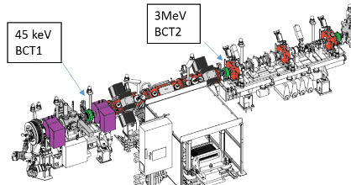
Confirmed at LINAC4 : 19-23 November 2021
Total 2.5 days of beam tests – effective 1.5 days
Most of the tests with the RFQ at operational voltage of 3.2 MV
Beam current from source 25-55 mA
Beam pulse length max 300 microsec
3 MeV
BCT.3113
MEBT
45 keV
BCT.1137
Solenoid and steerer optimization for max transmission through the RFQ
LEBT gas/space charge neutralization optimization
Puller voltage optimization
Beam energy variation from source (source voltage 44-46 kV)
  Some improvement with 46 kV
RFQ voltage scan (3.2-3.36 MV) with 50 mA beam
  Not enough time for other beam currents
RFQ
IS
LEBT

Slide 18
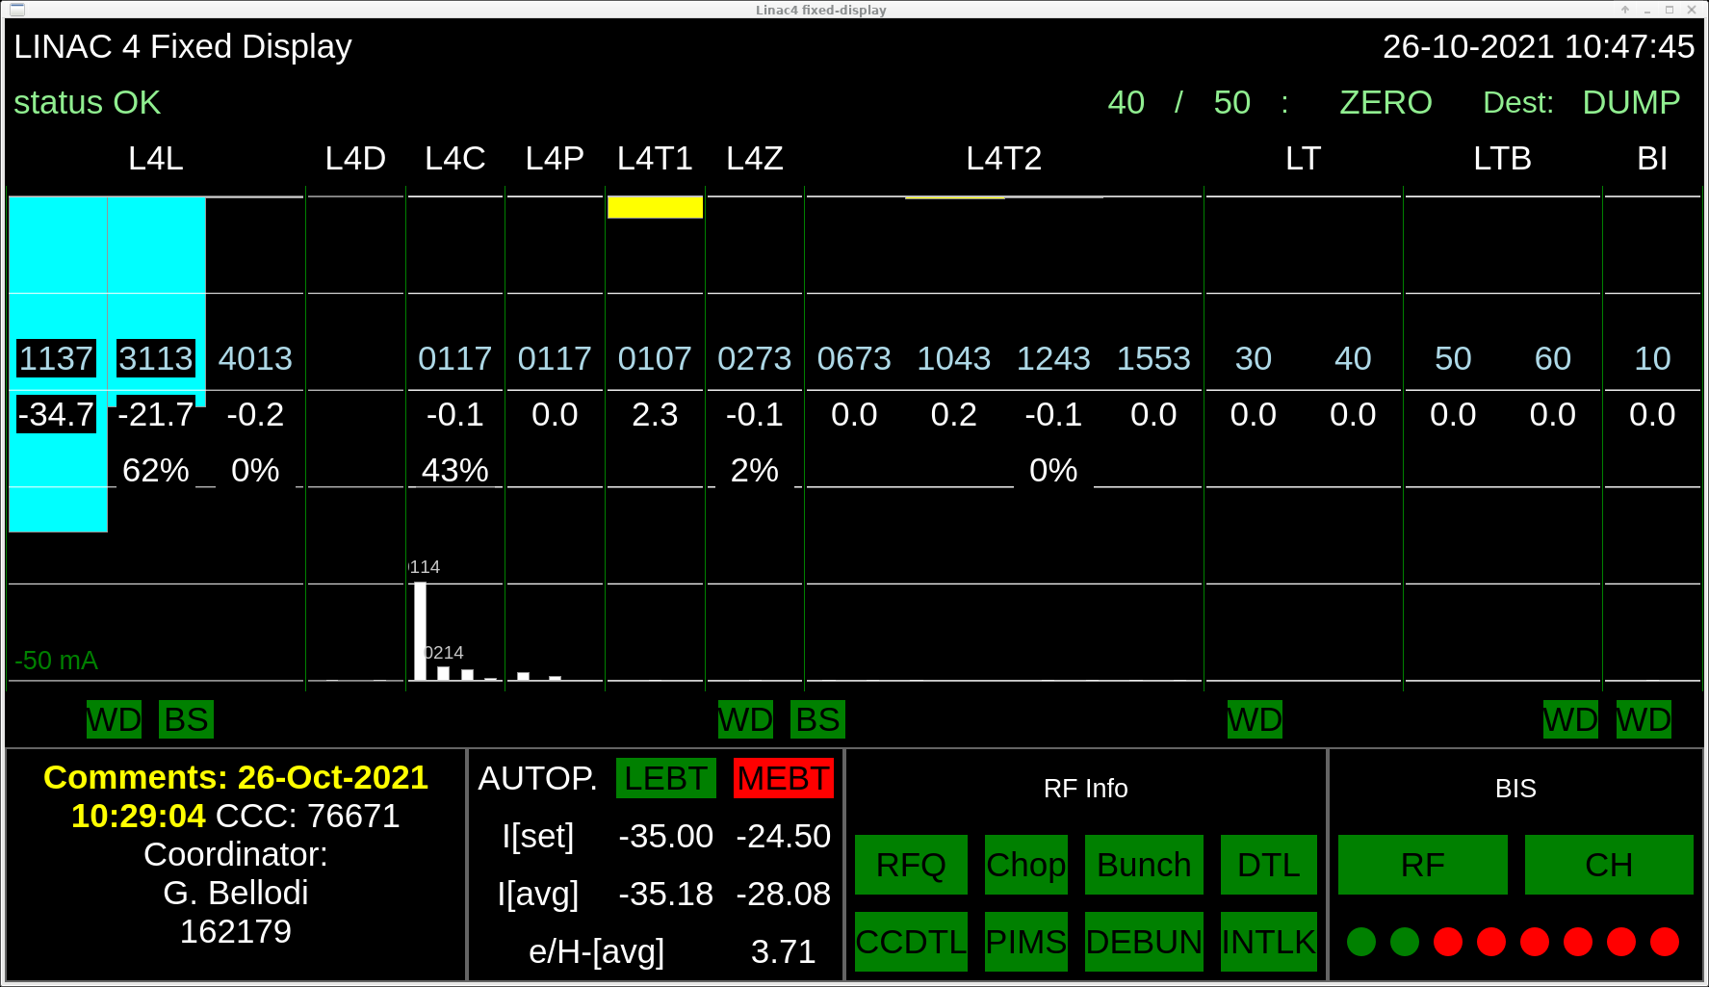
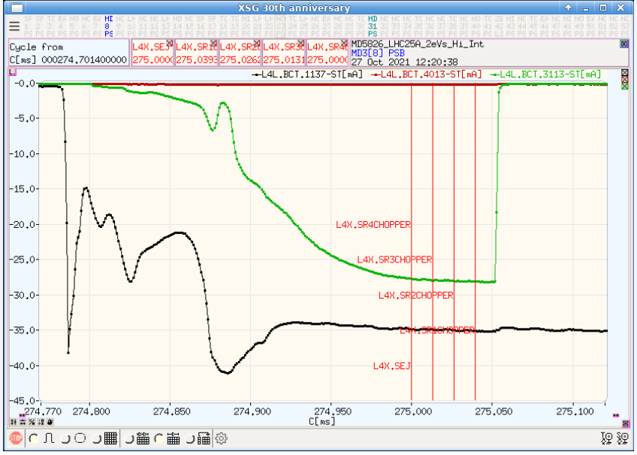
Where does the beam go? – on the 3MeV dump. Achieved by
1. Setting bunch length to 0
2. Setting Ring Inhibit to TRUE
Test was done on 27/10 see https://be-op-logbook.web.cern.ch/elogbook-server/GET/showEventInLogbook/3397828 thanks Piotr Skowronki
The machine protection system will not be touched, no interlock needs masking (thanks to Jan Uythoven and Christophe Martin for the very helpful discussion)
No beam after 3 MeV
Linac4 on

Slide 19
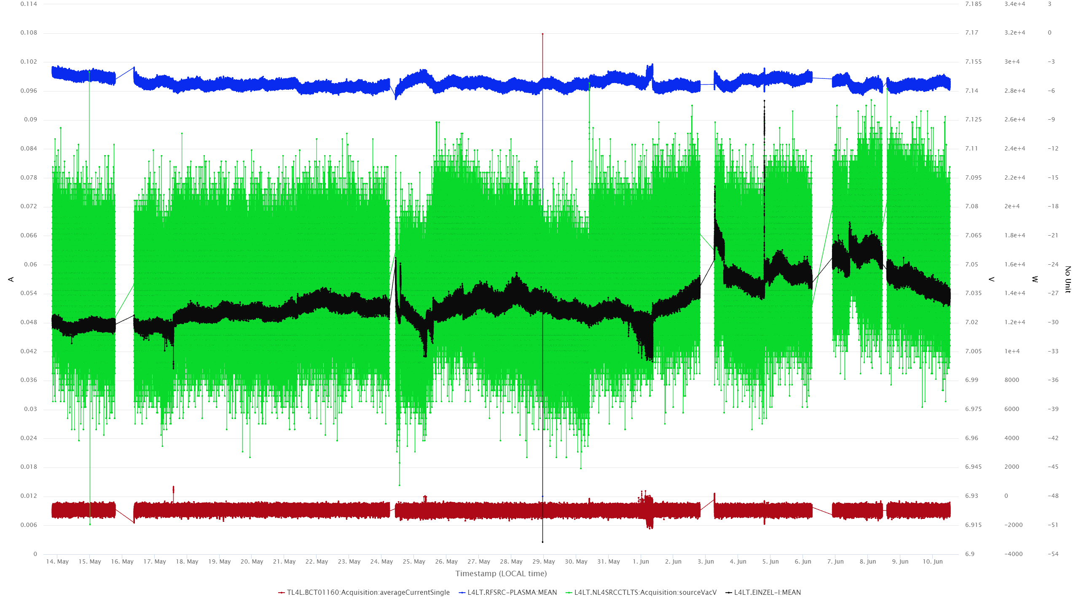
Irrelevant faults filtered out
mA
* EINZEL=Dump

Slide 20
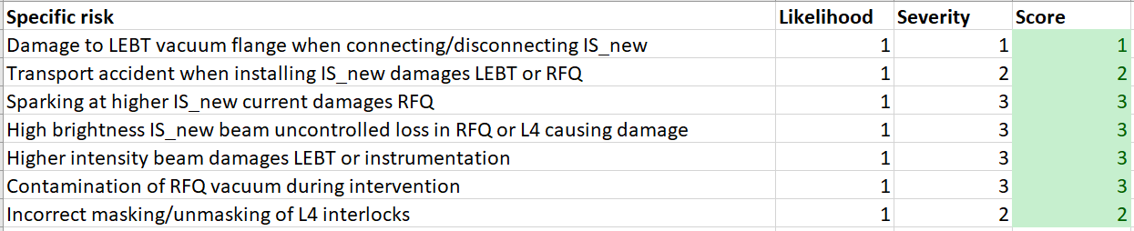
So all in all...it is an opportunity outweighing the risks
File attached to the indico contribution
Test outcome | Consequence | Effect on future operation
Higher transmission through the RFQ | We can be ready for the next source change (reliability run at the test stand, validated spares) | Reduce the operational losses in the RFQ by a factor of 10
Same transmission through the RFQ | Validated a source that needs one power supply less (=less chance of failure) | the source/linac4 more reliable as using one less power supply (sparks and failures)
Lower transmission through the RFQ | We have nevertheless learned. And we orient the activities at the test stand more effectively | None

Slide 21
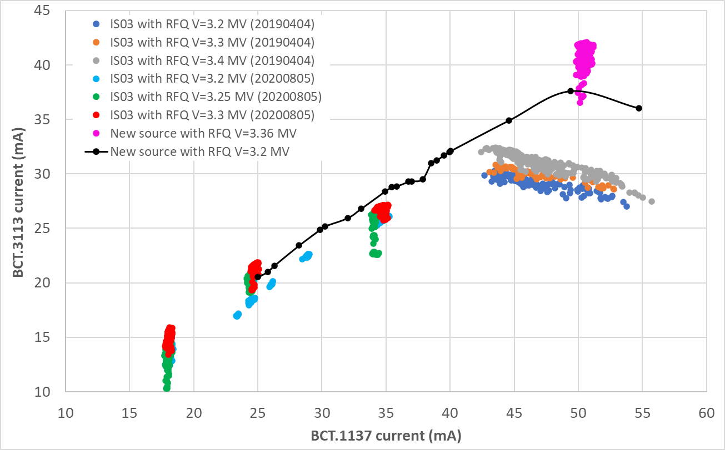
RFQ voltage scan with IS03 vs ISO04
RFQ voltage scans with IS03 show lower transmission compared to equivalent scans with IS04
Consistent with the smaller emittance measured at the test stand

