Slide 1

Token Transition Status and HTCondor-CE Future
Brian Lin
Center for High Throughput Computing
University of Wisconsin–Madison

Slide 2
Token Transition Status
Detailed timeline: https://htcondor.org/news/plan-to-replace-gct-in-htcss/
SCITOKENS authentication supports both the WLCG and SciTokens profiles
Sites in the OSG Consortium completed the transition to accepting token-only glidein submission
See Jaime’s talk later about refreshing tokens

Slide 3
Token Transition Status
HTCondor 10.0.0 binaries will no longer depend on the Grid Community Toolkit
  No more GSI authentication method
  X.509 proxy delegation still works, e.g. for use by the job for remote storage access
March 2023 end of HTCondor 9.0.x support, the last release to support the Grid Community Toolkit

Slide 4
Improving Token Support
Planning the addition of a token mapping callout
  HTCSS will verify signatures and validate the JWT
  Add the ability to specify a callout for mapping purposes
  Potentially useful for supporting EGI Check-In tokens and site specific logic
Non-blocking token authentication

Slide 5
Improving Token Debugging
Token-based capabilities are more stringently controlled by collaborations vs VOMS roles
Tool for admins to generate impersonation tokens accepted by their CE for testing and troubleshooting purposes
https://opensciencegrid.atlassian.net/browse/HTCONDOR-1115

Slide 6
Job Router Transforms
“New” job router syntax is fully supported in HTCondor-CE
  Routes split into different configuration variables
  Defaults split into pre and post route transforms
  If /else /endif blocks
  Transform macros and temporary variables
See HTCondor Week 2021 for more details: https://agenda.hep.wisc.edu/event/1579/contributions/23068/
Starting to plan the timeline for deprecating the old syntax: drop it in 10.1.x?

Slide 7
Configuration Testing
condor_transform_ads for testing specific individual job transforms (still need to add condor_ce_transform_ads)
HTCondor-CE development container
  https://github.com/htcondor/htcondor-ce/blob/V5-branch/tests/containers/README.dev.md
  Contains working local HTCondor and Slurm installation
  Contains test user with SciToken and X.509/VOMS creds
  Useful for testing configuration changes before prod

Slide 8
APEL Accounting
Added support for multiple scale factors
Improved ease of configuration
See Max’s talk for more details
Seeking a new documentation home for these contributions

Slide 9
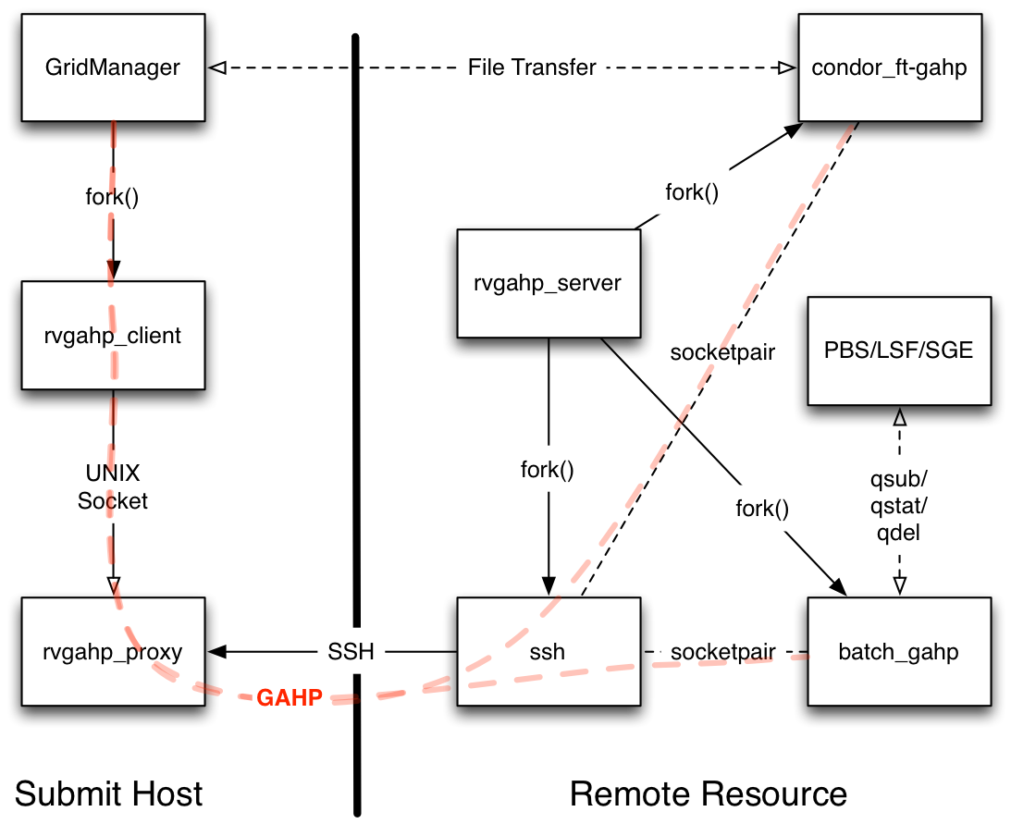
SSH Submission with MFA
HTCSS supports remote job submission over SSH, utilized heavily by OSG Hosted CEs
Some sites, particularly HPCs, require multi-factor authentication
Reverse GAHP adds the ability to open an SSH connection from the site to the remote Compute Entrypoint (or Access Point)
From https://github.com/juve/rvgahp

Slide 10
Updating Security Defaults
Alignment of HTCondor-CE AUTHENTICATION, ENCRYPTION, and INTEGRITY defaults with HTCondor
  https://github.com/htcondor/htcondor-ce/pull/552
Expected to be transparent to admins but we will target a new major HTCondor-CE version
Should we increment the version (6.0.0) or aim for alignment with HTCondor (10.0.0)?

Slide 11
Questions?
This material is based upon work supported by the National Science Foundation under Grant Nos. 1148698, 1836650 and 2030508. Any opinions, findings, and conclusions or recommendations expressed in this material are those of the author(s) and do not necessarily reflect the views of the National Science Foundation.

