Slide 1
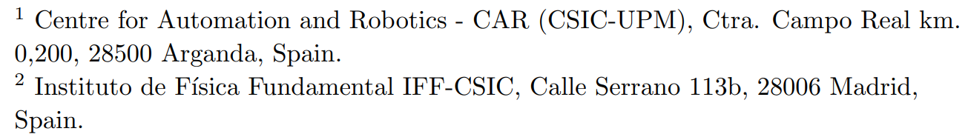

Automatic design of quantum feature maps
21 July 2022
Roberto Moretti
Sergio Altares-López¹, Angela Ribeiro¹, Juan José García-Ripoll²
Published 19 August 2021 – Quantum Science and Technology - IOP publishing

Slide 2
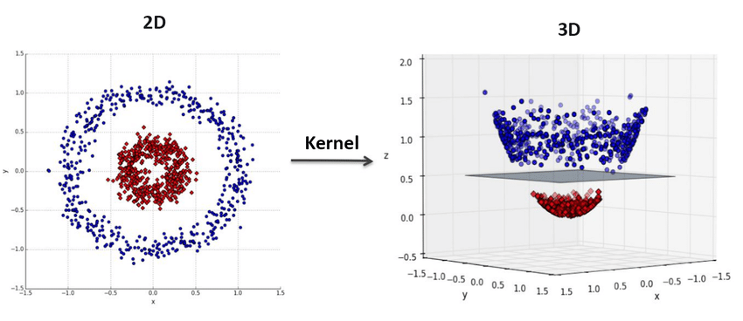
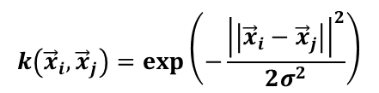
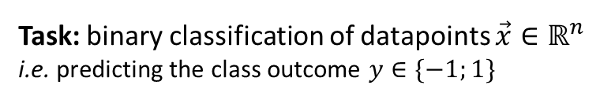
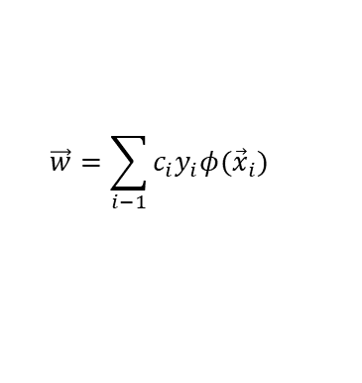
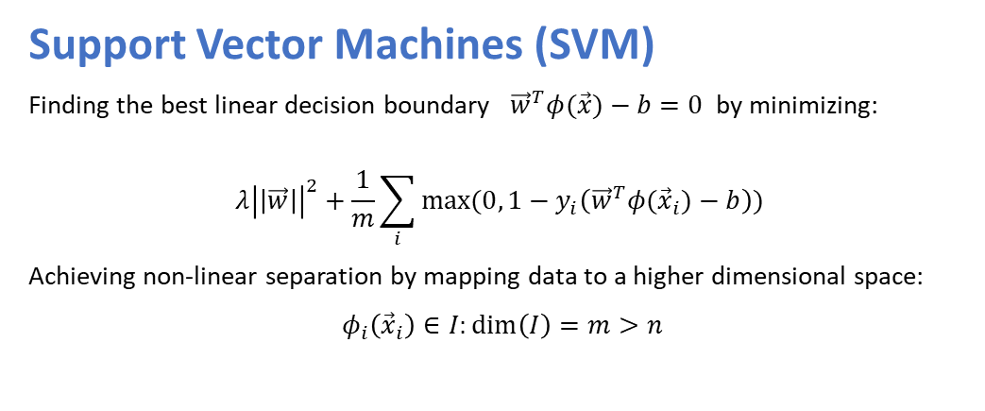
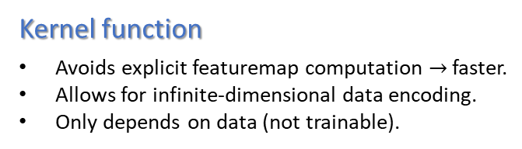

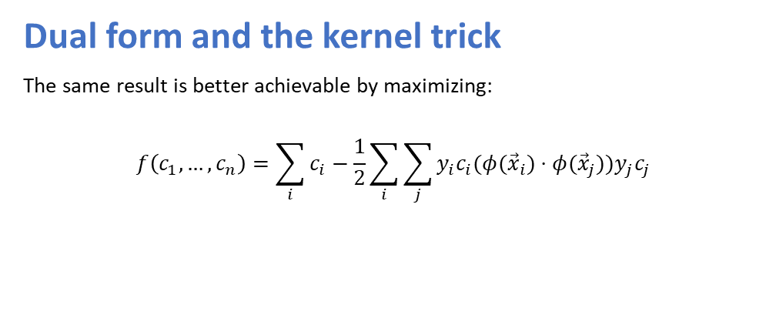
Support Vector Machines and Kernel Trick
Task: binary classification of datapoints $\vec{x}∈ℝ^{n}$
i.e. predicting the class outcome $y∈\{−1;1\}$
Support Vector Machines (SVM)
Finding the best linear decision boundary ${\vec{w}}^{T}φ(\vec{x})−b=0$ by minimizing:
$$λ{\left|\left|\vec{w}\right|\right|}^{2}+\frac{1}{m}\sum_{i}{max⁡(0, 1−y_{i}\left({\vec{w}}^{T}φ({\vec{x}}_{i})−b\right))}$$
Achieving non-linear separation by mapping data to a higher dimensional space:
$φ_{i}\left({\vec{x}}_{i}\right)∈I:\dim\left(I\right)=m>n$
Source
Dual form and the kernel trick
The same result is better achievable by maximizing:
$$f\left(c_{1}, …, c_{n}\right)=\sum_{i}{c_{i}}−\frac{1}{2}\sum_{i}{\sum_{j}{y_{i}c_{i}(φ({\vec{x}}_{i}})⋅φ({\vec{x}}_{j}))y_{j}c_{j}}$$
Kernel function
Avoids explicit featuremap computation $→$ faster.
Allows for infinite-dimensional data encoding.
Only depends on data (not trainable).
$$k\left({\vec{x}}_{i}, {\vec{x}}_{j}\right)=\exp\left(−\frac{{\left|\left|{\vec{x}}_{i}−{\vec{x}}_{j}\right|\right|}^{2}}{2σ^{2}}\right)$$
$$\vec{w}=\sum_{i−1}{c_{i}y_{i}φ({\vec{x}}_{i})}$$
e.g. gaussian kernel function:
$$k({\vec{x}}_{i}, {\vec{x}}_{j})$$

Slide 3
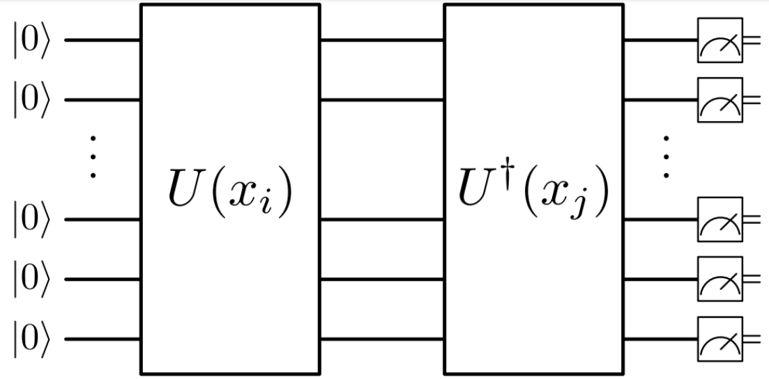
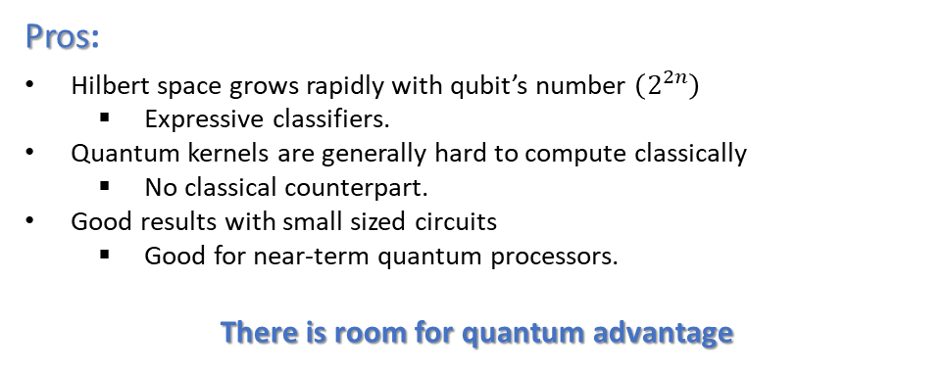

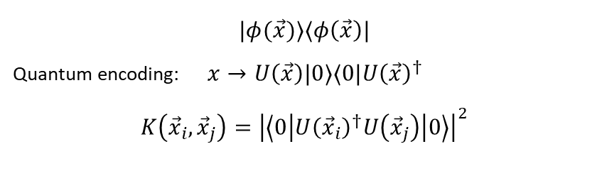
Quantum Kernel
Idea: promoting $φ(\vec{x})$ to a quantum state:
$|φ(\vec{x})⟩⟨φ\left(\vec{x}\right)|$
Quantum encoding: $x→U\left(\vec{x}\right)|0⟩⟨0|U{\left(\vec{x}\right)}^{†}$
$K\left({\vec{x}}_{i}, {\vec{x}}_{j}\right)={\left|\left\langle 0\left|U{\left({\vec{x}}_{i}\right)}^{†}U\left({\vec{x}}_{j}\right)\right|0\right\rangle \right|}^{2}$
Featuremap are still implicitly defined (by ciruit’s gate).
Kernel function is still a measure of similarity between different samples.
Source
Pros:
Hilbert space grows rapidly with qubit’s number $\left(2^{2n}\right)$
  Expressive classifiers.
Quantum kernels are generally hard to compute classically
  No classical counterpart.
Good results with small sized circuits
  Good for near-term quantum processors.
There is room for quantum advantage
Cons:
Lack of explainability
  Unintuitive relation between circuit and outcome.
Hardware noise
  The kernel circuit must be as simple as possible.
Usually set arbitrarily
  No recipe for the perfect kernel circuit.
How to deal with these?

Slide 4
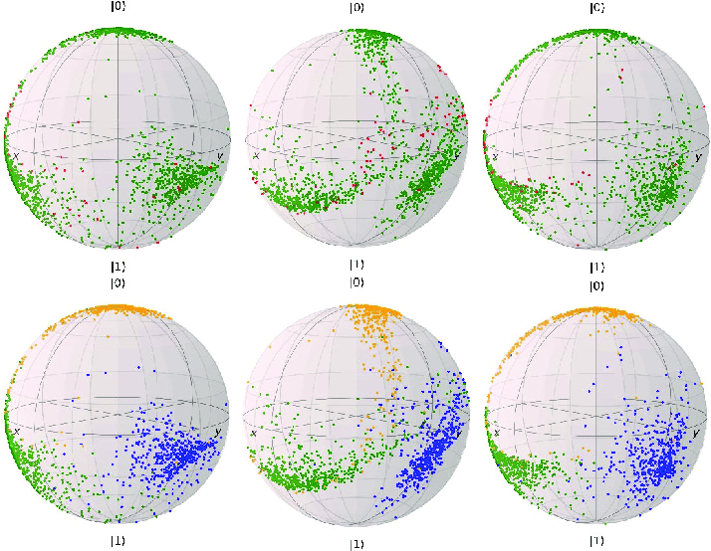
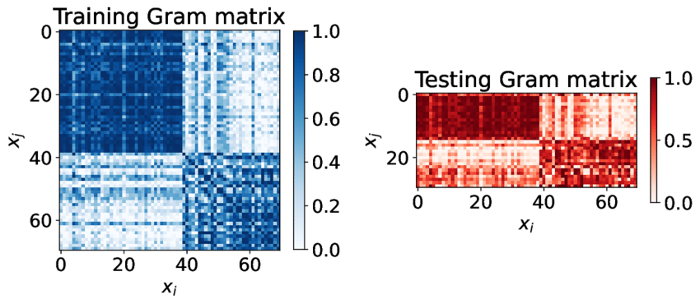
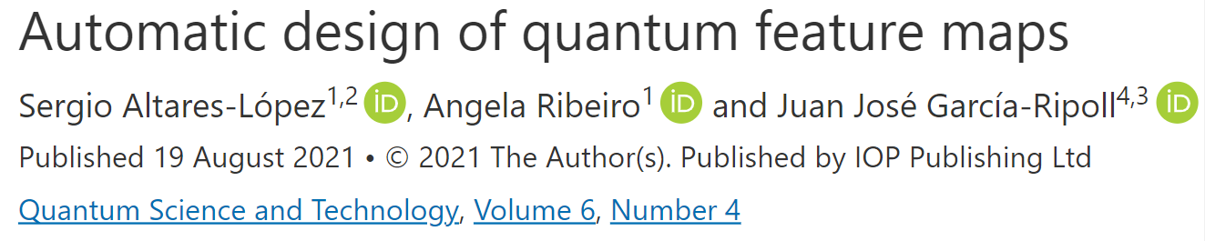
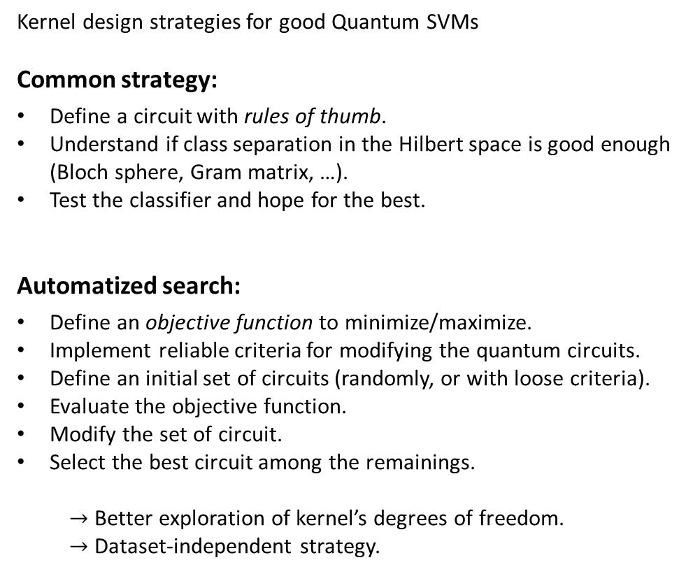
From heuristic to meta-heuristic
Kernel design strategies for good Quantum SVMs
Common strategy:
Define a circuit with rules of thumb.
Understand if class separation in the Hilbert space is good enough (Bloch sphere, Gram matrix, …).
Test the classifier and hope for the best.
Automatized search:
Define an objective function to minimize/maximize.
Implement reliable criteria for modifying the quantum circuits.
Define an initial set of circuits (randomly, or with loose criteria).
Evaluate the objective function.
Modify the set of circuit.
Select the best circuit among the remainings.
  $→$ Better exploration of kernel’s degrees of freedom.
  $→$ Dataset-independent strategy.
Repeat until satisfaction
Source
Source
Repeat until a stop condition is met

Slide 5
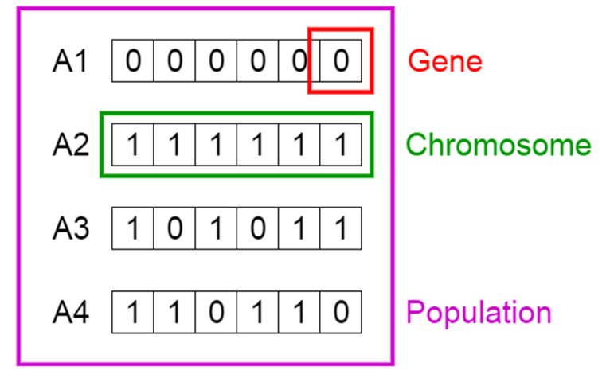
Genetic algorithm – overview
  INITIAL POPULATION
Defining an initial population (generation 0).
MUTATION
Operating random changes of the informational units (genes) that define individuals.
CROSSOVER
Exchanging Random genic information between different individuals.
Generation
OFFSPRING SELECTION
Evaluating the fitness of the new generation and selecting the best individuals that will compete with parents.
Source
NO
IS STOP CRITERION SATISFIED?
e.g. reaching the max number of generations.
YES
END
Returning the fittest individual among the last generation.

Slide 6
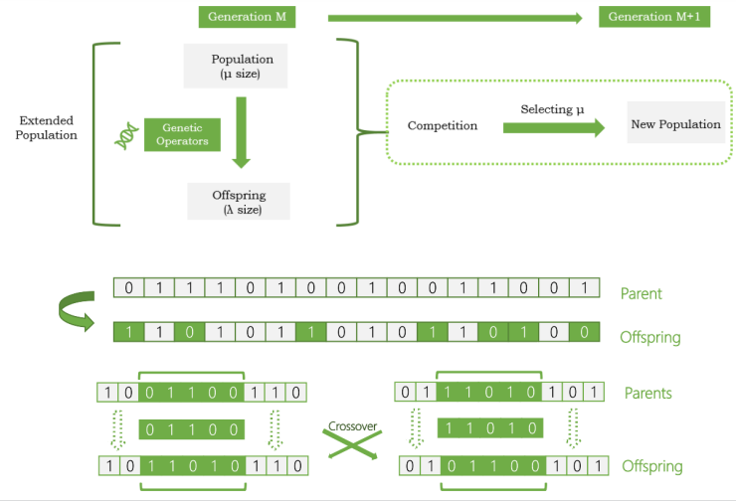
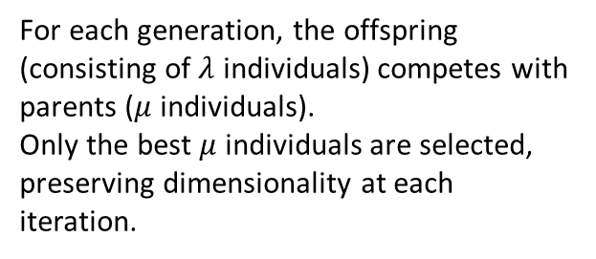
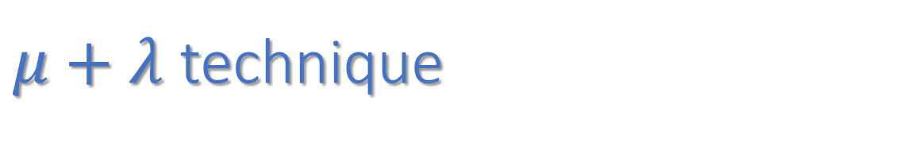
$μ+λ$ technique
For each generation, the offspring (consisting of $λ$ individuals) competes with parents ($μ$ individuals).
Only the best $μ$ individuals are selected, preserving dimensionality at each iteration.
Offspring from sigle-parent mutations.
Offspring from two-parents crossover.

Slide 7
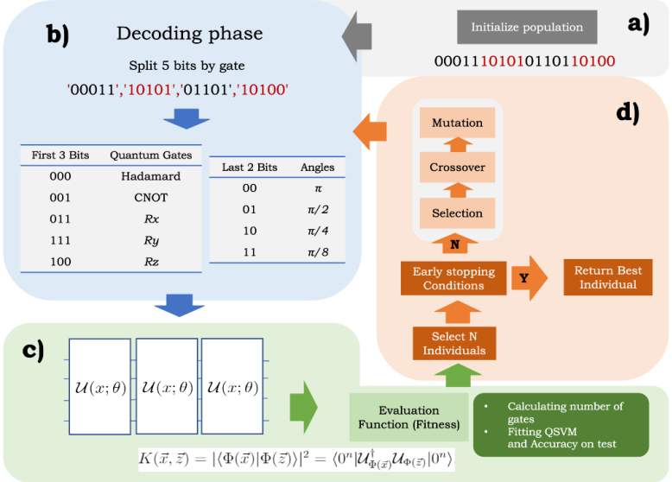
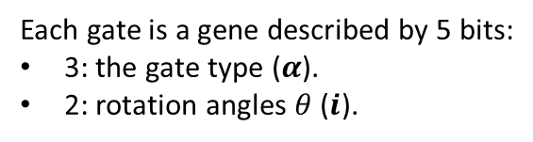




Binary encoding
The optimization algorithm continuously translates the circuit into binary and viceversa
Binary: for applying genetic operators.
Circuit: for evaluating the classifier.
Each gate is a gene described by 5 bits:
3: the gate type ($α$).
2: rotation angles $θ$ ($i$).
$$R_{α}\left(θ_{i},x_{k}\right)=exp⁡(−iθ_{i}x_{k})$$
$$k=i∗mod(d)$$
$d:$ featurespace dimension
On qubit $j$, set by string ordering.
Each chromosome/individual is an ensamble of 5-bit chunks.
The following quantity are free to evolve:
The number of gates for each qubit.
Number of qubits.

Slide 8
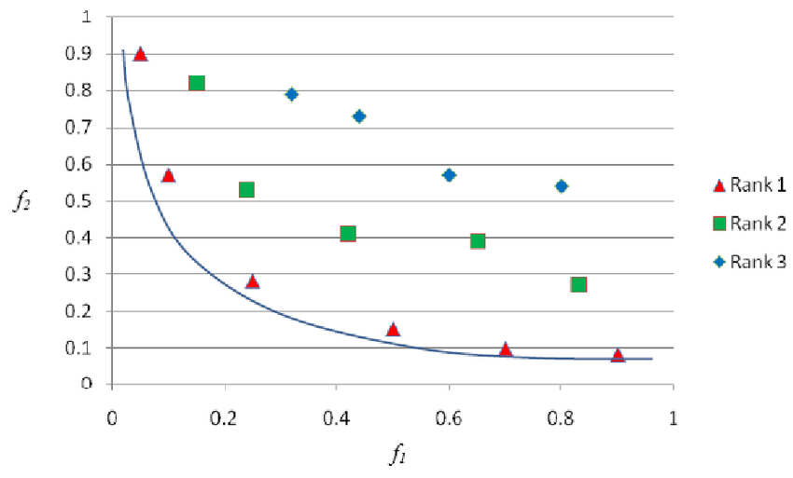
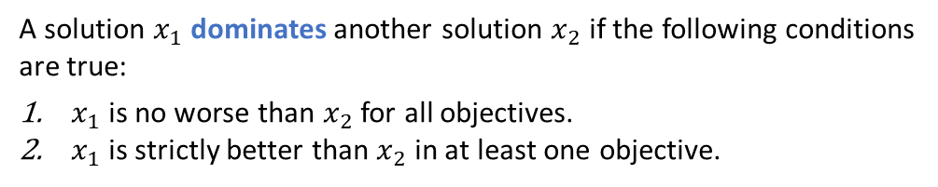

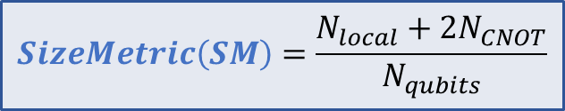
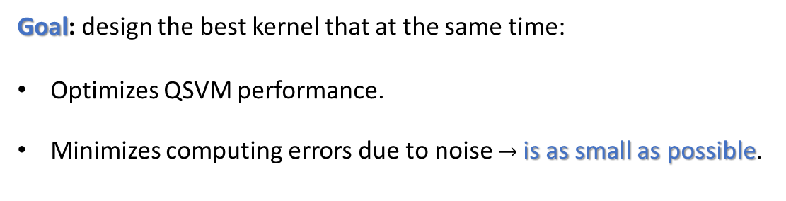
Multi-objective optimization
Goal: design the best kernel that at the same time:
Optimizes QSVM performance.
Minimizes computing errors due to noise $→$ is as small as possible.
$accuracy$ (on a validation set)
$$SizeMetric\left(SM\right)=\frac{N_{local}+2N_{CNOT}}{N_{qubits}}$$
$$Weight balance=SM+SM∗accuracy^{2}$$
Size and accuracy are conflicting: some kernels form a Pareto front.
Pareto front: the set of all non-dominated solutions in a generation.
A solution $x_{1}$ dominates another solution $x_{2}$ if the following conditions are true:
$x_{1}$ is no worse than $x_{2}$ for all objectives.
$x_{1}$ is strictly better than $x_{2}$ in at least one objective.
Source

Slide 9
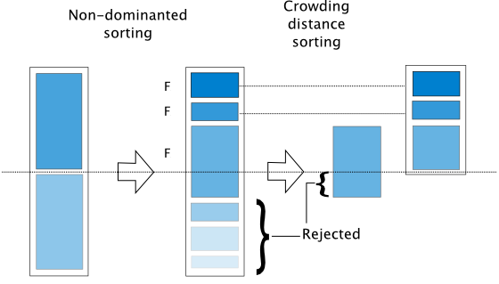
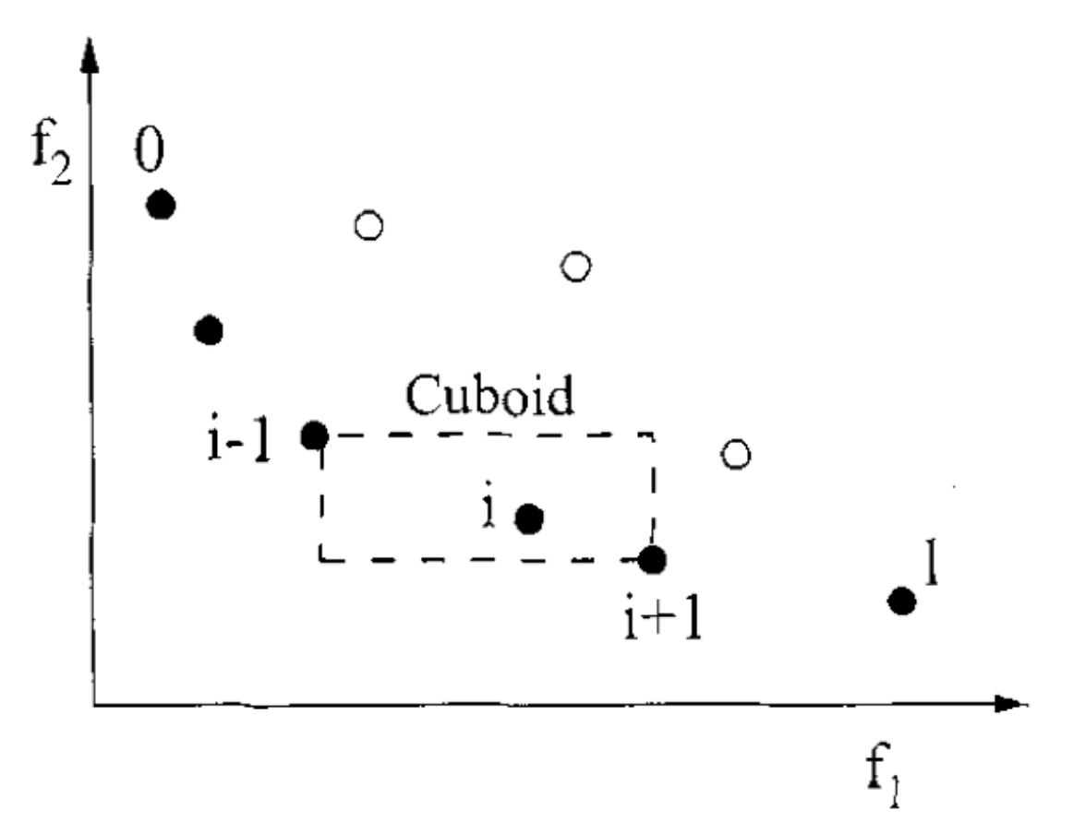

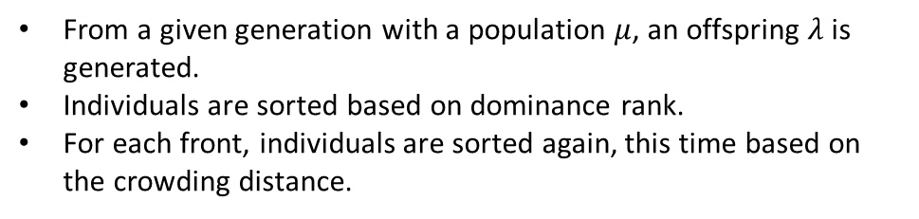


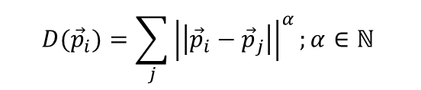
Non-dominated Sorted Genetic Algorithm II (NSGA-II)
Algorithm for dealing with multi-objective offspring selection, based on Pareto dominance and a crowding distance, for promoting kernel diversification.
$$D({\vec{p}}_{i})=\sum_{j}{{\left|\left|{\vec{p}}_{i}−{\vec{p}}_{j}\right|\right|}^{α};α∈ℕ}$$
New population
Current population
$$μ$$
$$μ$$
Offspring
$$λ$$
From a given generation with a population $μ$, an offspring $λ$ is generated.
Individuals are sorted based on dominance rank.
For each front, individuals are sorted again, this time based on the crowding distance.
Domination fronts
Source

Slide 10
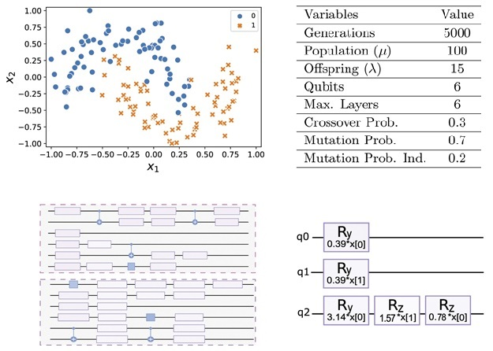
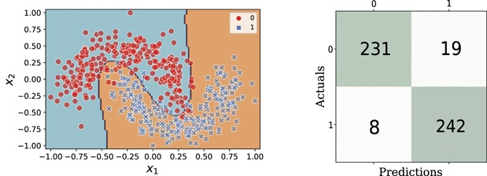
Results
Toy-model dataset: 2- classes Moons synthetic non-linear dataset.
Training set
Input parameters
150 datapoints (70% train, 30% test).
Max circuit allowed: 6 qubits, 6 layers
Number of generations: 5000.
Initial population: 100.
No entanglement required for fitting the model with 100% accuracy.
Validation set
Initial circuit structures
The fittest kernel
94.6% accuracy
Good generalization properties.
100% accuracy (on training)

Slide 11
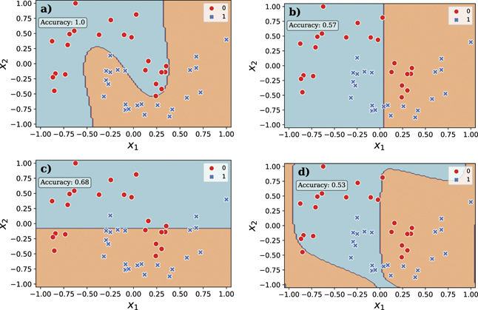
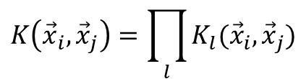
Interpretability
Due to the heavy penalization of entangling gates, it’s often possible to decompose qubit contributions to the kernel matrix.
Fittest kernel (a), and the single qubits (b, c, d) decision boundaries.
$$K\left({\vec{x}}_{i}, {\vec{x}}_{j}\right)=\prod_{l}{K_{l}({\vec{x}}_{i}, {\vec{x}}_{j})}$$
The single qubits have low accuracy, respectively of: 57%, 68%, 53%.
Only one qubit provides non-linearity.
Their combination of 3 ‘’weak classifiers’’ leads to 100% accuracy.

Slide 12
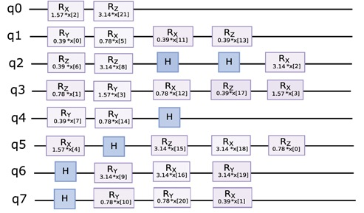
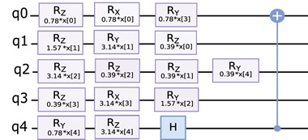

NSGA-II on other datasets
Output kernels for other famous benchmark datasets.
Parkinson
Drug classification
IoT irrigation
22 features
5 features
2 features
‘’Vestigial’’ gates
All reaching 100% accuracy on training.
Preference for separable circuits.
Qubit number increases with the number of features.

Slide 13
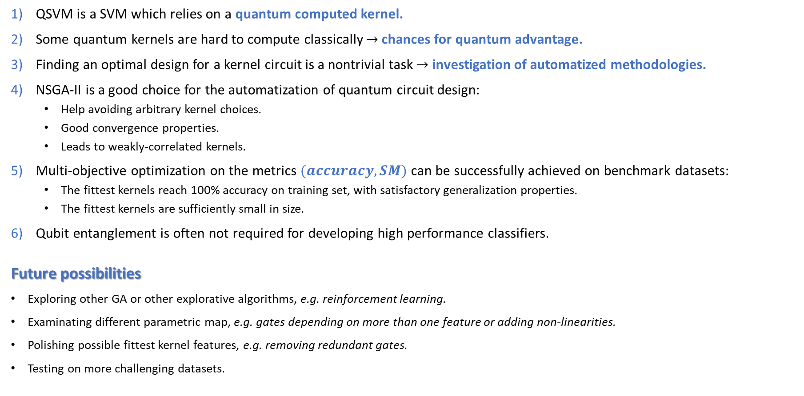
Summary and conclusions
QSVM is a SVM which relies on a quantum computed kernel.
Some quantum kernels are hard to compute classically $→$ chances for quantum advantage.
Finding an optimal design for a kernel circuit is a nontrivial task $→$ investigation of automatized methodologies.
NSGA-II is a good choice for the automatization of quantum circuit design:
  Help avoiding arbitrary kernel choices.
  Good convergence properties.
  Leads to weakly-correlated kernels.
Multi-objective optimization on the metrics $(accuracy, SM)$can be successfully achieved on benchmark datasets:
  The fittest kernels reach 100% accuracy on training set, with satisfactory generalization properties.
  The fittest kernels are sufficiently small in size.
Qubit entanglement is often not required for developing high performance classifiers.
Future possibilities
Exploring other GA or other explorative algorithms, e.g. reinforcement learning.
Examinating different parametric map, e.g. gates depending on more than one feature or adding non-linearities.
Polishing possible fittest kernel features, e.g. removing redundant gates.
Testing on more challenging datasets.

