Slide 1

HL-LHC motorized jacks
Project organisation, status and plans for pre-series supply
Jaime Pérez Espinós
Meeting – 06/07/22

Slide 2
Outlook
Scope
Procurement scenarios and boundary conditions for HL-LHC jacks
Project organisation, status and plans for pre-series supply

Slide 3
Scope (I)
Extraction from e-mail sent by P. Chiggiato on 06/04/22

Slide 4
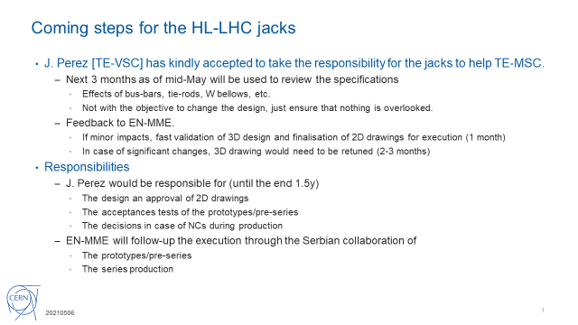
Scope (II)
Slide presented by J. M. Jiménez on 06/05/21

Slide 5
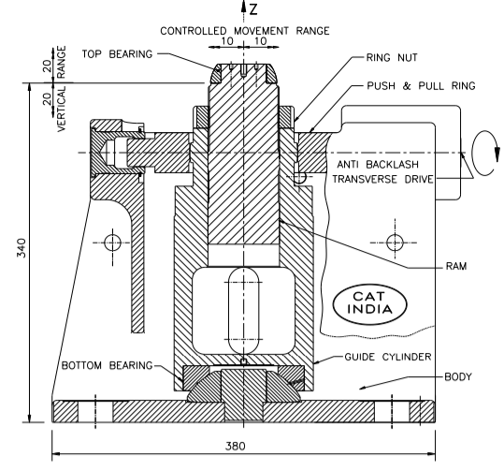
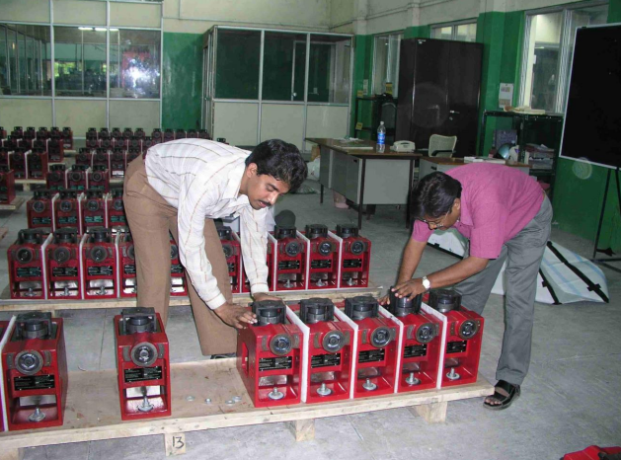
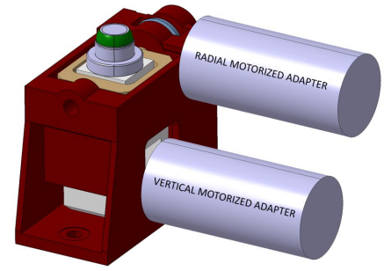
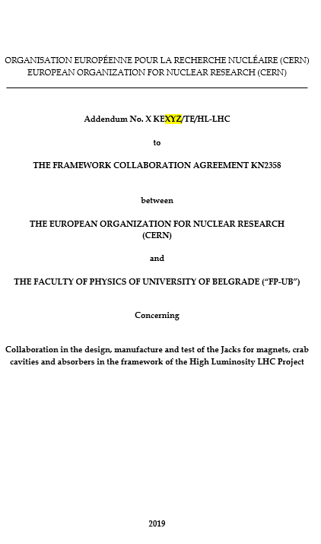
HL-LHC Jacks
Procurement scenarios and boundary conditions
DDR
PRR
2018 2019 2020 2021 2022
In fall 2021, notification from Serbian colleagues that they were not able to provide the Jacks as
in-kind Contribution and they preferred to give the estimated total amount to CERN as cash payment
Once the money is transferred to CERN, this must follow the Financial Rules at CERN
Due to the impact and urgency of the IT String units, IPT agreed to have a Noncompetitive tender (with the Serbian Firm) for the IT String units, but MS/IT are required for the Series units (LHC)
Unofficial RfQ to UNIOR has confirmed that the price largely exceeds the initial CERN estimations
Following the Financial Rules at CERN for non-competitive tenders, the order for the IT String units would need FC Approval (next one in June)
HL Coll Officer working on price reduction to enable to place the order soon
Series production will follow the usual procurement process at CERN (not part of the PRR Scope)
Design evolution to cope with requirements from different users as well as FRAS requirements
Design evolution to cope with the requirements from the in-kind Contribution (welded construction instead of casting)
Technical discussions with the Serbian Collaboration were maintained and design was progressing towards the final solution
Industrial partner (UNIOR) selected by Serbia also participated in the meetings
Initial discussions with Serbia (2018)
2019 - Memo issued for the potential in-kind contribution from Serbia to HL-LHC as special contribution to get the Associated MS status
2019- Collaboration Agreement drafted for the production of the mechanical bodies of the Jack (structural body, Motorization not included in the scope)
Contribution estimations based on the LHC design of the Jacks (designed and produced by India)
Technical meetings already started
Slide by H. García Gavela during PRR for the IT String jacks procurement (on 30/03/22)

Slide 6
Project organisation, status and plans for pre-series supply
Plans for pre-series supply:
  Orders for already released (EDH #9204149 and EDH #9280625) and paid entirely by WP3
Project status:
  HL-LHC jacks
    DR and PRR already made → design approved and overall production strategy endorsed
      Final lubrication decision, pending of lubricant irradiation campaign and latter dedicated tests → draft of test specification for irradiation campaign under internal review, to be followed by review and approval by WP leaders → campaign to start at best in Oct. ’22 → dedicated tests along 2023 → decision on lubrication decoupled from jacks for IT String
    Production: see next slides
  CERN acceptance test tool → need identified due to split of supply and/or orders → originally supposed to be designed and delivered by supplier
    Design → OK
    Production and assembly foreseen for end of July 2022 (W30)
    Test (on CERN prototype) in August 2022 (by W34)
    Shipment to supplier, beginning of September 2022
  CERN prototype
    Metrology of subcomponents expected beginning of July (W27)
    Assembly to follow, ~ mid-July (W29)

Slide 7
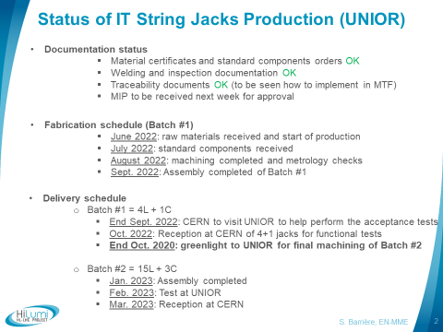
HL-LHC jack production
Schedule agreed with UNIOR is Dec. ‘22 for production and Jan. ‘23 for tests at their facilities

Slide 8
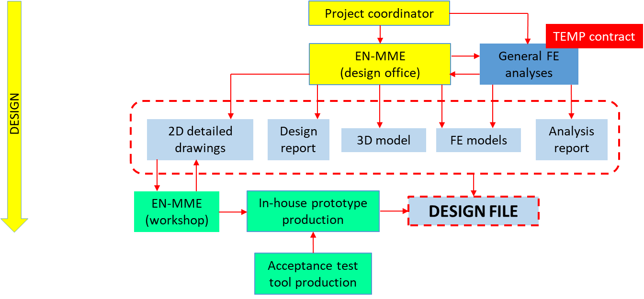
Project organization (as presented in the PRR) - Design
J. Perez
L. Krzempek (contract finished)
T. Lehtinen
S. Barriere
(M. Garlasche)
QA/QC: support from HL-LHC PO (V. Guillen)

Slide 9
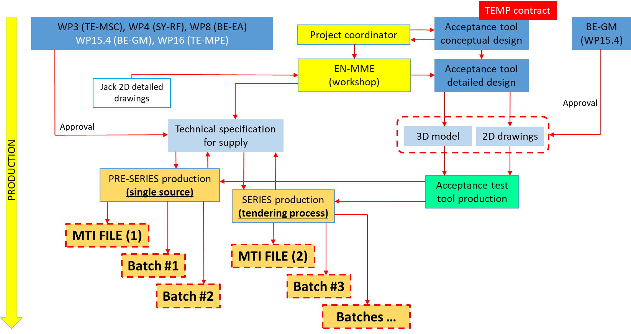
Project organization (as presented in the PRR) - Production
L. Krzempek (contract finished)
J. Perez
S. Barriere
(M. Garlasche)
M. Sosin (M. Noir)
E. Urrutia (design); M. Masci (analyses)
TBD
QA/QC: support from HL-LHC PO (V. Guillen)

Slide 10
Thank you for your attention

