Slide 1
MC Proton Driver parameters: US siting
FNAL from DUNE-era to MC-era
Jeffrey Eldred
Muon Collider Collaboration Meeting
October 12th, 2022

Slide 2
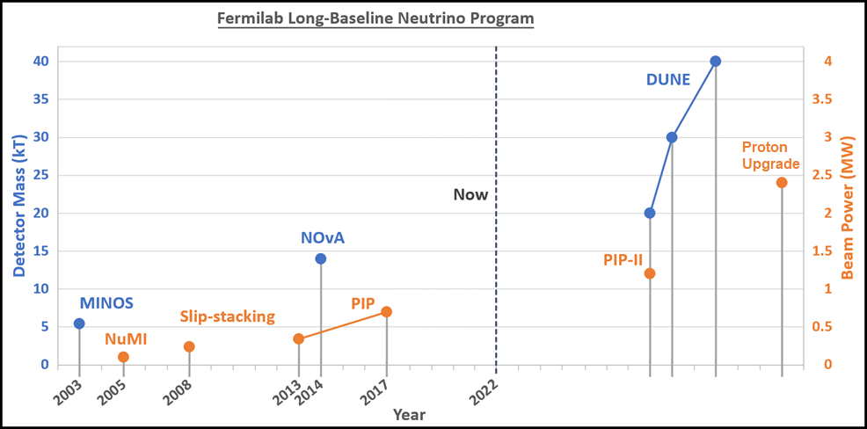
2
Neutrinos: Beam Power and Detector Size
DUNE long-baseline neutrino program calls for 2.4 MW
J. Eldred, JINST 2019
2
Jeffrey Eldred | 2.4 MW Upgrade with RCS
Notes:
2
2
2

Slide 3
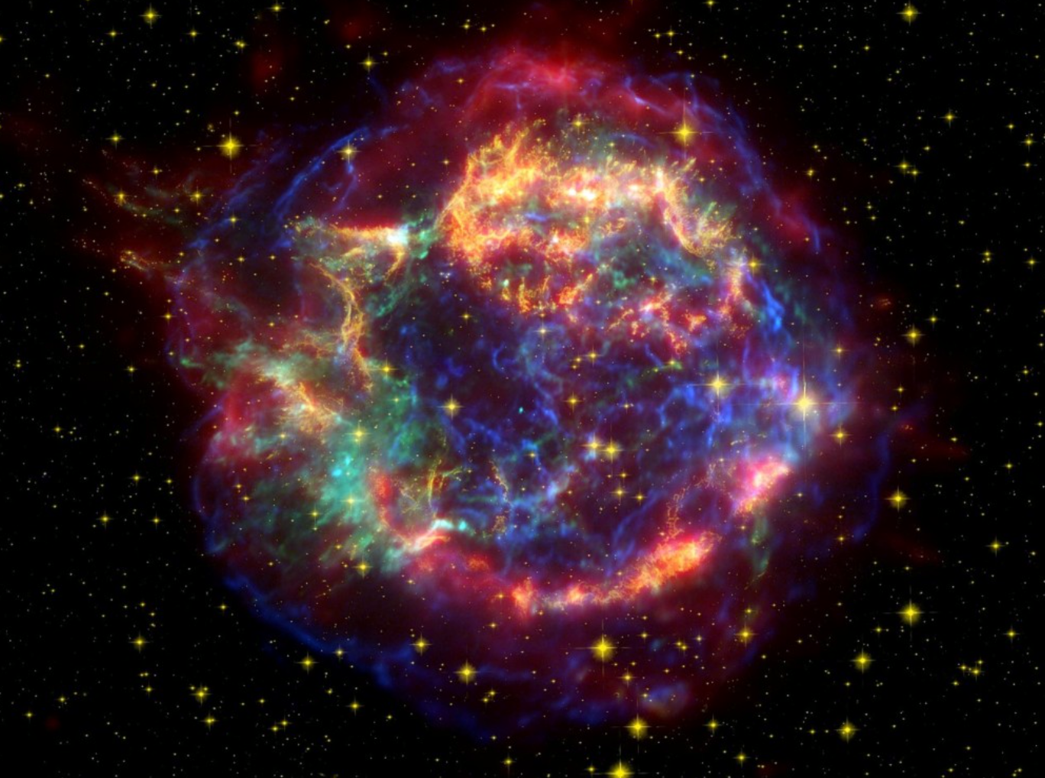
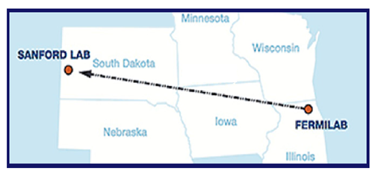
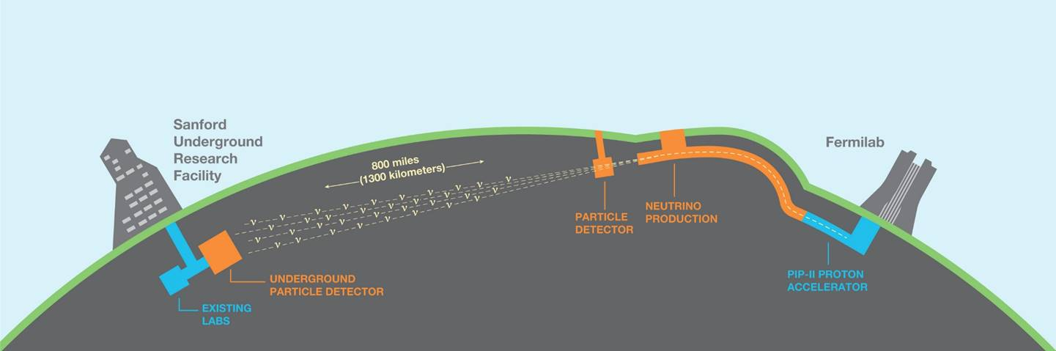
DUNE physics program
δ_{CP} Discovery, sigmas over time
Unambiguous, high precision measurements of Δm²₃₂, δ_{CP}, sin²θ₂₃, sin²2θ₁₃ in a single experiment
Discovery sensitivity to CP violation, mass ordering, θ₂₃ octant over a wide range of parameter values
Sensitivity to MeV-scale neutrinos, such as from a galactic supernova burst
Low backgrounds for sensitivity to BSM physics including baryon number violation
1.2 MW
2.4 MW
starts ~2032 -> ~2048
3
Jeffrey Eldred | 2.4 MW Upgrade with RCS

Slide 4
4
4
Proton Intensity Upgrade (PIU)
(aka DUNE/LBNF Phase II driver,
aka Booster Replacement,
aka PIP-III, aka 2.4 MW Upgrade,
Arguably aka Project X)
4
Jeffrey Eldred | 2.4 MW Upgrade with RCS

Slide 5
5
Acknowledgements & White Papers
Snowmass White papers related to DUNE/LBNF PIU upgrades
“A Cost-Effective Upgrade Path for the Fermilab Accelerator Complex”
Sergei Nagaitsev and Valeri Lebedev
“An Upgrade Path for the Fermilab Accelerator Complex”
Rob Ainsworth, Joe Dey, Jeff Eldred, Roni Harnik, Jonathan Jarvis, Dave Johnson, Ioanis Kourbanis, David Neuffer, Eduard Pozdeyev, Mike Syphers, Sasha Valishev, Vyacheslav Yakovlev and Bob Zwaska
“Design Considerations for Fermilab Multi-MW Proton Facility”
Jeff Eldred, Sergei Nagaitsev, Vladimir Shiltsev, Mike Syphers, Sasha Valishev, and
Bob Zwaska
“An 8 GeV Linac as the Booster Replacement in the Fermilab Power Upgrade”
Sergey Belomestnykh, Mattia Checchin, David Johnson, David Neuffer, Hasan Padamsee, Sam Posen, Eduard Pozdeyev, Vitaly Pronskikh, Nikolay Solyak, Vyacheslav Yakovlev
PIU-MC Group Pushpa Bhat, Jeff Eldred, Sergo Jindariani, Sergei Nagaitsev, David Neuffer, Sam Posen, Vladimir Shiltsev, Diktys Stratakis, Katsuya Yonehara,
5
Jeffrey Eldred | 2.4 MW Upgrade with RCS
Notes:
5
5
5

Slide 6
6
Fermilab PIP-II Era
Main Injector
(MI)
Recycler
Booster
PIP-II
Linac
8 GeV, 20 Hz,
2 us, 80 kW
120 GeV, 1.2 s,
11 us, 1.2 MW
0.8 GeV 2mA
CW-linac
H- Injection Location
6
Jeffrey Eldred | 2.4 MW Upgrade with RCS

Slide 7
7
Fermilab PIU – “RCS” Option
Main Injector
(MI)
Recycler
RCS
PIP-II
Linac
8-12 GeV, 10-20 Hz,
2 us, 330-950 kW
~2 GeV Linac
H- Injection Location
7
Jeffrey Eldred | 2.4 MW Upgrade with RCS

Slide 8
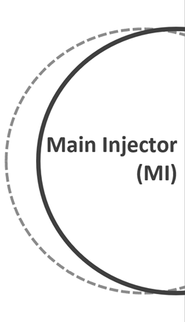
8
Fermilab PIU – “Linac” Option
Recycler
8 GeV
Accumulator
Ring
PIP-II
Linac
8 GeV, 10-20 Hz,
<2 us, 300-860 kW
8 GeV Linac
H- Injection Location
8
Jeffrey Eldred | 2.4 MW Upgrade with RCS
Notes:
8
8
8

Slide 9
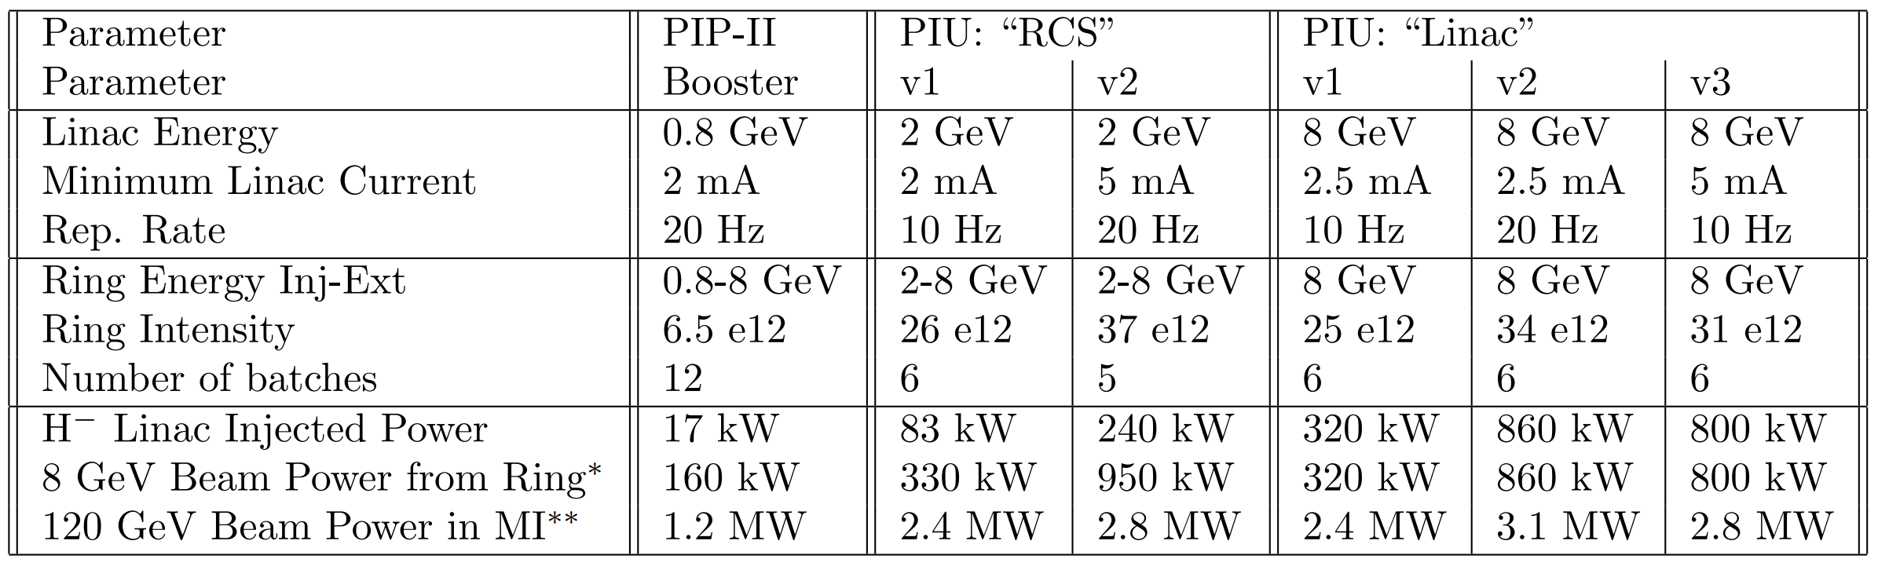
9
PIU Parameter Tables
Five versions of PIU have different implications for 8 GeV program.
* Total 8-GeV Beam Power, (2.4 MW MI program uses 160 kW)
- ~2 μs pulses either from RCS or an 8 GeV Accumulator Ring.
** DUNE/LBNF beam power strictly limited to 2.4 MW.
- all PIU scenarios deliver 2.4 MW for DUNE/LBNF.
9
Jeffrey Eldred | 2.4 MW Upgrade with RCS
Notes:
9
9
9

Slide 10
10
PIU Parameter Tables
Five versions of PIU have different implications for 8 GeV program.
Minimal versions of PIU have about 320 kW at 8 GeV, roughly half of which is sent to the MI program.
10
Jeffrey Eldred | 2.4 MW Upgrade with RCS
Notes:
10
10
10

Slide 11
11
PIU Parameter Tables
Five versions of PIU have different implications for 8 GeV program.
800-950 kW at 8 GeV available for only a small marginal cost.
These scenarios provide a clear path to Muon Colider Proton Driver.
11
Jeffrey Eldred | 2.4 MW Upgrade with RCS
Notes:
11
11
11

Slide 12
12
12
From PIU to
MC Proton Driver (MCPD)
12
Jeffrey Eldred | 2.4 MW Upgrade with RCS

Slide 13
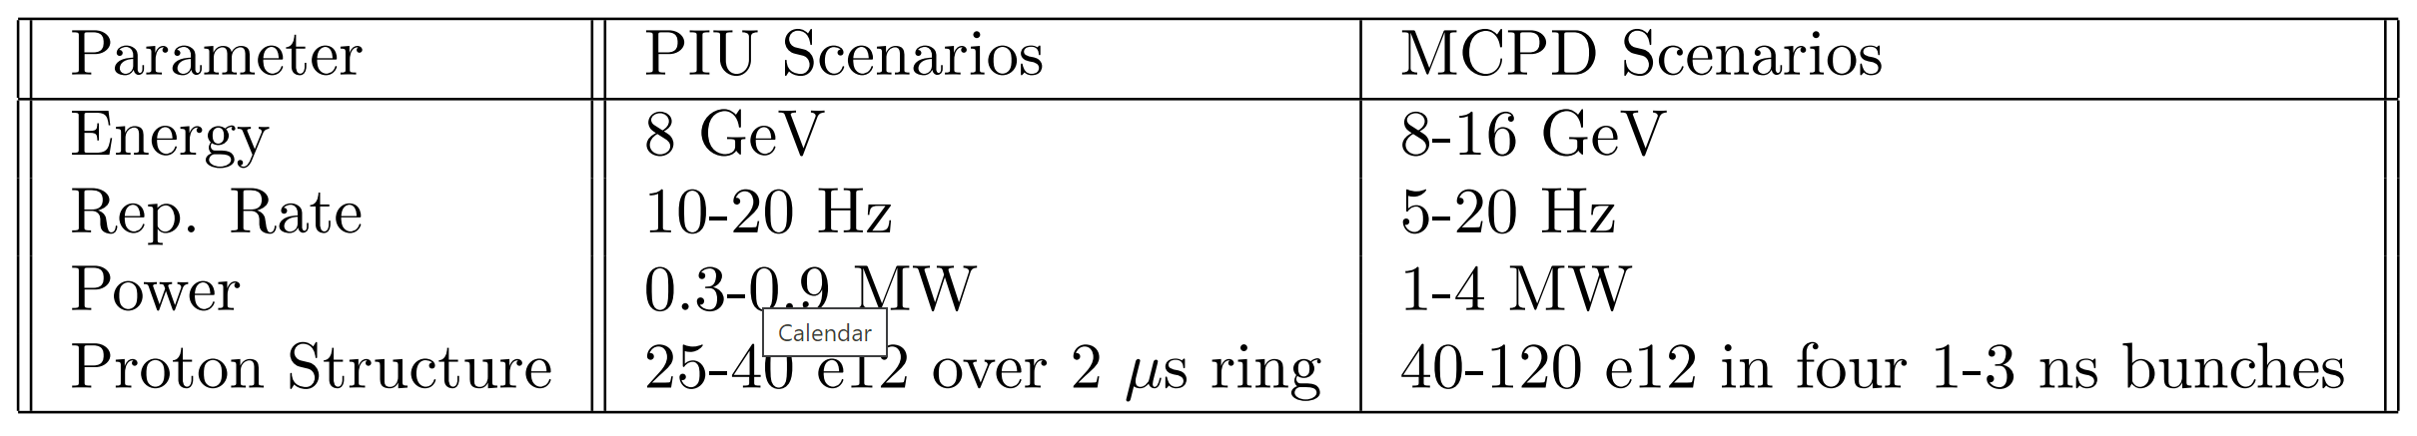
13
High Level FNAL MCPD Parameters
MCPD Energy: 8-16 GeV
- Starting from FNAL-PIU, doing less than 8 GeV doesn’t make sense.
- Muons / MW and other production/capture design aspects appear to be relatively insensitive to changes in energy.
- Proton compression is a challenging aspect, energy helps space-charge.
- Energy can be a convenient way to boost beam power.
13
Jeffrey Eldred | 2.4 MW Upgrade with RCS
Notes:
13
13
13

Slide 14
14
High Level FNAL MCPD Parameters
Rep. Rate 5-20 Hz
- For a 10 TeV collider, the muon lifetime is ~0.1s. Luminosity will be heavily front-loaded for a 5-20 Hz repetition rate.
- The RCS/Linac beam would either be used directly or be reconfigured for lower repetition rate.
14
Jeffrey Eldred | 2.4 MW Upgrade with RCS
Notes:
14
14
14

Slide 15
15
High Level FNAL MCPD Parameters
Power 1-4 MW
Proton Structure 40-120 e12 in four 1-3 ns bunches
- Intense ns-scale bunches maximize initial phase-space of muon beams.
- Assume four bunches will converge on target.
- Parameters targeting 2 e35 cm⁻²s⁻¹ luminosity for 10 TeV collider.
- Parameters achievable from proton driver perspective
- Proton compressor ring is used to adapt PIU to MC PD pulses.
- Preliminary assessment for space-charge and machine performance.
15
Jeffrey Eldred | 2.4 MW Upgrade with RCS
Notes:
15
15
15

Slide 16
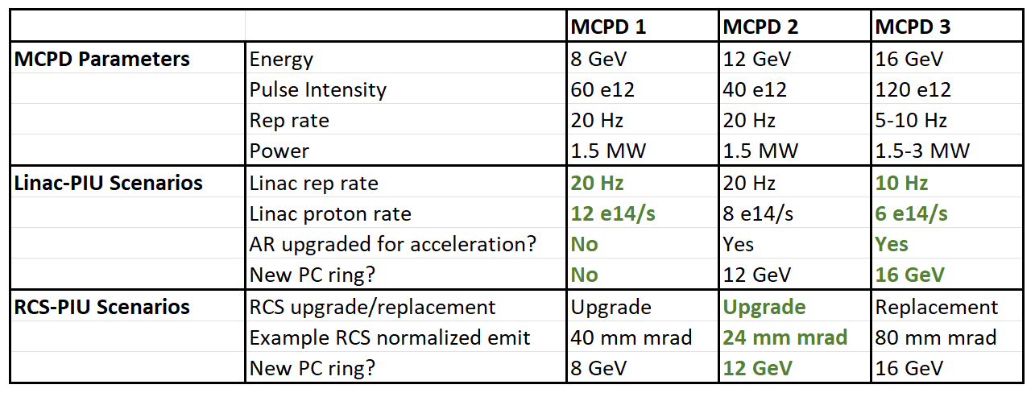
16
PIU-to-MCPD Scenarios
Many paths between PIU and MCPD, but a few to examine closely:
MCPD1 – Close to Linac-PIU scenario already.
16
Jeffrey Eldred | 2.4 MW Upgrade with RCS
Notes:
16
16
16

Slide 17
17
Fermilab PIU-Linac to MCPD 1
8 GeV
Accumulator Ring
& Proton Compressor
PIP-II
Linac
8 GeV Linac
x2 Average Current
H- Injection Location
Upgrade
AR now does proton compression.
Linac peak current or rep rate doubles.
17
Jeffrey Eldred | 2.4 MW Upgrade with RCS
Notes:
17
17
17

Slide 18
18
PIU-to-MCPD Scenarios
Many paths between PIU and MCPD, but a few to examine closely:
MCPD2 – Overdesign or upgrade of RCS, plus a new compressor ring
18
Jeffrey Eldred | 2.4 MW Upgrade with RCS
Notes:
18
18
18

Slide 19
19
Fermilab PIU-RCS to MCPD 1-2
Upgraded
8-12 GeV RCS
Proton
Compressor
PIP-II
Linac
~2 GeV Linac
H- Injection Location
Upgrade
RCS delivers higher charge or energy
Build
Proton Compressor
19
Jeffrey Eldred | 2.4 MW Upgrade with RCS

Slide 20
20
Fermilab PIU-RCS to MCPD 2-3
Upgraded
8 GeV RCS
8-16 GeV Accelerator
& Proton Compressor
PIP-II
Linac
~2 GeV Linac
H- Injection Location
Upgrade
RCS used directly or delivers more charge.
Build
Proton Compressor, also accelerates.
20
Jeffrey Eldred | 2.4 MW Upgrade with RCS

Slide 21
21
PIU-to-MCPD Scenarios
Many paths between PIU and MCPD, but a few to examine closely:
MCPD3 – At high energy, more intense pulses are possible. Will require some linac acceleration, some ring acceleration, and a pulse compressor.
Any of these PIU scenarios can go to any of these MCPD scenarios.
21
Jeffrey Eldred | 2.4 MW Upgrade with RCS
Notes:
21
21
21

Slide 22
22
Fermilab PIU-Linac to MCPD 2-3
8 GeV Accumulator Ring
& 12-16 GeV Accelerator
Proton
Compressor
PIP-II
Linac
8 GeV Linac
H- Injection Location
Upgrade
AR now accelerates
Build
Proton Compressor
22
Jeffrey Eldred | 2.4 MW Upgrade with RCS
Notes:
22
22
22

Slide 23
23
Fermilab PIU-RCS to MCPD 2-3
Replacement
12-16 GeV RCS
Proton
Compressor
PIP-II
Linac
~2-4 GeV Linac
H- Injection Location
Build
New RCS with higher energy and charge
Proton Compressor
23
Jeffrey Eldred | 2.4 MW Upgrade with RCS

Slide 24
24
PIU-to-MCPD Scenarios
Assumptions:
Accumulation // Acceleration // Compression
- Assume a ring can do any two out of three, but not all three.
Space-charge during injection dQsc < 0.2, compression dQsc < 0.6 .
Laser-stripping H- injection technology may be required to overcome limitations in H- injection foils (degradation and beam loss).
24
Jeffrey Eldred | 2.4 MW Upgrade with RCS
Notes:
24
24
24

Slide 25
25
MC Proton Driver R&D Topics
1) H- Laser Stripping (especially Linac-PIU)
- SNS has demonstrated 95% efficiency over μs-scale with UV laser.
- Recommend laser demonstrator for IR wavelengths and ms-scale.
2) Muon Targetry & Cooling.
- A core design aspect, but areas for production/cooling optimization alongside proton driver optimization.
3) Pulse Compression Beam Dynamics.
- Simulations and experimental benchmarks.
4) Fast-ramping HTS Magnets (especially RCS-PIU)
- Needed on muon-side, but also benefits for proton RCS design.
- aperture (5-20 cm), dipole field (1-4 T), ramping (60-600 T/s)
5) Extreme Space-charge (especially RCS-PIU)
- Muon Collider is at Energy Frontier and Intensity Frontier.
- SC during injection and proton compression stages.
25
Jeffrey Eldred | 2.4 MW Upgrade with RCS
Notes:
25
25
25

Slide 26
26
Summary & Outlook
Fermilab is planning on upgrading beam power for DUNE/LBNF, but how should we do that upgrade to prepare for “what’s next?”
- Muon Collider provides a potentially compelling answer but what are we prepared to commit to in our near term planning?
Muon Collider Proton Driver scenarios 8-16 GeV seem quite achievable.
- H- Laser Stripping is a critical R&D area.
- Operational experience on proton compression schemes.
- That’s proton-side perspective, muon-side R&D even more critical.
Evaluation of proton scenarios for FNAL PIU are instructive for any MCPD.
Dave Neuffer’s talk tomorrow on muon-side at FNAL.
Bob Bernstein’s talk tomorrow on muon CLFV points to a possible synergy
- AMF envisioned for 1-2 GeV, but 8 GeV PIU can also power it.
- AMF parameters an intermediate point between Neutrino & MC.
26
Jeffrey Eldred | 2.4 MW Upgrade with RCS
Notes:
26
26
26

Slide 27
27
27
Backup Slides
27
Jeffrey Eldred | 2.4 MW Upgrade with RCS

Slide 28
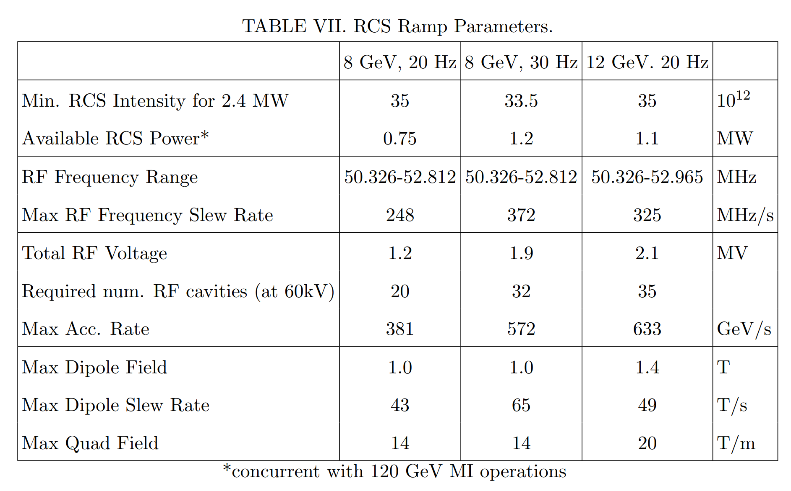
28
Rapid Cycling Synchrotron (RCS)
The 20 Hz RCS could be upgradeable to higher energy/rep.rate.
28
Jeffrey Eldred | An Upgrade Path toward Multi-MW Beam Power at Fermilab

Slide 29
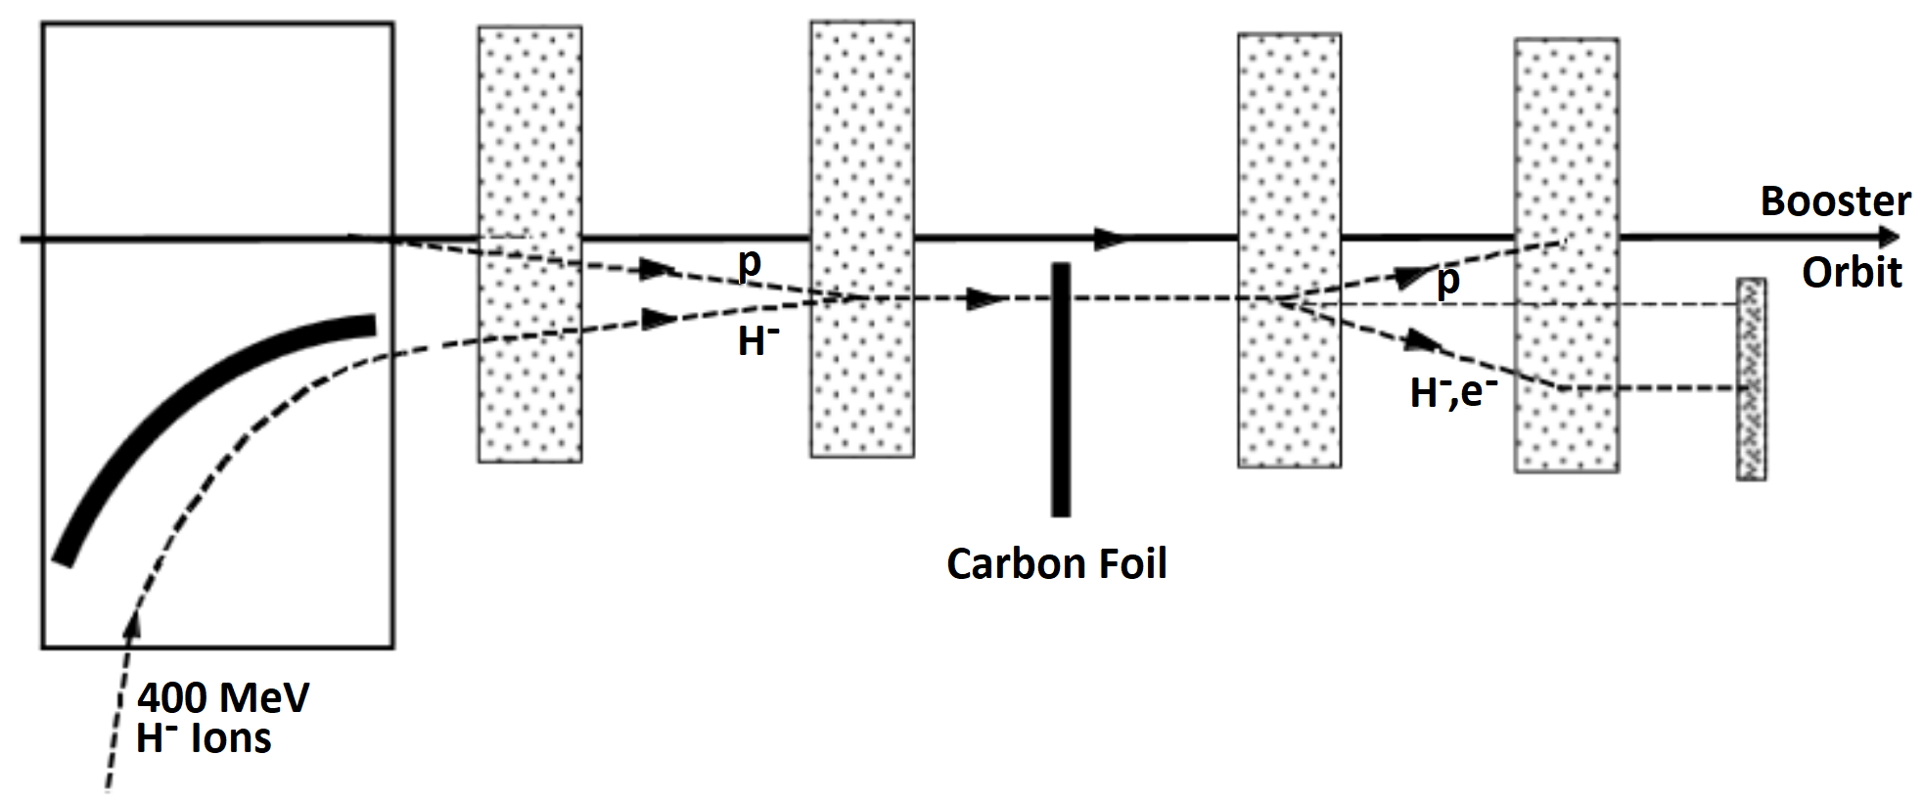
29
H- Injection through Foil, Process
H- linac beam transported into injection chicane.
Carbon foil strips the two electrons from the proton.
Proton beam accumulates in the ring.
Unstripped H- ions are sent to an absorber.
Ring cheats Louiville’s theorem, concentrates beam current by x10-x1000!
Essential for long-baseline program and many experimental programs.
29
Jeffrey Eldred | 2.4 MW Upgrade with RCS
Notes:
29
29
29

Slide 30
30
H- Injection through Foil, Challenges
Challenges:
- Chicane magnets must be sufficiently long (weak) to avoid stripping H- beam while also inflecting the beam towards the stripping foil.
- Losses from protons scattering off injection foil, high radioactivation.
- Thin stripping foil degrades from radiation and extreme heat.
- Losses of unstriped H- particles, requires absorber or extraction line.
- Injection optics interfere with symmetric ring lattice, causing resonances.
- Beam orbit must be maintained precisely over duration of injection.
30
Jeffrey Eldred | 2.4 MW Upgrade with RCS
Notes:
30
30
30

Slide 31
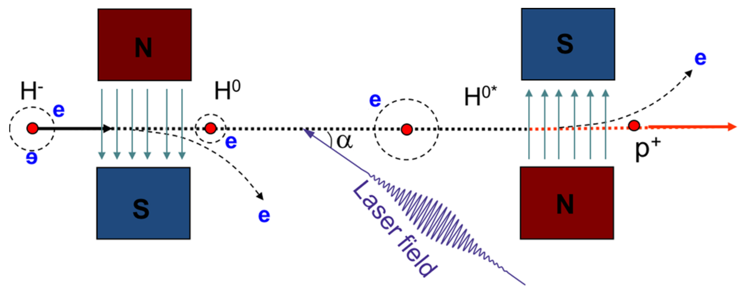
31
H- Injection through Laser
Laser-stripping technology R&D underway to eliminate many of these challenges....
SNS demonstrated 95% stripping efficiency of a 1 GeV H⁻ beam with 10 μs macropulse duration using a UV laser at 1 MW peak power.
However, millisecond duration with 99% efficiency is needed…
Present scenarios must proceed with a plan for H- foil injection (with laser-stripping as a subsequent retrofit).
Cousineau et al.
PRAB 2017
31
Jeffrey Eldred | 2.4 MW Upgrade with RCS
Notes:
31
31
31

Slide 32
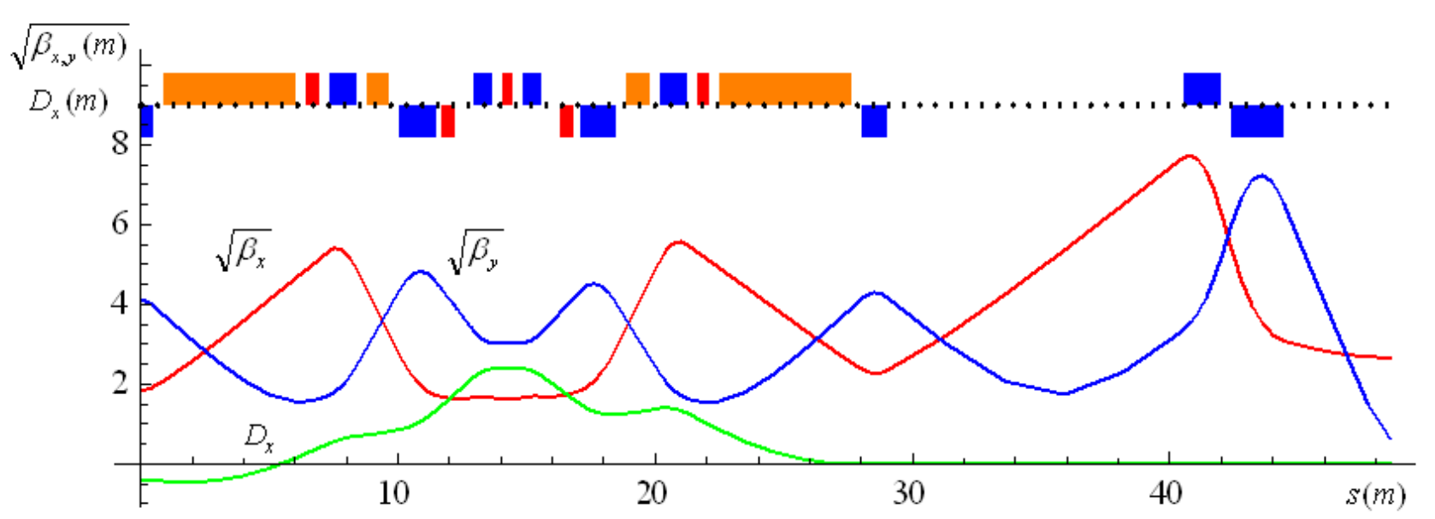
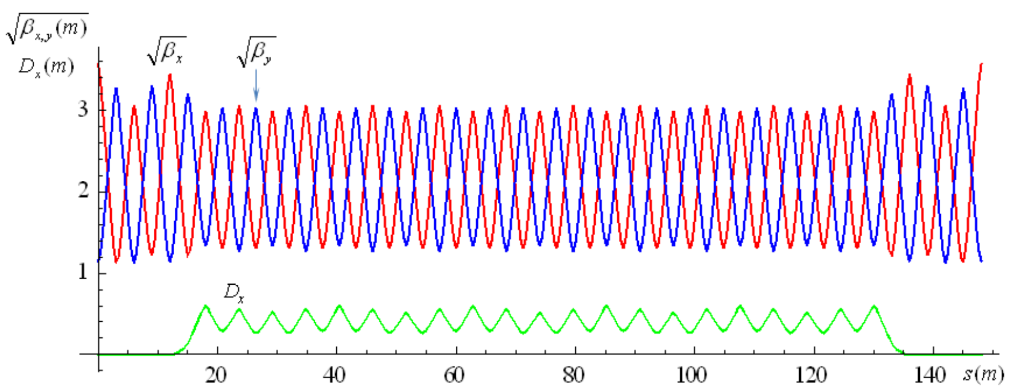
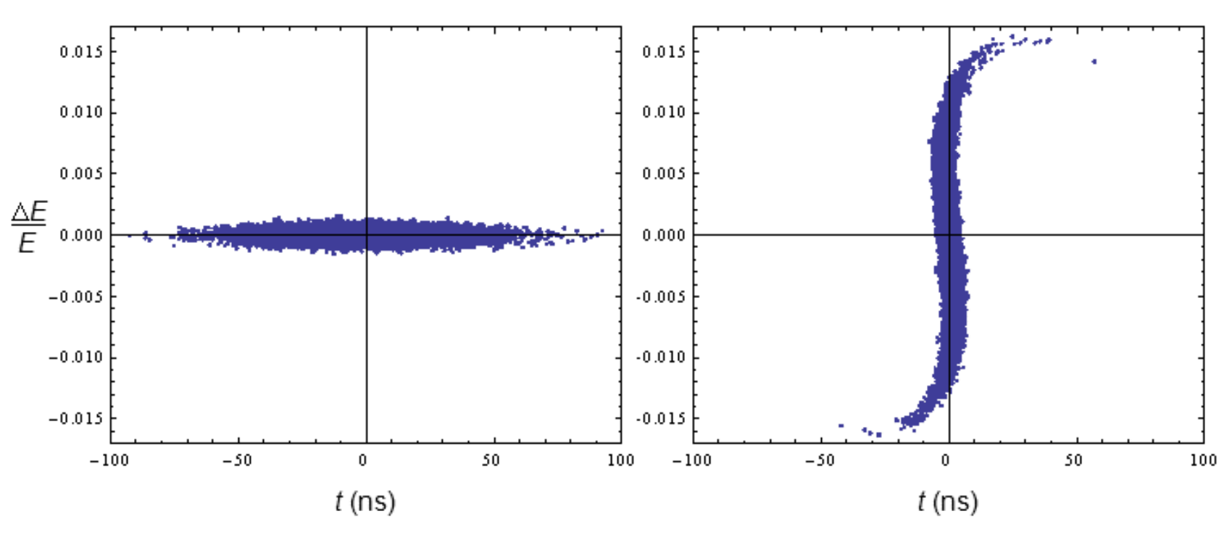
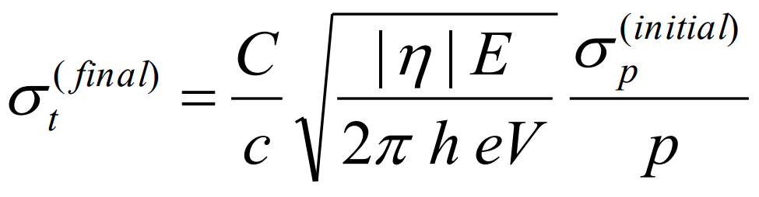
32
Example Pulse Compressor Ring Design
Alexahin, Jenner, Neuffer IPAC 2012
32
Jeffrey Eldred | 2.4 MW Upgrade with RCS
Notes:
32
32
32

Slide 33
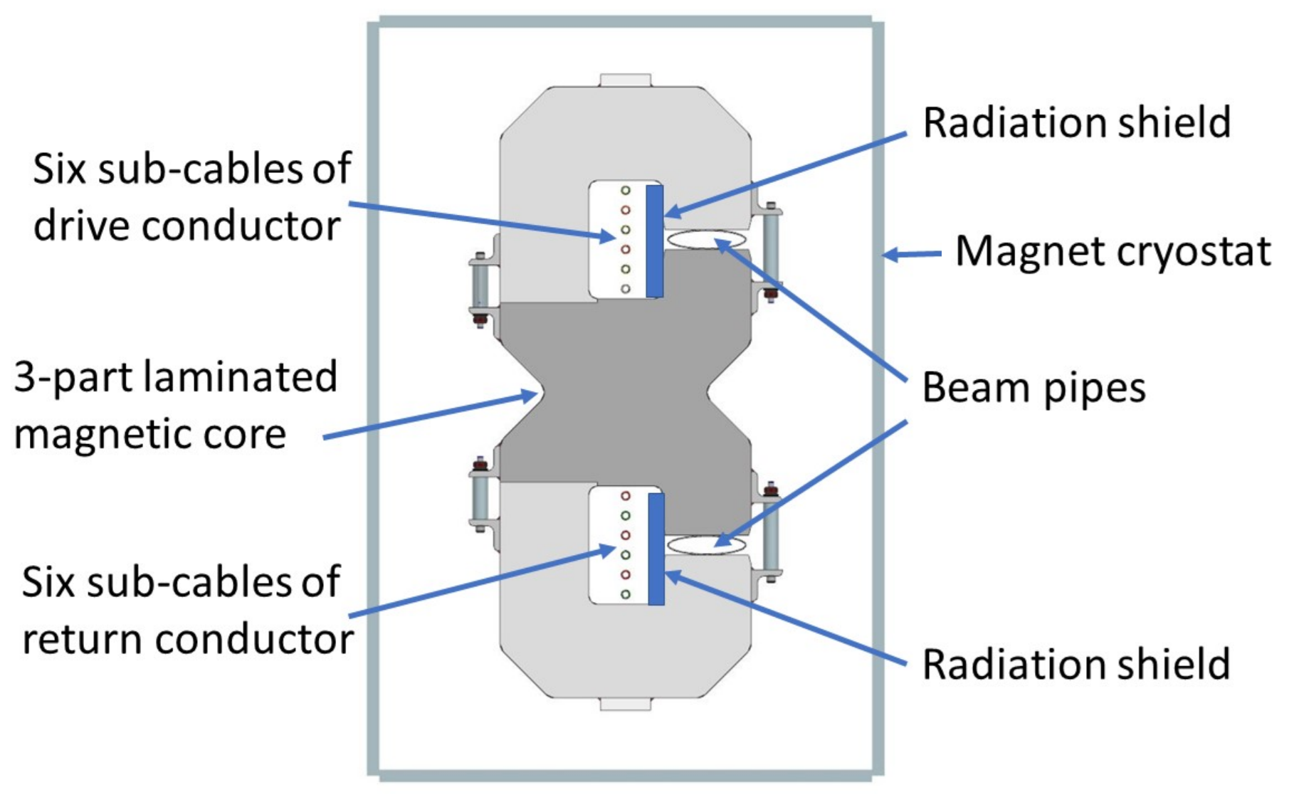
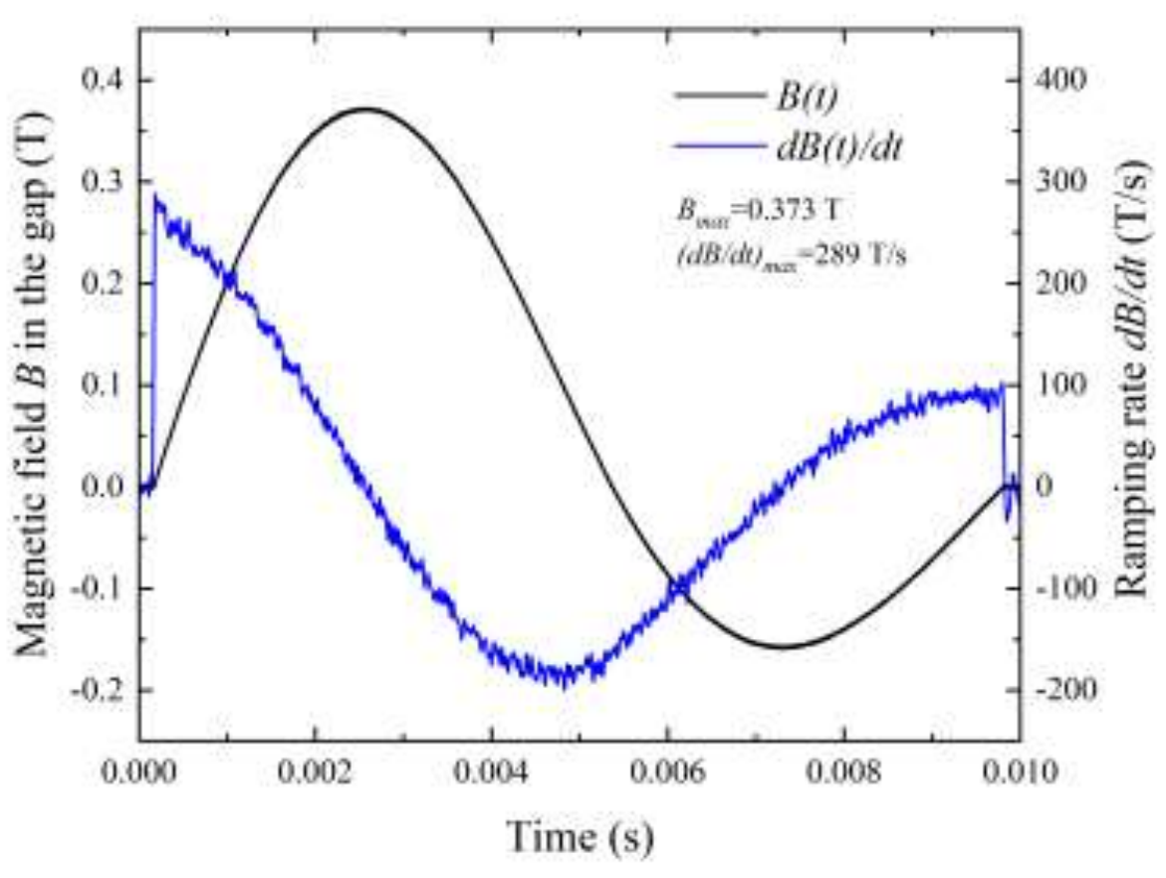
33
Fast-ramping HTS Magnets
YBCO-based HTS super-ferric dipole demonstrated >300 T/s. paper.
Potential for a fast-ramping compact RCS:
- Higher field strength at circumference → higher energy beams.
- Less circumference for extraction energy → RF power more efficient.
- More aperture at required field strength → greater beam intensity.
33
Jeffrey Eldred | Novel Approaches to High-Power Proton Beams
Notes:
33
33
33

