Slide 1


Muon Collider WP7-Task 2
Target, Capture and Cooling Magnets
Marco Statera
INFN LASA
CERN, 12-10-2022

Slide 2
Outline
Motivation
Highligths of the challenges
Discussion

Slide 3
Motivation 1 - where
Partecipating institutes
CERN-EP, Contact person: A. Dudarev
LNCMI,
contact person: Dr. X. Chaud, Dr. F. Debray
PSI, contact person: Dr. B. Auchmann
University of Geneva,
contact person: Prof. C. Senatore
INFN LASA, contact person: Marco Statera
University of Southampton,
contact person: Prof. Y. Yang
University of Twente, Prof. A. Kario
CEA, Dr. L. Quettier

Slide 4
Motivation 2
The objective of this work package is to address feasibility and technology limits of the magnet and powering systems, assess technology readiness and R&D timeline. The leading topics are:
  the value of the maximum field and free bore of the solenoids for the target, capture and cooling complex,
  the concept and feasibility, and
  design options
We address the above topics through a combination of conceptual design work, targeted tests and specific characterization measurements. We also plan to exploit synergies with on-going developments in other fields (high magnetic field science, NMR, fusion) and programs (EU High-Field Magnets R&D, US-MDP).

Slide 5
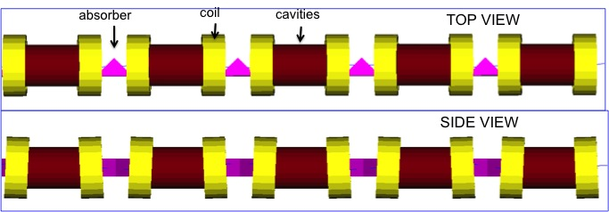
Solenoid zoo
Target solenoid
1.5 m 20 T 2MW
Muon coolig
1km 2 T to14 T
Final cooling
8.5 m – 40 T or 60 T

Slide 6
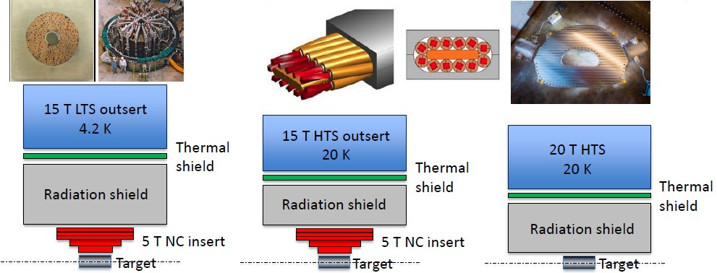
Challenges – Target solenoid
Challenges
Cost optimization
Sustanaibility
Same optimization for cooling solenoid
Based on exististing technology (ITER CS NB3SN CICC)
• 4.2 K cryogenics
• Resistive insert large power consuption
HTS internally cooled magnet wound with cable developed for fusion (CFS/MIT)
• Solenoid bore may be reduced by reducing shielding
• Improved cryogenic efficiency (a factor 5 better Carnot)
All-HTS internally cooled magnet, no resistive insert
• Minimal solenoid bore radius
• Reduced power consumption
• Large field on SC cable

Slide 7
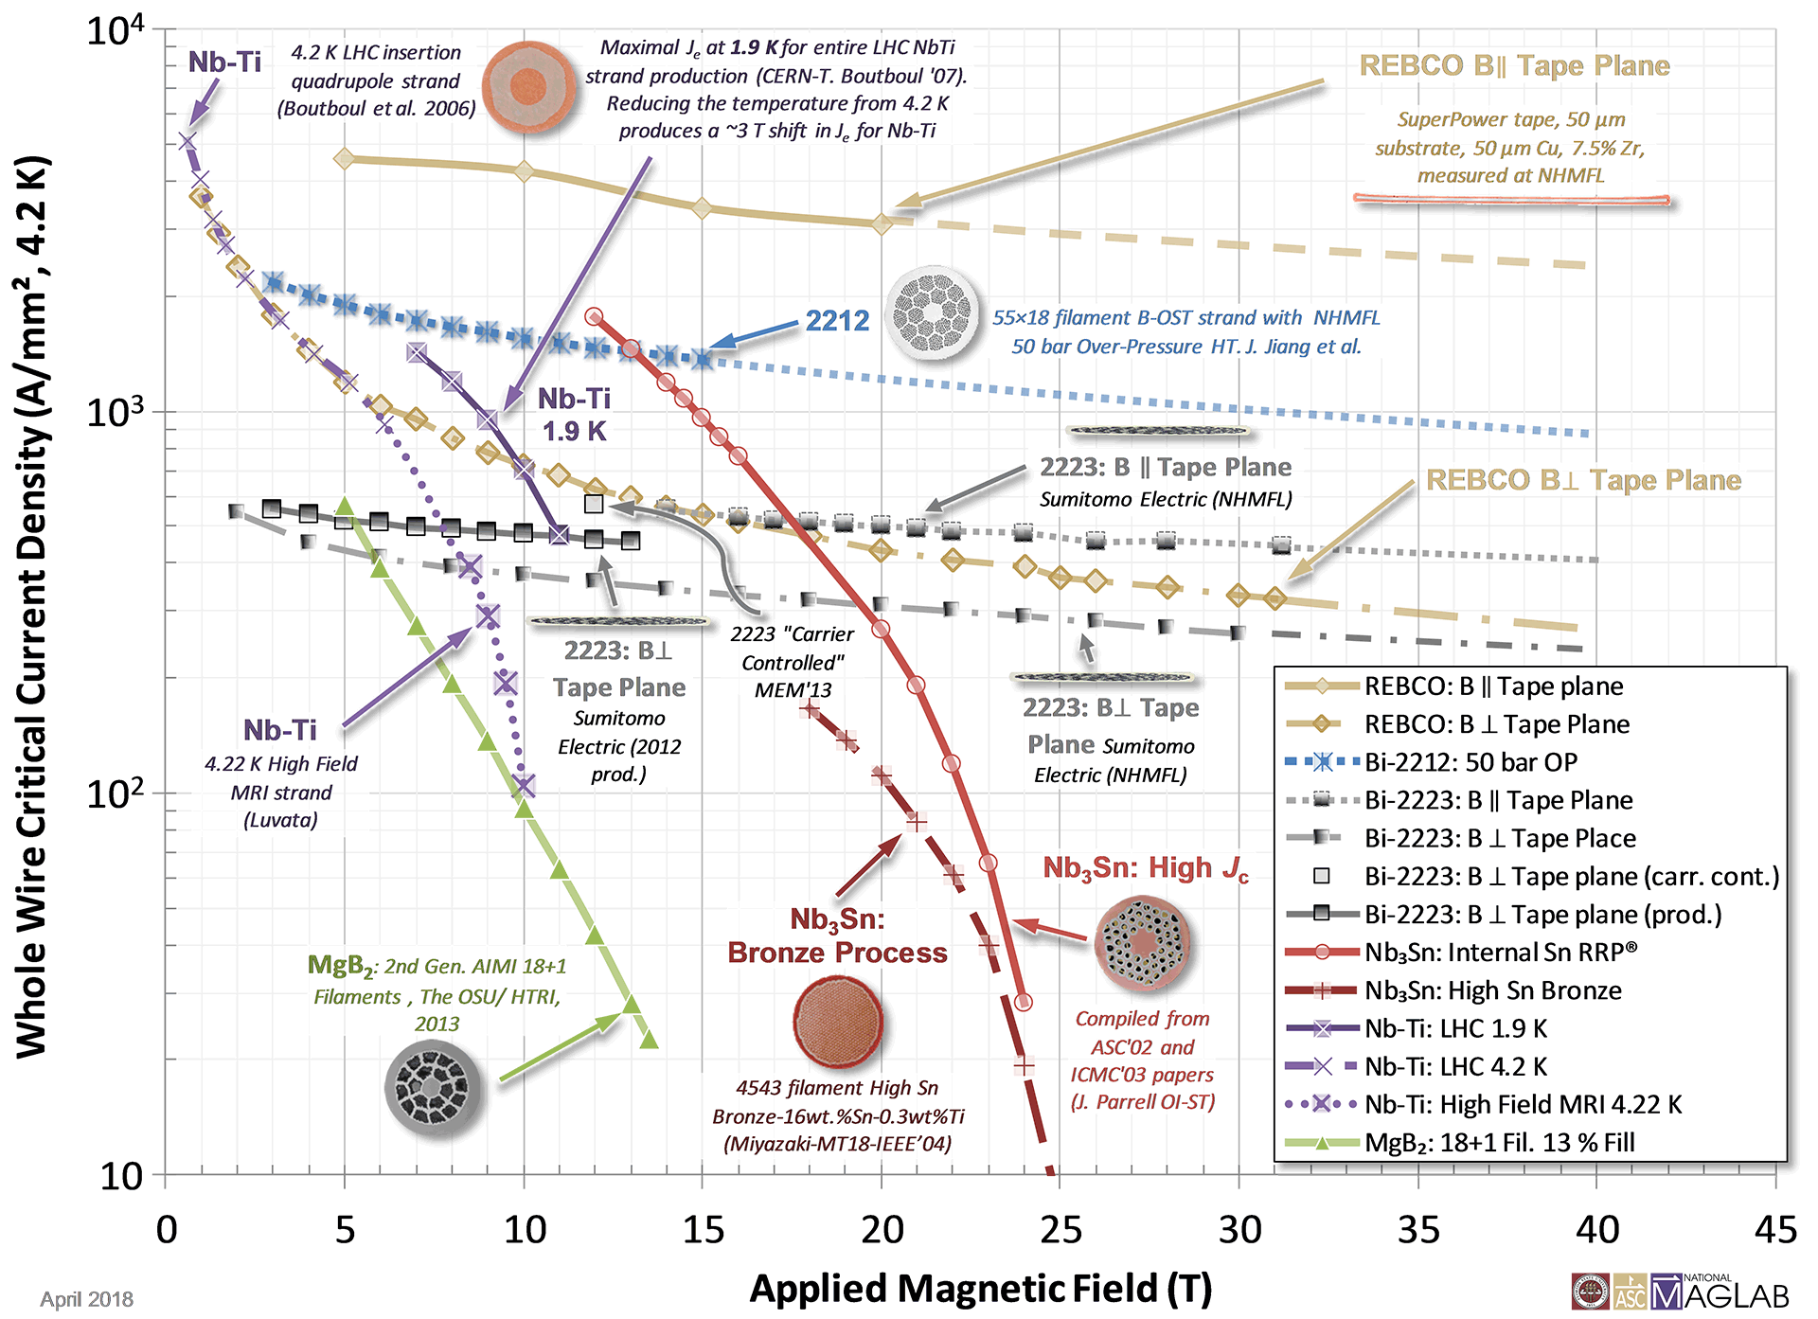
Challenges - final cooling solenoids
Target field 60T (40 T baseline)
Length 500 mm
Inner diameter 60 mm
Will be HTS
Mechanics and protection will most likely be the limit
Ultra High Field tests
Collaboration to high field inserts for tests 30 T - 40 T

Slide 8
Questions (and possible answers)
What is the maximum field that can be achieved in HF (target 20 T) and UHF (target 40…60 T) solenoids?
What is the R&D required to reach such field?
Can we increase the sustainability of such devices?
  A Review concepts and options for the target and final cooling solenoid (Hybrid/HTS only – Is Bi-2212 an option?) and preliminary design of solenoid families – the discussion we will initiate with the spotlights of today
  B Establish mechanical and protection limits of HF and UHF solenoids, in particular HTS tapes (internal adhesion, internal resistance, mechanical properties, radiation resistance, …)
    Instrument and test crucial properties on existing or new set-ups in order to establish the “technology reach”: Technology and Performance Limits experiments (TPL)

Slide 9
Discussion – ideas of topics
What is happening in the wider community?
Where do we stand with our solenoid challenges and options?
In practice, how can we
  Unite and leverage our efforts to achieve more than our single contributions? (this is the reason for the spot presentations)
  Profit from on-going programs other than muon collider R&D?
  Ensure our work is complementary and goes beyond the work of others?

Slide 10
THANKS

Slide 11
Deliverables
T₀+ 20 months M7.3 Workshop on Ultra High Field Solenoids
T₀+ 33 months D 7.1 Intermediate Report
T₀+ 45 months D 7.2 Consolidated report

