Slide 1

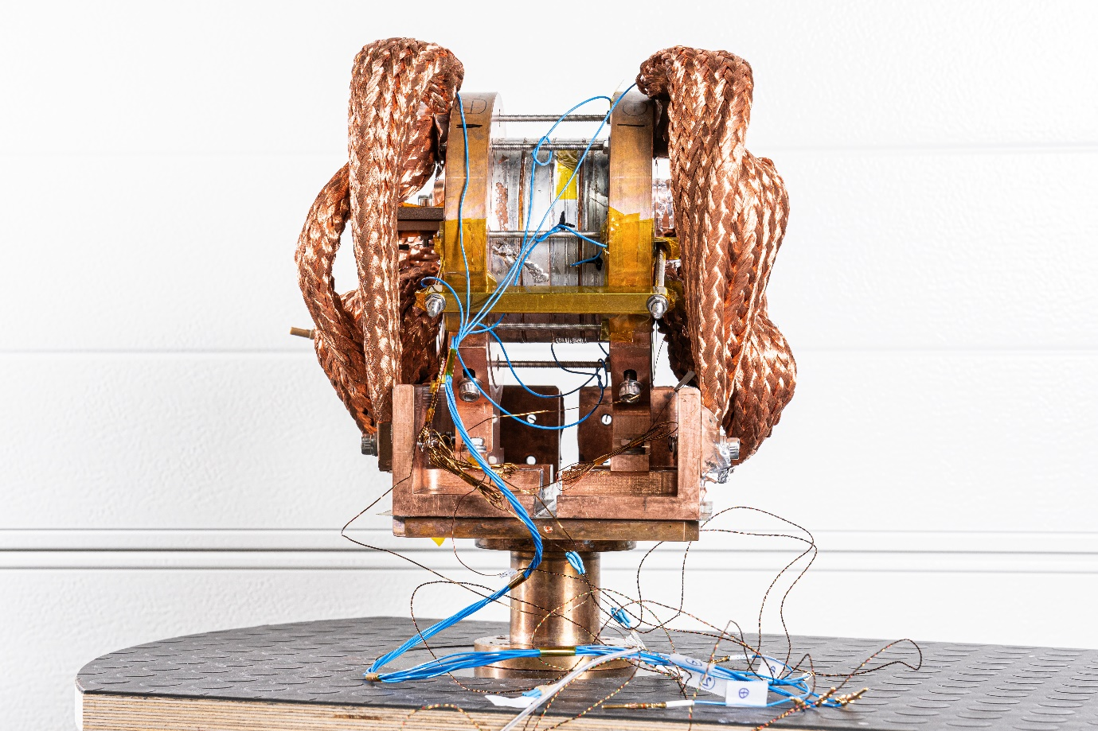
HTS solenoids at PSI
Jaap Kosse, Bernhard Auchmann, Michal Duda, Jeroen van Nugteren, Stephan Mueller,
Henrique Rodrigues, Stephane Sanfilippo
Work supported by the Swiss State Secretariat for Education,
Research and Innovation SERI
12/10/22

Slide 2
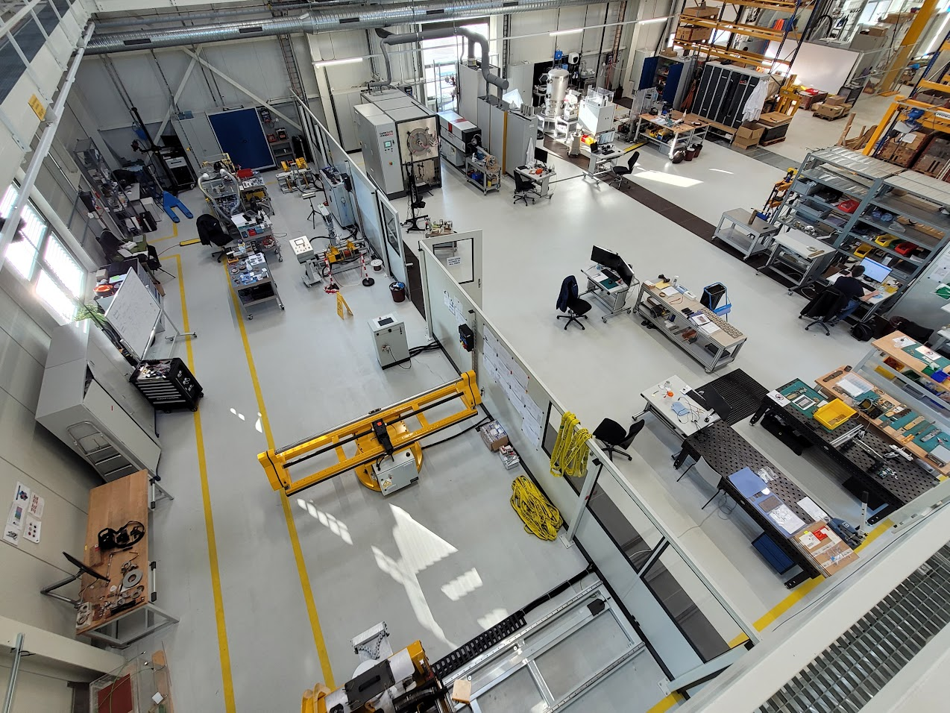
CHART2 MagDev @ PSI
“Swiss Accelerator Research and Technology – CHART” is a Swiss research network with PSI as a host institute and CERN, EPFL, ETHZ, and UniGE as additional members (http://chart.ch)
Heat treatment
Impregnation
CHART2 MagDev at PSI:
  creates magnet-development infrastructure
  LTS (Nb3Sn) technology development for the internat. high-field magnet project
  HTS (REBCO) superbend demonstrator
  bulk-HTS (REBCO) undulators
  HTS capture solenoid for a positron source
3D Scanning
HTS winding
1)
Storage
LTS re-reeler
Instrumentation
Loading / Assembly
2)
LTS winding

Slide 3

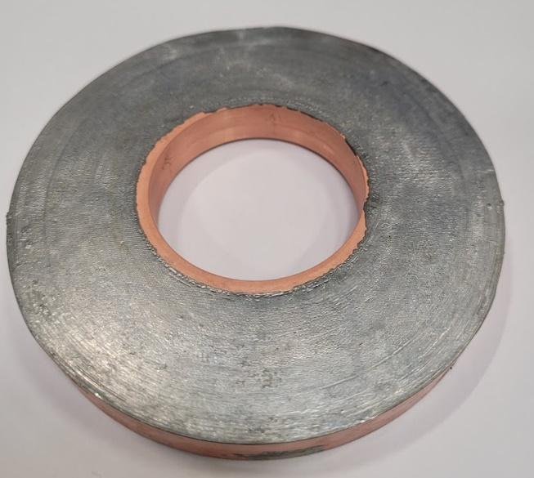
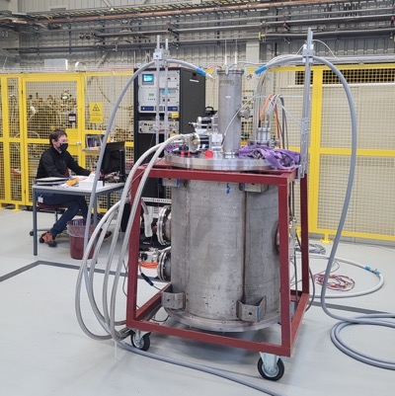
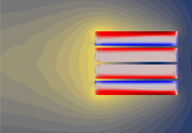
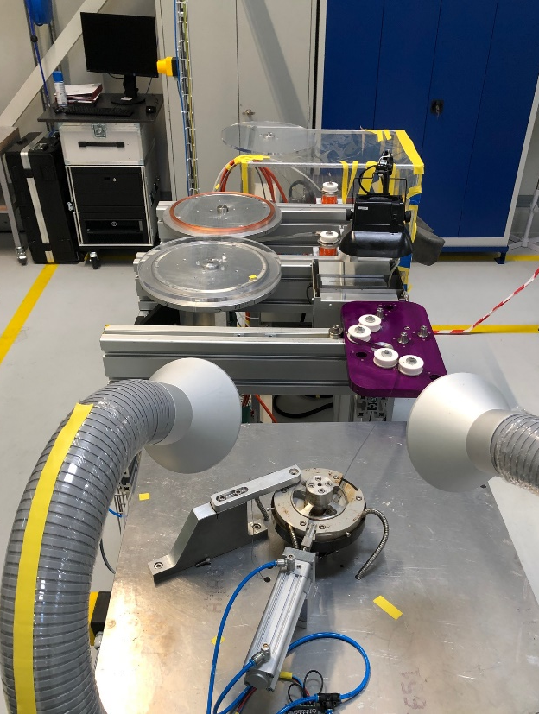
CHART2 MagDev: Technology Solenoid Program
Rapidly develop infrastructure for HTS coil manufacturing and testing
via NI coil technology license agreement with Tokamak Energy
Winding
Soldering
Testing
Modeling
Tensioning system developed by Francois-Olivier Pincot,
Jacky Mazet, CERN
Pre-tinning support by Davide Uglietti, PSI
Cryogen-free test station (2 kA)

Slide 4
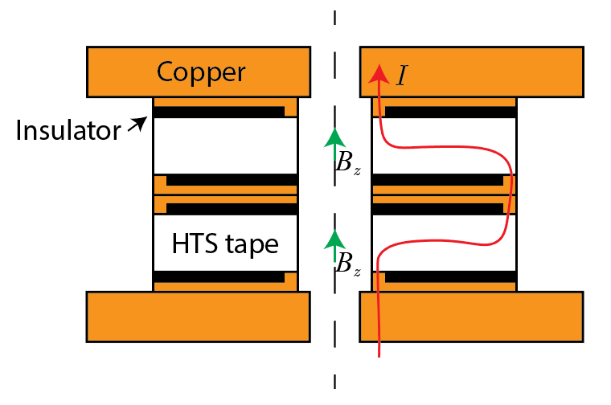
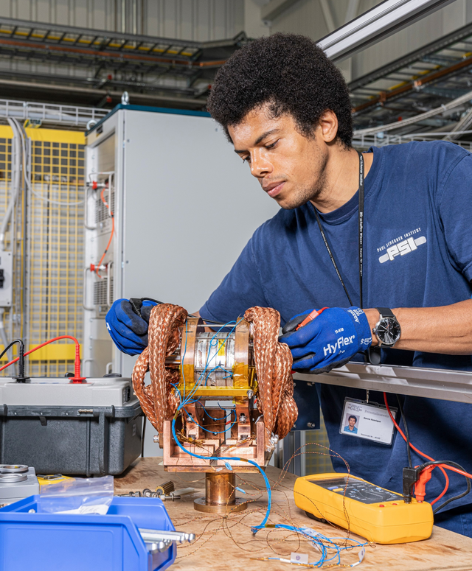
NI HTS Technology Solenoid
Stacked, single layer pancakes
Axial joints
4 coils, 12 mm SuperOx tape
Solder-potted coils
r_i 25 mm
r_o 50 mm

Slide 5
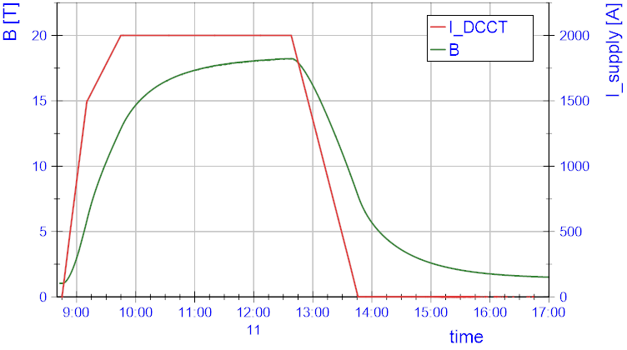
18 T by 4 stack at 2 kA, 12 K

Slide 6
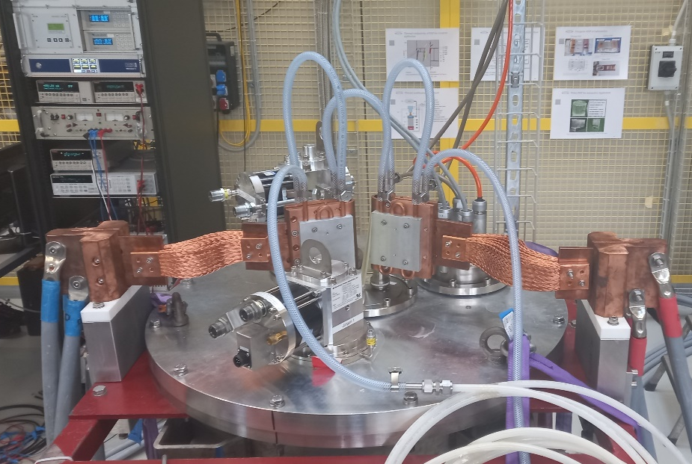
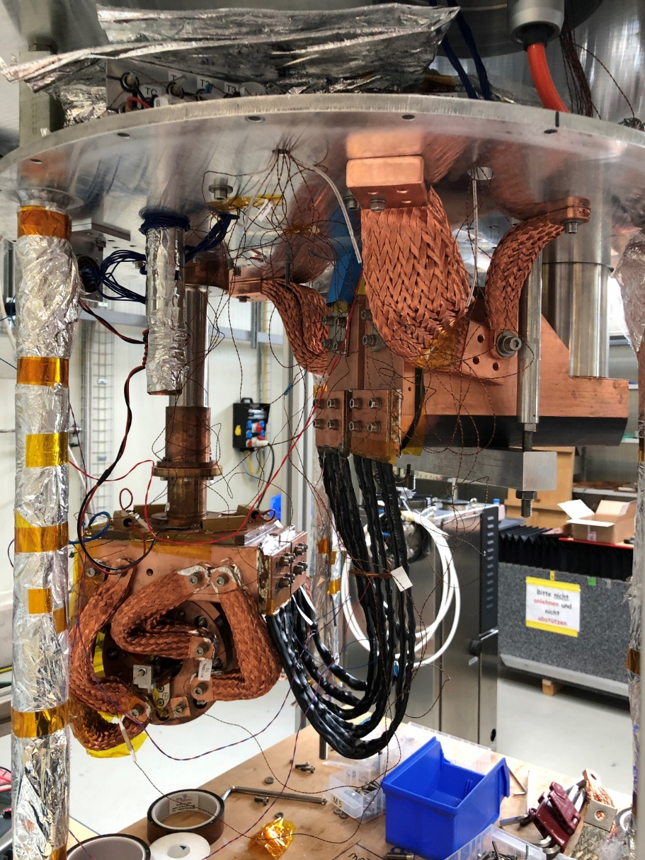
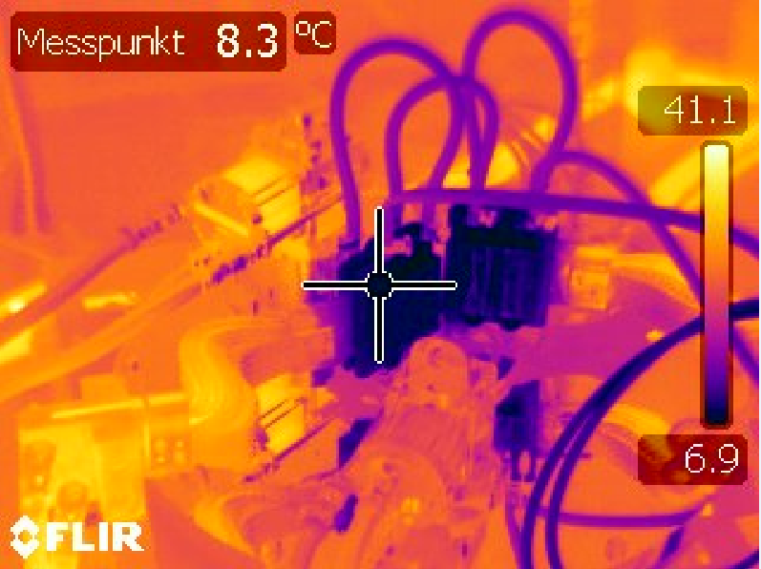
Cryogen-free test setup
radiation shield
top plate
2nd cryocooler
20K coldhead
1st cryocooler
4K coldhead
stack of 4 NI HTS coils with thermal/current
connectors
HTS leads

Slide 7
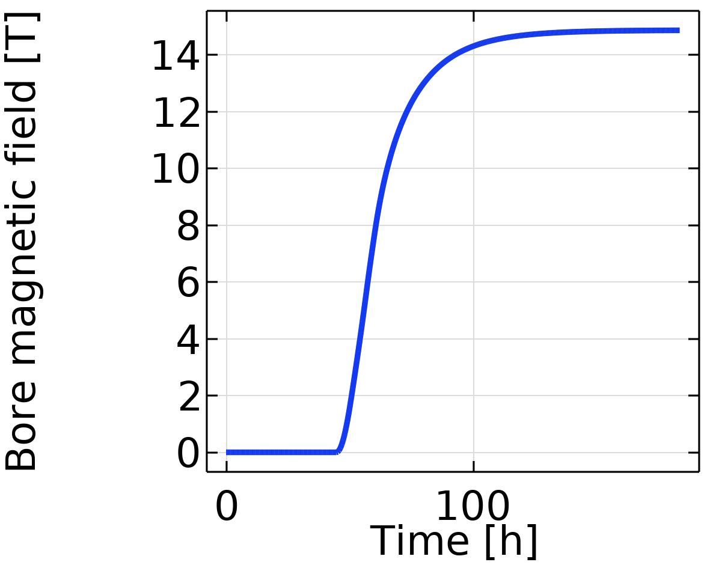
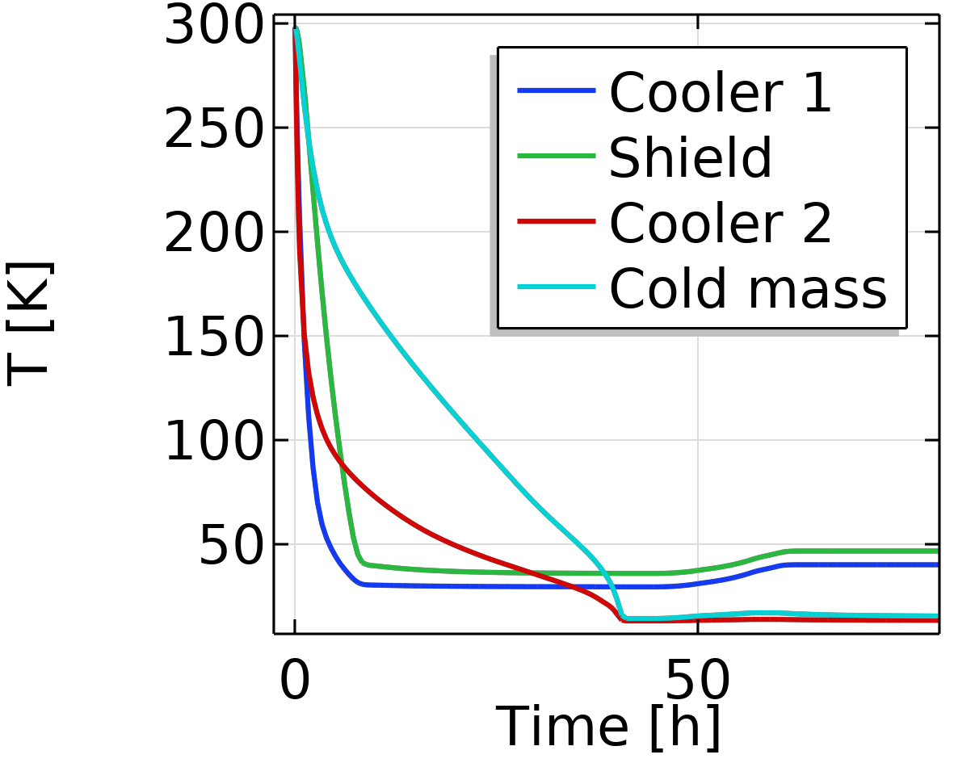
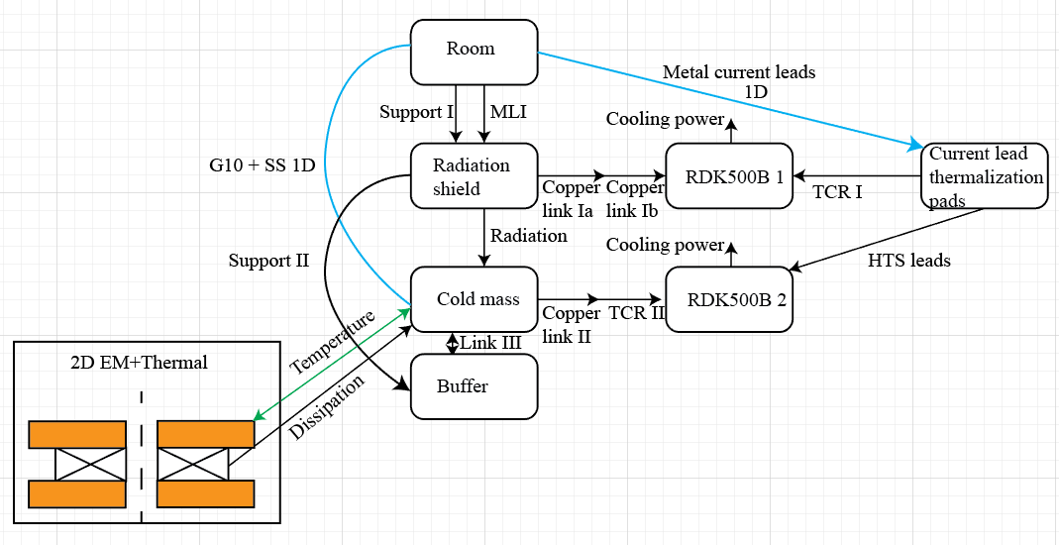
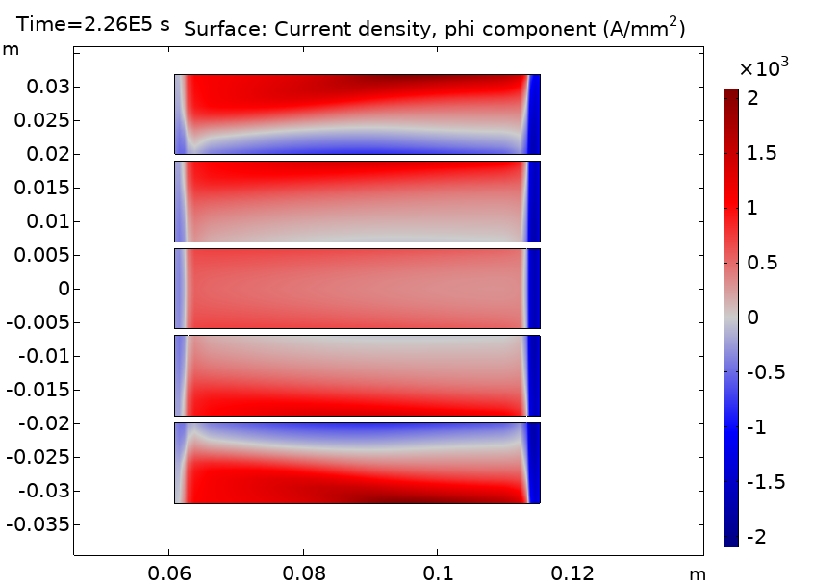
Modeling
Note: examples of P3 solenoid
NI charging effect
Cool-down and ramping
COMSOL 2D axisymmetric model
H-formulation based on [1]
coupled with thermal model
Screening currents
z
During ramp
[1] R Mataira et al, “Finite-element modelling of
no-insulation HTS coils using rotated anisotropic resistivity”, 2020
r
Disadvantage of axial joints

Slide 8
CHART2 MagDev: Technology Solenoid Program
Rapidly develop infrastructure for HTS coil manufacturing and testing
via NI coil technology license agreement with Tokamak Energy
Winding
Soldering
Testing
Modeling
Tensioning system developed by Francois-Olivier Pincot,
Jacky Mazet, CERN
Pre-tinning support by Davide Uglietti, PSI
Cryogen-free test station (2 kA)

Slide 9
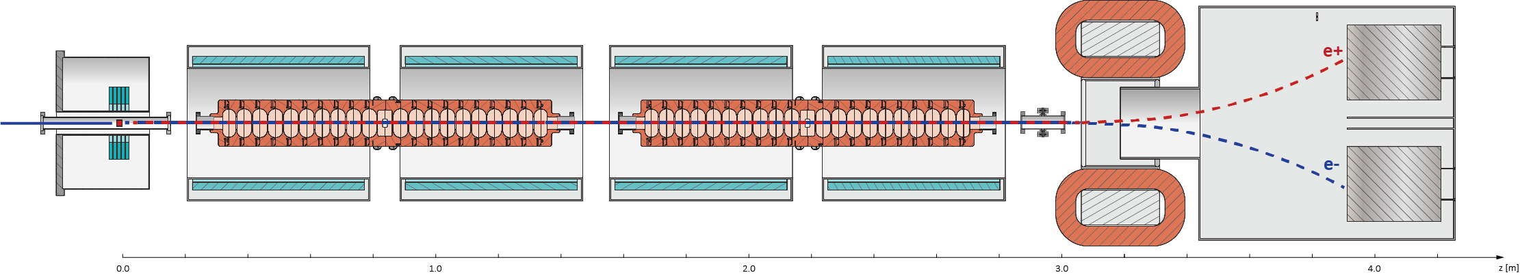
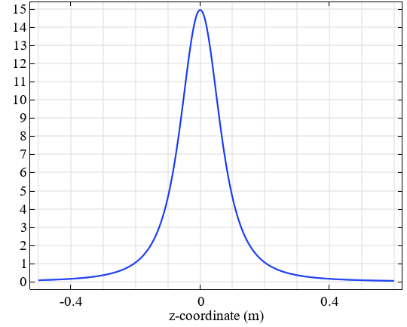
PSI Positron Production (P³) Experiment
Goal: experimentally validate high yield in context of FCC-ee, in 2025
Beam diagnostics
Concept design of P³
N. Vallis, PSI [3]
6 GeV beam from SwissFEL linac
Solenoids
Target and HTS Adiabatic Matching Device
RF Cavities
Magnetic field [T]
Yield
SuperKEKB Factory (State of the art, 3 GeV) [1] | 0.5
FCC-ee requirements [2] | 2 (incl. safety factor 2)
P³ simulations [3] | 3 (0.4 T RF sol.)-8 (1.5 T RF sol.)
[1] K. Akai, K. Furukawa, and H. Koiso, "Superkekb collider", 2018.
[2] I. Chaikovska et al., "Positron source for FCC-ee", 2019.
[3] N. Vallis, “PSI The P³ experiment: a Positron Source Demonstrator for FCC-ee”, 2022
Yield optimization Y. Zhao, Cern

Slide 10
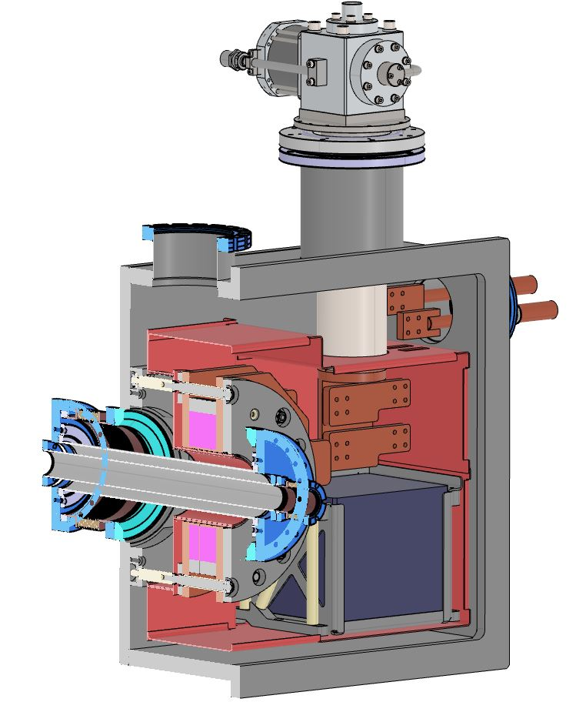
NI HTS solenoid for P3
72 mm warm bore
Coil r_i/r_o 61/115 mm
Conduction cooled, 15 K by RDK 500B #1
1.2 kA leads cooled by RDK 500B #2
15 T bore, 21 T max
Compact DC
NI magnet
NI HTS coils
Radiation
e-
Target
e+
FCC-ee P3
e-
Target power 13 kW 1 W
Shielding ~2 cm tungsten [1] none
P3 experiment is unshielded & will not test radiation robustness
[1] B. Humann, CERN

Slide 11
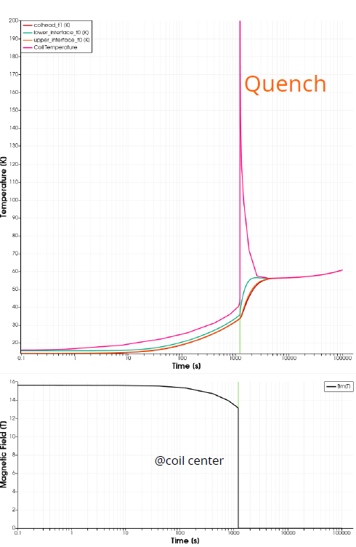
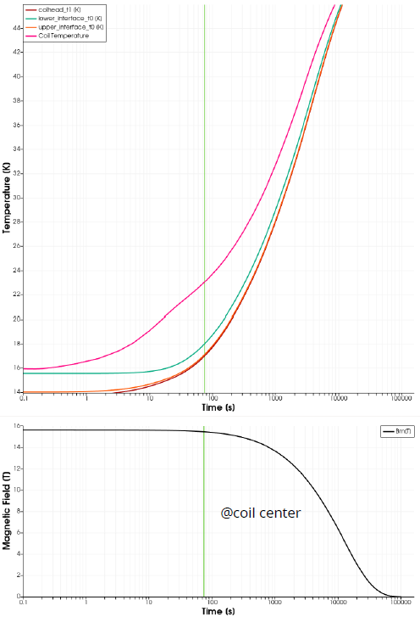
Case: HTS lead burn-out,
no thermal buffer
Case: HTS lead burn-out,
thermal buffer
Rely on thermal buffer in case of fault
T [K]
T [K]
Time [s]
Time [s]
B [T]
B [T]
Copper/lead mass
~200 kg
Neon could work
~40 L
J. van Nugteren, Little Beast Engineering
Time [s]

Slide 12
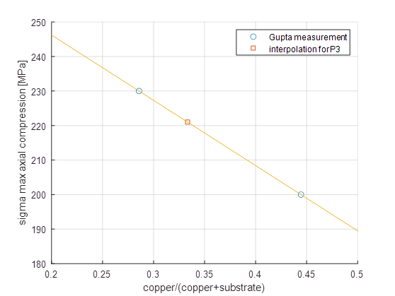
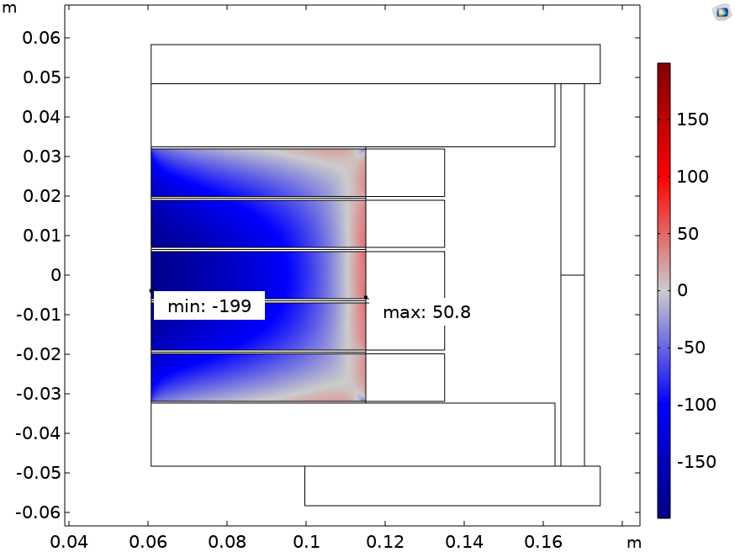
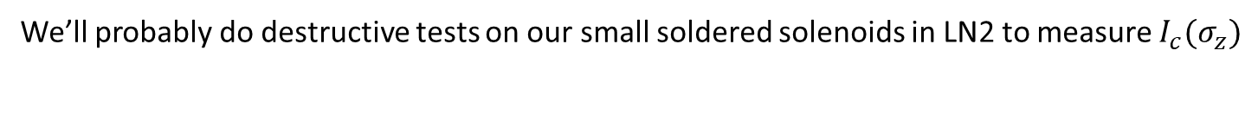
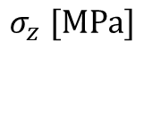
Main worry: axial compressive stress
$$σ_{z} [MPa]$$
[1]
We’ll probably do destructive tests on our small soldered solenoids in LN2 to measure $I_{c}(σ_{z})$
[1] 10.1109/TASC.2020.2966157

Slide 13
Conclusions
PSI team created infrastructure to wind, solder, test and model HTS coils
Test coil stack reached 18 T
Scaled-up version to be used in positron source experience at PSI in 2025

Slide 14
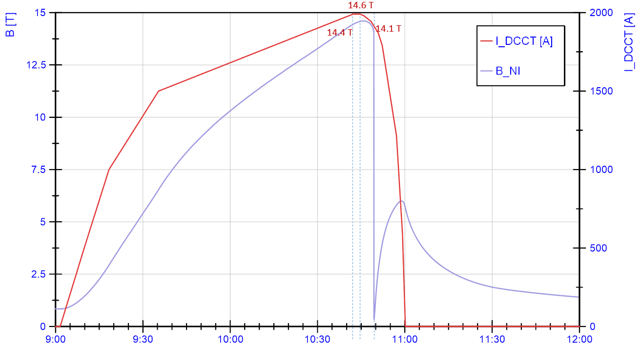
Quench event
Triggered by thermal runaway, due to badly clamped joint
5 min

