Slide 1
MDP Plans and Achievements – Relevance to a Muon Collider
Presentation to the 2022 Muon Collider Collaboration Meeting
Soren Prestemon
Director, US Magnet Development Program
Lawrence Berkeley National Laboratory
For the US MDP Team

Slide 2






Outline
The US Magnet Development Program: Vision and Goals
Current MDP focus areas and key challenges
Muon collider magnet needs and connections to MDP
Current and future synergistic research

Slide 3
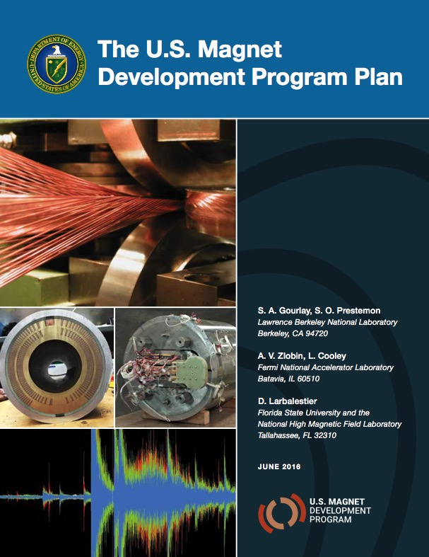
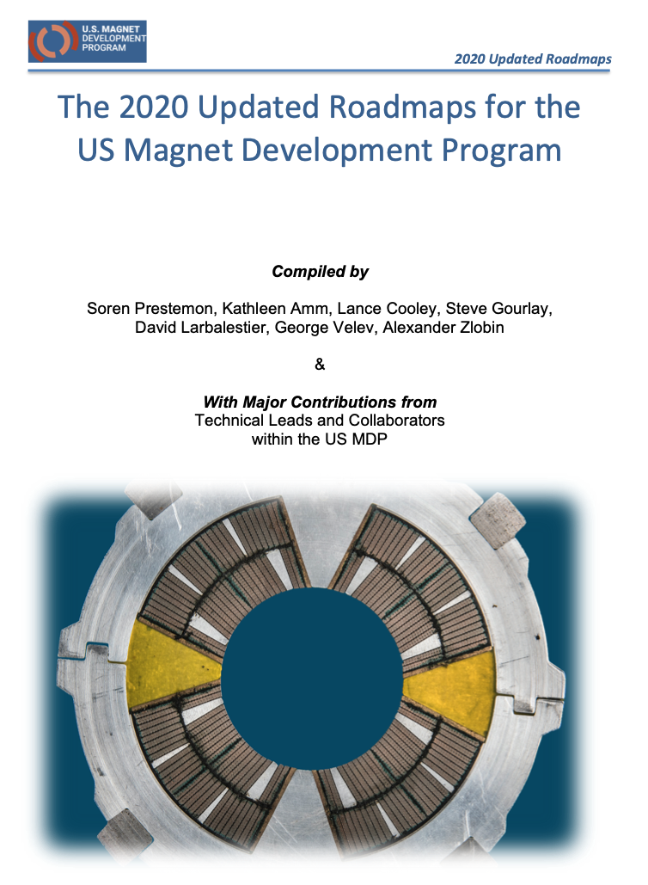
US MDP vision
Maintain and strengthen US Leadership in high-field accelerator magnet technology for future colliders
Focus on the four primary goals identified in the the original MDP Plan
  Explore the performance limits of Nb₃Sn accelerator magnets…
  Develop and demonstrate an HTS accelerator magnet with a self-field of 5T or greater…
  Investigate fundamental aspects of magnet design and technology…
  Pursue Nb₃Sn and HTS conductor R&D …
Further develop and integrate the teams across the partner laboratories and Universities for maximum value and effectiveness to the program
Identify and nurture cross-cutting / synergistic activities with other programs to more rapidly advance progress towards our goals
https://arxiv.org/abs/2011.09539

Slide 4
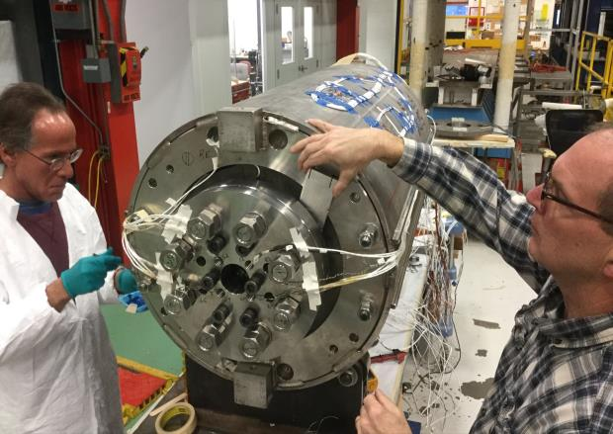
MDP strategy and goals: driving questions related to performance
Ultimate Performance of Magnets
  What is the nature of accelerator magnet training? Can we reduce or eliminate it?
  How do we best define operating margin for Nb₃Sn and HTS accelerator magnets, and to what degree can/should it be minimized?
  Can we control the disturbance spectrum and reduce operating margin and enhance reliable performance?
  What are the mechanical limits and possible stress-management approaches for Nb₃Sn, HTS, and 20 T hybrid LTS/HTS magnets, and do they have defined mechanical limits?
  Do hybrid designs benefit from the best features of LTS and HTS, or inherit the difficulties of both material technologies?
Example: MDP 4-layer, 60mm bore cosine-theta magnet led by FNAL
[I]: Highest priority issue: degradation
  Mechanisms; design mitigation
[II]: Second priority: Initial quench current
and memory after thermal cycle
[III]: Third priority: Training rate
Record field!

Slide 5
Program roadmap for the 2020-2024 period
Strategic directions for the (2020) updated plan:
  Probing stress management structures
  Hybrid HTS/LTS designs
  Understanding and impacting the disturbance-spectrum
  Advancing both LTS and HTS conductors, optimized for HEP applications
  We also introduced a new technology element
  20T Hybrid Magnet Design & Comparative Analysis,
  => designed to prepare for future milestones and directions

Slide 6
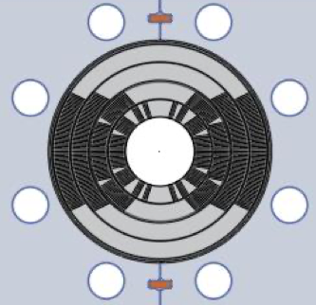
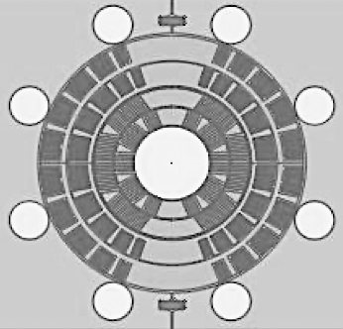
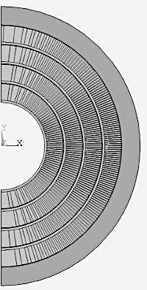

Stress-managed structures avoid force accumulation
- at the expense of more interfaces
Interception of azimuthal forces holds promise to enable high-field and large-bore dipoles – break the traditional scaling of stress with bore and field
Use new design concepts as opportunity to introduce cost-effective fabrication processes
“Traditional” Cos-theta
- Midplane stress due to azimuthal force accumulation
“Stress-managed” Cos-theta
- Groups of turns, azimuthal forces intercepted by support
“Canted” Cos-theta
- Every turn has azimuthal forces intercepted by support

Slide 7
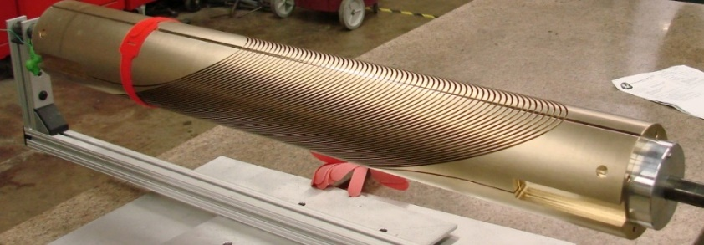
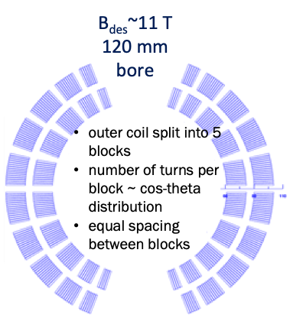
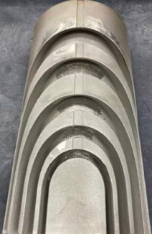
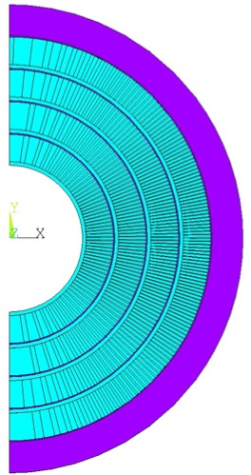
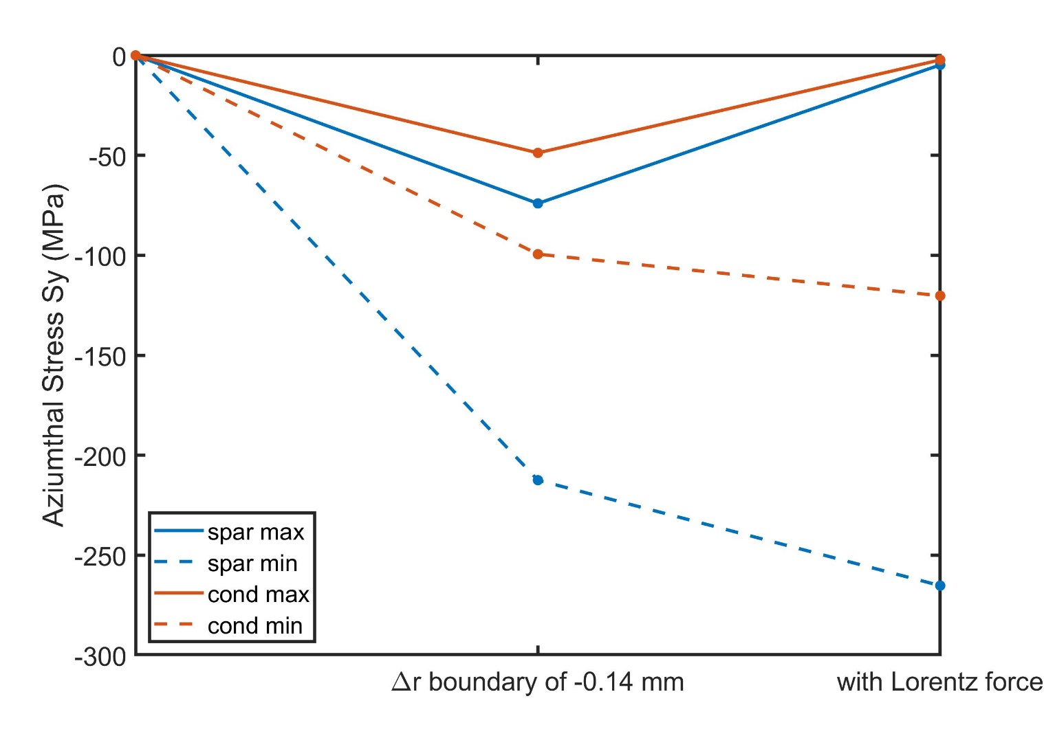
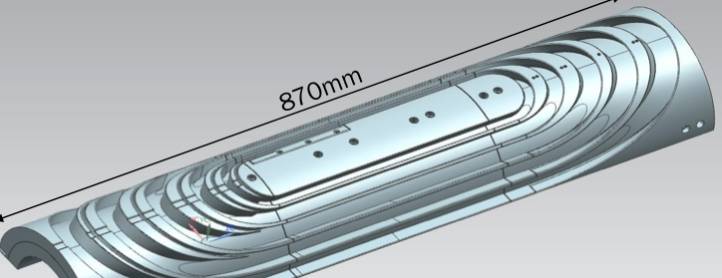
MDP stress management concepts target high fields and large bores for hybrid magnet needs
Canted Cosine-theta
Share utility structure
Shared modeling approaches
Similar instrumentation approaches to be used
Same aperture for HTS inserts
Stress-managed Cosine-theta

Slide 8
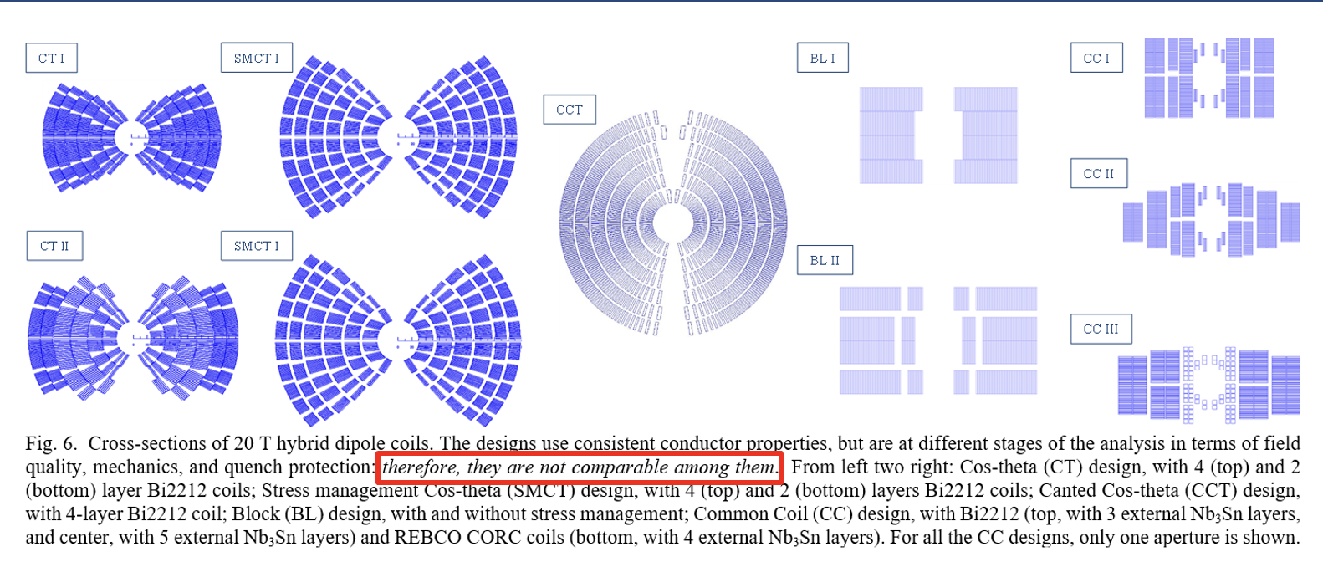
For very high field magnets, a “hybrid” HTS/LTS approach is most efficient
Design studies underway to explore 20+T dipole concepts
  Optimal use of superconductor
  Comparative study
  Identify research directions
See Snowmass whitepaper “A Strategic Approach to Advance Magnet Technology for Next Generation Colliders”
arXiv:2203.13985
Example: “stress-managed Cos(t)” concept, inner 2 coils bi2212; analysis underway to find solutions within conductor degradation limits

Slide 9
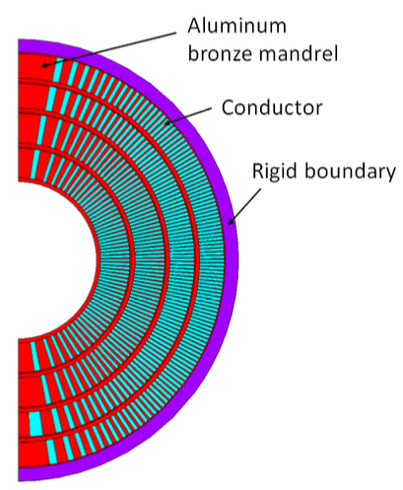
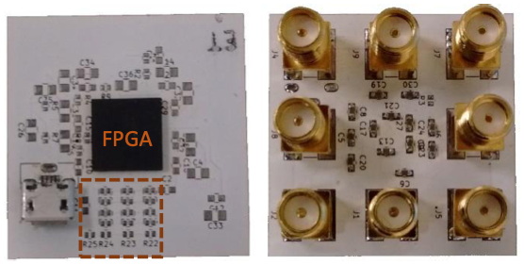
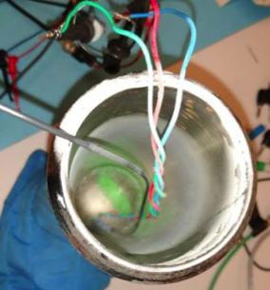
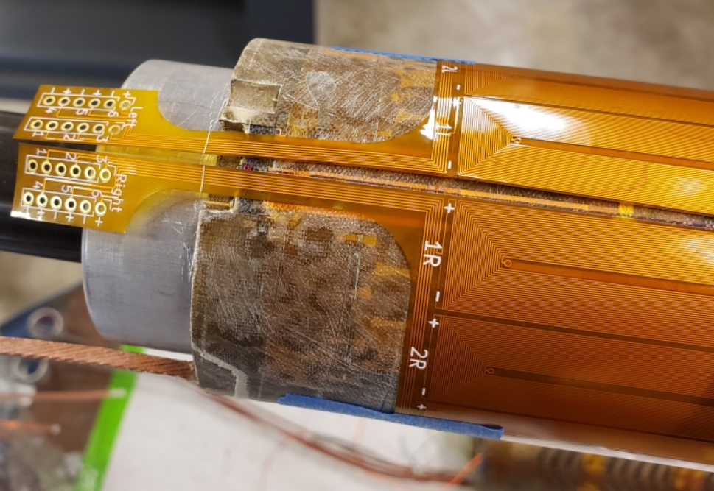
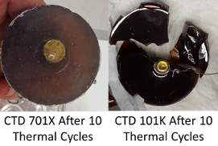
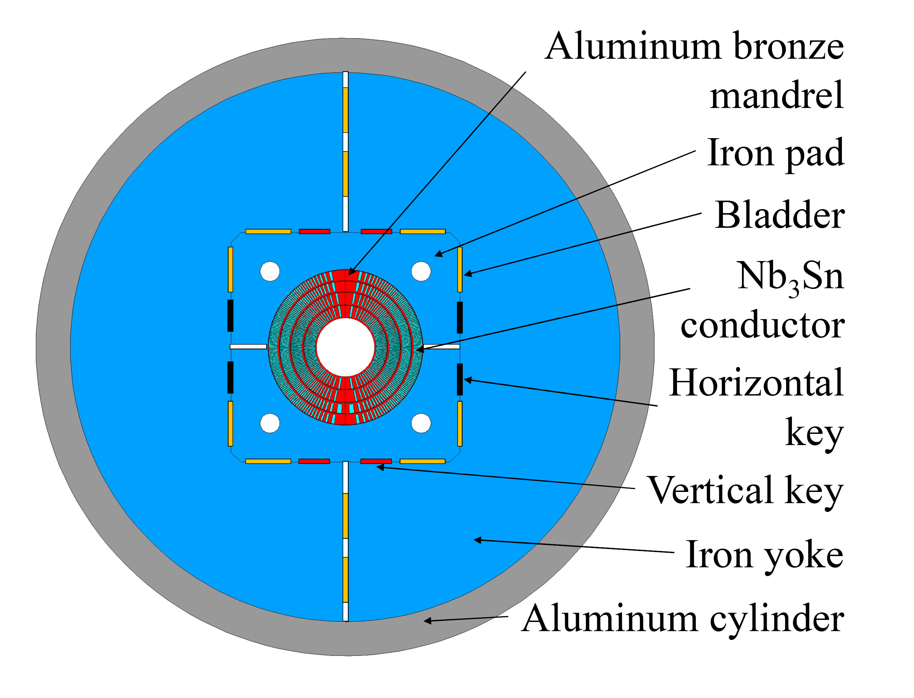
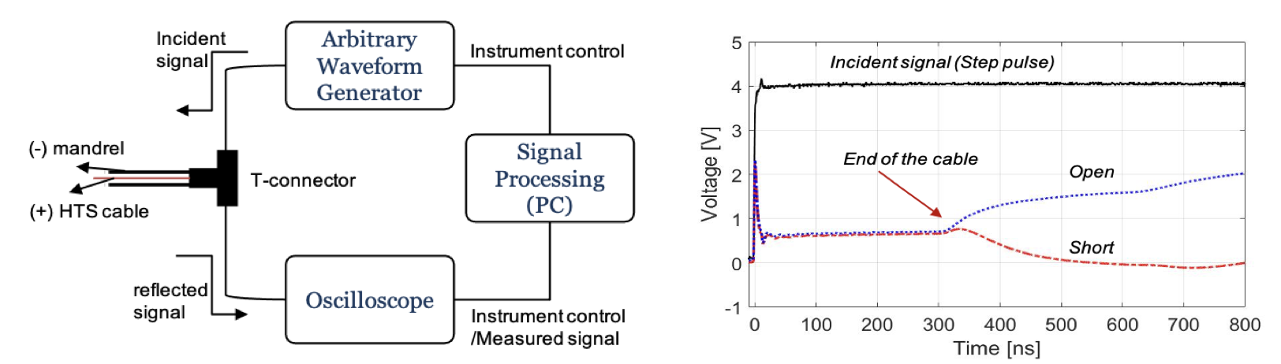
MDP results and developments prepare for high-field prototypes – stress-managed and hybrid magnets
MDP Magnet R&D results pave path to stress-managed high-field hybrid HTS/LTS magnets
Conductor/cable samples
Diagnostics & materials dev.
=> Fast turn-around, specific experiments
Subscale / HTS insert magnets
=> Critical to develop magnet technology
Full size R&D magnets
=> Final demonstration of MDP deliverables
Cryo-Field-programmable gate array
Plastic optical fiber
Development of advanced epoxies with US industry
Subscale CCT with new flexible quench antenna
Electrical reflectometry for magnet quality control / monitoring
Marchevsky et al, Snowmass whitepaper “Advancing Superconducting Magnet Diagnostics for Future Colliders”, arXiv:2203.08869v1

Slide 10
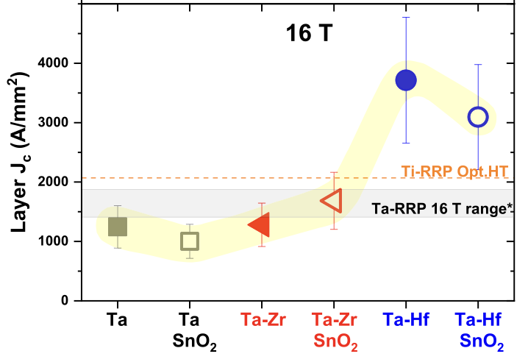
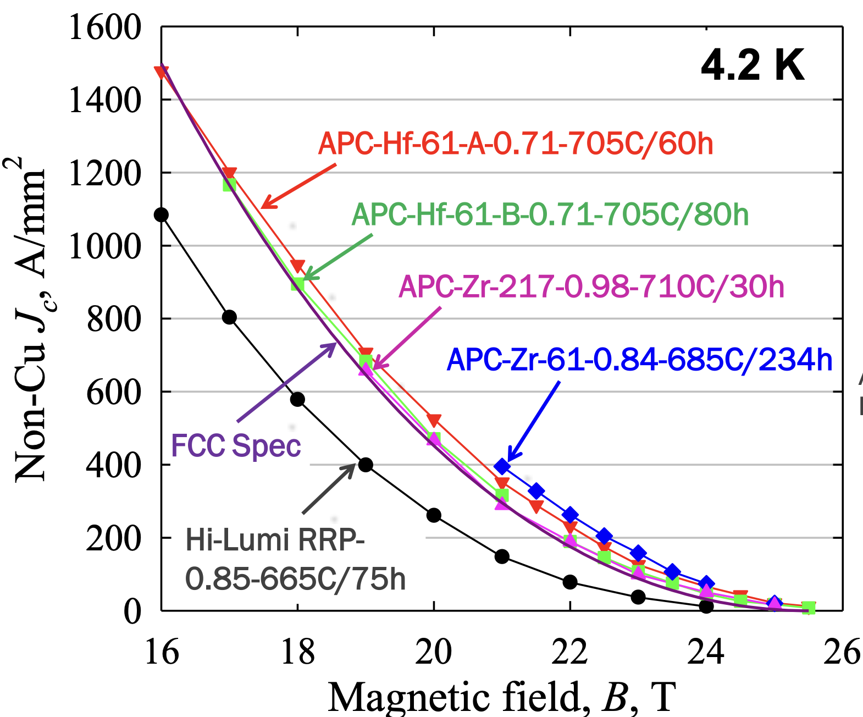
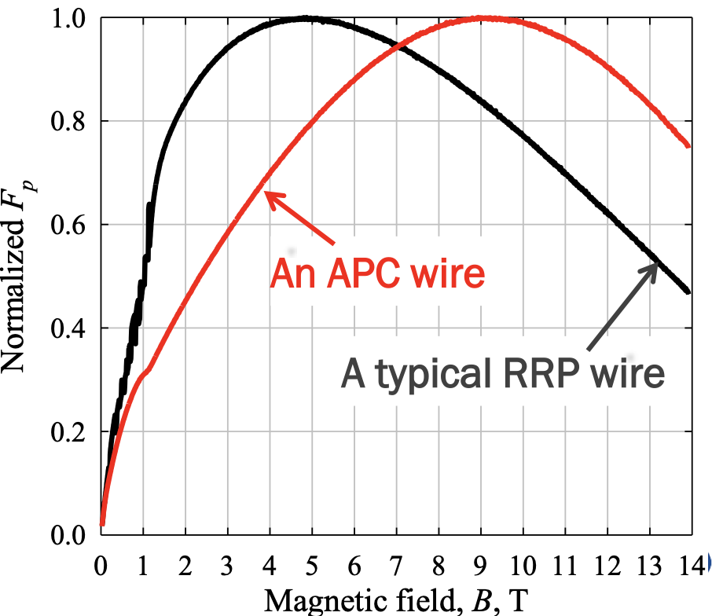
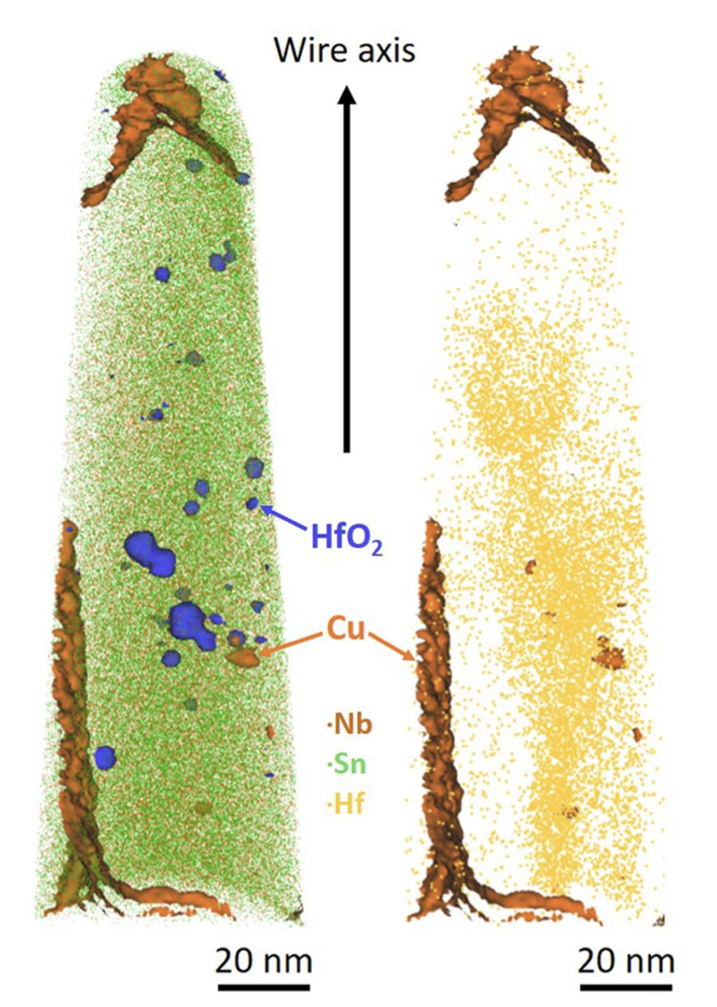
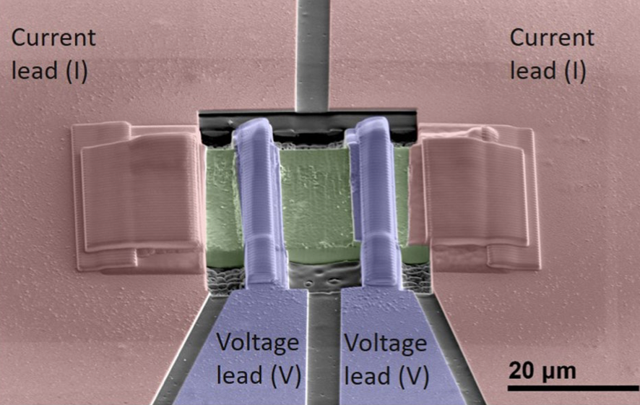
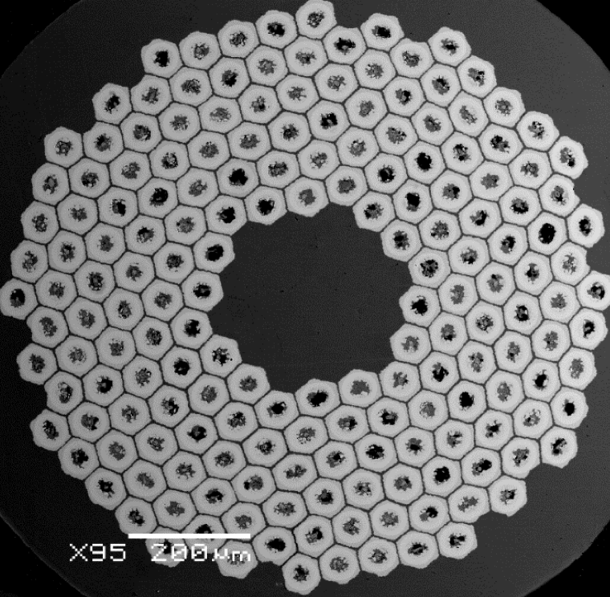

Example of Conductor Procurement and R&D:
Advances in Nb₃Sn performance by introducing new pinning sites
Path to “FCC spec” wires exists
  Powder-in-tube” approach advancing
  Also exploring Hf doping in “internal Tin” approach
Tarantini et al., Nature Scientific Reports, (2021) 11:17845
X. Xu, SoftA Workshop, CERN, 2021
See also Xu et al., J. AlloyCompd.857,158270(2021)
S. Balachandran et al 2019 SUST 32

Slide 11
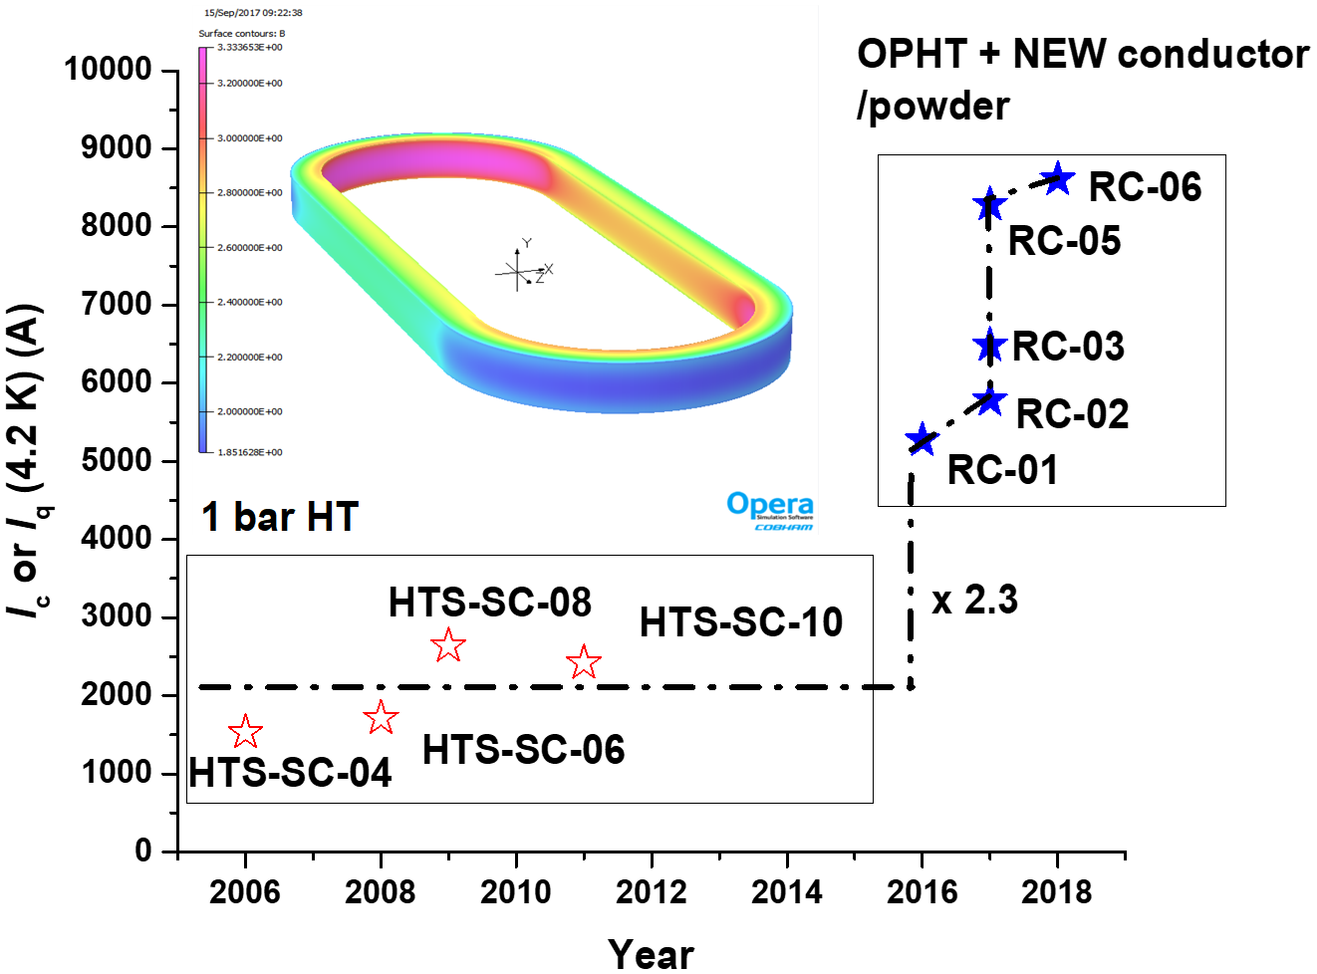
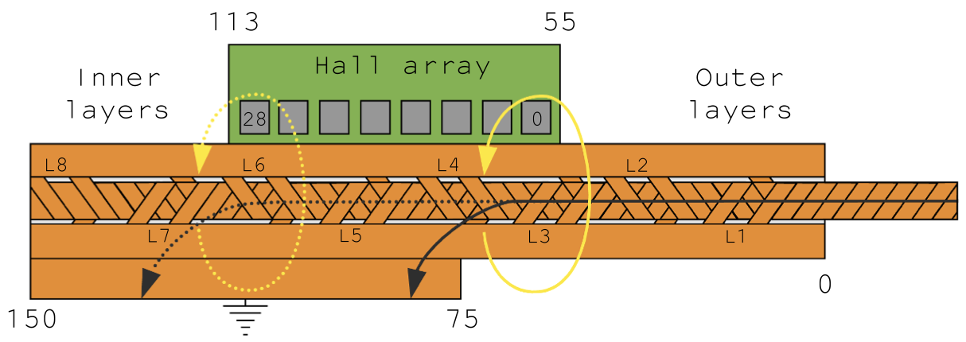
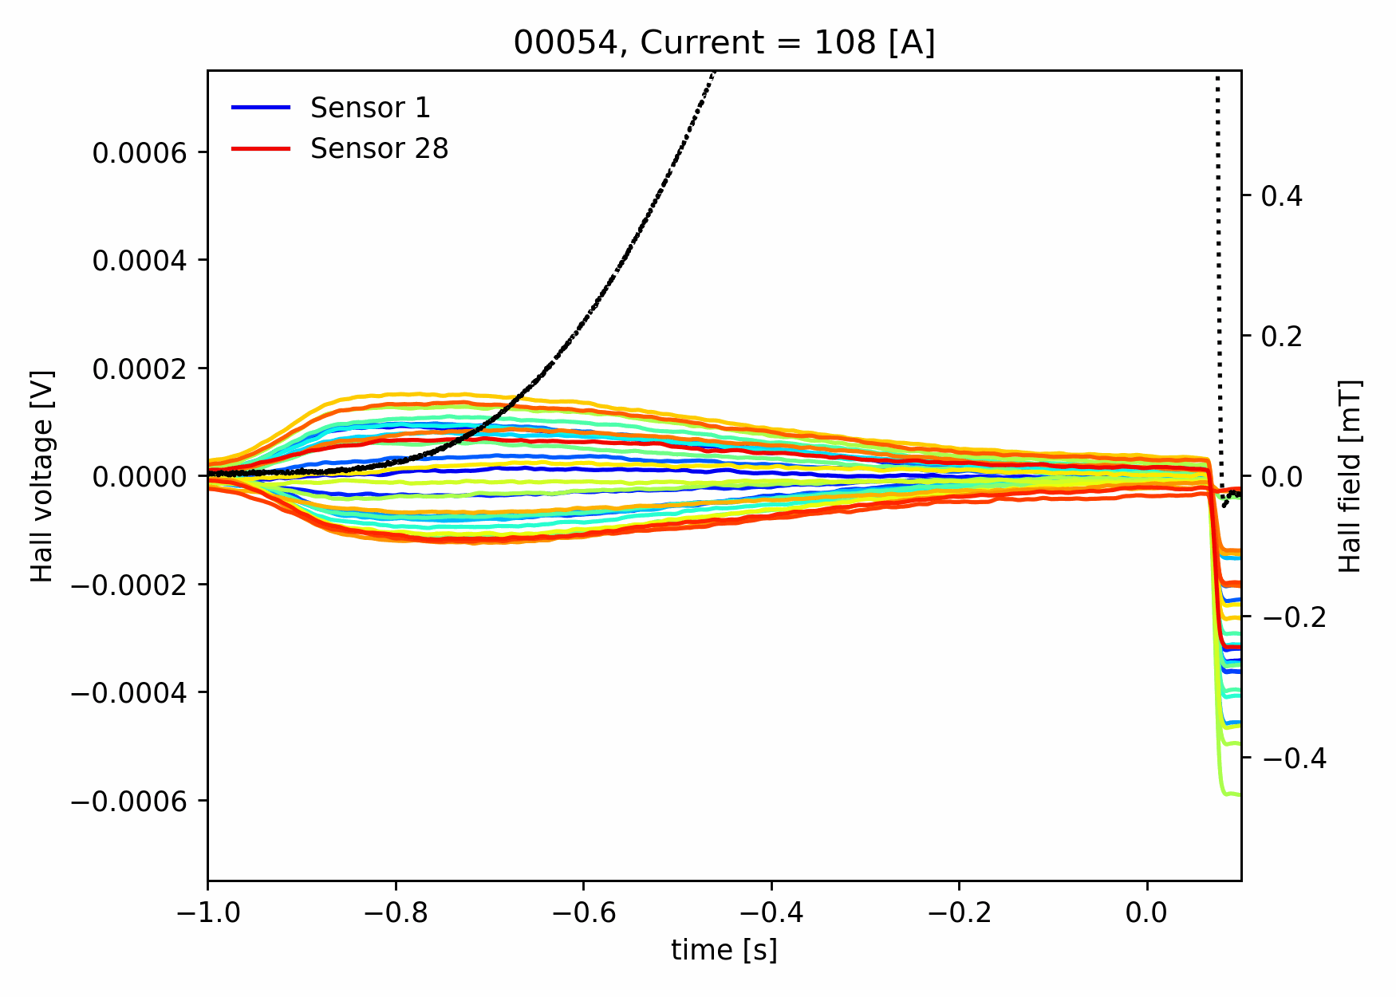
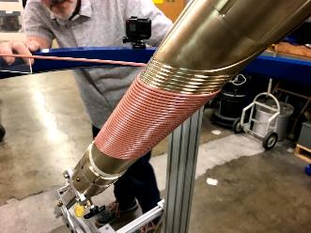
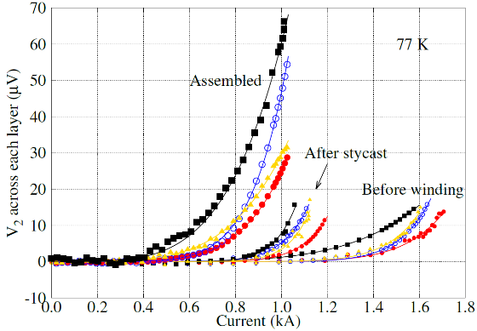
Current MDP focus areas and key challenges
Can stress-management provide a viable means of accessing high-field and/or large bore dipole magnets without risk of conductor degradation?
Can hybrid LTS/HTS magnets deliver on the promise of efficient high-field dipoles
  Will they inherit the “best of both” or the “worst of both”
Advance HTS magnet technology to a respectable level of maturity
=> make it “real”
Advance diagnostics and modeling to further enhance our insight into magnet performance and issues
Overcome the advanced Nb₃Sn architecture issues and mature them to industrial levels
Provide a substantial and timely quantity of conductor for magnet research and feedback to conductor development
Reed Teyber et al 2020 SUST. 33 095009
X. Wang et al SUST 34 (2021) 015012

Slide 12
A Muon collider has unique characteristics that drive magnets
“Time is of the essence” in a muon collider – capture and rapidly accelerate precious muons!
The MAP study identified key R&D challenges:
  Central elements: high field solenoids, large-bore dipoles,fast ramping, radiation env.
Issues
Status

Slide 13
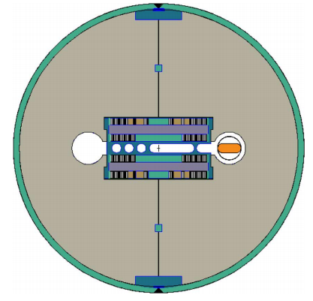
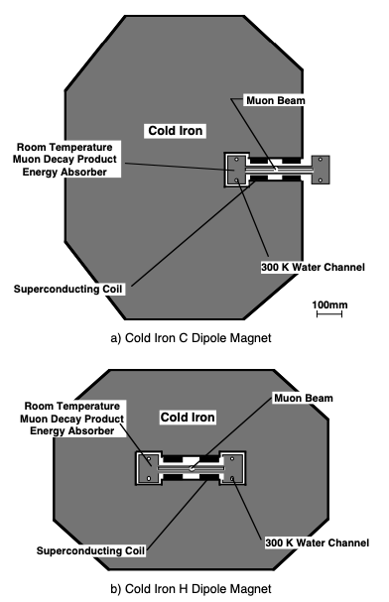
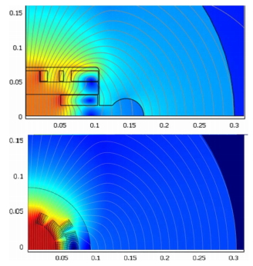
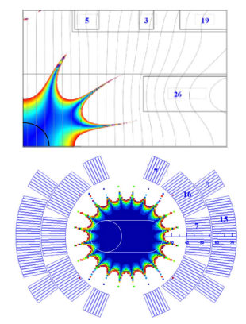
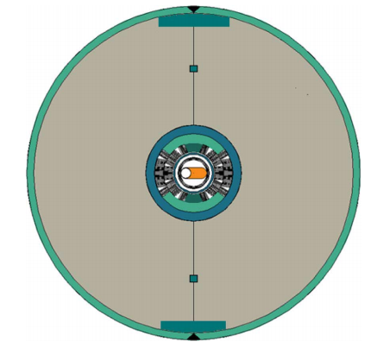
Muon Collider dipole magnets have unique requirements
Dipoles must address significant heat load as well as radiation load
  Open midplane or shielding (e.g. Tungsten)
  Example: 2TeV (4TeV c-m) study suggested 2kW/m deposition
  Must extract most heat at higher temperature in order to be feasible
Challenge for high field magnets
  Aperture is “costly” at high field
  Open midplane complicates field quality
Muon collider feasibility study 1997, LBNL-38946
Novitski et al., TAS 2011

Slide 14
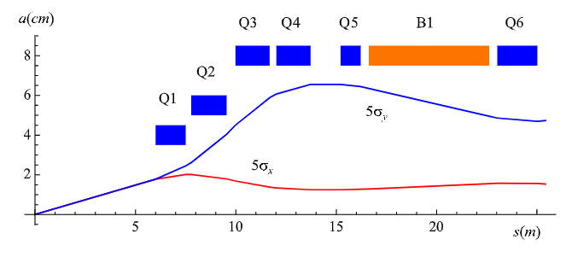
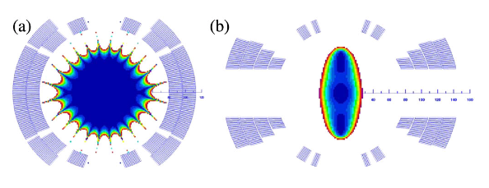
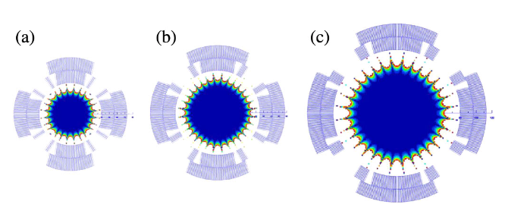
Interaction region magnets have similarities to Hadron colliders
IR quads operating at ~11-12T
  Large bore (~150mm)
  Parameters are similar to HL-LHC quads
IR Dipoles
  Need to tolerate high radiation
  =>Large bore, or open midplane
Alexahin et al., PTSTAB 14,2011

Slide 15
Main magnet research areas for a muon collider
MDP research is highly relevant to a subset of muon collider magnet R&D:
  the storage ring & IR arena (large-bore)
  HTS development is relevant to the high-field solenoids
  FFAG/non-ramping acc. Solutions

Slide 16
Some thoughts on areas for enhanced studies for Muon Collider magnets, beyond current MDP focus areas
Radiation is a major consideration:
  Study tradeoff in aperture/bore+shielding vs magnet radiation hardness
  Further advance understanding of radiation hardness of superconductors and magnet materials
Rapid acceleration is critical:
  Study fixed-field booster options where applicable
  Further investigate high dB/dt magnet concepts
  Evaluate acceleration (particularly low-energy) schemes in an integrated approach
Large thermal loads suggest higher-temperature operation (i.e. all-HTS)
  Explore facility and operational cost models
Leverage strong synergies with fusion and High-Field magnets (e.g. condensed matter):
  Fastest development path for very challenging target and cooling magnets
Example: “A collaboration framework to advance high- temperature superconducting magnets for accelerator facilities” (US-Japan Science and Technology Cooperation Program)

Slide 17
backup

Slide 18
The US MDP strives to be open and collaborative
We are a mature and vibrant integrated multi-lab research program focused on developing accelerator magnet technology for the next energy frontier collider
This is an international endeavor, and we are eager to collaborate and join forces to rapidly advance the field
High field accelerator magnets are essential for the next collider – the onus is on us to deliver!
We strive to…
  provide a clear vision for magnet development & conductor properties/performance we would like to see
be open with our results and progress so others can benefit from our advances
  identify and benefit from the achievements and progress of others
  be good collaborators – we recognize the strengths and enthusiasm residing in the broader community!

