Slide 1



IRIS
Innovative Research Infrastructure on applied Superconductivity
PNRR program (Next Generation Europe in Italy)
12 October 2022-Muon Collider Meeting@CERN
Lucio Rossi
University of Milan – Physics Department
& INFN- Milan LASA laboratory

Slide 2
IRIS project - scope
Response to a call by the Ministry for Research in the frame of the PNRR, Italian Next Generation Europe (or Recovery Funds)
Form a new distributed infrastructure for applied superconductivity in Italy, mutualizing existing infrastructures, competences, skills and by expanding with new laboratories
→ ultimate goal: contribute to Fundamental Physics instrumentation (particle accelerators for post-LHC era) and to Societal Applications for green energy and medicine.

Slide 3
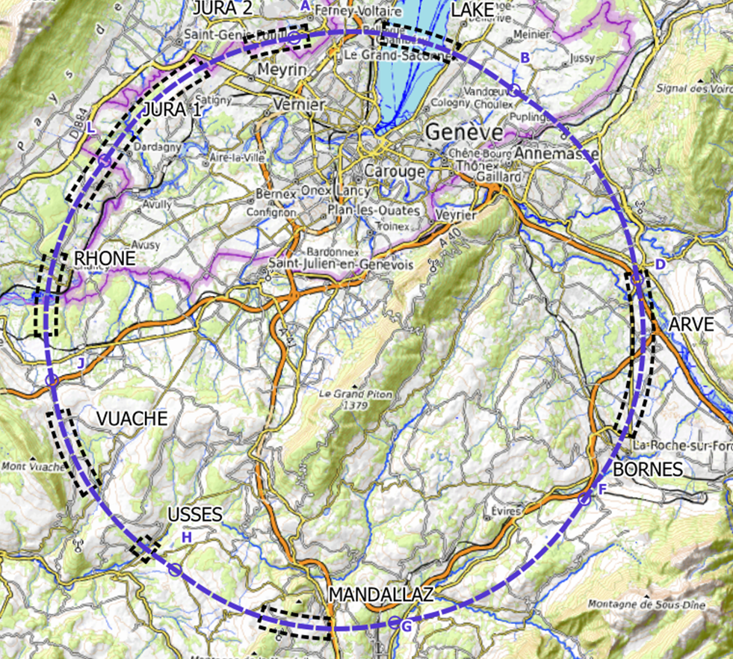
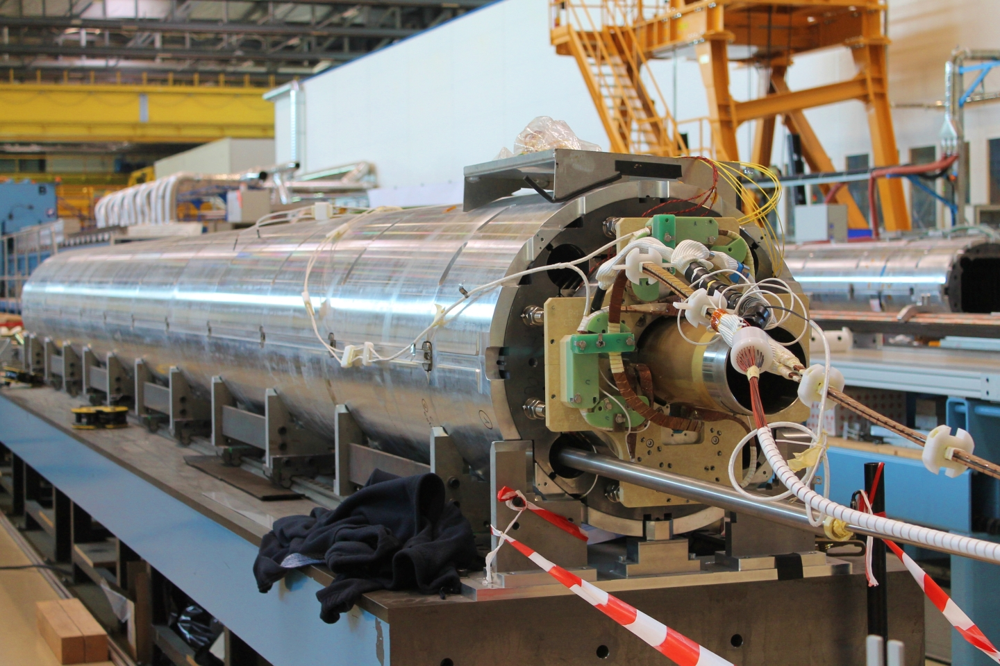
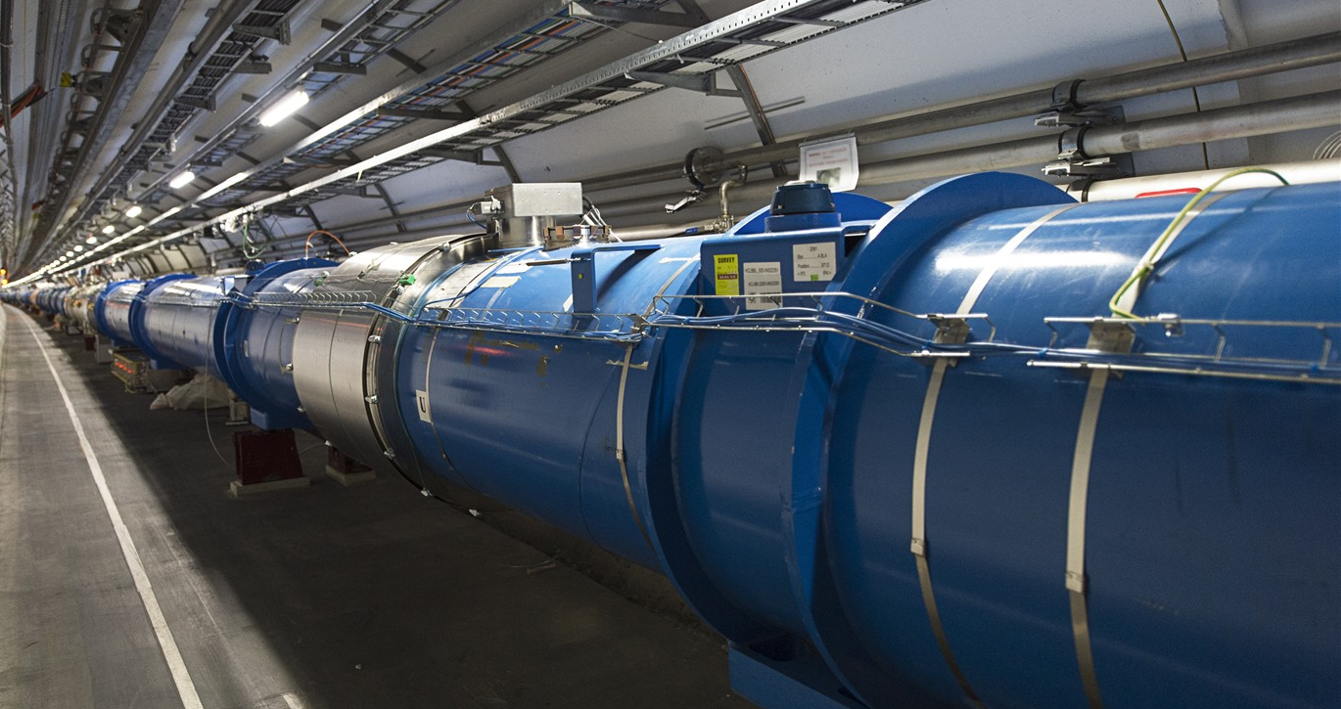
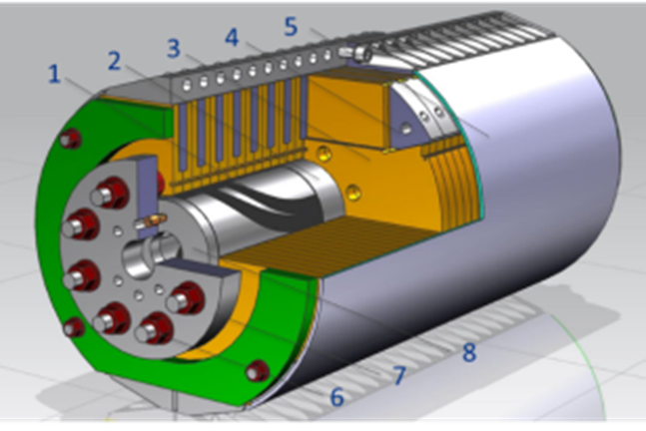
IRIS project scope -1
Fundamental Physics instrumentation
Superconductivity has been instrumental for the discovery of the Higgs boson and its development will be critical for future accelerators and we need of adequate infrastructure to sustain this.
LHC dipoles (8 T) in the tunnel
HiLumi MQXF quad (12 T)
FCC (12-16 T)

Slide 4
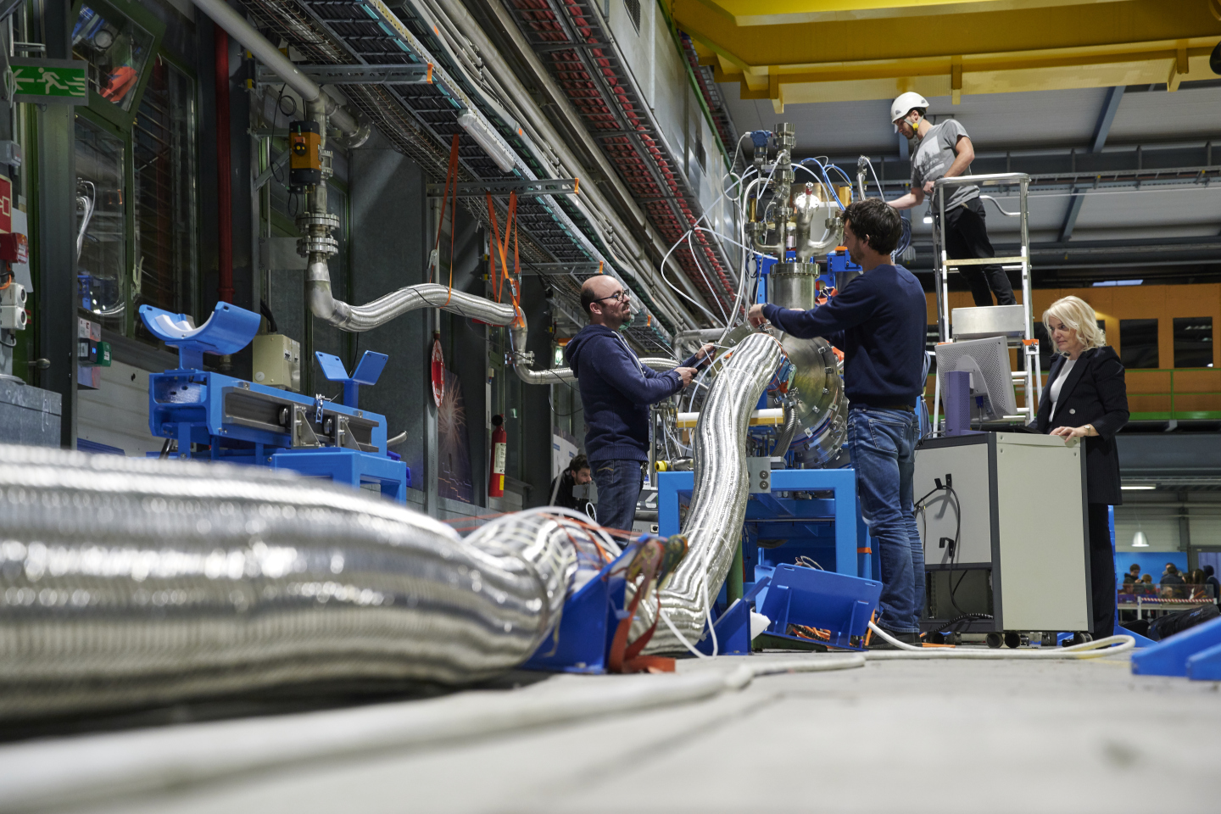
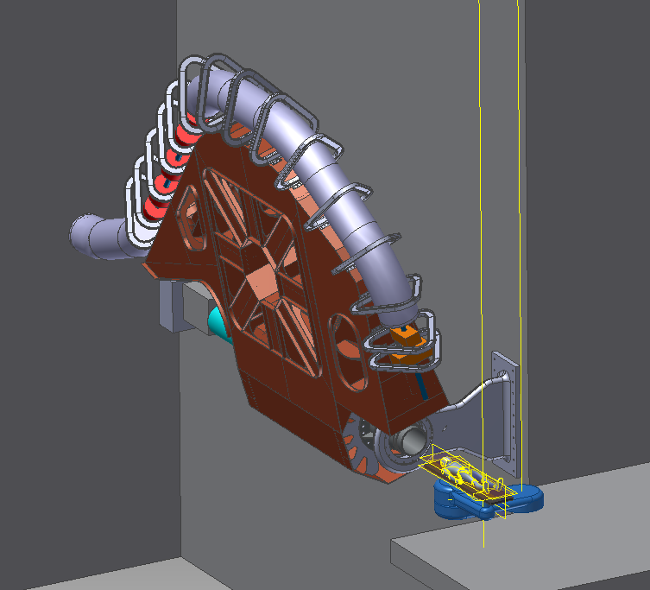
IRIS project scope -2
Societal Applications
Green Energy and Medical
Green : energy transport at zero emission and energy saving magnets.
  important for society but also for the sustainability of our research infrastructure
Medical: Superconductivity could play a key role in heavy ion therapy by enabling a rotatable gantry
Courtesy A. Ballarino - CERN
Medical: dismiss from these project
But pursued in part with other projects
Courtesy M. Pullia (CNAO –Italy)

Slide 5
IRIS - Time line
Avviso MUR n. 3264 del 28-12-20221
Application on 25 February 2022
Negotiation phase with MUR: 10 June 2022 (resubmission new proposal : 17 June 2022)
Decree of approval: 24 June 2022
Start date of the project: 1 November 2022
End of project: 28 February 2025
→ 6-month extension, to 30 October 2025 is possible (mentioned in the call)

Slide 6
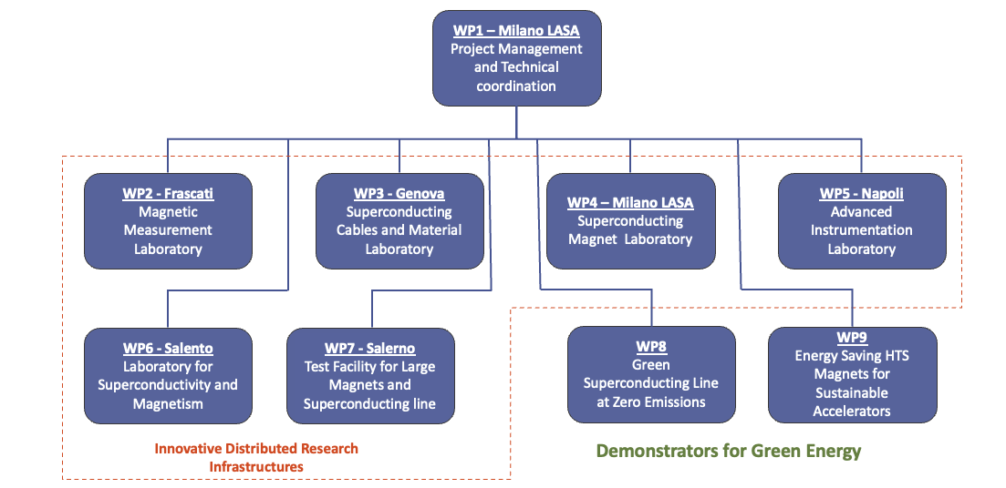







Organization and
Project structure
WP6 - Salento Laboratory for Superconductivity and Magnetism

Slide 7
Structure and Organigram
(by Project and by Institution)

Slide 8
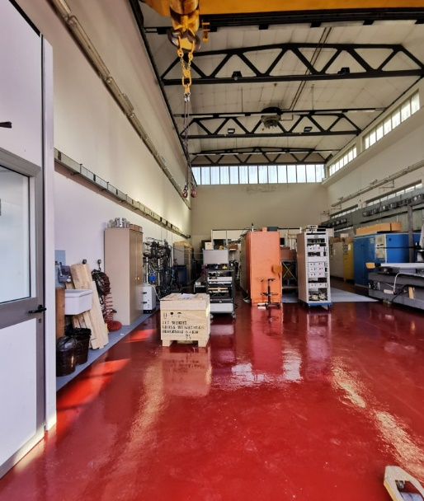
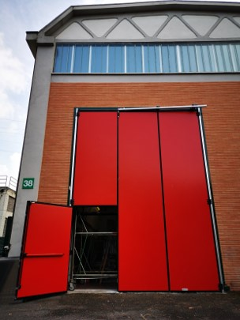
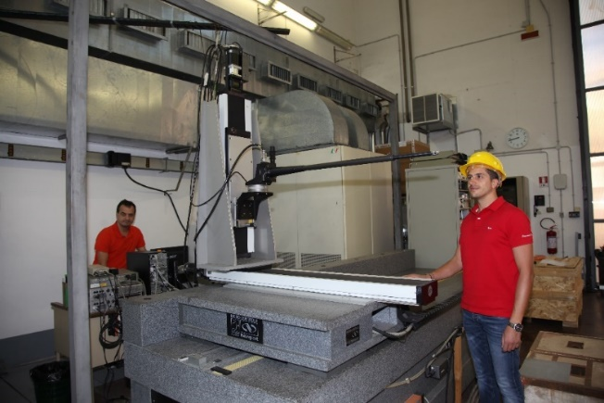
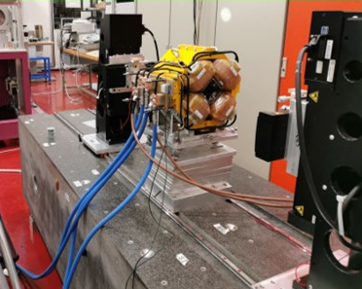
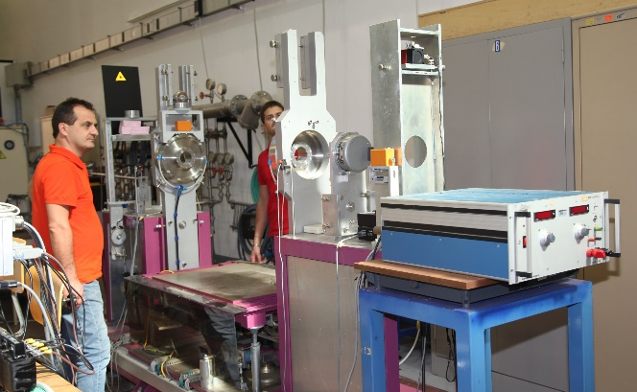
WP2 – Frascati
INFN-LNF
Magnetic Measurements Laboratory @ LNF
The INFN-LNF magnetic measurements laboratory, about 200 m², with 15 T crane has already :
a Hall effect digital teslameter with a 5-axes movement device on a granite bench;
a stretched wire bench for integral measurements of fields and mechanical fiducialization;
a rotating coil multipole measurement system; an NMR teslameter.
Several other ancillary instruments are available, such as gaussmeters, integrators, etc…
Hall probe mounted on the coordinatometer
Stretched wire bench
Rotating coil bench

Slide 9
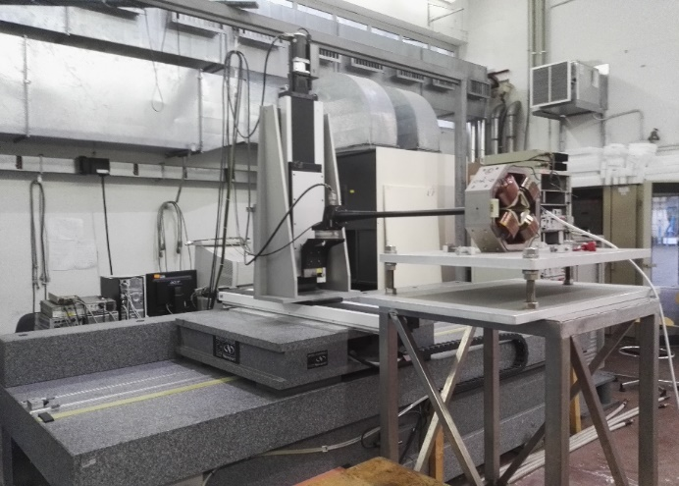
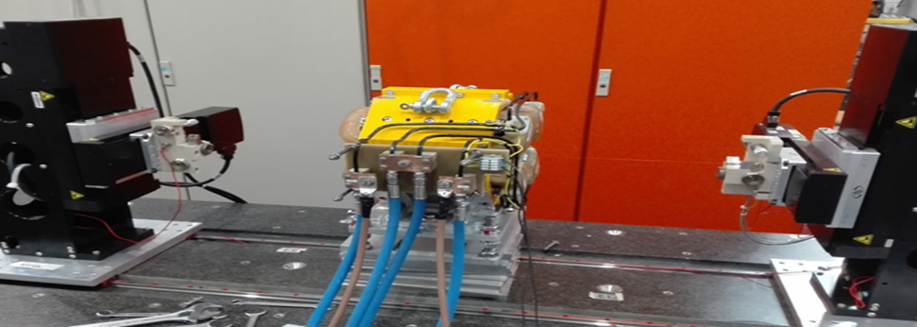
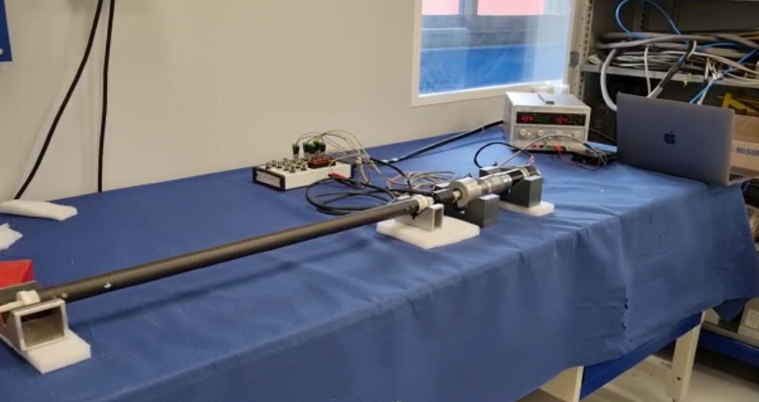
LNF Magnetic Measurements Facility
Z
wire
X
Y
Φ
θ
5-axes digital Movement device equipped with Hall Probe
Stretched Wire Measurement Bench
Rotating Coil under test at CERN

Slide 10
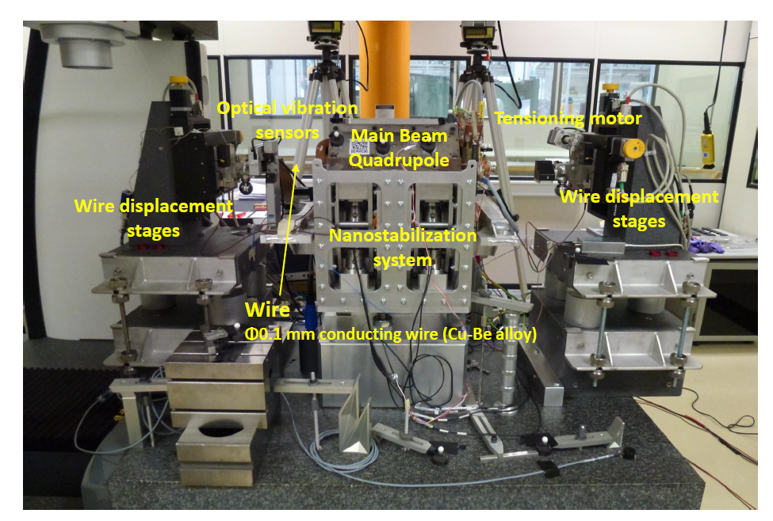
New instruments: Vibrating Wire

Slide 11
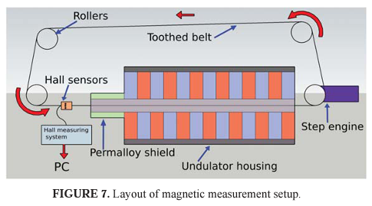
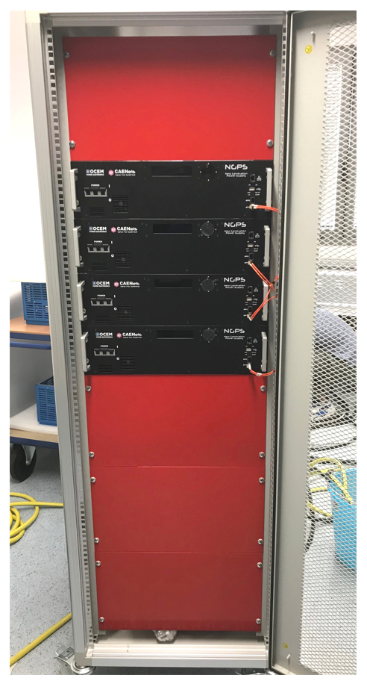
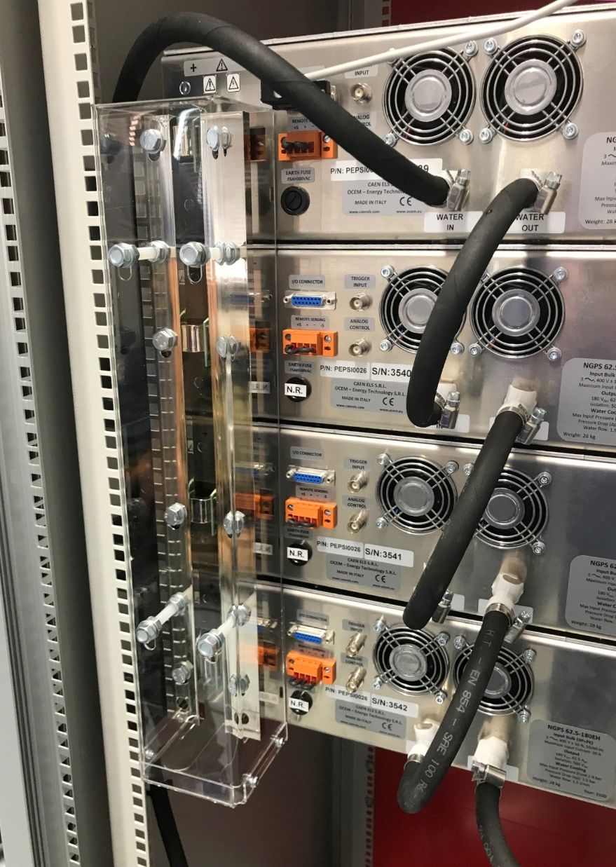
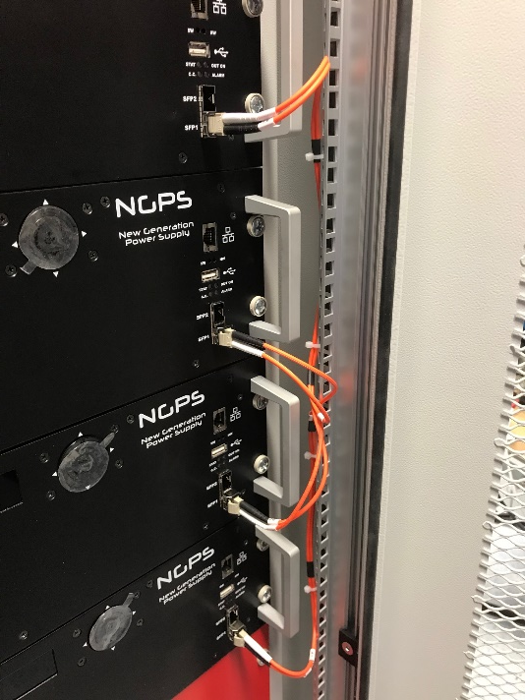
New instruments: Hall probe Mole and Modular PS

Slide 12
WP3 – Genova
INFN, CNR-SPIN, UNIGE-DIFI
Collaboration among the three Insitutes has been formalized with a new Joint Research Lab : LabCoR
INFN
  Characterization of very high current cable
  Design of SC magest for accelerators and Detectors
  Industrial Folow-ip of the SC magnets Construction
  R&D on future Magnets
CNR-SPIN
  Study of Sc material for application
  Development of SC wires
UniGe – Physics Dept.
  Research on SC material

Slide 13
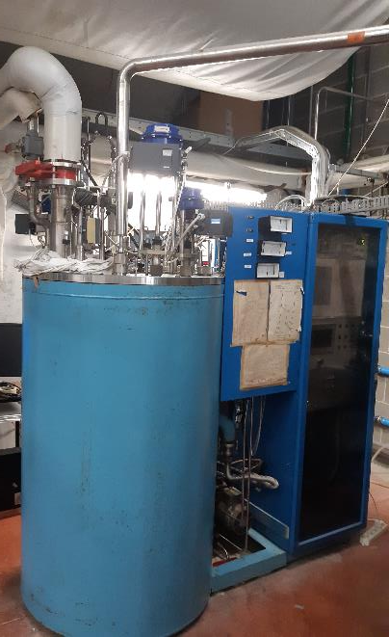
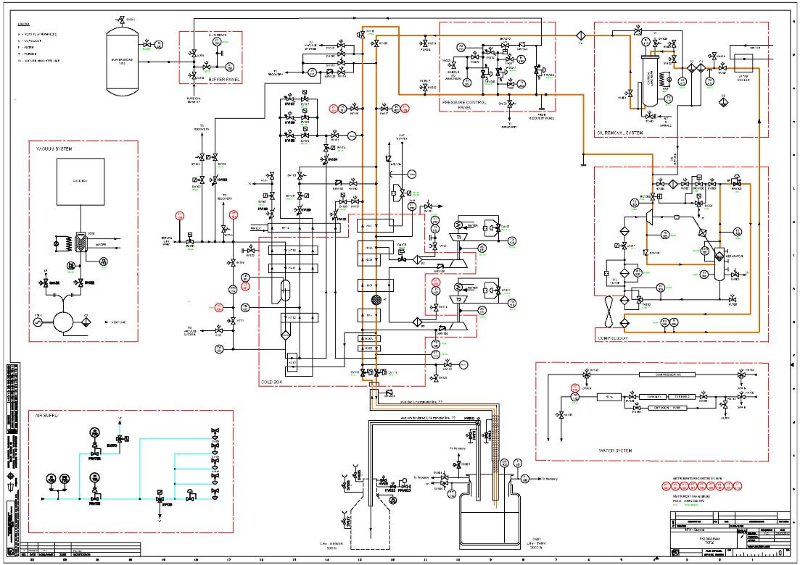
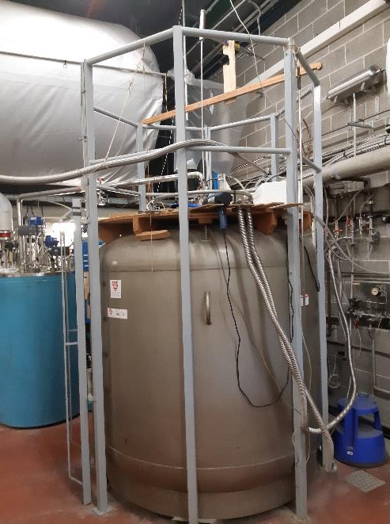
INFN: LINDE TCF20 Helium Liquefier (1989) + recovery and storage plant. It serves all three Institutes, must be revamped with better effciency, less losses and less manpower for its operation
Pressure control panel
Buffer
Compressor
T1
T2
Purifier
Cold box
Storage
dewar

Slide 14
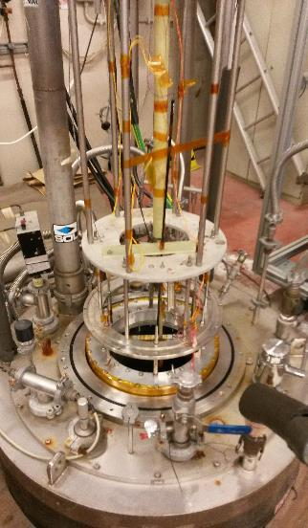
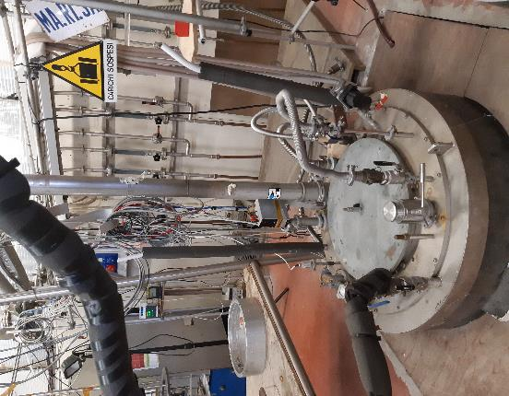
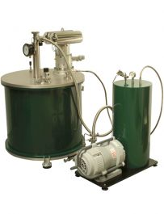
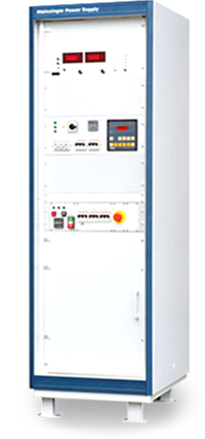
INFN-Ge lab
INFN-Ge lab is one of the few where very high current cables can be tested for particle physics.
Upgrade with better safety and energy efficiency, new Power Supplies, new test station at high field, new instrumentation
Test facility Ma.Ri.S.A.
High field test station
Power supply for superconducting magnets (1000 A, 10 V)

Slide 15
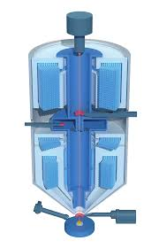
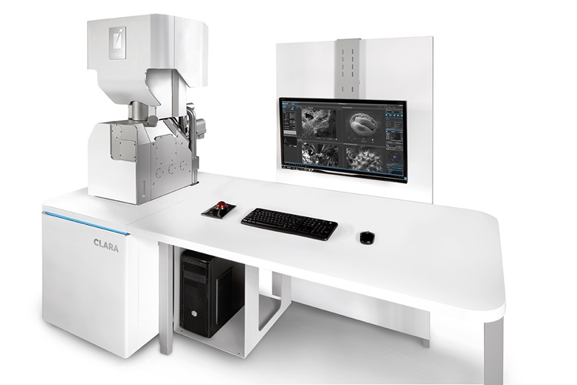
CNR-SPIN lab is used for new superconducting material development and new wires for future applications. It will be revamped with new instrumentation to improve competitiveness at international level.
Scanning Electron Microscope
Morphological and compositional analysis of superconducting meterials

Slide 16
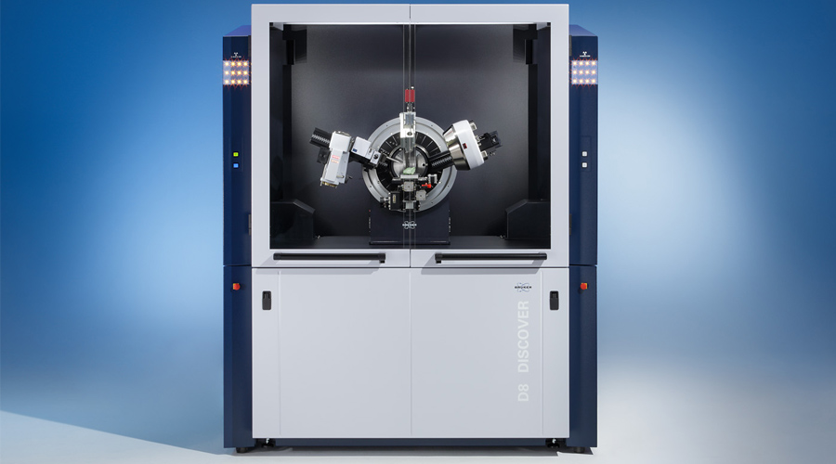
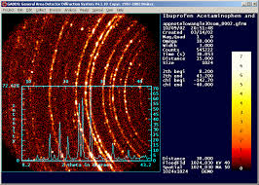
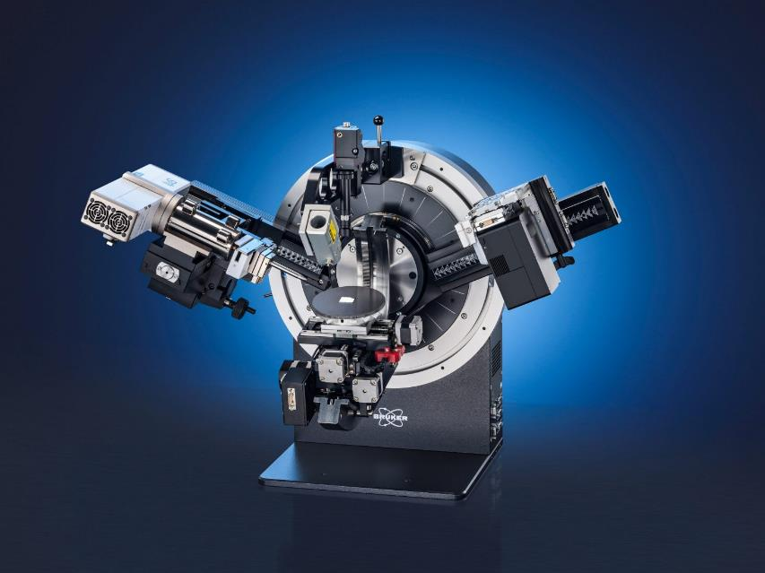
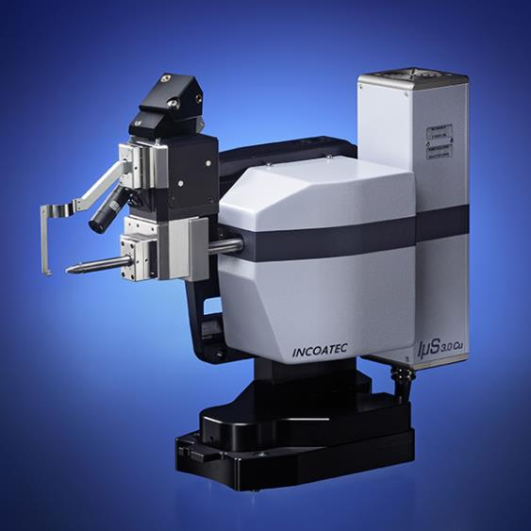
X-Ray diffractometer
Structural analysis of Superconducting materials

Slide 17
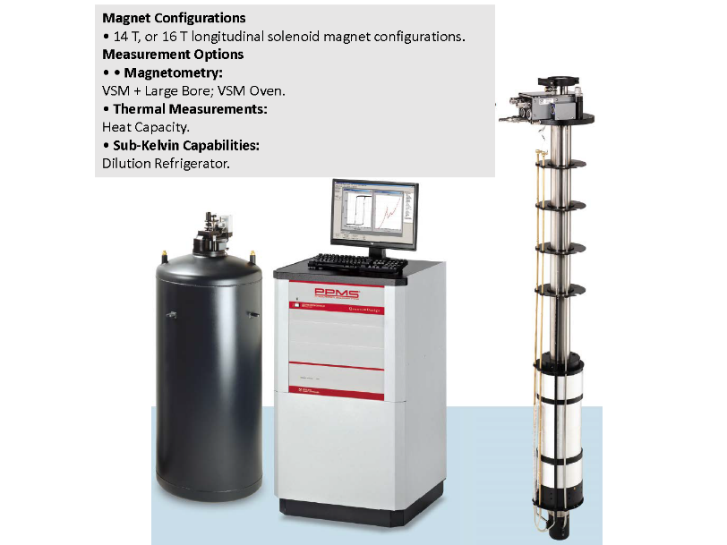
Unige - DIFI
The Physics Department will also contribute, with INFN, to the improvement of the cryogenic plant, (He recovery and LN distribution). A new test station with high magnetic field for thermal capacity and magnetization will increase competitivness of the resarch in superconducting material science.

Slide 18
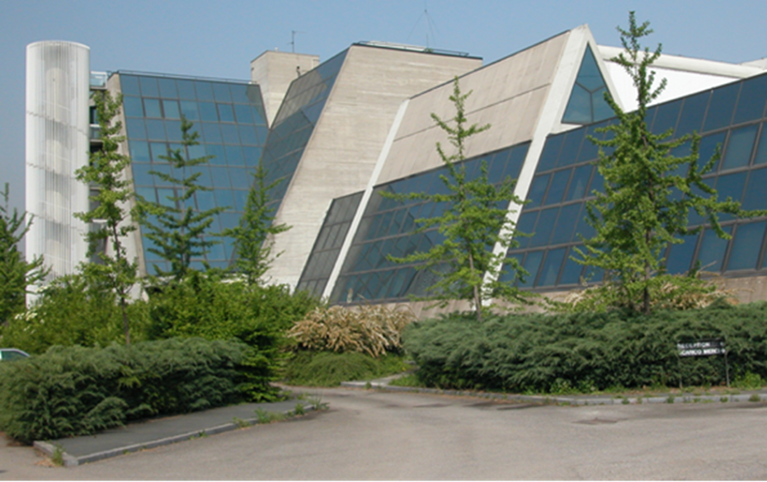
WP4 – Milano LASA
INFN-Milano, UNIMI-DIFI
Laboratorio Acceleratori & Superconduttività Applicata
  SC magnets and SRF cavities
Also photocathodes and other activities (BriXino, radionuclides studies)
(old) LHe plant to be renewed in the next 2 years
About 25 people active in applied superconductivity
Belong to Unimi, co-managed by INFN-Milano and Unimi-DIFI
It is National R.I. as INFN infrastructure (in the list of PNIR as medium priority)

Slide 19
Main activity WP4
Re-vamping of the exiting equipment in the main hall for SC magnet test
  (INFN) Revamping of the existing SC magnet test facility (for bare magnets) up to 30 kA
  (INFN) Addition of VTI for magnet tests at variable temperature, new feeding lines, etc…
(DIFI) New building for a Superconducting Magnet Laboratory open to other labs and Industry to support new projects (FCC, MuCol, other) and novel ideas
(DIFI) Metal AD equipment to support prototypal activity
(INFN) A complete set of new equipment for manufacturing small/medium size SC magnets

Slide 20
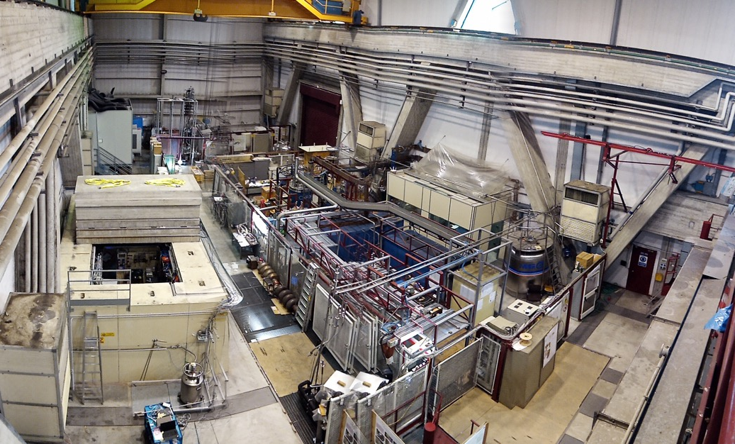
LASA Hall
High field solenoids
SC wire testing area
High current PS
Test Station for long magnets & High Current

Slide 21
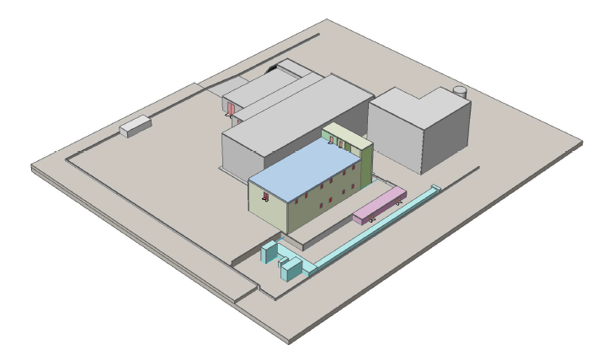
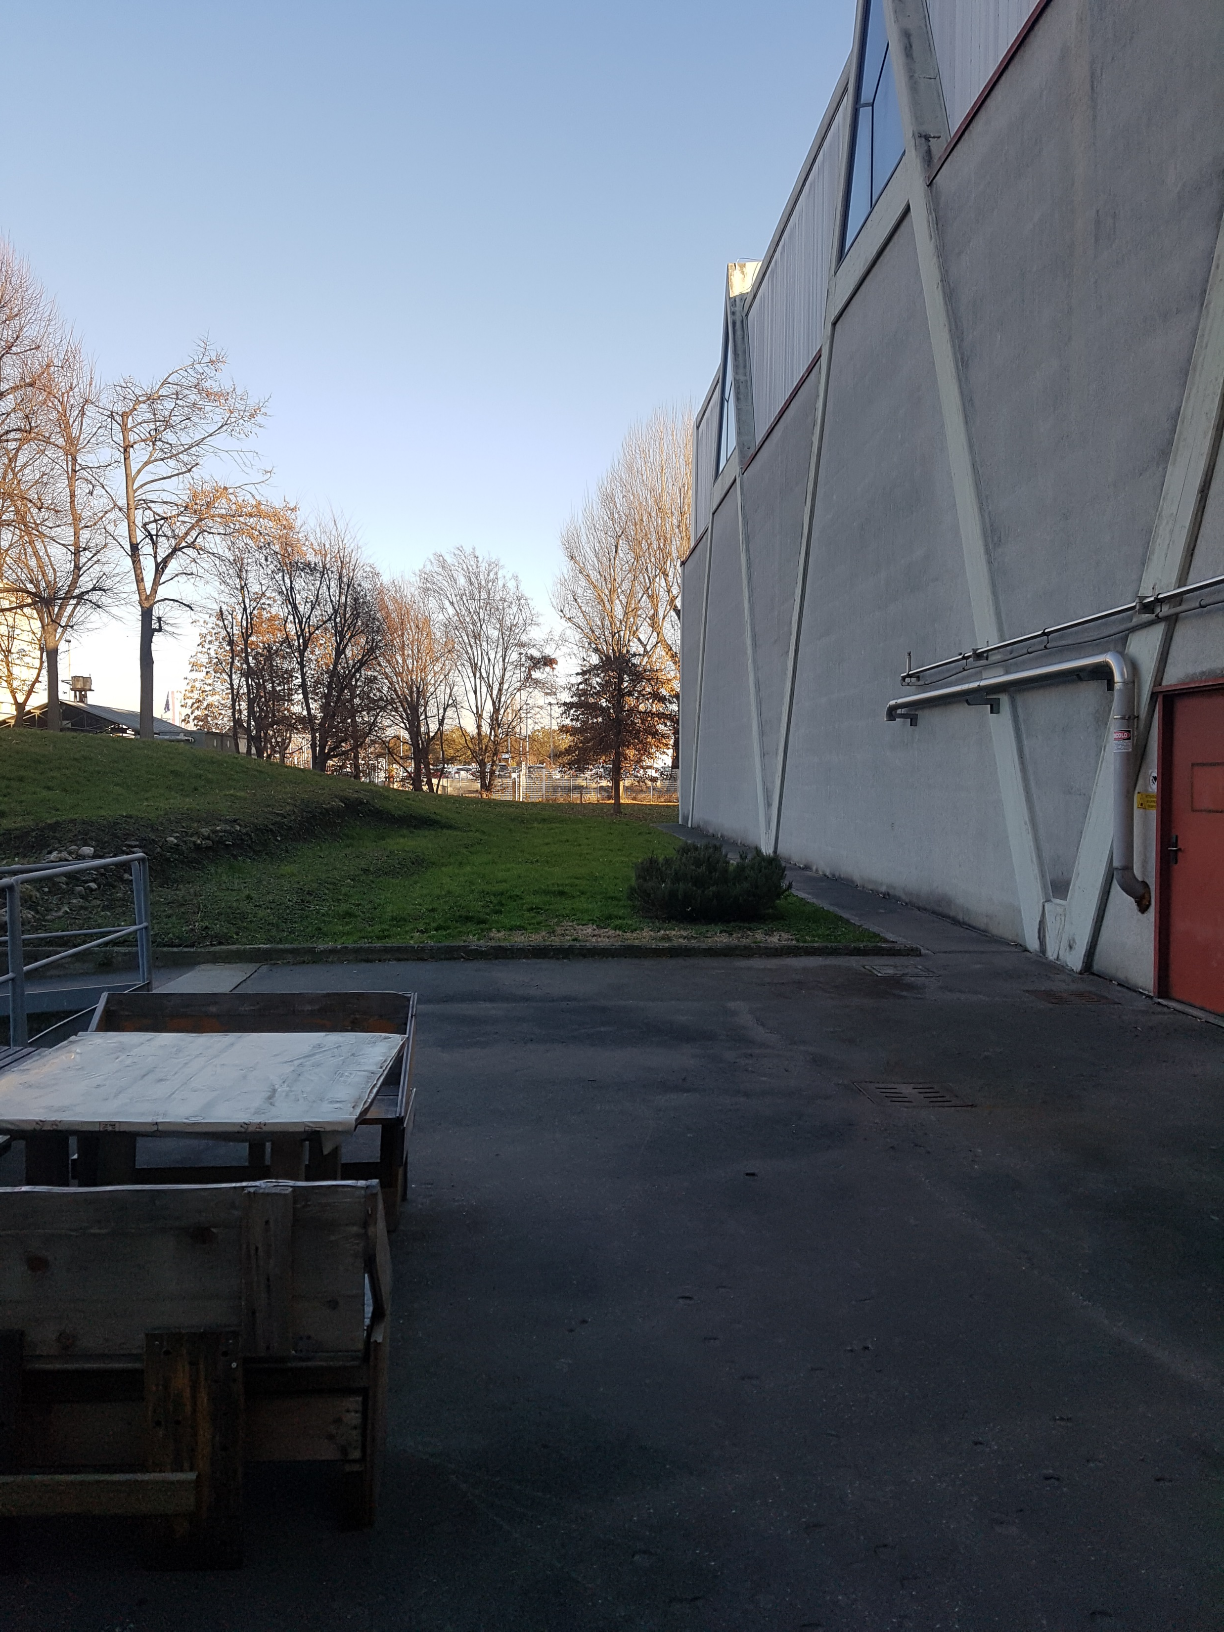
300-400 m2 surface building
2 floors + underground bunker

Slide 22
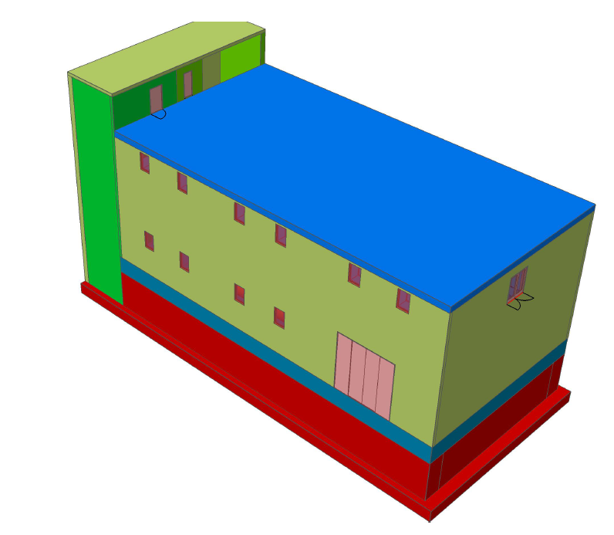
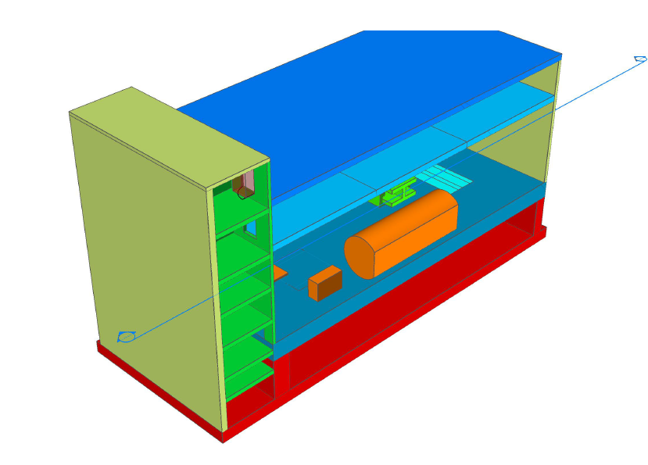

Slide 23




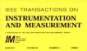
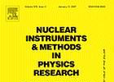

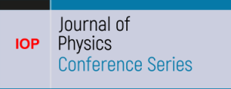






WP5 – Napoli - CIRMIS
IMPALAB expertise
Magnetic measurements
  Improved digital integrator for magnetic measurements.
  High rotation coil system.
  Measurements of field harmonics, gradients and magnetic centres in small aperture magnets.
  Vibrating wire for longitudinal field measurements
  Monitoring of accelerator magnets during operation
  Multi-purpose magnetic field mappers
  Characterisation of magnets
Measurements on superconducting cables
  Test station for superconducting cables with superconducting transformers
  Intelligent test controller for superconducting cables
Cryogenics
  Helium flow monitoring
  Failure detection for compressors
  Decentralisation diagnostics for refrigerated cryogenic systems
  Predictive maintenance for helium storage systems
  Virtual helium monitoring
2x
3x
2x
3x
7x
13x

Slide 24
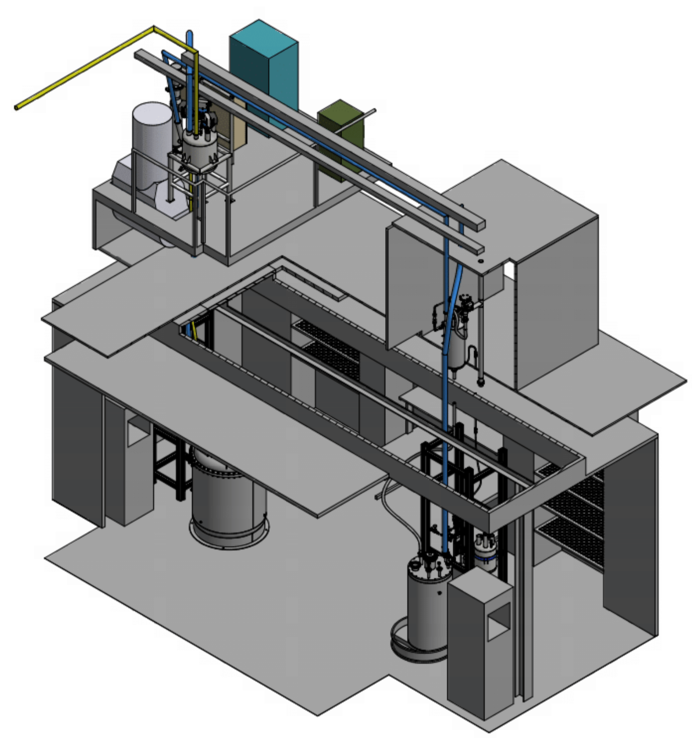
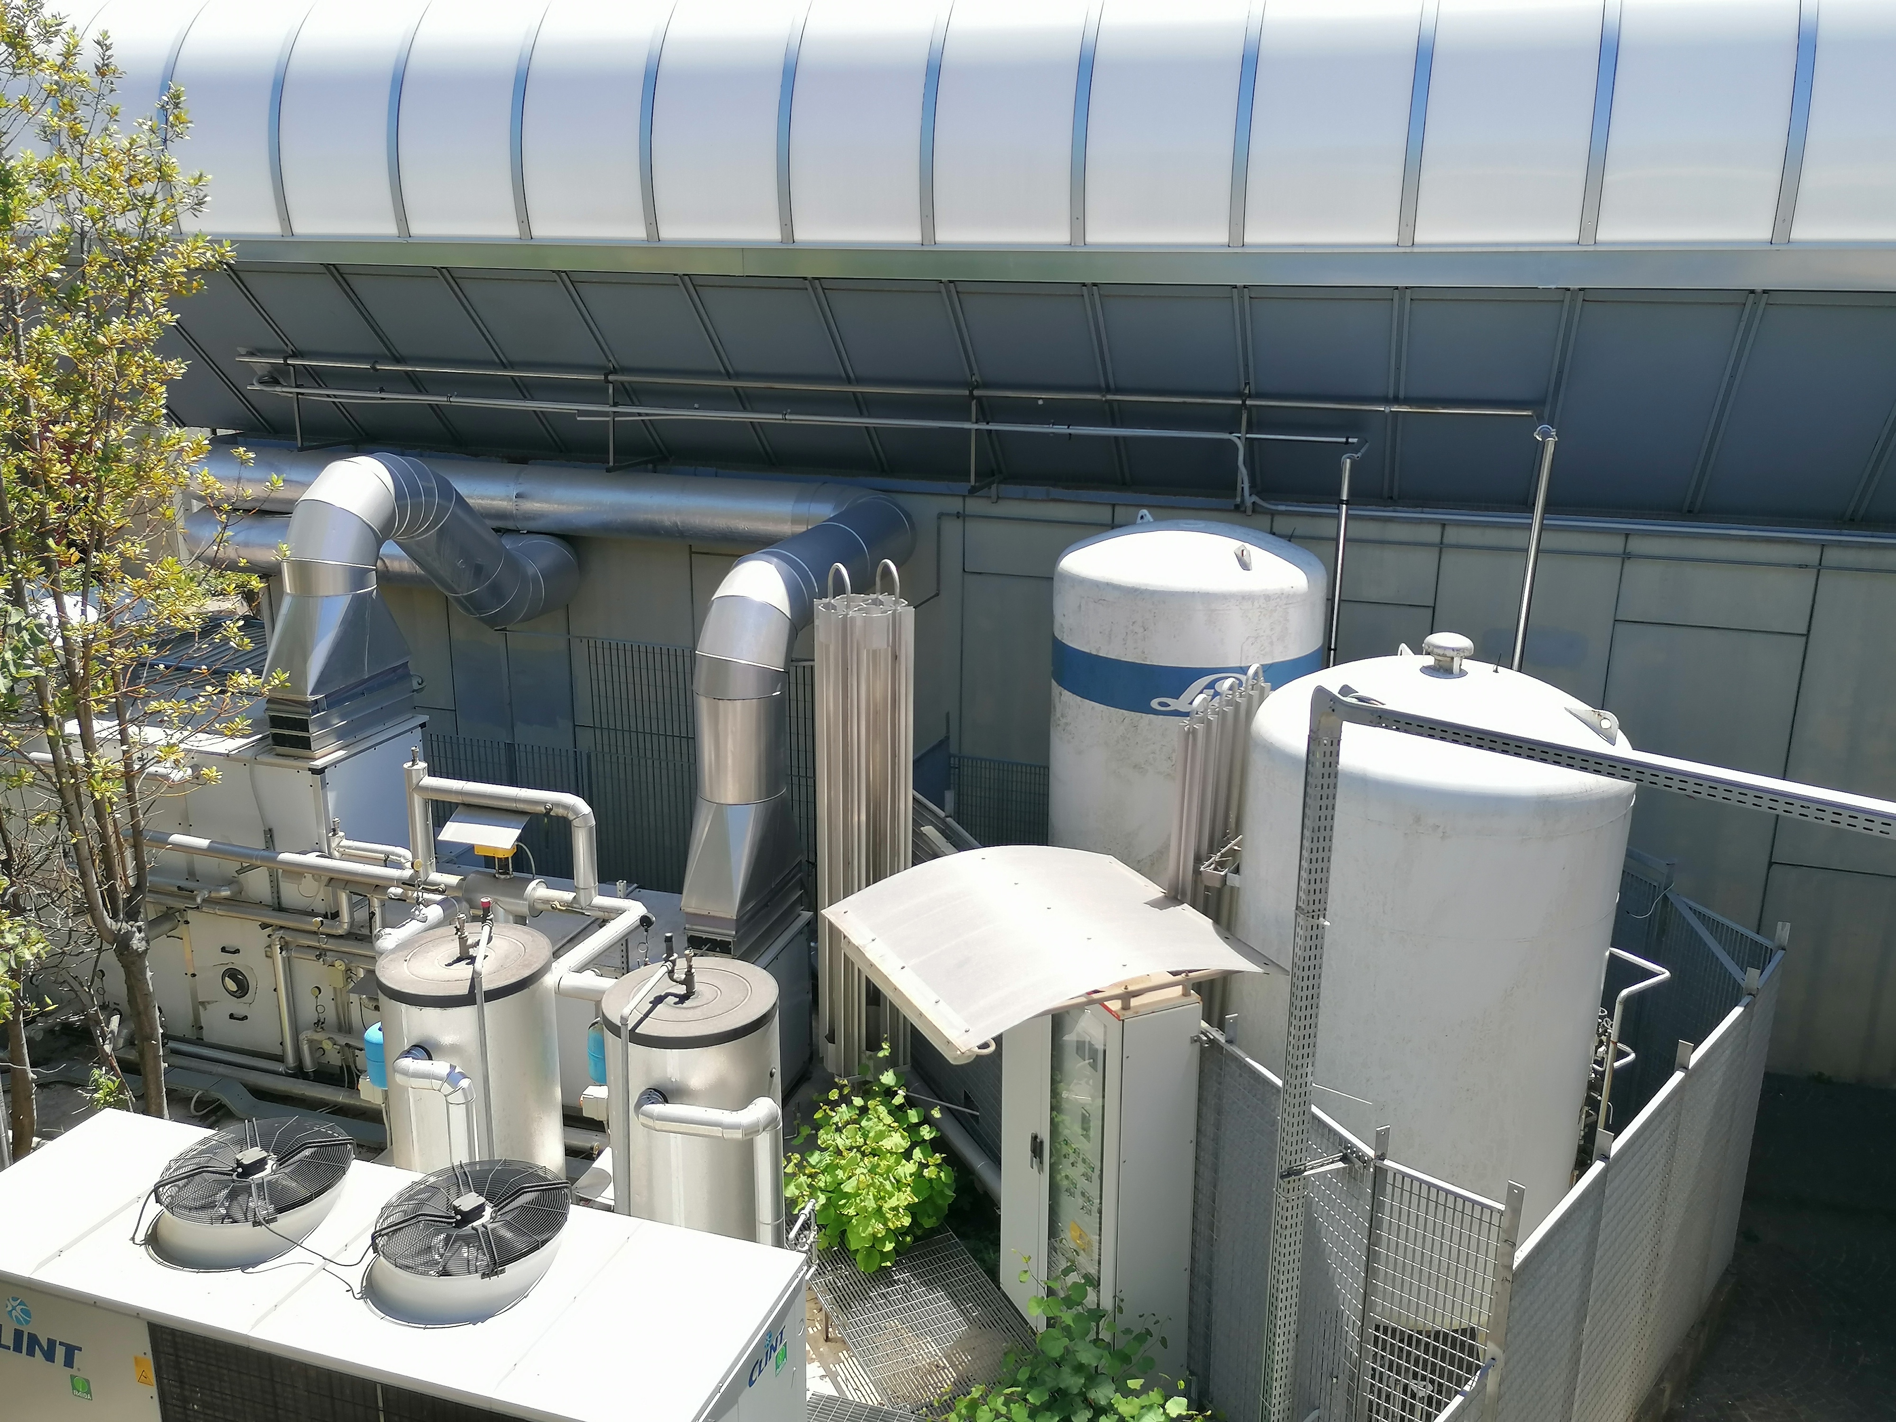
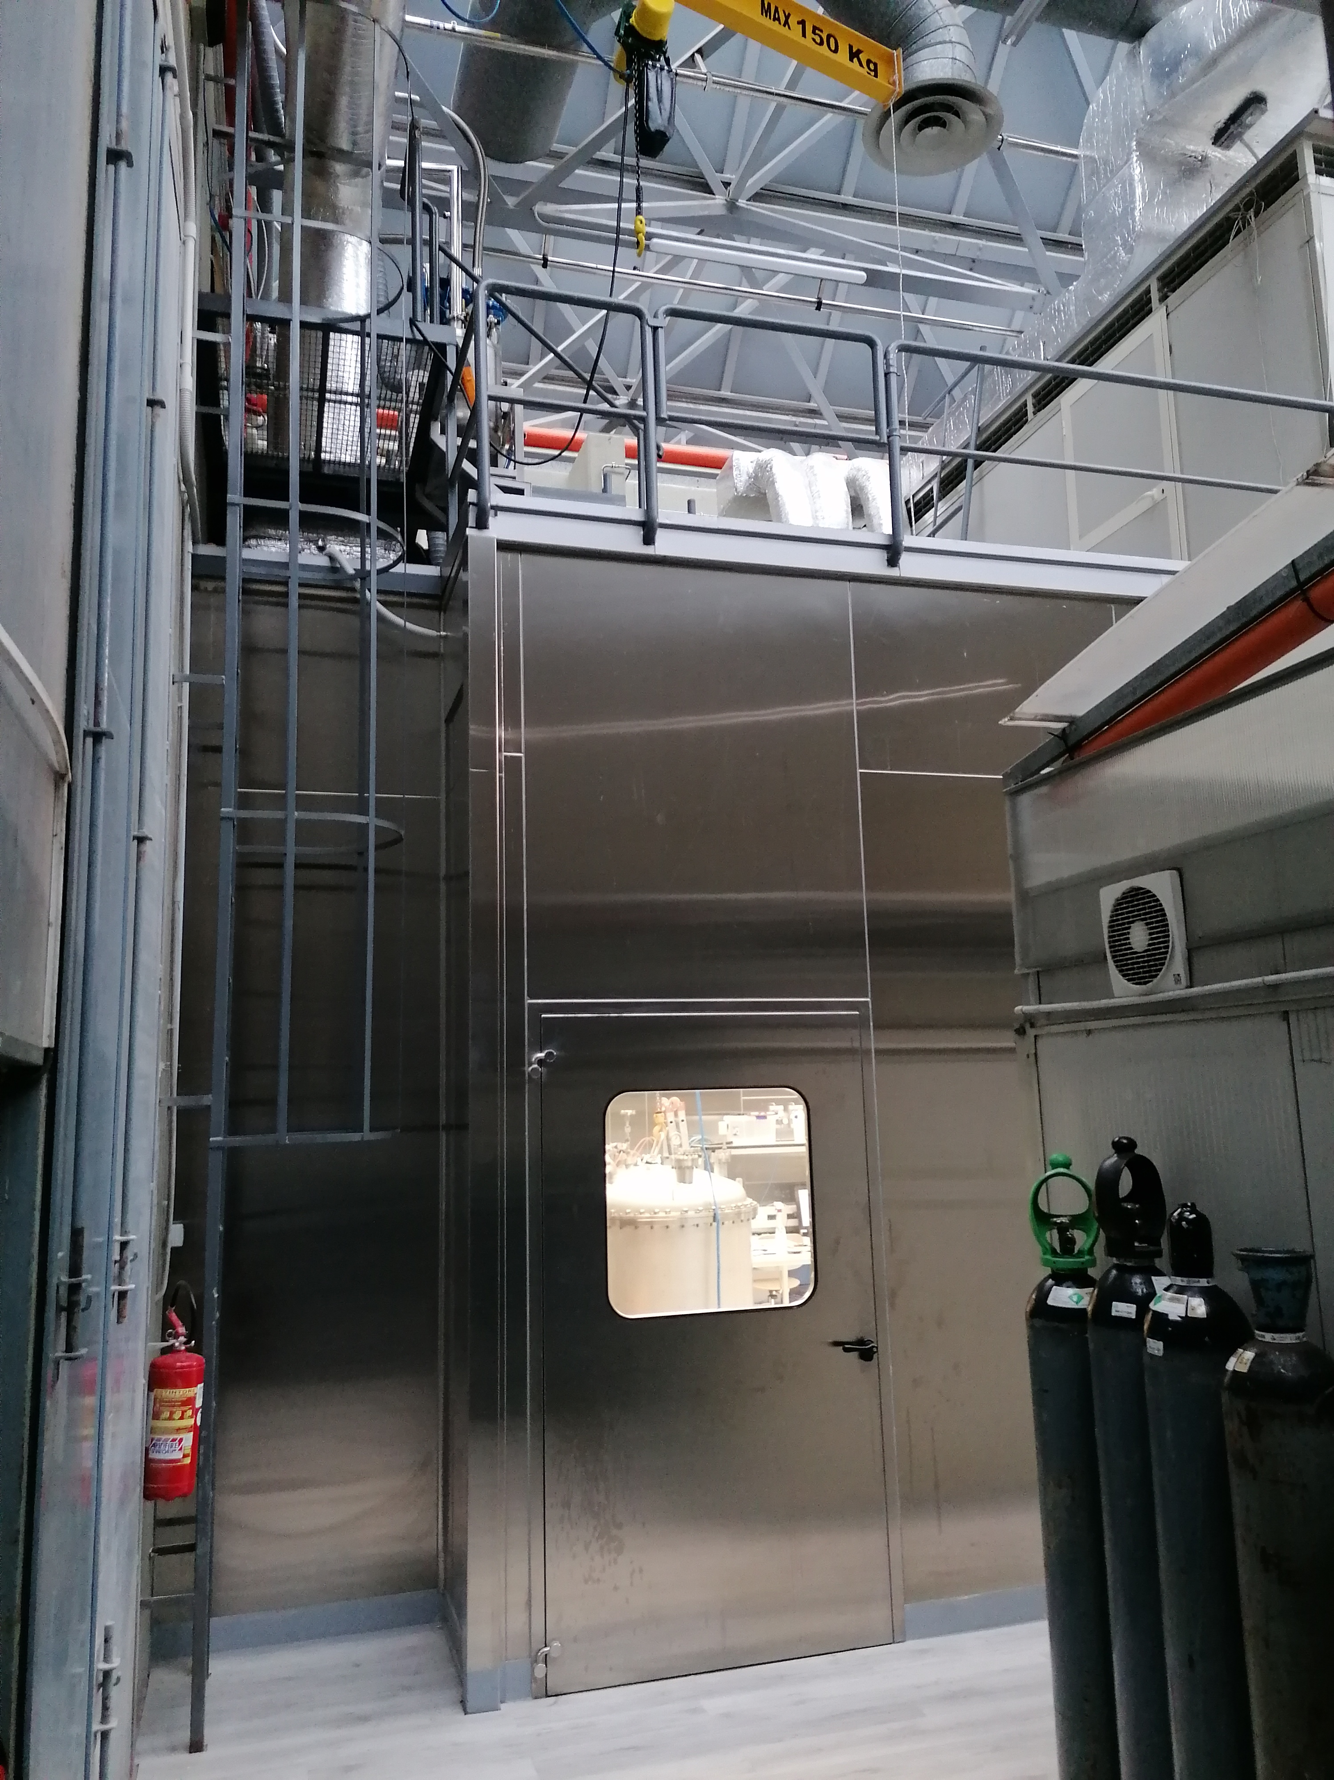
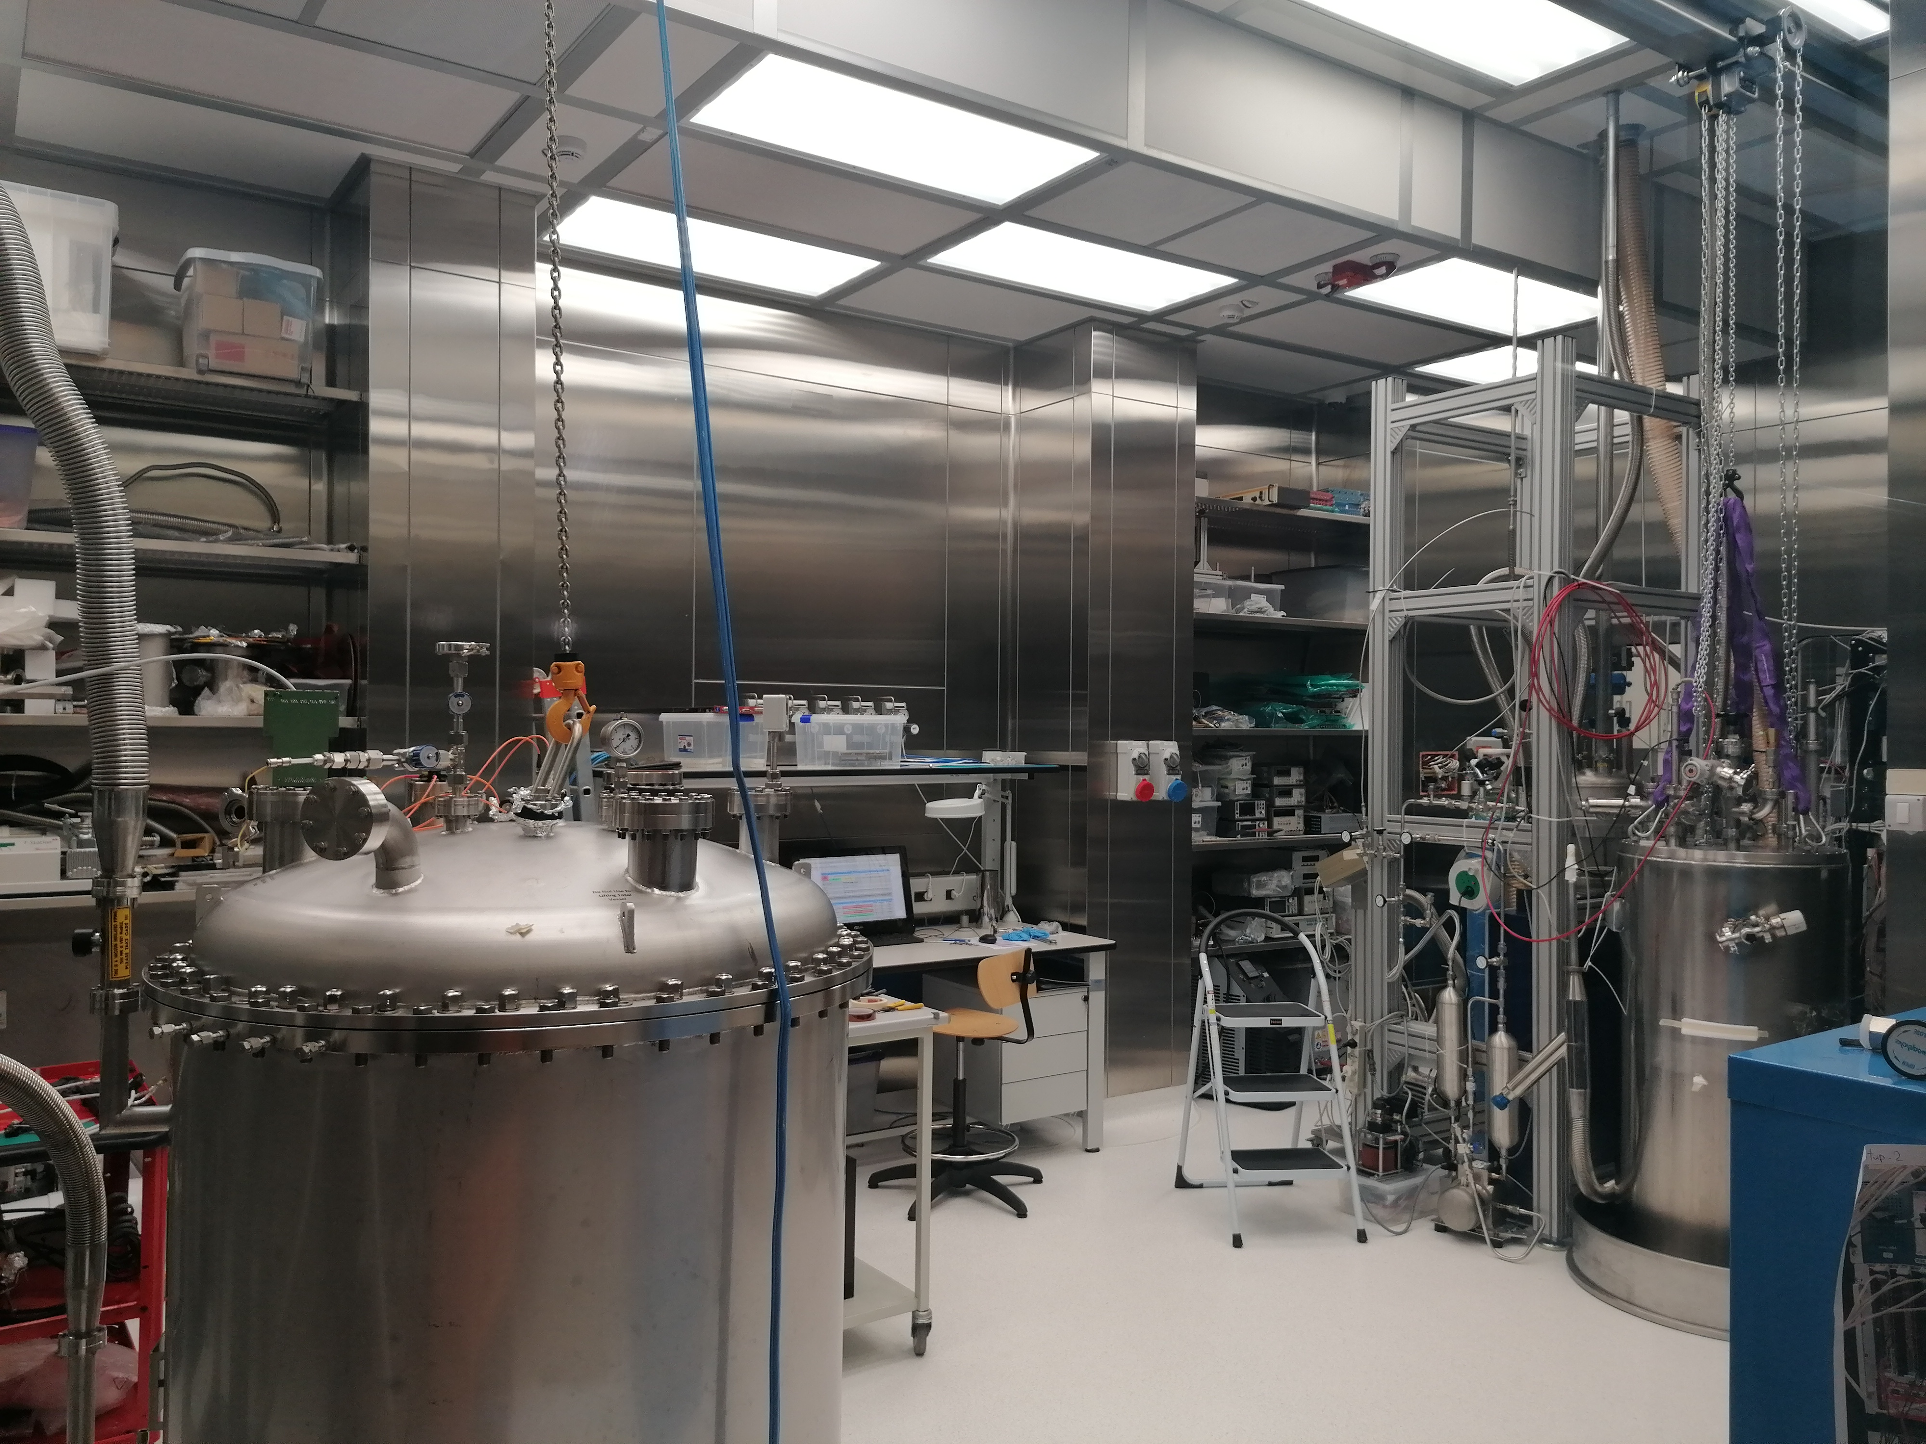
Napoli:
DIFI CRYOLAB
Light Detectors Test
Stand alone cryo system
Vacuum and cryogenic equipment
Cryogenic liquids storage

Slide 25
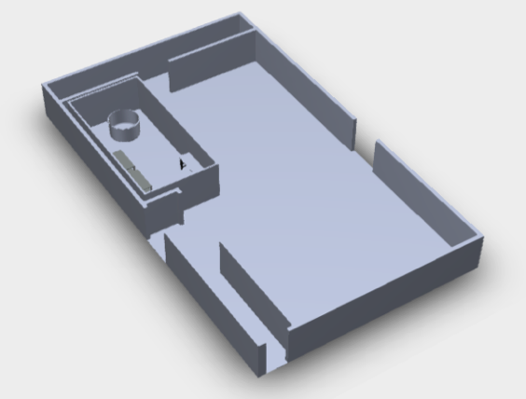
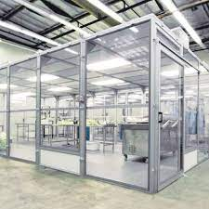
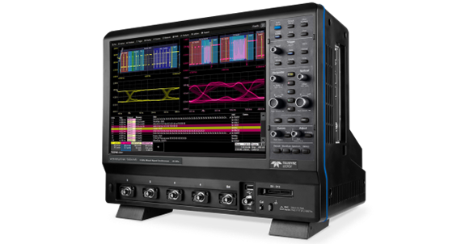
New facility: IRIS ACME laboratory
Aims:
Extend the current instrumentation and measurement procedure for superconducting magnets and cable
Improve the metrological feature of the measure
Develop new procedures for facing the state of the hard challenge for LTS and HTS
17.6 m
11.4 m
Advanced Machine Learning Architecture System
Measurement stations :
Machine for superconducting cables instrumentation

Slide 26

Napoli CNR-SPIN MOKE
Instrumentation for studying material properties relying on magneto-optic Kerr effect (Moke)

Slide 27













SALENTO (Lecde)
Laboratory for Superconductivity and Magnetism
Italian node of the European Infrastructure on Magnetism EMFL-ISABEL (funded within ISABEL project, H2020-INFRADEV-2018-2020, Grant No. 871106).
Cryogenic superconducting magnet (10.5 T, 0.3-300 K)
Oxford dilution refrigerator (down to 10 mK, vector magnet 6T/1T/1T)
Lakeshore Cryogenic RF probe station (down to 8 K and up to 0.5 T and 70 GHz).

Slide 28





Laboratorio di Superconduttività e Magnetismo
development plan
close-cycle SQUID magnetometer
close-cycle superconducting magnet for physical properties measurement
scanning probe microscope for material characterization
split pair cryogen-free magnet system for combined magneto-optical and FMR measurements

Slide 29
WP6 – Salento (Lecce)
UNISALENTO- DMF
Magnetometry measurements under external stimuli such as light irradiation and electric fields for the characterization of innovative materials [novel setup expected to attract users working in the fields of advanced magnetic materials with controllable bistable states and investigating the interplay among magnetism and superconductivity] +50% users
Measurements of physical properties of materials (e.g. magnetotransport and measurements of critical currents) in a wide range of temperatures and magnetic fields [novel setup expected to attract users working on spintronics, superconductive devices, sensors/detectors and quantum computation] +50% users
Combined magneto-optical and ferromagnetic resonance measurements [novel setup expected to attract users working in the fields of magneto-optics, magnonics and quantum computation] +30% users
AFM, MFM and PFM microscopy measurements for the characterization of superconducting, magnetic and multifunctional materials novel setup expected to attract users working in the field of advanced functional materials, spintronics and applied superconductivity] + 30% users

Slide 30
WP7 – Salerno
INFN-NA-G.C.Salerno, CNR-SPIN- UNISA
INFN-Salerno with UNISA has built and commissioned a new SC Magnet test facility in the last 5 year, THOR
It is used at present for testing GSI – SIS100 SC multiplets
With IRIS the INFN/Unisa facility will evolve by:
  Increasing the cryogenic power for SC magnets
  Ability to test magnets not only at Supercritical He flow and ability to test magnets of LHC/Hilumi/FCC size (however, no HEII at te moment)
  Adding a new test facility for Green SC Lines : up to 25 kV – 40 kA (1 GW),20 K He gas, with a dugout for cable as long as 140 m

Slide 31


WP7 – Salerno THOR Lab

Slide 32


THOR: present and IRIS extension

Slide 33

WP7 – Salerno CNR-SPIN
The SPIN Salerno Unit aims to acquire and setting up a magneto-transport measurement system including the application of strain and stress.
The equipment for magneto-transport (e.g. Quantum Design PPMS) consists of a variable temperature (1.9 to 300 K)-field (up to ±9 T) system, designed to perform a variety of automated measurements.
Additional elements to be acquired within IRIS are cryogenic strain and stress cells (e.g. Razorbill Instruments), which are fully compatible with the PPMS probe.
The main goal is to strengthen the capacity for investigating the role of strain/stress on the transport properties of superconducting materials.

Slide 34


WP8 – Demonstrator
Green SC LINE at zero emission
Left: Superconducting Line, in its flexible cryostat, 60 m , 100 kA – 3 kV, during successful test in 2020 at CERN for the High Luminosity LHC Project
(courtesy of A. Ballarino, CERN)
Right: cabling a subelement of a MgB₂ cable for High Luminosity LHC Project
Scope: Manufacturing a demonstrator capable of 1 GW DC, operated at 20 K and test it in “operative” conditions in a test facility that will then be available for other projects. 40 kA-25 kV, 20 K; use of round wire MgB₂
Use: beside long-distance large electrical power transmission, significant place in the electric system for HVDC back-to-back system (study for placing the demonstrator in an Italian facility after the PNRR).
We will design the facility and this demo for cooling with He gas; however, in second stage compatibility with LH cooling will be investigated, too.
(courtesy of A. Ballarino, CERN, archive)

Slide 35

IRIS 1GW DC 25 kV-40 kA power cable
A very compact environmental friendly unrivalled solution !!!
Equivalent Cu section 125000 mm²
Easier to install due to a large reduction of cross section
Large saving of raw materials and CO₂ emissions
No thermal impact
Superconducting cable
> 350 mm
49 mm
Resistive Copper bus bar
Iris solution

Slide 36











Manufactured with industrial cabling processes
IRIS 1GW DC 25 kV-40 kA power cable
Planetary assembling machine
for the final conductor
Lapping line for the HV insulation
and protection
Planetary cabling machine for the petal
Courtesy of E. Bruzek , ASG Itlay
d =1,33 mm
d =14,4 mm
d =43,2 mm
d =49 mm

Slide 37

IRIS 1GW DC 25 kV-40 kA power cable
Its integration within the grid needs:
A cooling machine
Two terminations and when necessary joints for long cables
Cable control systems connected to the grid mgt
+
-
Terminations
-
+
SCADA
Power
Heat
Joints
Bulk LN₂
Storage
Return
Cooling system
Supply
Courtesy of E. Bruzek , ASG Itlay

Slide 38



WP9 – Demonstrator
Energy Saver Superconducting Magnet in HTS
Cable in HTS for da 10 kA, developed in the EU collaboration FP7-Eucard2 GA 312453
The record field for HTS dipole (with some accelerator quality) is Eucard2, only 4.5 T… it is time to try to see if HTS can really be useful for accelerators.
Scope : a dipole rated for:
10 T – 150 mm bore – 10-20 K operation as background field for cable test.
As technology driver for 15 T – 20 K operation for FCC…
https://news.mit.edu/2021/MIT-CFS-major-advance-toward-fusion-energy-0908

Slide 39


Post HiLumi LHC SC Magnets
Nb₃Sn : fields in excess of the 12 T of Hilumi seems very difficult. Now in Hilumi big success with 3 magnets in a raw that did work.
  However a lot of work will be needed just to consolidate the 12 T region (INFN Falcon D project, and all HFM program (CERN, CEA, PSI, etc…).
  The zone of 14-16 T si not impossible but training and degradations will be a severe obstacle. In addition B=16 T needs HeII (baseline in FCC-hh). 300 MW cryo!

Slide 40

HTS should be explored for next hadron collider design
HTS : today record for dipole is 4.5 T but very little effort
  Solenoids are at 30-40 T!
  Cost of HTS is still vey high but is steadily (however slowly) decreasing in $/kA-m
So far HTS dipole design more for 20+T regime @ 2-4 K.
Now we think that could 12-16 T @ 10-20 K: Electric bill 5-10 limes less!
Towards colliders with HTS magnets: State-of-the-art of the main objectives and challenges by Lucio Rossi (CERN), ECFA Newsletter #4, Winter 2019, Following the Plenary ECFA meeting, 14-15 November 2019, https://indico.cern.ch/event/847002/overview
Cost of Cryogenics evolution over 30 years
(source: Serge Claudet, CERN, Hilumi LHC project

Slide 41





8 T- 10 K 810 T 20 K) DIPOLE steady state
Cloverleaf desing
Courtesy : J. van Nugteren
Little Beast Engineering
Aperture 80X50 mm
700 mm straight section
B3 B5 geometric field quality
12 mm wide REBCO tape (stack)
1.2 MJ stored energy
10 K temperature margin
11 km of HTS tape (~1 M$)
550 A/mm² cable current density
10T 20K Test Station Magnet with Cloverleaf-End Design Sketch

Slide 42


Alternative Dipole design: flat race track (with return flux coils)
Pictures from Magnus Dam, INFN-LASA

Slide 43
Thee figure includes VAT and other duties)

Slide 44
-18 days to the start!
3 years to build
Thanks for your attention

