Slide 1




RF Parameter Choices and
Longitudinal Stability
F. Batsch, H. Damerau, I. Karpov
Acknowledgements: David Amorim, Scott Berg, Fulvio Boattini, Luca Bottura, Christian Carli, Antoine Chancé, Alexej Grudiev, Elias Metral, Daniel Schulte
Presented on the 1st Muon Collider Annual Meeting, CERN, 2022

Slide 2

Outline
The TESLA cavity and RCS parameter
Intensity effects & longitudinal beam dynamics:
Short-range wakefield and beam loading compared to the cavity voltage
Synchrotron tune & Number of RF stations versus emittance
Emittance evolution during the acceleration stages
Outlook and Summary
F. Batsch

Slide 3
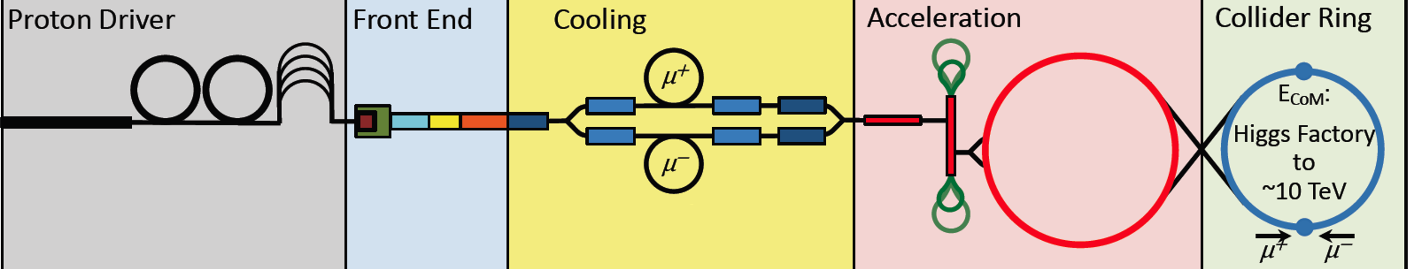
Muon acceleration to high energies
hybrid
RCS
5 TeV
Details on RCS: See talk by H. Damerau
Chain of rapid cycling synchrotrons, counter-rotating μ⁺/μ⁻ beams
→ 63 GeV → 314 GeV → 750 GeV → 1.5 TeV (→ 5 TeV)
Hybrid RCSs have intersecting normal conducting (NC) and superconducting (SC) magnets
Studies presented aim to determine the RF (cavity) and lattice parameters (number of RF stations, momentum compaction factor,…)
hybrid
RCS
1.5 TeV
norm. cond. RCS
hybrid RCS
Both in the same tunnel
H. Damerau
F. Batsch

Slide 4
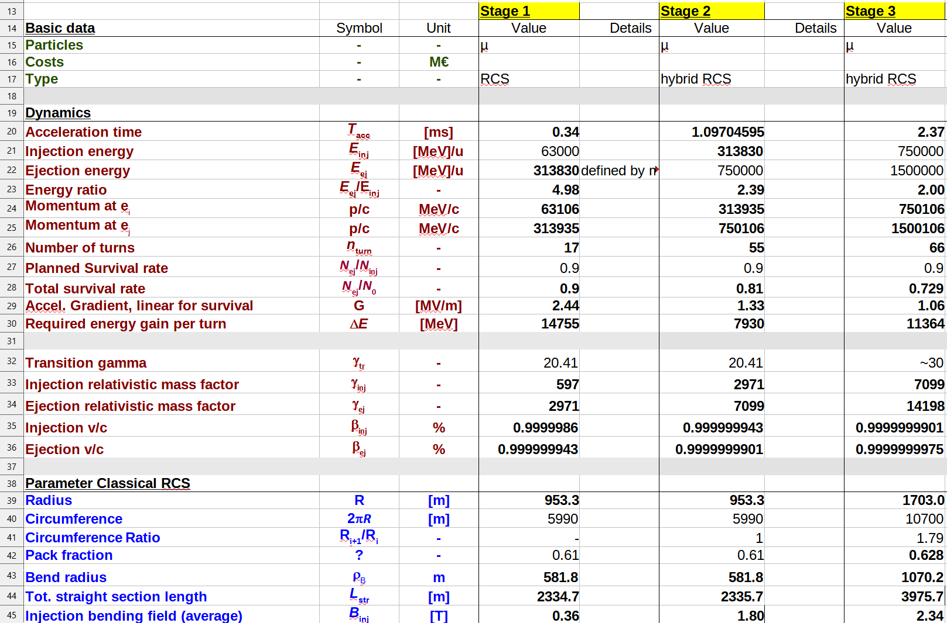
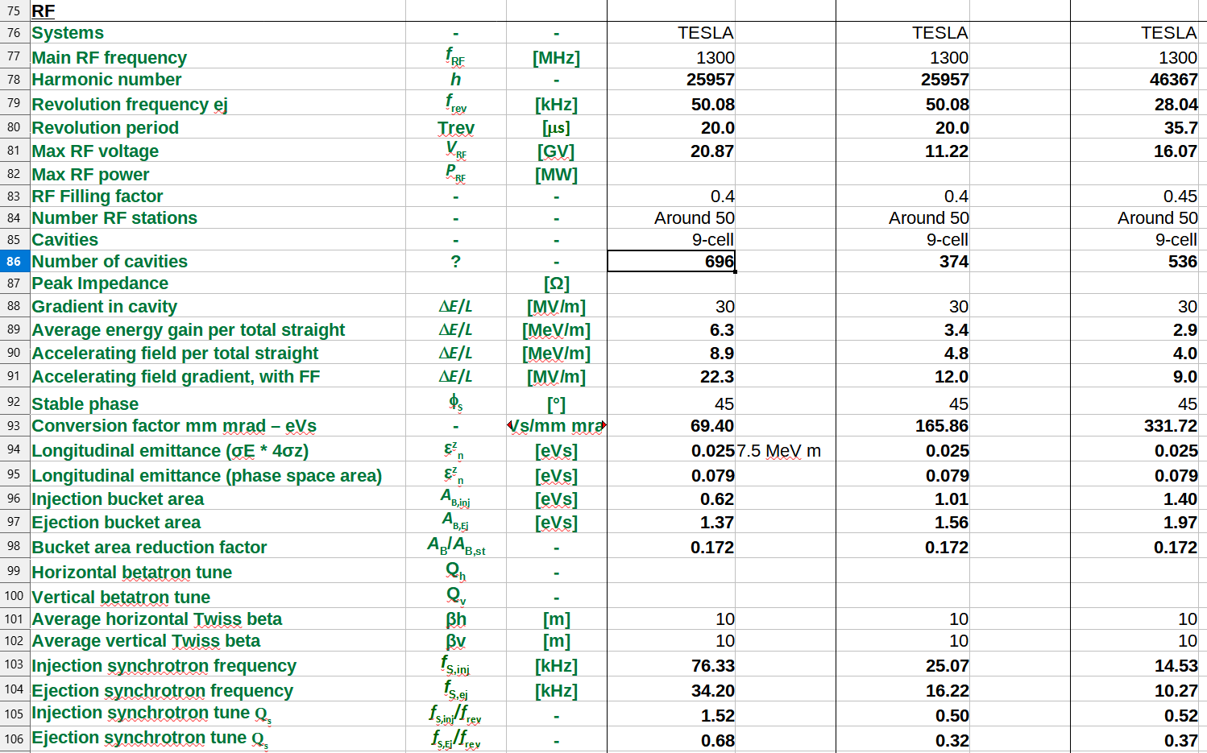
Parameters and tools:
General parameter
Detailed parameter table: https://cernbox.cern.ch/index.php/s/I9VpITncUeCBtiz
 | RCS1→314 GeV | RCS2→750 GeV | RCS3→1.5 TeV
Circumference, 2πR [m] | 5990 | 5590 | 10700
Energy factor, E_{ej}/E_{inj} | 5.0 | 2.4 | 2.0
Repetition rate, f_{rep} [Hz] | 5 (asym.) | 5 (asym.) | 5 (asym.)
Number of bunches | 1μ⁺, 1μ⁻ | 1μ⁺, 1μ⁻ | 1μ⁺, 1μ⁻
Bunch population | 2.5x10¹² | 2.3x10¹² | 2.2x10¹²
Survival rate per ring | 90% | 90% | 90%
Acceleration time [ms] | 0.34 | 1.04 | 2.37
Number of turns | 17 | 55 | 66
Energy gain per turn, ΔE [GeV] | 14.8 | 7.9 | 11.4
Acc. gradient for survival [MV/m] | 2.4 | 1.3 | 1.1
Acc. field in RF cavity [MV/m] | 30 | 30 | 30
Max. RF voltage for φ_{s}=45° [GV] | 20.9 | 11.2 | 16.1

Slide 5
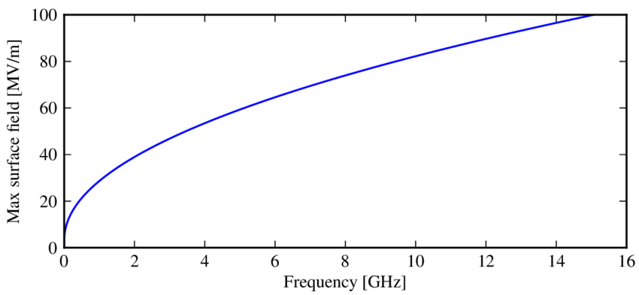
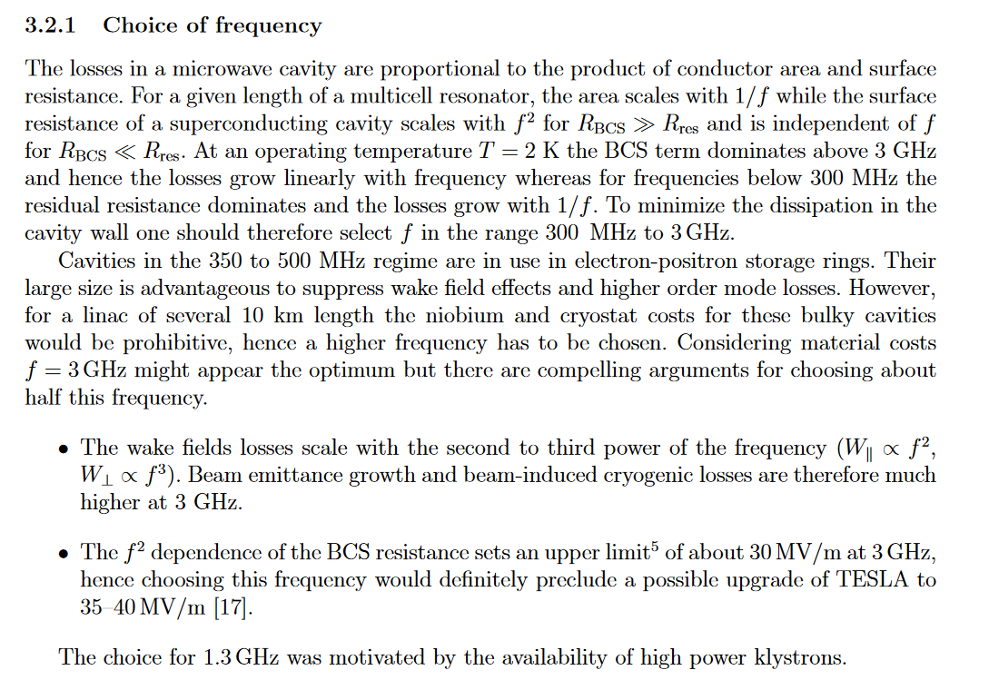
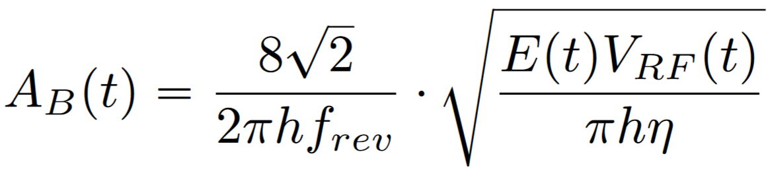
Parameters and tools:
RF – The TESLA cavity
Kilpatrick limit
Source link
Common f_{RF}, from H. Damerau’s talk & citation from design report:
f_{RF} & h impact bucket area and gradient!
→ 1.3 GHz TESLA cavity as base for muon collider RCS
Frequency | Accelerator | Remark
352 MHz | LEP | Moderate gradient
400 MHz | LHC | Moderate gradient
800 MHz | ERL, FCC | Alternative for μRCS
1.3 GHz | TESLA, ILC, FELs (XFEL) | μRCS
1.5 GHz | JLab-CEBAF
~1/h^{3/2}
Phys. Rev. ST Accel. Beams 3, 092001, 2000

Slide 6
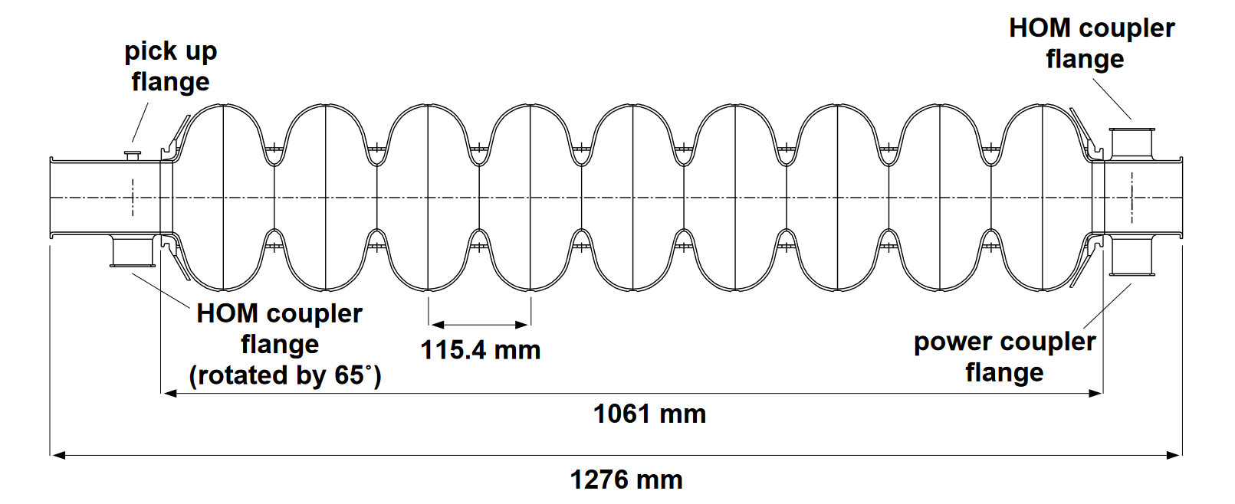
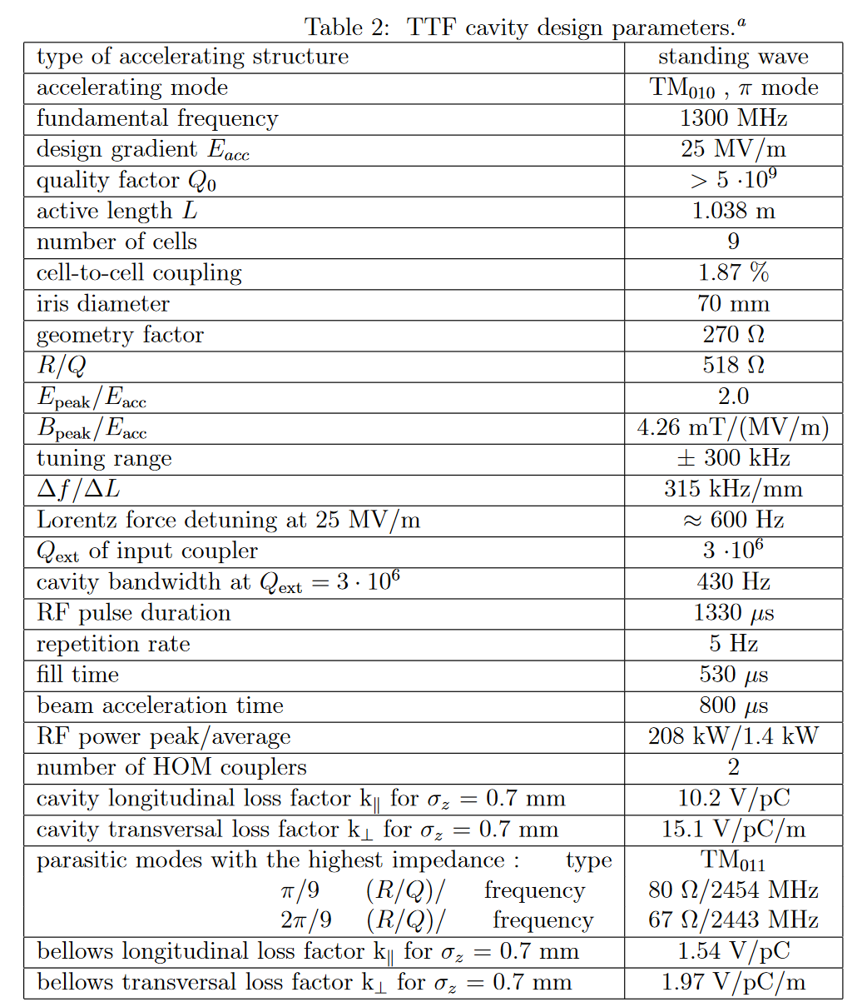
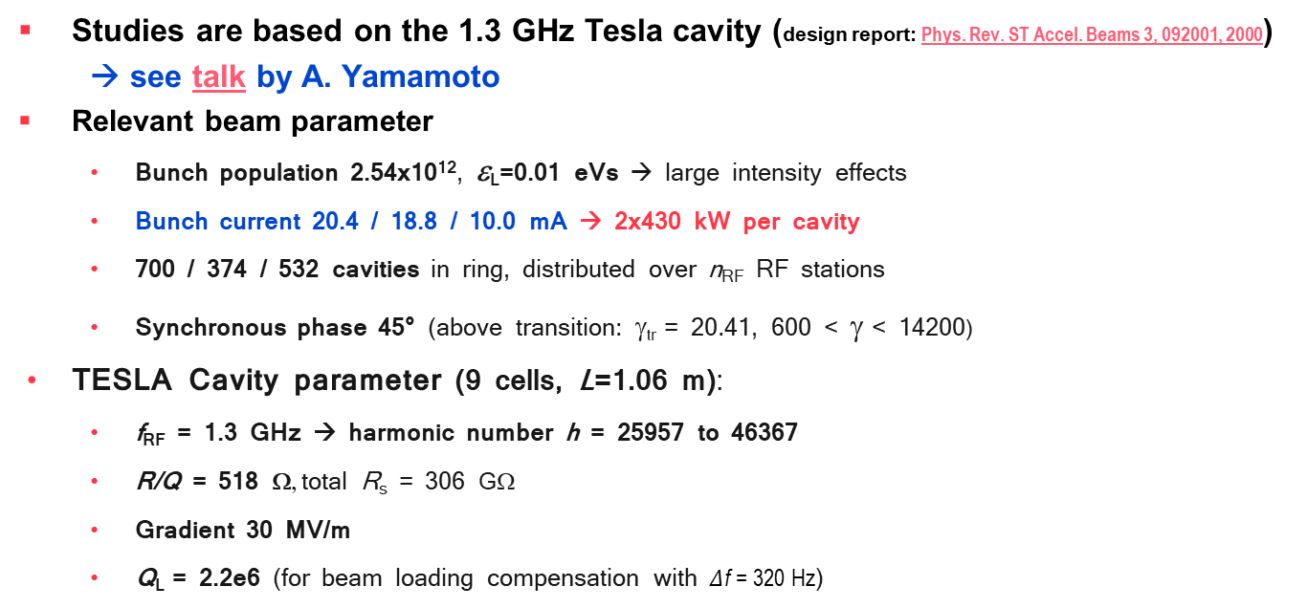
Parameters and tools:
RF – The TESLA cavity
From design report
Studies are based on the 1.3 GHz Tesla cavity (design report: Phys. Rev. ST Accel. Beams 3, 092001, 2000)
→ see talk by A. Yamamoto
Relevant beam parameter
  Bunch population 2.54x10¹², ε_{L}=0.01 eVs → large intensity effects
  Bunch current 20.4 / 18.8 / 10.0 mA → 2x430 kW per cavity
  700 / 374 / 532 cavities in ring, distributed over n_{RF} RF stations
  Synchronous phase 45° (above transition: γ_{tr} = 20.41, 600 < γ < 14200)
TESLA Cavity parameter (9 cells, L=1.06 m):
  f_{RF} = 1.3 GHz → harmonic number h = 25957 to 46367
  R/Q = 518 Ω, total R_{s} = 306 GΩ
  Gradient 30 MV/m
  Q_{L} = 2.2e6 (for beam loading compensation with $Δ$f = 320 Hz)
(with 30 MV/m accelerating gradient)
From design report

Slide 7
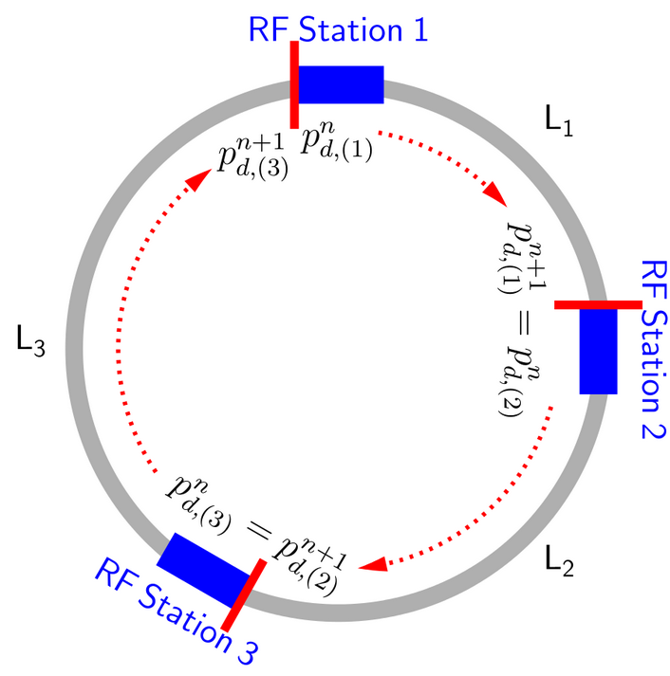
Studies & BLonD code
(Beam Longitudinal Dynamics code)
BLonD: macro-particle tracking code, developed at CERN since 2014
Links: documentation and github
MuC-specific to multiple RF stations & muon decay
Using the BLonD code to observe effects of
  Short-range wakefields
  Fundamental beam loading
  Synchrotron tune Q_{s} between RF stations
First studies with only one bunch, 2nd to follow
From BLonD documentation
F. Batsch

Slide 8
Outline
The TESLA cavity and RCS parameter
Intensity effects & longitudinal beam dynamics:
Short-range wakefield and beam loading compared to the cavity voltage
Synchrotron tune & Number of RF stations versus emittance
Emittance evolution during the acceleration stages
Outlook and Summary
F. Batsch

Slide 9
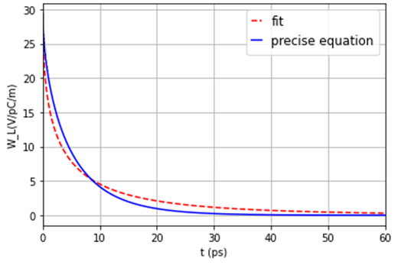
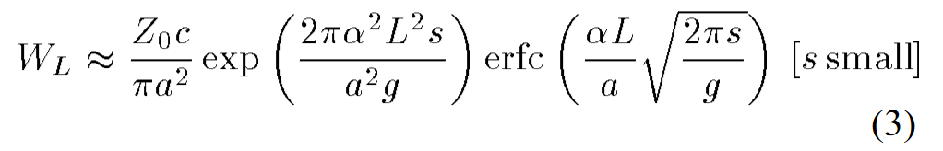
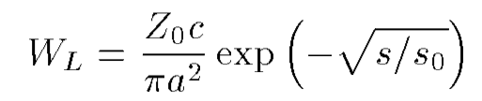
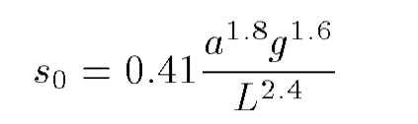
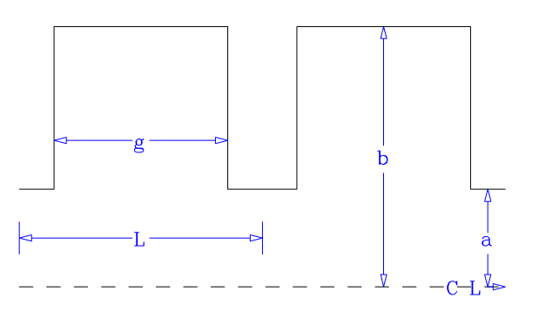
Induced voltages: Short-range wakefields
Based on K. Bane et al., ‘Calculation of the short-range longitudinal wakefields in the NLC linac’, ICAP98, 1998
The longitudinal wake function is given by:
One can approximate this by a semi-analytically expression, valid for small s and s/L < 0.15:
The parameters for the Tesla cavity¹ gives long. wake functions on the order of 30 V/pC/m:
Adjusting ‚a‘ can be a powerful tool to mitigate wakefields!
The BLonD code convolutes the wake function with the beam profile to obtain the induced voltage
L= 115.4 mm
g= 82 mm
a= 35 mm
b= 103.3 mm
¹Wakefield studies for the Tesla cavity shown in TESLA Report 2003-19
13 October 2022
9
F. Batsch
9

Slide 10
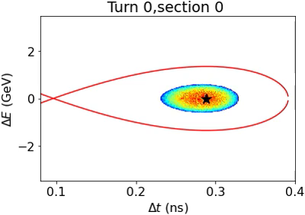
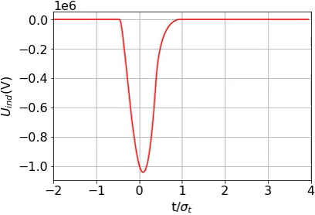
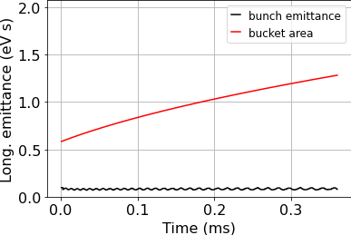

Short-range wakefields
Simulations for RCS1 (63 → 314 GeV), n_{RF} = 48
Initial mismatch due to assumption of continuous synchrotron motion in matching routine
$→$ Improves with a higher n_{RF} (see following slides)
Induced voltage from the short-range wakefield: 1.5 MV per cavity, i.e., also 1.5 MV/m
Total induced voltage per turn is around 5% of V_{acc}
Phase space
Induced voltage per cavity
Longit. emittance
V_{ind} (V)
Emittance = area under Hamiltonian containing 99% of the bunch
13 October 2022
10
10

Slide 11
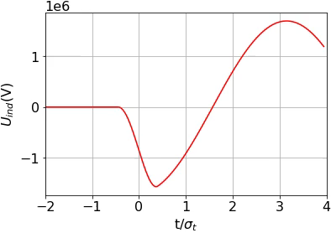
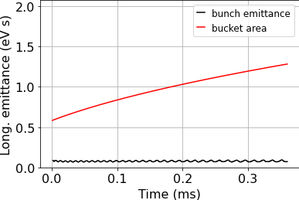
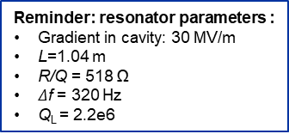
Induced voltages: Fundamental Beam loading
Simulations for RCS1 (63 → 314 GeV), n_{RF} = 48, with induced voltage from fundamental mode beam loading, single turn, no short-range wakefields
Induced voltage from beam loading for a single turn is similar, 1.5 MV per cavity (confirmed by simulations from A. Grudiev, see this presentation), with similar effects
Note: So far for a single turn only, multi-turn implementation to follow
Reminder: resonator parameters :
Gradient in cavity: 30 MV/m
L=1.04 m
R/Q = 518 Ω
$Δ$f = 320 Hz
Q_{L} = 2.2e6
Phase space
Induced voltage per cavity
Longit. emittance
V_{ind} (V)
13 October 2022
11
F. Batsch
11

Slide 12
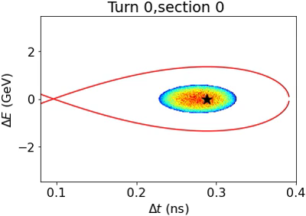

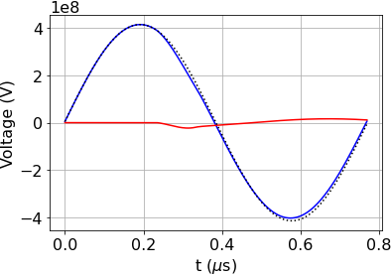
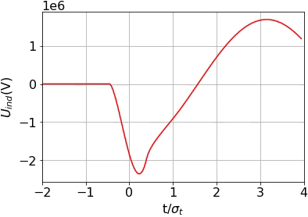
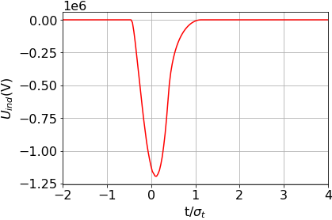
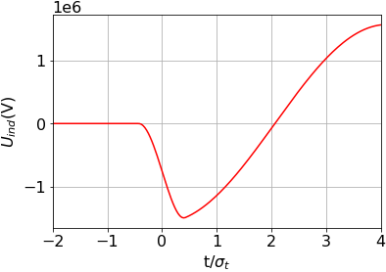
Induced voltages: both contributions
Both effects combined: total induced voltage in a cavity is around 2.2 MV per cavity / per meter, i.e. 10-11% of the RF voltage
Intensity effects on bunch are mitigated by high RF voltage
n_{RF} = 48
n_{RF} = 48
RF voltage
Induced voltage
Total voltage
Total induced voltage per cavity = short-range wakefield + beam loading, fundamental
V_{ind} (V)
V_{ind} (V)
13 October 2022
12
F. Batsch
12

Slide 13
Outline
The TESLA cavity and RCS parameter
Intensity effects & longitudinal beam dynamics:
Short-range wakefield and beam loading compared to the cavity voltage
Synchrotron tune & Number of RF stations versus emittance
Emittance evolution during the acceleration stages
Outlook and Summary
F. Batsch

Slide 14
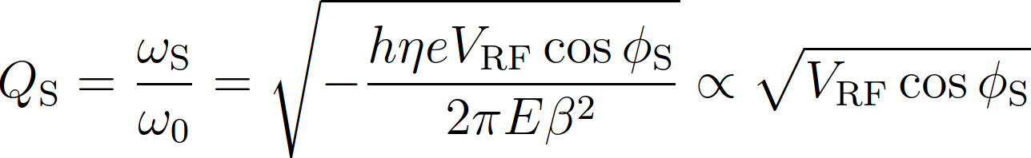
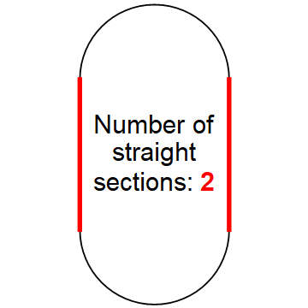
Synchrotron tune and number of RF stations
From:
H. Damerau
Number of synchrotron oscillations per turn:
Stable synchrotron oscillations and phase
focusing only for Q_{s} << 1/π (T. Suzuki, KEK Report 96-10)
  RCSs exceed this limit: 0.3 < Q_{s} < 1.5
  Several longitudinal kicks per turn for small Q_{s} between stations
  Distribute RF system over n_{RF} sections
Advantageous also for counter-rotating beams!
→ n_{RF} is an important quantity to determine!
LHC: Q_{s}=0.005
F. Batsch
14

Slide 15
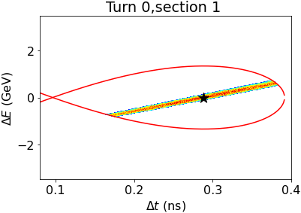
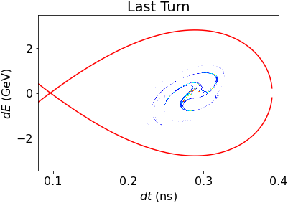
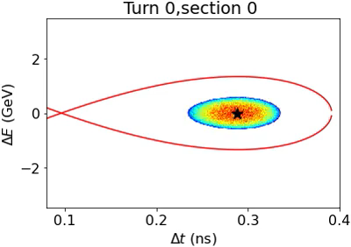
Synchrotron tune and number of RF stations
Why not choosing a high n_{RF} to fulfil Q_{s} << 1/π ?
High n_{RF} → smaller quadrupole-like oscillations caused by discrete energy steps and resulting mismatching
BUT: higher n_{RF} results in higher construction / cooling / cryogenics and powering costs, even though the number of cavities is constant and defined by ΔE per turn
→ Determine emittance growth using BLonD, also as a function of n_{RF} as
main criteria for beam quality for each RCS
Examples: n_{RF} = 4
RCS1, 17 turns, no V_{ind}
High Q_{s} destroys bunch!
13 October 2022
15
F. Batsch
15

Slide 16
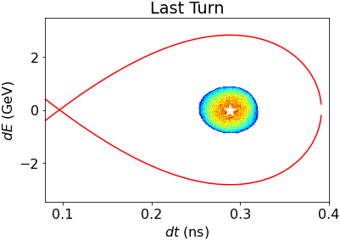

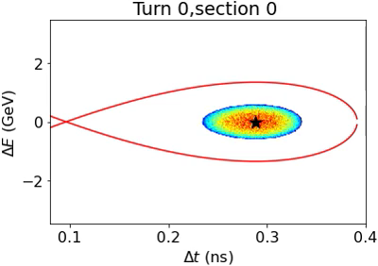
Synchrotron tune and number of RF stations
Why not choosing a high n_{RF} to fulfil Q_{s} << 1/π ?
High n_{RF} → smaller quadrupole-like oscillations caused by discrete energy steps and resulting mismatching
BUT: higher n_{RF} results in higher construction / cooling / cryogenics and powering costs, even though the number of cavities is constant and defined by ΔE per turn
→ Determine emittance growth using BLonD, also as a function of n_{RF} as
main criteria for beam quality for each RCS
Examples: n_{RF} = 48
Emittance growth: 4%
13 October 2022
16
F. Batsch
16

Slide 17
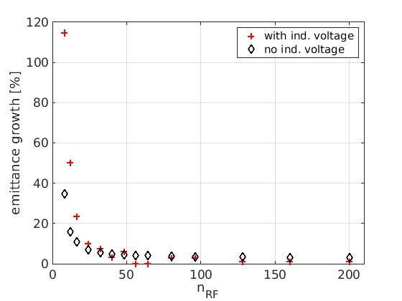
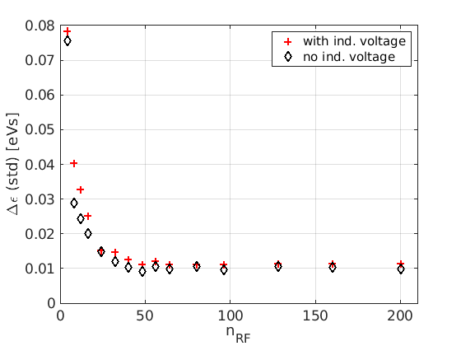
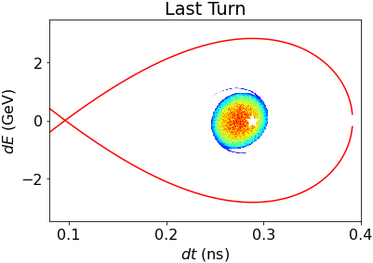
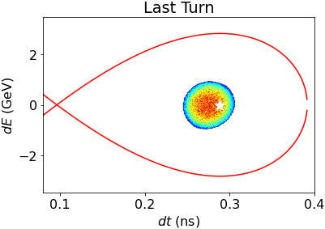
Synchrotron tune and number of RF stations
Results for each RCS, with and without induced voltage / intensity effects:
No improvement in emittance growth for n_{RF} >48
Minimum n_{RF}>24 RF stations for RCS1, e.g. 32.
RCS1
Standard deviation measure for bunch oscillations:
n_{RF}=24
n_{RF}=48
17
17

Slide 18
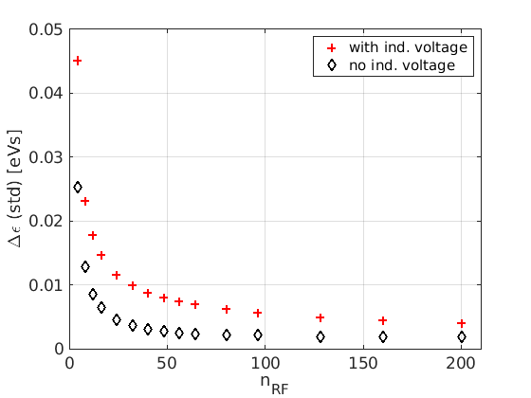
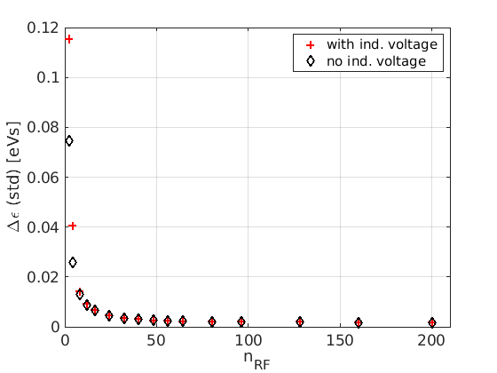
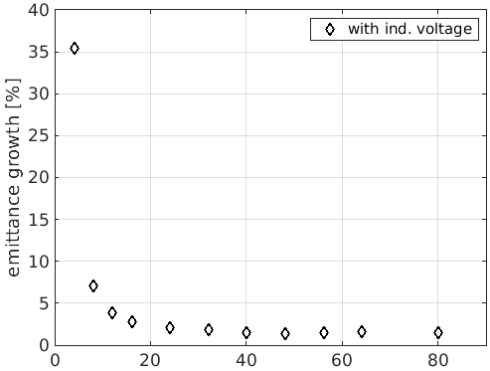
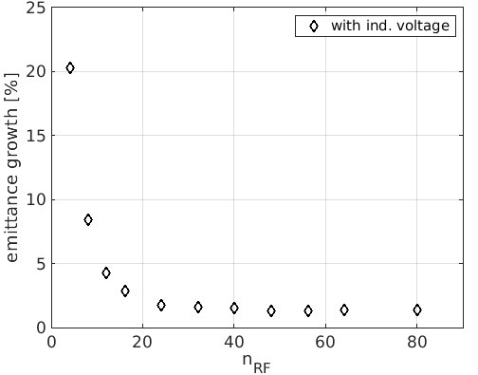

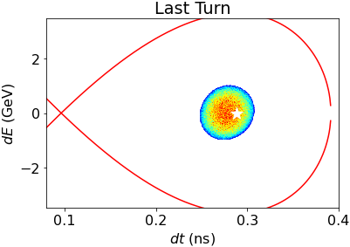
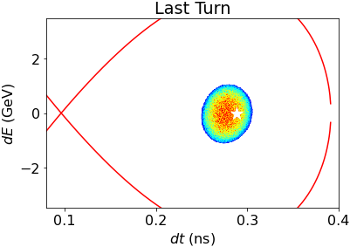

Synchrotron tune and number of RF stations
Results for each RCS and with and without induced voltage / intensity effects:
Similar behaviour for RCS 2&3, no change for n_{RF} > 48
Lower Q_{s} allows for slightly smaller number in RCS 2&3,
e.g. n_{RF} = 24 and 16
Influence of small n_{RF} on two bunches to be investigated
RCS1, Δε (std)
RCS2, Δε (std)
RCS3, Δε (std)
n_{RF}=32
n_{RF}=24
n_{RF}=16
18
18

Slide 19
Outline
The TESLA cavity and RCS parameter
Intensity effects & longitudinal beam dynamics:
Short-range wakefield and beam loading compared to the cavity voltage
Synchrotron tune & Number of RF stations versus emittance
Emittance evolution during the acceleration stages
Outlook and Summary
F. Batsch

Slide 20
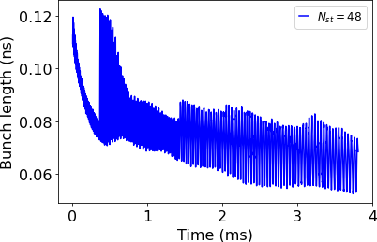
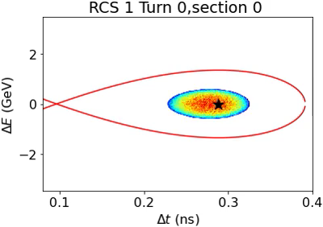
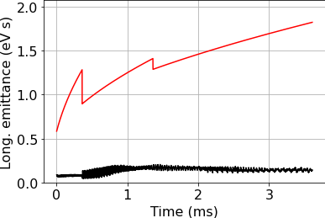
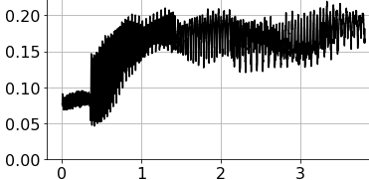
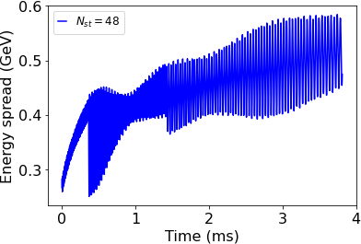
Beam transport though the RCS chain:
Evolution of bunch parameter
How do the bunch length, energy spread and emittance evolve when propagating the bunch through not one, but all RCS?
All RCS with n_{RF}=48
Unmatched bunch remains main problem, emittance growth 90%
13 October 2022
20
F. Batsch
20

Slide 21
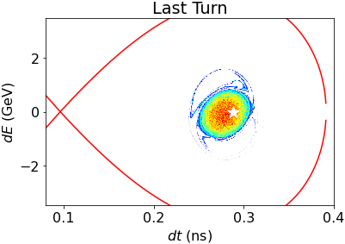
Beam transport though the RCS chain:
Evolution of bunch parameter
How do the bunch length, energy spread and emittance evolve when propagating the bunch through not one, but all RCS?
All RCS with n_{RF} = 48
Unmatched beam main problem, emittance growth 90%
→ Optimize voltages ≙ acc. time ≙ decay rate between RCS
Final bunch parameter:
4πσ_{t}σ_{E} < 0.19 eVs
(190MeVm)
4σ_{t} = 0.08 ns
σ_{E} = 0.6 GeV
Factor 2-3 above nominal, but improvement with better matching
21
F. Batsch
21

Slide 22

Outlook – Follow ups
Parameter to be optimized for the construction point-of-view:
  Decay rate: RF voltage and ramp rates better distributed to e.g. lose more muons earlier and less later. Matching improved?
  Synchronous phase ⇔ higher voltage ⇔ emittance budget
  Beam optics, see e.g. talk by A. Chancé before
  Magnet’s ramping functions: See my talk tomorrow at 14:20
Multi-turn wakefields and resistive-wall impedance will have an effect, which must be included
Wakefields of the counter-rotating bunch remains open question
Smaller emittance blow-up
F. Batsch

Slide 23
Summary
1.3 GHz TESLA Cavity suited for muon acceleration in the RCSs, but not all effects studied
High intensities: Short-range wakefields and beam loading cause induced voltage ~2 MV/m per cavity, or 10% of V_{acc}, but do not harm beam transport due to the high Q_{s} and high V_{RF}
Beam is transported with % level emittance growth in each RCS, if n_{RF} high enough
A large number of RF stations on the order n_{RF} = 32 needed to ensure a sufficiently low synchrotron tune between the stations
F. Batsch

Slide 24


