Slide 1





FLUKA dose calculations for neutrinos
G. Lerner, D. Calzolari, A. Lechner, C. Ahdida
Muon Collider Collaboration Meeting
13th October 2022

Slide 2
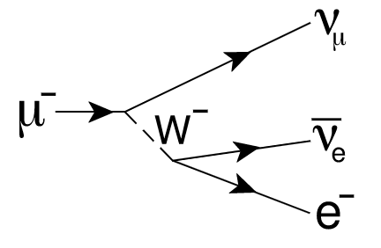
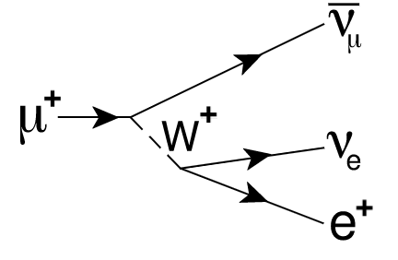
Introduction
Neutrinos from µ± decays can lead to significant dose levels, as introduced in the talk by C. Ahdida
Main features:
  Narrow neutrino cone (width ~ 1/γ) emerging on the earth’s surface
  Neutrino cross sections growing linearly with the energy
  No benefit from shielding (possibly detrimental)
Strong dependence of the peak dose on the muon energy
Figure by C. Carli
Previous work (among others):
  Calculations by B.J. King: arXiv:physics/9908017 (1999), arXiv:hep-ex/0005006 (2000)
  Work by N. Mokhov, A. Van Ginneken: Proc. 9th Int. Conf. Rad. Shielding, J. Nucl. Sci. Tech. S1 172 (2000)

Slide 3



Requirements for a full dose assessment in real scenarios
Focus of this talk
DOSE KERNEL: dose (or dose-equivalent) in a reference material vs longitudinal and lateral distance from fixed-point decay of monoenergetic and mono-directional muons,
per unit muon decay
Talk by C. Carli
Folding with BEAM PARAMETERS taking into account space distribution of muon decays (e.g., along arc or straight sections), angular divergence (due to optics) and beam intensity
Talk by G. Lacerda
Merging the the real-world geometry to obtain a realistic DOSE SURFACE MAP using dedicated tools (e.g., GeoProfiler)
G. Lerner Muon Collider Collaboration meeting 13/10/2022

Slide 4
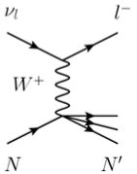
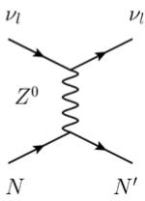
Two-step FLUKA simulation of effective dose kernel
MUON DECAYS
  Samples the muon decay products with a focus on the neutrinos
  Yields (1) a list of all decay neutrinos with their flavor, energy, and lab-frame angle
  Yields (2) a list of interacting neutrinos by filtering the above list based on the interaction probability in soil (via the macroscopic cross section)
NEUTRINO INTERACTIONS IN SOIL
  Input: list of interacting neutrinos from the muon decay
  Samples linearly the distance of the interaction from the muon decay point within a user-defined range, obtaining the exact (x-y-z) position of the interaction by combining it with the angular direction from the input
  Simulates the radiation showers from the neutrino interactions in soil
  Scores 3D distributions of relevant quantities (e.g., absorbed dose, effective dose…)
4

Slide 5
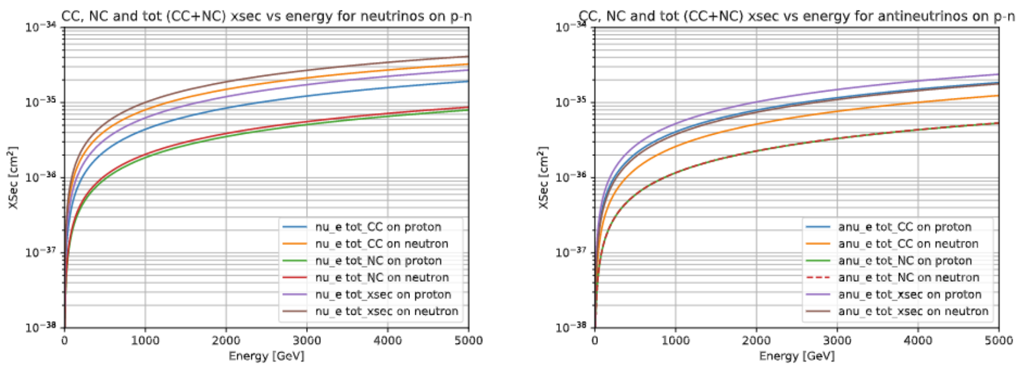
Neutrino cross sections on nucleons in FLUKA
Individual curves of neutrino cross section vs energy for:
  Target nucleons (proton vs neutron)
  Reaction process (dominated by Deep Inelastic Scattering, DIS)
  Neutrino flavours (e-µ-τ) yielding negligible differences (especially at high energy)
  Neutrino vs antineutrino, with antineutrino cross sections generally lower (around a factor 2)
Close to the values used by B.J. King in arXiv:physics/9908017 (1999)
5

Slide 6
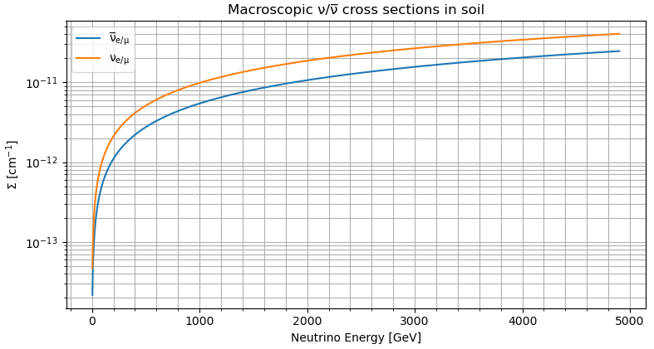
Macroscopic neutrino cross sections in soil
$$Σ(E)=np·σp(E)+nn·σn(E)$$
Soil density: 2 g/cm³
Composition in the backup
Proton/neutron density in soil
Neutrino cross section on protons/neutrons
This simplified approach yields a macroscopic cross section vs energy curve in soil
Neglected: Fermi motion and Pauli exclusion principle, requiring more accurate simulations (verified for a few energies, finding small discrepancies from the above formula)
6

Slide 7
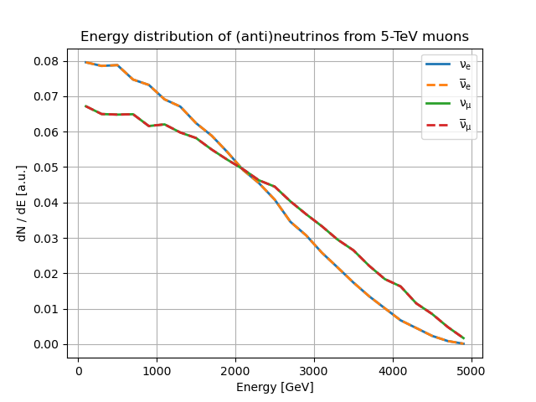
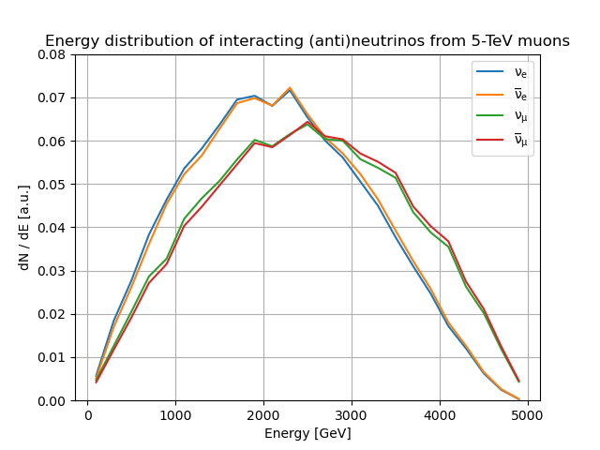
5-TeV muon decay: neutrino energy spectra
Energy spectrum of the interacting neutrinos peaking at around half of the muon beam energy
CROSS SECTION FILTERING
INTERACTING NEUTRINOS (IN SOIL)
ALL NEUTRINOS
7

Slide 8
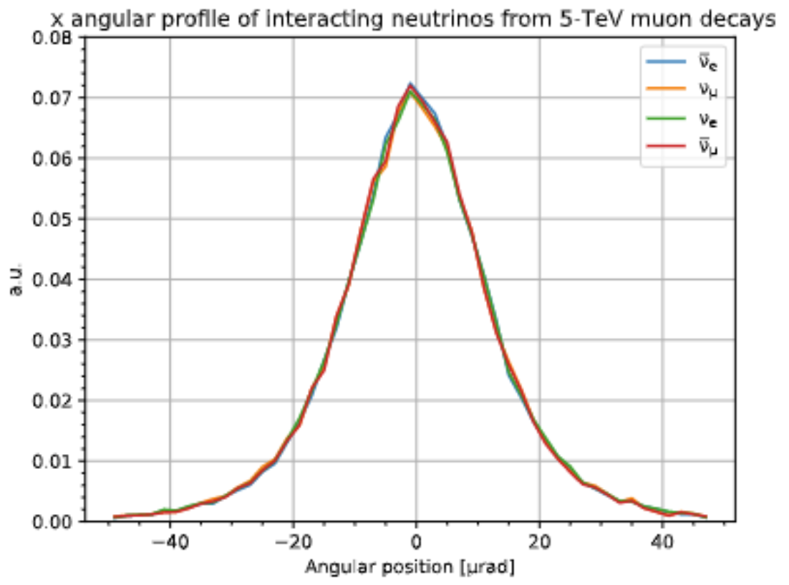
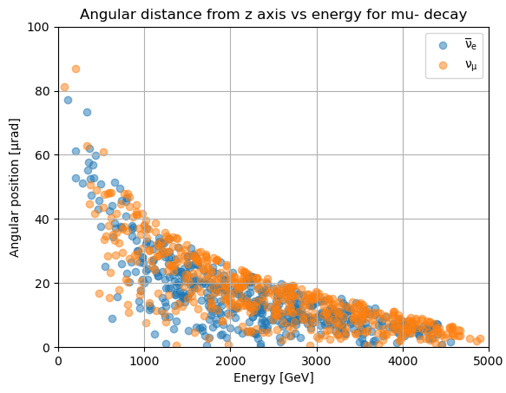
5-TeV muon decay: neutrino angles and energy
Very narrow neutrino cone, with
anti-correlation between neutrino energy and angle
O(1m)
at 100 km
[~1/γ]
8

Slide 9
Two-step FLUKA simulation of effective dose kernel
MUON DECAYS
  Samples the muon decay products with a focus on the neutrinos
  Yields (1) a list of all decay neutrinos with their flavour, energy, and lab-frame angle
  Yields (2) a list of interacting neutrinos by filtering the above list based on the interaction probability in soil (via the macroscopic cross section)
NEUTRINO INTERACTIONS IN SOIL
  Input: list of interacting neutrinos from the muon decay
  Samples linearly the distance of the interaction from the muon decay point within a user-defined range, obtaining the exact (x-y-z) position of the interaction by combining it with the angular direction from the input
  Simulates the radiation showers from the neutrino interactions in soil
  Scores 3D distributions of relevant quantities (e.g., absorbed dose, effective dose…)
9

Slide 10
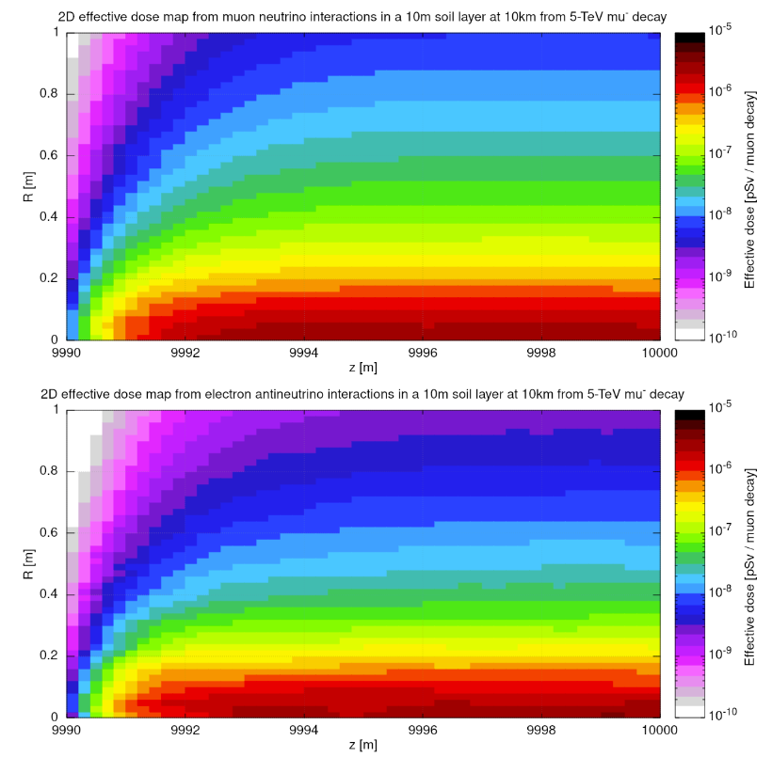
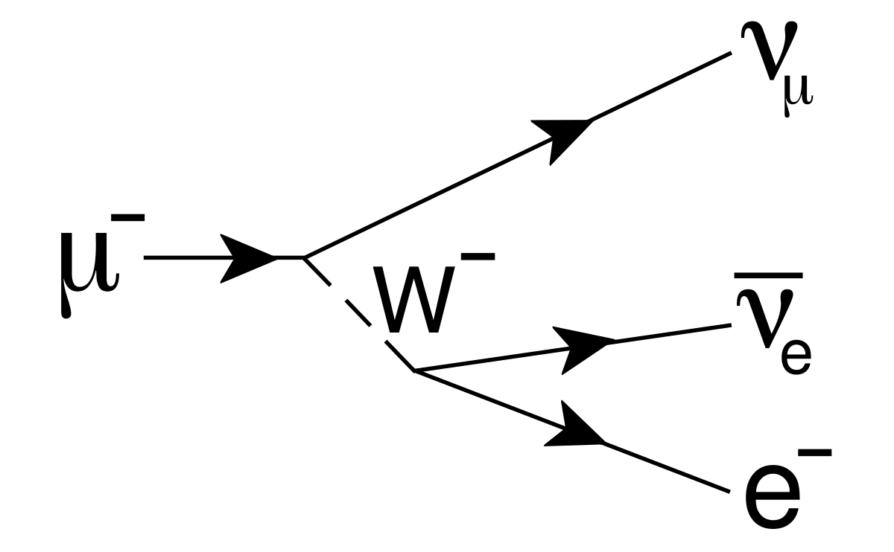
Effective dose build-up in soil for 5-TeV µ⁻
Sampling the neutrino interactions within a 10m range at 10km from the muon decay
Narrow cone of effective dose (see the talk by C. Ahdida) near the neutrino beam axis (i.e., at small R)
The build-up of the shower occurs within a few meters
(very similar results for µ⁺)

Slide 11
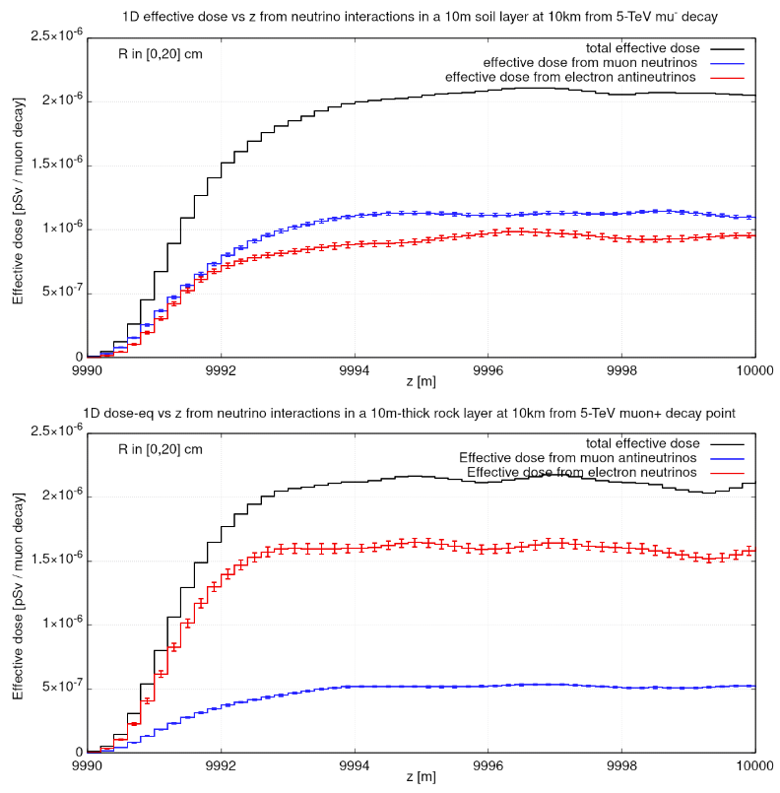
Effective dose build-up in soil for 5-TeV µ⁻ and µ⁺ (1D)
The 1D projections of the effective dose within 20cm from the neutrino beam axis show that a plateau of the effective dose is reached after a few meters
In µ⁻ and µ+ decays the contribution of the two neutrinos to the total effective dose is different, but the plateau values of the effective dose are similar

Slide 12
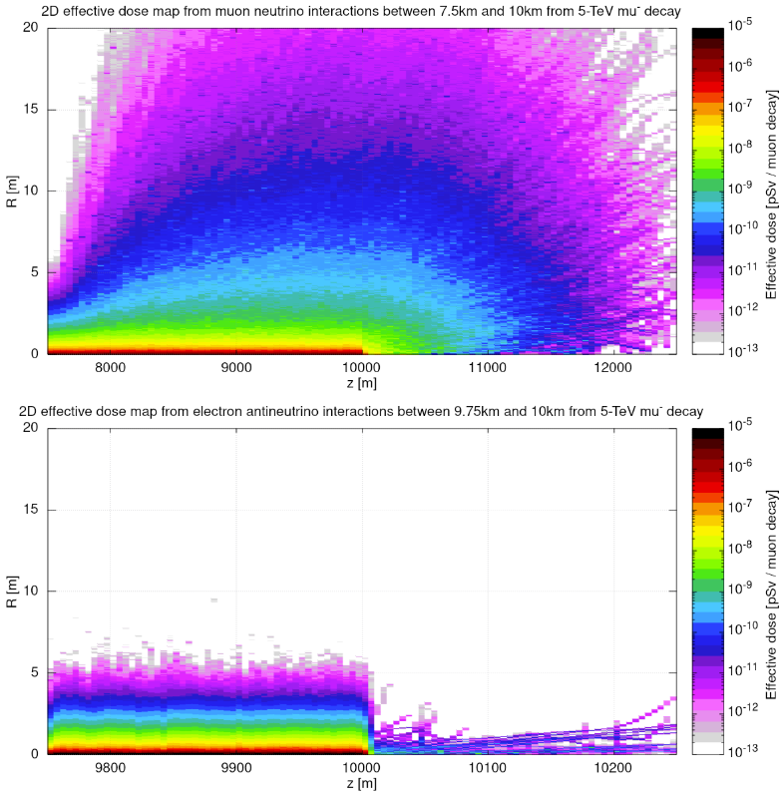
Effective dose build-up in soil for 5-TeV µ⁻: large distances
Due to high-energy muon production, the radiation showers induced by muon neutrinos and antineutrinos build up over km-scale distance, and reach larger radial distances
…but muons give a small contribution to the effective dose, so they can be ignored for the dose kernel calculations
High-energy muons!
(very similar results for µ⁺)

Slide 13
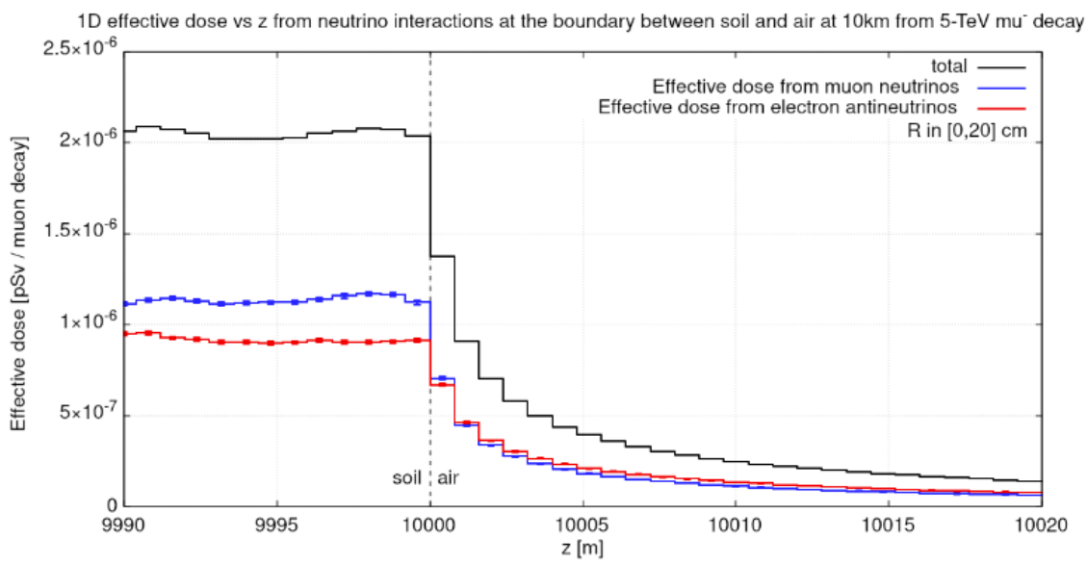
Effective dose from 5-TeV µ⁻: from soil to air
If we assume that the neutrino beam exits orthogonally from soil to air, the effective dose rapidly drops from the plateau in soil (more than 4x decrease after only 5m)
In realistic scenarios the angle between the neutrino beam and the earth’s surface plays a role, but we can regard the plateau dose in soil as the maximum dose that a person can be exposed to

Slide 14
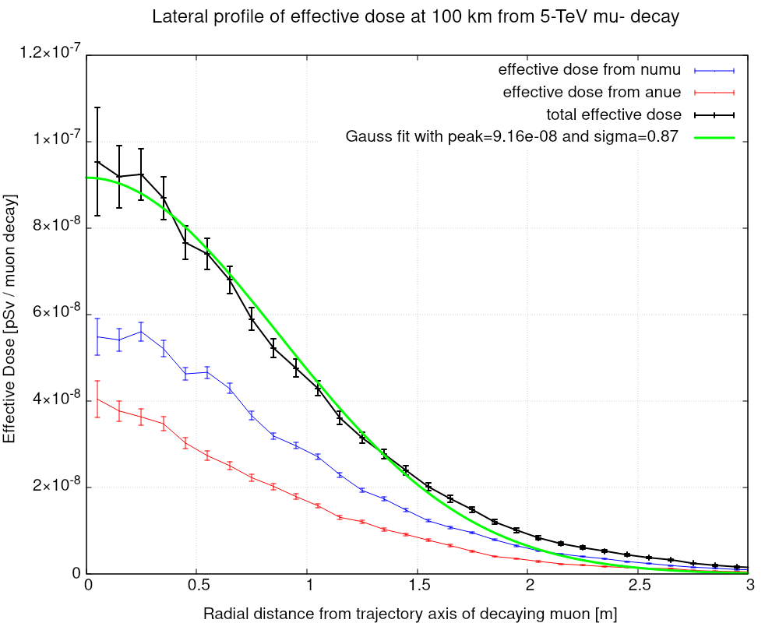
Effective dose kernel calculation: effective dose vs R
1D projection of the effective dose vs R at the plateau in soil
The profile is modeled by a Gaussian fit (not accurate in the tails) yielding:
  Peak dose [pSv / µ decay]
  Dose width [σ, in meters]
To obtain the effective dose kernel we extract these two parameters for different muon signs, energies, and baseline distances from the decay point
The breakdown of the effective dose from different particle types is shown in C. Ahdida’s talk

Slide 15
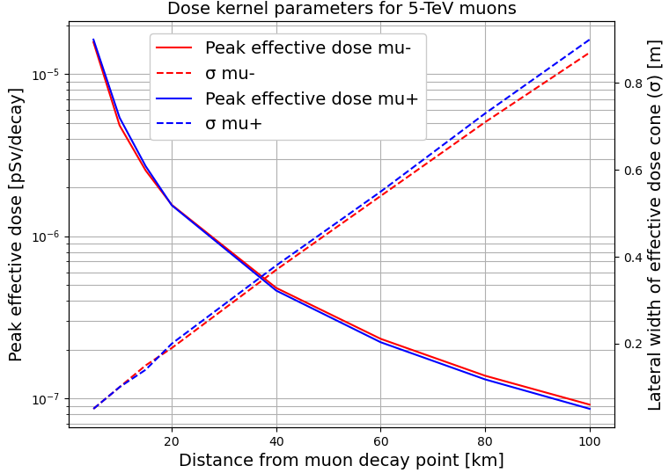
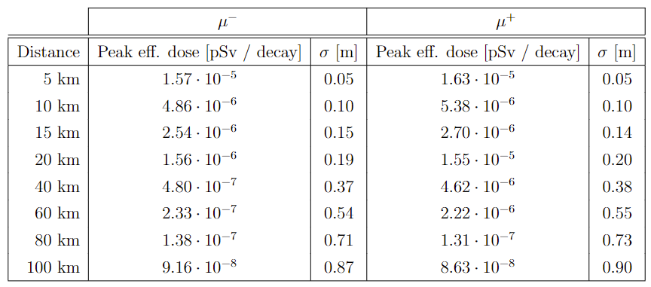
Effective dose kernel results: 5-TeV muon beam
Very similar effective dose parameters for positive and negative muons
Peak dose from ~1.6·10⁻⁵ pSv/decay at 5 km to ~9·10⁻⁸ pSv/decay at 100 km
σ exhibits a linear increase from just 5 cm at 5 km to ~90 cm at 100 km, reflecting the increasing aperture of the neutrino cone

Slide 16
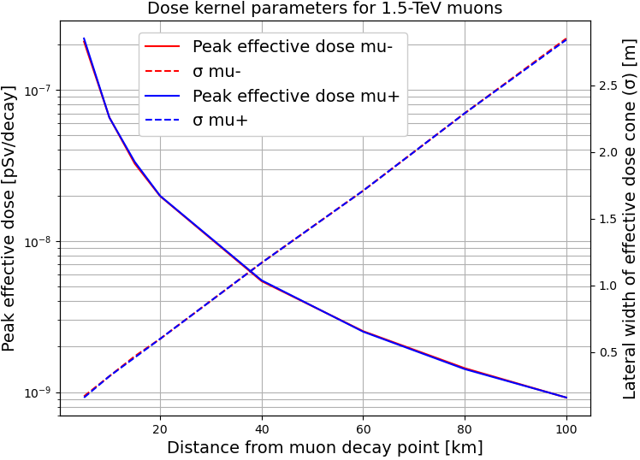
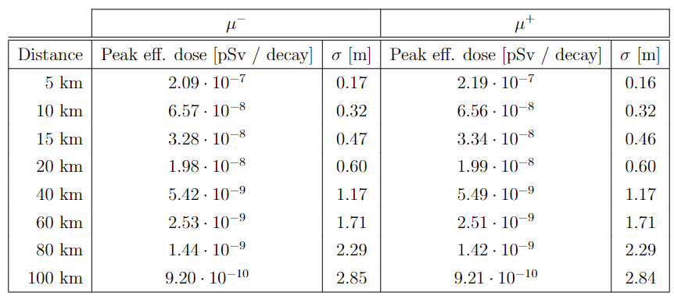
Effective dose kernel results: 1.5-TeV muon beam
Peak dose from ~2·10⁻⁷ pSv/decay at 5 km to ~9·10⁻¹⁰ pSv/decay at 100 km, i.e., lower by a factor of ~100 compared to the 5-TeV beam
σ from ~16 cm at 5 km to ~285 cm at 100 km, i.e., ~3x larger than the 5-TeV case, coherently with the 1/γ scaling of the neutrino cone width

Slide 17
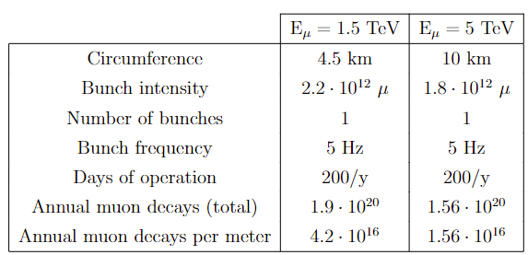
First look at an (unrealistic) straight section
Reminder: the effective dose kernel refers to a single muon trajectory
Still, we can combine the kernel with baseline accelerator parameters to compute the effective dose in a hypothetical/simplified straight section of 1m where we neglect the muon beam divergence
Peak effective dose at 100km:
  1.5 TeV → ~40 µSv/y
  5 TeV → ~1.4 mSv/y
>>10 µSv/y
Important message: the muon divergence and, possibly, mitigation measures are essential to reduce the peak dose in realistic scenarios (see talk by C. Carli)

Slide 18
Summary and Outlook
The issue of neutrino-induced radiation is critical at muon colliders, as introduced in the talk by C. Ahdida: “Update on RP aspects”
An effective dose kernel is calculated using the FLUKA Monte Carlo code for neutrino-induced radiation
For muon beam energies of 1.5 TeV and 5 TeV, and for baseline distances ranging from 5 km to 100 km, we provide:
  Peak dose in soil [pSv / µ decay]
  Dose cone width [σ, in meters]
The above parameters serve as a key input for more specific calculations considering the muon collider lattices
→ talk by C. Carli: “Neutrino radiation for a realistic collider”
→ talk by G. Lacerda: “Dose tool development and siting at CERN”

Slide 19
BACKUP

Slide 20
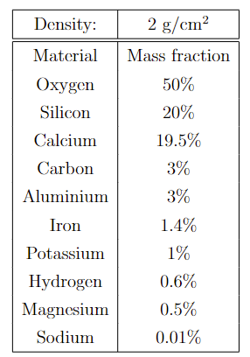
Soil composition and density
The soil composition used to obtain the effective dose kernel is shown in the table
Different calculations must be made for different materials and/or densities
While no major differences are expected regarding the material composition, a larger density will result in a higher concentration of neutrino interactions, likely resulting in a higher peak dose inside the material

Slide 21
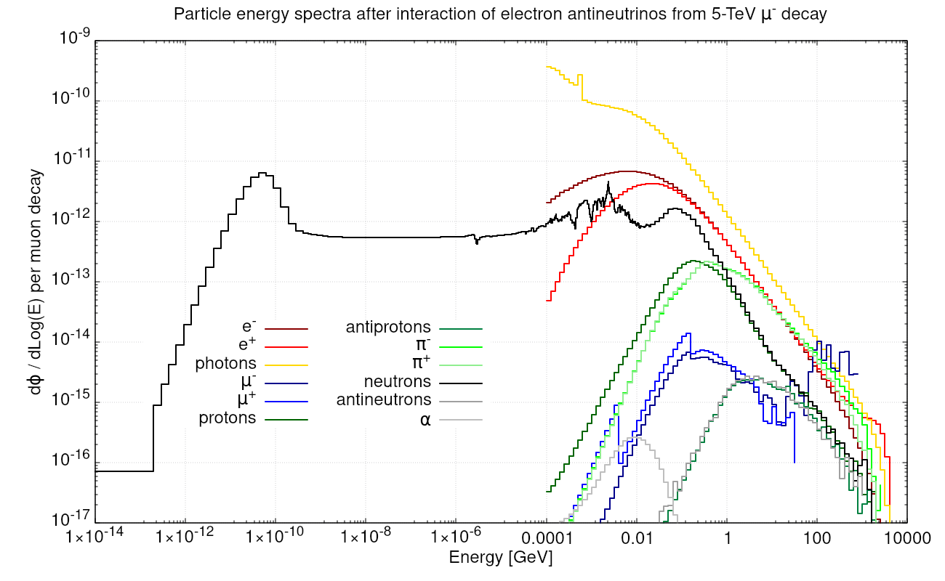
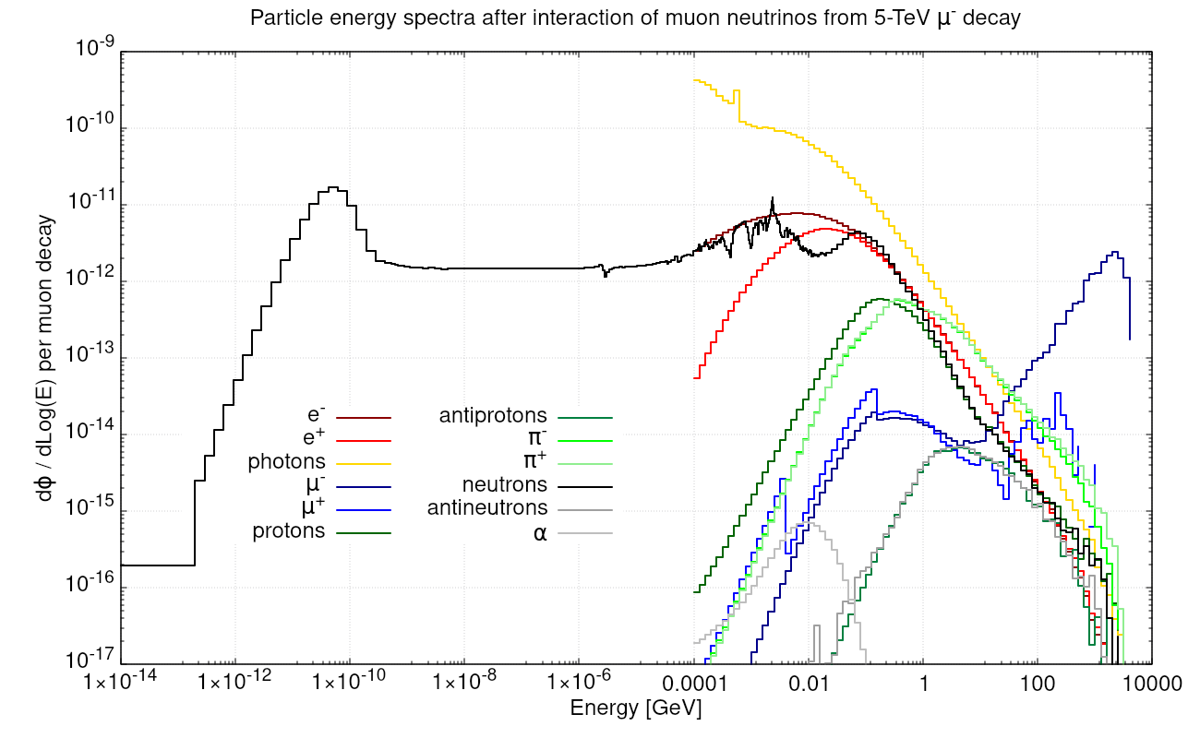
Energy spectra: 5-TeV µ⁻ decay

Slide 22
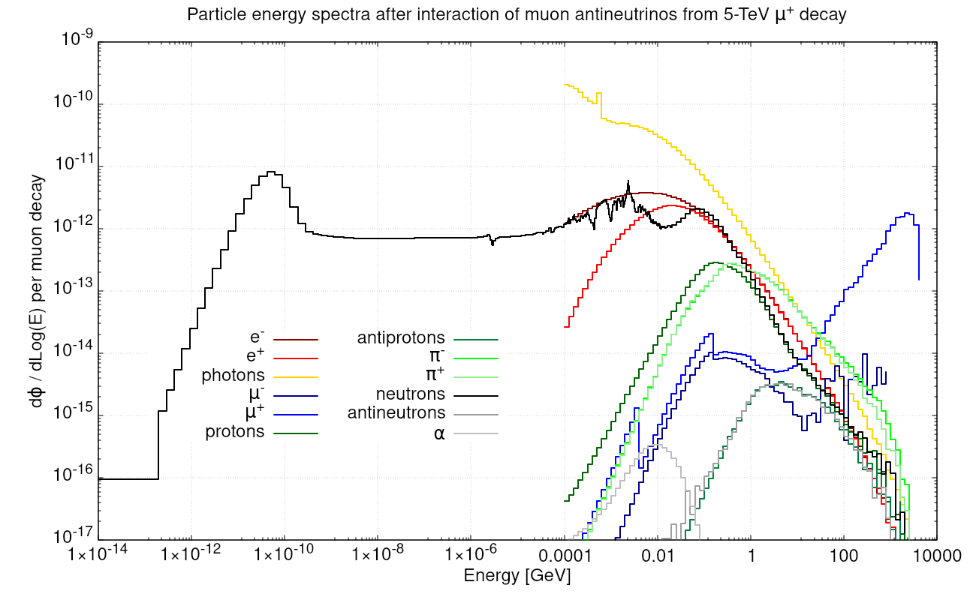
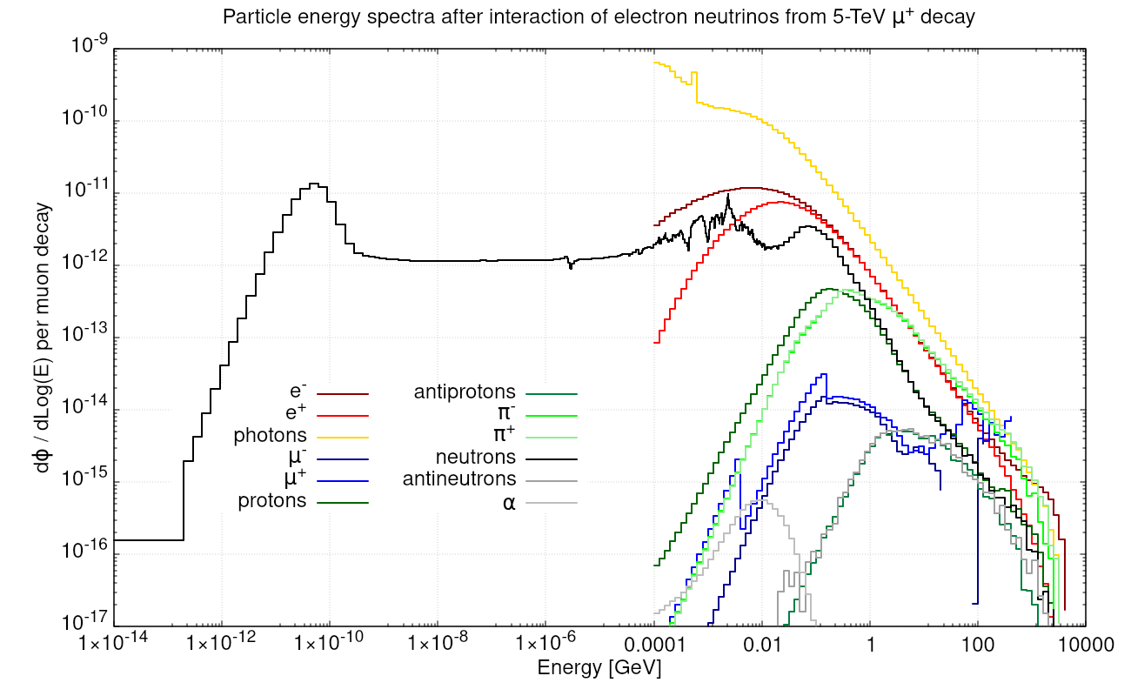
Energy spectra: 5-TeV µ⁺ decay

Slide 23
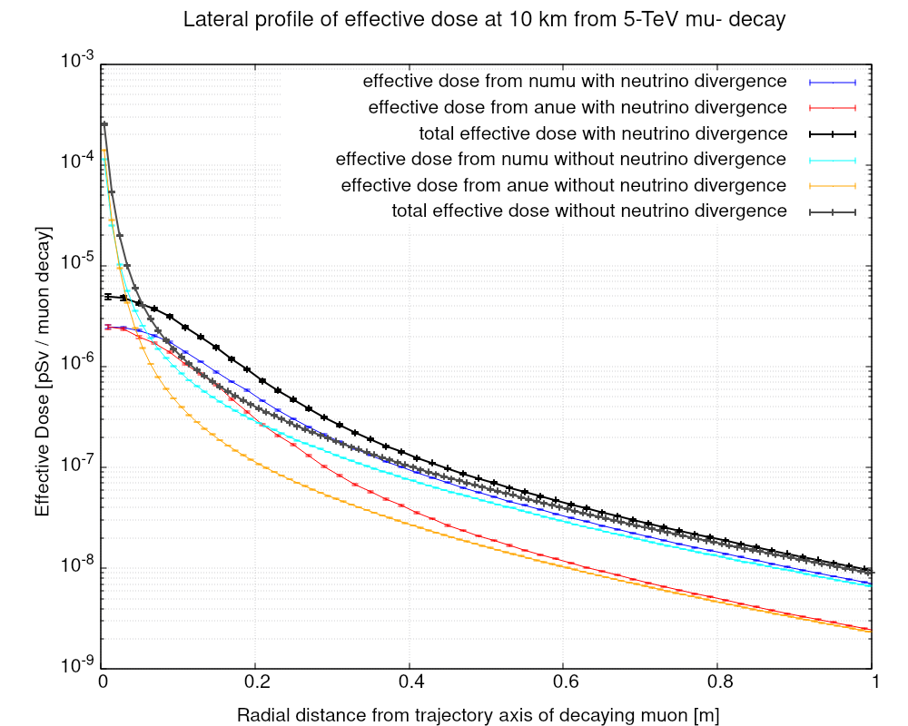
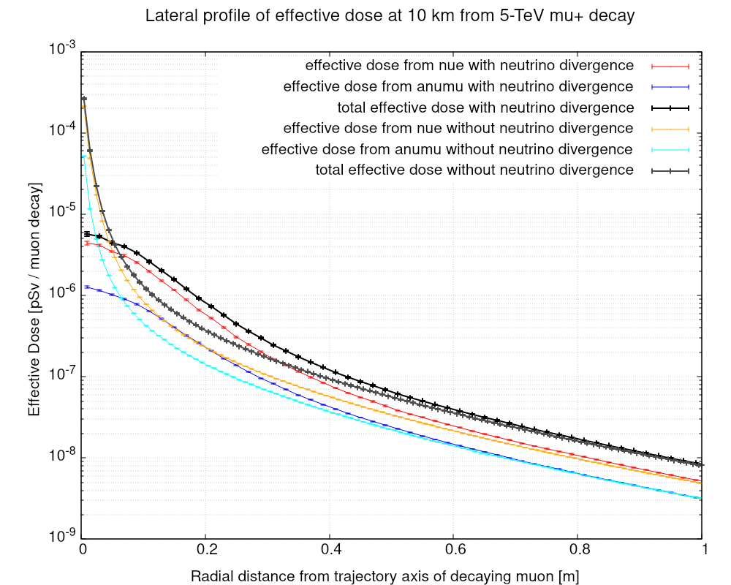
Impact of the angular width of the neutrino beam
The peak effective dose is driven by the width of the neutrino beam
Instead, the tails are driven by the width of the radiation shower originating from the neutrino interactions

Slide 24
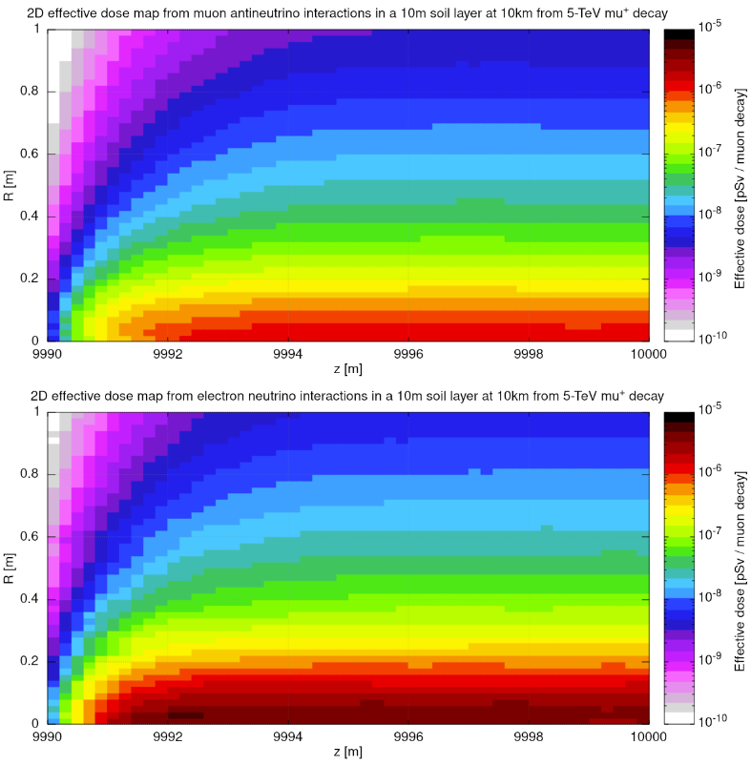
Effective dose build-up in soil for 5-TeV mu⁺
Sampling the neutrino interactions within a 10m range at 10km from the muon decay
Narrow cone of effective dose (see the talk by C. Ahdida) near the neutrino beam axis (i.e., at small R)
The build-up of the shower occurs within a few meters

Slide 25
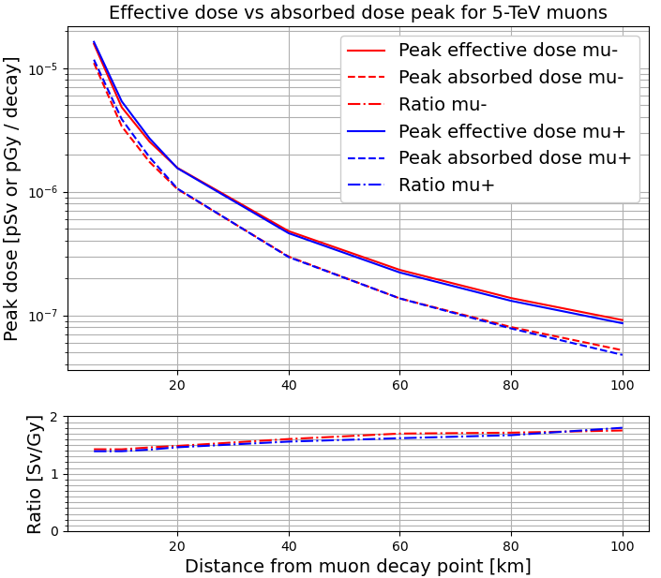
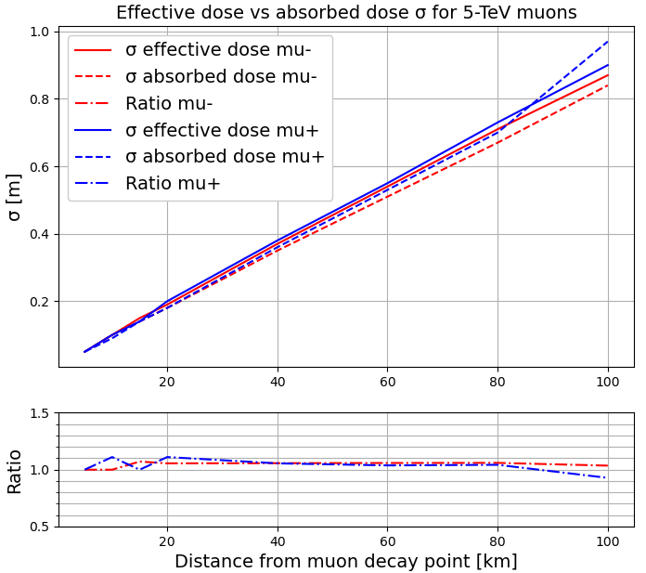
Effective dose vs absorbed dose: 5-TeV µ decay
The effective dose peak is larger than the absorbed dose by a factor of 1.5-2, while the σ is similar for the two quantities

Slide 26
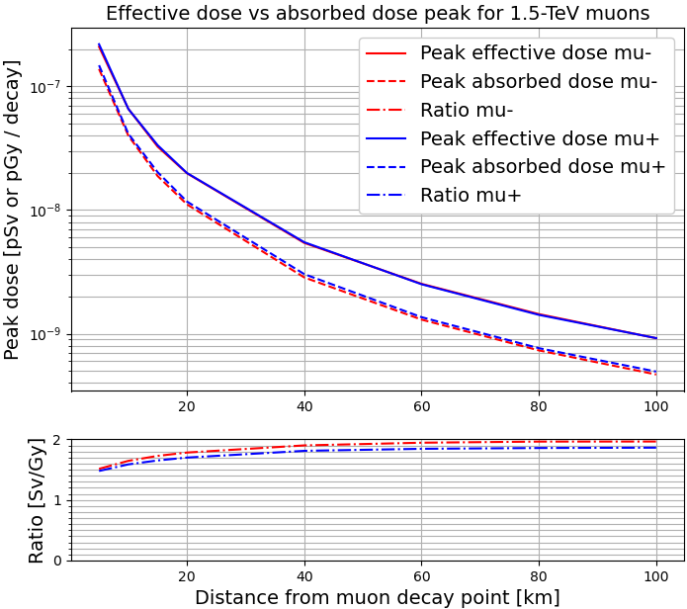
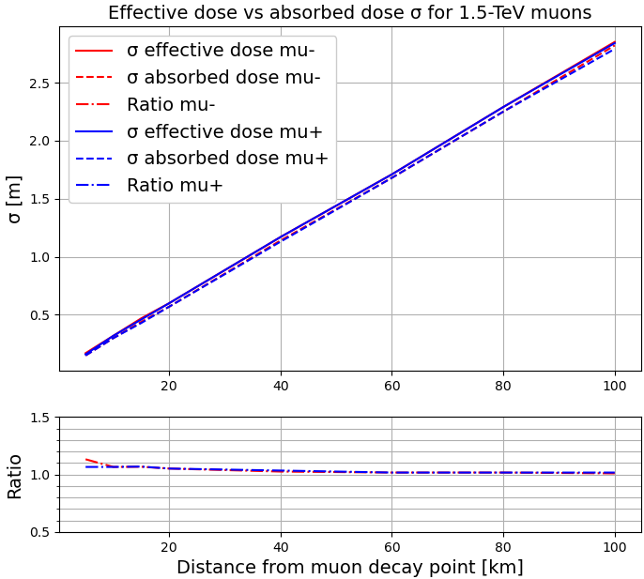
Effective dose vs absorbed dose: 1.5-TeV µ decay
The effective dose peak is larger than the absorbed dose by a factor of 1.5-2, while the σ is similar for the two quantities

Slide 27
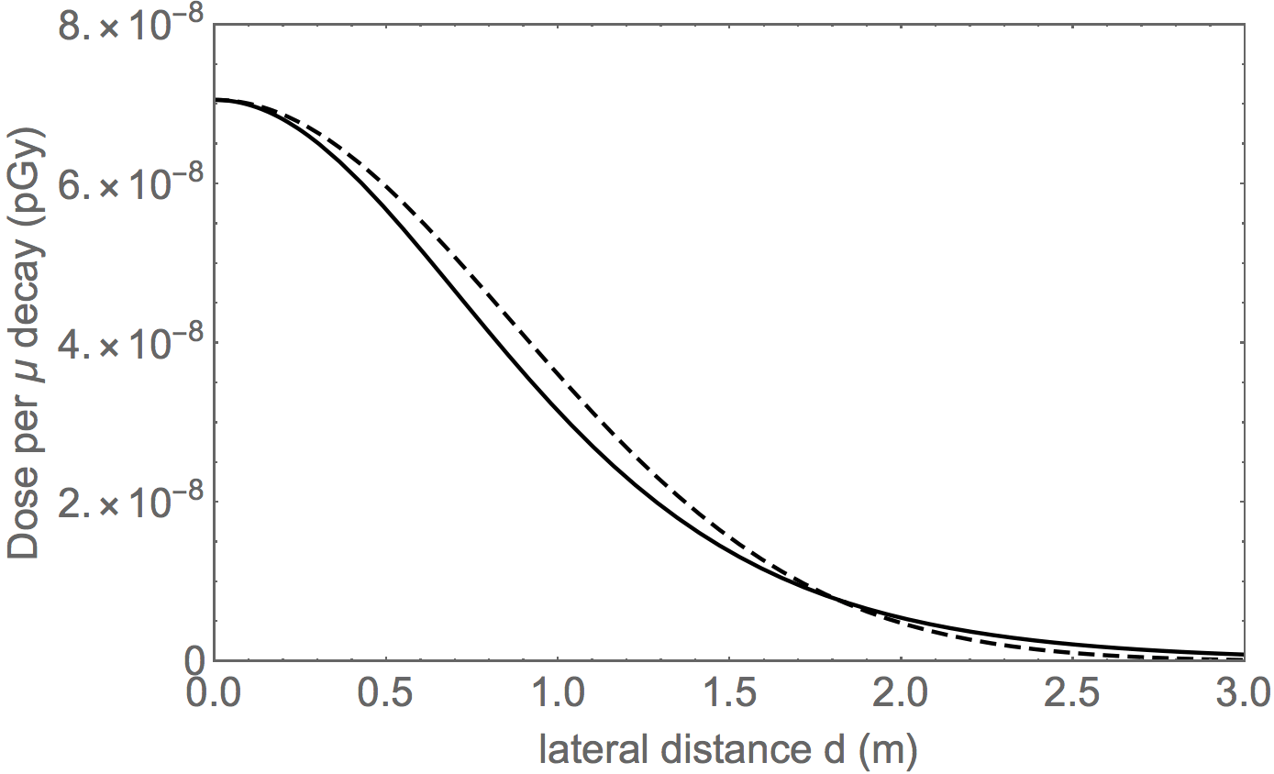
Comparing FLUKA and B. J. King / C. Carli calculations
Comparison with the absorbed dose profile calculated by C. Carli, which yields a peak of approximately 7·10⁻⁸ pGy / µ
To be compared with a peak effective
dose of around 9·10⁻⁸ pSv / µ (from
the kernel)
From FLUKA we have seen that the
ratio of effective dose and absorbed
dose at 100km is around 1.7-1.8
→ C. Carli’s prediction corresponds
to around 1.2·10⁻⁷ pSv / µ, i.e.,
approximately 30% more than the
FLUKA-based effective dose kernel
C. Carli figure
(with B.J. King
approach)
10 TeV c.o.m. energy, L_{s} = 100 km

