Slide 1
Fermilab “Site Filler”:
Muon Collider?
David Neuffer
P. Bhat, A. Bross, J. Eldred, S. Jindariani, N. Mokhov, S. Posen, V. Shiltsev, D. Stratakis, K. Yonehara

Slide 2
Outline
Fermilab –
  Site filler - Muon Collider ?
    possible future high-energy facility on Fermilab site
Motivation
  “Energy Frontier”
Muon Collider Components
  Muon source
  Accelerator
    Fast-cycling
  Collider Ring
Parameters
  Up to ~10 TeV Muon collider “site-filler”

Slide 3
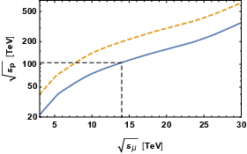
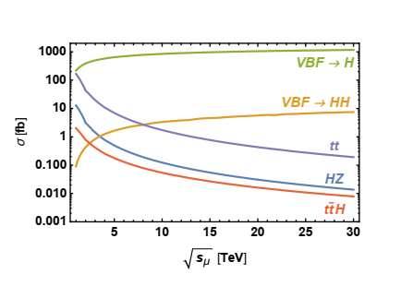
Energy Frontier
10TeV μ⁺-μ⁻ collider has an energy reach of
100 TeV pp collider
Need High- Luminosity
  (͞qq events σ ~ 1/s)
  Vector boson fusion
    σ ~ ln(s)
Goal is ~ 2 attobarn⁻¹/year
  L = 2 10³⁵ cm⁻²s⁻¹ 10⁷ s/year
pp Collider
Electro-weak NP
͞qq new physics
μ⁺-μ⁻
collider

Slide 4
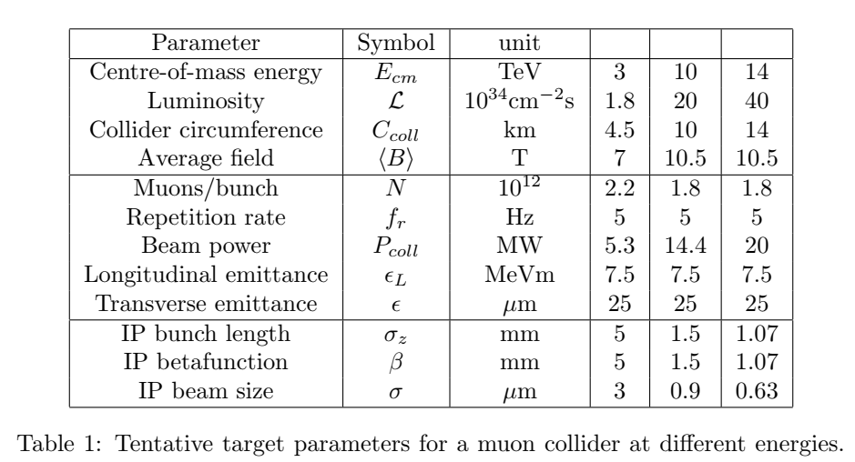
Muon Collider - MAP Concept
An international collaboration on Muon Collider
MUST (MUon STudy)
3 → 10→ 14 TeV Collider
μμ Collider R&D included in European Strategy Doument

Slide 5
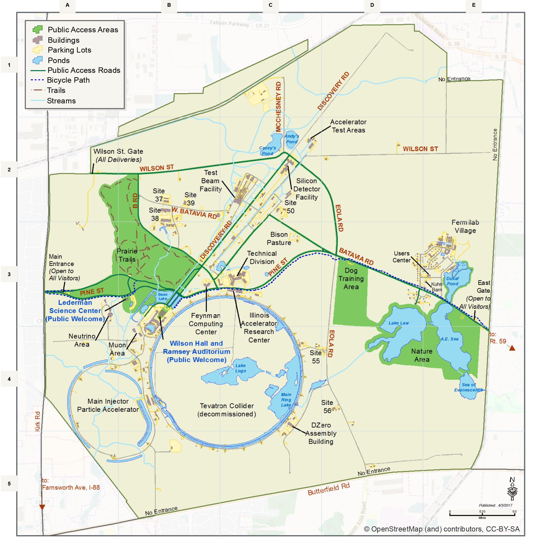
Site filler Accelerator
Largest
Radius is ~2.65 km
  ~16.5 km Circumference
    ~2/3 LHC
    ~RCS accelerator
    If B_{ave}= 3 T → E_{μ}= 2.4 TeV
      (B_{max} = 8T, B_{pulse} =±2T)
  Doubled ?
    B_{ave}= 6.3 T → E_{μ}= 5 TeV
      (B_{max} = 16T, B_{pulse} =±4T)
  10 TeV collider
  Collider Ring ~10 km
  B_{ave} = 10 T
  τ_{μ} = 0.104 s
Accelerator Ring
Collider Ring

Slide 6
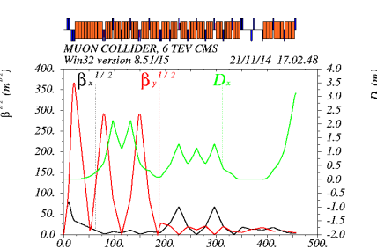
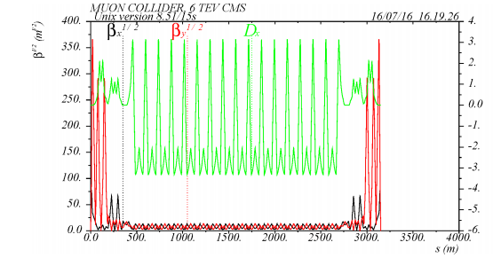
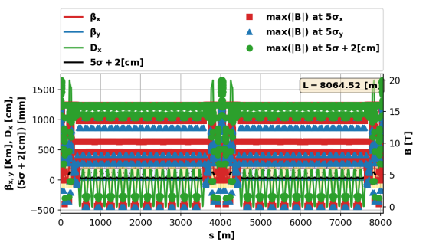
Sample collider lattice-
6 TeV (3x3) lattice – MAP
Wang, Nosochkov, Cai and Palmer JINST 11, P09003
  C=6.3 km (B_{ave}= 10 T)
    Max pole-tip fields
      15-20 T dipoles, 15 T quads
        ~16 T bending
    ~isochronous
Extrapolate to 10 TeV
  C→10.5 km, R=1.67 km
    Fits within Fermilab site
First draft lattice
  Kyriacos Skoufaris and Christian Carli
    C=8.06 km +
Accelerator is larger
  Includes rf, cycling elements

Slide 7
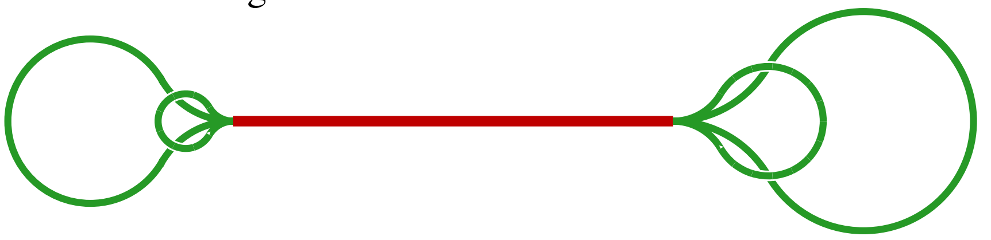
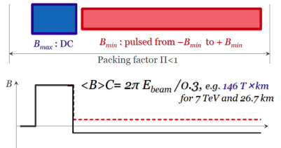
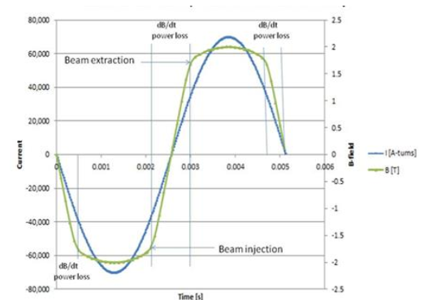
Acceleration methods
Linear Accelerator
    5 TeV → > 100 km
Race-track Recirculating Linac (RLA)
    (like CEBAF)
  Separate return transports
    5-6 turns → ??
    cost/complexity of multiple turns
Rapid Cycling Synchrotron
    B_{typ} = ~1.5 T, 15- 60 Hz
    Hybrid – High field + pulsed
      Example:
        B_{max}=8T B_{pulsed}=±2.0, f= 0.25
        3.5 / 0.5 T

Slide 8
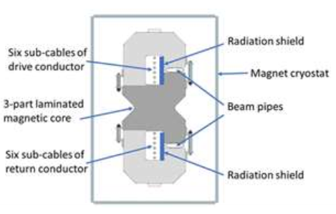
Bending, Accelerating fields:
Conventional (Ferric)
  ~ 2T
Superconducting –NbTi
  Tevatron ~4 T
  LHC ~8 T
Superconducting Nb₃Sn
  HL-LHC + → 16T
HTS superconductor …
  REBCO → 40 T ?
Pulsed magnets
  ±2 T → ± 4 T ~200-600 T/s
    12 T/s HTS → 270 T/s
    Piekarz et al. NIM A 943, 162490 (2019)
    Piekarz et al. Fermilab-conf-21-695 (2021)
SRF accelerating fields
  17 MV/m (650 MHz PIP-II)
  30 MV/m (1300 MHz SLS-2)
Future upgrades
  40 → 50 MV/m → 80??
Pulsed rf – Cu → ??
    50 → 100 MV /m

Slide 9
Acceleration to 5 TeV at Fermilab
0-65 GeV Linac + 10-turn RLA
65 GeV → 5 TeV
  RCS 1 – 65→330 GeV r=1km
    Normal conducting: 0.3→1.55T
  RCS 2 – 330→1000 GeV r=1km
    Hybrid 8±2 T
  RCS 3 – 1 → 5 TeV “site filler”
    Hybrid 16±4 T
65 GeV → 5 TeV Scenario
 | RCS-LE(nc) | RCS-HE(hybrid) | RCS-HF 16/4 hybrid
Input Energy | 65 | 330 | 1000 GeV
Output Energy | 330 | 1000 | 5000 GeV
Circumference | 6.28 | 6.28 | 16.5 km
Pack Fraction | 0.75 | 0.83 | 0.88
Total straight section | 1.57 | 1.07 | 1.96
B-highfield |  | 8 | 16 T
B-lowfield |  | ±2 T | ±3.95 T
B_{ave} | 0.3→1.55 T | 1.4→4.4 T | 1.44→7.2 T
Fraction high-field |  | 0.34 | 0.27
Acceleration Scenario
Acceleration turns | 36 | 97 | 270
Acceleration Time | 0.76 | 2.03 | 15 ms
Beam survival | 0.80 | 0.85 | 0.75
Rf voltage (φ_{s} = 60°) | 8.63 GV | 7.94 GV | 17.1 GV
Ramp Rate | 1650 T/s | 1970 T/s | 530 T/s
~6 GeV Recirculating Linac
650 MHz
~10 turns to 65GeV
3 GeV Linac
650 MHz SRF

Slide 10
5 TeV with ±2 T RCS components
Requires additional site-filler RCS ring
  1->3.25 TeV
    19% 16 T magnets
  3.25→ 5 TeV
    37% 16 T magnets
~ 10 GV more rf
  Decay losses higher
65 GeV → 5 TeV Scenario
 | RCS-LE(nc) | RCS-HE(hybrid) | RCS-HE 1 | RCS-HE 2
Input Energy | 65 | 330 | 1000 GeV | 3250 GeV
Output Energy | 330 | 1000 | 3250 GeV | 5000 GeV
Circumference | 6.28 | 6.28 | 16.5 km | 16.5 km
Pack Fraction | 0.75 | 0.83 | 0.88 | 0.88
Total straight section | 1.57 | 1.07 | 1.96 | 1.96
B-highfield |  | 8 | 16 T | 16 T
B-lowfield |  | ±2 T | ±2.0 T | ±2.0 T
B_{ave} | 0.3→1.55T | 1.4→4.4 T | 1.44→4.7 T | 4.7→7.2T
Fraction high-field |  | 0.34 | 0.192 | 0.37
Acceleration Scenario
Acceleration turns | 36 | 97 | 161 | 249
Acceleration Time | 0.76 | 2.03 | 8.9 ms | 13.7 ms
Beam survival | 0.80 | 0.85 | 0.80 | 0.85
Rf voltage (φ_{s} = 60°) | 8.63 GV | 7.94 GV | 16.1 GV | 8.1 GV
Ramp Rate | 1650 T/s | 1970 T/s | 450 T/s | 290 T/s

Slide 11
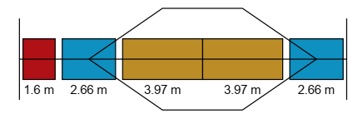
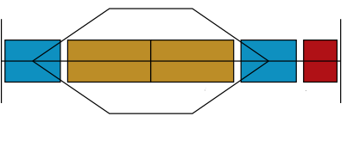
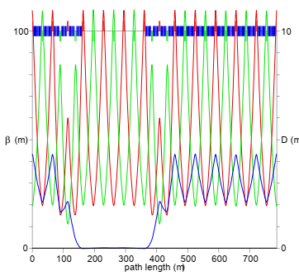
Hybrid RCS Acceleration
High-field fixed and low-field cycling magnets interleaved
  Orbit through cycling magnet varies in acceleration
  Quadrupoles needed
    Fixed or ramped ?
      Fixed fields probably not stable
    Limited to ramping fields
      0→2 T ( or 0→4 T at pole tips)
      Extra length for ramping quads must be included in lattice
Sample Lattice
  A. Garren and S. Berg
      MAP-doc-4307 (2011)
  750 GeV in Tevatron
  Quadrupoles are ramped to keep tune constant
25m

Slide 12
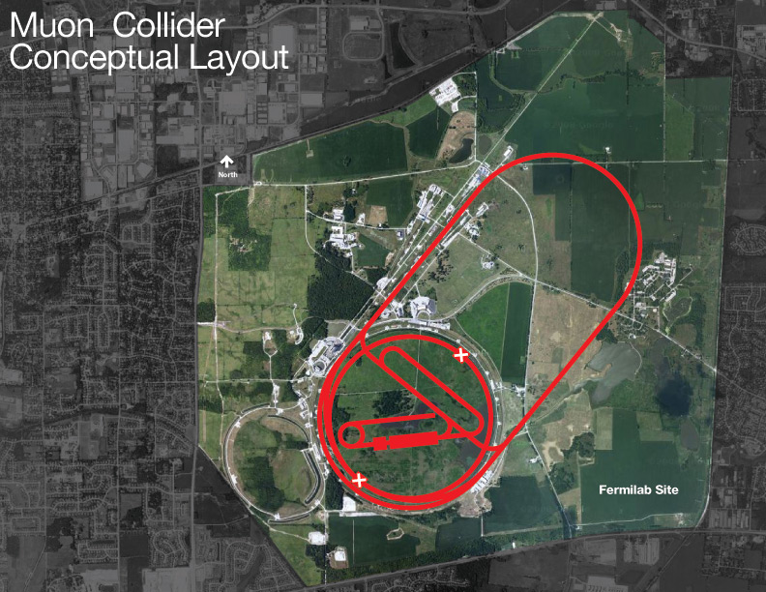
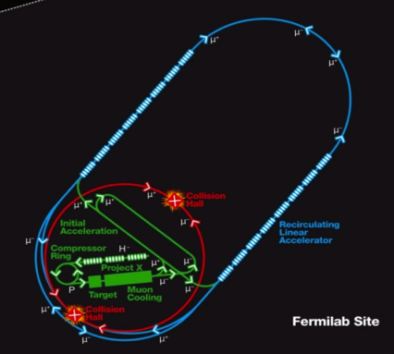
RLA~4→10 TeV Muon Collider (~2005-RLA
4 TeV Muon Collider
  2 TeV ring (~8T magnets)
  RLA accelerator
    ~18 turns
    2km linacs -50 GeV each
    ~30 MV/m rf
    Arcs are ~8T magnets each
Not quite site filler
  Easily expand to 2.5x2.5
  (5 TeV)
Double gradients, B_{max}, larger racetrack
  10 TeV (5 x 5) – (16 T – 60 MV/m)

Slide 13
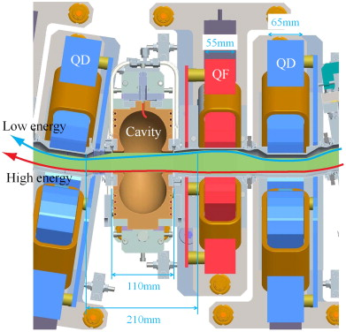
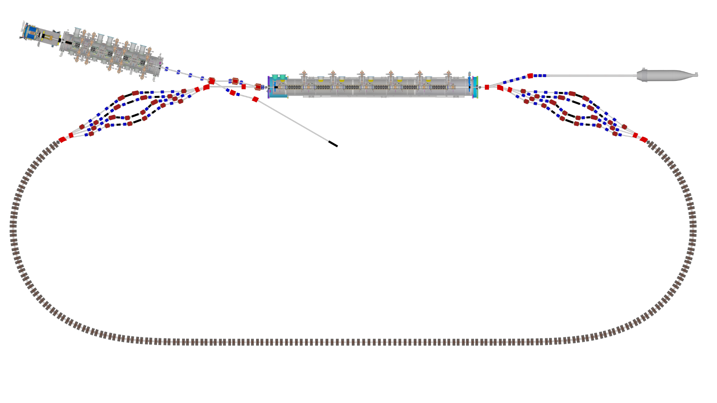

Fixed Field Accelerators
Fixed field alternating- gradient (FFA)
  Scaling -> edge focusing
    Constant tunes
  Non-scaling
    Crosses integer tunes
    EMMA demo
CBETA
  ~RLA with FFA arcs
    Tests concept of multiple passes in one transport
Muon Acceleration ?
  FFA in arcs

Slide 14
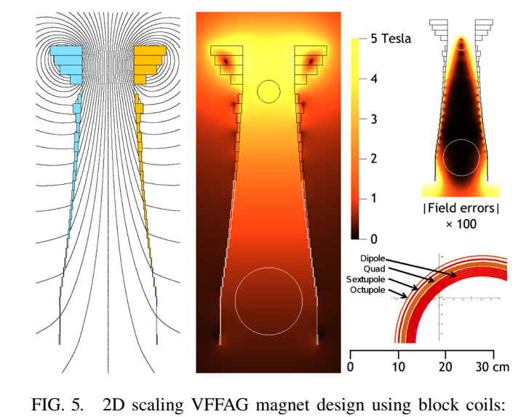
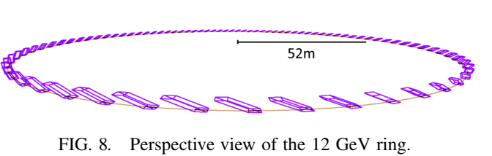
FFA acceleration
Vertical FFAG
        S.Brooks, PRSTAB 16, 084001 (2013)
    ~same circumference for all energies
      More isochronous
    Edge focusing
Scaling → non-scaling
Adaptable to muons ?

Slide 15
Site filler Accelerator
Proton Source
    PIP-III→target
μ Cooling
Linac + RLA → 65 GeV
    125 GeV Higgs
RCS 1 and 2 → 1000 GeV
    Tevatron-size
RCS 3 1 → 5 TeV
  Site filler accelerator
  10 TeV collider
  Collider Ring ~10 km
Accelerator Ring
Collider Ring
Protons
Cooling
RCS 1-2

Slide 16
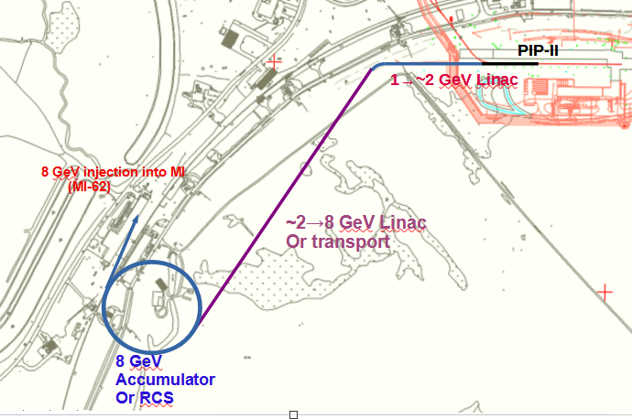
Fermilab Proton Intensity Upgrade
PiP-2 upgrade to ~8 GeV
  LBNF-DUNE to 2.4+ MW +p
  RCS –based or 8 GeV Linac
    Inject into MI for DUNE
    8 GeV beam for other experiments
Could provide MW proton beams
  8 GeV Linac upgrade to
  5 ma 2.5ms 20 Hz
    → 2 MW
    8 GeV RCS 800 kW baseline
    upgrade by 2.5x to 2 MW

Slide 17
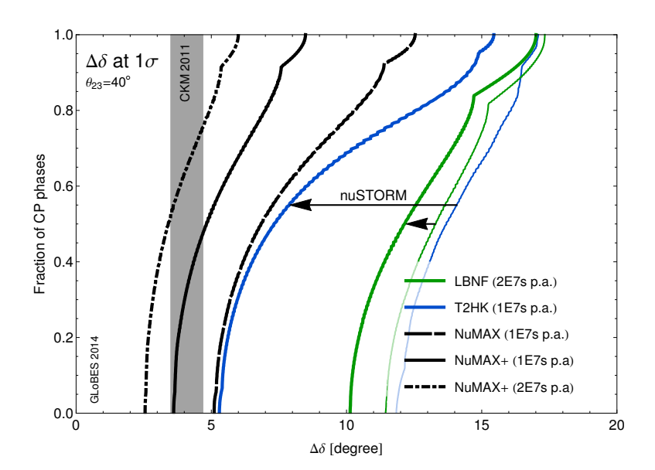
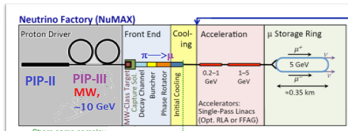
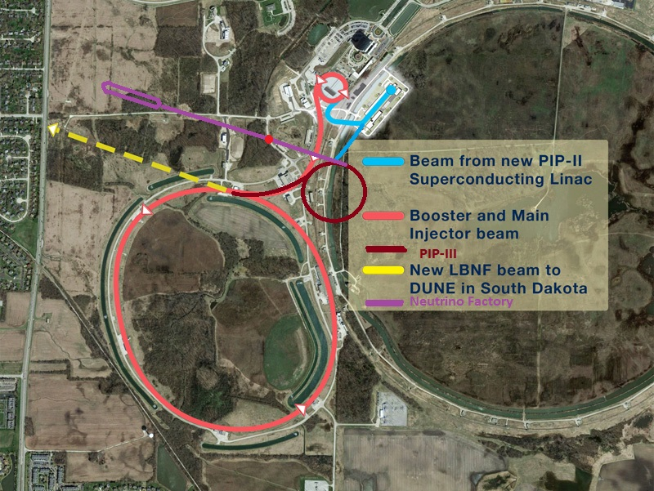
Fermilab “PIP-III” Neutrino options
DUNE → ???
  PIP-II→ “PIU”
Muon-based (μ→eνν*) beams
  Short BL (nuSTORM)
  Long baseline → DUNE
  ~4 GeV μ Storage ring
Muon source can be extended to feed a high-energy Collider
ν-FACT
DUNE

Slide 18
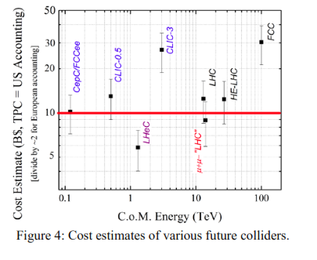
Costs ??
Affordable?
  according to Shiltsev cost model (JINST 9 T07002 (2014)):
α≅ 2G$ for civil construction,
β ≅ 1, 2 or 10 G$
for NC, SC magnets or SRF
γ≈ 2B$ wall plug power
  L=16, 60 GV rf, E_{cm}=10, P= ? MW
    ~10¹ G$ ?

Slide 19
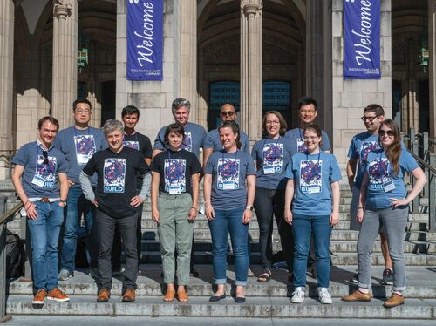
Summary
Fermilab site filler Collider possible
  Muon Collider up to ~10 TeV Collider is possible
    (5 × 5 TeV)
    Requires ~16 T dipoles , in RCS scenarios
      With rapid-cycling 2—4 T magnets
    RLA/FFA scenarios also possible
Strong interest at Snowmass
  Muon Collider Forum report
    K. M. Black, S. Jindariani et al.
    ArXiv 2209.01318
  Future Collider Options for the US
    P. C. Bhat et al. 2203.08088

Slide 20

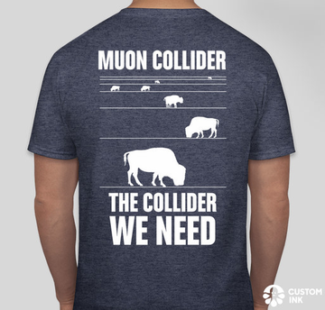
Thank you for your attention

