Slide 1






Shared resources, simulated sample, and FastSim update
Donatella Lucchesi
University and INFN Padova
for
Physics and Detector Group

Slide 2
Local Resources for Physics & Detector activities:
INFN-University Padova
INFN-Trieste
INFN-Bari
Berkeley
NERSC/Cori
FermiLab
IHEP
DESY
Mainly access by local people, with some exception
Shared Resources for Physics & Detector activities:
INFN Tier-1
CPU resources access not possible outside INFN currently due to software configuration, possible in the future with new software framework or wrapper if that takes too long
Disk storage access possible via GRID tools provide you are in the VO muoncoll.infn.it
CERN
Access via subscription to the e-groups:
muoncollider-batch (batch queue)
muoncollider-readers (read from disk)
muoncollider-writers (write to disk) Granted to developers for the moment
Granted to everybody of the Muon Collider collaboration

Slide 3
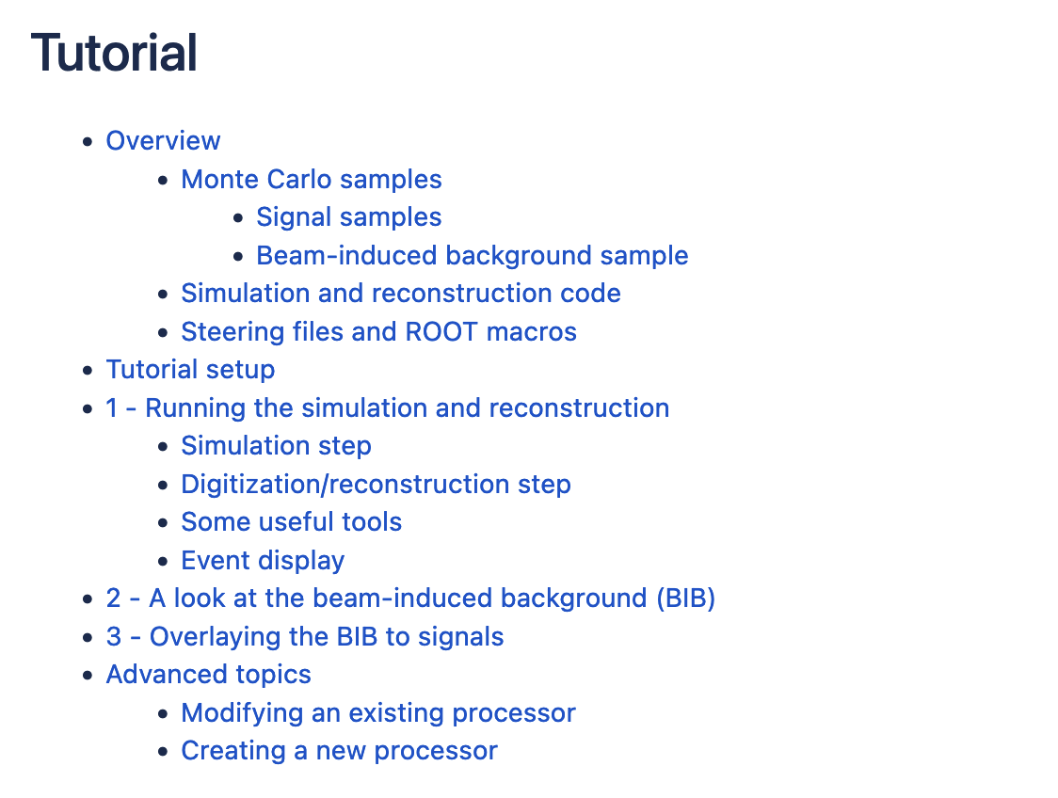
Full simulation/reconstruction comments
Same type of events, full BIB overlaid:
Conformal tracking, Double Layer requirement ~ 32 hours per event, often crashes, ~40GB of memory needed
ACTS: 10 minutes ~ 8 GB memory

Slide 4
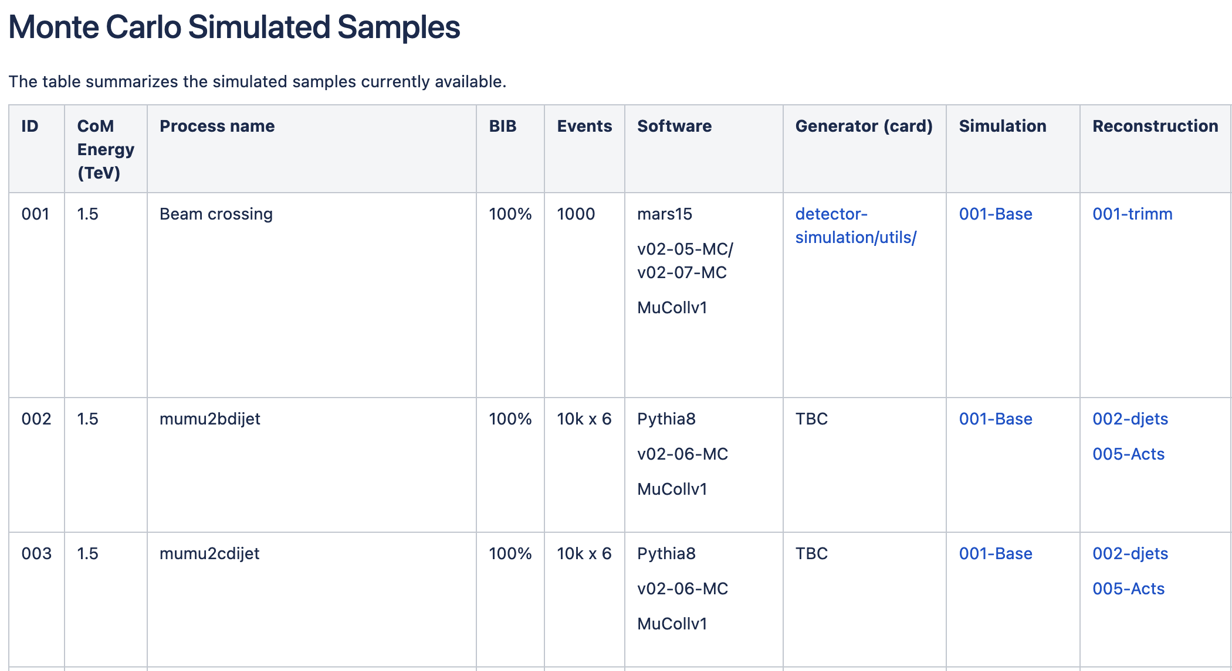
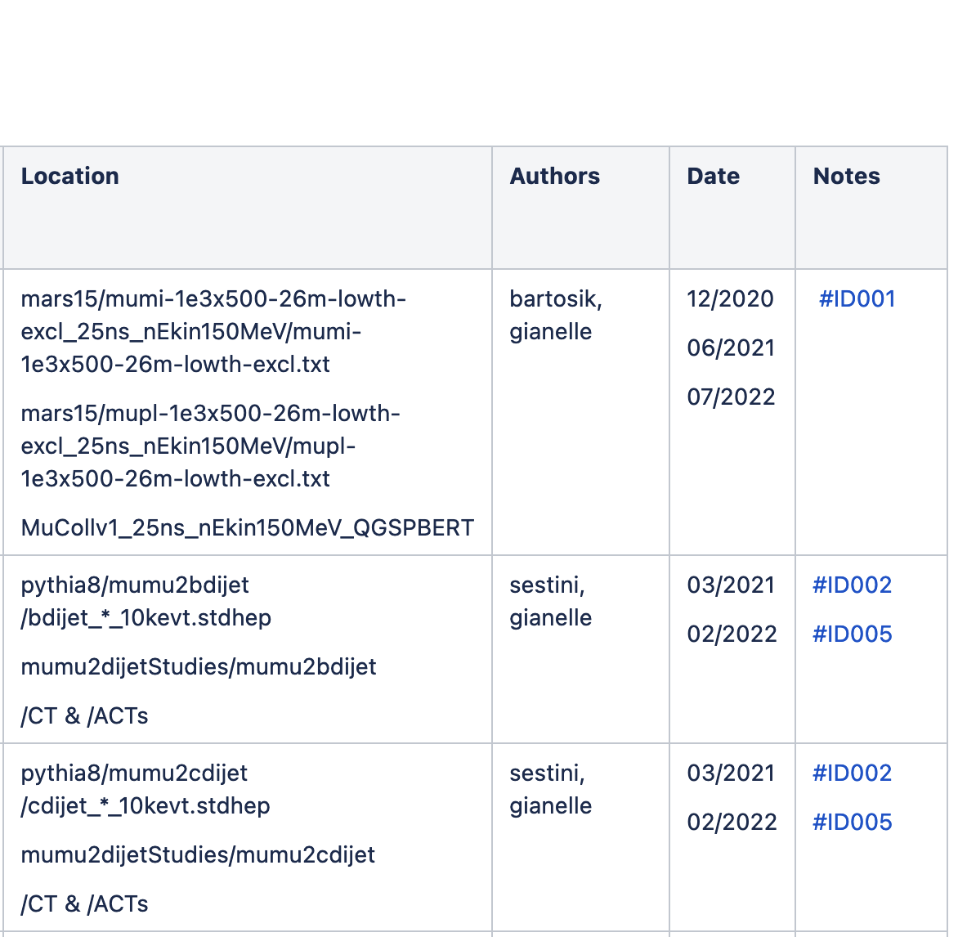

Simulated and reconstructed sample available to everybody
https://confluence.infn.it/display/muoncollider/Monte+Carlo+Simulated+Samples
… and much more
Beam-induced background events, will be copied at CERN. Example on how to use them need to be published to avoid mis-usage.

Slide 5
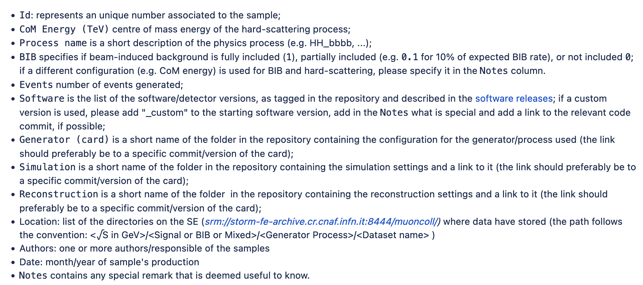
Among the information:

Slide 6
FastSim Status aka delphes card
and
Comparison with FullSim

Slide 7
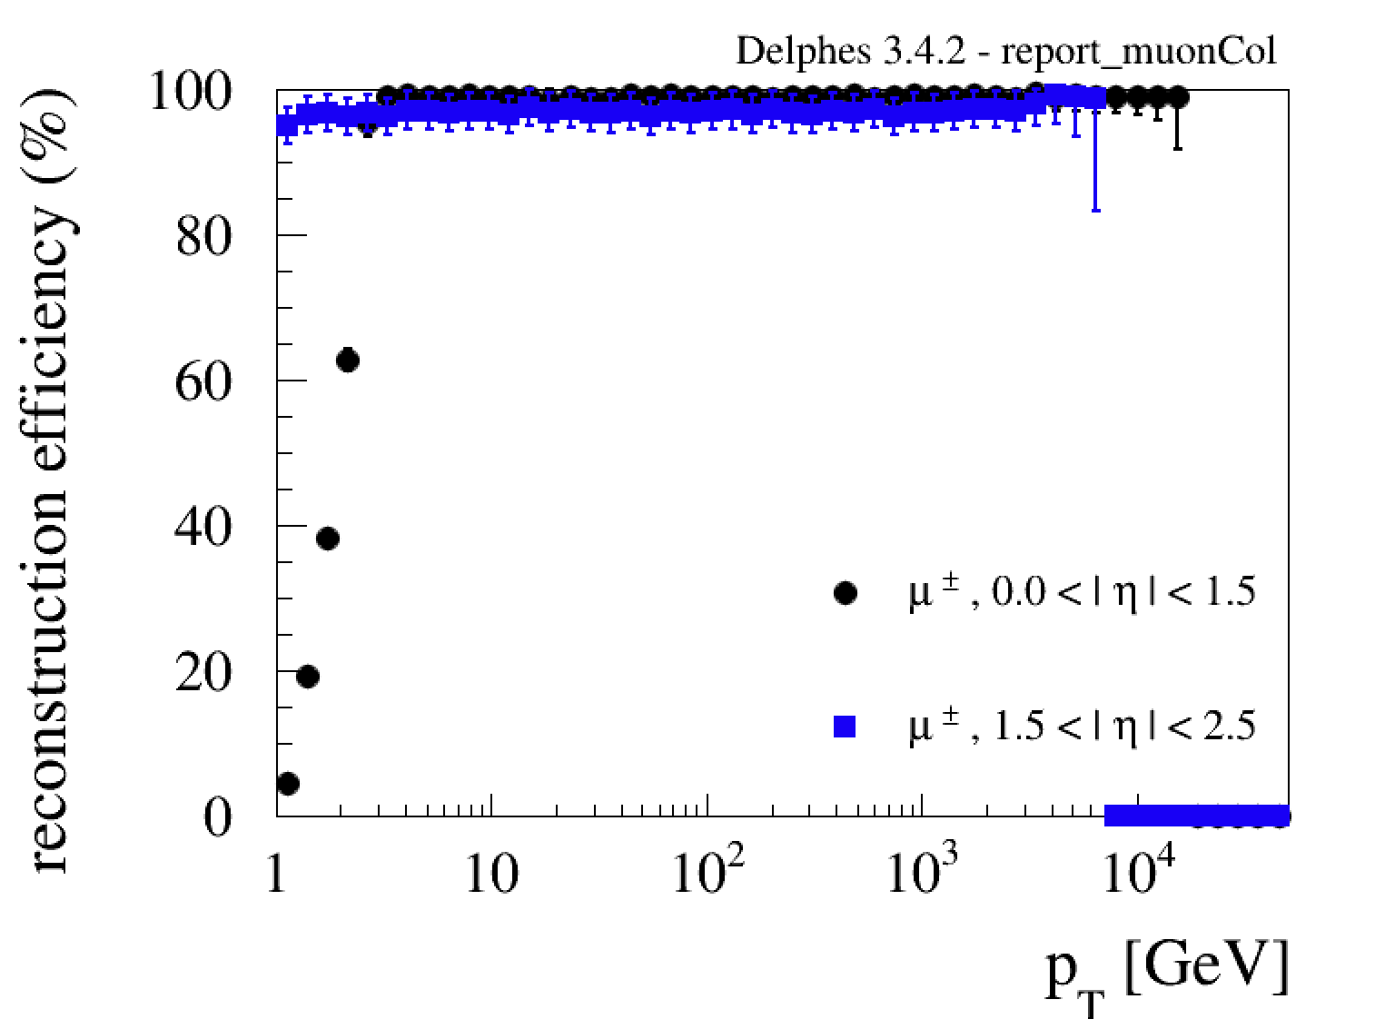
Muon Efficiency
Delphes card
Michele Selvaggi
Muon collider card performance
FullSim

Slide 8
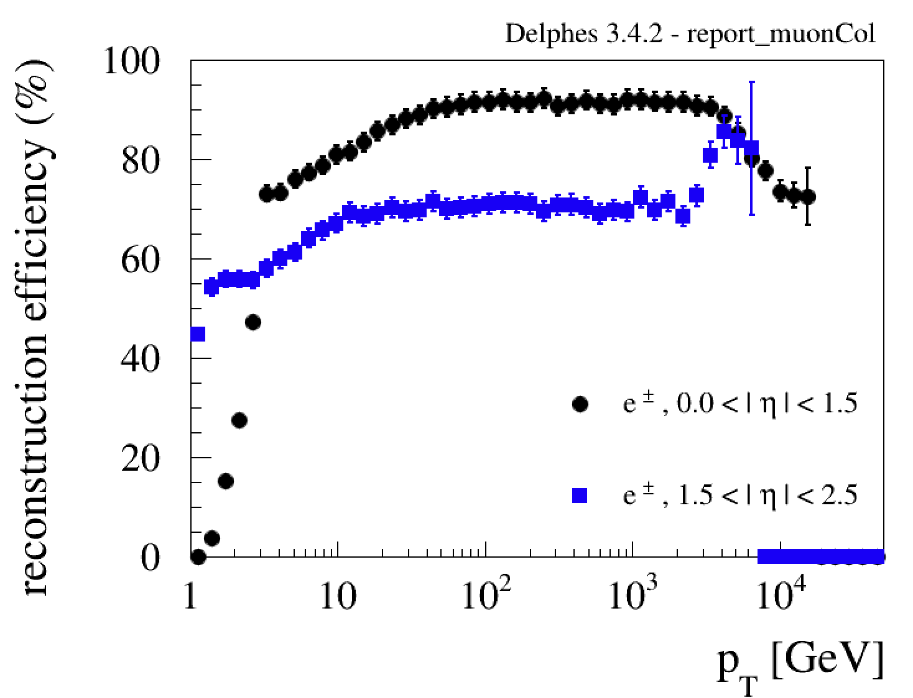
Tentative Scenario
Electron Efficiency
Delphes card
Michele Selvaggi
Muon collider card performance
FullSim

Slide 9
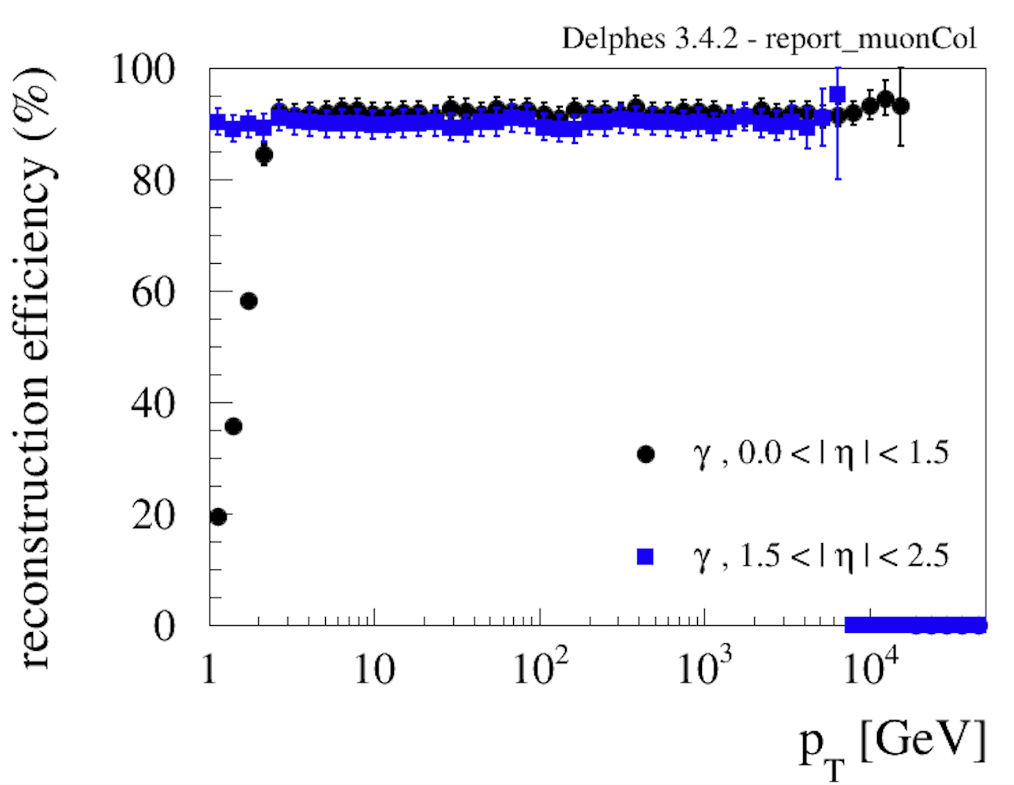
Tentative Scenario
Photon Efficiency
Delphes card
Michele Selvaggi
Muon collider card performance
FullSim

Slide 10
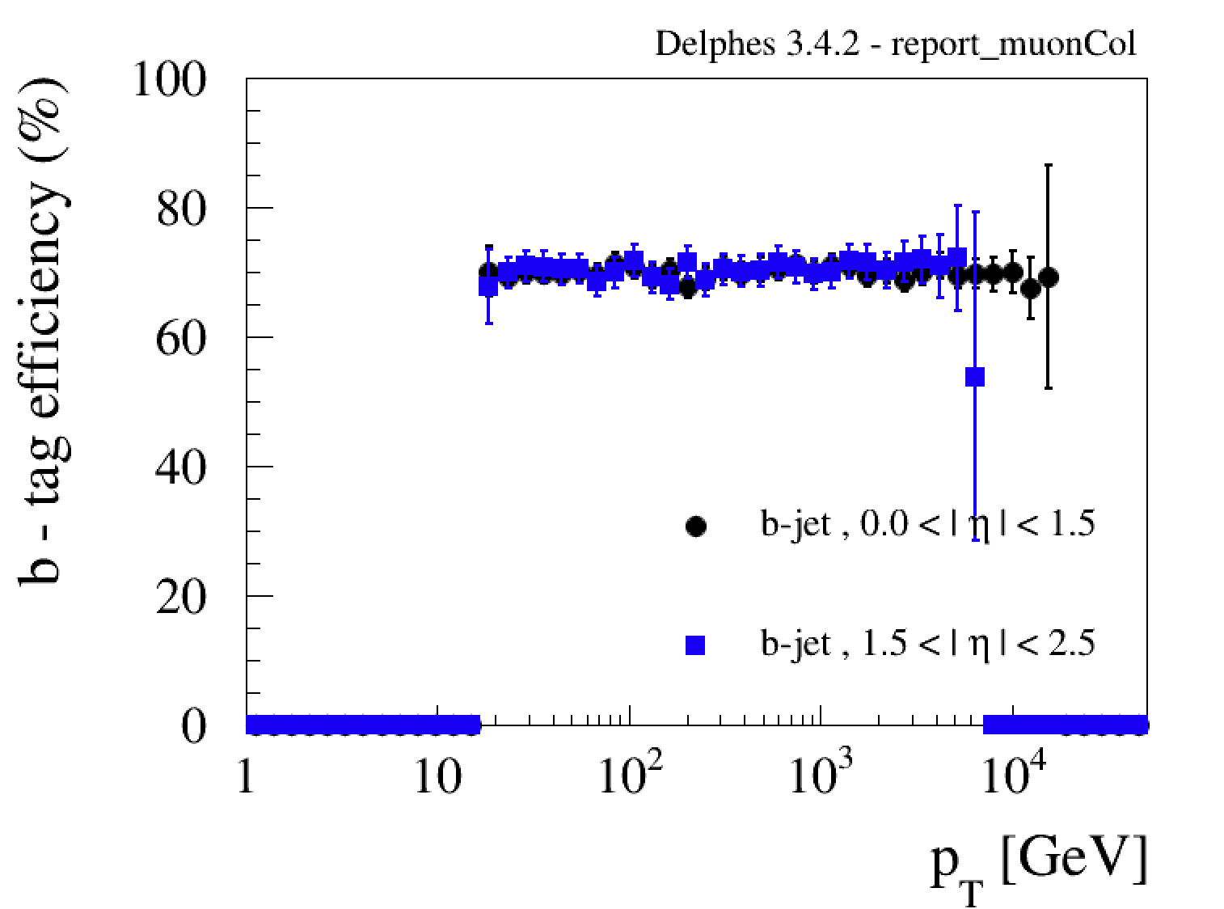
Tentative Scenario
b-tag Efficiency
Delphes card
Michele Selvaggi
Muon collider card performance
FullSim

Slide 11
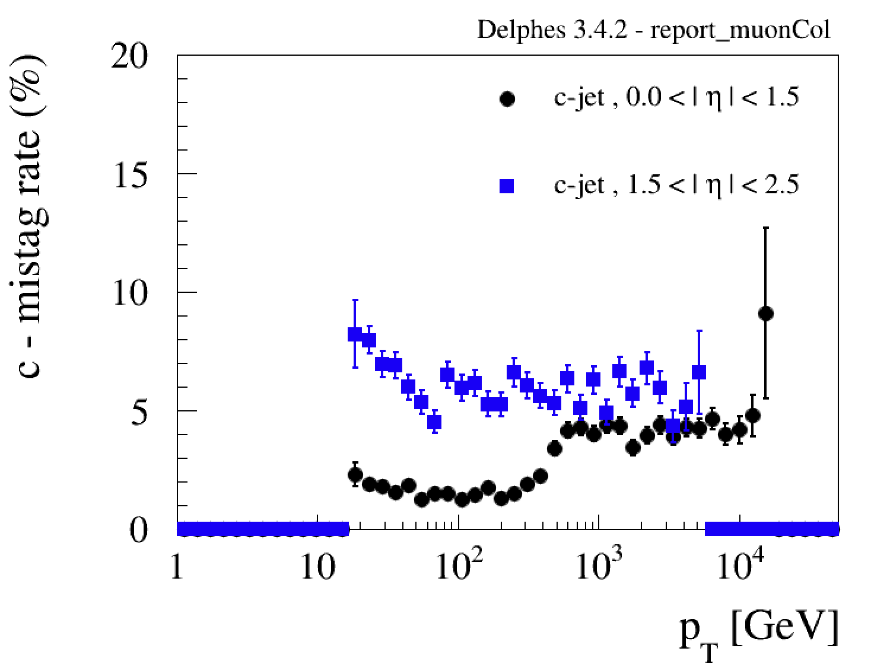
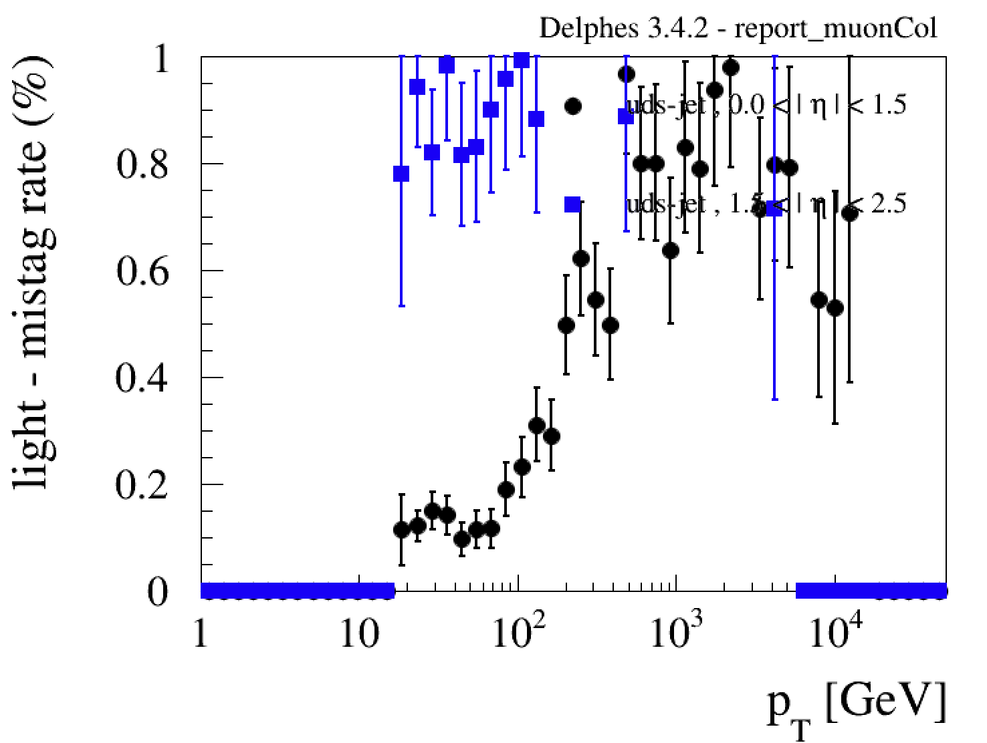
Tentative Scenario
Mistag
Michele Selvaggi Muon collider card performance
Delphes card
FullSim

Slide 12
Tentative Scenario
Summary and next steps
A working package, beam-induced background sample at 1.5 TeV, and simulated/reconstructed data are available.
Resources are available in several places and common shared resources start to be available
Future steps
Move to a common framework that all the resources may/can (?) be used from every collaborator everywhere
Define rules, procedure and resources to make beam-induced background events available to the collaboration and publish instructions to use them
Update the delphes card:
  keep a target efficiencies and resolutions at 3 TeV for pheno studies
  have 3 TeV “realistic” version for student’s thesis
  Different proposal?

