Slide 1
An R&D path for the muColl silicon tracker
Request for the muColl tracker
State of the art of LGAD-based 4D sensors
Path forward for a muColl tracker based on UFSD_RSD
N. Bartosik, N. Cartiglia, N. Pastrone
INFN, Torino

Slide 2
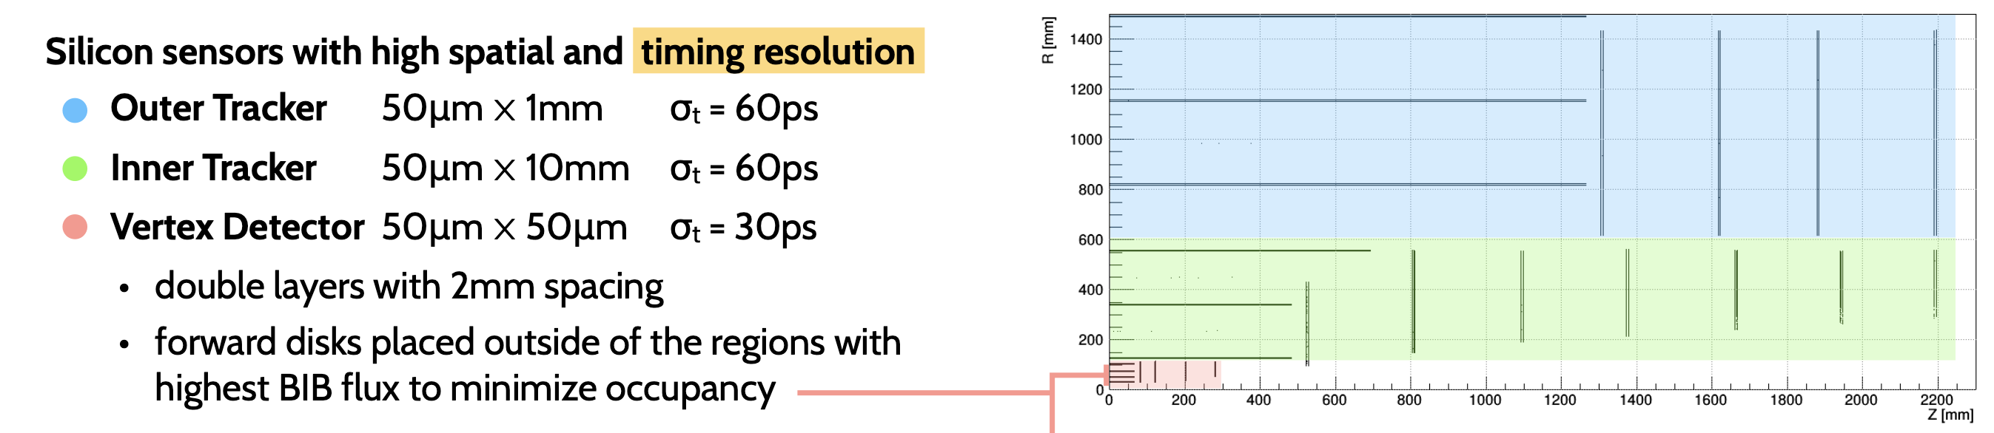
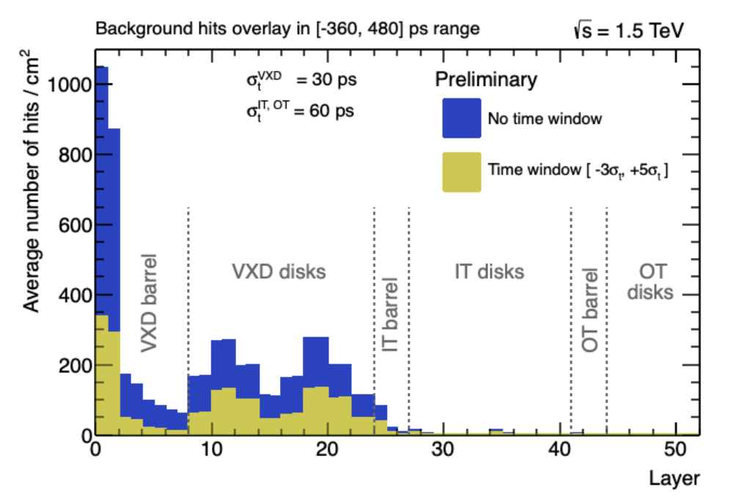

Setting the stage: resolution and occupancy
$σ_{∅}\sim 7 μm,σ_{z}\sim 90 μm σ_{t}\sim 60 ps$ (strips)
$σ_{∅}\sim 7 μm,σ_{z}\sim 90 μm σ_{t}\sim 60 ps$ (macropixels)
$$σ_{∅}\sim 5 μm,σ_{z}\sim 5 μm σ_{t}\sim 30 ps (pixel, 25x25 μm)$$
Fairly stringent requests for resolutions
Very high occupancy in the vertex detector
To be combined with:
As low as possible material budget
As low as possible power consumption

Slide 3
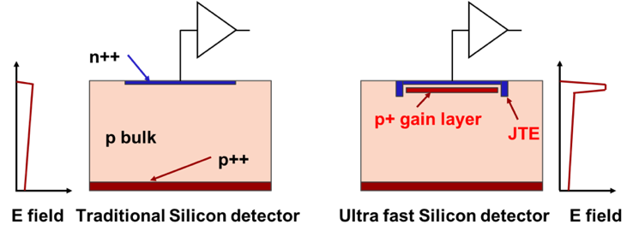
First design innovation: low gain avalanche diode (LGAD)
zoom
Drift area with gain
0.5 – 2 μm long
The gain layer:
a parallel plate capacitor with high field
High field obtained by adding an extra doping layer
E ~ 300 kV/cm, closed to breakdown voltage
The low-gain mechanism, obtained with a moderately doped p-implant, is the defining feature of the design.
The low gain allows segmenting and keeping the shot noise below the electronic noise, since the leakage current is low.
Low gain is the key ingredient to good temporal resolution
LGAD optimized for timing are often called Ultra-Fast Silicon Detector (UFSD)

Slide 4
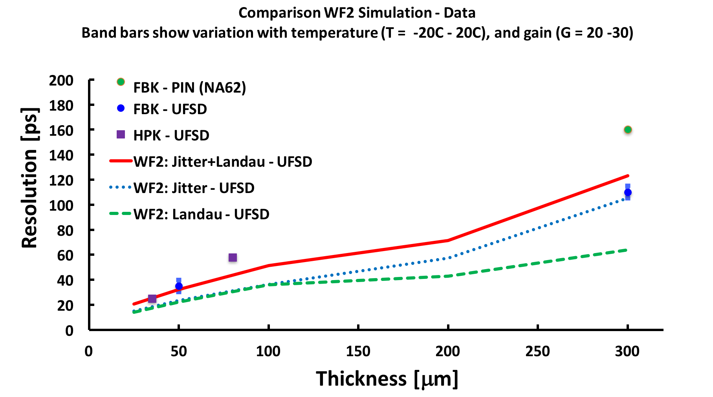
Summary of UFSD temporal resolution
Resolution without gain
There are now hundreds of measurements on 45-55 μm-thick UFSDs
➔ Current sensor choice for the ATLAS and CMS timing layers

Slide 5
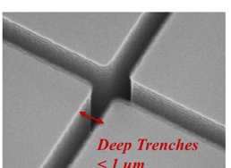
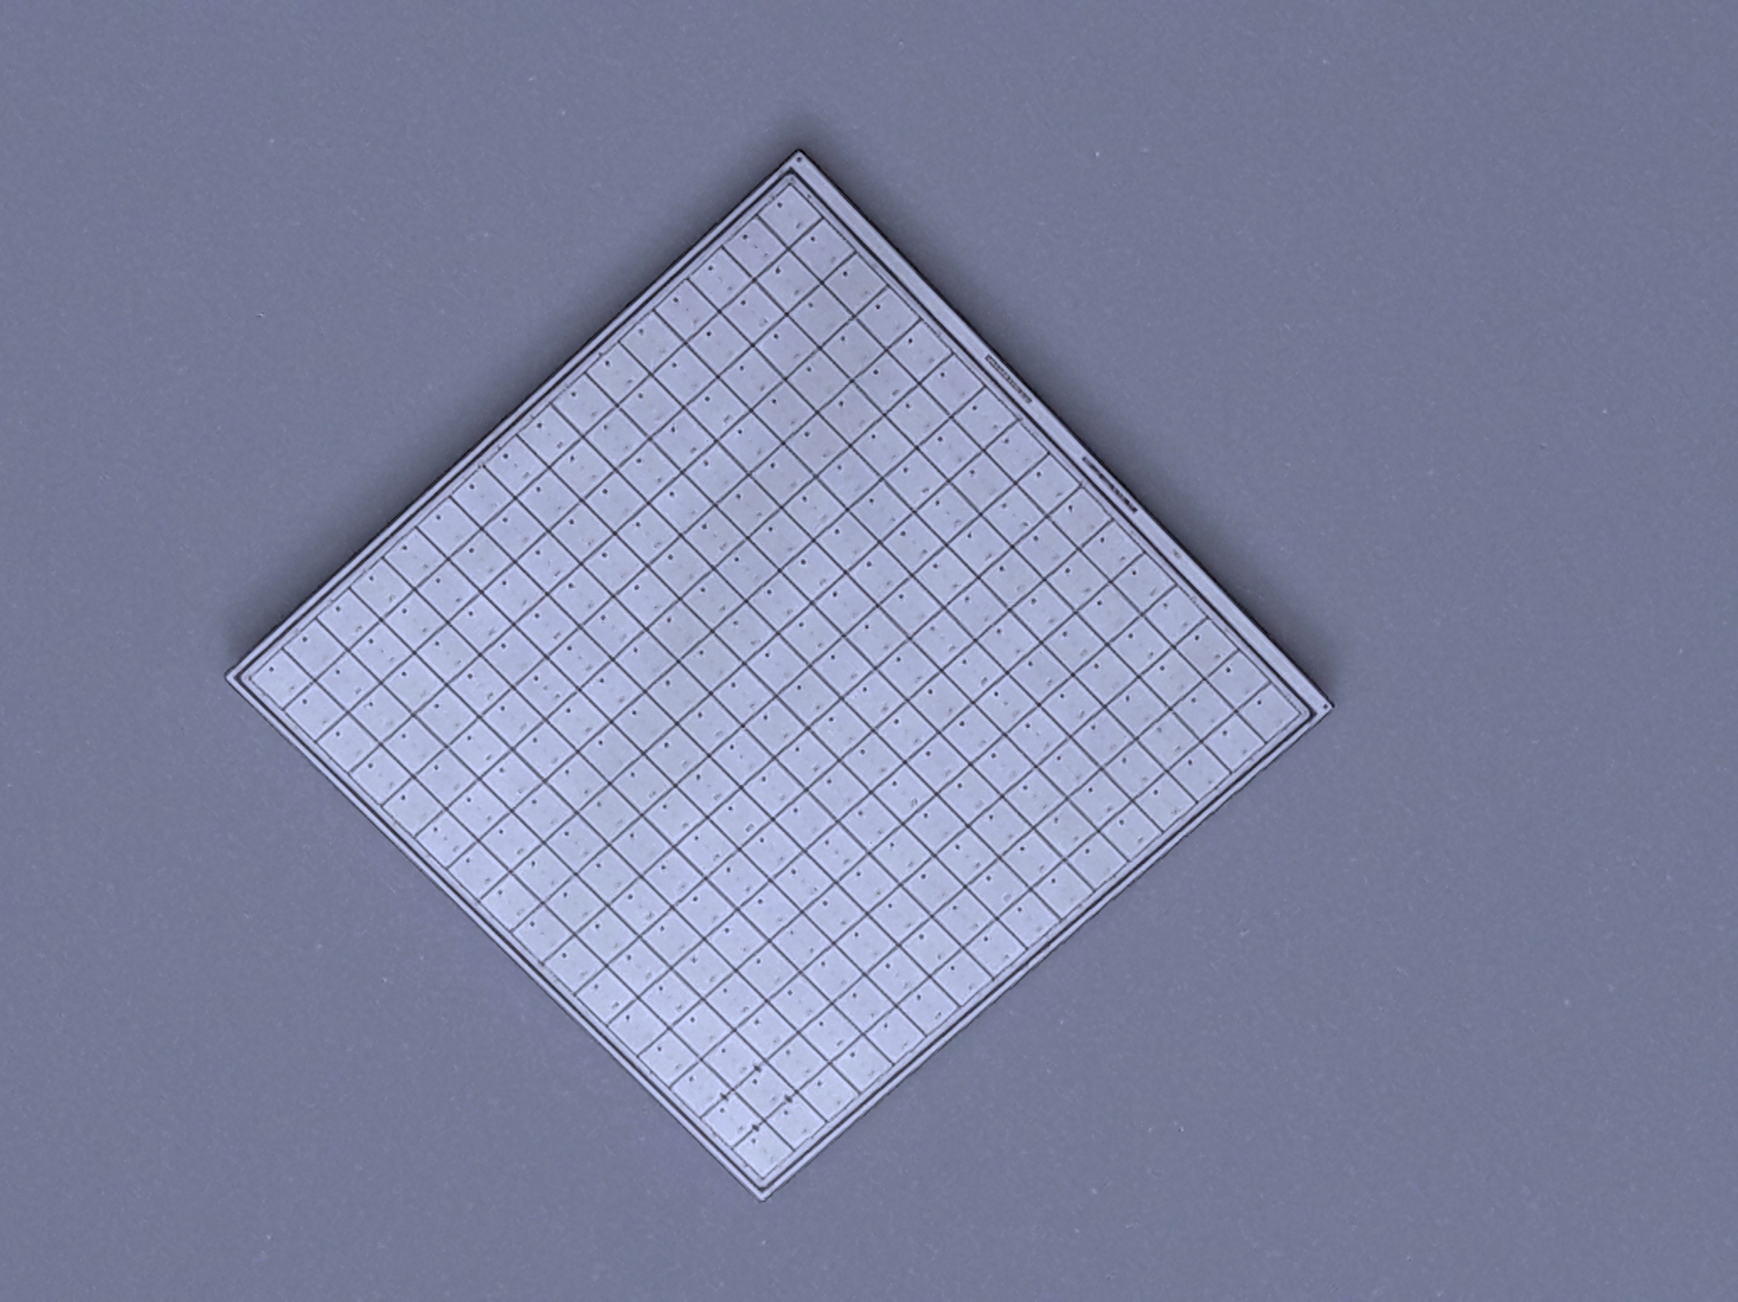
UFSD: State-of-the art
Physicist
No gain area ~ 50 um
No gain area ~ 5 um
JTE + p-stop design
CMS && ATLAS choice
Not 100% fill factor
Hit contained in a single pixel
Very well tested
High Occupancy OK
Rate ~ 50-100 MHz
Rad hardness ~ 2-3E15 n/cm2
Trench-isolated design
Almost 100% fill factor
Hit contained in a single pixel
Temporal resolution (50 μm) : 35-40 ps
High Occupancy OK
Rate ~ 50-100 MHz
Rad hardness: ~ 1E15 n/cm2
2.1 cm
HPK2
16x16 array

Slide 6
Second design innovation: resistive read-out
The signal is formed on the n+ electrode ==> no signal on the AC pads
The AC pads offer the smallest impedance to ground for the fast signal
The signal discharges to ground
short RC
short RC
Fast signal
Fast signal
long RC
long RC
-+
-+
-+
-+
-+
-+
In resistive readout the signal is naturally shared among pads (4-6) without the need of B field or floating pads
Thanks to the internal gain, full efficiency even with sharing
Results presented here are from the FBK RSD2 production

Slide 7
RSD principle of operation in motion

Slide 8
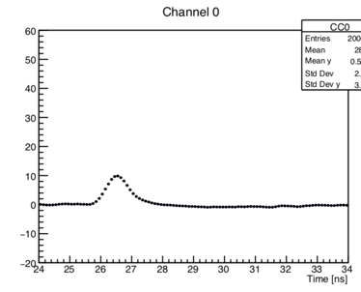
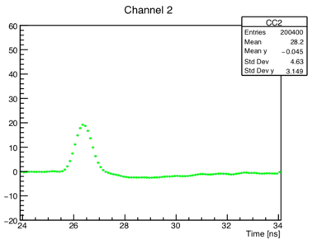
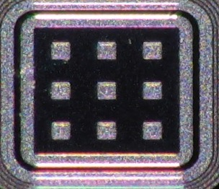
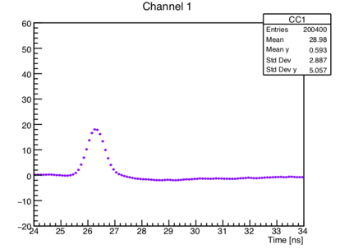
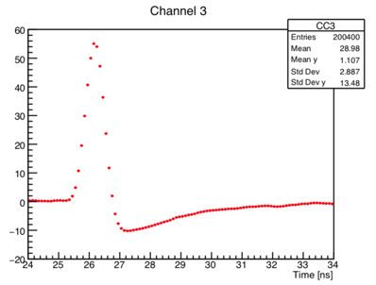
Example of signal sharing
P 1
Pad 1
60
40
20
0
-20
60
40
20
0
-20
Pad 1
Pad 2
Amplitude [mV]
50-mm thick RSD,
Gain ~ 20
0 2 4 6 8 10
0 2 4 6 8 10
1
2
60
40
20
0
-20
60
40
20
0
-20
Pad 3
Pad 4
3
4
Amplitude [mV]
0 2 4 6 8
0 2 4 6 8 10
Time [ns]
Time [ns]
The laser is shot at the position of the red dot: the signal is seen in 4 pads

Slide 9
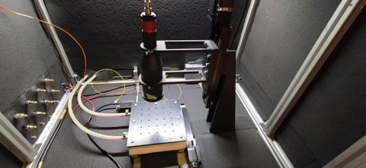
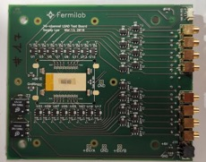
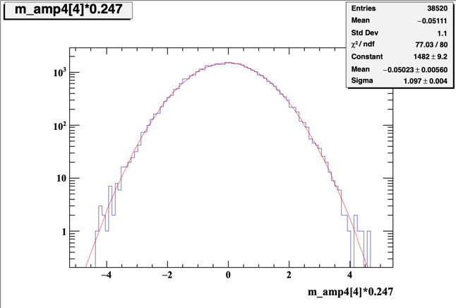
Experimental set-up
The Particulars TCT laser setup has been used:
  IR laser generates a signal in the RSD,
  simulating the passage of a MIP
  laser spot size ~ 8 μm
  Laser temporal precision: ~ 8 ps
  movable x-y stage provides reference positions of the laser shots, precision: σ _{Laser}~ 2 μm
Sensors are read out with 16-ch fast analogue board, developed at FNAL
The signals are recorded with16-ch CAEN Digitizer (5 Gs)
Amplitude of pre-signal samples
RMS noise level ~ 1.1 mV
Amplitude [mV]

Slide 10
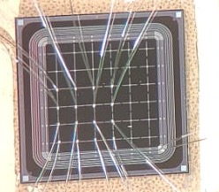
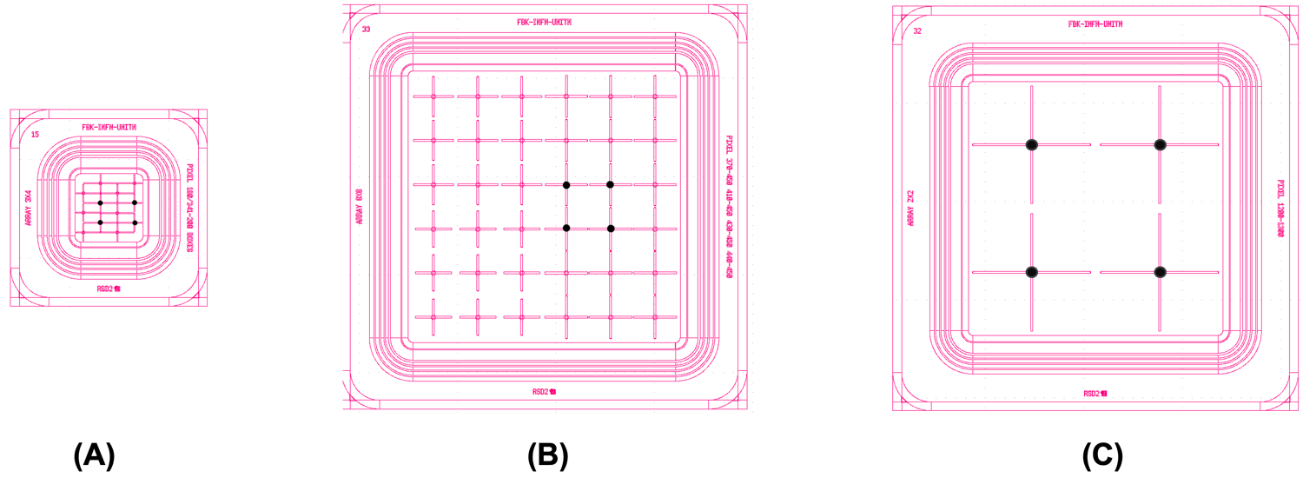
RSD2 structures used in this analysis (FBK - RSD2 production)
Pitch = 0.45 mm
In this study, the perfomance of sensors with electrodes shaped as crosses is presented.
4 different dimensions: 200, 340, 450, and 1300 μm
200 x 340 μm²
Pitch = 450 μm
Pitch = 1300 μm

Slide 11
RSD position resolution (FBK RSD2 production)
RSDs at gain = 30 achieve a spatial resolution of about 2-3% of the pitch size:
RSD:
1300 x 1300 mm²: σ_{x} ~ 30 μm
450 x 450 mm²: σ_{x} ~ 5 μm
Compared to a standard pixel
1300 x 1300 mm²: σ_{x} ~ 920 μm
450 x 450 mm²: σ_{x} ~ 320 μm
gain = 30

Slide 12
RSD temporal resolution (FBK RSD2 production)
The resolution depends mostly upon the signal size and weakly on the pixel size
RSDs at gain = 30 achieve a temporal jitter of about 20 ps
gain = 30

Slide 13
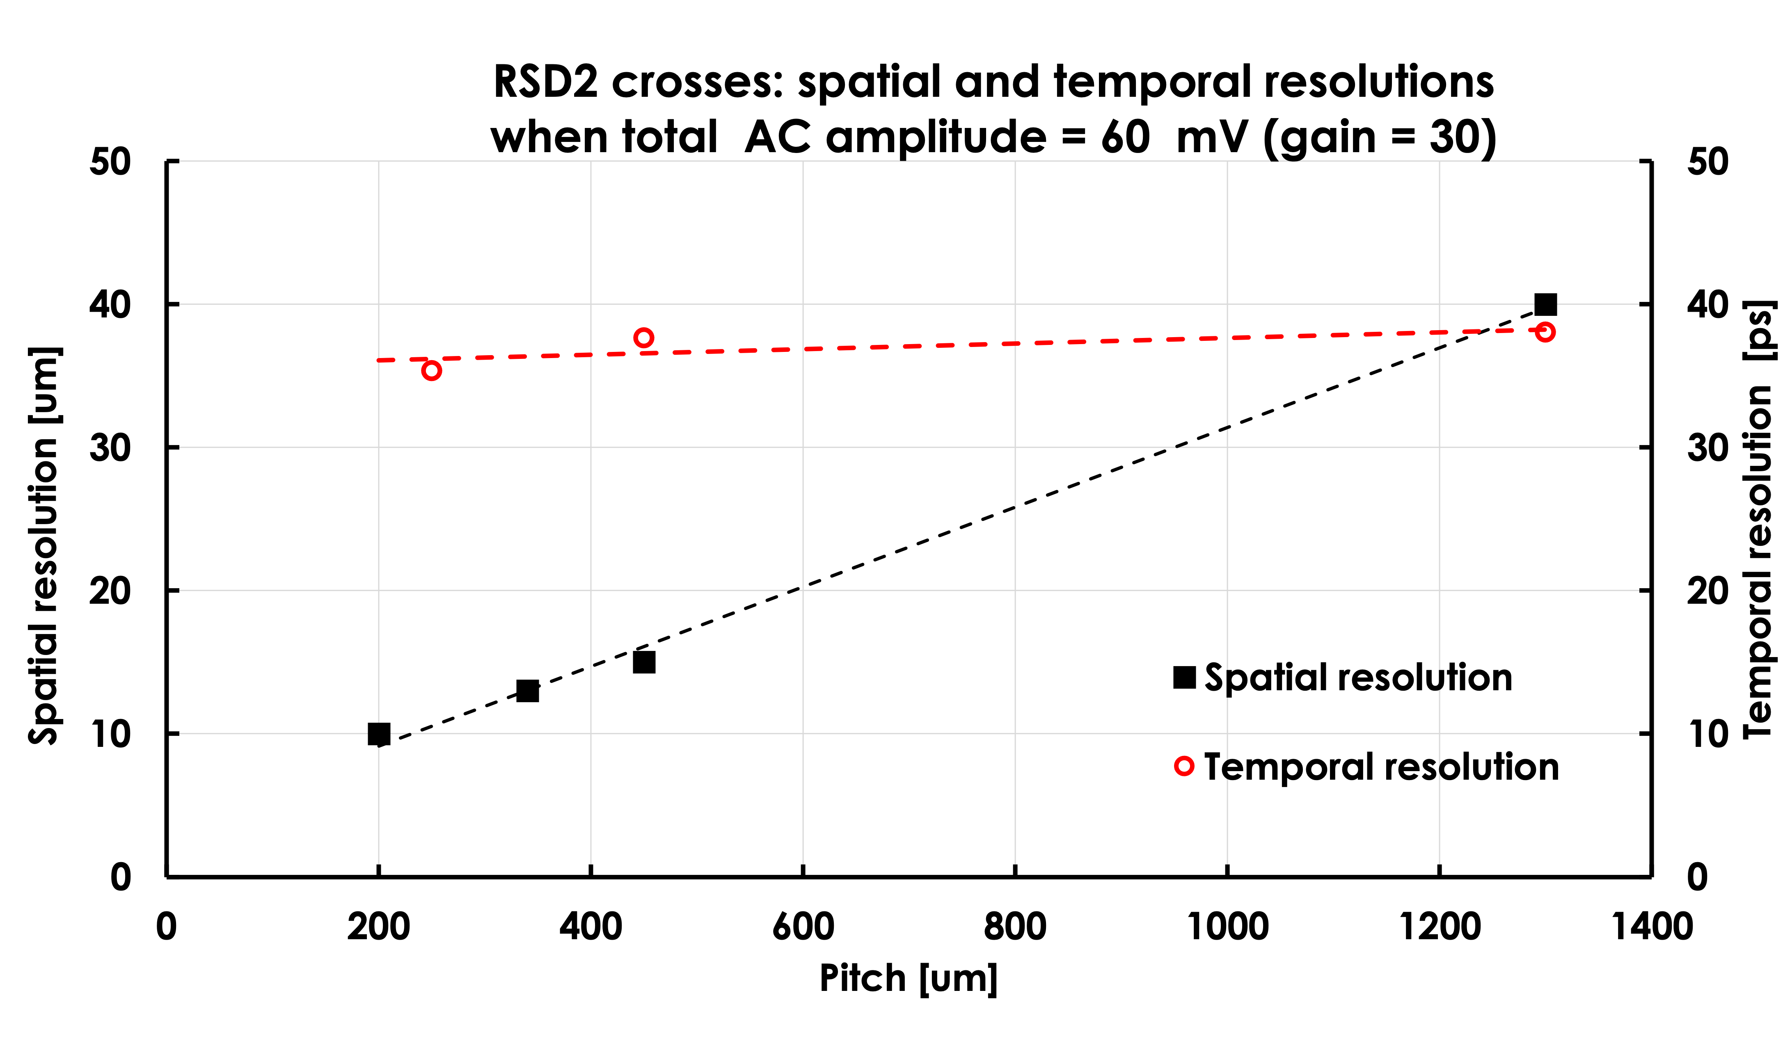
RSD2 performance summary

Slide 14
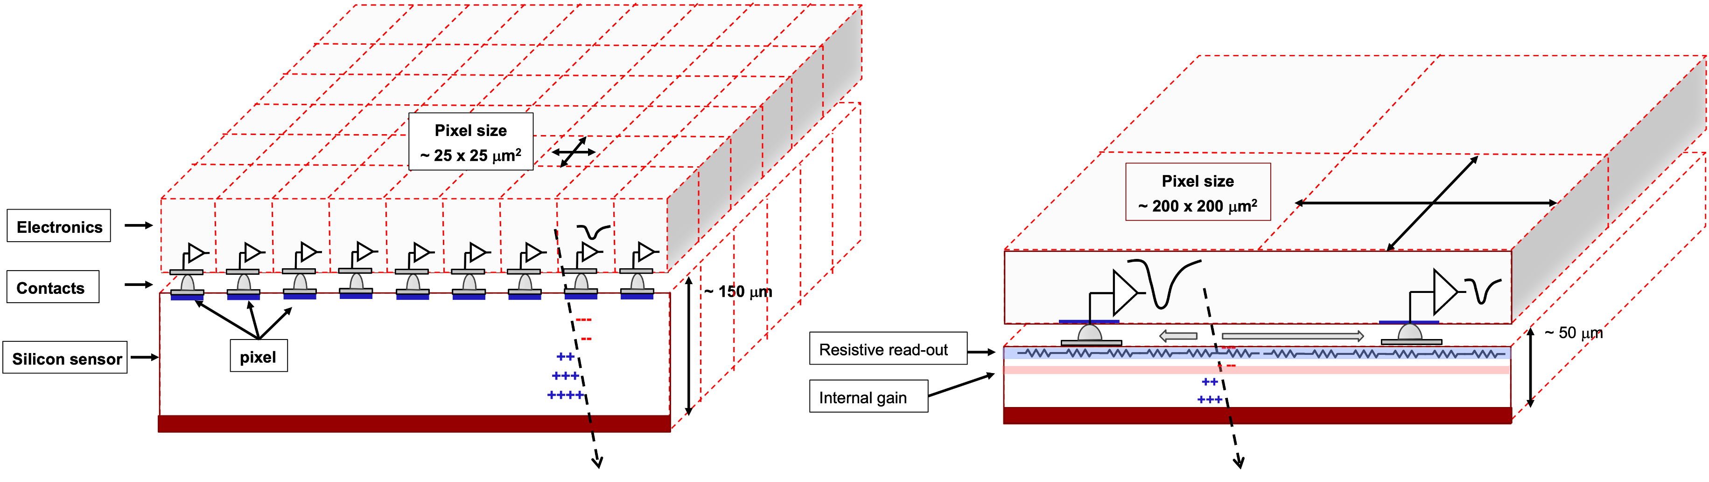
Final goal of RSD R&D: a completely new tracker
Standard tracker
RSD-based tracker
The design of a tracker based on RSD is truly innovative:
It delivers ~ 20 -30 ps temporal resolution
For the same spatial resolution, the number of pixel is reduced by 50-100
The electronic circuitry can be easily accomodated
The power consumption is much lower, it might even be air cooled (~ 0.1-0.2 W/cm²)
The sensors can be really thin

Slide 15
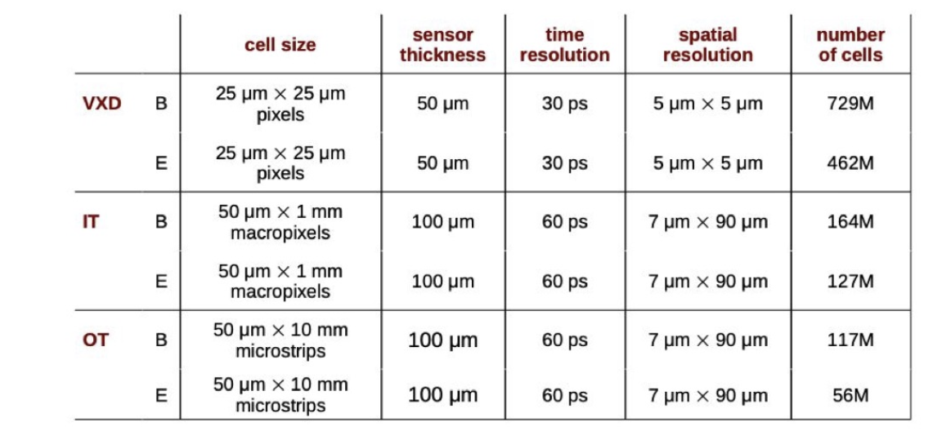
Matching UFSD-RSD capabilities to the muColl requests
High occupancy and levels.
TI-LGAD can be used up to 1-2E15 n/cm²
R&D in radiation harness needed to cover the full radiation field
Low occupancy and radiation levels. Ideal for macro-pixels.
Pixel size, spatial, and temporal resolutions are a perfect fit for present RSD technology
RSD will strongly reduce the number of pixels
Very Low-occupancy and radiation levels. Long strips do not provide accurate temporal resolution.
Propose to replace it with RSD macro pads

Slide 16
Conclusions
UFSD and RSD offer very good combined spatial and temporal performances
These designs are a good fit to the need of the muColl design
Proposed detector
Cell size | Number of cells | Thickness | Detector
To be decided |  | 50 um | TI_LGAD
200 um x 2 mm | 1/8 # of present design | 50 um | RSD
200 um x 2 mm | Similar to the present design | 50 um | RSD
Very difficult (impossible?) to achieve good timing with strips
Better to use macro-pads?
In Torino we are continuing the development of TI-LGAD and RSD for applications to the muColl tracker

