Slide 1





Reports of the working groups: Acceleration and collider
by Antoine Chance (CEA Paris-Saclay)
and Christian Carli (CERN)
Acknowledgements:
F. Batsch, H. Damerau , David Amorim , Kyriacos Skoufaris , Fulvio Boattini,
Max Topp-Mugglestone, I. Karpov, Elias Metral, Scott Berg,
Luca Bottura, Alexej Grudiev, Daniel Schulte

Slide 2
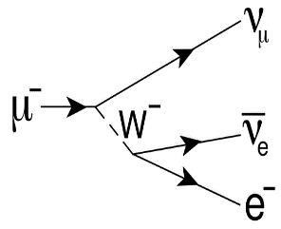
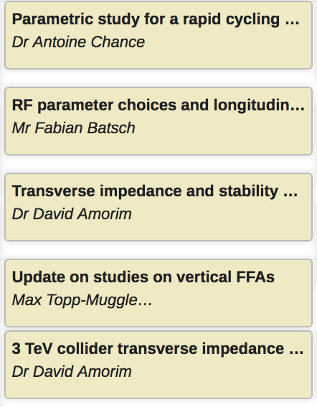
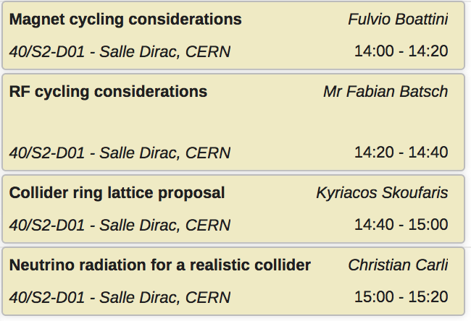
High Energy Complex working group
Acceleration to high energy (after rec. linacs)
  Pulsed synchrotrons challenging
    Very fast magnet ramping (power, eddy ..)
    Orbit variations with fixed SC and
    cycled NC magnets
    Circumference variations and
    longitudinal dynamics
  FFAs (vertical) an alternative
Collider ring
  Very challenging conditions for lattice
    Small β*, short bunches, large energy spread..
    High energy, neutrino radiation
    Chromatic effects and compensation …..
  Iterations with WGs on magnet design,
  beam loss, MDI, radiation protection ..
Wednesday 14:00
6/R-012
Thursday 14:00
40/S2-D01
Dedicated sessions on Wednesday
and Thursday afternoon
Contributions to and interaction with many WGs
(MDI, magnets, beam loss, RP, RF ..)

Slide 3
Rapid Cycling Synchrotron
Detailed parameter table: https://cernbox.cern.ch/index.php/s/I9VpITncUeCBtiz
hybrid
RCS
5 TeV
Chain of rapid cycling synchrotrons, counter-rotating μ⁺/μ⁻ beams
→ 63 GeV → 0.31 TeV → 0.75 TeV → 1.5 TeV (→ 5 TeV)
Hybrid RCSs have intersecting normal conducting (NC) and superconducting (SC) magnets
The studies presented aim to determine the RF (cavity) and lattice parameter (number of RF stations, momentum compaction factor,…)
Courtesy: Heiko Damerau
hybrid
RCS
1.5 TeV
norm. cond. RCS
hybrid RCS
Both in the same tunnel

Slide 4
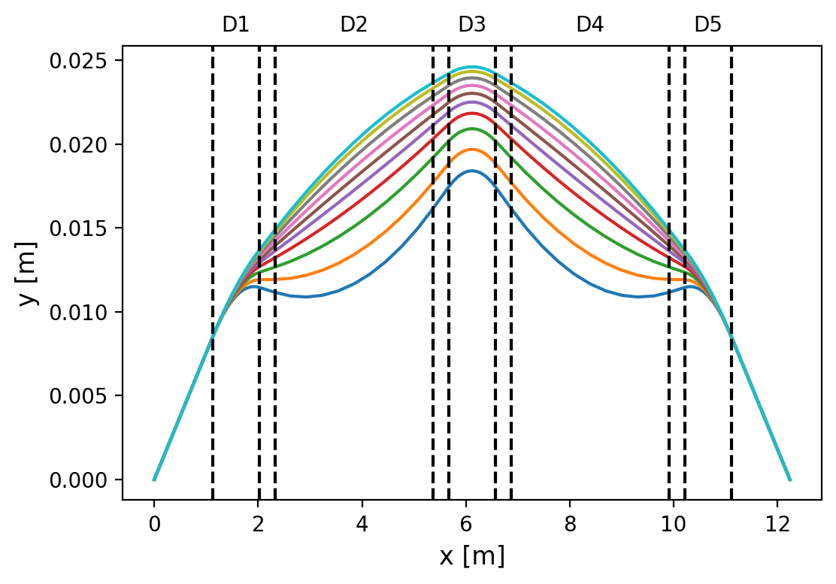
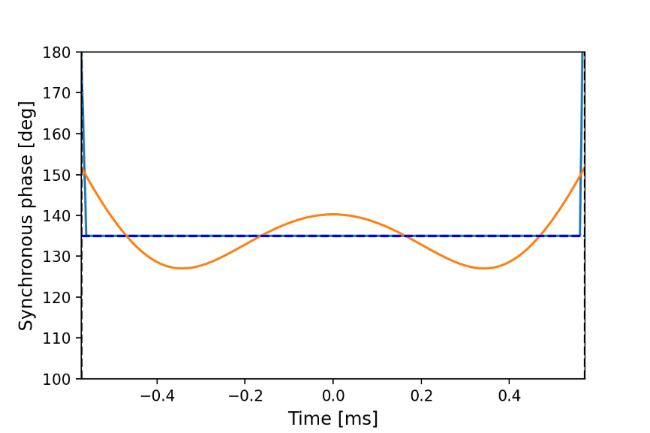
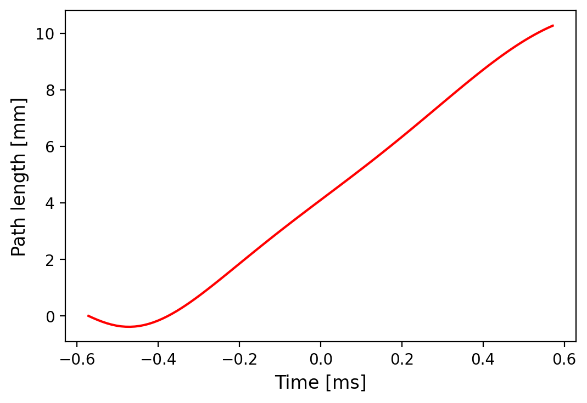
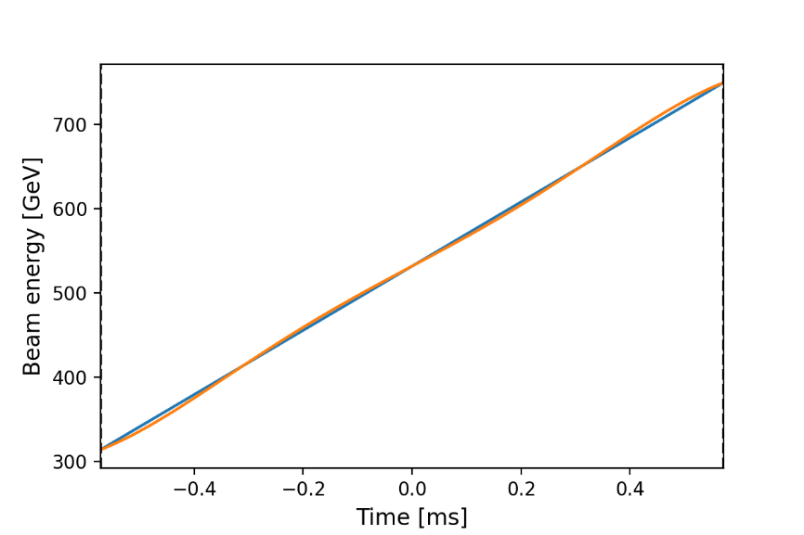
RCS2:
Case SC first with 5 dipoles and 208 cells
That is possible to get a path length variation of about 1 cm. However, the cell is very compact.
Although the energy ramp is quasi-linear, the synchronous phase varies by more than 10 degrees.
The voltage is assumed to be constant in the cavity.

Slide 5
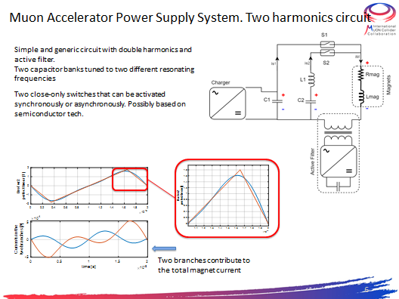
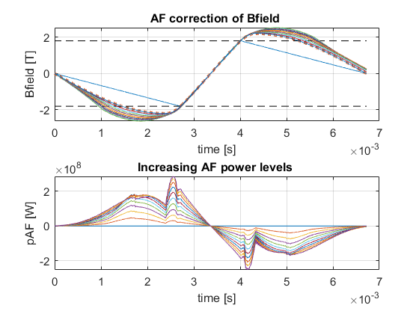
Magnet cycling
Courtesy: Fulvio Boattini
Multi-step optimization: Bref calculation, Circuit parameters, optimization of free oscillation, Active Filter contribution
Promising steps towards an analytic model of the vFFA have been made!

Slide 6
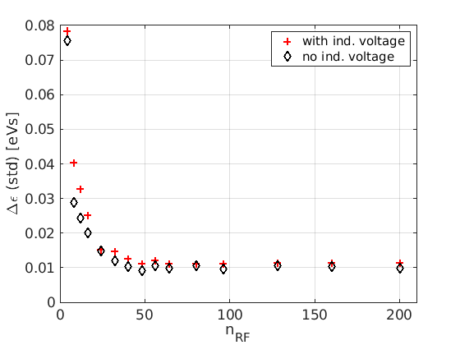
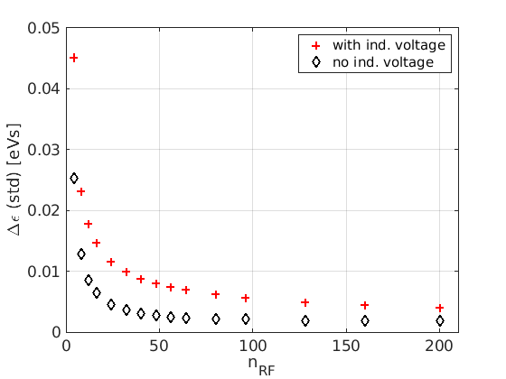
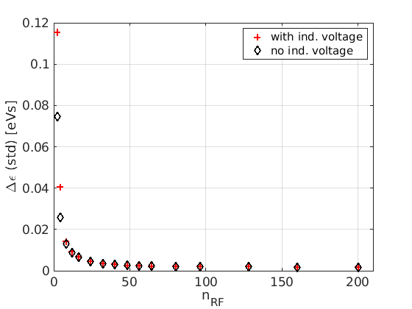
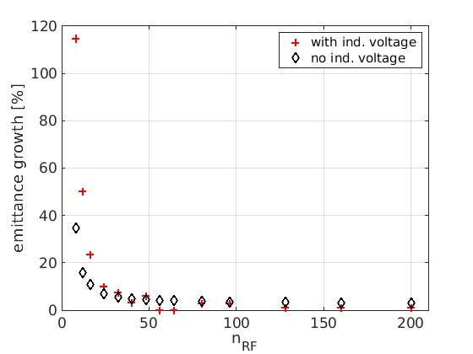
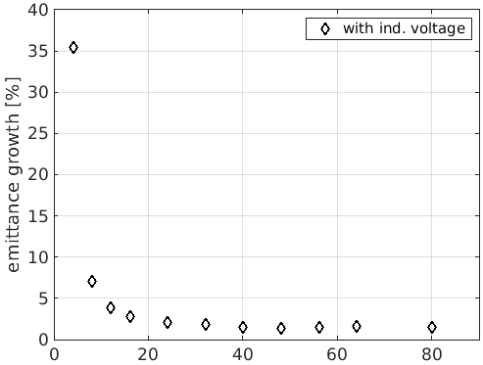
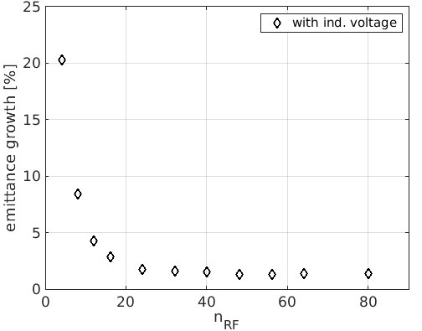

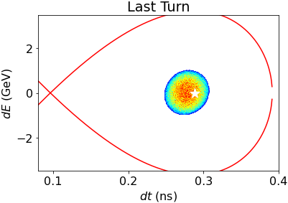
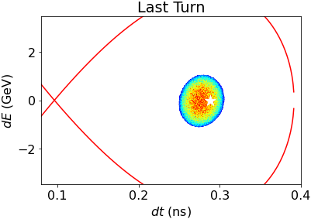

Synchrotron tune and number of RF stations
(TESLA-like cavities)
Courtesy: Fabian Batsch
Results for each RCS and with and without induced voltage / intensity effects:
Similar behaviour for RCS 2&3, no change for n_{RF} > 48
Lower Q_{s} allows for slightly smaller number in RCS 2&3,
e.g. n_{RF} = 24 and 16
Influence of small n_{RF} on two bunches to be investigated
RCS1, Δε (std)
RCS2, Δε (std)
RCS3, Δε (std)
n_{RF}=32
n_{RF}=24
n_{RF}=16
6
6

Slide 7
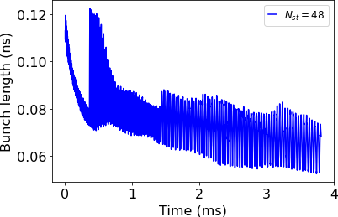
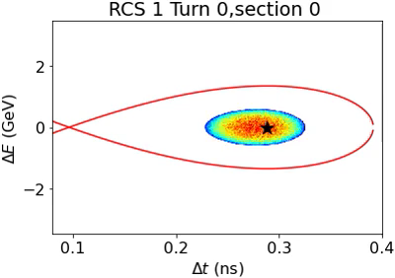
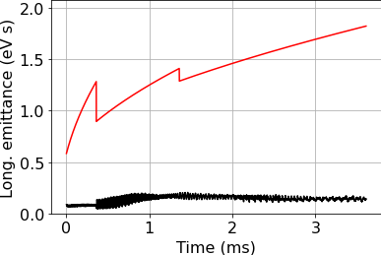
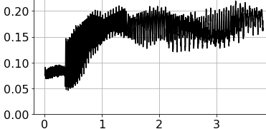
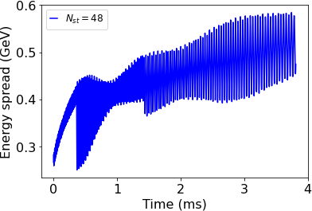
Beam transport though the RCS chain:
Evolution of bunch parameter
How do the bunch length, energy spread and emittance evolve when propagating the bunch through not one, but all RCS?
All RCS with n_{RF}=48
Unmatched bunch remains main problem, emittance growth 90%
14 October 2022
7
F. Batsch
7

Slide 8
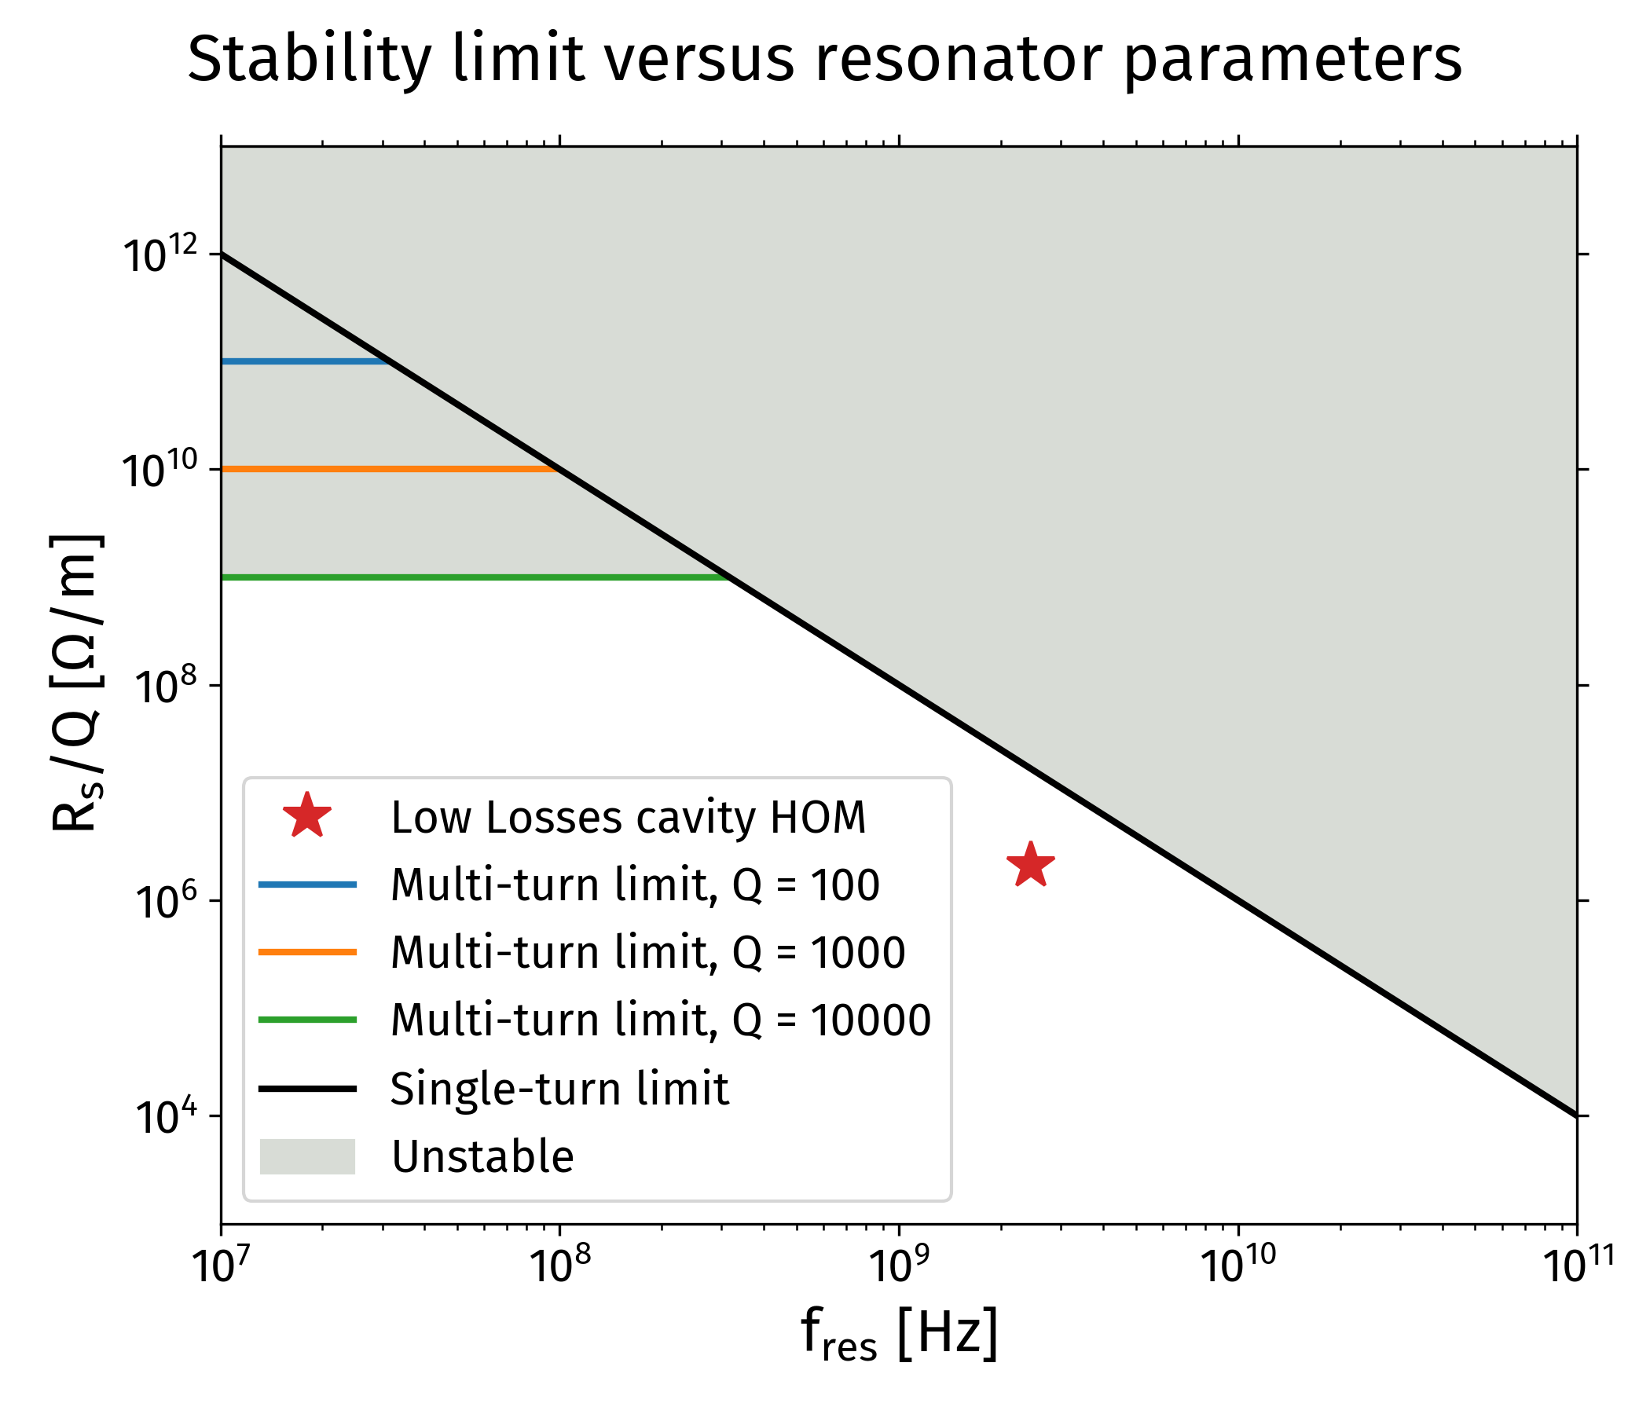
Mode stability prediction
Transverse stability in RCS 1
Courtesy: David Amorim
  Stability threshold (single turn) R_{s}/Q ~ 100 [MΩ/m] / f² [GHz²]
  This HOM at 2.45 GHz:
    [R_{s}/Q]_{threshold} = 100/2.45² = 16.7MΩ/m
    [R_{s}/Q]_{total} = 2.1 MΩ/m
HOM below the predicted stability limit by factor 8

Slide 9
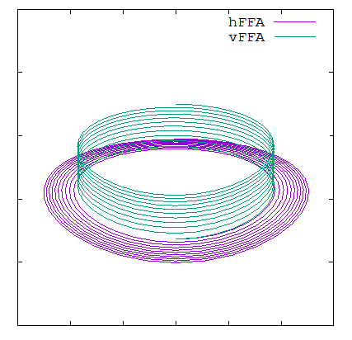
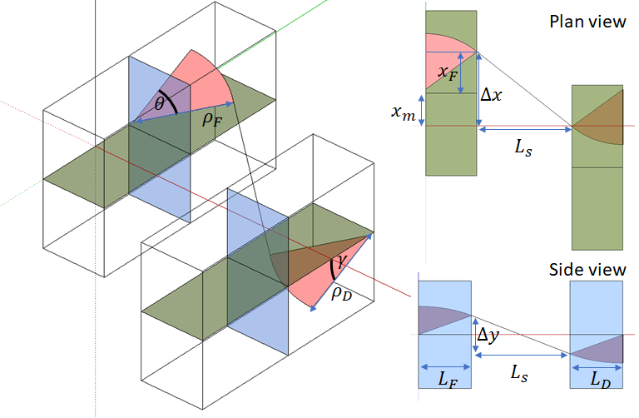
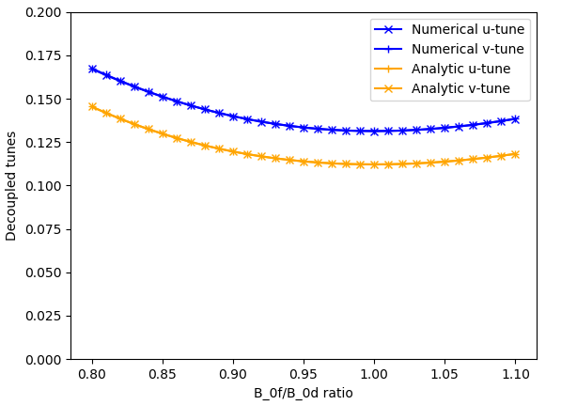
Alternatives to RCS vFFA
Courtesy: Max Topp-Mugglestone
Development of analytic tools to modelize the 3D orbit
Promising steps towards an analytic model of the vFFA have been made!

Slide 10
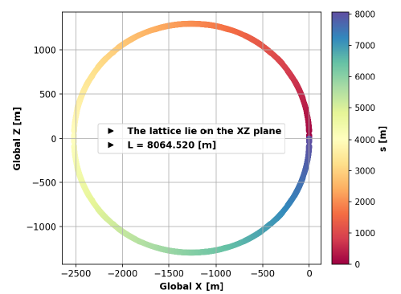
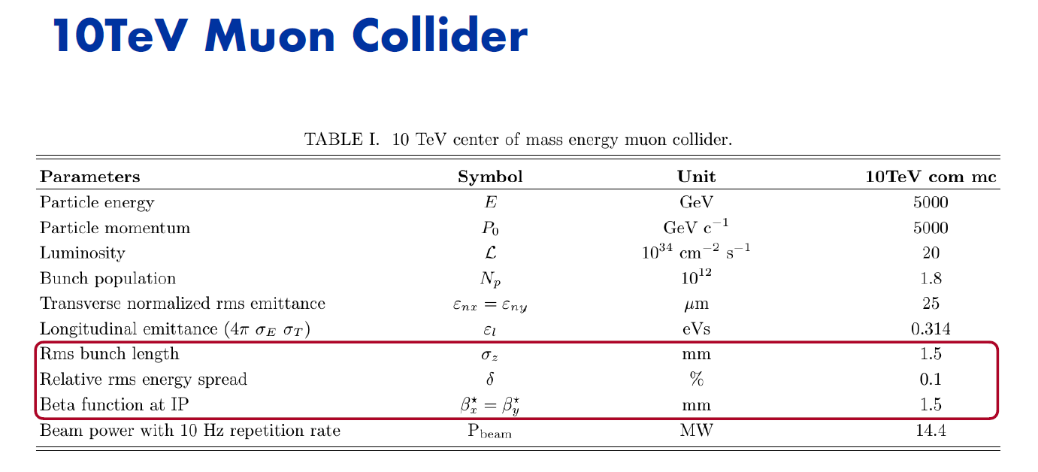
10 TeV collider
Courtesy: Kyriacos Skoufaris

Slide 11
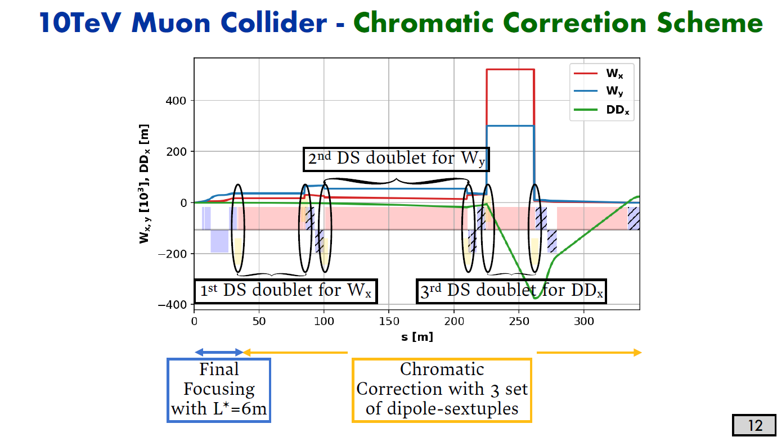
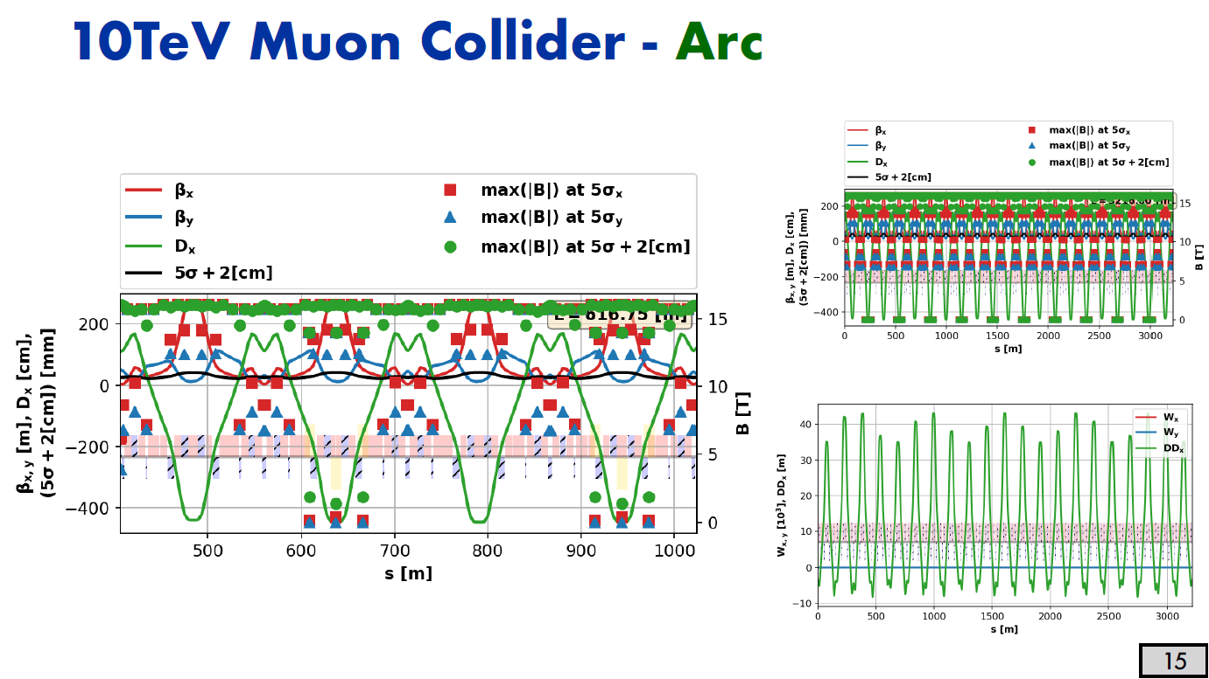
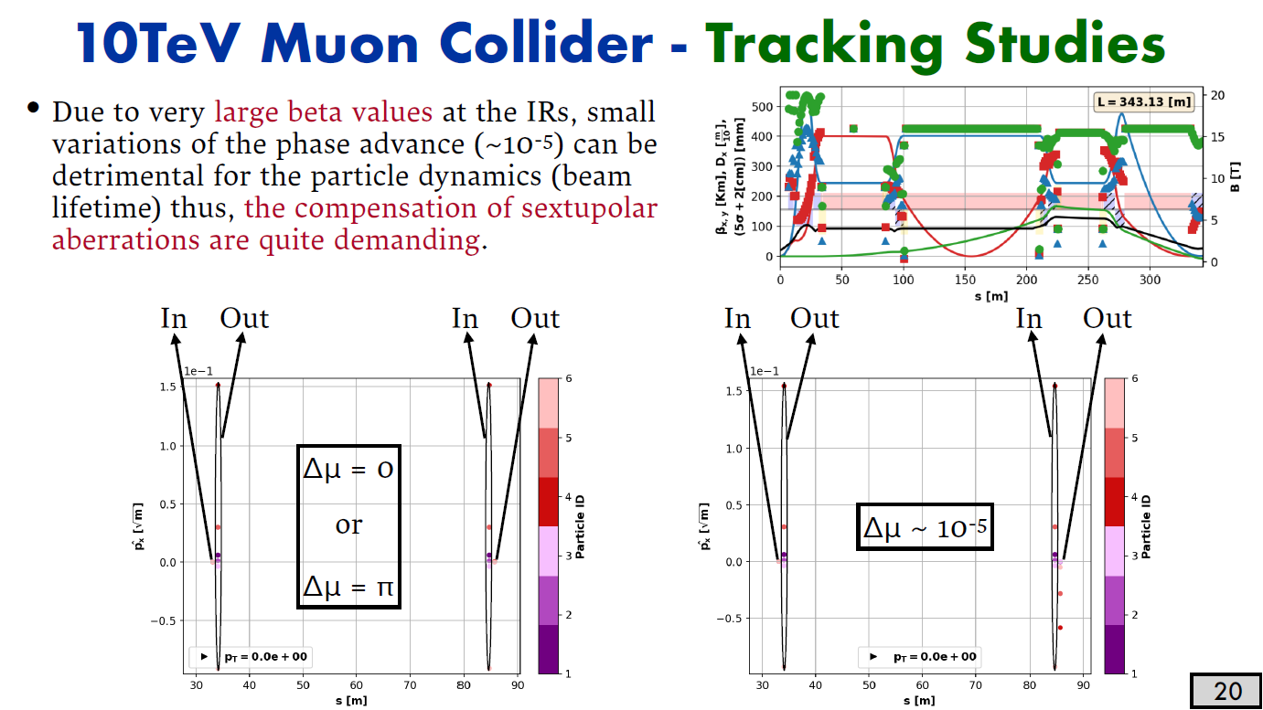
Collider: a tremendous chromatic correction scheme
Courtesy: Kyriacos Skoufaris

Slide 12
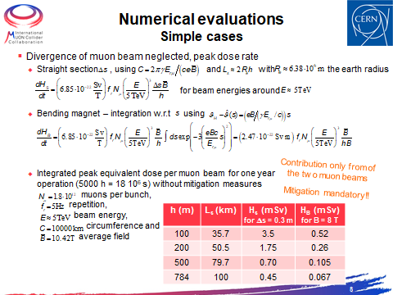
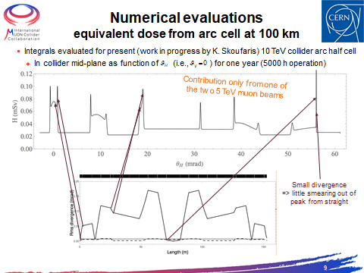
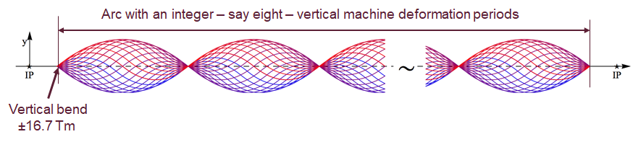
Neutrino Radiation for a realistic Collider
Courtesy: Christian Carli
Wobbling: first proposals to generate some parabola pieces with a cycled vertical dipoles.

Slide 13
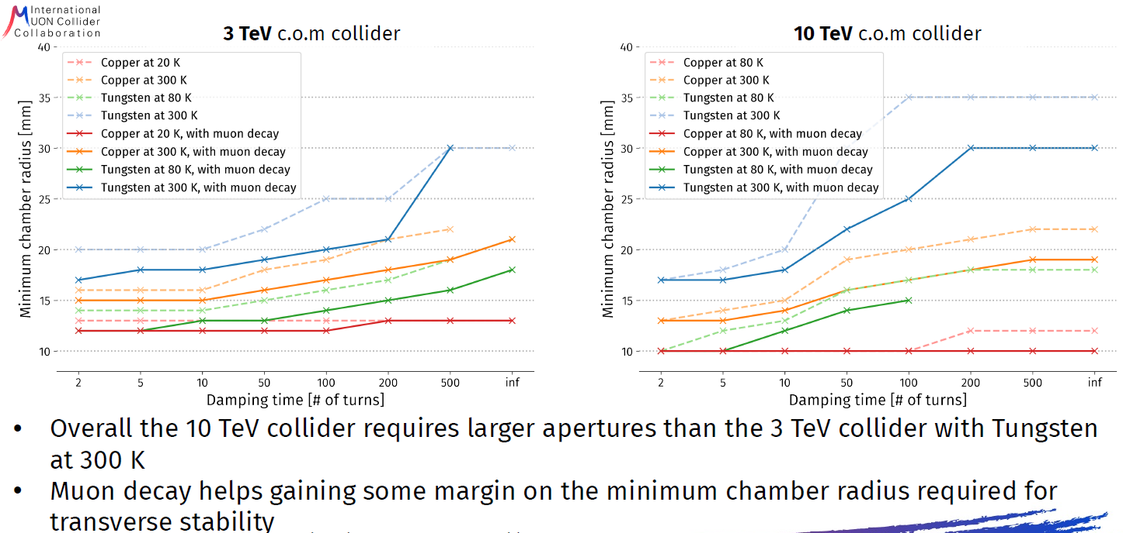
Transverse impedances for & 3 TeV and 10 TeV collider
Courtesy: David Amorim

Slide 14
Conclusion
Pulsed synchrotron and FFA
The design of resistive magnets has begun. Shaping correctly the reference field ramp is essential to optimize the maximum power to be delivered. Optimization with RF has started.
First longitudinal studies show that 1.3 GHz TESLA Cavity is suited for muon acceleration in the RCSs. Short-range wakefields and beam loading are huge but seem manageable. A large number of RF stations is needed to ensure a sufficiently low synchrotron tune between the stations. If done, beam is transported with % level emittance growth in each RCS.
A parametric model is under development to make easier the coupling between magnet, RF, optics, stability constraints.
One Low losses SRF cavity was investigated from transverse stability for RCS1. The most critical HOM remains below the stability threshold with a margin factor ~8 for this single mode.
Analytic vFFA modelling is close to a solution under a set of approximations and to be applied to a muon ring resign.

Slide 15
Conclusion
Collider
Extensive use of combined function magnets with independent control of their multipolar components in order to evenly distribute the muon decay products and to minimize the collider length.
Different designs for the Final Focusing scheme that aim to mitigate the BIB. The BIB reduction due to dipolar components was so far found lower than expected, but the study is still ongoing.
The Chromatic Correction scheme has been designed. Arc design with Flexible Momentum Compaction cells that control the momentum compaction factor, the linear chromaticity and the 2π closing of the trajectory with independent knobs.
Dose generated at earth surface due to showers generated by nu interactions is a serious issue.
Time-dependent vertical deformation of the whole arc proposed as mitigation measure.
With a 100-turn damper transverse beam stability would require at least 25 mm radius with Tungsten at 300 K for the 10 TeV collider.

Slide 16
Next steps
A lot of parameters for the RCS need to be optimized:
  Decay rate: RF voltage and ramp rates better distributed between the different rings
  Synchronous phase ⇔ higher voltage ⇔ emittance budget.
  Beam optics: dedicated arc cells integrating RF cavities.
  Magnet’s ramping functions to reduce power consumption.
  Better Matching between the different rings to reduce emittance growth.
The transverse stability study will continue (more detailed cavity models, same studies for other RCS, adding counter-rotating beam, impact of chromaticity correction and needs for mitigation).
Completion of vFFA analytic tools to go to a design of vFFA ring.
Magnet design for FETS-vFFA ring has been carried out. Prototype magnet due for construction over the next few months.

Slide 17
Next steps
Collider
The next steps for the collider is to refine the location of the straight sections, the Final Focusing design for a better control of the Beam Induced Background and the Chromatic Correction scheme.
Estimation of key parameters as well their tolerances for the: minimum aperture, maximum allowed magnetic fields, maximum beta values out of the IR, chromaticity values, etc…
Feasibility of the Time-dependent vertical deformation to be studied.
Collective effects: Include additional instability mitigation measures to help reach tighter chamber radii (positive chromaticity, Landau damping with octupoles).Simulate a more detailed vacuum chamber when available. Include the second, counter-rotating, beam effects. Investigate other potential shielding materials
Collider and RCS relie on a close interaction between WP2/5/6/7.
A lot of technical issues are addressed but still a lot of work before saying that such a complex is feasible but that is why MuC is motivating ;-).

Slide 18
Thank you
for your attention

Slide 19
Backup

Slide 20
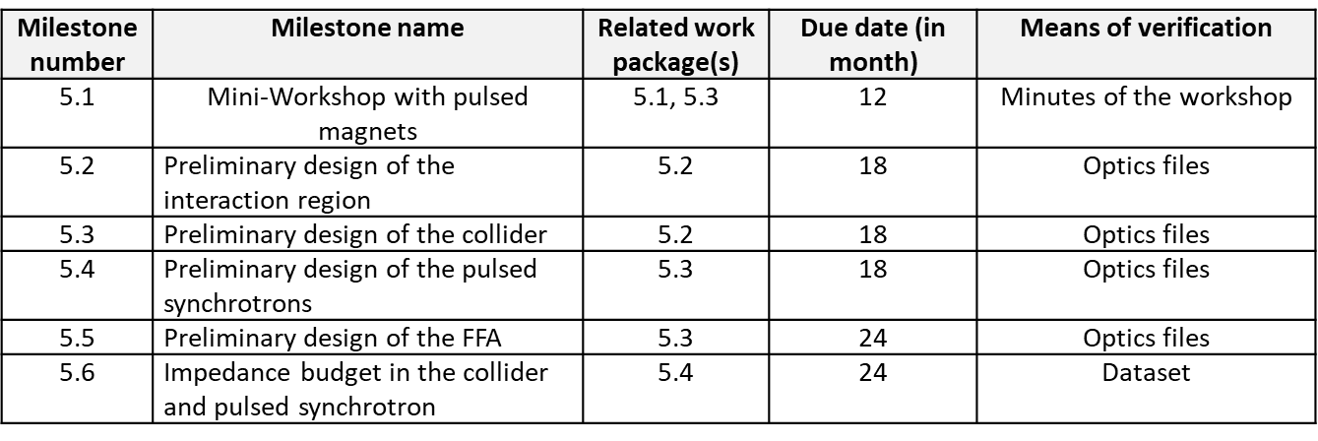
MuCol
Milestones

Slide 21
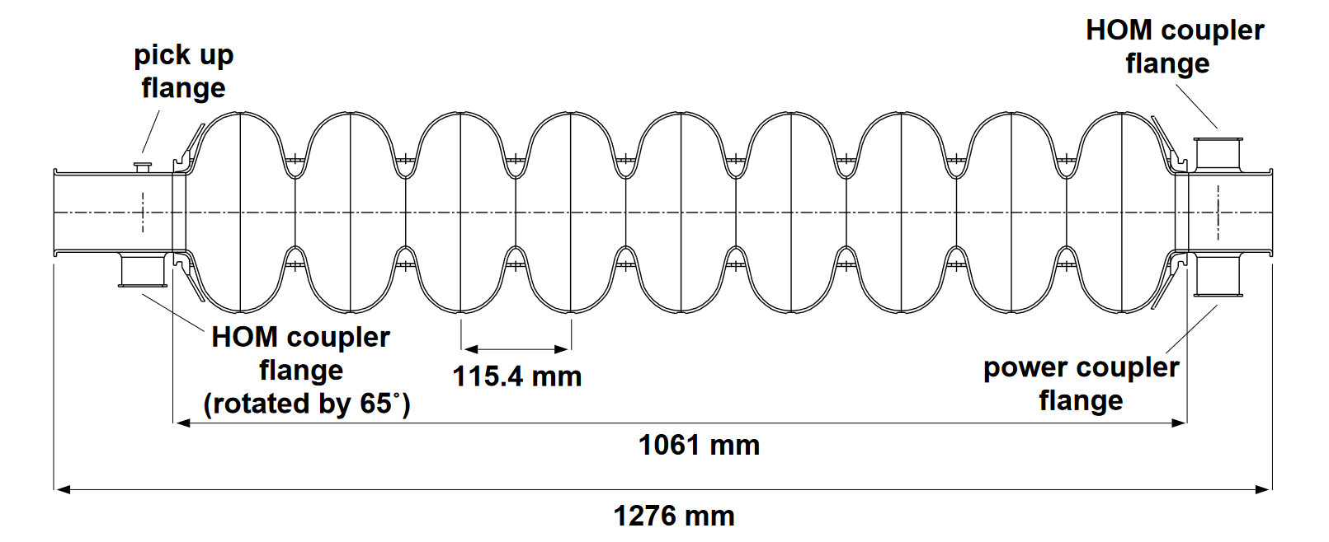
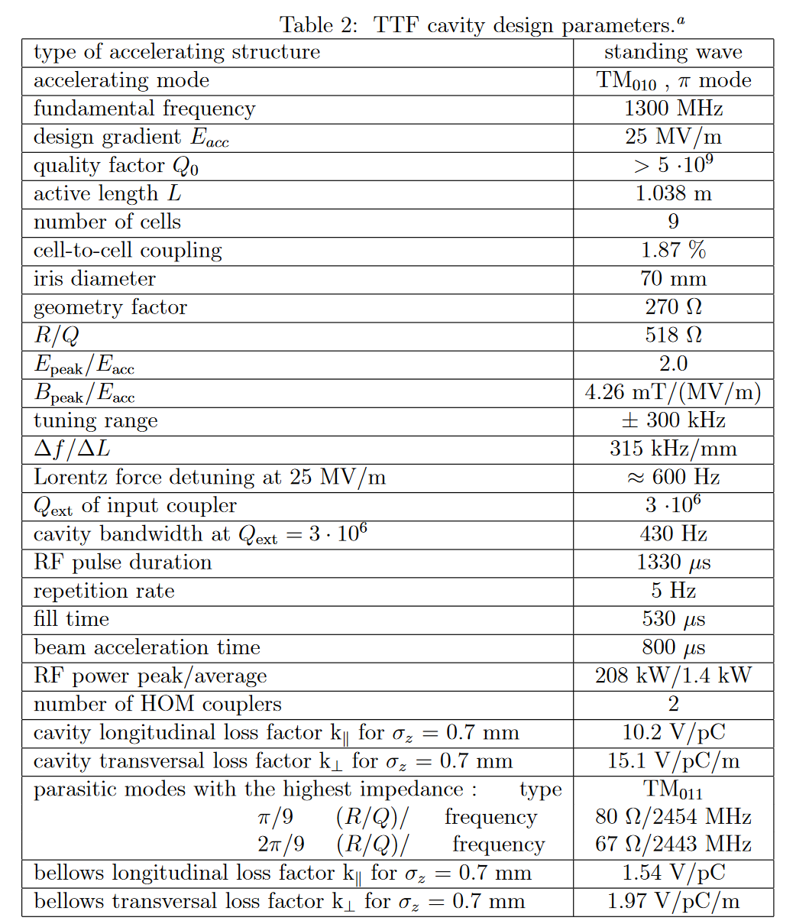

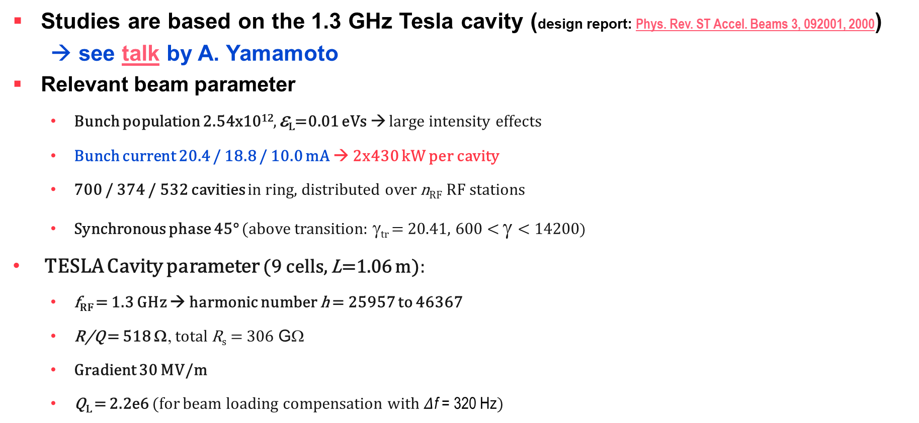
Parameters and tools:
RF – The TESLA cavity
From design report
Studies are based on the 1.3 GHz Tesla cavity (design report: Phys. Rev. ST Accel. Beams 3, 092001, 2000)
→ see talk by A. Yamamoto
Relevant beam parameter
  Bunch population 2.54x10¹², ε_{L}=0.01 eVs → large intensity effects
  Bunch current 20.4 / 18.8 / 10.0 mA → 2x430 kW per cavity
  700 / 374 / 532 cavities in ring, distributed over n_{RF} RF stations
  Synchronous phase 45° (above transition: γ_{tr} = 20.41, 600 < γ < 14200)
TESLA Cavity parameter (9 cells, L=1.06 m):
  f_{RF} = 1.3 GHz → harmonic number h = 25957 to 46367
  R/Q = 518 Ω, total R_{s} = 306 GΩ
  Gradient 30 MV/m
  Q_{L} = 2.2e6 (for beam loading compensation with $Δ$f = 320 Hz)
(with 30 MV/m accelerating gradient)
Courtesy: Fabian Batsch
From design report

Slide 22
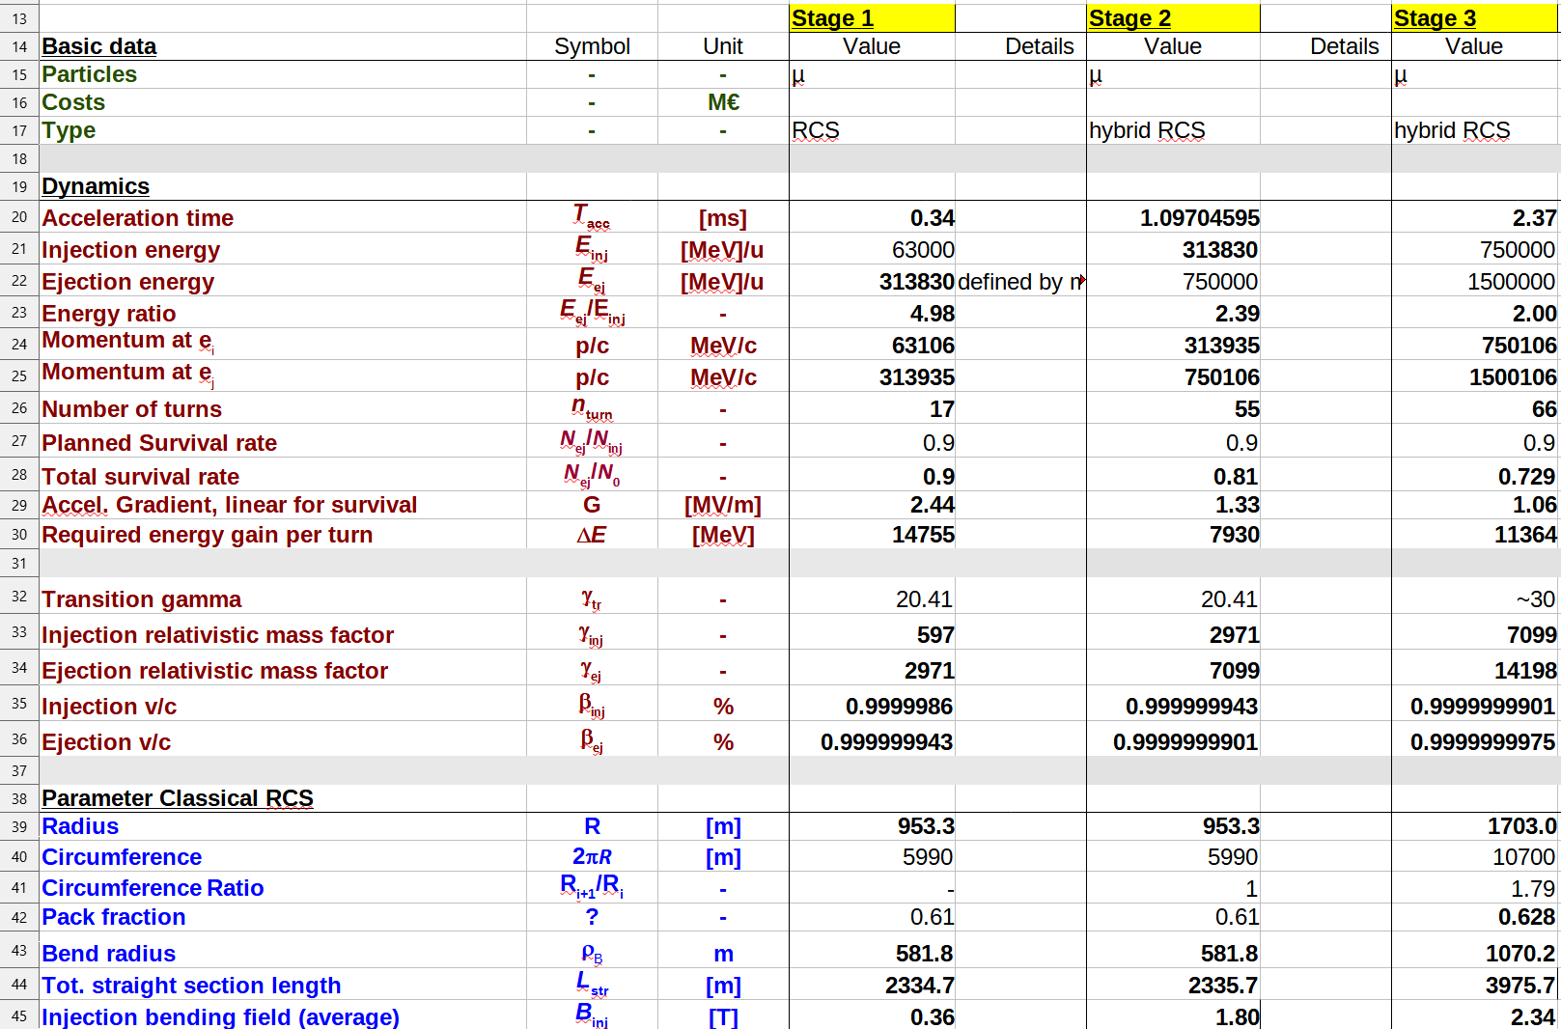
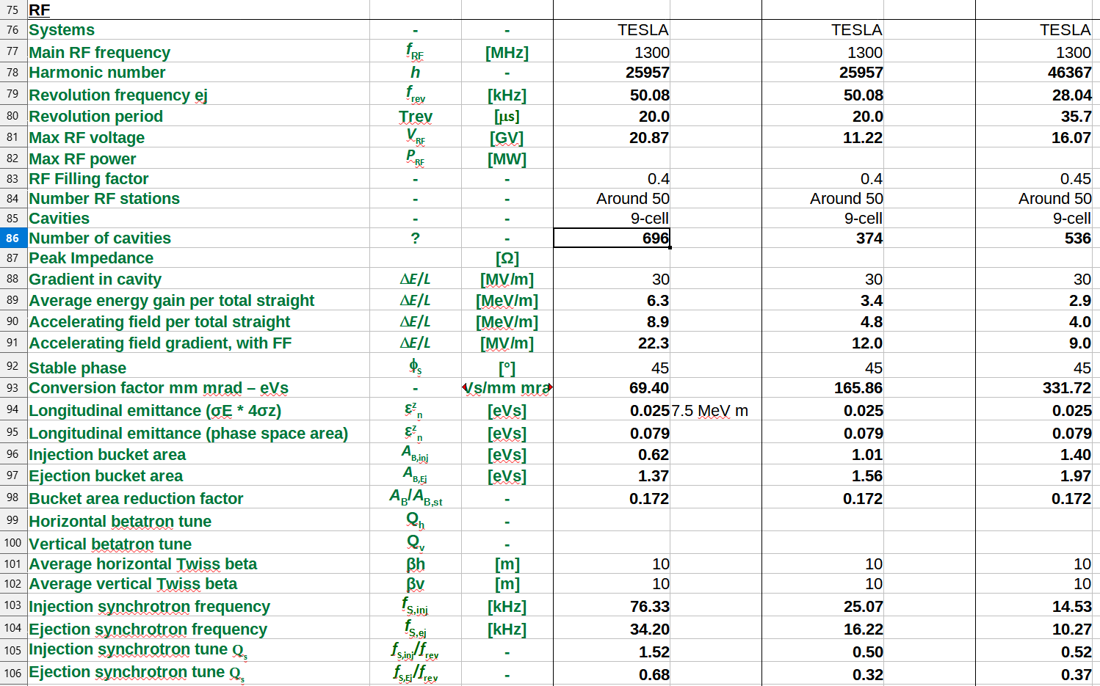
Parameters and tools:
General parameter
Courtesy: Fabian Batsch
Detailed parameter table: https://cernbox.cern.ch/index.php/s/I9VpITncUeCBtiz
 | RCS1→314 GeV | RCS2→750 GeV | RCS3→1.5 TeV
Circumference, 2πR [m] | 5990 | 5590 | 10700
Energy factor, E_{ej}/E_{inj} | 5.0 | 2.4 | 2.0
Repetition rate, f_{rep} [Hz] | 5 (asym.) | 5 (asym.) | 5 (asym.)
Number of bunches | 1μ⁺, 1μ⁻ | 1μ⁺, 1μ⁻ | 1μ⁺, 1μ⁻
Bunch population | 2.5x10¹² | 2.3x10¹² | 2.2x10¹²
Survival rate per ring | 90% | 90% | 90%
Acceleration time [ms] | 0.34 | 1.04 | 2.37
Number of turns | 17 | 55 | 66
Energy gain per turn, ΔE [GeV] | 14.8 | 7.9 | 11.4
Acc. gradient for survival [MV/m] | 2.4 | 1.3 | 1.1
Acc. field in RF cavity [MV/m] | 30 | 30 | 30
Max. RF voltage for φ_{s}=45° [GV] | 20.9 | 11.2 | 16.1

