Slide 1




The Muon Collider Collaboration

Slide 2
Ingredients of the Collaboration Governance
Memorandum of Collaboration(MoC): Being signed by collaboration members: LINK
Governance document: “Collaboration own” document, with updated description of the organisation, also taking into account being part of the European Accelerator R&D roadmap:
LINK
Today the first International Collaboration Board meeting (more later)
Recently, a successful EU design study project application, to be started in 2023 (MuCol) – requires its own governance, but we should aim to minimize potential conflicts and overlapping responsibilities

Slide 3
Governance Documents
The original document
A proposal giving some more implementation detail and including LDG/Council requests

Slide 4
Main elements of the governance structure
Formal organization
International Collaboration Board (ICB)
  First meeting today
Steering Board (SB) (links to LDG, CERN Council, major FA, strategy … )
  Chair Steinar Stapnes
Coordination committee
  Study Leader Daniel Schulte, deputies: Andrea Wulzer, Donatella Lucchesi, Chris Rogers, to be endorsed by the ICB
  The members are already working

Slide 5
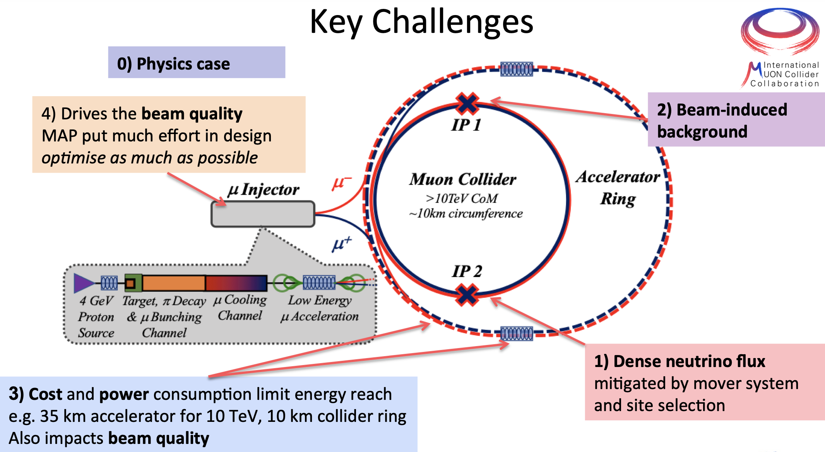
CC Members
US (detector) | Sergo Jindariani
US (accelerator) | Mark Palmer
Asia (China) | Jingyu Tang
Asia (Japan) | tbd
Physics | Andrea Wulzer
Detector and MDI | Donatella Lucchesi
Protons | Natalia Milas
Muon production and cooling | Chris Rogers
Muon acceleration | Antoine Chance
Collider | Christian Carli
EU Design Study WP leaders:
EU RF WP | Claude Marchand
Cooling cell | Lucio Rossi
Magnets | Luca Bottura
RF | Alexej Grudiev
Beam-matter int. target systems | Anton Lechner
Collective effects | Elias Metral
Proposal for deputies (to be endorsed by ICB):
Andrea Wulzer, Donatella Lucchesi, Chris Rogers
Cooling cell design | to be filled after EU decision
Demonstrator | Roberto Losito
Notes:
Add

Slide 6
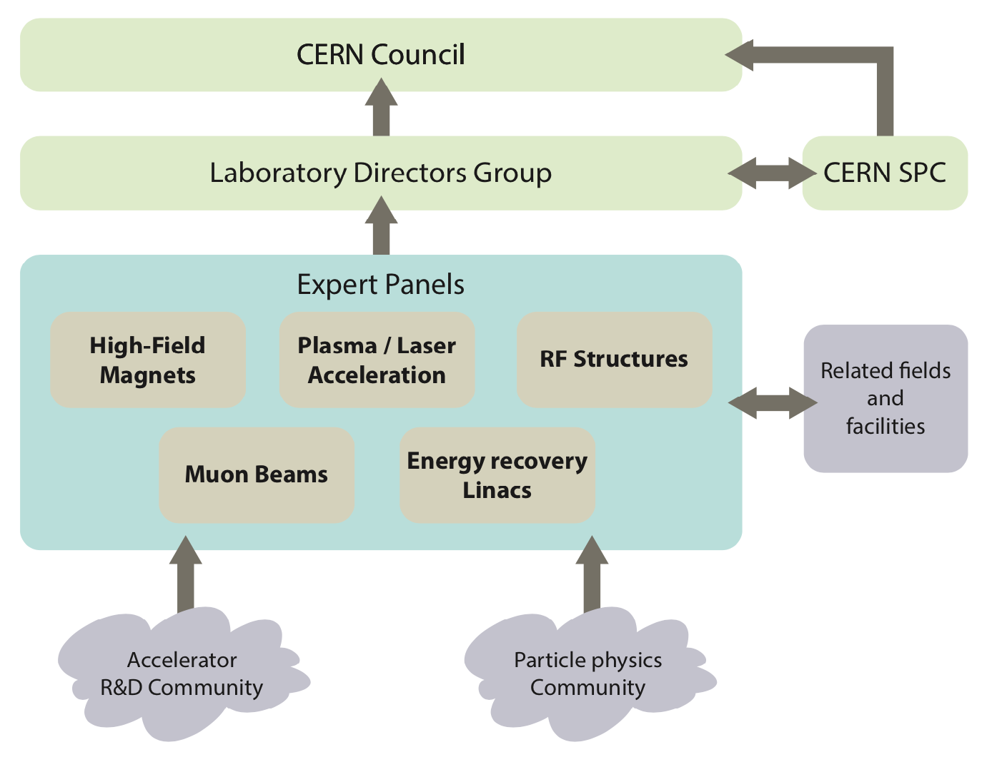
European Accelerator R&D roadmap –> muon SB
https://cds.cern.ch/record/2800190/files/146-138-PB.pdf
Note: For the muon collaboration this is addressed with a Steering Board (next slide)

Slide 7
Steering Board
LDG / Council want committee(s) to oversee Roadmap, chair selected by LDG, similar for magnets, RF etc.
Proposed solution: Steering Board
host organisation (CERN) proposes chair (Steinar Stapnes)
The SB oversees the execution of the Muon Collider Study by assessing the progress, resource usage and providing guidance. The SB will report to the Laboratory Directors Group (LDG) in Europe and to similar regional supervising organisations in other regions as required.
The SB is proposed to be composed of:
the lead representative of the Host Organisation (for CERN the ATS director)
up to two additional members appointed by the Host Organisation
up to three members appointed by the ICB
the Study Leader and Deputies
The Host Organisation appoints one of the members to act as the chair.

Slide 8
International Collaboration Board
The ICBs role is to provide a forum for participants to examine ongoing activities, assure appropriate, well directed use of contributions and ensure a balanced portfolio of engagements. See draft mandate next page.
The chair of the ICB is elected by its members.
The ICB consists of one representative of each participating institute that has signed the MoC. The ICB invites the following representatives as members with no voting rights:
the Steering Board representatives of the host organisation,
representatives of institutes that signed a letter of interest,
the Study Leader and Deputies.
In addition, the ICB chair can invite other participants if deemed useful.
For example, in the meeting this week we have invited many institutes and observers that are in the process of joining the collaboration.

Slide 9
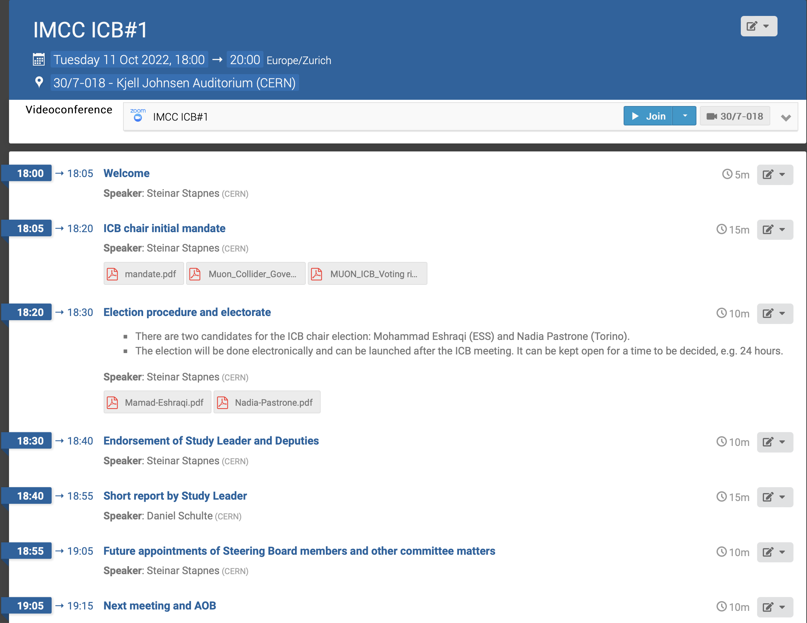
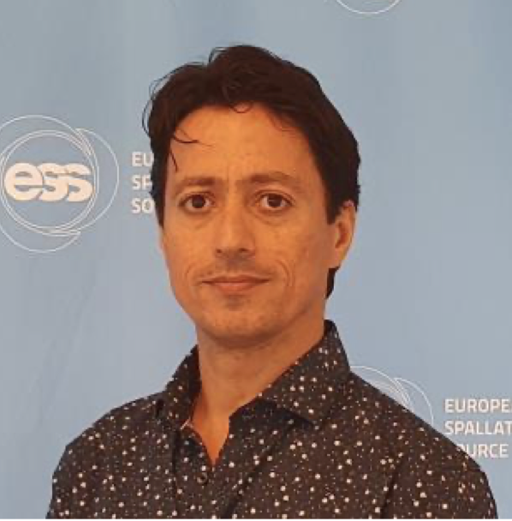
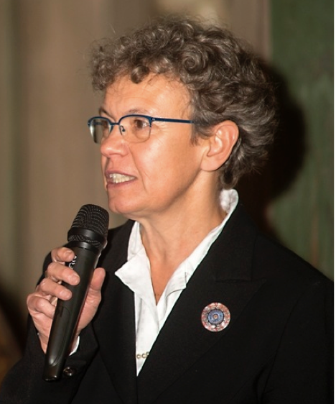
Search committee:
Ken Long, Alan Bross, Mats Lindroos, Philippe
Schune, Steinar Stapnes
Agenda:
https://indico.cern.ch/event/1209681/

Slide 10
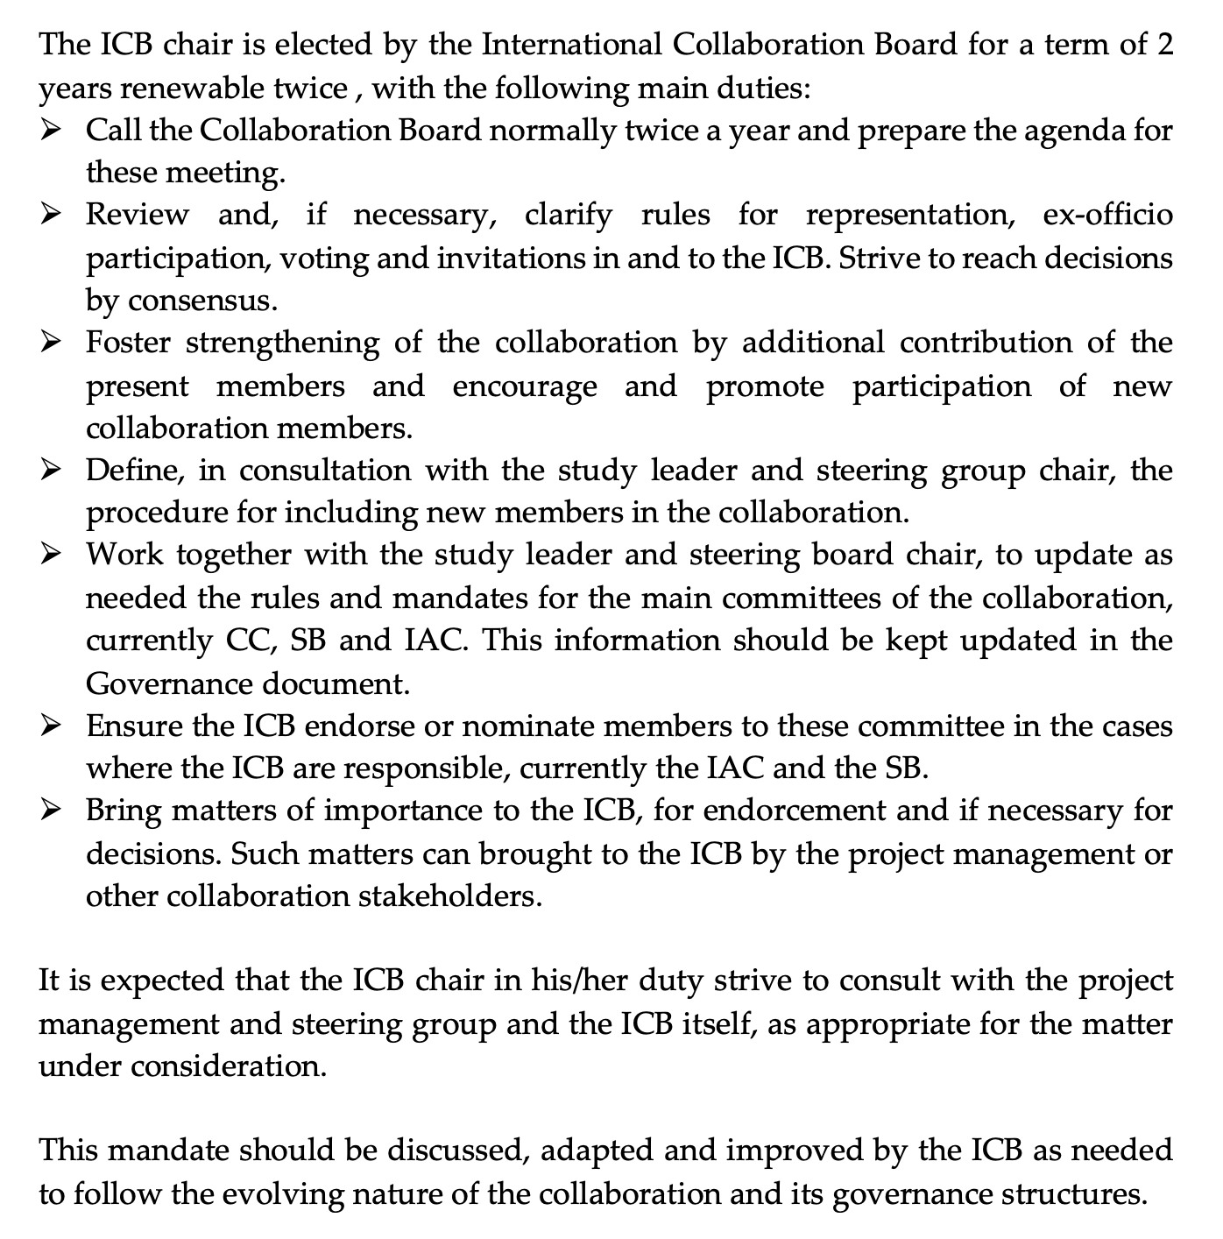
Draft ICB chair mandate

Slide 11
The three main wheels
SB – interface to LDG//Council, other main FAs, strategies towards next phase
CC – organization ad coordination of the technical studies within the collaboration
ICB – collaboration members and meetings
Some tuning of roles and interfaces will be needed as the work moves ahead and the collaboration size increases

Slide 12
International Advisory Committee
The mandate of the International Advisory Committee is to review the scientific and technical progress of the Study, typically on an annual basis and to submit recommendations to the ICB and SB.
The IAC consists of external experts, not actively participating in the Muon Collider Study, with expertise covering the key technological and scientific domains relevant to the Study.

Slide 13
Main points
The collaboration is very active – technical work moving ahead (CC)
The collaboration has a solid basis of important institutes but is also (expected to) grow further rather quickly (MoC signature process, EU study and hopefully P5 providing key incentives)
The EU study is an important achievement, and we need to deal with in the Collaboration Structure
Further work on securing resources will be a priority (but not discussed in this talk)
To establish a functional ICB with its Chair is important for next steps, goal this week
Will also allow to complete the SB and later the IAC as foreseen
The main Governance Structures with ICB, Project management with study leader, deputies and CC, SB and IAC seems good and workable, but we should allow flexibility and adjustment of compositions and appointment procedures as we gain “operational” experience

