Slide 1

AD Stochastic PU
Summary
First analysis
Drawing details
Localization of thermocouples
Future action

Slide 2
Summary
During 2021 operation, a number of pressure spikes have been observed on the pressure monitoring
We contacted our contractor Leybold for a Service of 12 cryo pumps for YETS 21-22 (4 in C10 & 8 in PU)
This year ,we observed also some spikes with a smaller range on PU
Taking the information available, we try the identification of the origin of the spikes

Slide 3
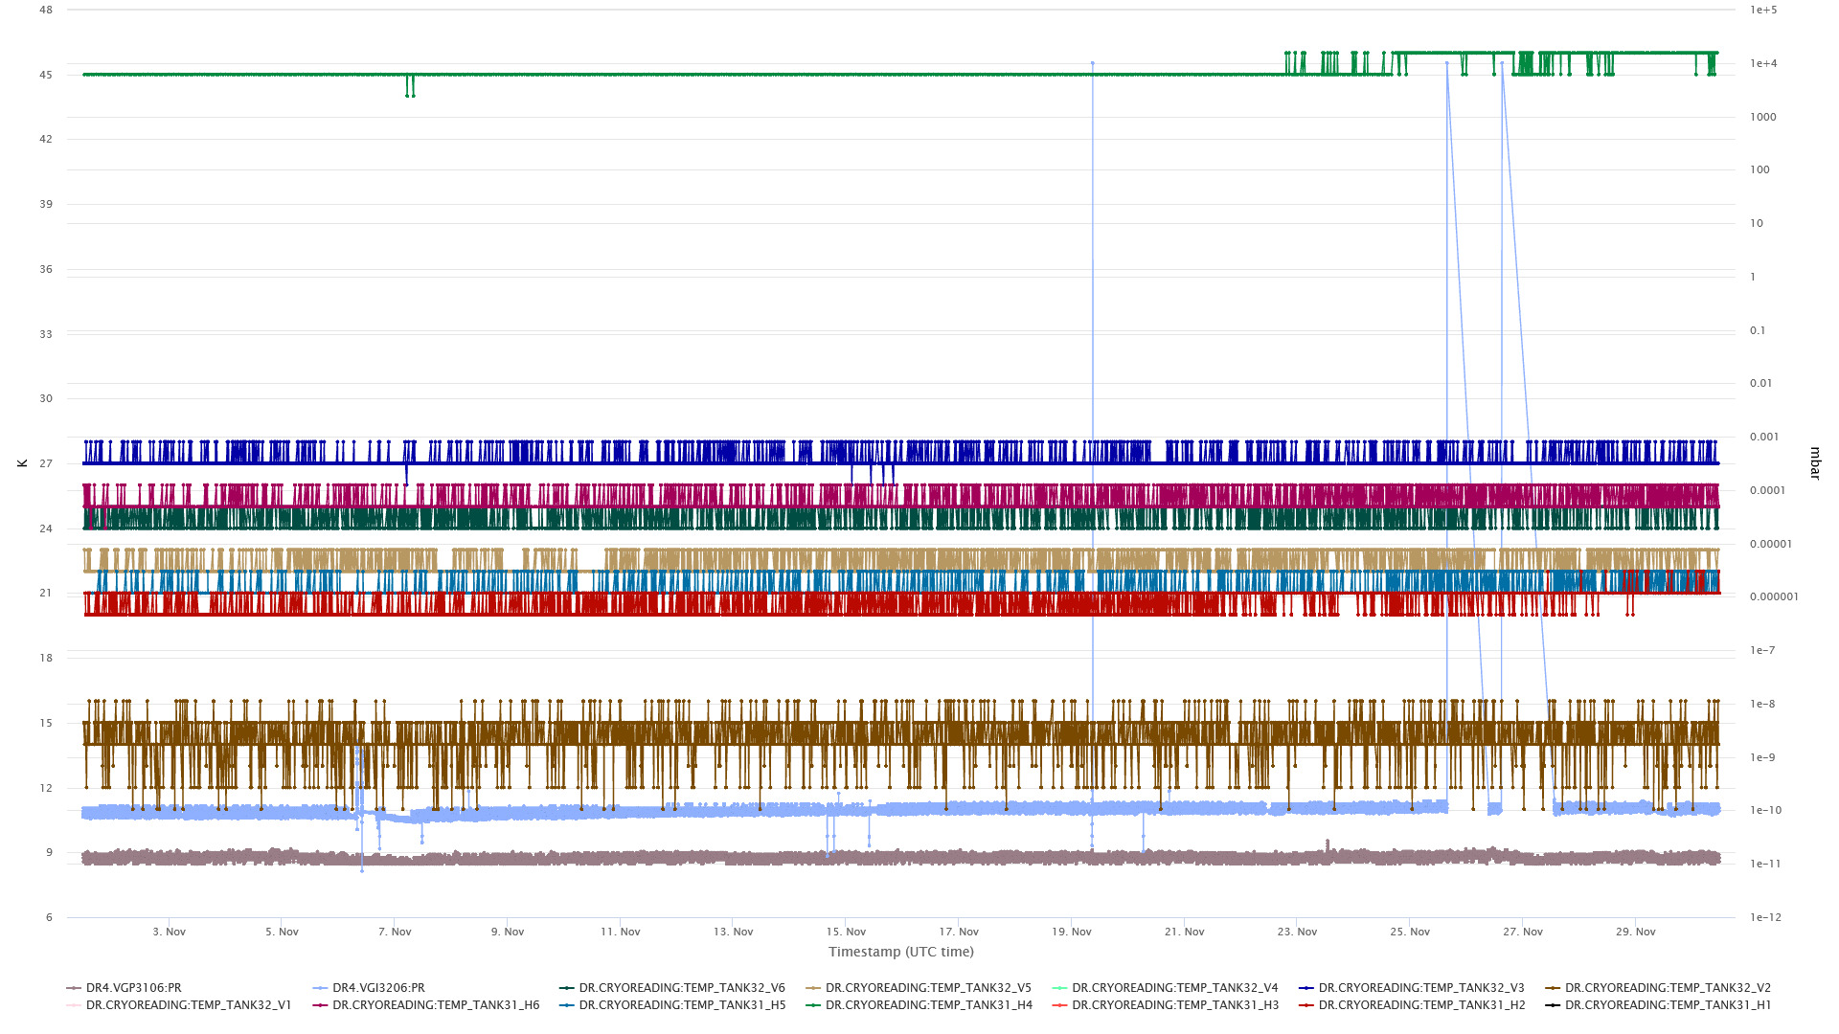
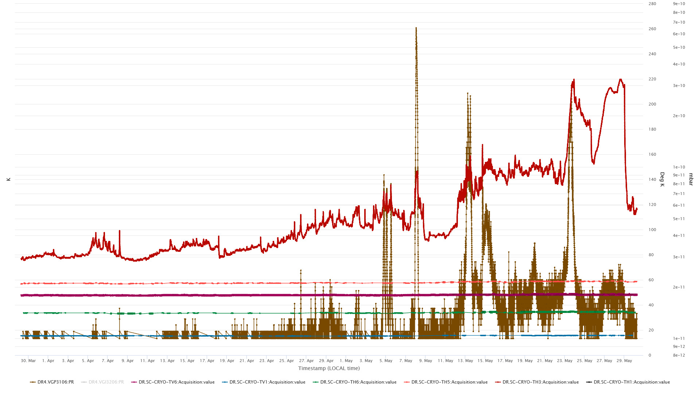
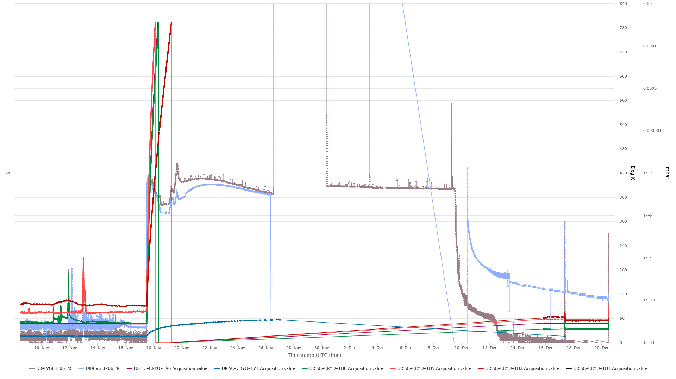
First analysis
NOVEMBER– DECEMBER 2021
APRIL – MAY 2022
Before LS1

Slide 4
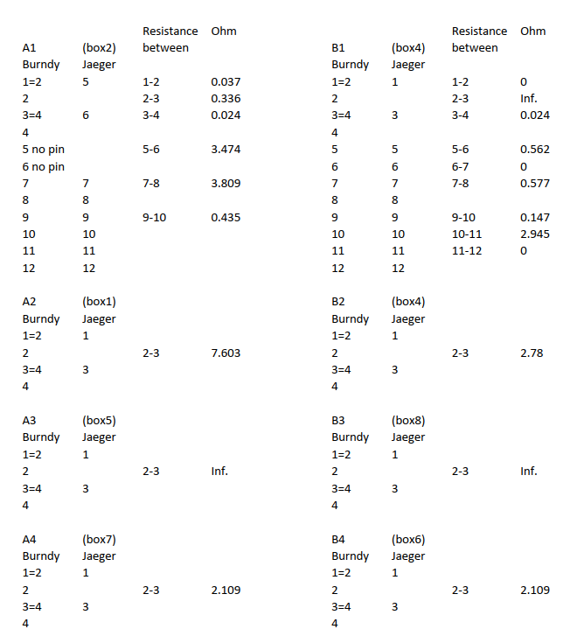
First analysis
Pressure rise looks located on the PU 31
Thermocouples measurements are available on TIMBER but :
  What is the correspondence between Timber signals and PT100 in the Tunnel?
  Can we get all signal available?
  Is there any calibration factor to apply?
Reinier gave information about PT100 signal

Slide 5
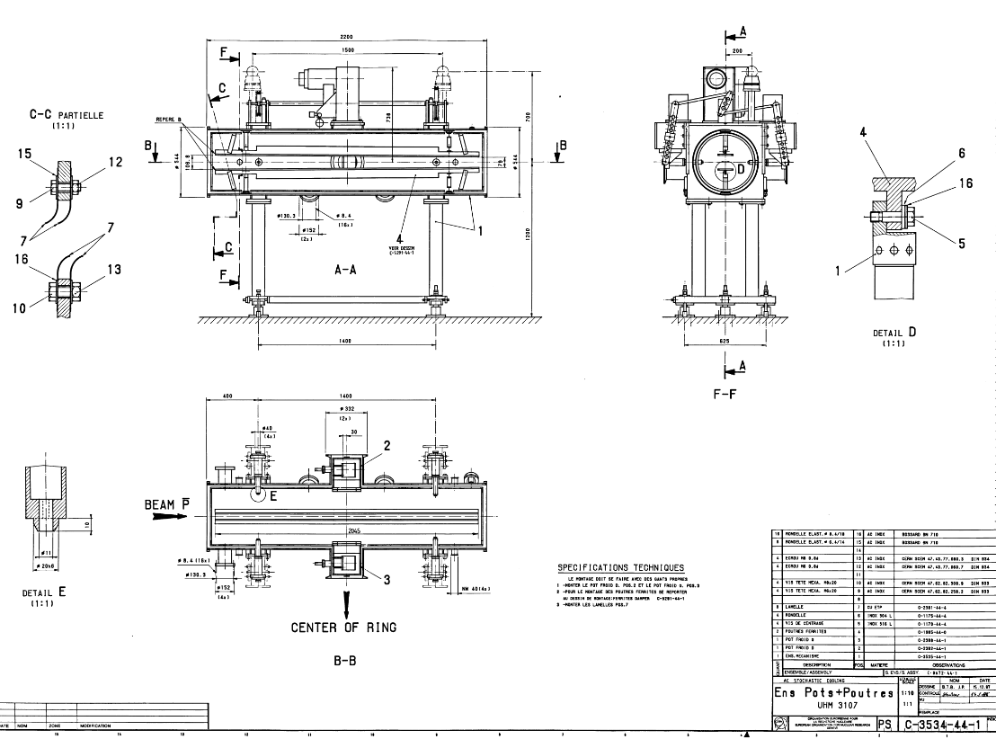
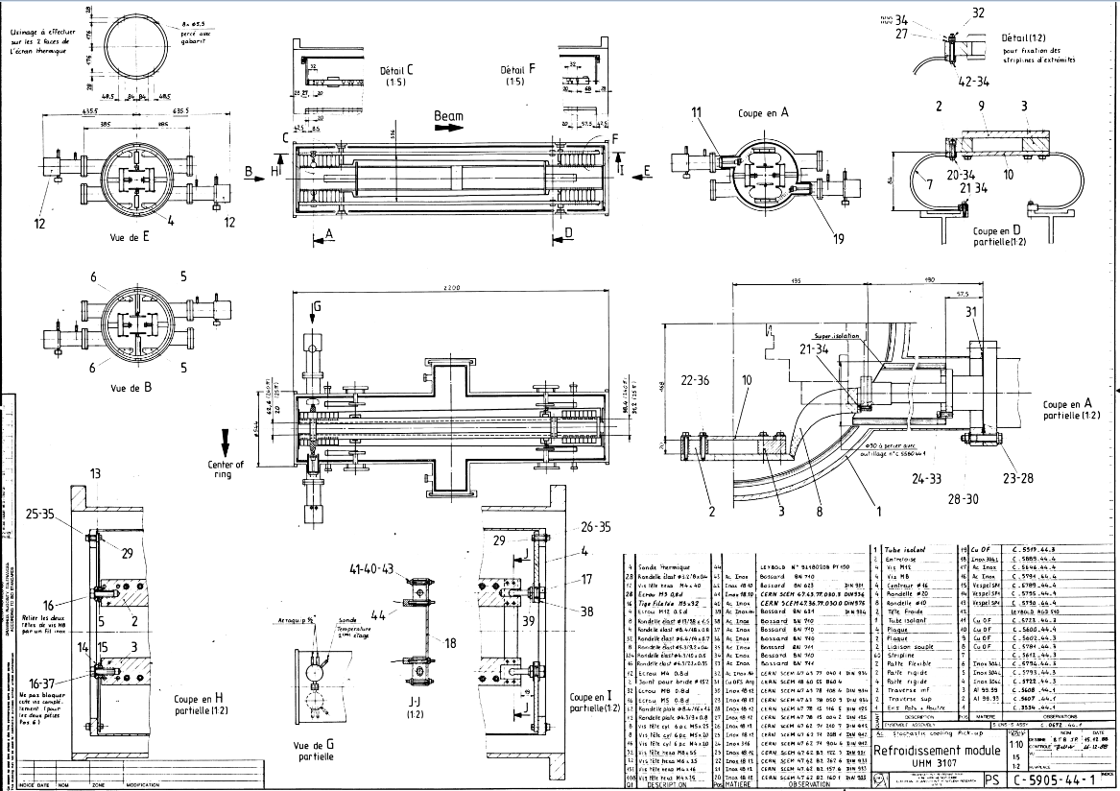
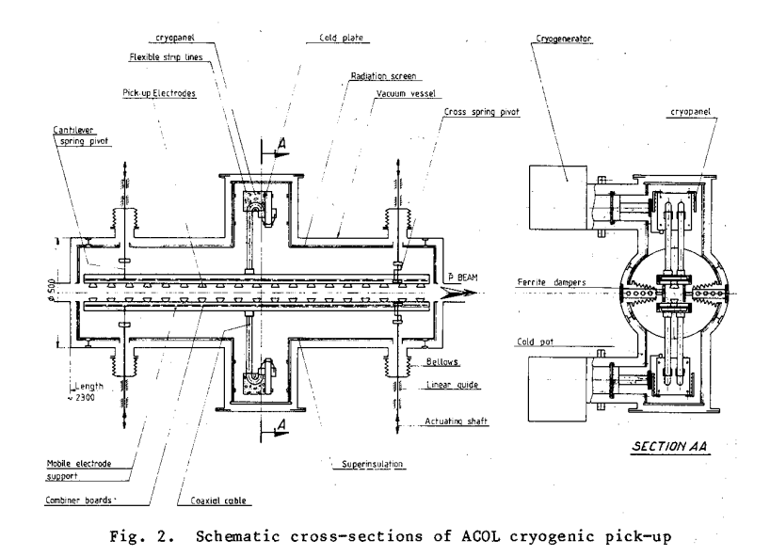
Drawing details

Slide 6
Localization of thermocouples
Could we identify the thermocouple precisely?

Slide 7
Future action
Keep a track of the pressure rise during operation
Prepare a plan for identification of the cryo pumps with limited performance
Submit to machine coordinator a planning for next YETS intervention

