Slide 1
Welcome to UCSC and the Rare Pion Decay Workshop
Rare Pion Decay Workshop
October 6-8, 2022
Under the gracious auspice of the Gordon and Betty Moore Foundation

Slide 2
Land Use Acknowledgment
“The land on which we gather is the unceded territory of the Awaswas-speaking Uypi Tribe. The Amah Mutsun Tribal Band, comprised of the descendants of indigenous people taken to missions Santa Cruz and San Juan Bautista during Spanish colonization of the Central Coast, is today working hard to restore traditional stewardship practices on these lands and heal from historical trauma.”

Slide 3
Welcome!
It’s a pleasure and a privilege to host everyone, remote and in person, for this unique workshop
We hope this leads to new connections and collaborations, and the sharpening of ideas about how phenomenological and experimental effort can advance our fundamental theories of causation
We also hope everyone enjoys the welcoming environment of UCSC and the Santa Cruz community

Slide 4
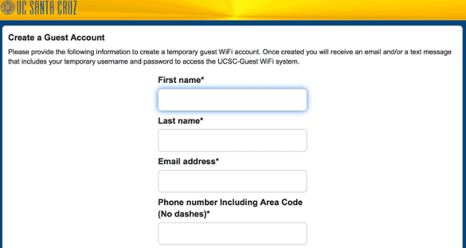
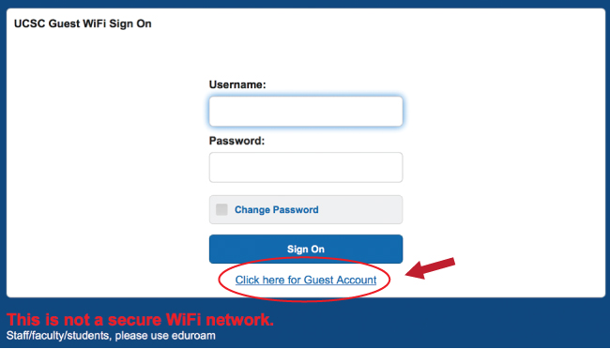
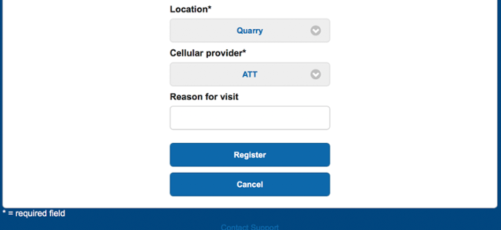
UCSC Guest Wifi
Register with the required details, then sign in with the username/pwd received by email or text message
Account valid for 7 days

Slide 5
Dinner: Cowell Courtyard (2 minute walk)
Meeting Room
Core West Parking
BAY
Dinner

Slide 6
Other Relevant Information
Coffee breaks / lunch to be served just outside
We may put together informal gatherings in town for Friday and Saturday evenings (just show up if you like)
If instead you wish to go off on your own and explore the region’s delights, feel free to do so (see conference website for some suggestions!)

Slide 7
Travel reimbursement
Reimbursement form sent to all participants in info email
Read the instructions and submit all required documents
Foreign nationals:
Copy of passport bio page
Electronic form I-94 (most recent US entry)

Slide 8
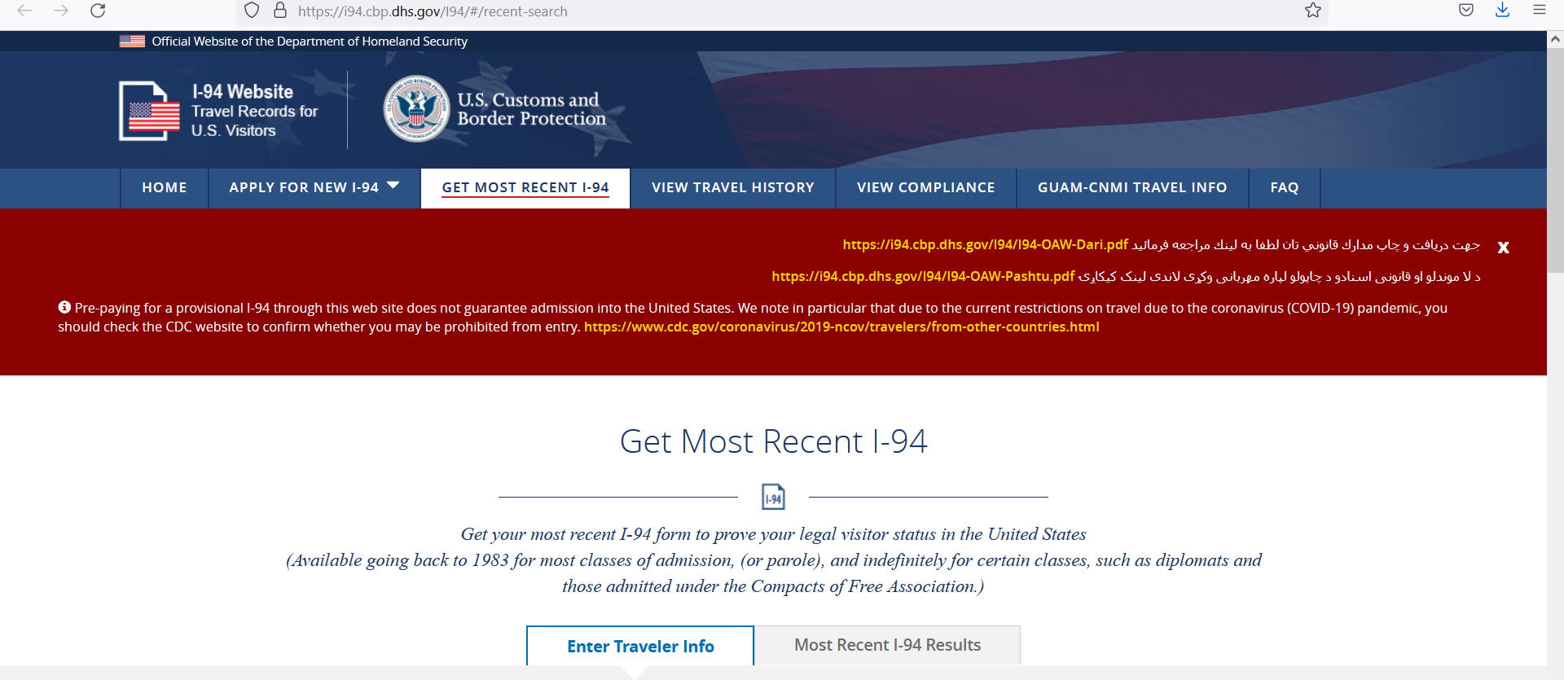
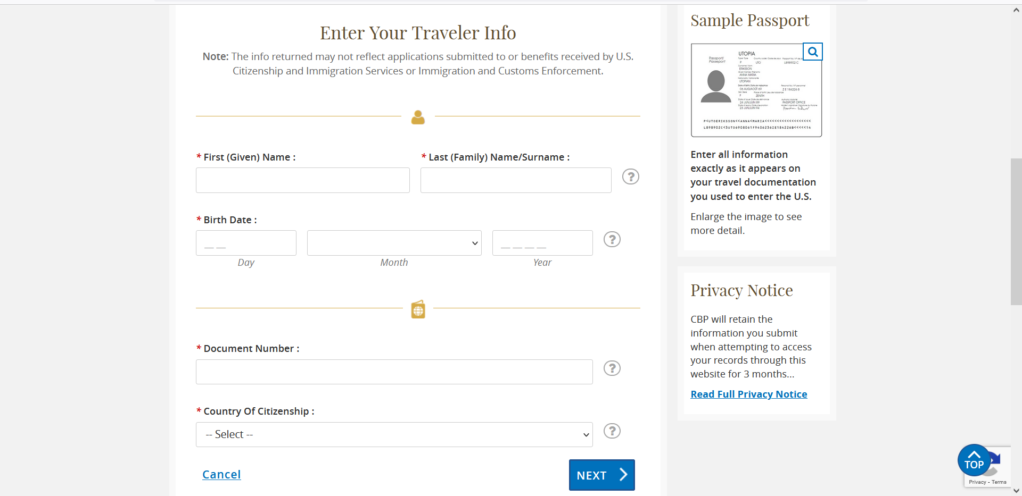
I-94 form
https://i94.cbp.dhs.gov/I94/#/recent-search

Slide 9
Enjoy the workshop!

