Slide 1
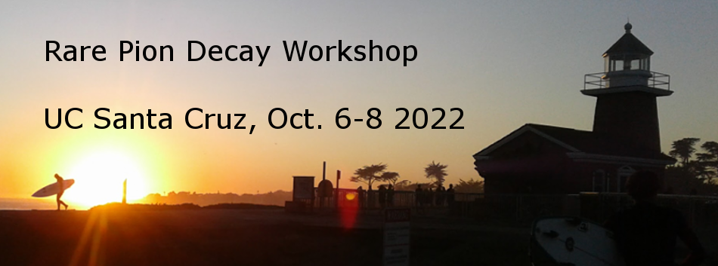

Workshop Introduction and Meeting Goals
David Hertzog
University of Washington

Slide 2
Purpose of this meeting: a mostly “in person” event!
Articulate the Science cases for a RPD measurement program
  LFUV, π−beta and V_{ud}, exotic searches, … BSM motivations …
  THANK YOU to our many theory friends who will present and who have helped launch this program!
Review experiences from experts on recent RPD experiments
  Lessons learned and how to overcome pitfalls.
  PIENU and PEN have an enormous vault of experiences. We must first LEARN
Launching PIONEER to the next level with 1st in-person meeting of most of the participants
  A lot has been done remotely, virtually, and so on
  It’s time to interact and discuss as a real collaboration does – in person as much as possible (we know, it’s not totally possible)

Slide 3
Beyond these more obvious comments, what would we really like to accomplish or get out of this Workshop?
On the experimental physics side:
  Identify Key Performance Parameters (KPPs)* and begin to assign values
    Beam: dP/P; pi purity; intensity; spot size
    Stopping target: (x,y,z) “resolution”; Energy dynamic range; Timing response;
      Practical stuff: allowed cabling thicknesses for various phases; cross talk acceptance;
    Calorimeter options: resolution needed; pileup / rate capability; triggering options
      Practical stuff: supports, thicknesses of wrappings; #channels; calibration method
    Triggering, Digitization; DAQ:
      digitization speed and depth for Calo and ATAR; triggering options for tail triggers and others
      Practical stuff: #channels; platform choices (too soon?); building up test stands for groups to use
    Cylindrical Tracker: (z,phi) resolution; speed of response; thickness maximum;
      Practical stuff: footprint to surround ATAR but avoid Calo
* This language is not accidental. We will have to use it in funding proposals and in general reports on progress

Slide 4
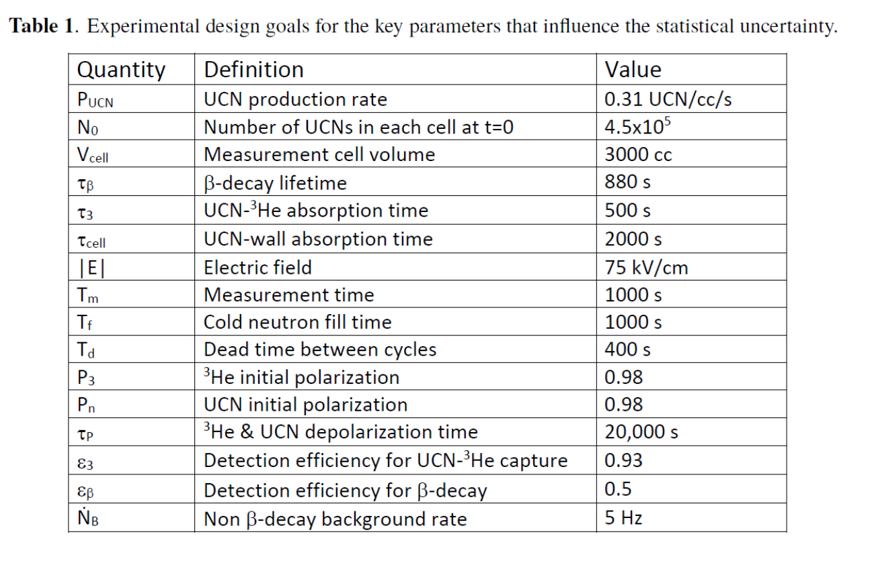
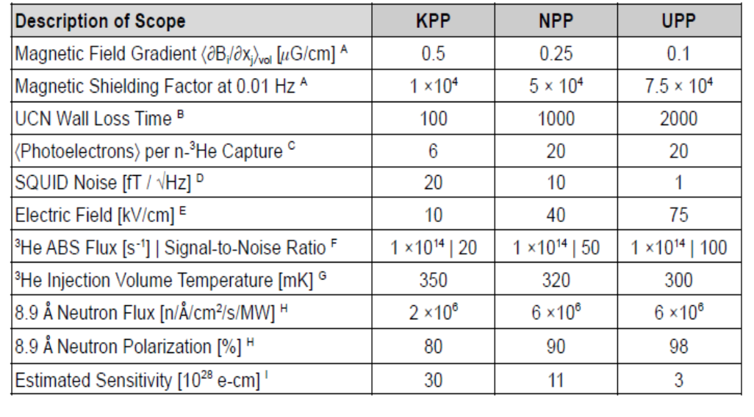
KPPs … example expanded (from nEDM collaboration)
Performance Parameters:
  KPP (Key) = Threshold KPP
  NPP (Nominal) = Objective KPP
  UPP (Ultimate) = Ultimate KPP
DO NOT WORRY ABOUT THESE ENTRY NAMES OR VALUES; IT IS ONLY THE SPIRIT OF THIS EXERCISE THAT WE SHOULD EXAMINE
Their “design goals” … much like our Proposal goals
Now, map to RANGEs of achievable values
This last line that I am hiding is experimental sensitivity given achieving all the values above in each column
The nEDM folks then did a fantastic exercise of developing analytical expressions for how the final sensitivity would depend on any combination of achieved KPP values. What matters most

Slide 5
PIONEER examples (Phase 1) … let’s just have 2 steps
 | KPP (lowest) | UPP (Ultimate)
Beam flux @ 65 MeV/c | 200 k/s | 300 k/s
dP/P (%) | 2.5 | <2
ΔX x ΔY (FHWM, mm²) |  | 10 x 10
ΔX’ x ΔY’ |  | ±10°
Muon contamination
Electron contamination
ATAR parameters
X,Y pitch
Z thickness
Timing resolution (ns)
Energy dynamic range
CALO parameters
Resolution at 69 MeV
AND SO ON … TO BE FILLED IN

Slide 6
This week, we will hear reports on individual system progress… no coupling yet, nor implications on the final result sensitivity
1st beam tests at PSI
Many ATAR development efforts and measurements
How to go from MEG II LXe experience to a PIONEER-ready design and needed R&D
Crystal calorimeter options, using PEN CsI in a hybrid configuration
Next-gen electronics platform ideas for digitization, triggering, and DAQ
Simulation platforms to guide designs

Slide 7
How do we assess these given the interplay between all parameters?
We need to do a pseudo analysis, following PIENU and PEN efforts
Sim group will discuss plans, run a simulation Bootcamp and establish target dates for realistic productions

Slide 8
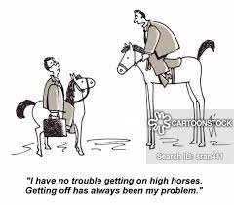
Back to practical
Let’s learn
Let’s encourage discussion
Let’s use the breaks to brainstorm
Let’s formalize our Collaboration

Slide 9
Key dates coming …
December: -- Sim team will talk about external input “due”
January:
  Report to PSI
  Beam time 2023 request (if we want it; discuss after talks)
  Possible pre-proposal for R&D to NSF (discuss Saturday)
  Launch major Simulation of events (discuss later)
Feb – April
  Submission of …

