Slide 1
PIONEER Simulation General Results and Paths Forward
Josh LaBounty
Rare Pion Decay Workshop
10/6/2022

Slide 2
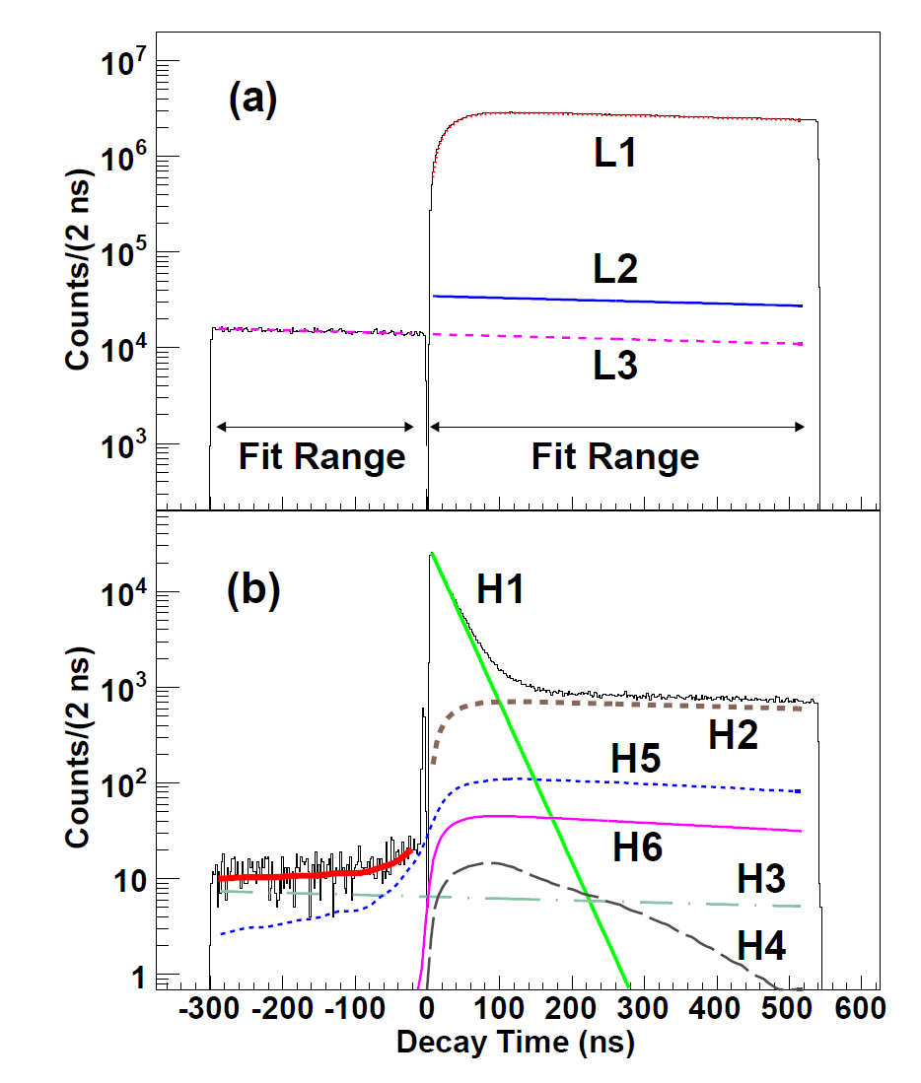
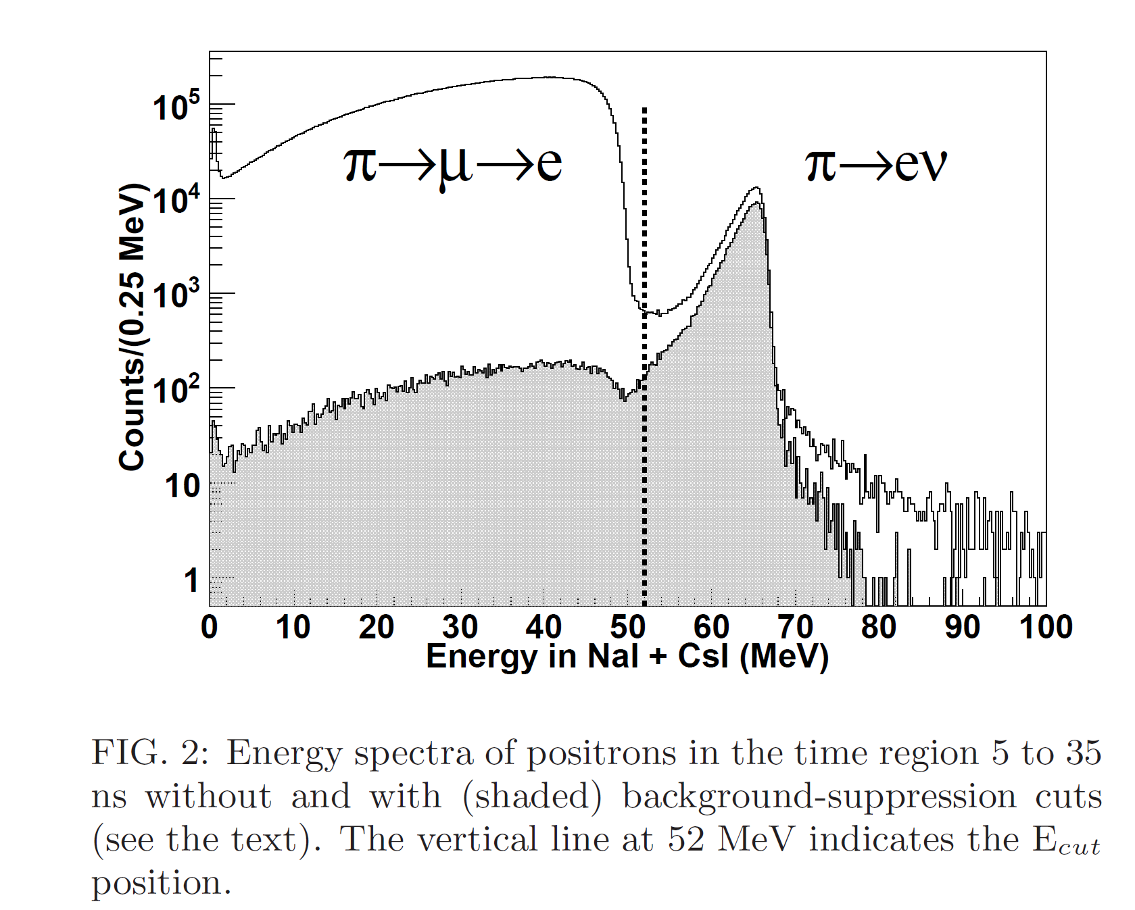
Analysis Technique Reminder
Requires:
  Energy Resolution
  Timing Resolution
  Fast Triggering
Phys. Rev. Lett. 115, 071601 (2015)

Slide 3
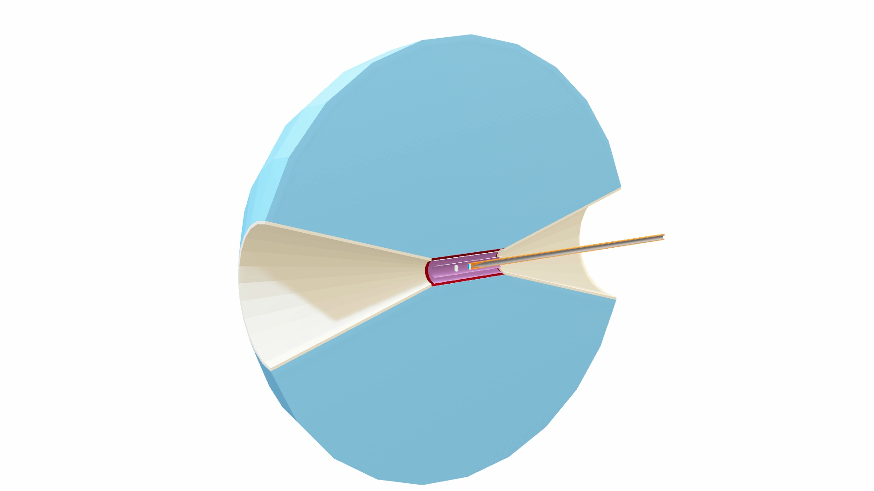
What’s in the Simulation?
+ Optical Models for all materials (LXe, LYSO, Al, Si…)
+ Calorimeter Outer shell/readouts (not shown here)
+ reconstruction
+ …

Slide 4
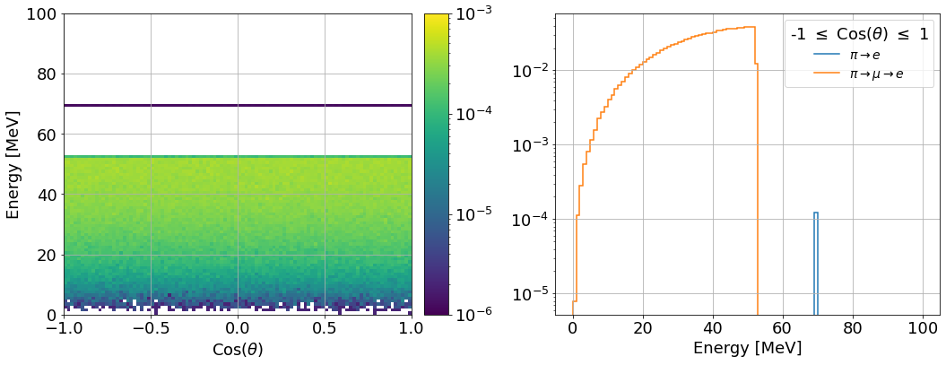




Building Up The Simulation: A Perfect World
$$e^{+}$$
$$θ$$
$$∞$$
$$π^{+}$$
Starting with an infinite, perfect calorimeter and no ATAR.
This diagram will update as the simulation gets more accurate

Slide 5
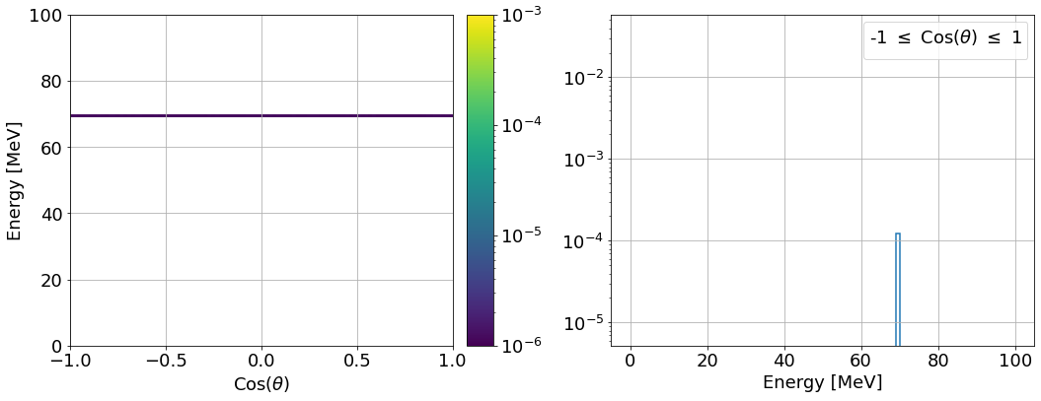
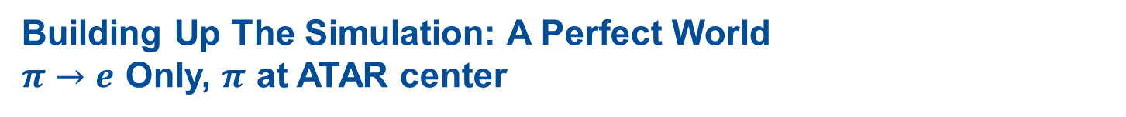
Building Up The Simulation: A Perfect World
$π→e$ Only, $π$ at ATAR center
$$e^{+}$$
$$θ$$
$$∞$$
$$π^{+}$$

Slide 6
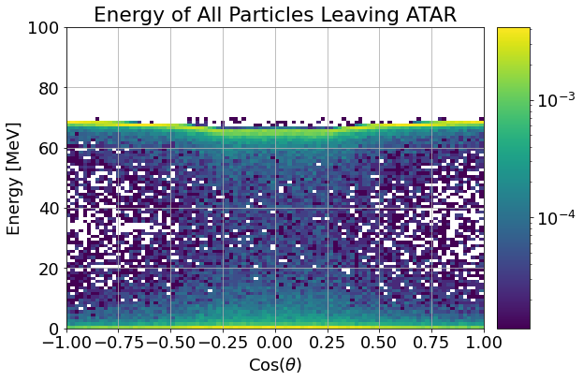
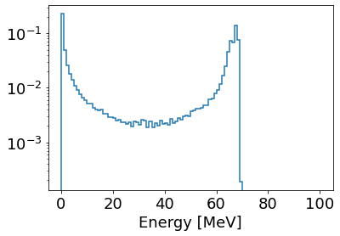
Building Up The Simulation: ATAR
Energy of Any Particles Leaving ATAR
$$∞$$
“Normal” Events
Intermediate Events (Bhabha scattering, Bremsstrahlung, etc.)
Low Energy Events (won’t be able to see them anyway)
Takeaway: radiative processes matter!

Slide 7
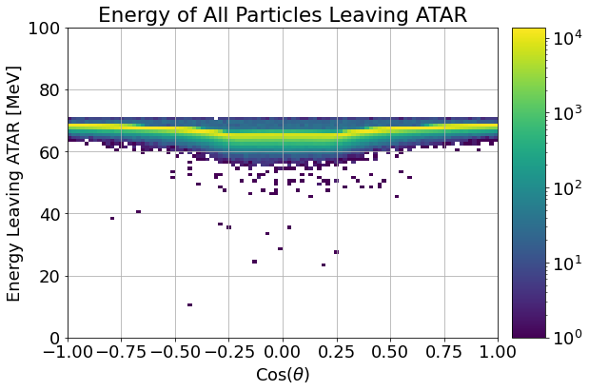
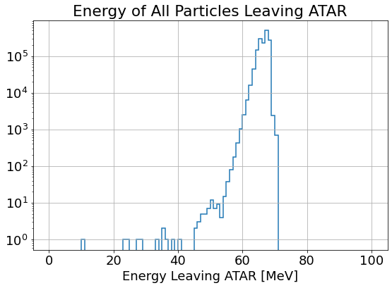
Building Up The Simulation: ATAR (Summed)
$$∞$$
Takeaway: We need to recombine multiple tracks for some events

Slide 8
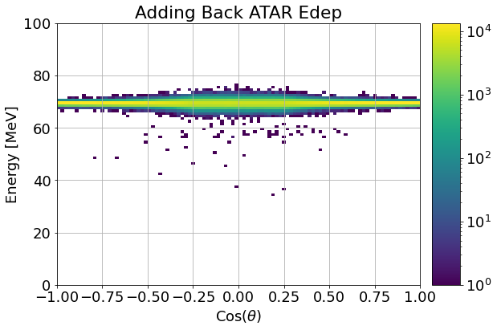
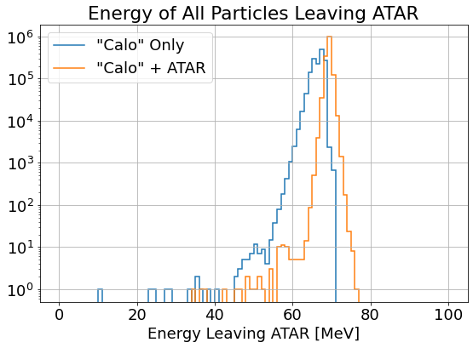
Building Up The Simulation: ATAR (Summed)
$$∞$$
Calo: Perfect Resolution
ATAR: 20% Resolution
Takeaway: ATAR impact on CALO Resolution is highest $⊥$ to the beam

Slide 9
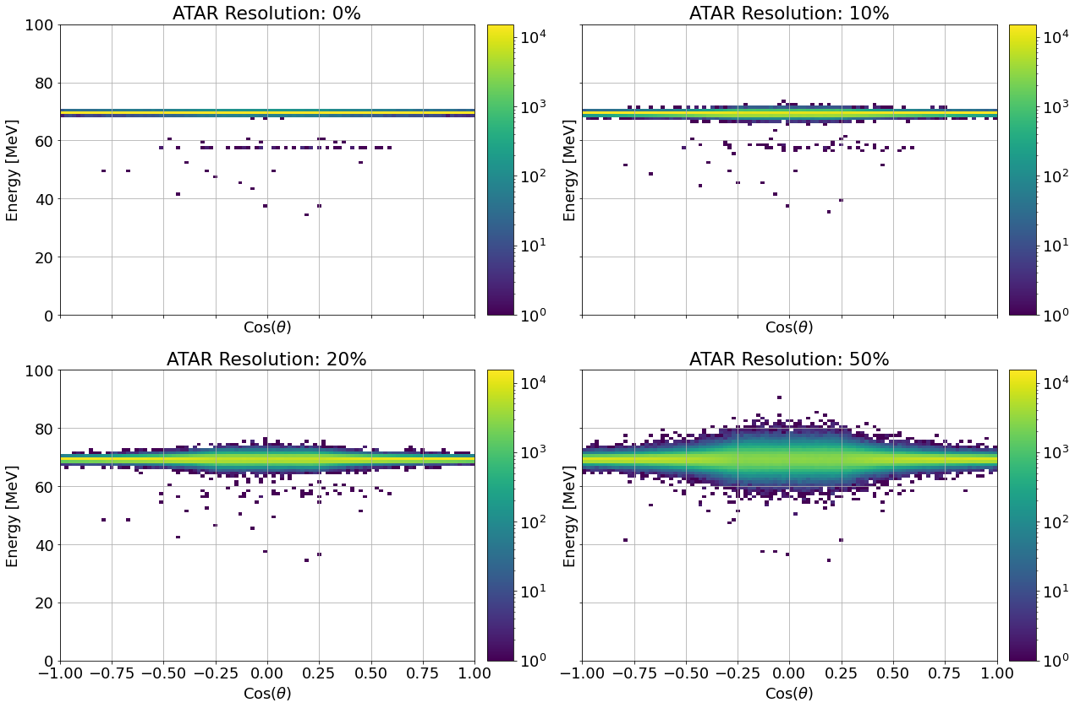
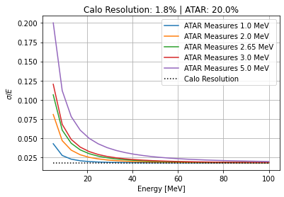
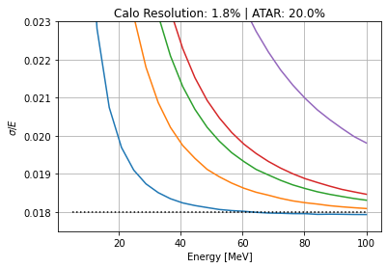
Aside: ATAR Energy Resolution
Perfect Calo Resolution
$$∞$$
Average Energy Loss in ATAR
Takeaway: An ATAR with poor energy resolution can be deadly, 20% ok

Slide 10
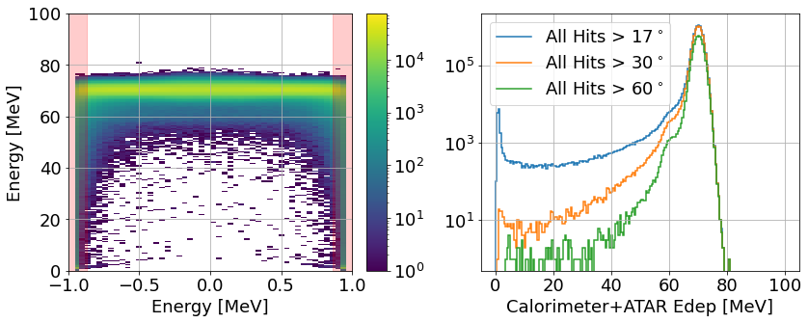



With any physical detector, we don’t see a “perfect” spectrum
$${17}^{∘}$$
Calo Resolution: 1.8%
ATAR Resolution: 20%
$$25 X_{0}$$
Cos($θ$)
Takeaway: Opening angle and finite length increase the tail fraction.

Slide 11
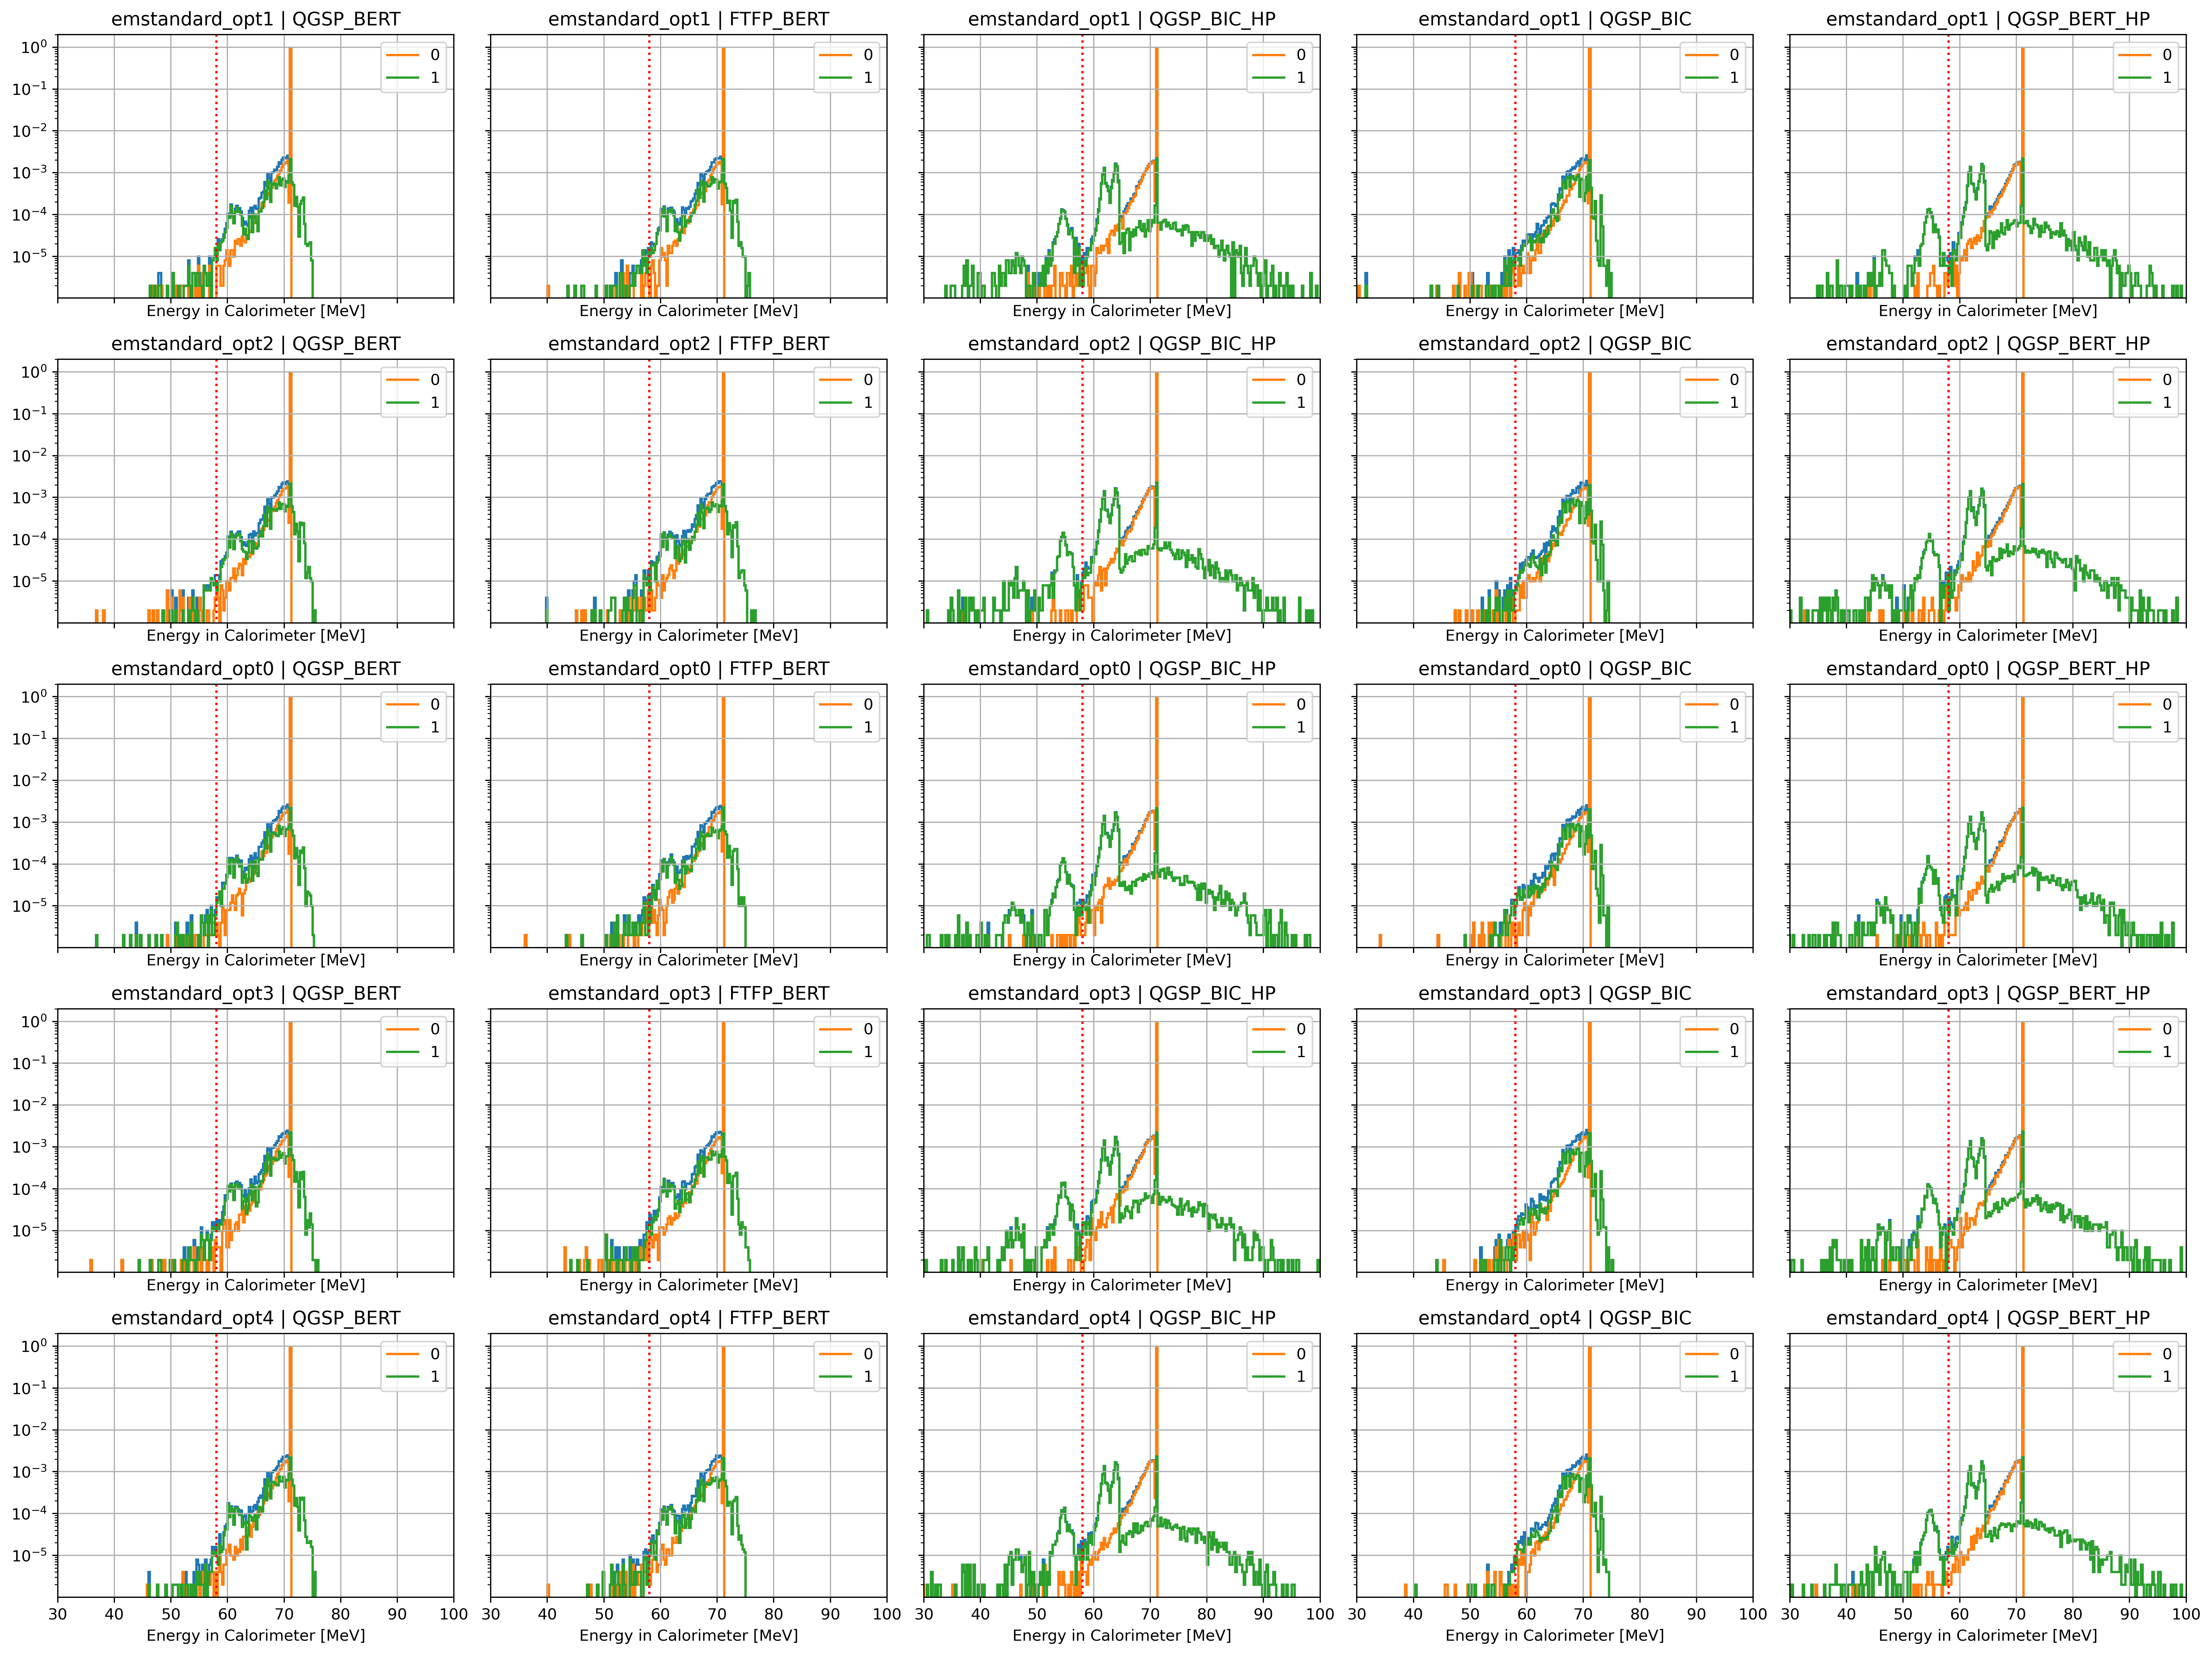
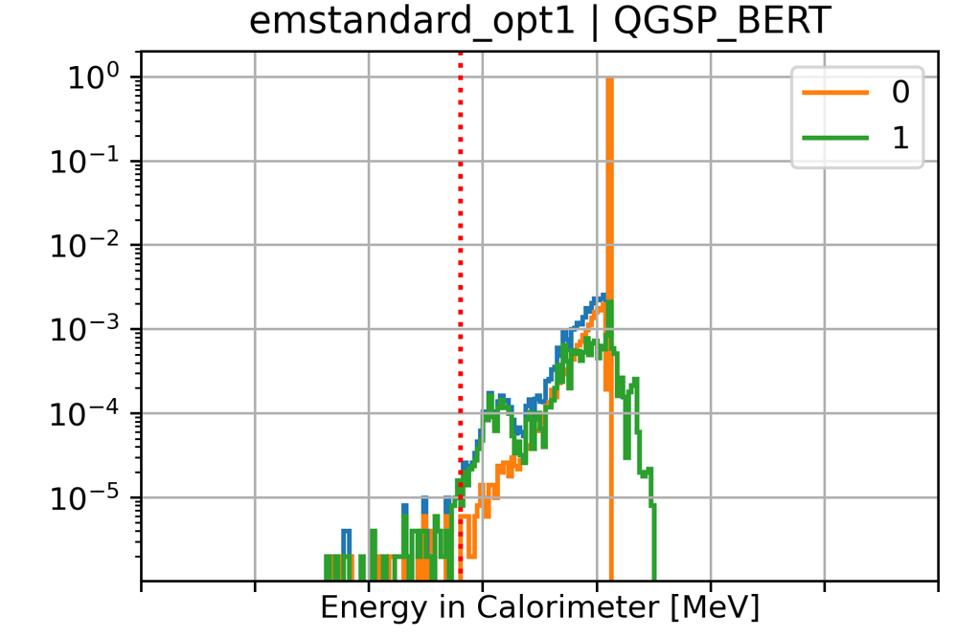
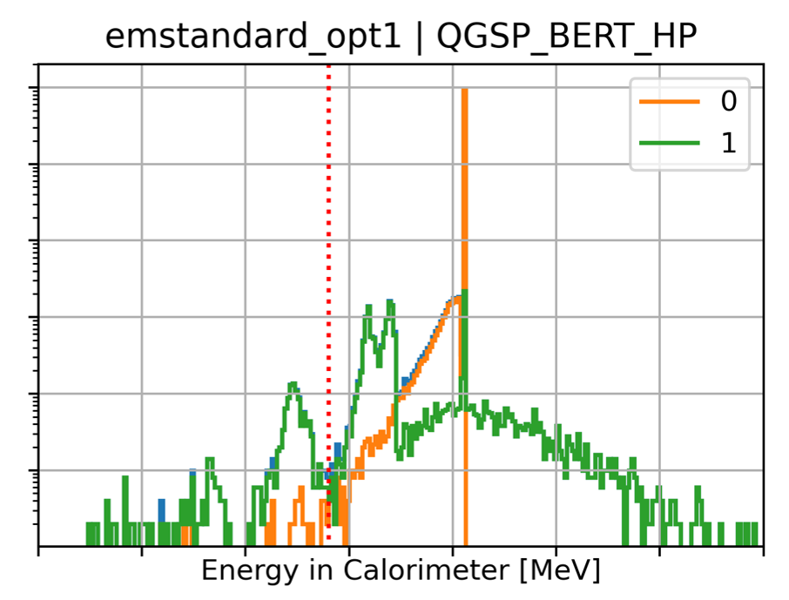
Aside: Physics Lists
All Events
Electromagnetic
Hadronic
Takeaway: Geant4’s physics cannot be taken as gospel

Slide 12
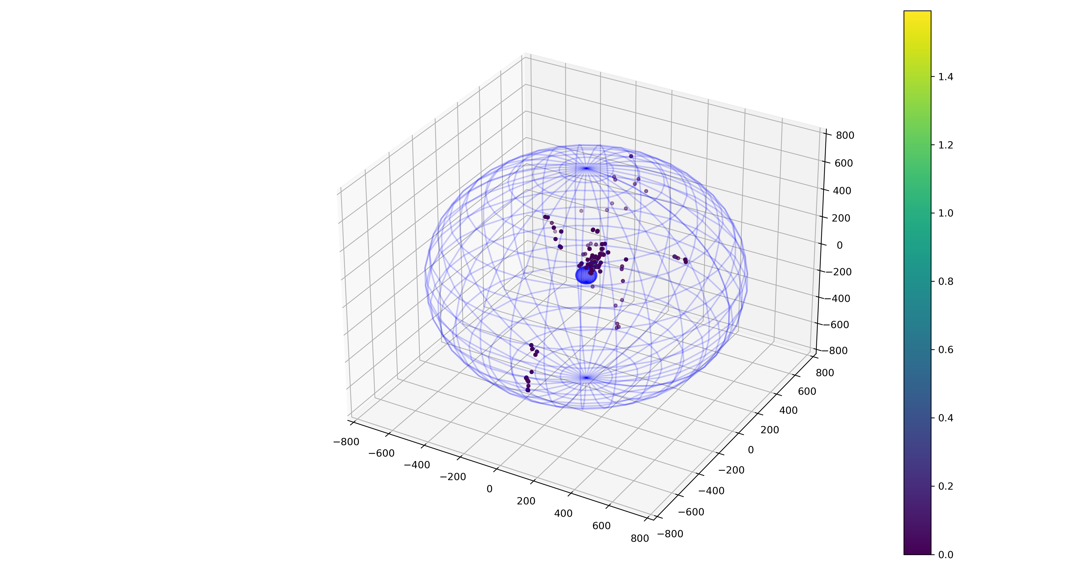
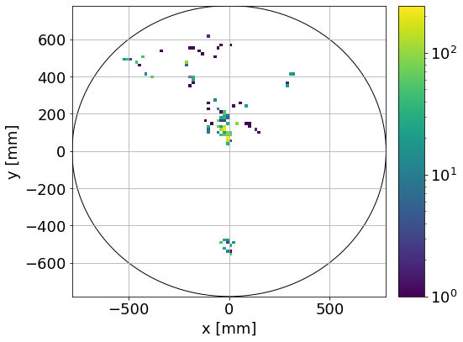
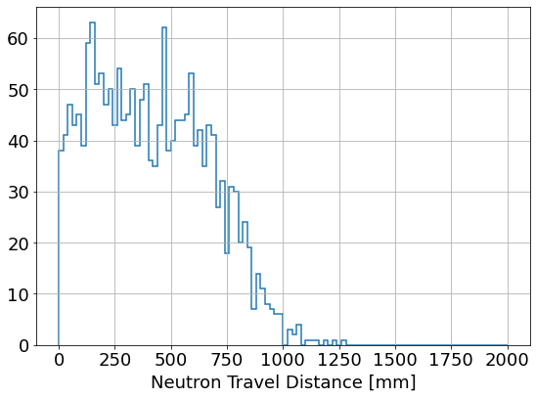
Aside: Wandering Neutrons
Looks like pileup!
QGSP_BERT_HP
Neutrons can travel for 100’s of ns
(more in Patrick’s talk tomorrow)

Slide 13
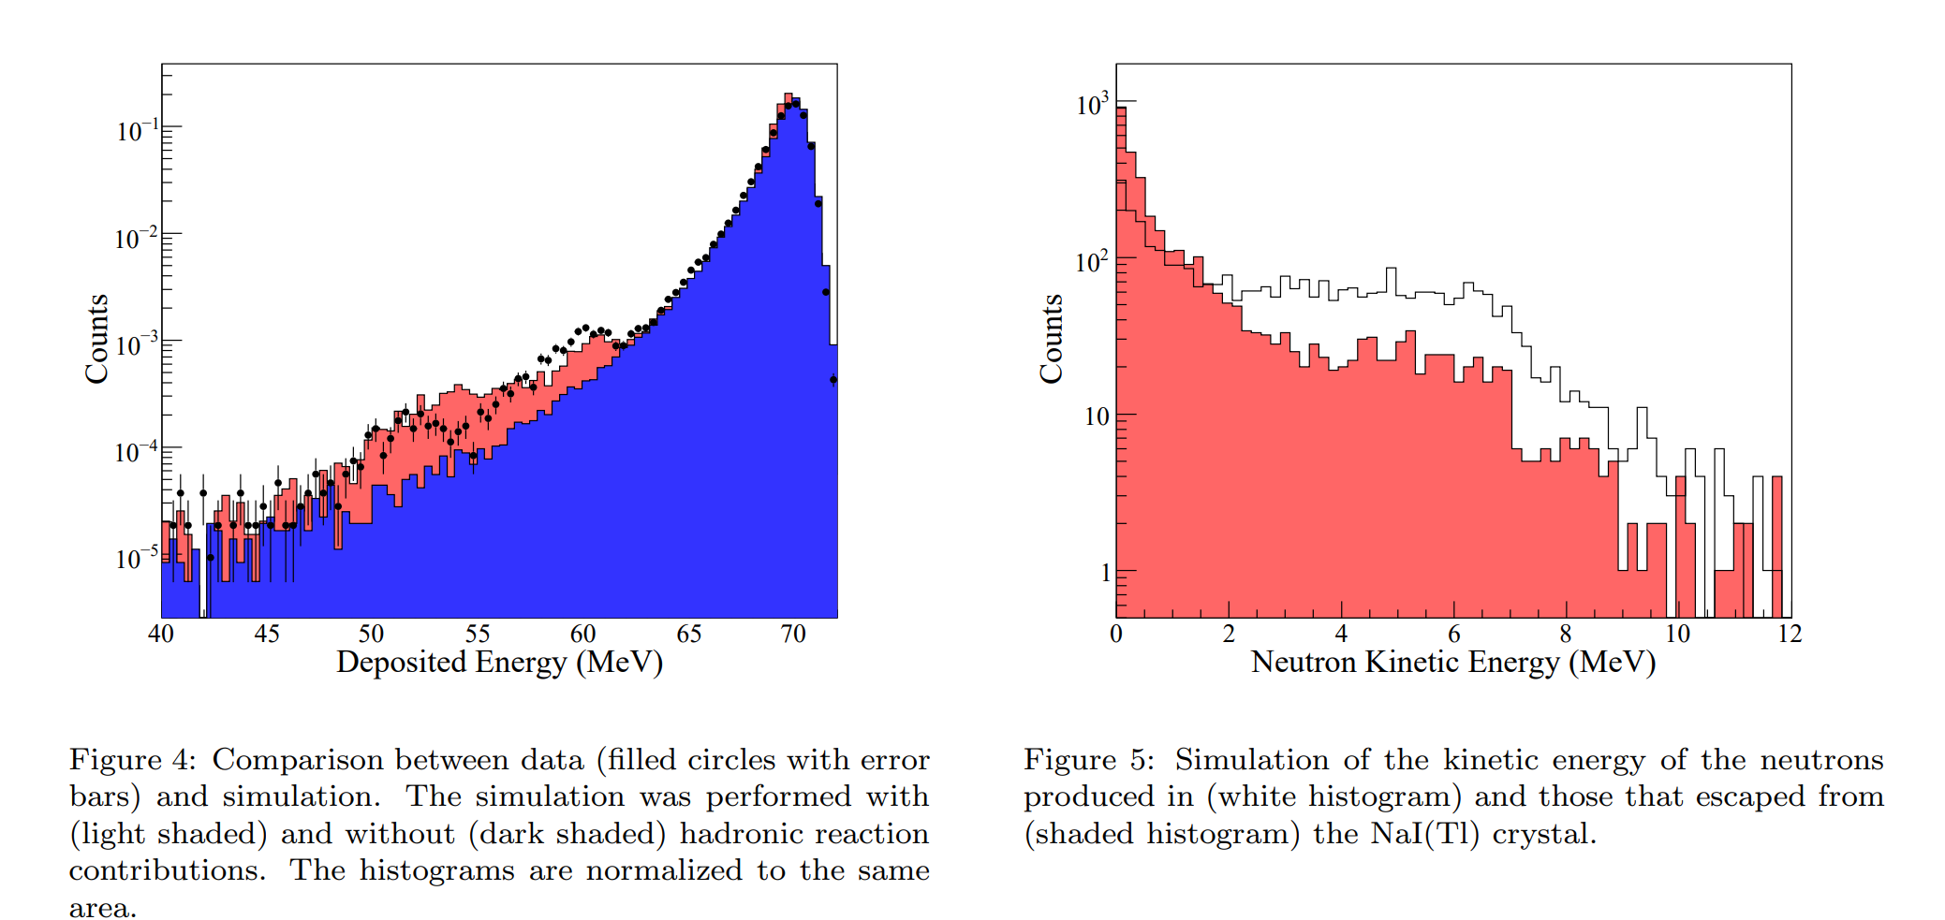
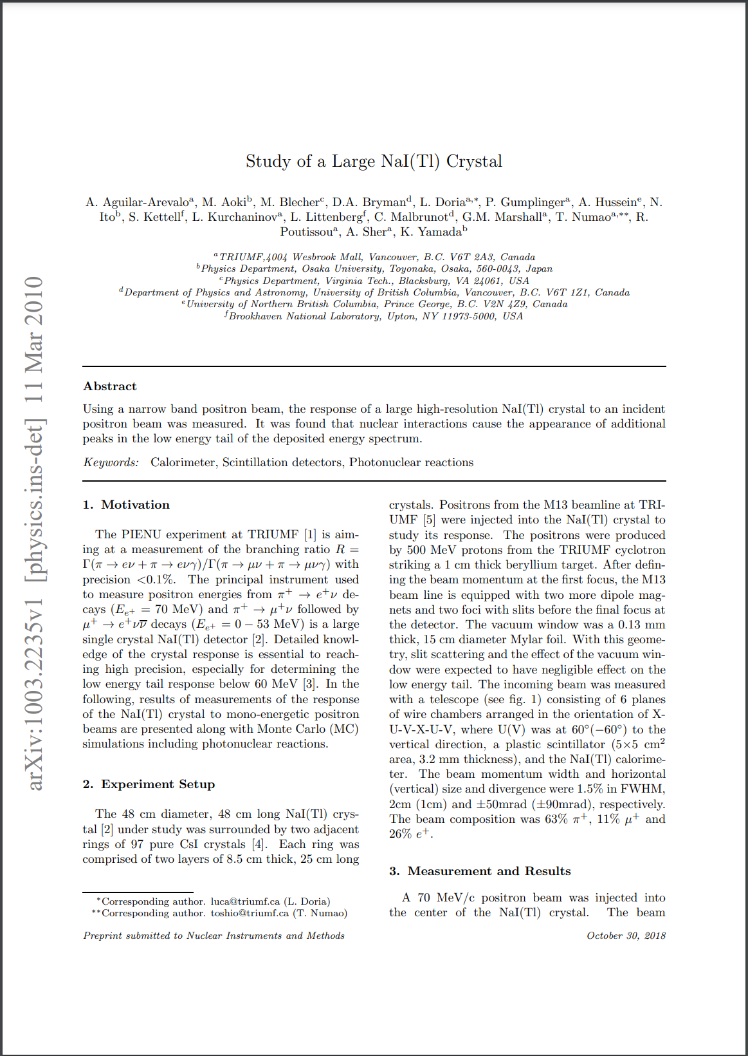
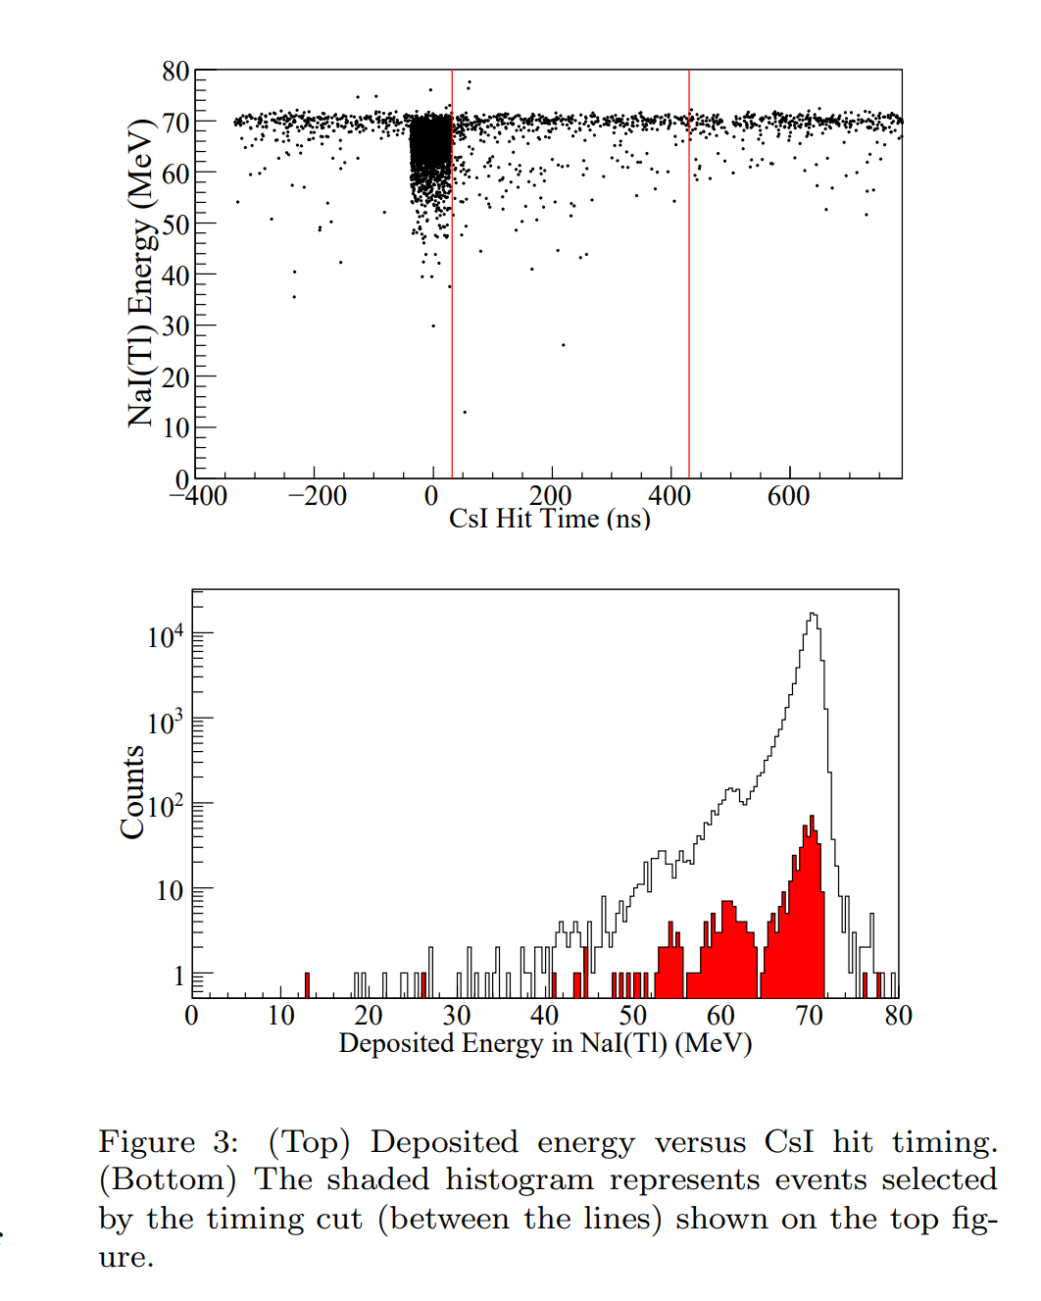
Photonuclear Effects: Measurements Required
Takeaway: A dedicated (prototype) measurement campaign is required to tune the simulation

Slide 14
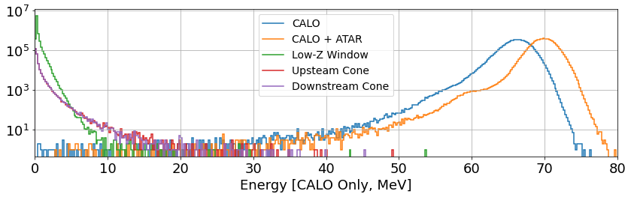
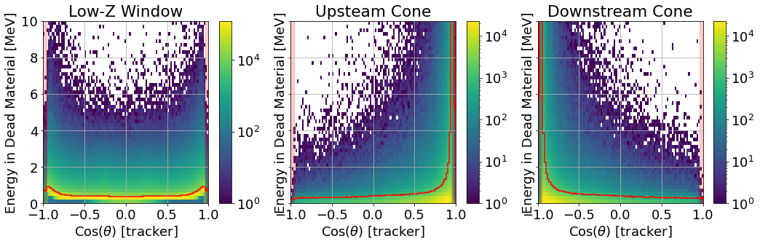

Dead Material: Beampipe
$${17}^{∘}$$
Window: 0.1 cm Be
Cones: 1 cm Al
$$25 X_{0}$$
Resolution$1.8\%→2.1\%$
Takeaway: Immense challenge to design a multi-ton detector with as little dead material as possible

Slide 15
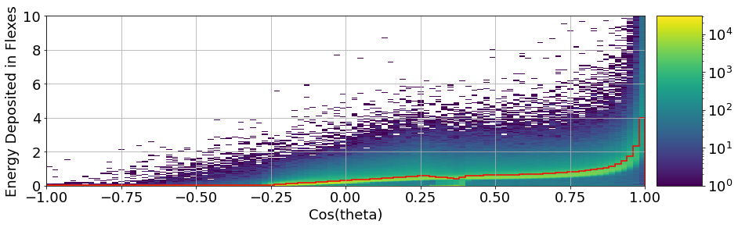
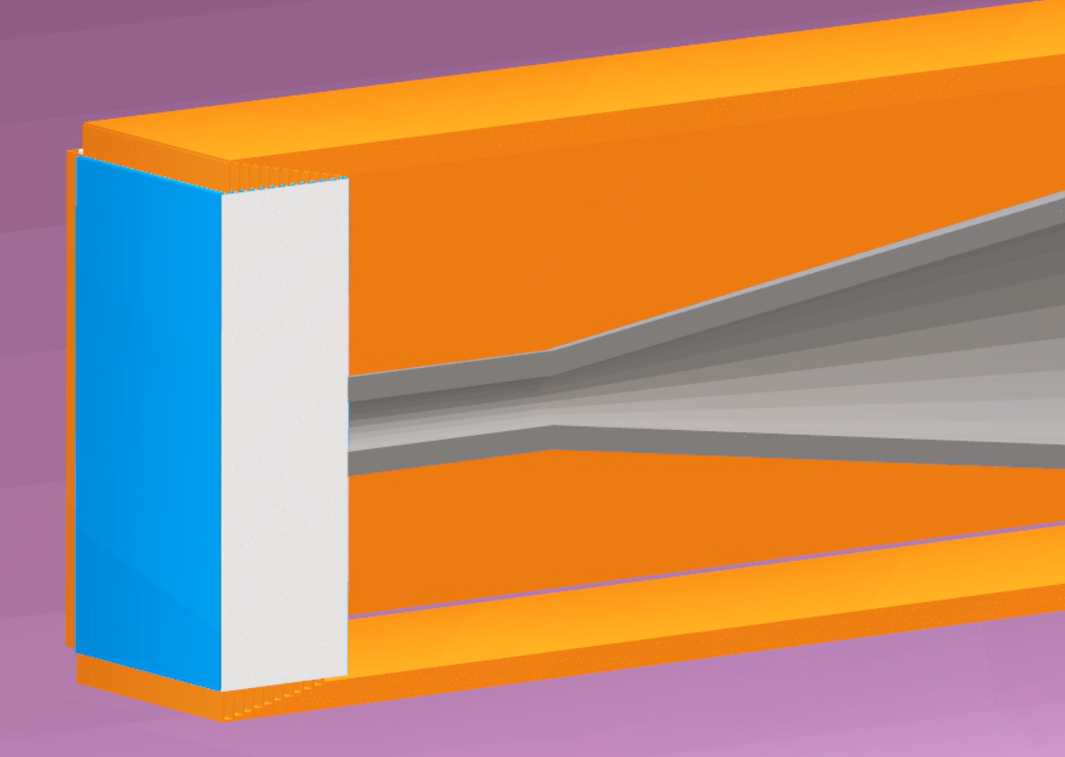
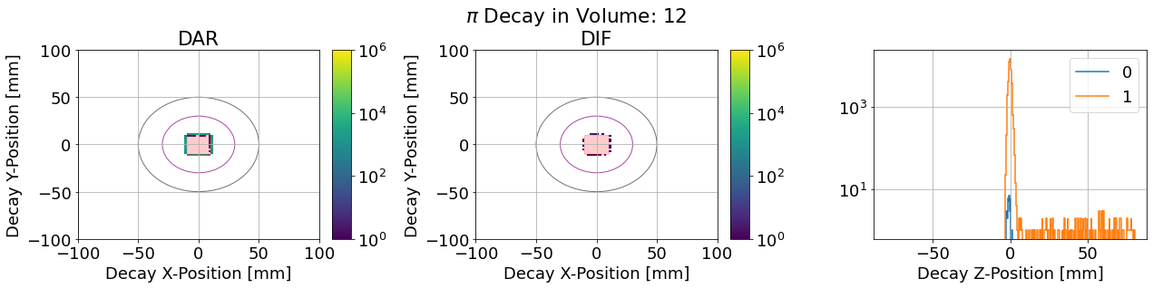
Dead Material: ATAR Readout
$${17}^{∘}$$
PCB/Epoxy
$$25 X_{0}$$
Takeaway: Readouts will affect the energy loss and will capture $π^{+}$, must be carefully engineered.

Slide 16
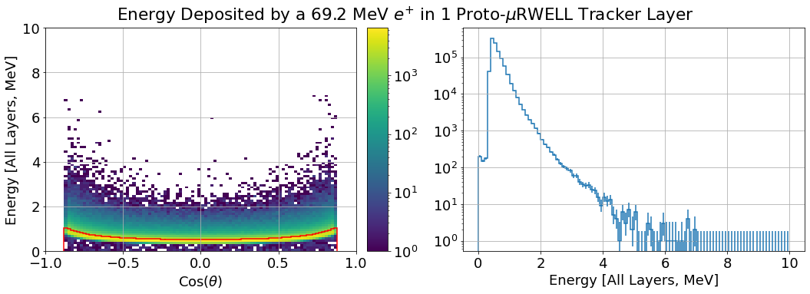
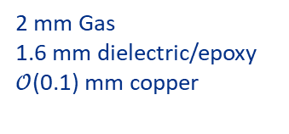
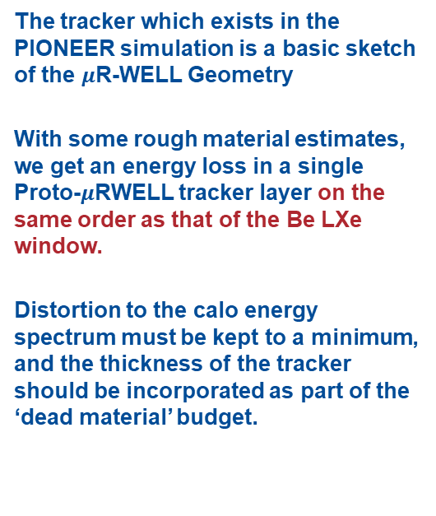
Adding A Tracker
$${17}^{∘}$$
The tracker which exists in the PIONEER simulation is a basic sketch of the $μ$R-WELL Geometry
With some rough material estimates, we get an energy loss in a single Proto-$μ$RWELL tracker layer on the same order as that of the Be LXe window.
Distortion to the calo energy spectrum must be kept to a minimum, and the thickness of the tracker should be incorporated as part of the ‘dead material’ budget.
$$25 X_{0}$$
PCB/Epoxy
Copper
Ar/CO₂/CF₄ (45/15/40)
Gas
2 mm Gas
1.6 mm dielectric/epoxy
$𝒪$(0.1) mm copper
Copper
Kapton
Backing
Takeaway: The tracker will contribute to the low energy tail, and so any design must be lightweight
Thanks to Jaydeep for providing preliminary dimensions!

Slide 17
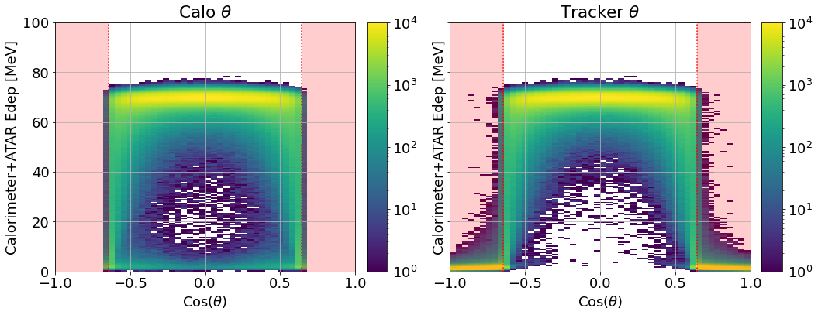
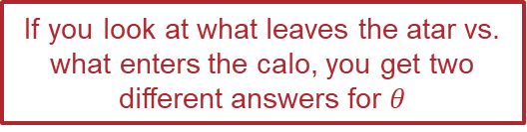
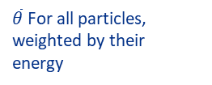

Aside: Truth vs. Calo $θ$
Example: 2 Particles leaving ATAR, the higher energy one misses CALO
$${50}^{∘}$$
$\overline{θ}$ For all particles, weighted by their energy
If you look at what leaves the atar vs. what enters the calo, you get two different answers for $θ$
$$25 X_{0}$$
Takeaway: A tracker/endcap extending beyond the Calo opening angle will help reduce tail
Note: exaggerated opening angle to illustrate effect

Slide 18
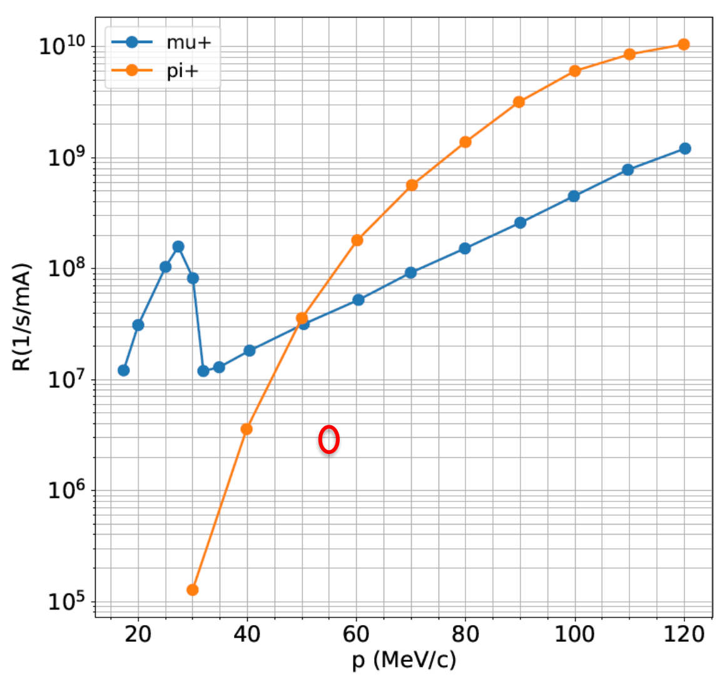
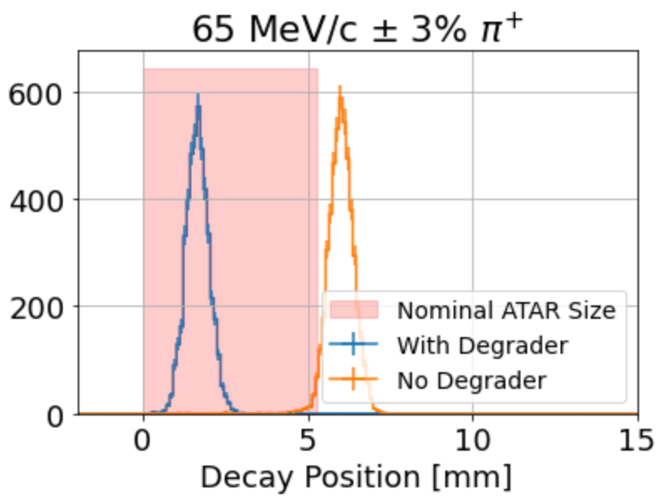
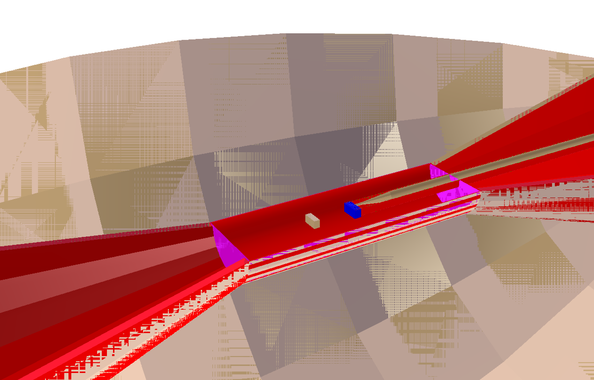
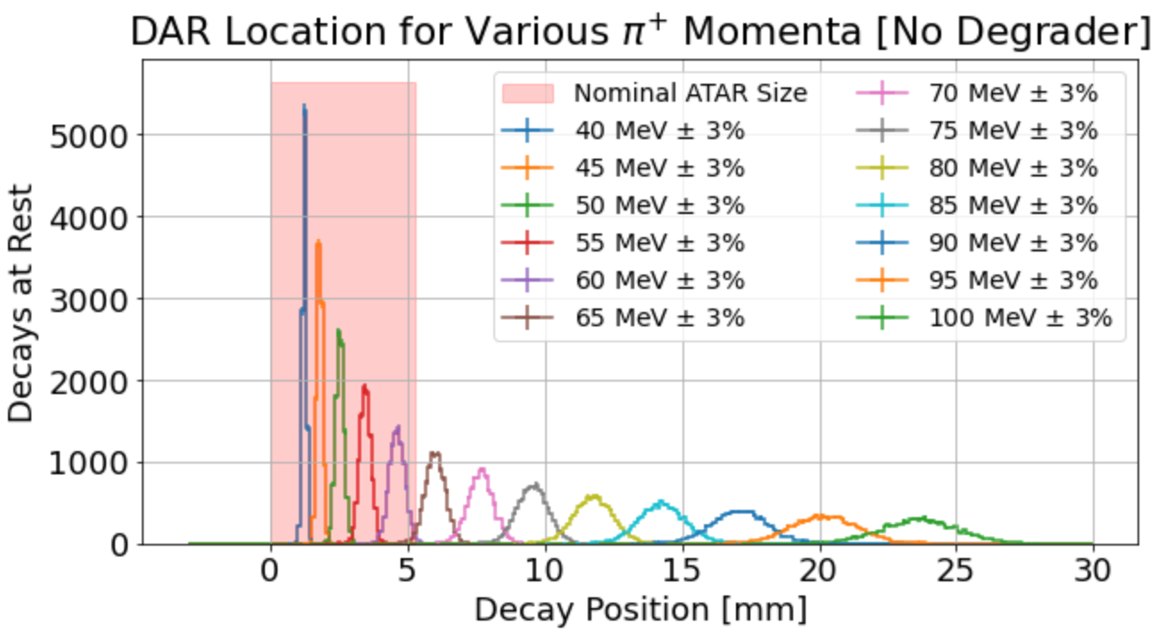
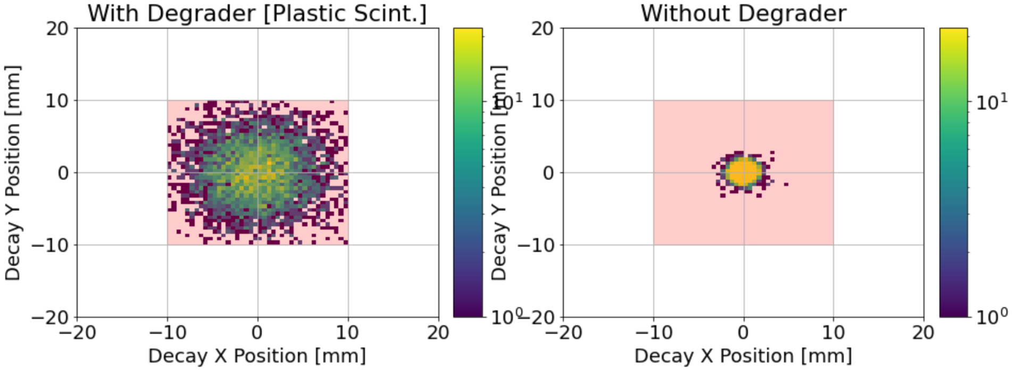
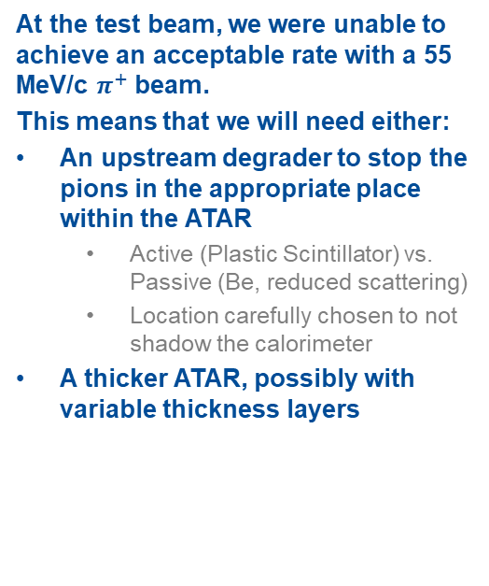
Beam: Tradeoffs of a Degrader
$${17}^{∘}$$
At the test beam, we were unable to achieve an acceptable rate with a 55 MeV/c $π^{+}$ beam.
This means that we will need either:
An upstream degrader to stop the pions in the appropriate place within the ATAR
  Active (Plastic Scintillator) vs. Passive (Be, reduced scattering)
  Location carefully chosen to not shadow the calorimeter
A thicker ATAR, possibly with variable thickness layers
$$25 X_{0}$$

Slide 19
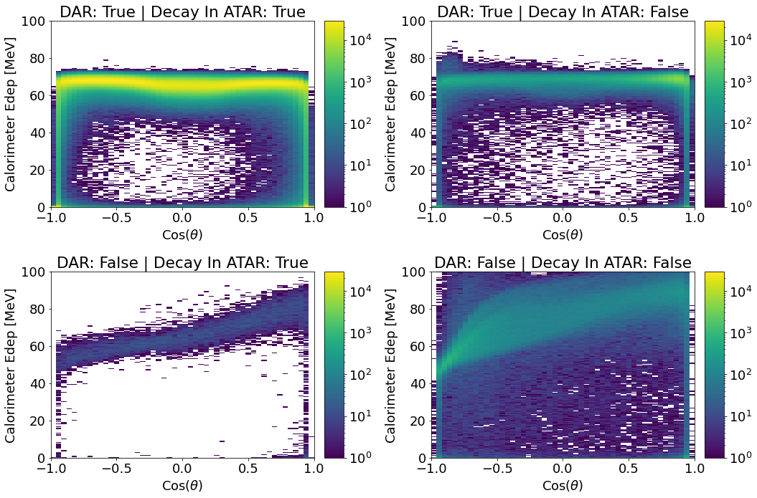
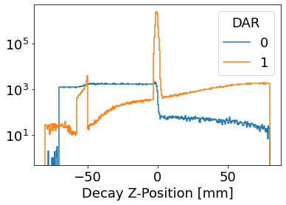
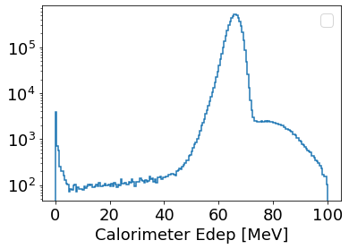
Aside: Pion Decay Locations / Decay in Flight
$${17}^{∘}$$
$$25 X_{0}$$
Takeaway: ATAR tagging of pions will be essential to reject background

Slide 20
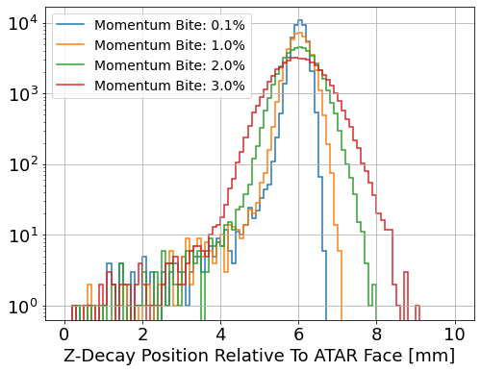
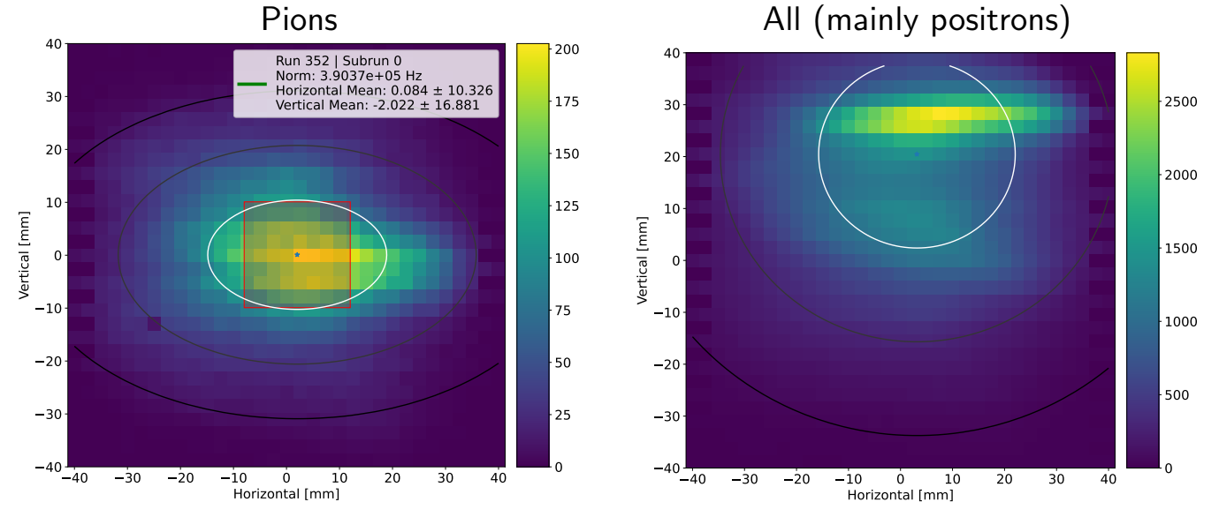
Beam Inputs: Realistic Phase Space
$${17}^{∘}$$
In order to finalize the design of the ATAR, we will need to know what the acceptable fiducial volume is.
This changes based on the divergence and momentum spread within the beam. Having an upstream degrader will make some requirements more stringent.
Inputs about the contamination of the beam will also be crucial for simulations of backgrounds
$$25 X_{0}$$

Slide 21
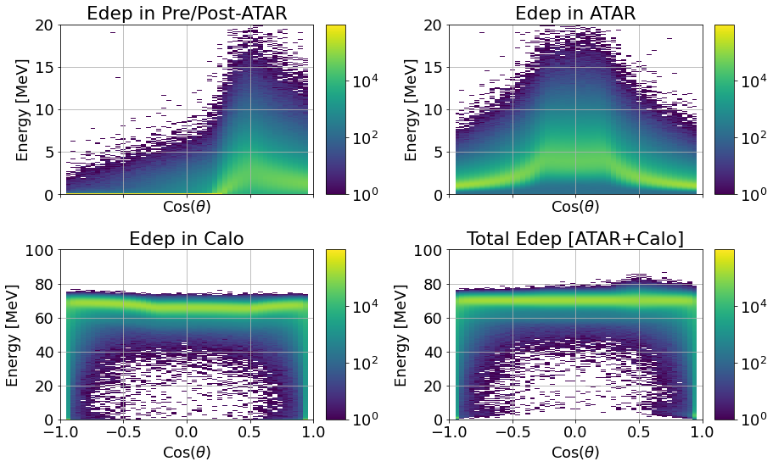
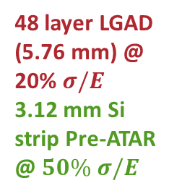
Pre-ATAR
$${17}^{∘}$$
$$25 X_{0}$$
48 layer LGAD (5.76 mm) @ 20% $σ/E$
3.12 mm Si strip Pre-ATAR @ $50\% σ/E$

Slide 22
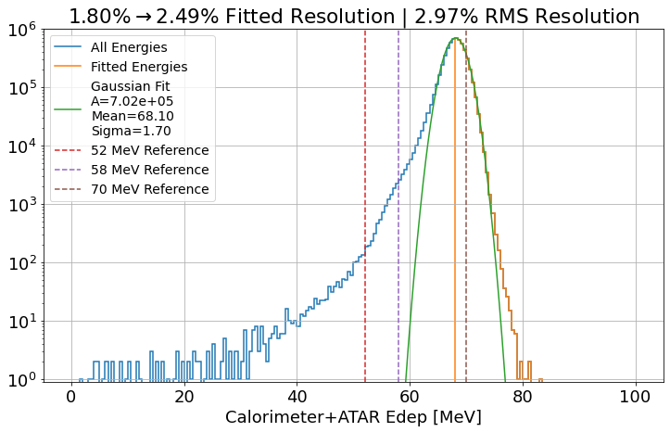

Final Resolution for $π_{DAR}$ Positrons: 1.8% $→$ 2.5%
$${17}^{∘}$$
Finally:
0.1 cm Be window
2 Tracking layers
ATAR/Calo resolution
Readouts
…
$$25 X_{0}$$
Note: Here no dead material energy ‘repair’ has been attempted

Slide 23





TLDR: Things Get Complicated Quickly
$${17}^{∘}$$
$$∞$$
$$25 X_{0}$$
$$−0.5≤\cos\left(θ\right)≤0.5$$
+ Pileup
+ Reconstruction effects
+ Detector response
(see later talks)

Slide 24



Proposal: Simulation Data Challenge
Critical Inputs: Dec 12th
  Best guess at all geometries
  Event combination (pileup generation, etc.)
External Inputs: Jan 15th
  Detector response functions
  Initial analysis features
Campaign Launches: Jan 31st
  ~2e9 unbiased $π^{+}$ decays
  ~70 TB of raw simulation data, equivalent amount of reconstructed data
Afterwards: Analysis Challenge (Feb-March)
  Replicate a PIENU style analysis using the simulated data and ‘realistic’ detector response
  Cut the collaborations teeth on big data processing
Hope to refine and push forward this idea during the workshop!

Slide 25
Summary
The PIONEER Simulation is helping to tackle big design choices, with many knobs to turn. Challenges are large, but not insurmountable.
Takeaways:
Thank you!
Radiative/scattering processes matter!
We may need to recombine multiple tracks/event
ATAR impact on CALO Resolution is highest ⊥ to the beam
An ATAR with poor energy resolution can be deadly
ATAR should be as live as possible, but small dead layers aren’t a disaster
Opening angle and finite length increase the tail fraction.
Geant4’s physics cannot be taken as gospel
A dedicated prototype measurement campaign is required to tune the simulation
Immense (but necessary) challenge to design a multi-ton detector with as little dead material as possible
The tracker will contribute to the low energy tail, and so any design must be lightweight
A tracker/endcap extending beyond the Calo opening angle will help reduce tail
ATAR tagging of pions will be essential to reject background
Some more exciting simulation results to see in the next few days!

Slide 26
Thank you!!

Slide 27
Backups

Slide 28

Works In Progress: ATAR
ATAR Group is working hard to make this detector a reality
We will see a lot of interesting talks from them on
Hardware design/implementation
Modelling detector response
Event reconstruction
And much more!

Slide 29
Works In Progress: LXe
Input from MEG, PANDAX, and more will be invaluable in forging a path forward.
Many talks from those sharing their experiences with LXe and those in PIONEER beginning to develop tools to understand it.

Slide 30

Works In Progress: Beam

Slide 31
Works In Progress: Tracker

Slide 32




Aside: Angular Distribution of Energies
Takeaway: Multi-particle events usually appear co-linear in Calo.

Slide 33



Aside: Number/Energy of Particles
$$∞$$

Slide 34

Aside: ATAR Summed with Energy Cut

Slide 35

Aside: ATAR Summed with Energy Cut

Slide 36


Aside: ATAR Dead Material
Resolution on live material: 20%
Not corrected for track length
$$∞$$
Takeaway: ATAR should be as live as possible, but small dead layers aren’t a disaster

Slide 37

Aside: ATAR Summed with Energy Cut
(Does not include atar live energy)

Slide 38

Aside: ATAR Summed with Energy Cut
(Includes atar live energy, 20% resolution)

Slide 39

Aside: ATAR Summed with Energy Cut
(Includes atar live energy, 20% resolution)

Slide 40

Building Up The Simulation: ATAR (Summed)
$$∞$$
Calo: Perfect Resolution
ATAR: 20% Resolution
Takeaway: ATAR impact on CALO Resolution is highest $⊥$ to the beam

Slide 41



How much energy can we put in ATAR before it hurts us?
$\overline{E}=2.65$ MeV

Slide 42


Aside: Choice of Opening Angle
$$N^{∘}$$
$$25 X_{0}$$

Slide 43






LYSO Radioactivity: Constant “Rumble” at 1 MeV
Jianglai Liu, Yong Yang, Guangping Zhang (SJTU)

Slide 44

Simulation Upgrade Introduced
Photonuclear Changes

Slide 45
Physics List Choice is Important
Photonuclear processes in Geant4 do not conserve energy “on an event by event basis”

Slide 46


Aside: Window Thickness
$${17}^{∘}$$
$$25 X_{0}$$
Takeaway: Immense challenge to design a multi-ton detector with as little dead material as possible

Slide 47

Dead Material: Beampipe
$${17}^{∘}$$
$$25 X_{0}$$
Takeaway: Immense challenge to design a multi-ton detector with as little dead material as possible

Slide 48



Tail Fraction vs. Angular Fiducial Volume

Slide 49


Adding A Degrader

Slide 50



Aside: Dead Material Energy Putback
*study done with previous version of the simulation
RMS (%) = 2.123
Tail Fraction (< 58 MeV) = 0.0355 %
RMS (%) = 1.802

Slide 51

Aside: Tracker Energy Loss
Energy deposit in the tracker is driven primarily by the upper ‘PCB’ epoxy layer
(Note: Log x-bins)

Slide 52


Pre-ATAR + Post-ATAR
$${17}^{∘}$$
$$25 X_{0}$$
48 layer LGAD @ 20% $σ/E$
3.12 mm Si strip Pre/Post-ATAR @ $50\% σ/E$
(positron energy only)

Slide 53

Aside: Truth vs. Calo $θ$
Example: 2 Particles leaving ATAR, the higher energy one misses CALO
$${50}^{∘}$$
$$25 X_{0}$$
Takeaway: A tracker/endcap extending beyond the Calo opening angle will help reduce tail

Slide 54




Aside: DIF Cuts
$${17}^{∘}$$
$$25 X_{0}$$

Slide 55



Aside: Pion Decay Locations
$${17}^{∘}$$
PCB/Epoxy
$$25 X_{0}$$
Takeaway: ATAR tagging of pions will be essential to reject background

Slide 56



Final Resolution for $π_{DAR}$ Positrons: 1.8% $→$ 2.5%
Pre + Post ATAR
$${17}^{∘}$$
Finally:
0.1 cm Be window
2 Tracking layers
ATAR/Calo resolution
Readouts
…
$$25 X_{0}$$
Note: Here no dead material energy ‘repair’ has been attempted

