Slide 1
The piE5 Beamline Model and Going Forward
Peter Kammel for the Nascent PIONEER Beam Dynamics Team
David Rubin (Cornell)
David Tarazona (Cornell)
Urs Langenegger (PSI)
Anna Soter (PSI)
Thanks: A. Knecht, P-R. Kettle, Z. Hodges, G. Dal Maso
Workshop is being generously supported by an award from the Gordon and Betty Moore Foundation

Slide 2
Overview
Experimental requirements
piE5 beamline
PIONEER Run ‘22 results
TRANSPORT studies
Major upgrades
Beam development plan
All PIONEER data preliminary

Slide 3

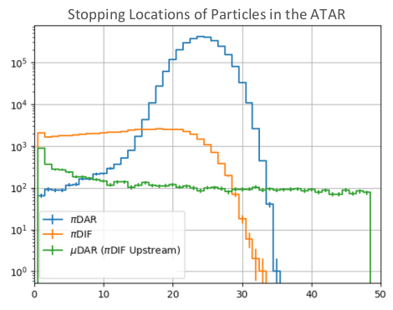
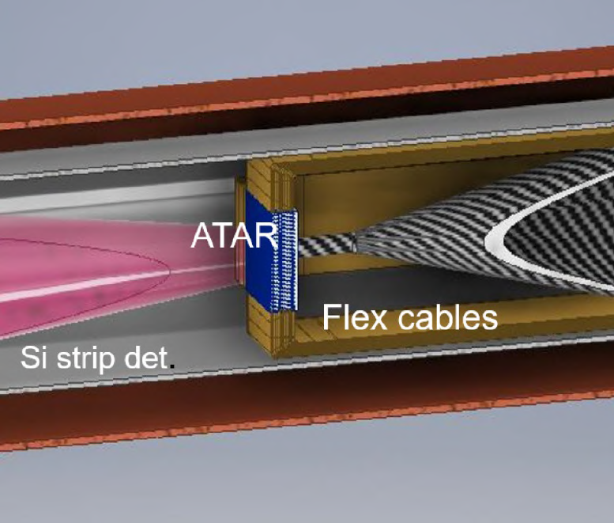
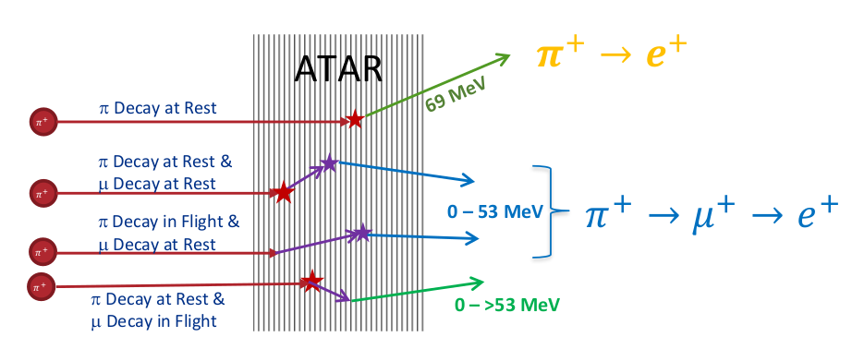
Requirements Phase I
Rate
  300k π/s stopped in ATAR
Momentum bite
  ∆p/p <2%
Momentum
  lowest p preferred 55-70 MeV/c
Spot size
  smaller than ATAR Size of 20mm x 20mm
Particle contamination
  µ/e less than 10% of π

Slide 4
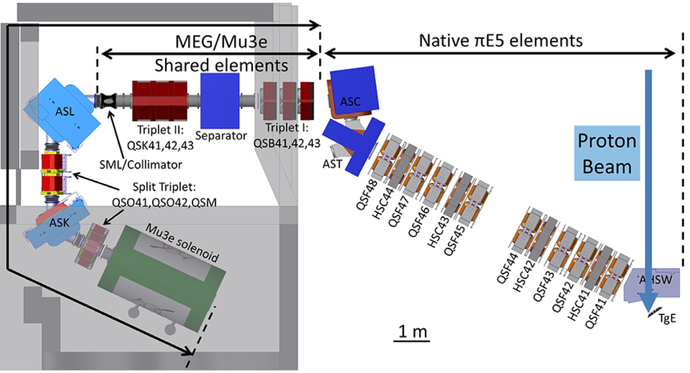

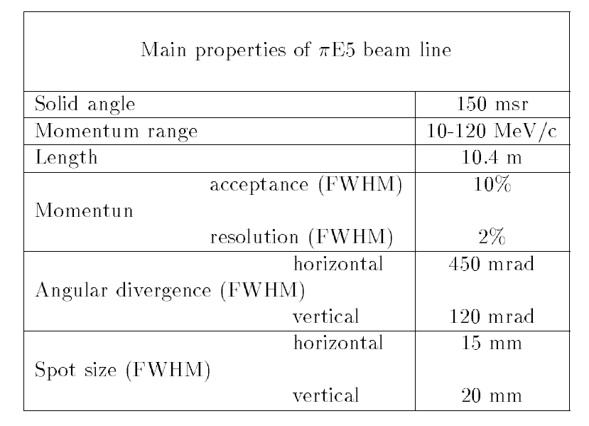

piE5 @ PSI - World’s Brightest Stopped Pion Beam
PIONEER
MEG
Mu3e
        carefully studied for fundamental muon experiments
still surprises for pions, unique PIONEER requirements
experimenters have full control over beam line (after first bend)

Slide 5
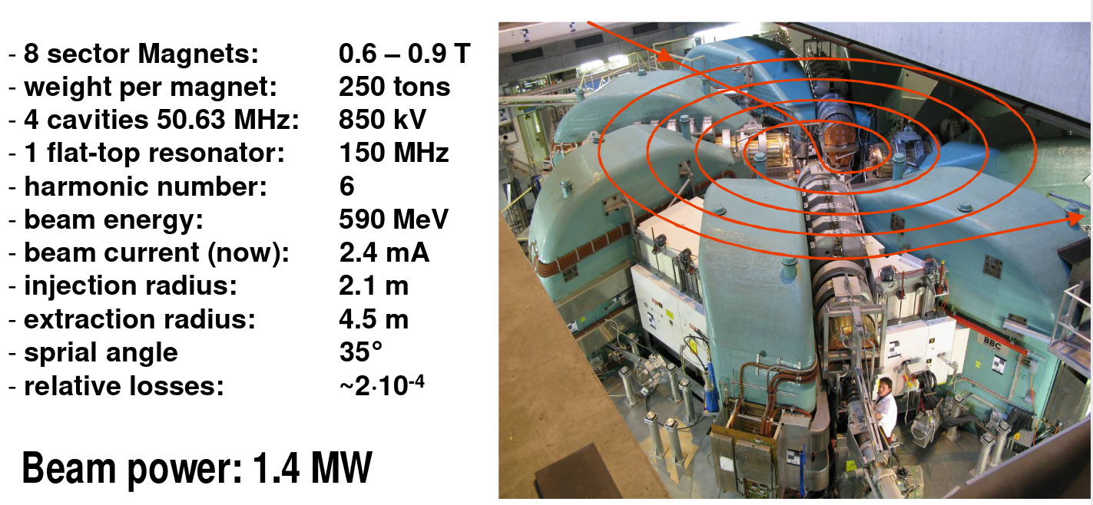
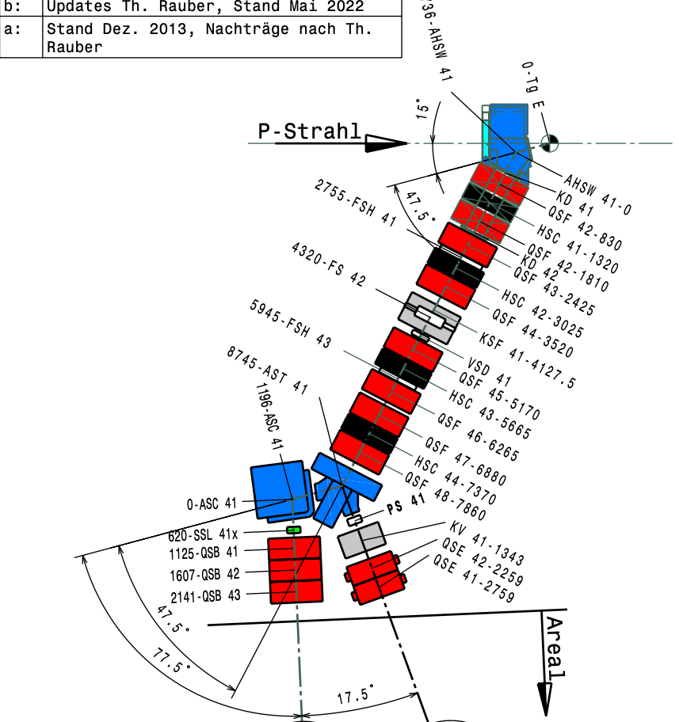
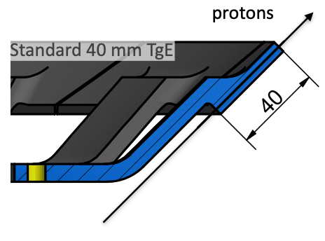
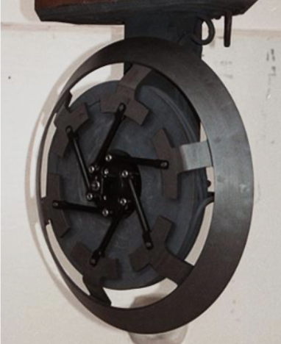
Target E and Pion Production
15⁰
π⁺
165⁰ to proton beam
bending +47.5⁰, -47.5⁰, +77.5⁰

Slide 6
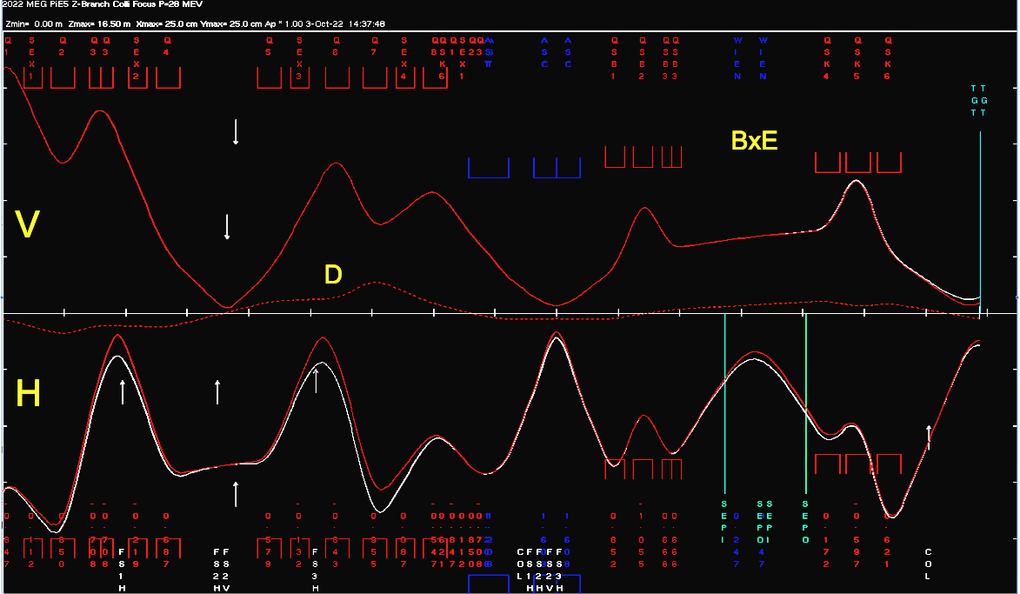
Simple Transport Model
MEG tune adjusted to PIONEER geometry, P-R Kettle
Compare Δp/p= 3/0 %
1st order only
  2nd order diverges
  other discrepancies to
  PIONEER Run ‘22
upstream part in shielding
    indirect diagnostics with slits
20 cm
BxE
separator
V
beam envelope in V-H planes
D
π⁺
H
dipoles
20 cm
extraction, momentum selection and achromat
particle separation, focus on target

Slide 7
Overview
Experimental requirements
piE5 Beamline
PIONEER Run ‘22 results
TRANSPORT studies
Major upgrades
Beam development plan

Slide 8
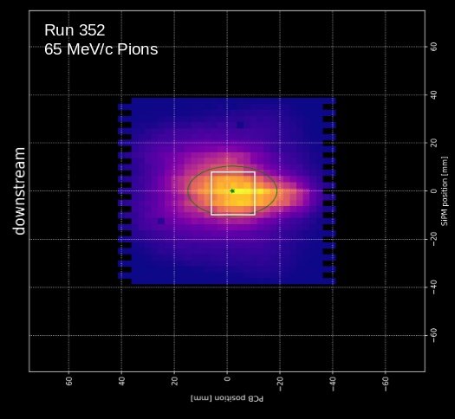
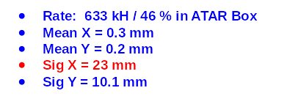
Good Enough Focus ?
Beam behaves as expected (basic p scaling)
  we measured 28 MeV/c muons and
  pions of 55, 65 and 75 MeV/c
Pions better focus than surface muons
But only 46% of beam in ATAR box
AST/ASC combination not problematic
Not yet

Slide 9
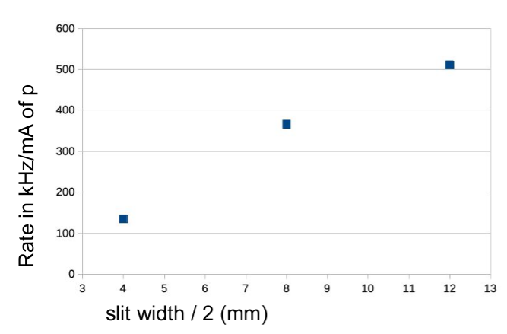
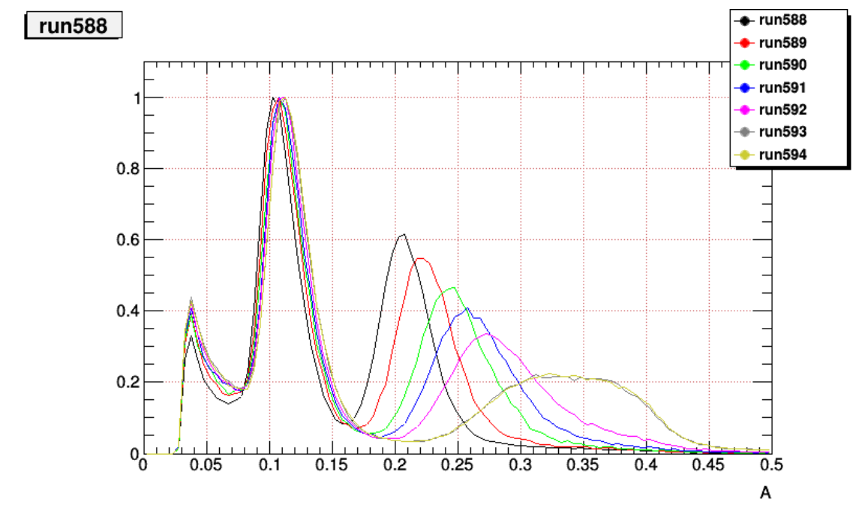

Sufficient Rate and Small ∆p/p ?
Cannot answer without determination of ∆p/p
First impression
  55 MeV/c insufficient
  65 MeV/c enough rate
Longitudinal phase space (i.e. ∆p/p),
two methods being analyzed
Direct stopping measurement with range curve
pion signal amplitudes with different degraders
use π→ μ sequence to identity stops
Time of flight
16m beamline
1% Δp/p ~ 1 ns (65 MeV/c)
scintillator
μ
π
degrader
signal amplitude in scint.

Slide 10
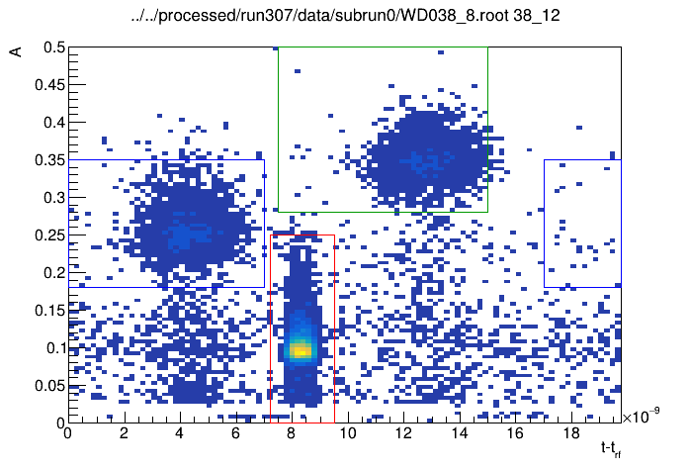
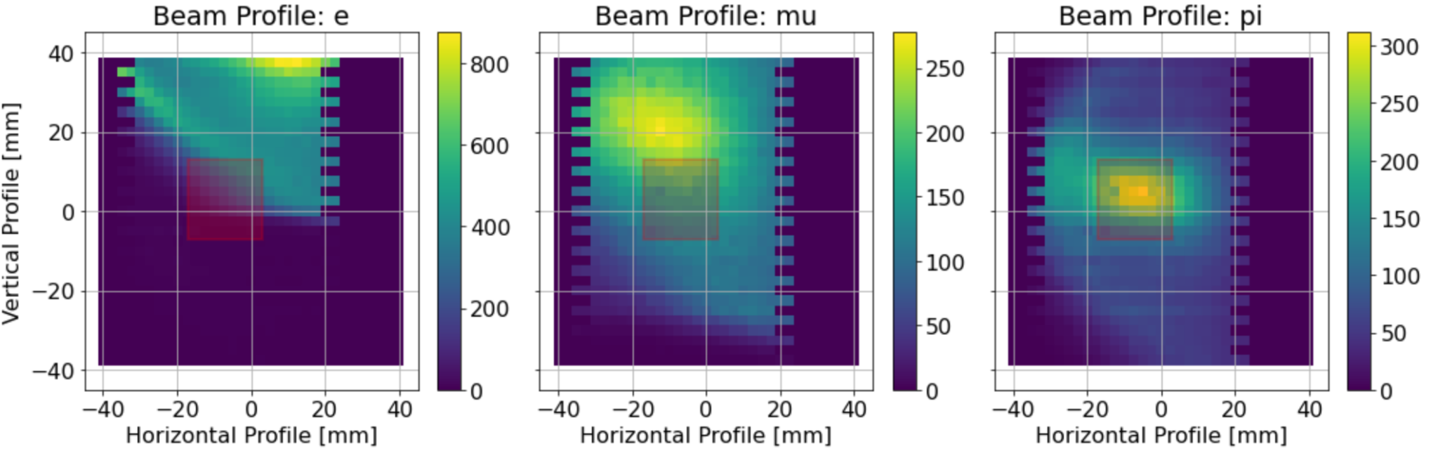
Particle Separation Good Enough?
μ
π
No
location of collimator !
Separator HV can be increased
In area restricted to ATAR
(optimistic accounting)
e: 25.0%
μ: 32.1%
π: 42.9%
amplitude in scint.
e
TOF (ns)
Patrick
Josh

Slide 11
Dispersion at Target Location?
Patrick
TOF changes when when detector moves 5 cm to the left
X=X(P), significant dispersion D at target location, deteriorates focus.

Slide 12
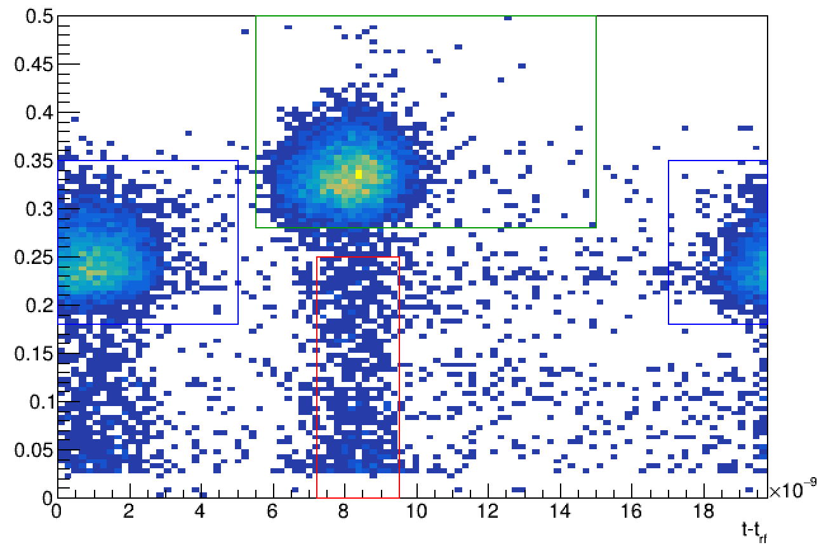
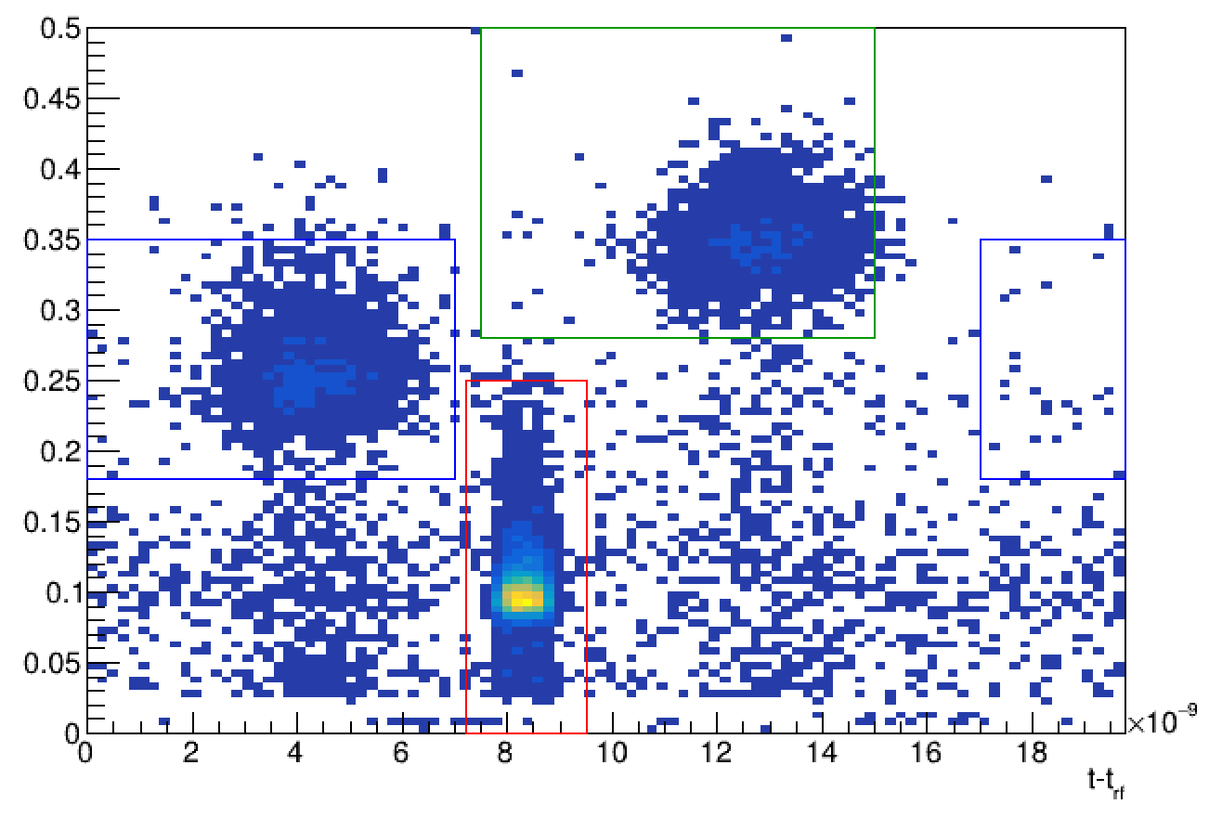

Dispersion at Target Location?
D~1 cm/%
similar to dispersive section??

Slide 13
Other Results
Momentum slits inconsistent with simple TRANSPORT model
Beam meandering in upstream channel
Quad scan to measure phase space at target
  indirect, not yet analyzed
  next time direct measurement with wire chambers?
  important for beam optimization and extension

Slide 14
Overview
Experimental requirements
piE5 beamline
PIONEER Run ‘22 results
TRANSPORT studies
Major upgrades
Beam development plan

Slide 15
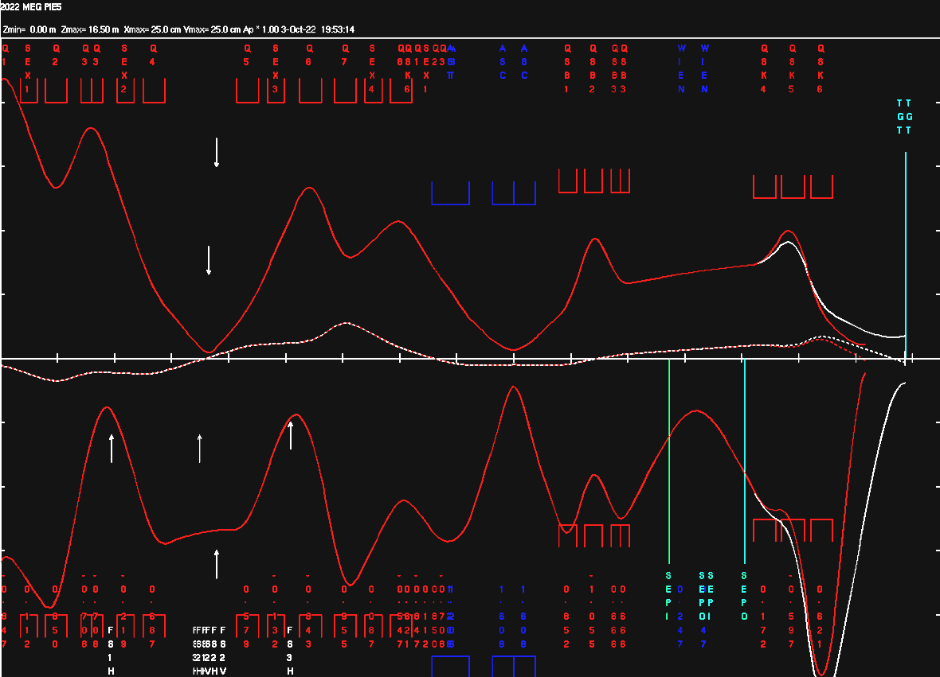
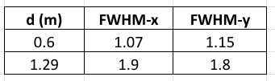
Final Focus Variants
vary focus distance
  closer focus promising
  larger final quads required
  but limited by d and
  calo opening angle
typically similar/poorer results
with inverted last triplet used
in run’22 ??

Slide 16

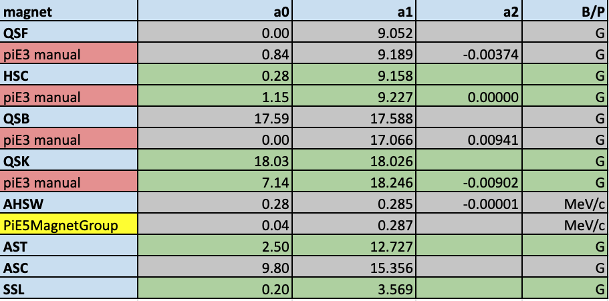
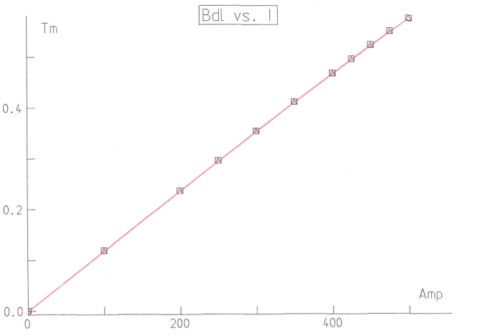
Magnet Calibration
Magnet calibration from PSI sources
(P-R Kettle and old manuals)
Opera field maps available (?), new maps of shielded magnets impossible
Unfortunately, when translating Run’22 current files, beam optics does not seem correct ??
example AST

Slide 17
Overview
Experimental requirements
piE5 beamline
PIONEER Run ‘22 results
TRANSPORT studies
Major upgrades
Beam development plan

Slide 18
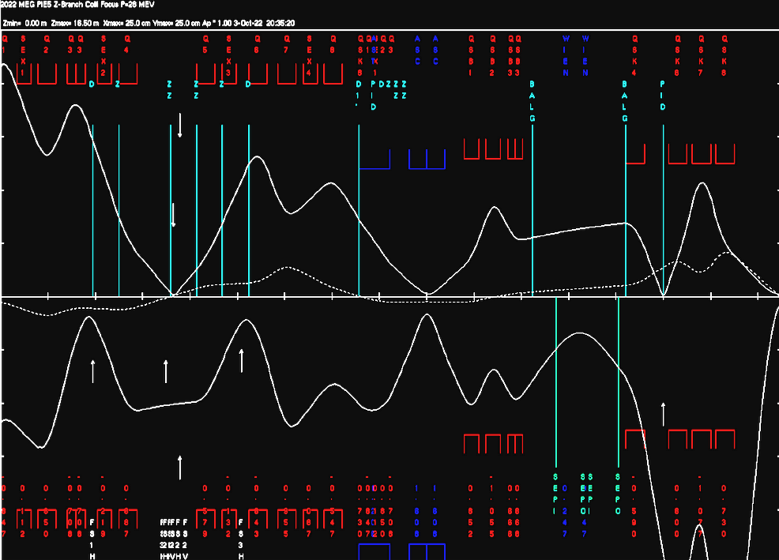
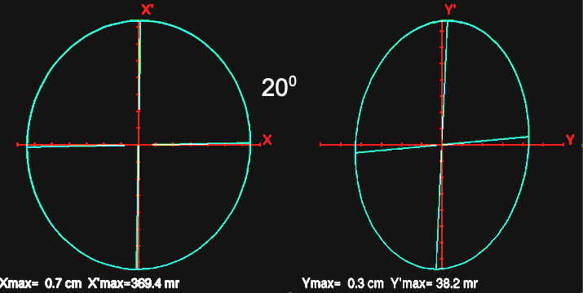
Extend Beam with Two Vertical Foci
For particle separation and target focus two separate foci required,
so that background is rejected outside of detector
  1st focus separates particles after ExB velocity filter and reject μ and e on collimator
  2nd focus is a double x/y focus aimed at ATAR
First attempt with s-t promising
  large final magnet
  phase space
    initial x: 240 π cm mr
    y: 9 π cm mr
    promising final focus
20⁰
!

Slide 19
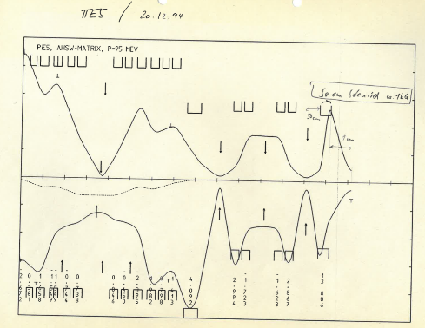
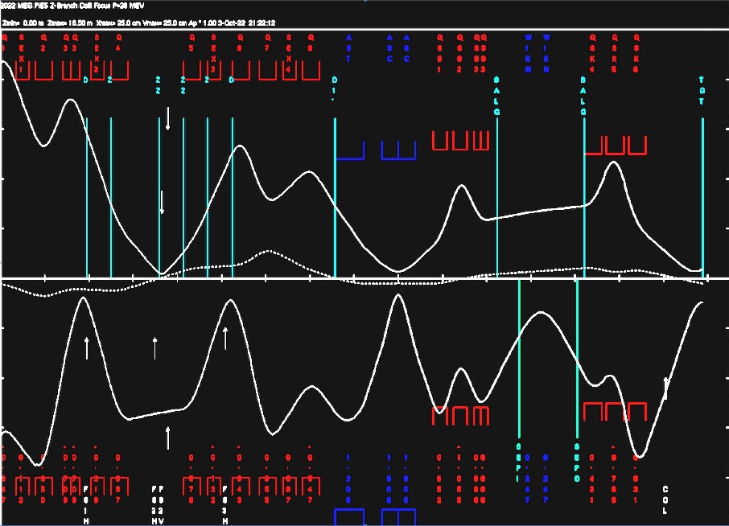
Smaller Momentum Bite
another exercise in history

Slide 20
Overview
Experimental requirements
piE5 beamline
PIONEER Run ‘22 results
TRANSPORT studies
Major upgrades
Beam development plan

Slide 21
Beam Development Plan
Higher order calculations and corrections
(chromatic and large transverse phase space)
  modern programs: BMAD, COSY, G4BL
Characterize individual elements
  including field maps
  compare transfer matrices in different programs
  resolve inconsistencies with actual current files used
Beamline
  upstream
    modern pion production and first bend model (HIMB)
    (currently historic 2nd order matrix is used in TRANSPORT)
    systematic measurement program with slits
    proper higher order sextupol corrections
  downstream
    optimize separation and final focus

Slide 22
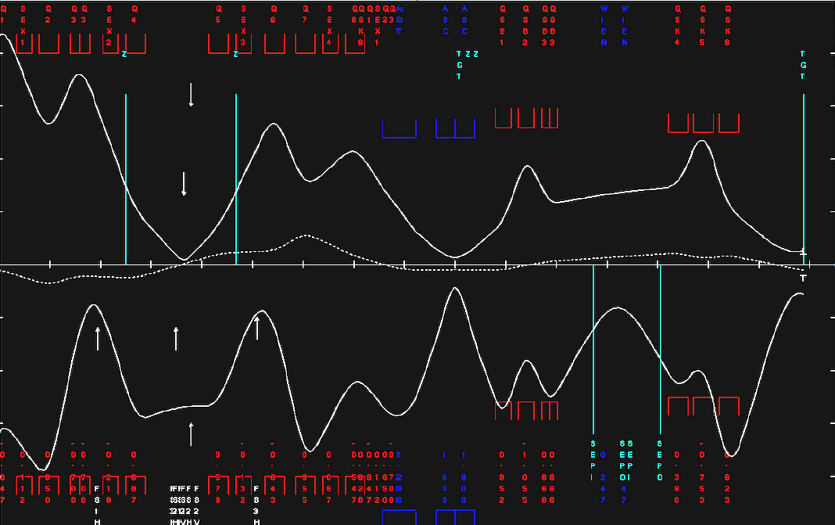
Beam Development Plan
cannot achieve PID separation and target focus simultaneously
Explore/explain
most striking puzzles
beam meandering
significant
dispersion
strong
dispersion
insufficient focus

Slide 23
Beam Development Plan
Higher order calculations and corrections
  modern programs: BMAD, COSY, G4BL
Characterize individual elements
  including field maps
  resolve inconsistencies with actual
  current files used
Beamline
  upstream
    systematic measurement program with slits
    modern pion production and first bend model
    proper higher order sextupol corrections
  downstream
    focusing and separation
Explore/explain most striking puzzles
Major upgrade studies
  Two vertical foci
  upstream retune for large dispersion
  dE/dx π/μ/e separation in last bends?

Slide 24
Summary
Overall promising results, but
  PIONEER requirements are challenging and unique
  lot of work remains towards realizing the potential
  often success of ambitious experiment
  intimately linked to beam quality
Beam team needs to be strengthened with
professional beam physicists from PSI, …
  synergy with
    High Intensity Muon Beam project
    Cornell center?
    Muon g-2 as template
Rate
  300k π/s stopped in ATAR
Momentum bite
  ∆p/p <2%
Spot size
  smaller than ATAR Size of 20mm x 20mm
Particle contamination
  µ/e less than 10% of π
ok
can improve (?)
that’s hard, impact on exp.
can improve (?)

Slide 25
Backup

Slide 26
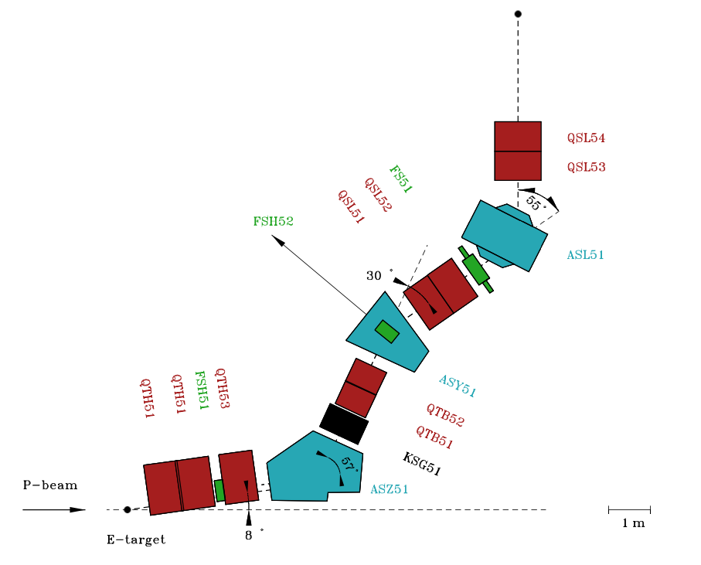
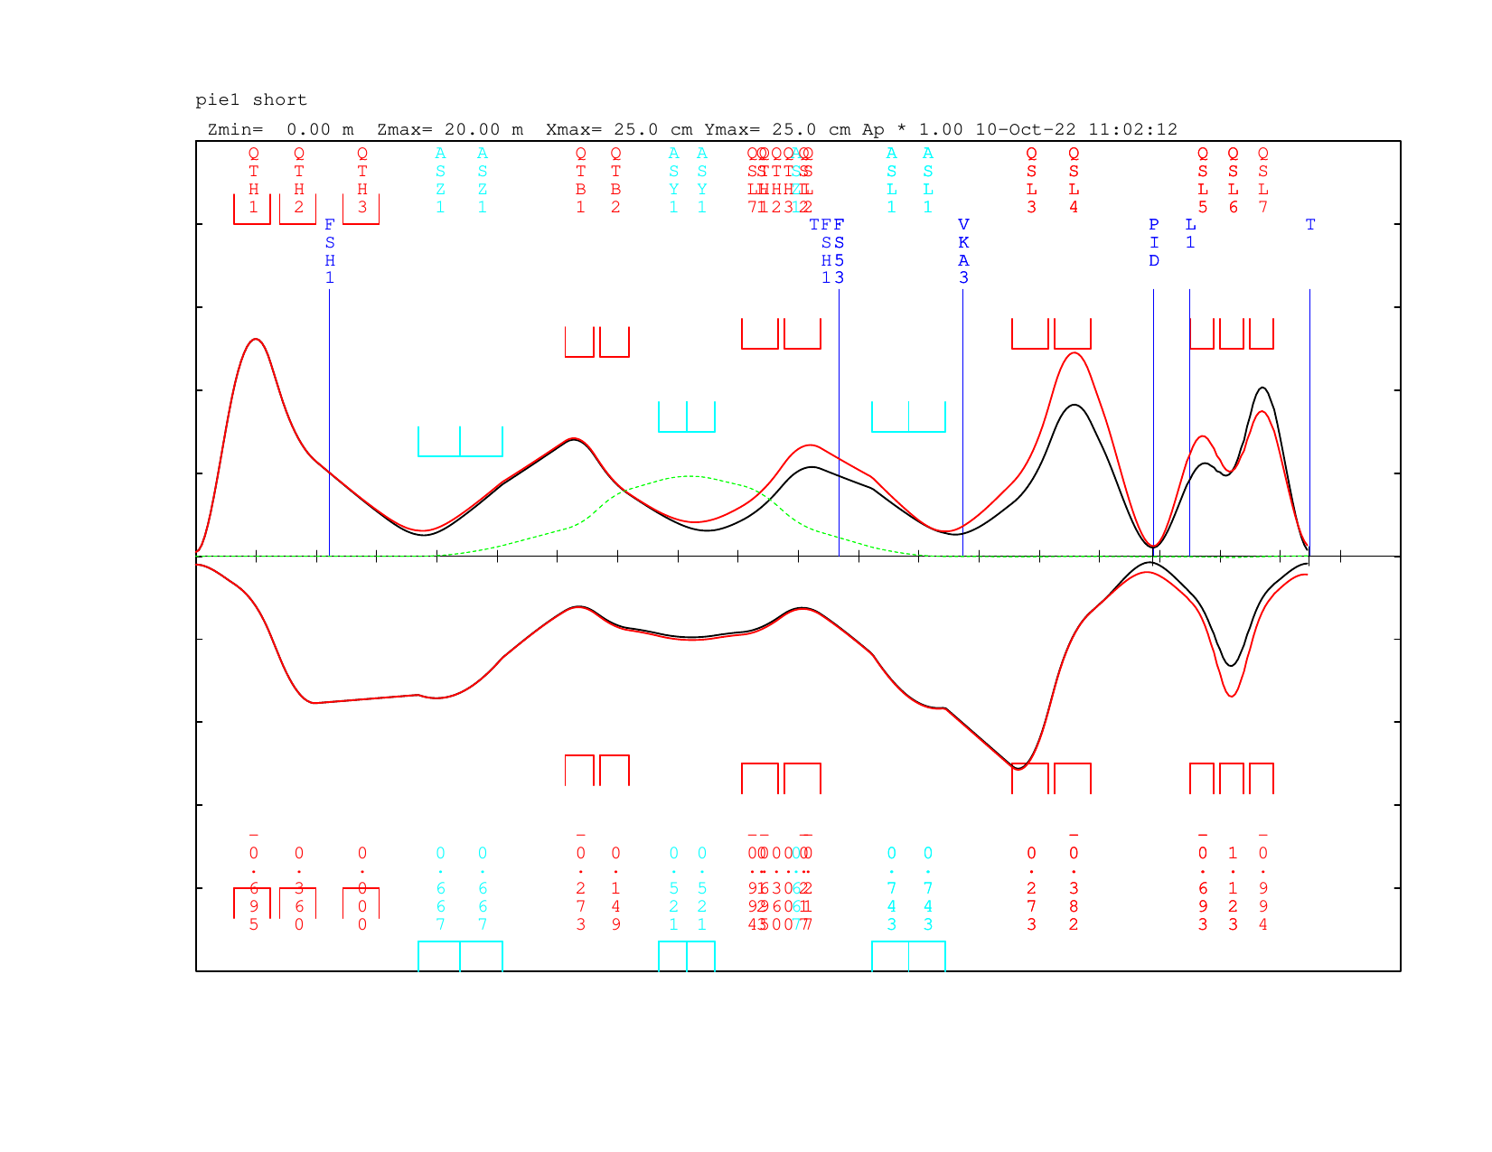
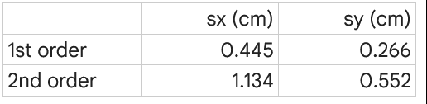
piE1 study for PIONEER
Beamline setup (Peter 10/10/22)
Profiles
Initial phase space
 | ε (cm mr) | X (cm) | X’ (mr)
x | 12.5 | 0.6 | 25
y | 40 | 0.3 | 160

Slide 27
piE1 beamline
TITEL | LABEL | Z |  | X |  | Y |  | R16 |  | R36
*BEAM* | BEAM | 0 | m | 0.5 | cm | 0.25 | cm | 0 | cm/% | 0 | cm/%
*DRIFT* |  | 0.638 | m | 1.67 | cm | 10.21 | cm | 0 | cm/% | 0 | cm/%
*QUAD* | QTH1 | 1.238 | m | 4.73 | cm | 11.69 | cm | 0 | cm/% | 0 | cm/%
*DRIFT* |  | 1.393 | m | 6.11 | cm | 9.89 | cm | 0 | cm/% | 0 | cm/%
*QUAD* | QTH2 | 1.993 | m | 8.85 | cm | 5.71 | cm | 0 | cm/% | 0 | cm/%
*DRIFT* | FSH1 | 2.218 | m | 8.78 | cm | 5.03 | cm | 0 | cm/% | 0 | cm/%
*DRIFT* |  | 2.443 | m | 8.72 | cm | 4.35 | cm | 0 | cm/% | 0 | cm/%
*QUAD* | QTH3 | 3.043 | m | 8.54 | cm | 2.6 | cm | 0 | cm/% | 0 | cm/%
*DRIFT* |  | 3.693 | m | 8.35 | cm | 1.29 | cm | 0 | cm/% | 0 | cm/%
*Z RO* |  | 3.693 | m | 8.35 | cm | 1.29 | cm | 0 | cm/% | 0 | cm/%
*ROTAT* | R11 | 3.693 | m | 8.35 | cm | 1.29 | cm | 0 | cm/% | 0 | cm/%
*BEND* | ASZ1 | 4.389 | m | 8.22 | cm | 2.29 | cm | -0.17 | cm/% | 0 | cm/%
*BEND* | ASZ1 | 5.086 | m | 6.12 | cm | 4.32 | cm | -0.64 | cm/% | 0 | cm/%
*ROTAT* | R12 | 5.086 | m | 6.12 | cm | 4.32 | cm | -0.64 | cm/% | 0 | cm/%
*Z RO* |  | 5.086 | m | 6.12 | cm | 4.32 | cm | -0.64 | cm/% | 0 | cm/%
*DRIFT* |  | 6.132 | m | 3.27 | cm | 6.84 | cm | -1.64 | cm/% | 0 | cm/%
*QUAD* | QTB1 | 6.607 | m | 3.32 | cm | 6.11 | cm | -2.61 | cm/% | 0 | cm/%
*DRIFT* |  | 6.712 | m | 3.58 | cm | 5.55 | cm | -2.96 | cm/% | 0 | cm/%
*QUAD* | QTB2 | 7.187 | m | 4.33 | cm | 3.74 | cm | -4.03 | cm/% | 0 | cm/%
*DRIFT* |  | 7.68 | m | 4.66 | cm | 2.6 | cm | -4.55 | cm/% | 0 | cm/%
*ROTAT* |  | 7.68 | m | 4.66 | cm | 2.6 | cm | -4.55 | cm/% | 0 | cm/%
*BEND* | ASY1 | 8.149 | m | 4.88 | cm | 1.76 | cm | -4.82 | cm/% | 0 | cm/%
*BEND* | ASY1 | 8.618 | m | 4.77 | cm | 1.57 | cm | -4.64 | cm/% | 0 | cm/%
*ROTAT* |  | 8.618 | m | 4.77 | cm | 1.57 | cm | -4.64 | cm/% | 0 | cm/%
*DRIFT* |  | 9.071 | m | 4.57 | cm | 2.18 | cm | -4.25 | cm/% | 0 | cm/%
*QUAD* | QSL1 | 9.671 | m | 3.69 | cm | 3.97 | cm | -2.98 | cm/% | 0 | cm/%
*DRIFT* |  | 9.771 | m | 3.45 | cm | 4.39 | cm | -2.66 | cm/% | 0 | cm/%
*QUAD* | QSL2 | 10.371 | m | 3.47 | cm | 5.27 | cm | -1.44 | cm/% | 0 | cm/%
*DRIFT* | FS53 | 10.671 | m | 4.25 | cm | 4.84 | cm | -1.13 | cm/% | 0 | cm/%
*DRIFT* |  | 11.229 | m | 5.89 | cm | 4.08 | cm | -0.54 | cm/% | 0 | cm/%
*Z RO* |  | 11.229 | m | 5.89 | cm | 4.08 | cm | -0.54 | cm/% | 0 | cm/%
*ROTAT* | R31 | 11.229 | m | 5.89 | cm | 4.08 | cm | -0.54 | cm/% | 0 | cm/%
*BEND* | ASL1 | 11.832 | m | 8.44 | cm | 2.49 | cm | -0.14 | cm/% | 0 | cm/%
*BEND* | ASL1 | 12.435 | m | 9.11 | cm | 1.4 | cm | 0.01 | cm/% | 0 | cm/%
*ROTAT* | R32 | 12.435 | m | 9.11 | cm | 1.4 | cm | 0.01 | cm/% | 0 | cm/%
*Z RO* |  | 12.435 | m | 9.11 | cm | 1.4 | cm | 0.01 | cm/% | 0 | cm/%
*DRIFT* | VKA3 | 12.735 | m | 10.06 | cm | 1.36 | cm | 0.02 | cm/% | 0 | cm/%
*DRIFT* |  | 13.55 | m | 12.64 | cm | 3.18 | cm | 0.03 | cm/% | 0 | cm/%
*QUAD* | QSL3 | 14.15 | m | 9.31 | cm | 6.62 | cm | 0.02 | cm/% | 0 | cm/%
*DRIFT* |  | 14.25 | m | 7.96 | cm | 7.55 | cm | 0.02 | cm/% | 0 | cm/%
*QUAD* | QSL4 | 14.85 | m | 3.38 | cm | 8.11 | cm | 0.02 | cm/% | 0 | cm/%
*DRIFT* |  | 15.05 | m | 2.72 | cm | 6.57 | cm | 0.02 | cm/% | 0 | cm/%
*DRIFT* | PID | 15.9 | m | 0.4 | cm | 0.52 | cm | 0.03 | cm/% | 0 | cm/%
*DRIFT* | L1 | 16.5 | m | 2.14 | cm | 4.69 | cm | 0.03 | cm/% | 0 | cm/%
*FRINGE* |  | 16.5 | m | 2.18 | cm | 4.61 | cm | 0.03 | cm/% | 0 | cm/%
*QUAD* | QSL5 | 16.89 | m | 4.69 | cm | 5.3 | cm | 0.05 | cm/% | 0 | cm/%
*FRINGE* |  | 16.89 | m | 4.58 | cm | 5.39 | cm | 0.05 | cm/% | 0 | cm/%
*DRIFT* |  | 17 | m | 5.76 | cm | 4.9 | cm | 0.06 | cm/% | 0 | cm/%
*FRINGE* |  | 17 | m | 5.61 | cm | 5.07 | cm | 0.06 | cm/% | 0 | cm/%
*QUAD* | QSL6 | 17.39 | m | 5.32 | cm | 7.09 | cm | 0.05 | cm/% | 0 | cm/%
*FRINGE* |  | 17.39 | m | 5.46 | cm | 6.82 | cm | 0.05 | cm/% | 0 | cm/%
*DRIFT* |  | 17.5 | m | 4.13 | cm | 8.64 | cm | 0.04 | cm/% | 0 | cm/%
*FRINGE* |  | 17.5 | m | 4.28 | cm | 8.44 | cm | 0.04 | cm/% | 0 | cm/%
*QUAD* | QSL7 | 17.89 | m | 1.73 | cm | 8.78 | cm | 0.01 | cm/% | 0 | cm/%
*FRINGE* |  | 17.89 | m | 1.69 | cm | 8.99 | cm | 0.01 | cm/% | 0 | cm/%
*DRIFT* |  | 18.49 | m | 0.44 | cm | 0.27 | cm | -0.03 | cm/% | 0 | cm/%
*DRIFT* | T | 18.491 | m | 0.44 | cm | 0.27 | cm | -0.03 | cm/% | 0 | cm/%

Slide 28
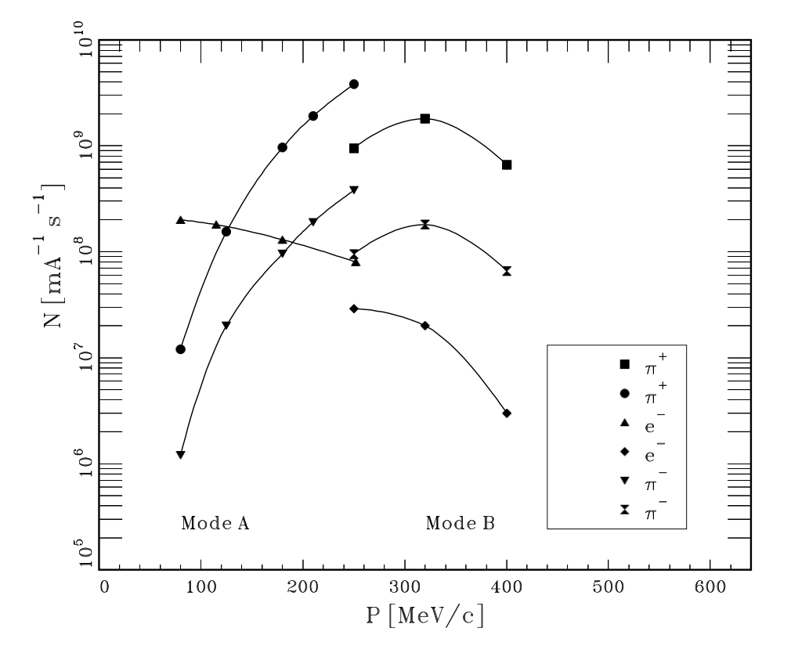
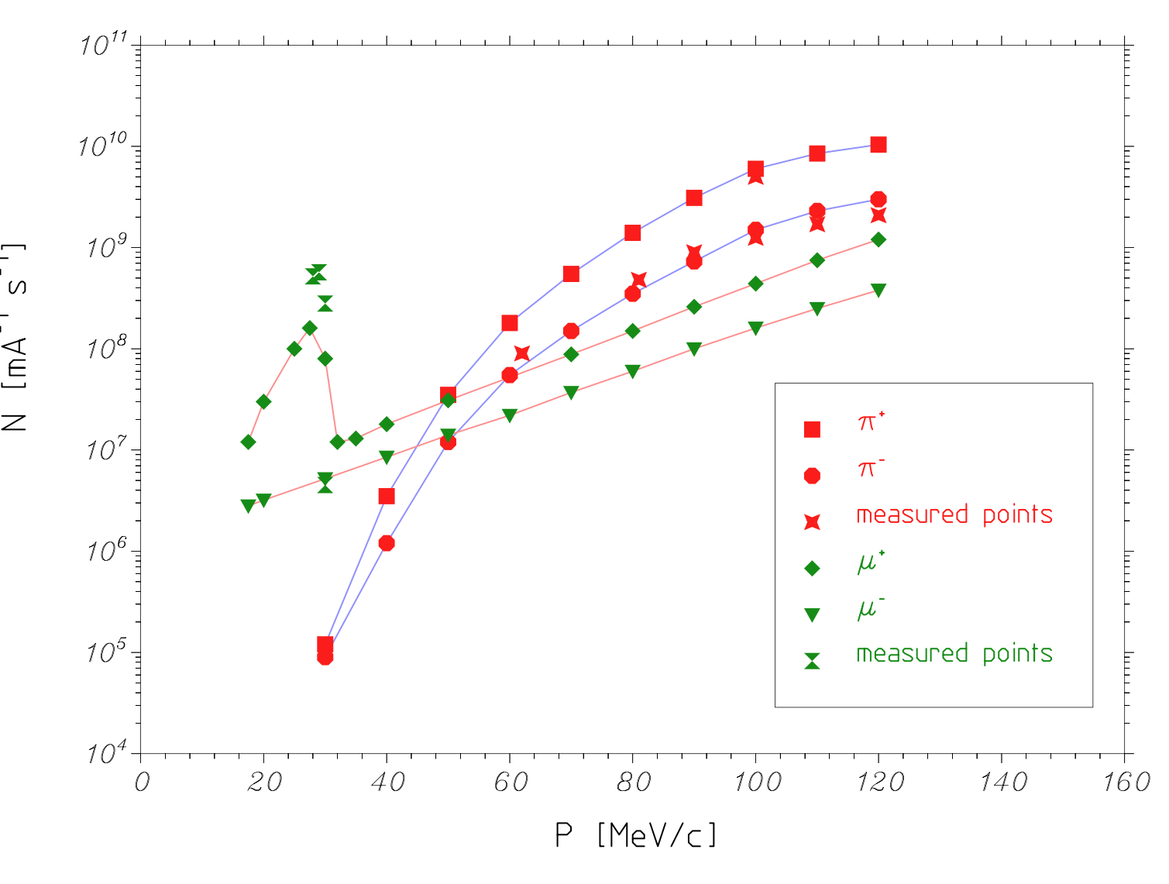
piE1/5 comparison
piE1
dp/p ±1% ??
piE5
dp/p ??
can check with
beam test
need Dinko’s point
rate and target

Slide 29
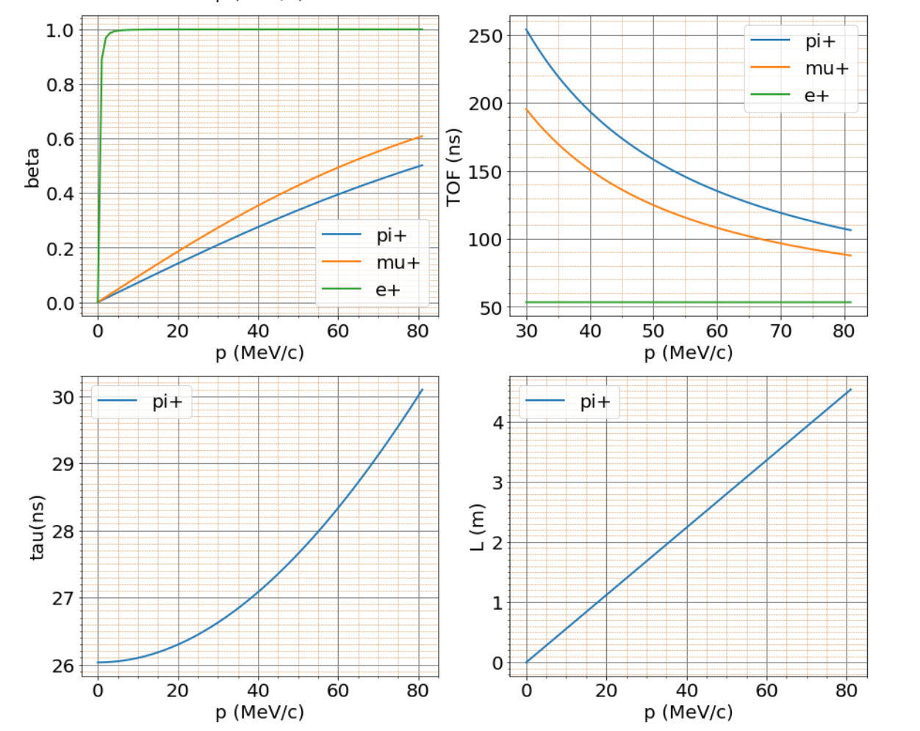
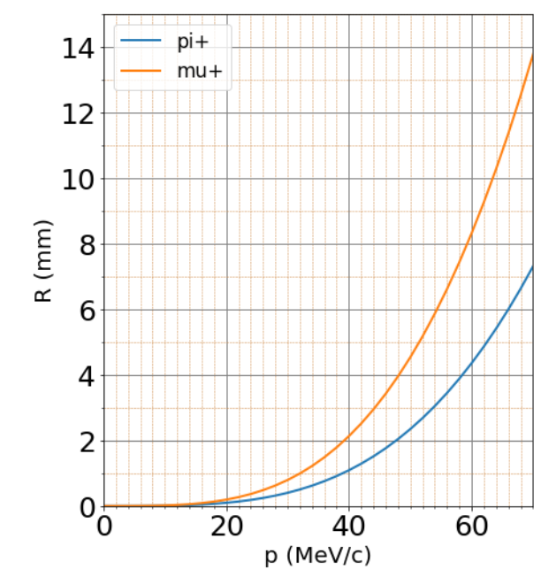
Properties of beam particles
kinematics
range

Slide 30
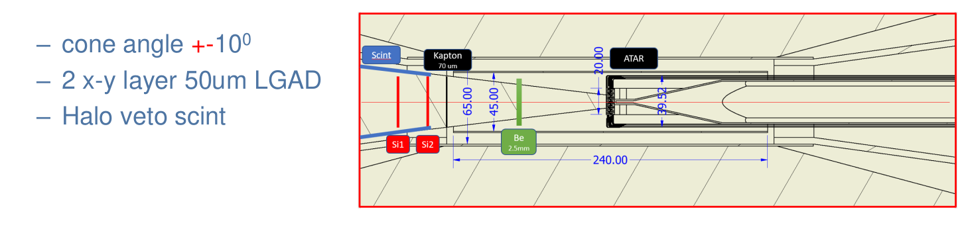

Slide 31
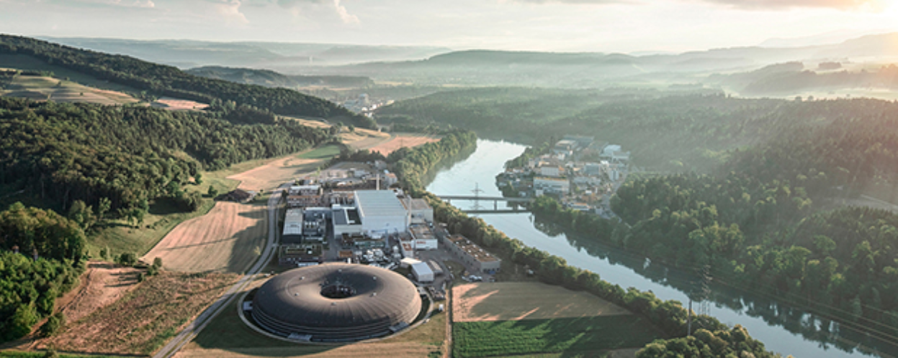
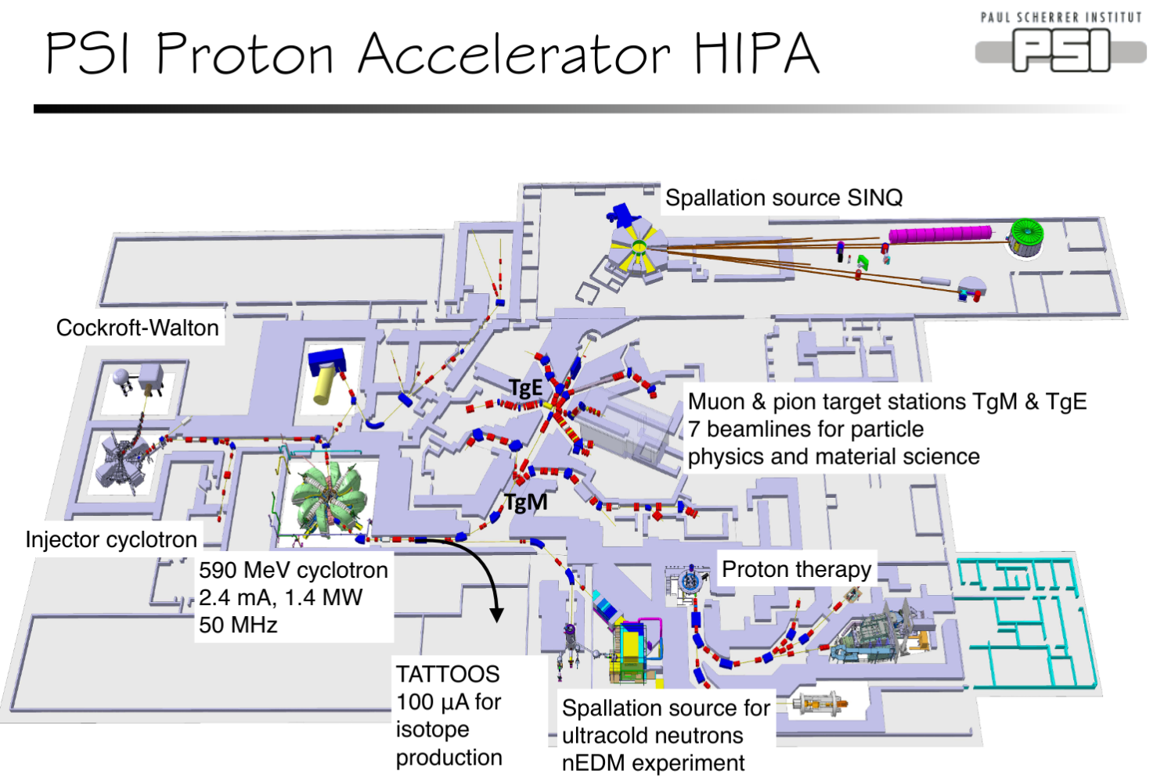
Paul Scherrer Institute
A multi-disciplinary research driver

Slide 32
