Slide 1


Finding New Physics with PIONEER
Andreas Crivellin
PSI & UZH
PIONEER collaboration meeting, 07.10.2022
Work supported by

Slide 2
Outline
Introduction
Anomalies
  LFUV
  Cabibbo Angle Anomaly
  Non-resonant di-leptons
  W mass and EW fit
Explanations
Implications for PIONEER
Conclusions
Andreas Crivellin

Slide 3
PIONEER Goals
Improve
  R(π)=π→µν/π→eν
  Pion beta decay π⁺→ π⁰eν
  by an order of magnitude compare to current limits
Provide most precise test of
  µ/e universality
  CKM unitarity
What is the impact of these measurements?
Which New Physics can be found?
Andreas Crivellin

Slide 4
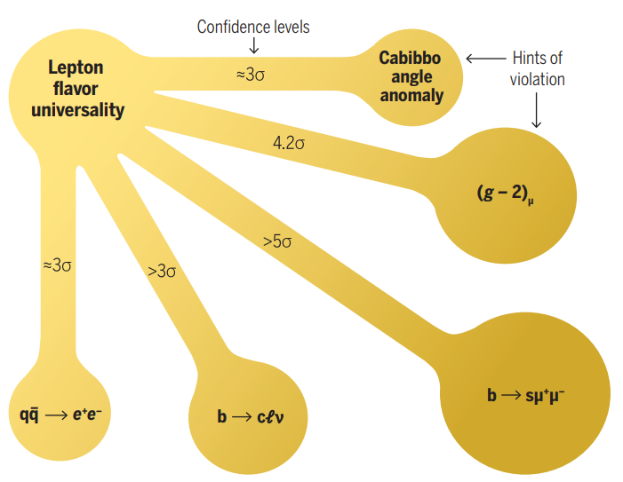
Hints for New Physics
EW observables
LFUV
AC, M. Hoferichter, Science 374 (2021)
m_{W}
≈3-4σ
Z→bb
Direct searches
γγ
ττ
bbγγ
WW
jj(jj)
Andreas Crivellin

Slide 5
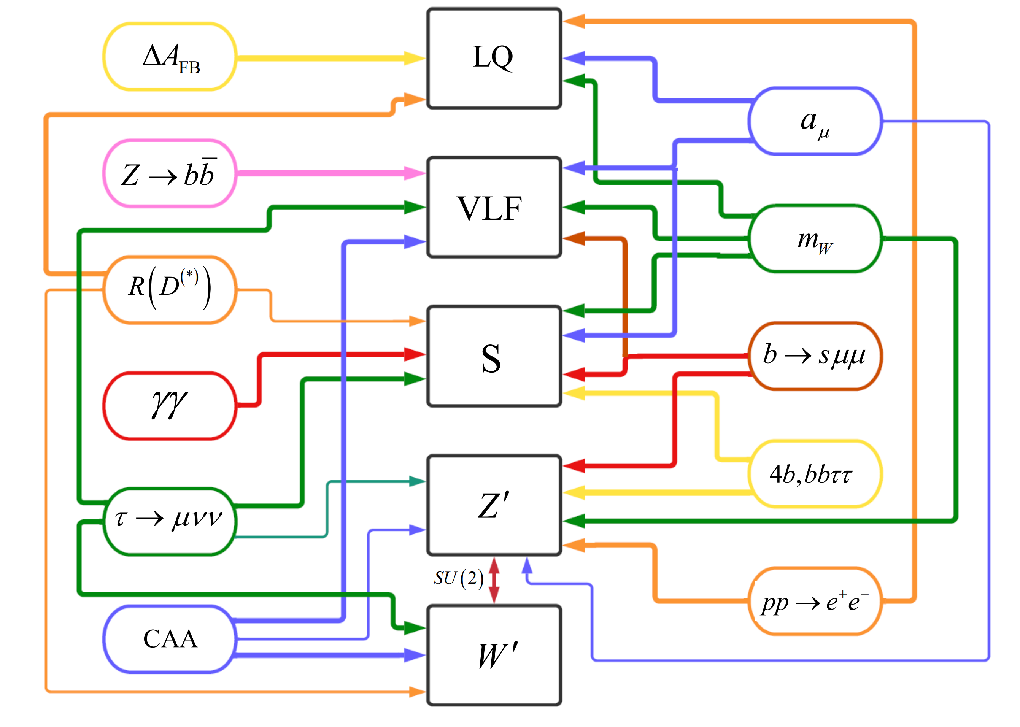
Expanations

Slide 6
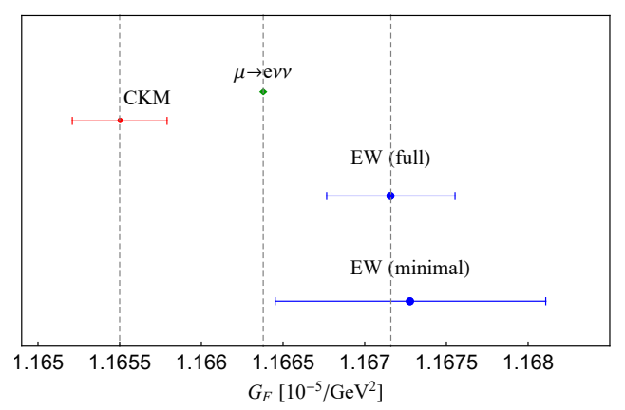
Cabibbo Angle Anomaly (CAA)
talk of Martin
Deficit in first row and first column CKM unitarity
NP in the determination
of from beta decays
needed
Can be interpreted as
  NP in beta decays
  NP in the Fermi constant
  LFUV (modified Wµν coupling)
AC, Hoferichter, Manzari, PRL 127 (2021)
3σ tension, can be interpreted as LFUV

Slide 7
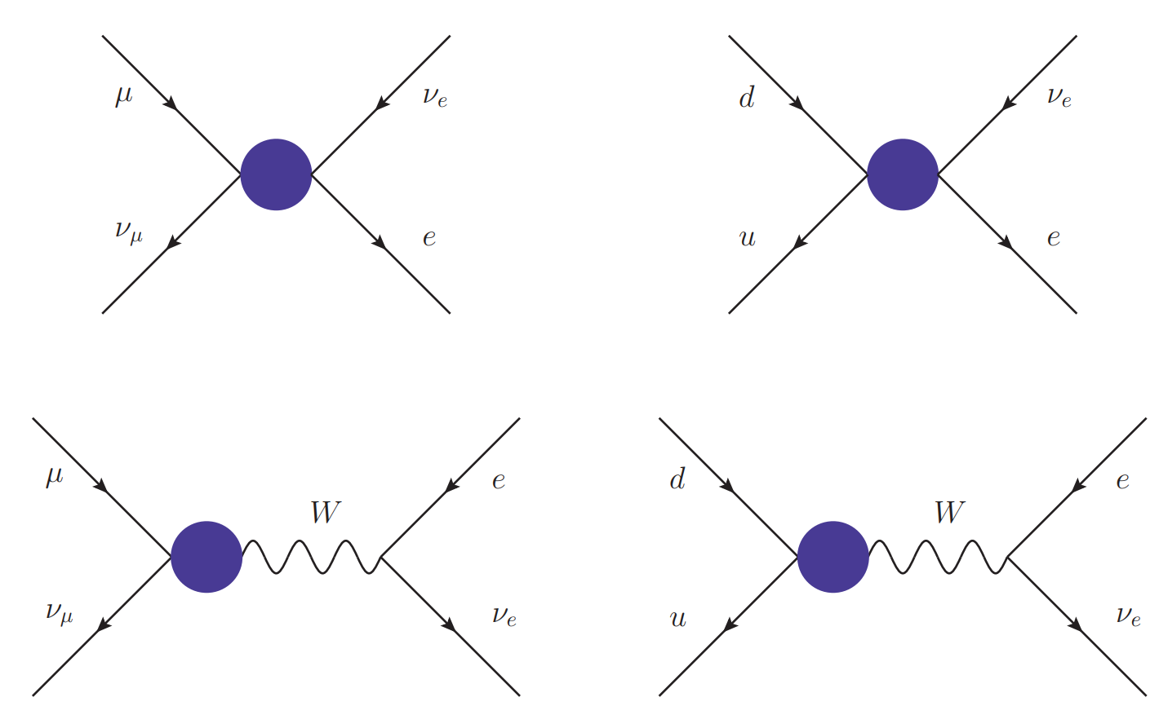
Cabibbo Angle Anomaly and EW Fit
4fermion effect in beta decays
  LQs
  W‘
Modifed W coupling in muon decay
  W-W‘ mixing
  Vector-like leptons
4 fermion effect in muon decay
  Z‘
  Singly charged scalar
Modified Wud coupling
  Vector-like quarks
>5σ improvement over SM hypothesis with VLLs

Slide 8
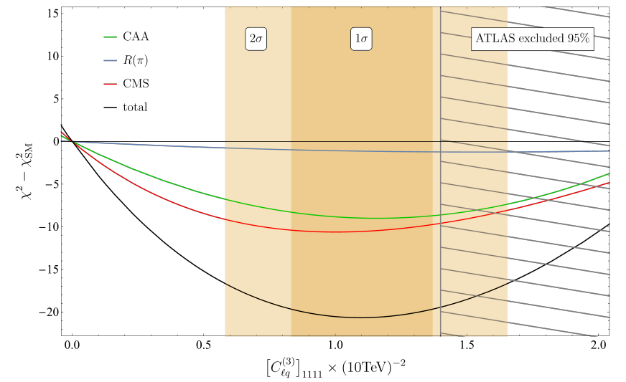
CAA and Non-Resonant Di-Leptons
AC, C. Manzari, M. Montull, 2103.12003
4.5σ better than SM, prediction for R(π)

Slide 9
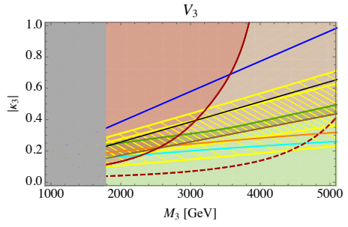
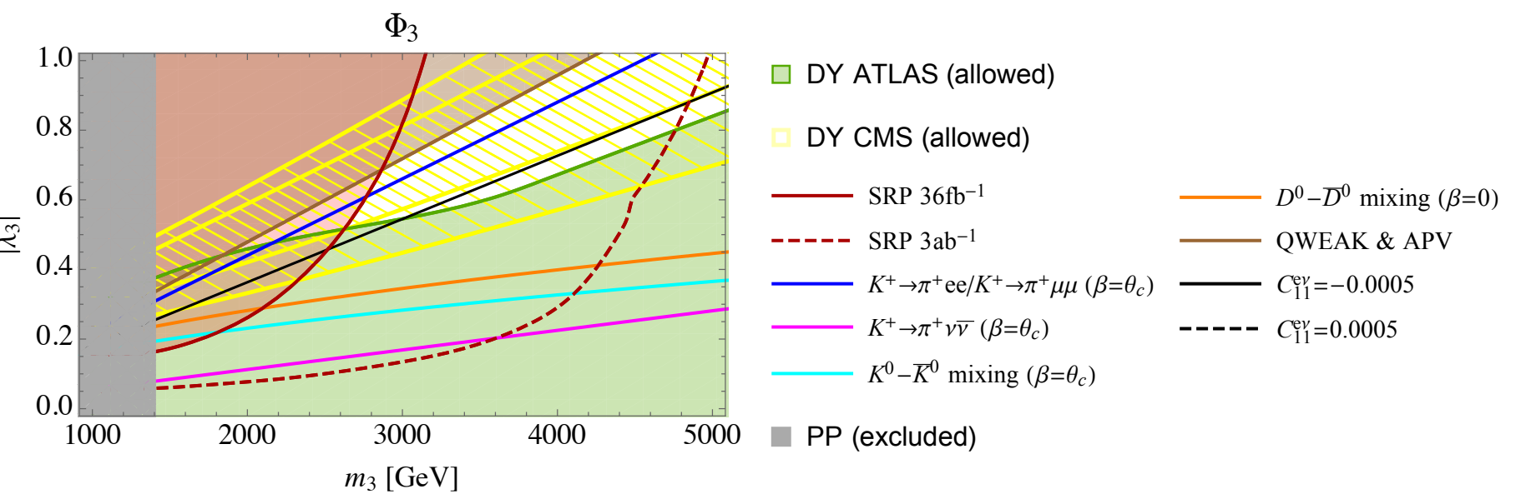
Leptoquarks
10 representations
Effect in R(π) and
beta decays
Simple model provides combined explanation
8

Slide 10
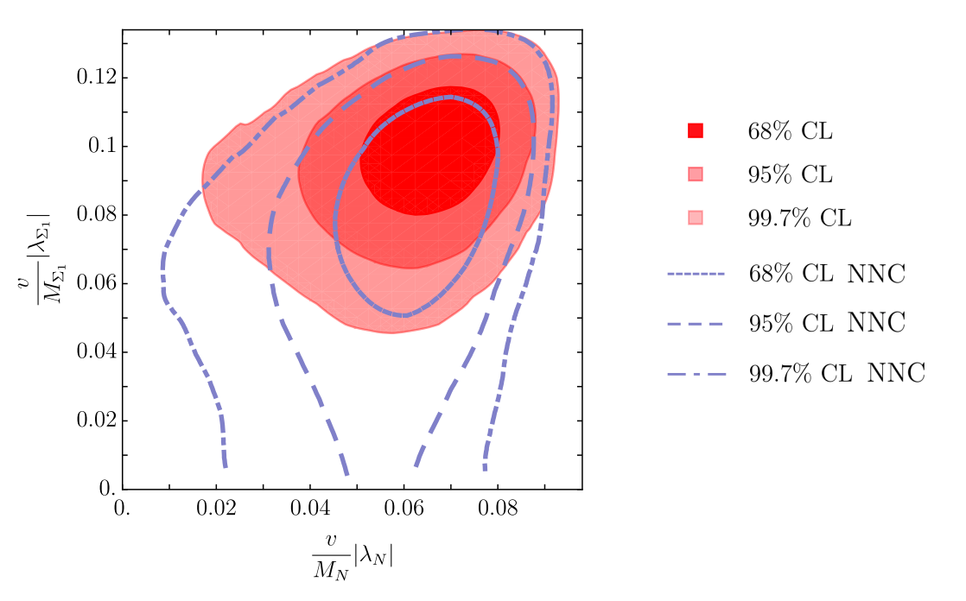
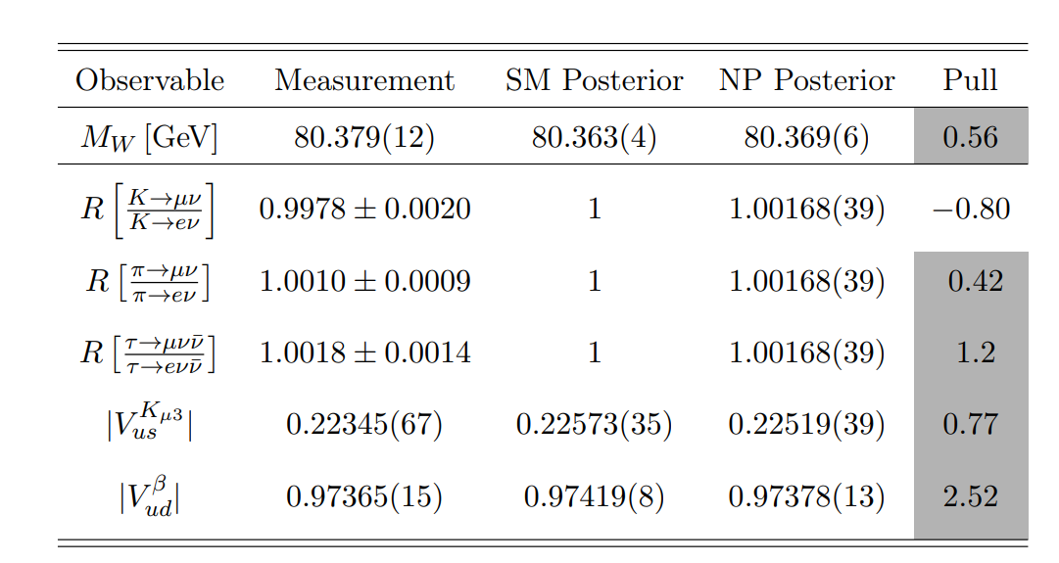
Vector-like leptons
5 represenations of
which 3 generate
modified Wlν
couplings
Bounds from EW
precision
observables
Effect in R(π), R(K)
and LFUV in τ decays

Slide 11
W’ in R(V_{us}) & b→sll
Region preferred by
EW fit overlaps with
b→sll region
Correlations
between
e.g. π→μν/π→eν
and R(K⁽*⁾) are
predicted
Global fit significantly
improved
Common explanation possible
8

Slide 12
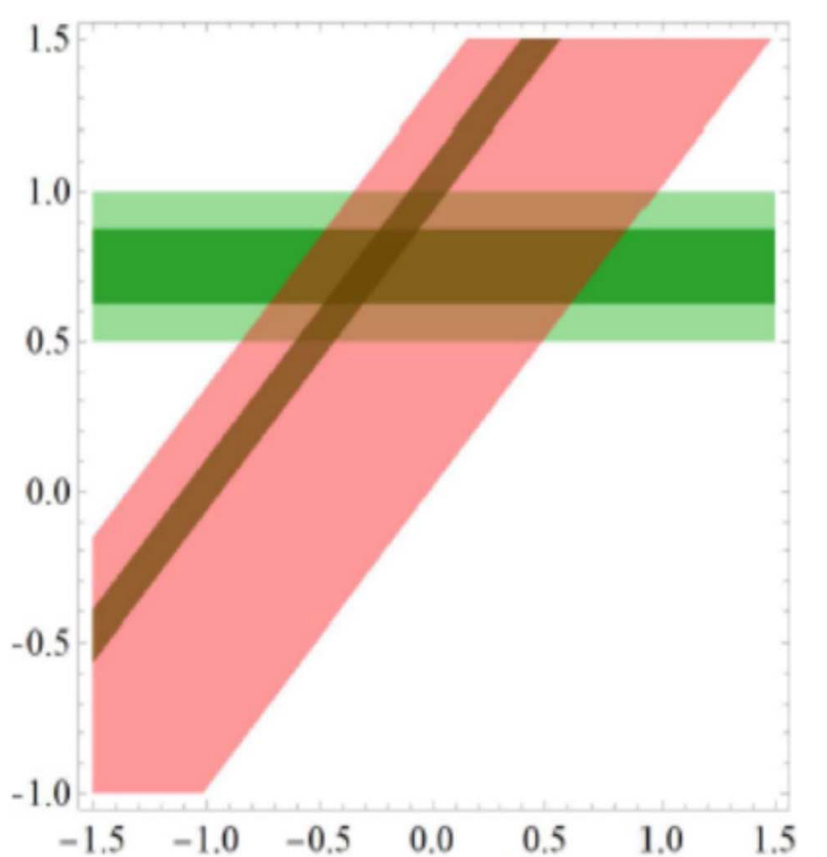
Impact of PIONEER
Test µ-e LFUV with unprecedented precision
Measure V_{ud} in theoretically clean pion beta decay
Test of New Physics
model
  Leptoquarks
  Vector-like leptons
  W` bosons
  Vector-like quarks
  Light new physics
talks of Asaf and Robert

Slide 13
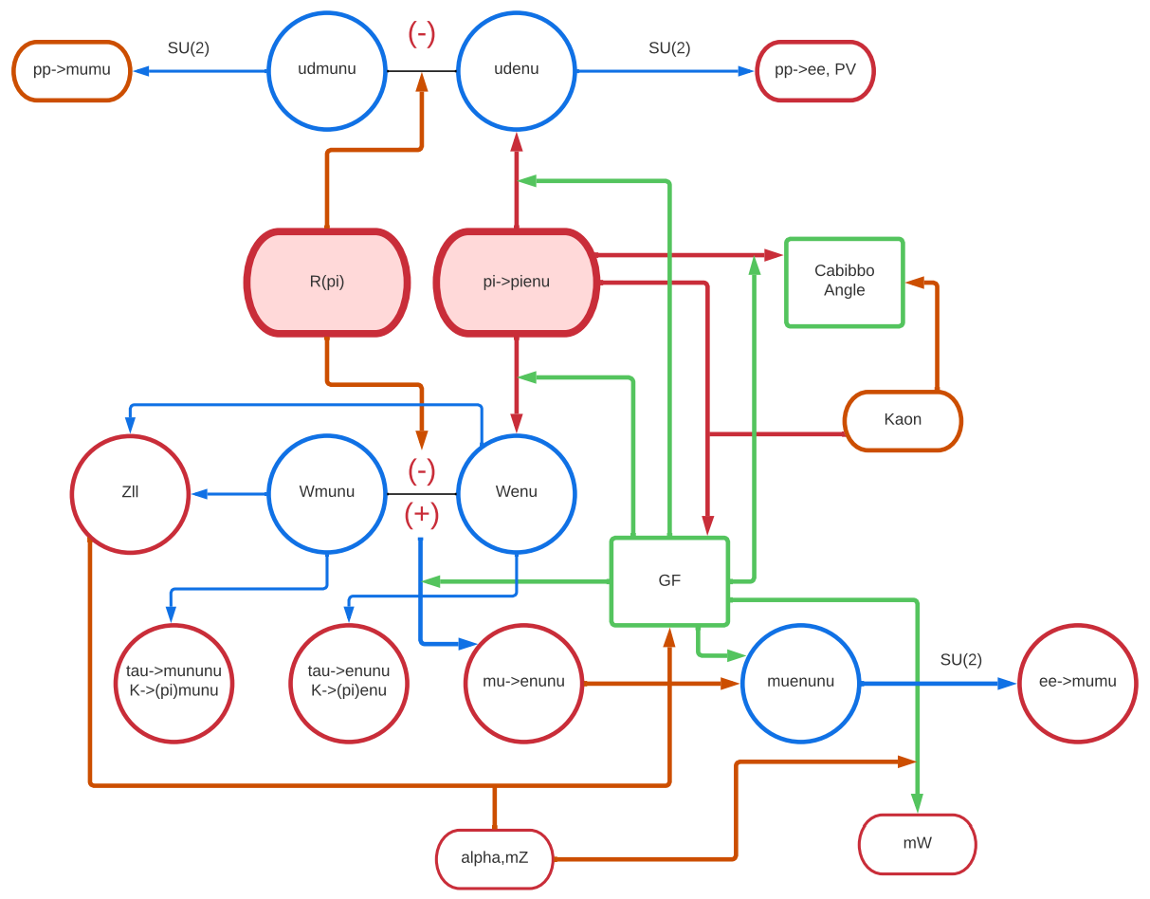
Impact of PIONEER II
Observables
Operators
SM Parameters

Slide 14
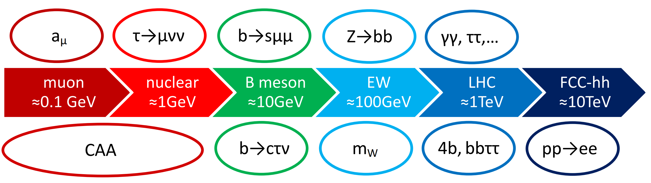
Conclusions
The Standard Model is crumbling;
PIONEER can contribute to its fall
Many intriguing anomalies emerged in the last years:
  LFUV
  EW observables
  Direct LHC searches

Slide 15
Backup

Slide 16
Discovering New Physics
Cosmic Frontier
  Cosmic rays and neutrinos
  Dark Matter
  Dark Energy
Energy Frontier
  LHC
  Future colliders
Intensity Frontier
  Flavour
  Neutrino-less double-β decay
  Test of fundamental symmetries
  Proton decay
Energy
Frontier
Dark
Matter
NP
NP
Intensity
Frontier
Cosmic
Frontier
writescience.wordpress.com
Dark
Matter
Andreas Crivellin

Slide 17
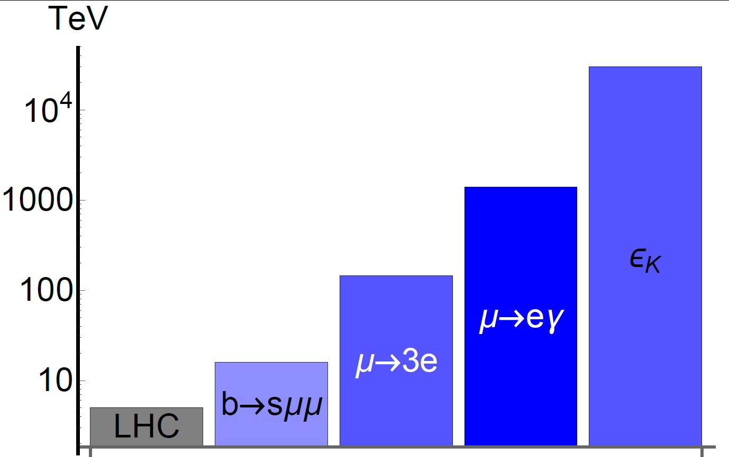
Indirect Searches for New Physics
Perfrom high-statistics measurements to search for the quantum effects of new particles
Experiment
Flavour observables
Standard Model
Direct searches
New Physics
PSI
PSI
Flavour observables can be sensitive to higher energy scales than collider searches
Andreas Crivellin

Slide 18
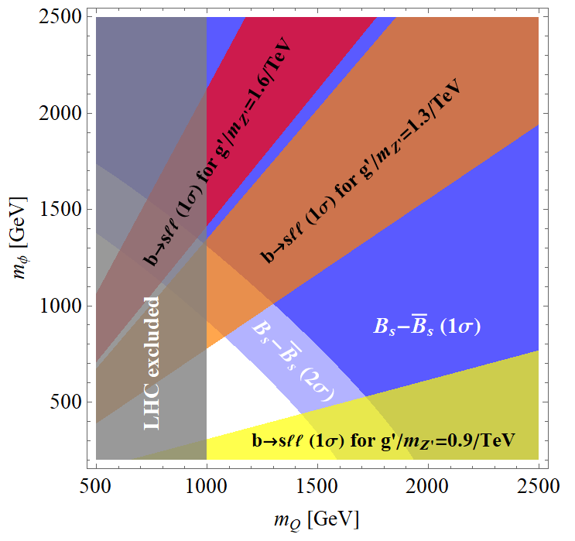
Model for b→sℓℓ, CAA, Z→bb and τ → μνν
Z → bb
τ→μνν
CAA
Zbb
box
Tree-level
Q_{L,R}
D_{L,R}
Z’
Φ⁺
Z’ penguin
Zsb coupling
Z’ penguin
Z’ penguin
Z’ penguin + modified Zsb
coupling give very
good fit to b→sll data
b→sμμ
Simple model provides combined explanation
8

Slide 19
Implications for FCC-ee
pp→e⁺e⁻
ΔA_{FB}
Z→bb
R(D⁽*⁾)
e⁺e⁻→ff
1.5x10¹²
b
5x10¹²
Z
3x10¹¹
τ
VLQ, VLL
LQ
W’
Z’, loop
VLL
CAA
b→sμμ
a_{μ}
τ →µνν
Andreas Crivellin

Slide 20
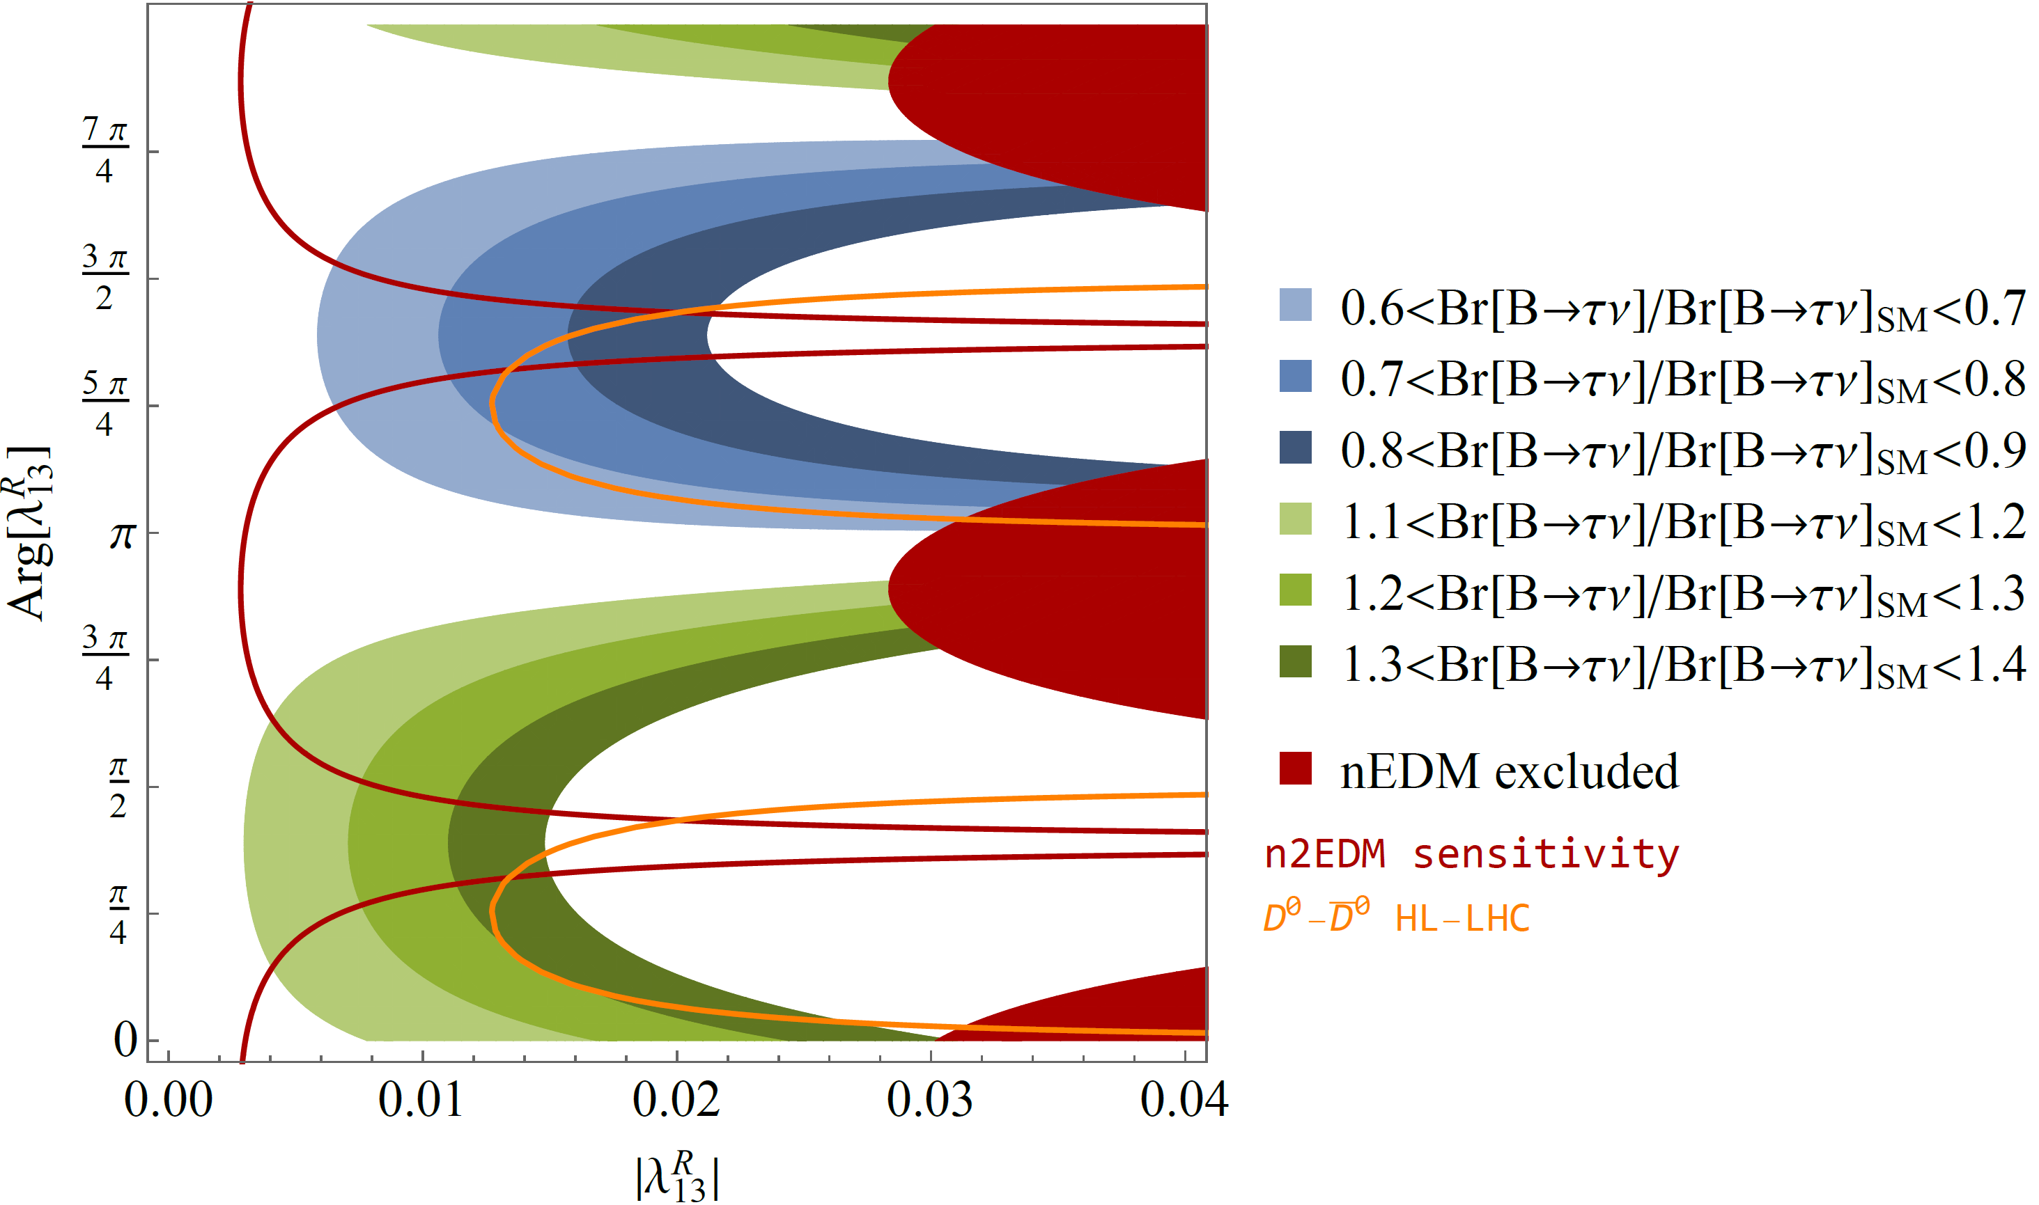
Correlations the neutron EDM with S1
W. Dekens, J. de Vries, M. Jung,
K. K. Vos, arXiv:1809.09114
AC, F. Saturnino
arxiv:1905:08257
1905:08257
J. Aebischer, AC, F. Saturnino, 1905.xxx
Effect in B predicts measurable nEDM effect

Slide 21
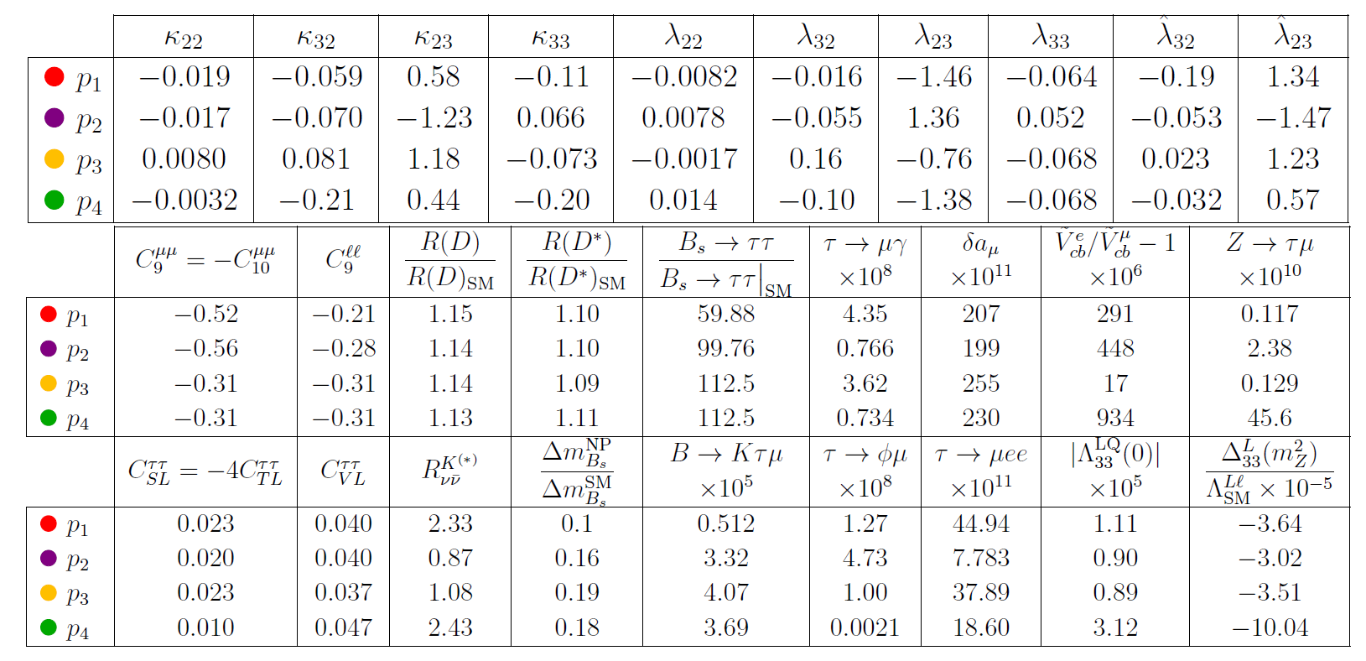
R(D⁽*⁾), b→sll and a_{µ}
4 benchmark points
AC, D. Mueller, F. Saturnino
arxiv:1912.04224
Common explanation possible

Slide 22
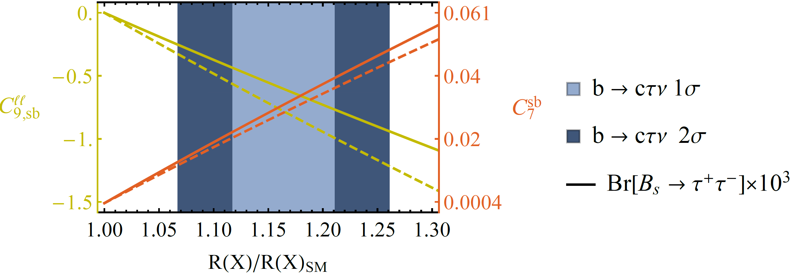
Important Loop-Effects
Explanation of b→cτν requires large bτ and sτ couplings (follows from SU(2) invariance)
AC, C. Greub, D. Müller,
F. Saturnino, PRL 2018
Large loop effects in b→sμμ

Slide 23
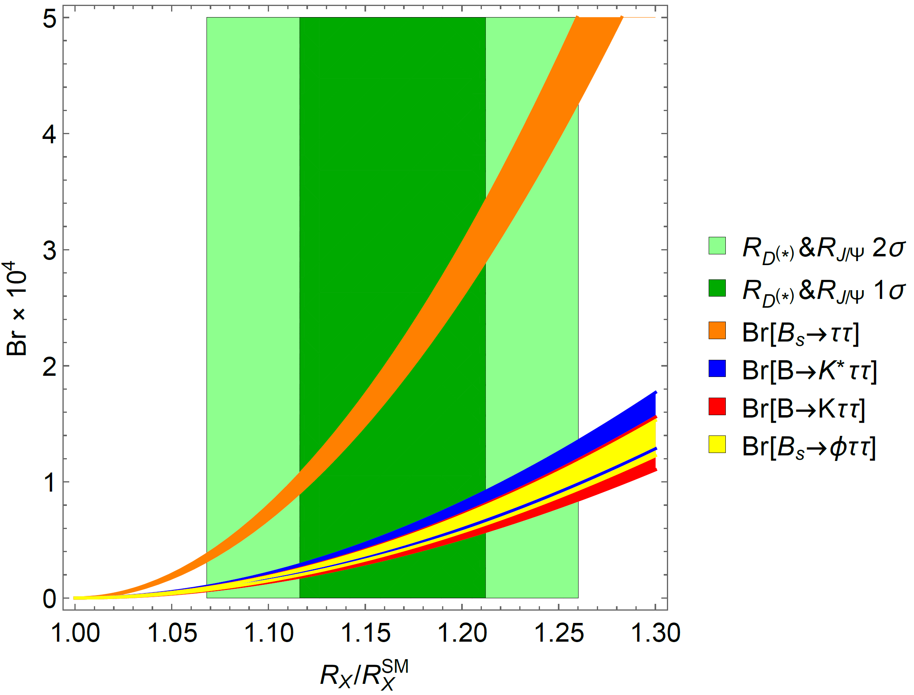
R(D⁽*⁾) and b→sττ
Large couplings to the second generation
b→sττ
very strongly enhanced
B. Capdevila, AC, S. Descotes-Genon, L. Hofer and J. Matias, PRL.120.181802

Slide 24
Important Loop-Effects
Explanation of b→cτν requires large LQ-bτ and LQ-c-ν_{τ} couplings
Via SU(2) invariance this
leads to large effects in
b→sττ processes
Closing the tau-loop gives a LFU
effect in b→sll
Effect goes in the right direction
AC, C. Greub, D. Müller,
F. Saturnino, PRL 2018
M. Algueró, B. Capdevila, S. Descotes-Genon, P. Masjuan, J. Matias, PRD, 2019
Explanation of b→cτν leads to
loop effects in b→sμμ

Slide 25
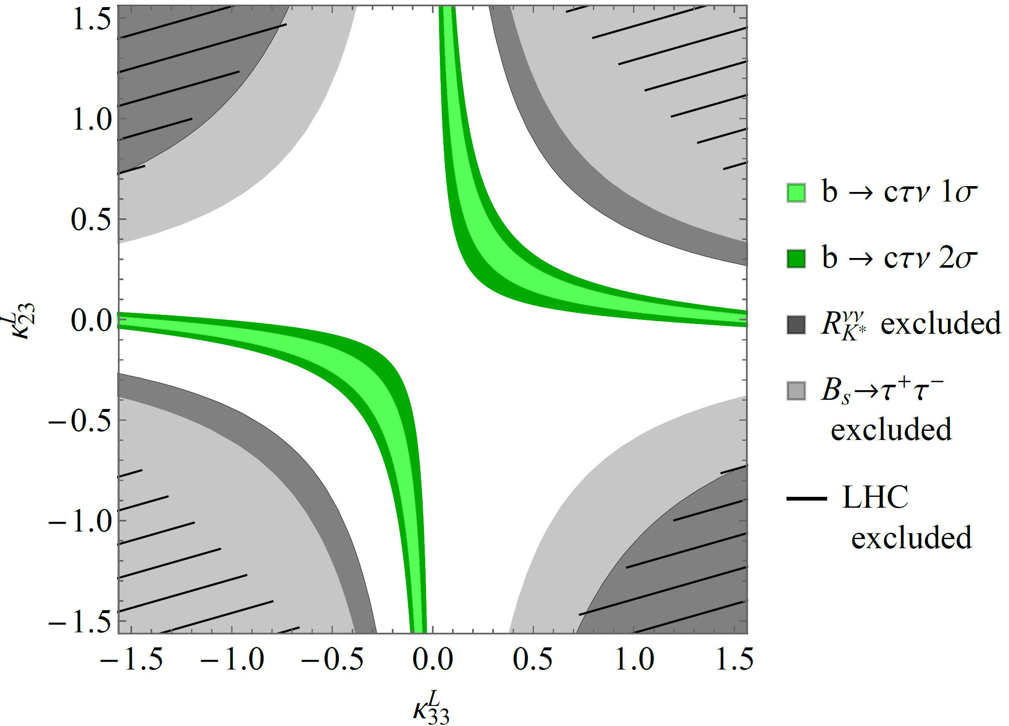
Vector LQ Phenomenology
Compatible with constraints for generic couplings

Slide 26
Possible UV completions
SU(4)×SU(3)’×SU(2)_{L}×U(1)_{Y} + Vector-like fermions
L. Di Luzio, A. Greljo, M. Nardecchia, arXiv:1708.08450
SU(4)×U(2)_{L}×SU(2)_{R} + Vector-like fermions
L. Calibbi, AC, T. Li, arXiv:1709.00692
SU(4)×SU(4)×SU(4)
M. Bordone, C. Cornella, J. Fuentes-Martin, G. Isidori, arXiv:1712.01368
SU(4)×SU(2)_{L}×SU(2)_{R} including scalar LQs and
light right-handed neutrinos
J. Heeck, D. Teresi, arXiv:1808.07492
SU(8) might even explain ɛ’/ɛ
S. Matsuzaki, K. Nishiwaki and K. Yamamoto, arXiv:1806.02312
SU(4)×SU(2)_{L}×SU(2)_{R} in RS background
M. Blanke, AC, arXiv:1801.07256
Good solution, but challenging UV completion

Slide 27
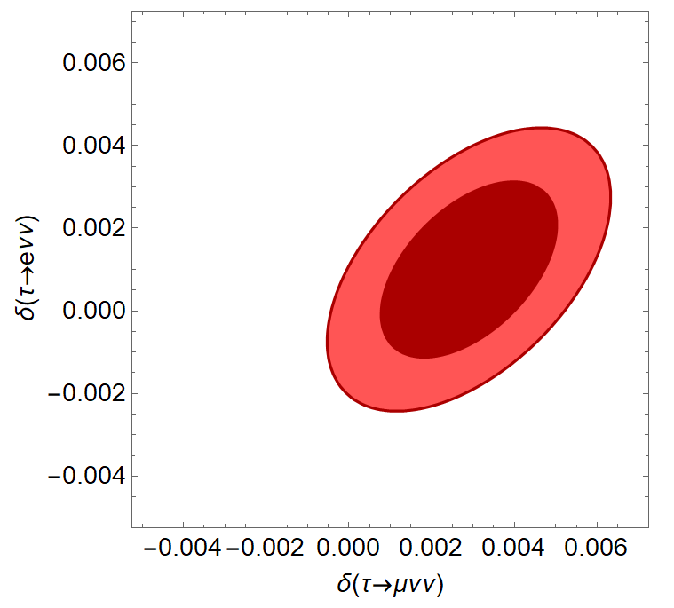
τ→μνν
Ratios of leptonic
tau decays
NP in muon decay too
constrained from EW data
≈2σ hint for LFUV in tau decays

Slide 28
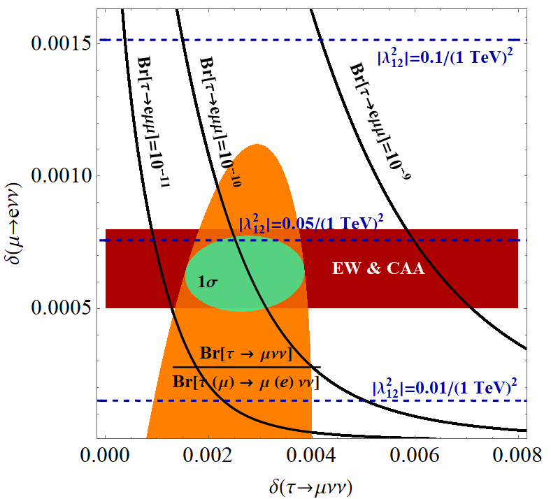
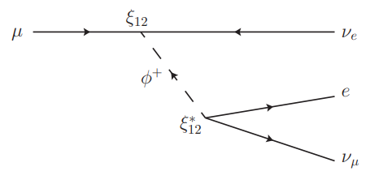
τ→μνν
L_{μ}-L_{τ} Z‘ (box diagrams)
LFV violating Z‘
Modified Wlν couplings
W‘
Singly charged scalar
Singly charged scalar
A.C., F. Kirk, C. Manzari, L. Panizzi, arXiv:2012.09845
4σ hint for modified neutrino couplings

Slide 29
Vector Triplet in R(V_{us}) & b→sll
Region preferred by
EW fit overlaps with
b→sll region
Correlations
between
e.g. π→μν/π→eν
and R(K⁽*⁾) are
predicted
Global fit significantly
improved
Common explanation possible
8

