Slide 1



High granularity fast silicon sensors for the PIONEER Active TARget detector
Jennifer Ott on behalf of the SCIPP PIONEER team
Rare Pion Decay Workshop, UC Santa Cruz, Oct 6-8 2022
*jeott@ucsc.edu

Slide 2
Overview
Criteria for ATAR sensors
Silicon sensor candidates for the ATAR
  Standard LGAD
  AC-LGAD
  TI-LGAD
  AC/DC –readout LGAD
  Planar silicon – in presentation by Xin Qian
Signal readout with flexes
Investigation of gain suppression with beta and alpha particles
Summary, Outlook

Slide 3
ATAR sensor criteria and motivation
Spatial resolution
  Separation of tracks – π , e and µ
  (Location of decay vertex)
  Position resolution of < 200 µm
Area
  2x2 cm² for each plane, as little inactive material as possible: not convenient to divide this into multiple sensors or have bump-bonded pixels
  → Strip sensors, every other plane rotated 90°
Granularity in z:
  Thin sensor to provide granularity in z as well as fast rise time
  Sufficiently thick to not require inactive support material
Timing resolution
  Rise time: precision timing of hits within < 100 ps
  Fall time: recovery of baseline to register subsequent hits with 1-2 ns temporal separation
  → Signal multiplication needed: LGAD
Efficiency
  Fill-factor (fraction of active vs inactive area) should be as high as possible
  → Conventional LGAD likely not feasible
  High-energy event deposits in addition to MIPs: cross-talk over adjacent segments cannot be too large
  → Challenge!

Slide 4
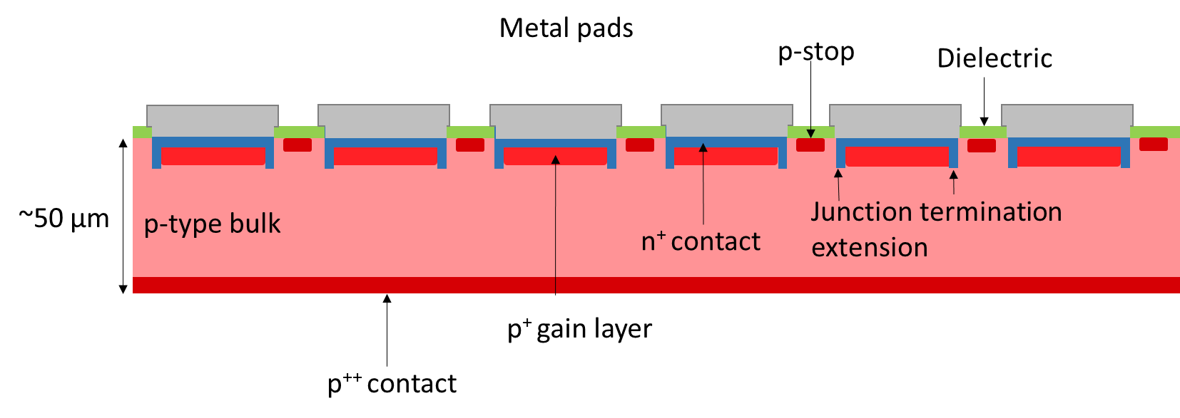
Recap: Low Gain Avalanche Diodes
Developed in the past 5-7 years for high-energy physics, primarily in the scope of the CMS and ATLAS endcap timing detector upgrades
  Ultrafast timing and 4D tracking essential in future HEP experiments to mitigate effects of higher luminosity and pile-up
LGAD key characteristics
  Thin sensors, typical thickness 50 µm (on top of mechanical support wafer)
  Low to moderate gain (5-50) provided by p⁺ multiplication layer
  Timing resolution down to ca. 20 ps
  Good radiation hardness up to 10¹⁵ n_{eq}/cm²
  High-field region of the gain layer needs to be terminated between neighbouring pads: limited downscaling of this technology
Usually include 300-500 µm support wafer in addition to the depicted active region!

Slide 5
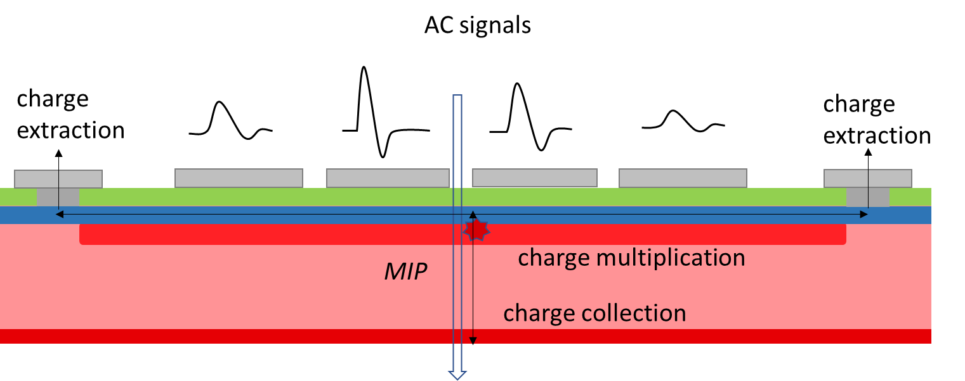
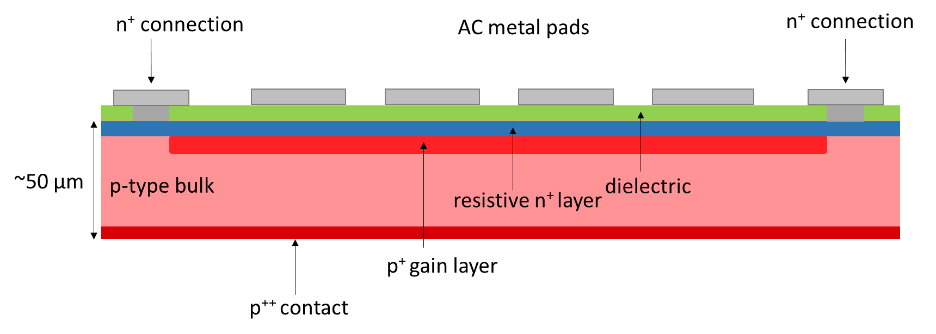
AC-coupled low gain avalanche diodes
In AC-coupled LGADs, also referred to as Resistive Silicon Detectors (RSD), the multiplication layer and n⁺ contact are continuous, only the metal is patterned:
  Signal is read out from metal pads on top of a continuous layer of dielectric
  The underlying resistive n⁺ implant is contacted only by a separate grounding contact
The continuous n⁺ layer is resistive, i.e. extraction of charges is not direct
  Mirroring of charge at the n⁺ layer on the metal pads: AC-coupling
  Strong sharing of charge between metal pads
  Impact on signal sharing by segment pitch, metal width, distance; electrode shape and geometry; n⁺ layer resistivity?
G. Giacomini et al., Fabrication and performance of AC-coupled LGADs, JINST 2019, 14, P09004
A. Apresyan et al., Measurements of an AC-LGAD strip sensor with a 120 GeV proton beam, JINST 2020, 15, P09038
S. M. Mazza, An LGAD-Based Full Active Target for the PIONEER Experiment, Instruments 2021, 5(4), 40

Slide 6
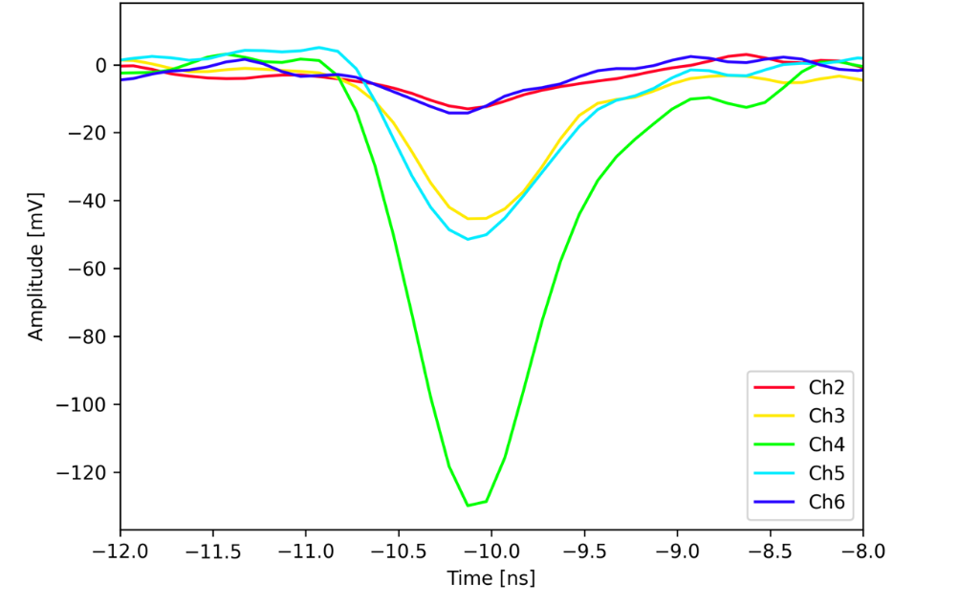
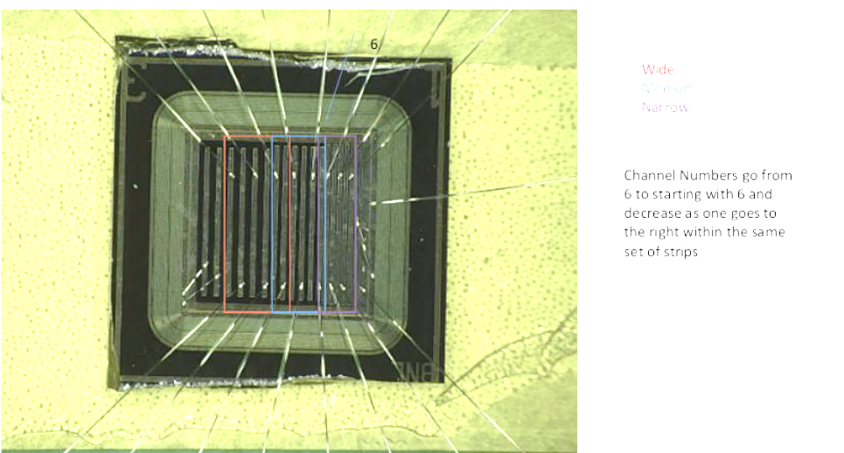
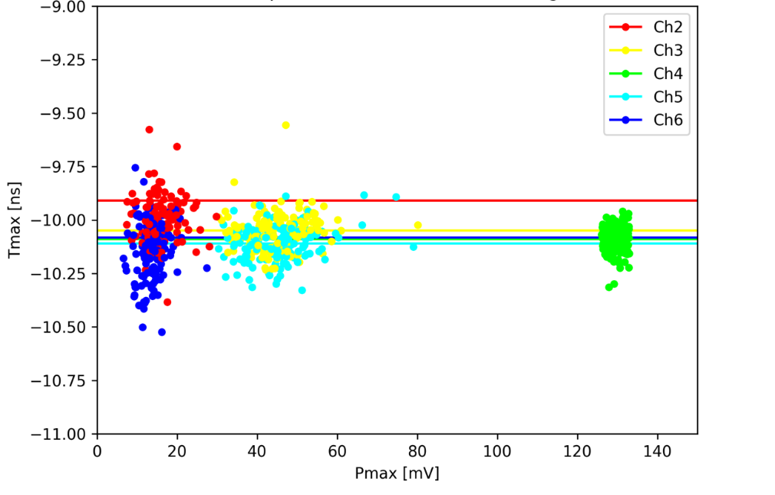
Signal pulse shapes
Signal in first and second neighbors is observed, but with lower amplitude and wider spread in maximum amplitude and peak time, respectively
  Slower rise time: impact on jitter → timing resolution

Slide 7

Pulse fraction and position resolution
Case of two adjacent strips
The pmax sum ist not constant under the strip metal, but fairly constant between strip centers
The pmax fraction of an individual strip is defined as:
$$pmax fraction (channel)= \frac{pmax (channel)}{\sum{pmax}}$$
The position resolution can be calculated from the fraction of pmax at a given position (fitted with an error function):
$${position resolution σ}_{pos}= \sqrt{2}\frac{d(position)}{d(fraction)}/\frac{S}{N}$$
ν
Signal-to-noise ratio is favourable in (AC-)LGADs due to their internal gain

Slide 8
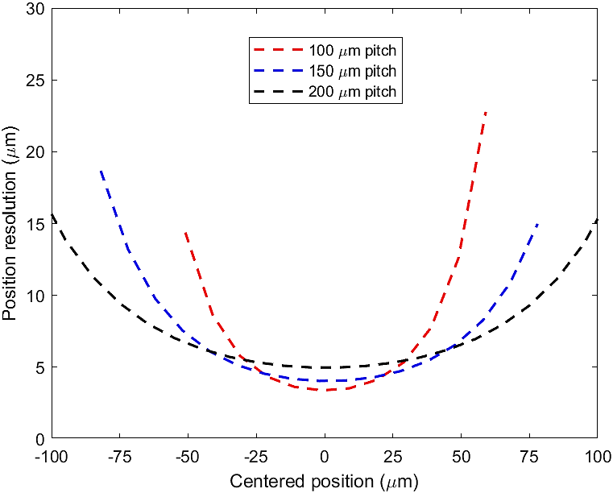
Position resolution in BNL 2021 strips
Strip pitch is expected to - and appears to - have a large impact on charge sharing as seen in the pmax fraction profile …
… position resolution of ca. 15 µm at the respective strip metal centers (end of the data points in the plot): in fact very similar for all three pitches
Between strips, a position resolution of ~6 µm or less is reached; slightly better for smaller pitch
  At best, < 1/20 of the pitch

Slide 9
Charge sharing in long strips
Charge sharing over wide distances is observed, in particular for wide and long strips
Sharing is increased with strip length, with a difference visible already between 0.5 and 1.0 cm

Slide 10
Charge sharing in long strips
Charge sharing over wide distances is observed, in particular for wide and long strips
Sharing is increased with strip length, with a difference visible already between 0.5 and 1.0 cm
  Adjustment of (inter)strip capacitance, (inter)strip resistance through the metal size and n⁺ resistivity is going to be of central importance
2.5 cm sensor

Slide 11
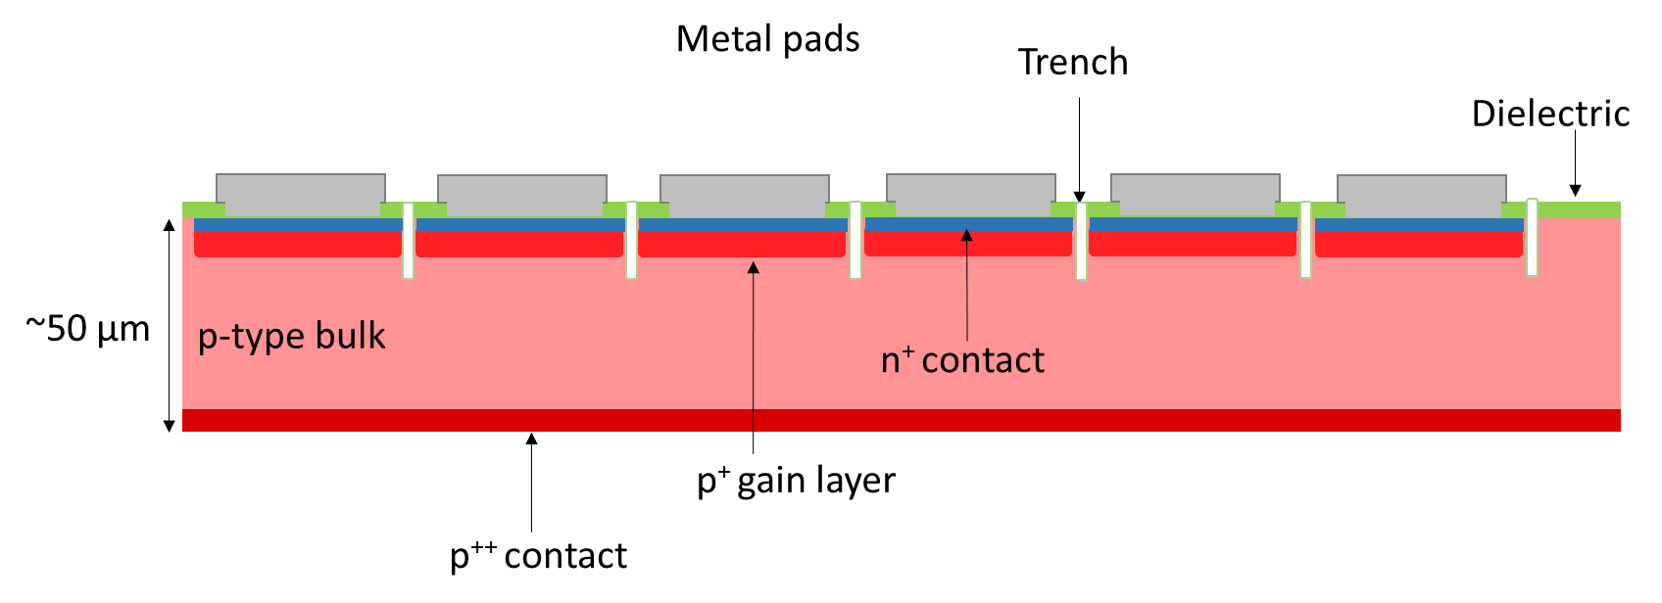
Trench-insulated LGADs
Rely on direct readout from metal pads and segmented gain layer in the same way as standard LGADs
Gain layer is not terminated electrically by an implant, but with etched trenches (fabricated e.g. by Reactive Ion Etching)
  Very high fill factor, 99-100%
  No charge sharing
Relatively early stage of prototyping: focused on small pad arrays, no long strip sensor prototypes yet

Slide 12
Trench-insulated LGADs

Slide 13
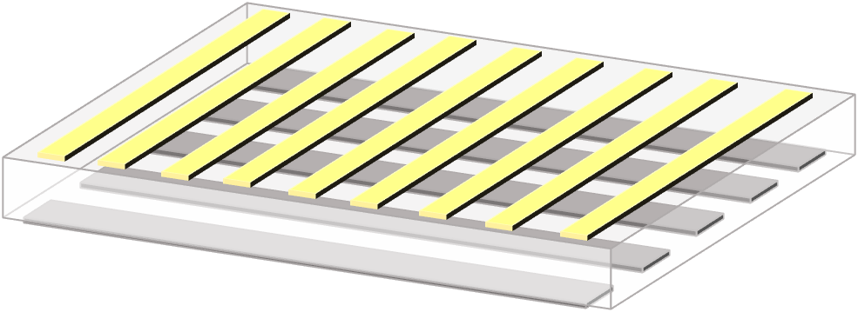
Combined AC-LGAD and DC readout
More recently suggested by BNL: adaptation of AC-LGAD strips to also include strip pattern and readout on the (DC) back side of the sensor
  AC side for position resolution (charge sharing)
  DC side for timing resolution (no sharing – faster rise time)
  Even a combined reconstruction?
Structure still requires simulation effort: no prototypes fabricated yet
Adds complexity to the readout, since strips on both sides would need to be read out

Slide 14
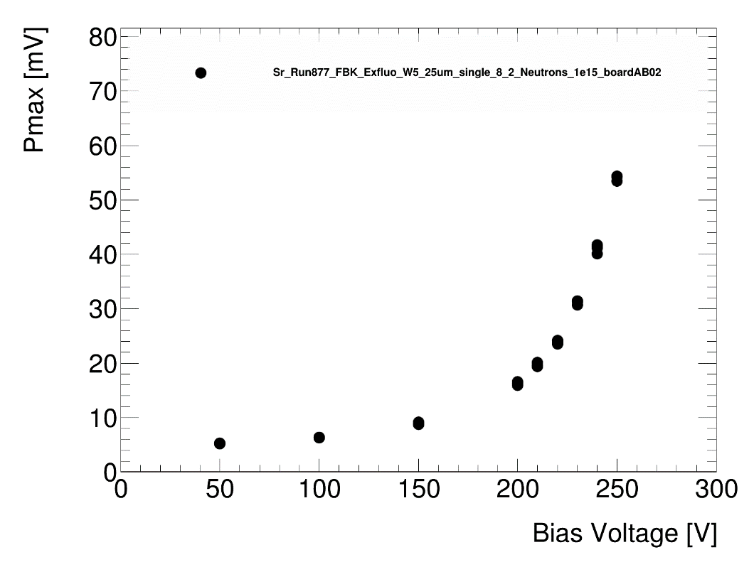
Studies of gain suppression
Gain can be suppressed if a very large amount of charge carriers is present around the gain layer: absorption of high-mass particles in the surface layers of the Si sensor
  Development of an alpha particle testing station at SCIPP
  Comparison of alphas vs minimum-ionizing beta particles, in resemblance of charged pion and e/µ events

Slide 15
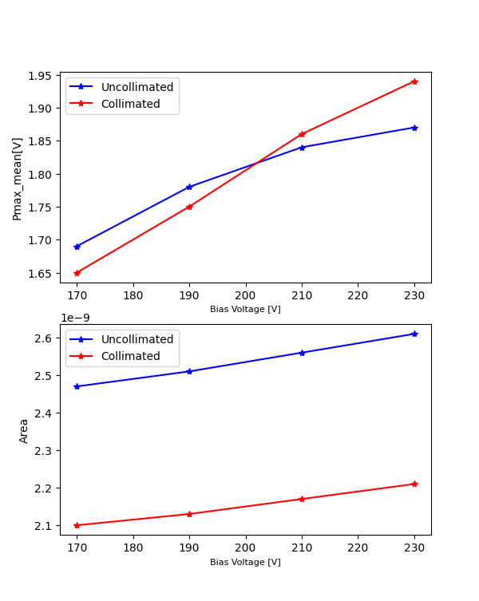
Gain suppression in the alpha station
5mm
5mm
Alpha Source
1mm
5mm
Collimator
10 mm
Sensor

Slide 16
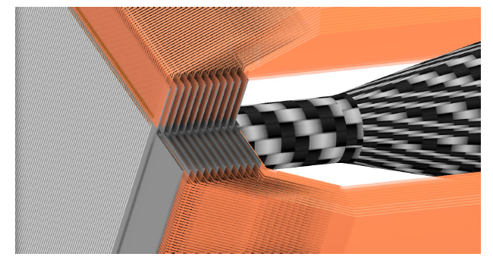
Flex readout
Transfer of raw signals from the ATAR sensors by flex cable: readout chips do not need to be positioned in the beam or path of the decay products
Prototypes: 3 – 7 cm flexes
100 and 300 µm trace pitch

Slide 17
Flex readout

Slide 18
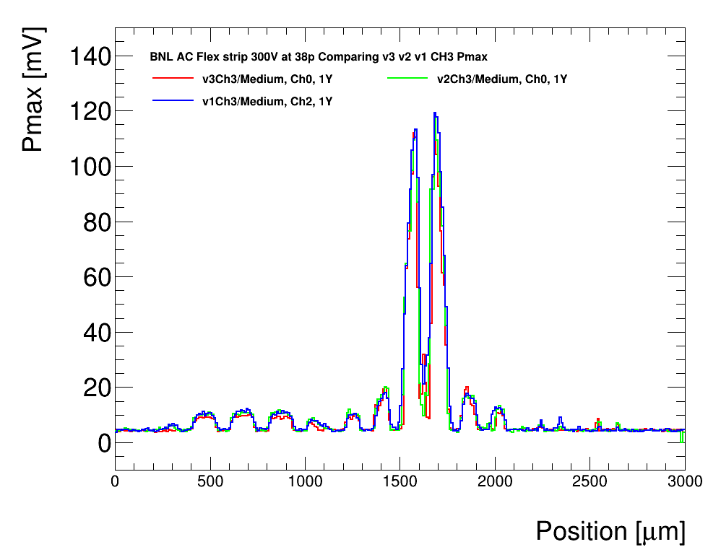
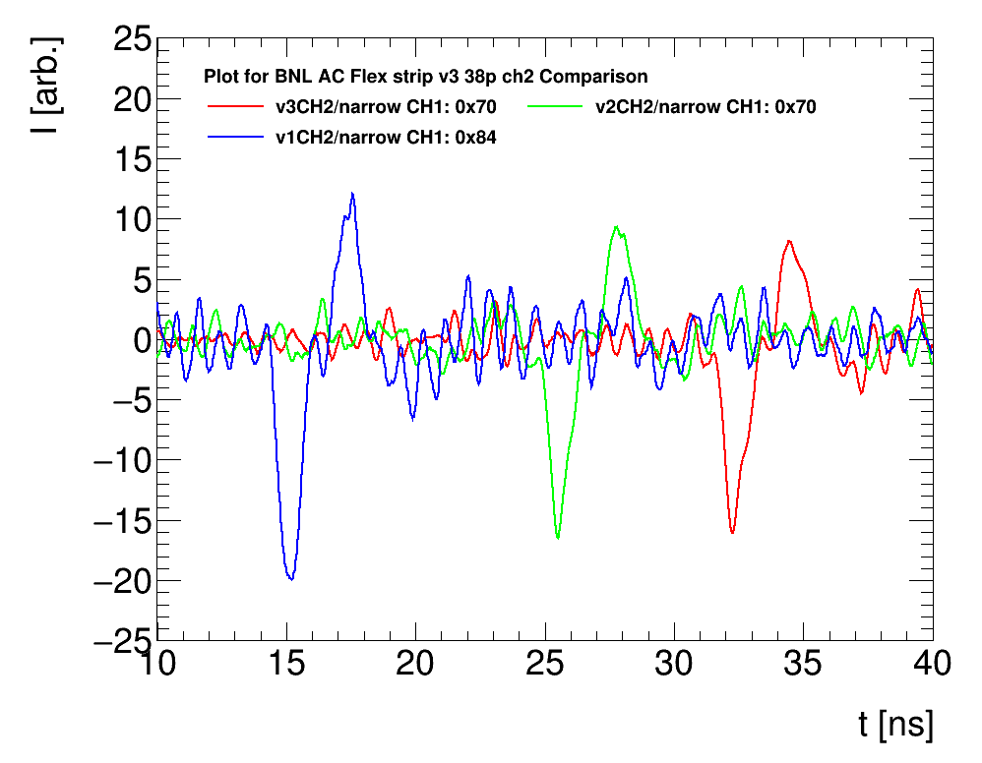
Flex readout
Bonding of a sensor to the flex cable is mechanically challenging
Charge sharing with neighboring strip, and baseline noise of channels are increased when connected to the flex
Strong long-range pick-up from wide strip traces is observed
  Attempts to reduce this by spacing connections further apart, grounding traces in between: slight improvement, but not solved
  Very recently, started to study the flex separately from the sensor with a dedicated probe and pulse generator

Slide 19
Summary and Outlook
ATAR: extensive lists of requirements and aspects to consider in terms of temporal and spatial resolution, electrical performance, readout, mechanical considerations, …
However, for many of these requirements the precise target or range is not yet known:
  Input from sensor simulation needed!
  Input from detector simulation needed!
AC-LGADs are the baseline technology, but other types of silicon sensor are still worth considering and investigating
  Continued investigation of charge sharing and gain suppression at higher particle energies
  Analysis of PSI beam test data!
Detector performance is significantly influenced by readout electronics
  Routing of signals via flex is nontrivial
  Different types of particles require a large dynamic range of the front-end

Slide 20

Thank you!
Thank you!

Slide 21
BackuP

Slide 22
Comparison of sensor technologies
Sensor | Fill factor | Spatial resolution | Timing resolution | Charge sharing | Production-ready | No. of channels to reach 20 µm pos.res.
LGAD | + | -- | +++ | - | ++ | N/A*
AC-LGAD | +++ | +++ | ++ | +++/-- | ++ | ++
TI-LGAD | ++ | ++ | +++ | - | + | +
DC/AC-LGAD | +++ | ++ | - | ++ | - | ++ ?
Planar Si | ++ | - | -- | + | +++ | +
* Position resolution limited to ca. 1 mm/$\sqrt{12}$

