Slide 1

TCAD Simulation of AC-LGAD
Mohammad Nizam*,
T. Shin, A. Seiden, B. Schumm, H. Sadrozinski, S. Mazza, J.Ott, E. Ryan,
M. Wong, Y. Zhao (SCIPP, UCSC)
RARE PION DECAY WORKSHOP – UCSC
10/07/ 2022

Slide 2
Outline
Motivation
2D Simulation in Silvaco Victory device
Comparison with the test beam data
3D Simulation in Synopsis Sentaurus
Effect of strip length
Gain Suppression study in Sentaurus

Slide 3
Motivation
Technology Computer Aided Design (TCAD) extensively used in semiconductor industry
The goal of TCAD simulation of LGADs is to reproduce the existing results from the test beam data and optimize various parameters (e.g., N+ sheet resistance, bulk thickness, pitch size, strip size etc) for the PIONEER to provide input to the production.

Slide 4
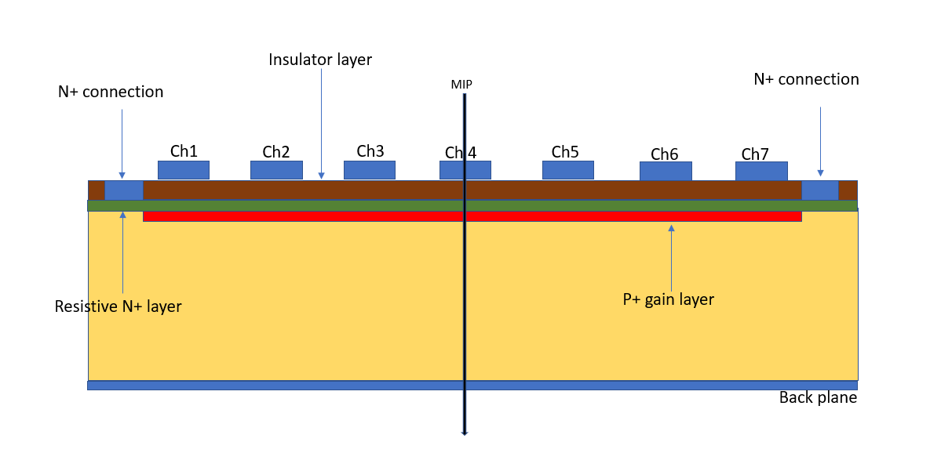
2D Simulation
AC-coupled Low Gain Avalanche Diode (AC-LGAD)
A variant of LGAD with an insulating layer between the read-out pads/strips and the N+ layer.
N+ layer is contacted only by a separate grounding electrode.
The signal on the metal pad/strip is a mirror image of the charges reaching the N+ layer.

Slide 5
Simulation Framework
2D Silvaco© Victorydevice
Impact Ionization = Grant (has a low-field, an intermediate-field, and a high-field region, there is no temperature dependence)
Mobility Models:
- Conmob (the concentration dependent mobility model)
- Fldmob (the lateral electric field-dependent mobility model)
Recombination model = Shockley – Read –Hall Recombination model (SRH )
Method = Newton (Nonlinear solutions are obtained using the Newton method)
Charge deposition (MIP) using singleeventupset method (80 e/h pairs per micron)
X-mesh size = 5 um
Y-mesh size= 0.01 um – 1.0 um

Slide 6
Simulated Device Parameters
 | Device 1 | Device 2 | Device 3
Pitch (um) | 100 | 150 | 200
Metal size (um) | 80 | 80 | 80
Channels | 7 | 7 | 7
Oxide layer (nm) | 20 | 20 | 20
Nitride layer (nm) | 85 | 85 | 85
Bulk thickness (um) | 50 | 50 | 50
Doping Profiles | FBK/BNL | FBK/BNL | FBK/BNL

Slide 7
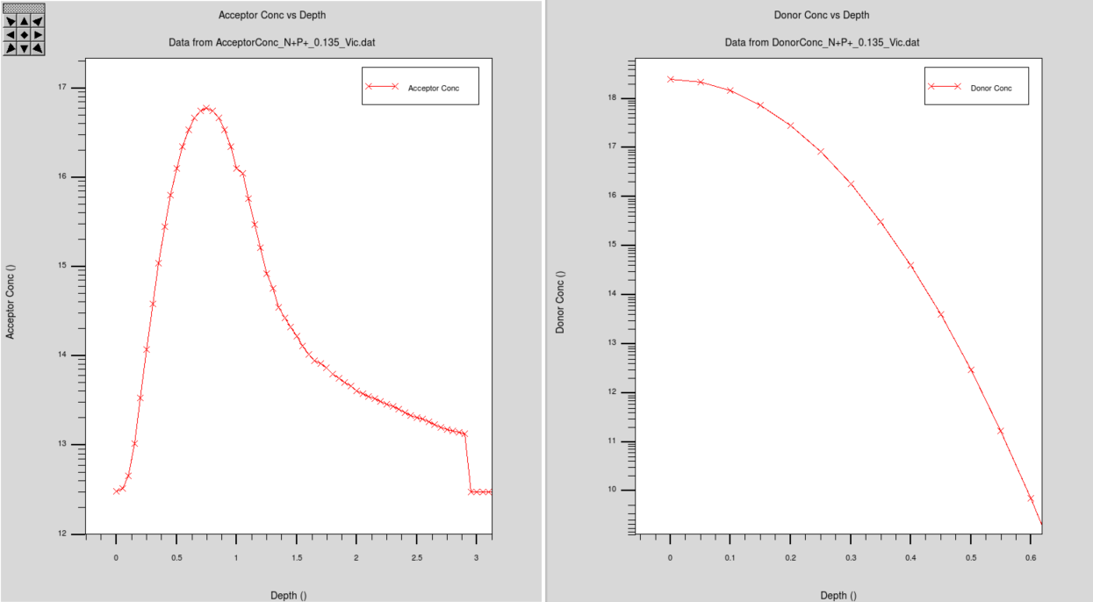
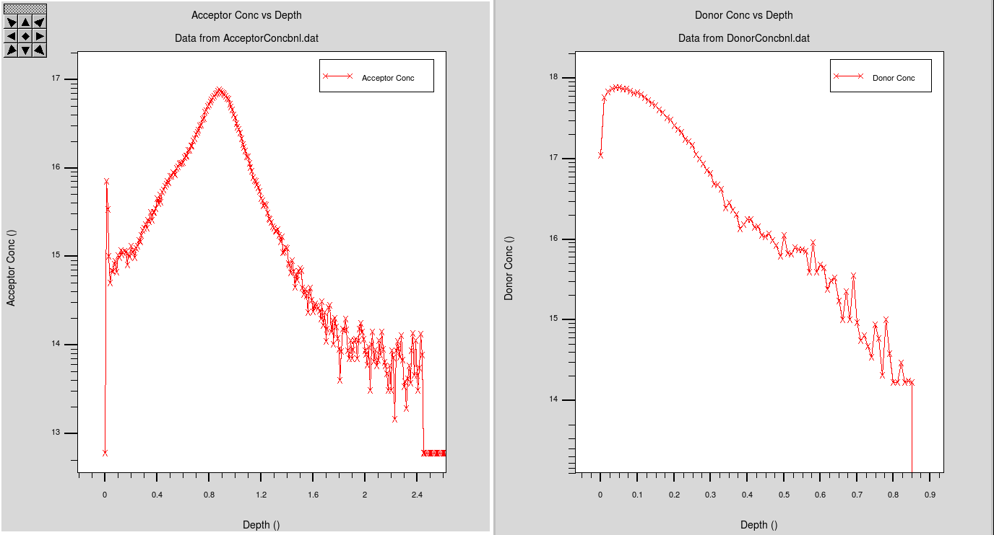
Doping profiles (per cm^3): Gain Layer and the N+ layer (Bulk= 50um, metal = 80 um, Pitch = 200 um
Gain Layer
N+ layer
Sheet resistance = 1k ohm/sq (FBK profiles)
Sheet resistance = 1.26k ohm/sq (BNL profiles)

Slide 8
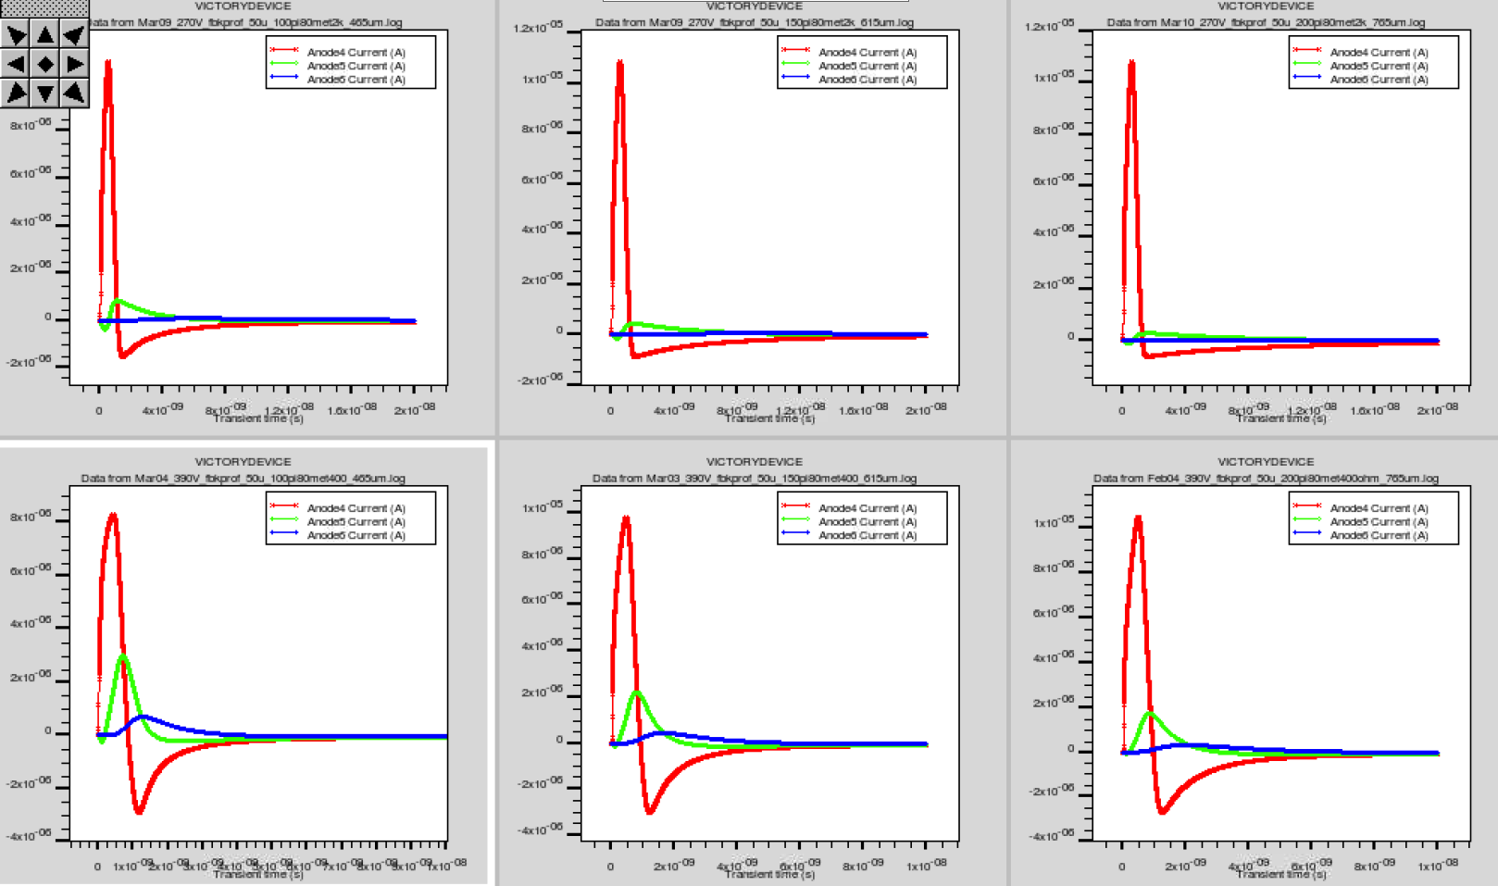
Simulated signal pulses:
Bulk=50 um, Metal=80 um, FBK doping profiles
Pitch=100um
N++ 2k ohm
Pitch=150um
N++ 2k ohm
Pitch=200umN++ 2k ohm
Pitch=100um
N++ 400 ohm
Pitch=150um
N++ 400 ohm
Pitch=200um
N++ 400 ohm

Slide 9
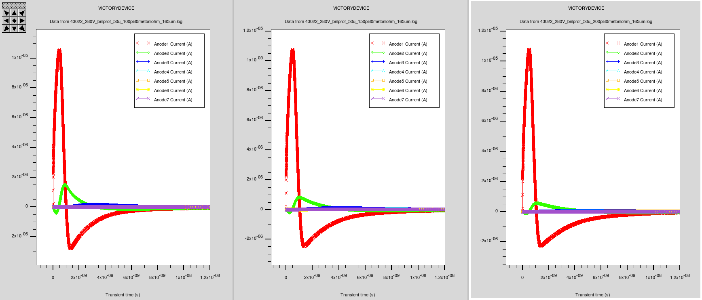
Simulated signal pulses:
Bulk=50 um, Metal=80 um, BNL doping profiles
Pitch=150um
N++ 1.26k ohm
Pitch=200um
N++ 1.26k ohm
Pitch=100um
N++ 1.26k ohm

Slide 10
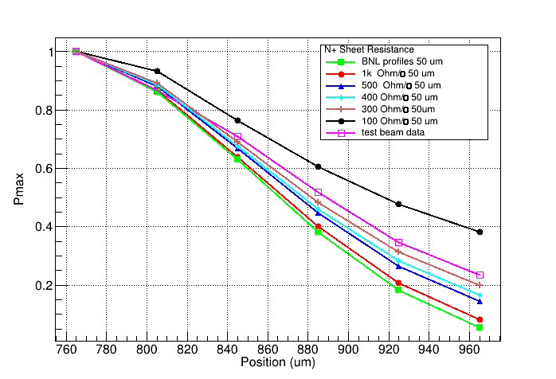
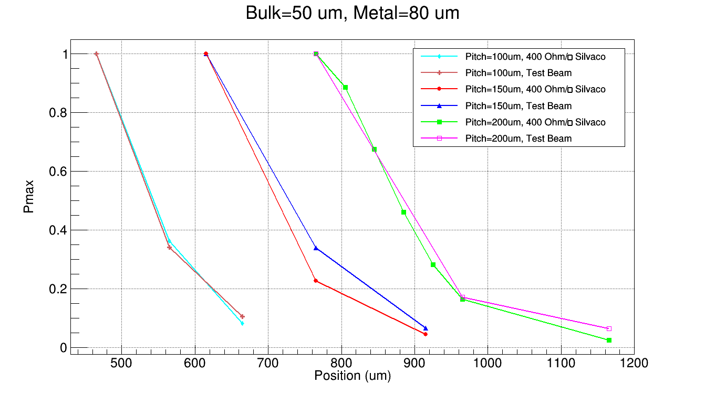
Comparison with the test beam data
Bulk=50 um, Pitch=200 um Metal=80 um
Pitch = 100um, 150um, 200um
Test Beam data analysis by Marcus Wong
Test Beam data analysis by Jennifer Ott

Slide 11
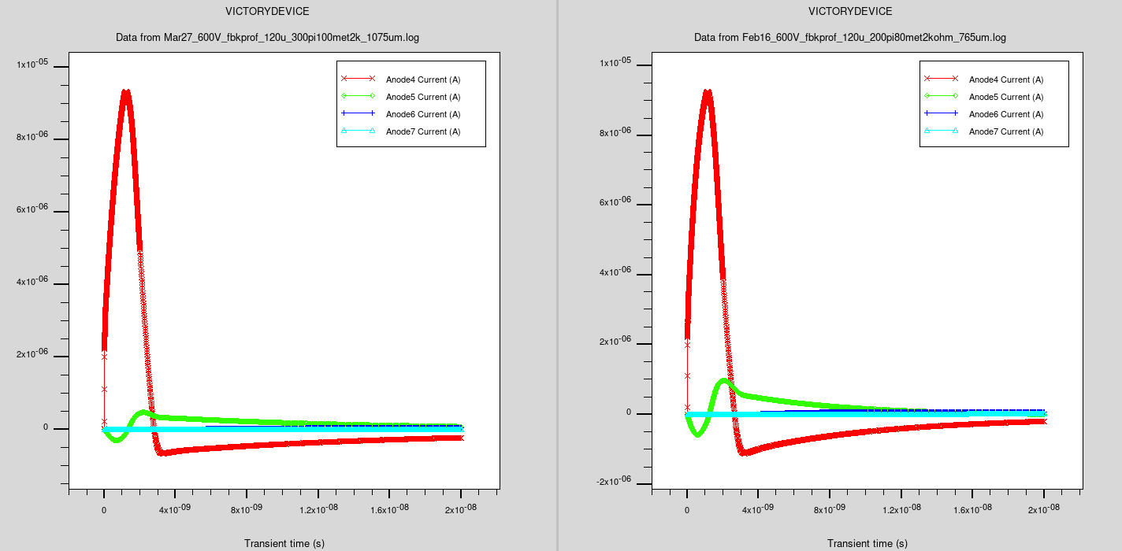
Simulation of 120um bulk sensor:
N+ sheet resistance = 2k Ω/□
Pitch=300um
Metal=100um
Pitch=200um
Metal=80um

Slide 12
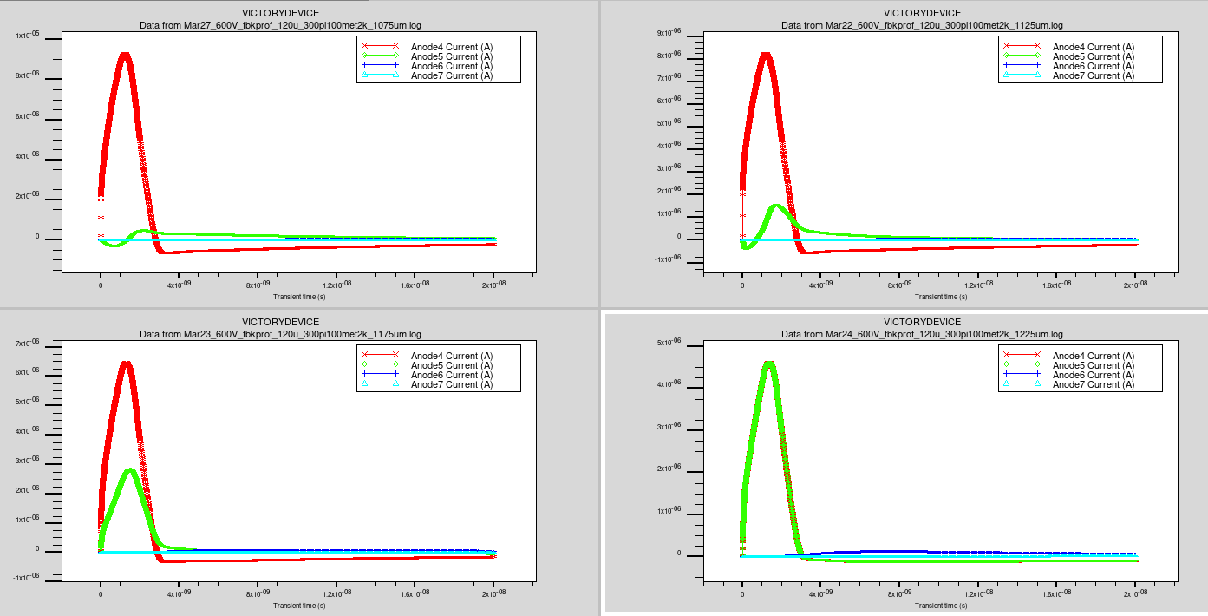
Bulk=120 um, Pitch=300 um, Metal=100 um, N++ 2k ohm
1075um
1125um
1175um
1225um

Slide 13
Sharing between the channels:
120um bulk, N+ sheet resistance = 2k Ω/□
Pitch, metal,MIP LOC | 300,100,ch4 | 200,80,ch4 | 300,100, mid ch4&ch5 | 200,80, mid ch4&ch5
Channel ratio
Ch4/ch4 | 9.33E-06/9.33E-06=1 | 9.25E-06/9.25E-06=1 | 4.63E-06/4.63E-06=1 | 4.64E-06/4.64E-06=1
Ch5/ch4 | 4.66E-07/9.33E-06=0.05 | 9.75E-07/9.25E-06=0.11 | 4.62E-06/4.63E-06=0.99 | 4.64E-06/4.64E-06=1
Ch6/ch4 | 4.01E-08/9.33E-06=0.004 | 7.84E-08/9.25E-06=0.008 | 1.23E-07/4.63E-06=0.026 | 2.26E-07/4.64E-06=0.05
Ch7/ch4 |  |  | 1.67E-08/4.63E-06=0.0036 | 3.59E-08/4.64E-06=0.0077

Slide 14
3D Simulation
@ Synopsis SentaurusTM
--Taylor Shin

Slide 15
Effect of strip length on signal sharing between the neighbouring channels
Strip length = 0.5 mm
Strip length = 3 mm
Strip length = 1 cm
Strip length = 2 cm
--Taylor Shin

Slide 16
Effect of strip length on signal sharing between the neighbouring channels
--Taylor Shin

Slide 17
Gain Suppression Study
@ Synopsis SentaurusTM
--Yuzhan Zhao

Slide 18
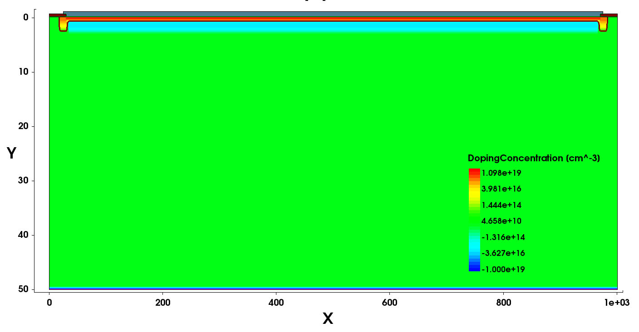
Simulation Setup
For ion track injection, the following scans were simulated:
  Scan over different angles
  Complete horizontal track
Track at angle
Horizontal track
θ
--Yuzhan Zhao

Slide 19
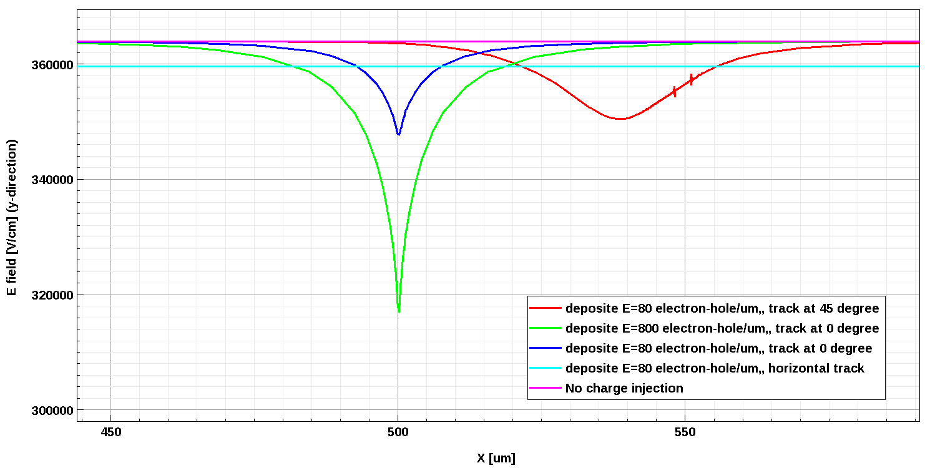
Electric Field within the Gain Layer
Since the gain, or avalanche mechanism, depends on the high electric field in the gain layer region, it would be interesting to study the E-field for various tracks.
The following plot show the time snapshot of the E-field within the gain layer.
  The E-field decreases as more charges were put in, and the affected location is large for track at angle.
  In the case of horizontal track, the field is generally lower across the entire gain layer.
NOTE: this process is dynamic, which is not covered in the single time snapshot.
--Yuzhan Zhao

Slide 20
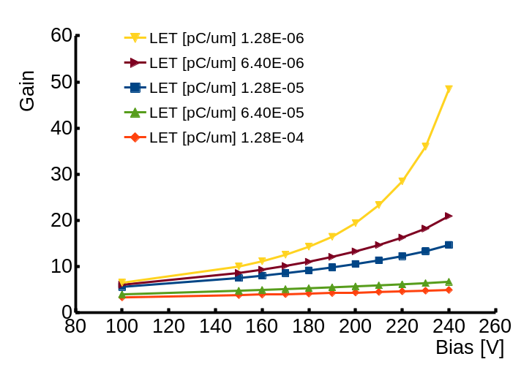
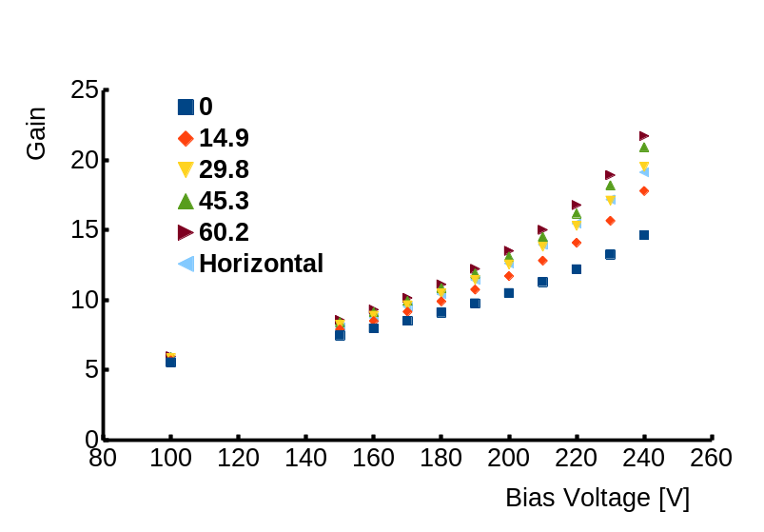
Particle Injection with different energies and at different angles
One of the tunable parameters of the partcle track is the Linear energy transfer (LET)
  For LET=1.28e-5 pC/um, which corresponds to generated ~80 eh/um
The following plot shows for vertical track injection (0 degree), the gain is reduced as more charge is injected.
  The difference is more significant at high bias voltage.
--Yuzhan Zhao

Slide 21
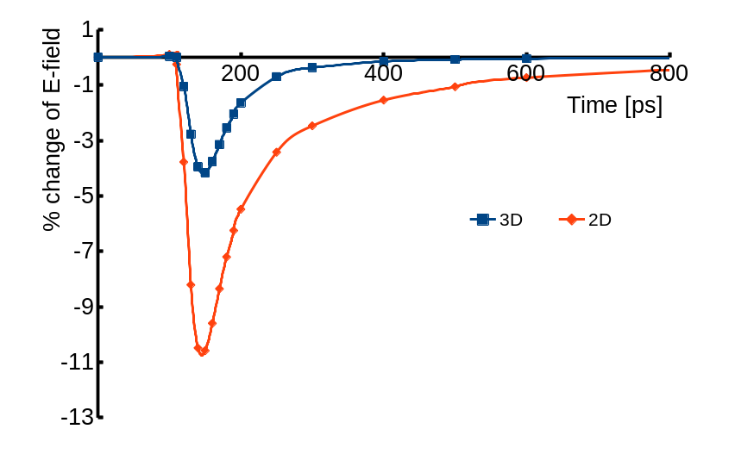
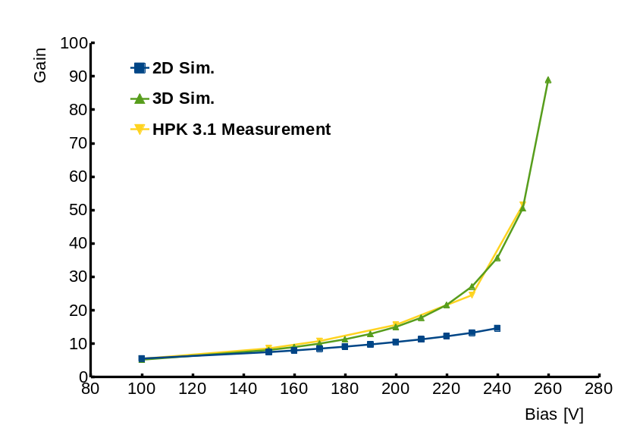
3D simulation for localized charge
Device size : 250 um x 250um x 50um
The change of E-field is much smaller for 3D case??
--Yuzhan Zhao

Slide 22
Summary
In 2D TCAD simulation, we have characterized effects of N+ resistivity, strip metal size a, pitch size and substrate thickness.
Sharing between the neighbouring channels depends on N+ resistivity, pitch size and the bulk thickness.
3D TCAD simulation gives more realistic results in terms of strip length, but we have benchmark it with the existing test beam results (by Taylor Shin)
It seems Sentaurus can simulate the gain suppression and the work is in progress (by Yuzhan Zhao)

Slide 23
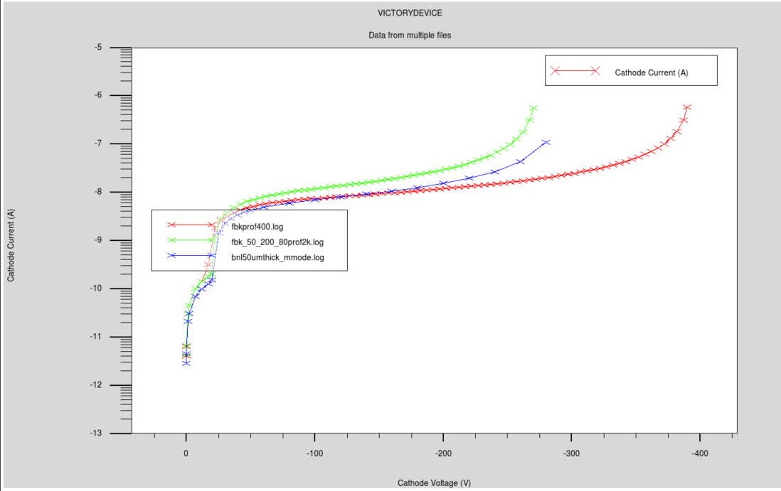
IV characteristics
N+ sheet resistance
400 Ω/□ (FBK doping density=1.05e19/cm^3 )
2k Ω/□ (FBK doping density=6.3e17/cm^3)
1.26k Ω/□ (BNL doping profile)

Slide 24
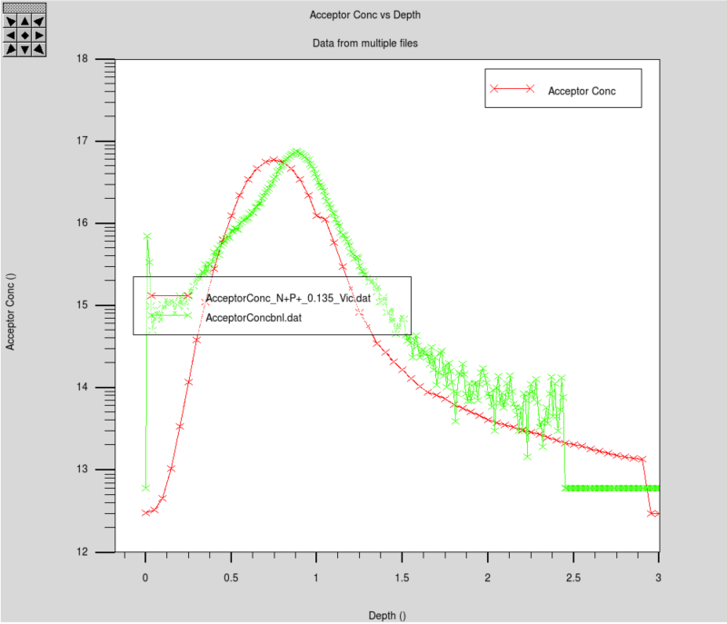

Slide 25
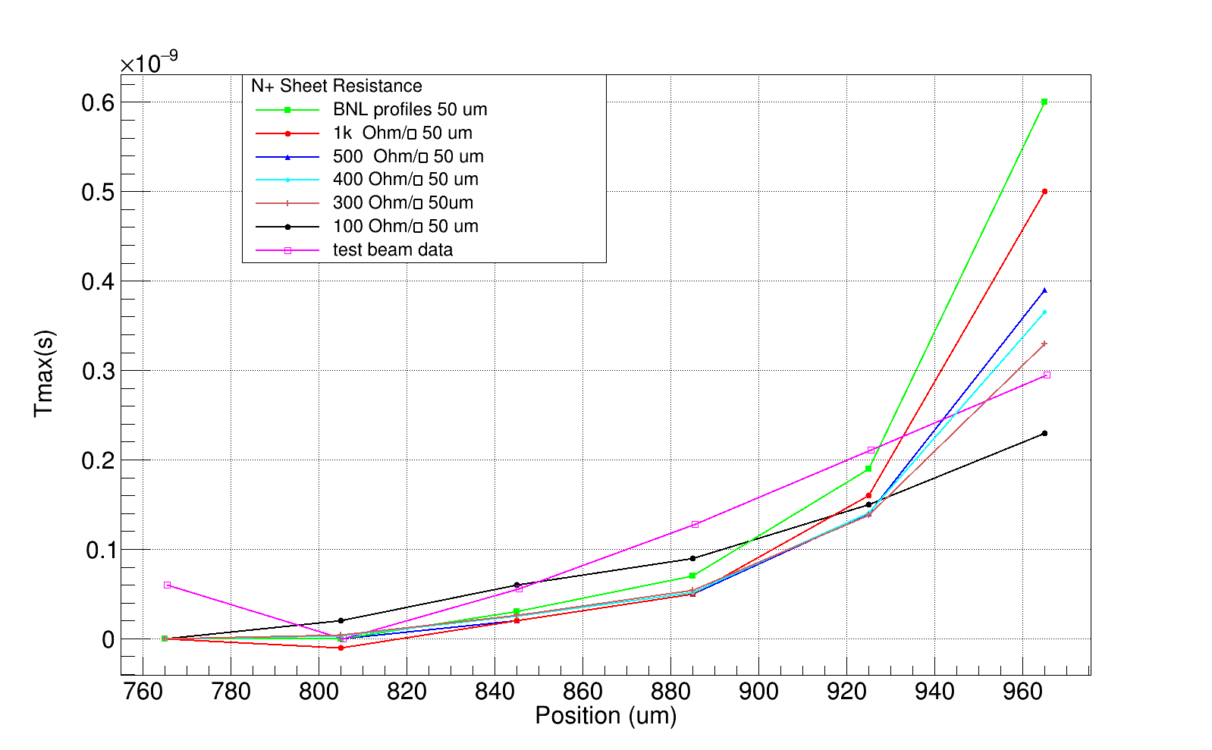

Slide 26
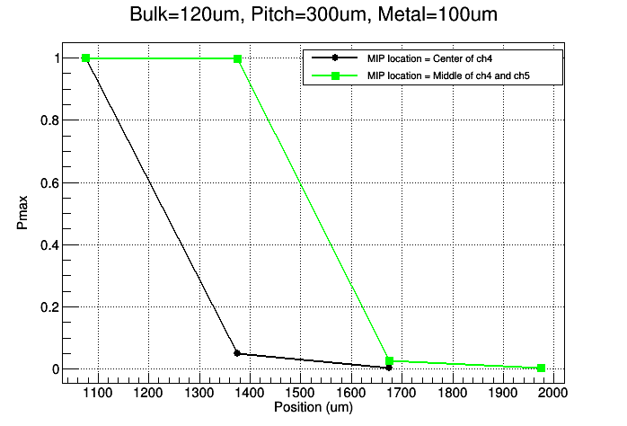
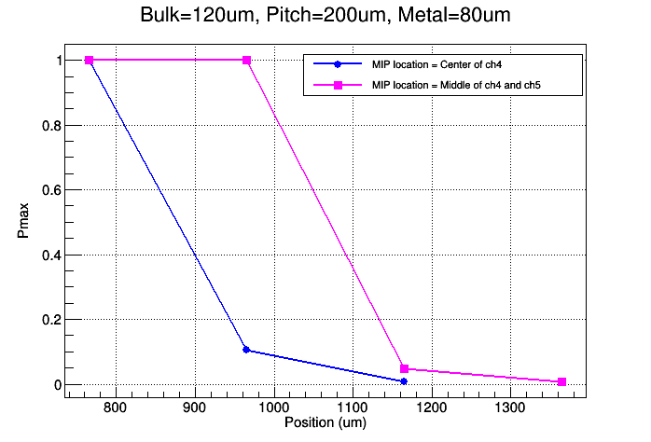
Sharing between the channels
120um bulk, N+ sheet resistance = 2k Ω/□

