Slide 1
Proposal of An Alternative Active Target Design based on PIN
Xin Qian
BNL
With fruitful discussions with Veljko Radeka, Sergio Rescia, Gabriele Giacomini, Vladimir Tishchenko, Chao Zhang and many others

Slide 2
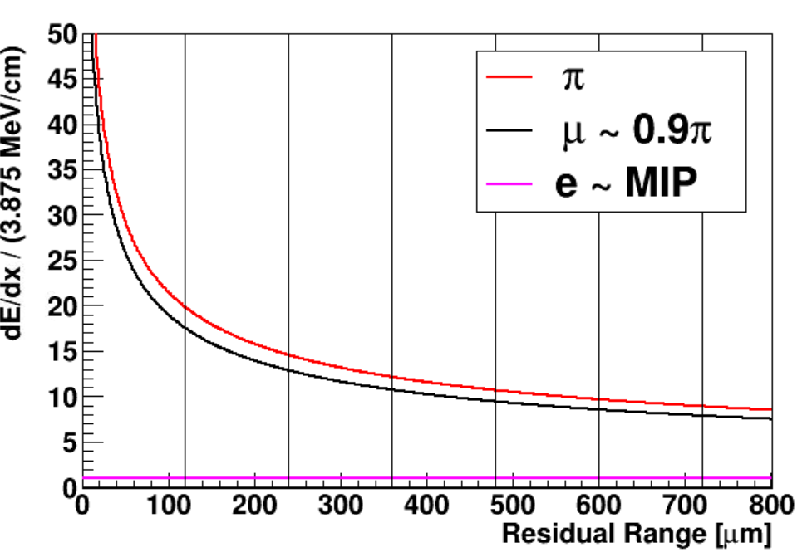
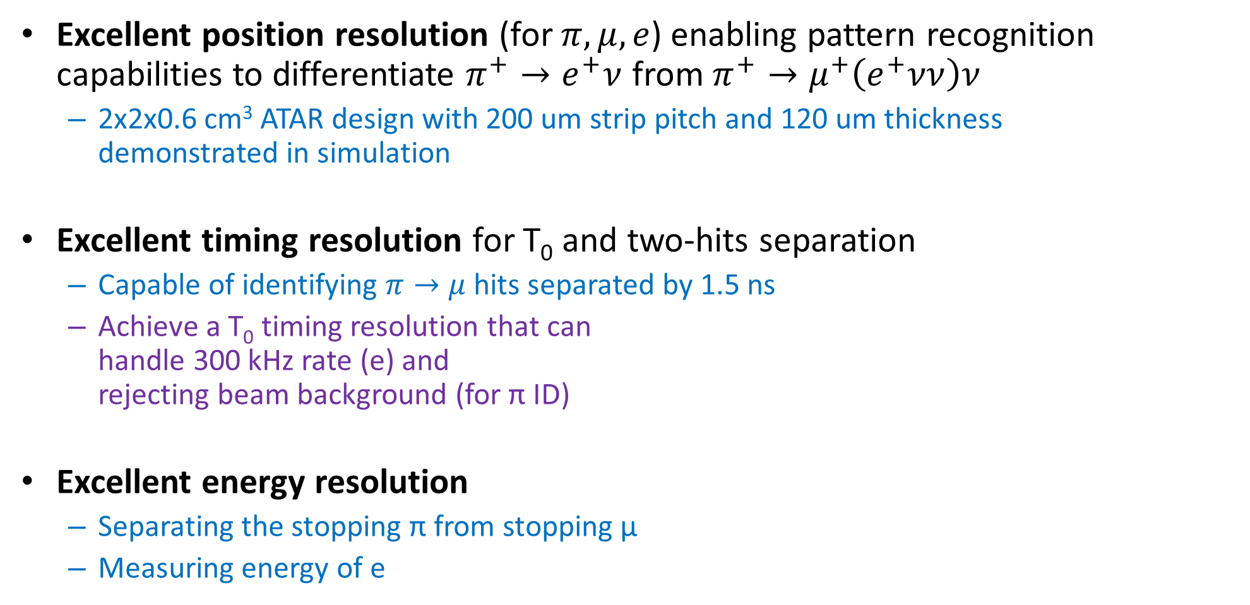
Active Target (ATAR) Requirement for PIONEER
Excellent position resolution (for $π, μ, e$) enabling pattern recognition capabilities to differentiate $π^{+}→e^{+}ν$ from $π^{+}→μ^{+}\left(e^{+}νν\right)ν$
  2x2x0.6 cm³ ATAR design with 200 um strip pitch and 120 um thickness
  demonstrated in simulation
Excellent timing resolution for T₀ and two-hits separation
  Capable of identifying $π→μ$ hits separated by 1.5 ns
  Achieve a T₀ timing resolution that can
  handle 300 kHz rate (e) and
  rejecting beam background (for π ID)
Excellent energy resolution
  Separating the stopping π from stopping µ
  Measuring energy of e

Slide 3
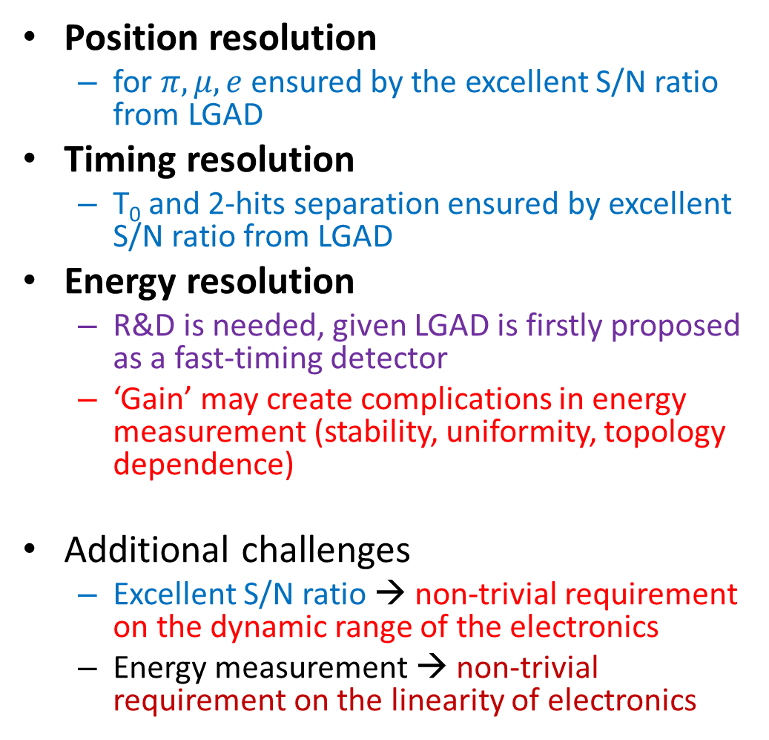
ATAR Design in PSI Proposal
Position resolution
  for $π, μ, e$ ensured by the excellent S/N ratio from LGAD
Timing resolution
  T₀ and 2-hits separation ensured by excellent S/N ratio from LGAD
Energy resolution
  R&D is needed, given LGAD is firstly proposed as a fast-timing detector
  ‘Gain’ may create complications in energy measurement (stability, uniformity, topology dependence)
Additional challenges
  Excellent S/N ratio → non-trivial requirement on the dynamic range of the electronics
  Energy measurement → non-trivial requirement on the linearity of electronics
48 layers 1-side strip readout with 120 um thickness
100 strips with 200 um pitch covering
2x2 cm² area
Sensors packed in stack of two with facing HV side and rotate 90º
AC or TI LGAD to ensure excellent Signal-to-Noise (S/N) Ratio

Slide 4
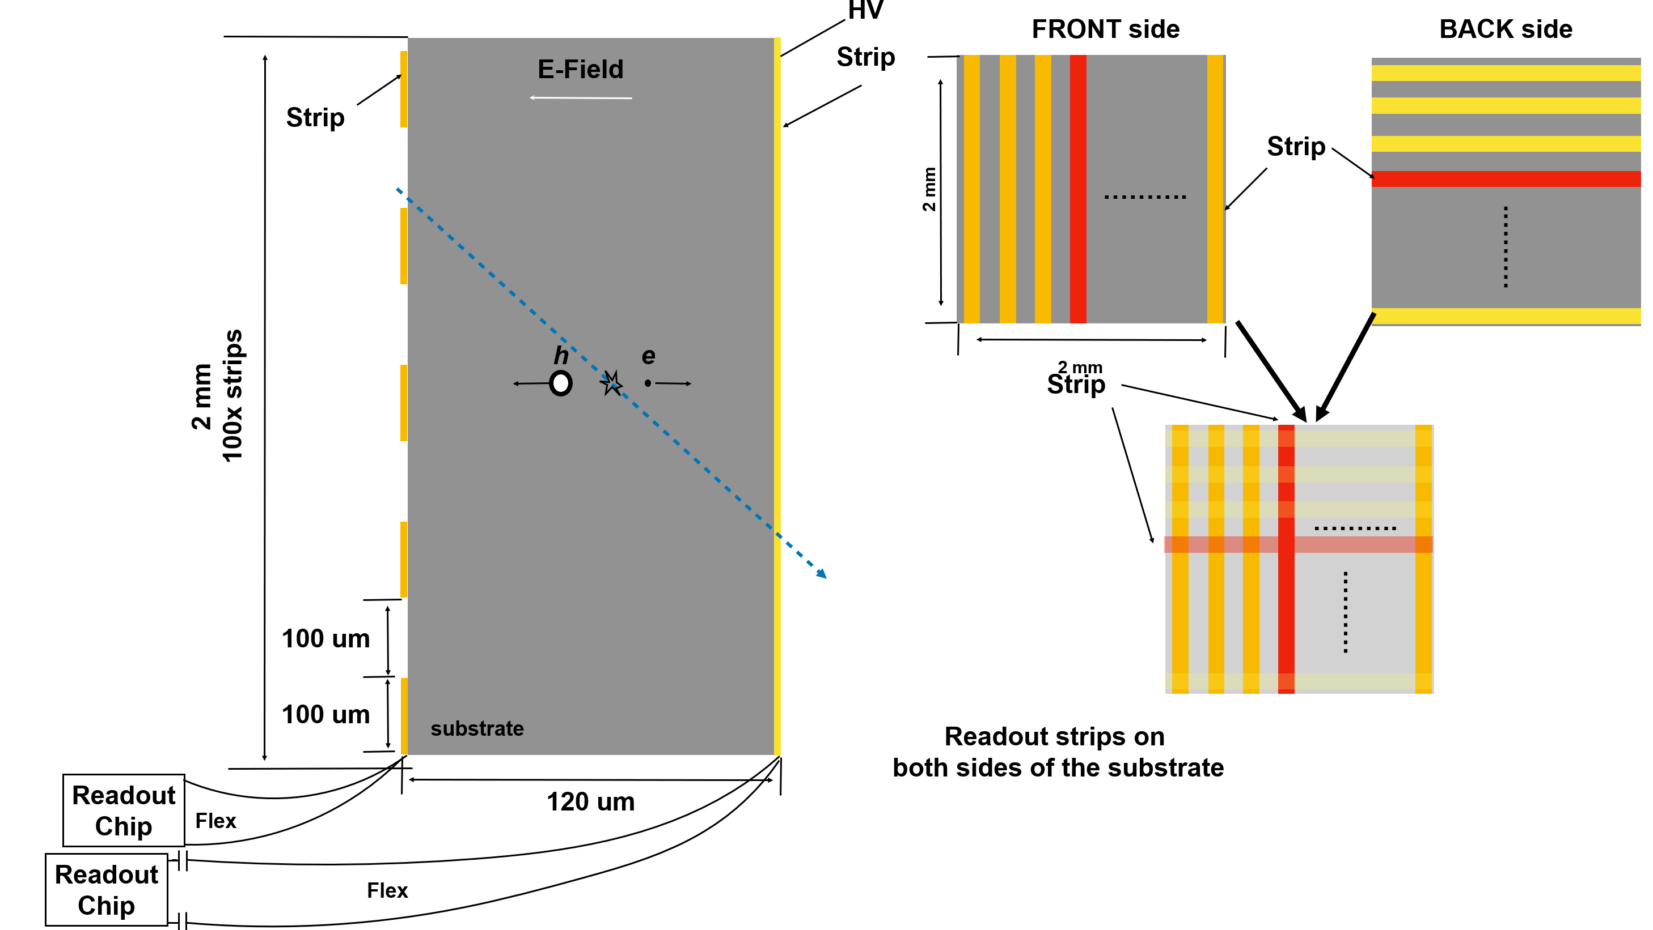
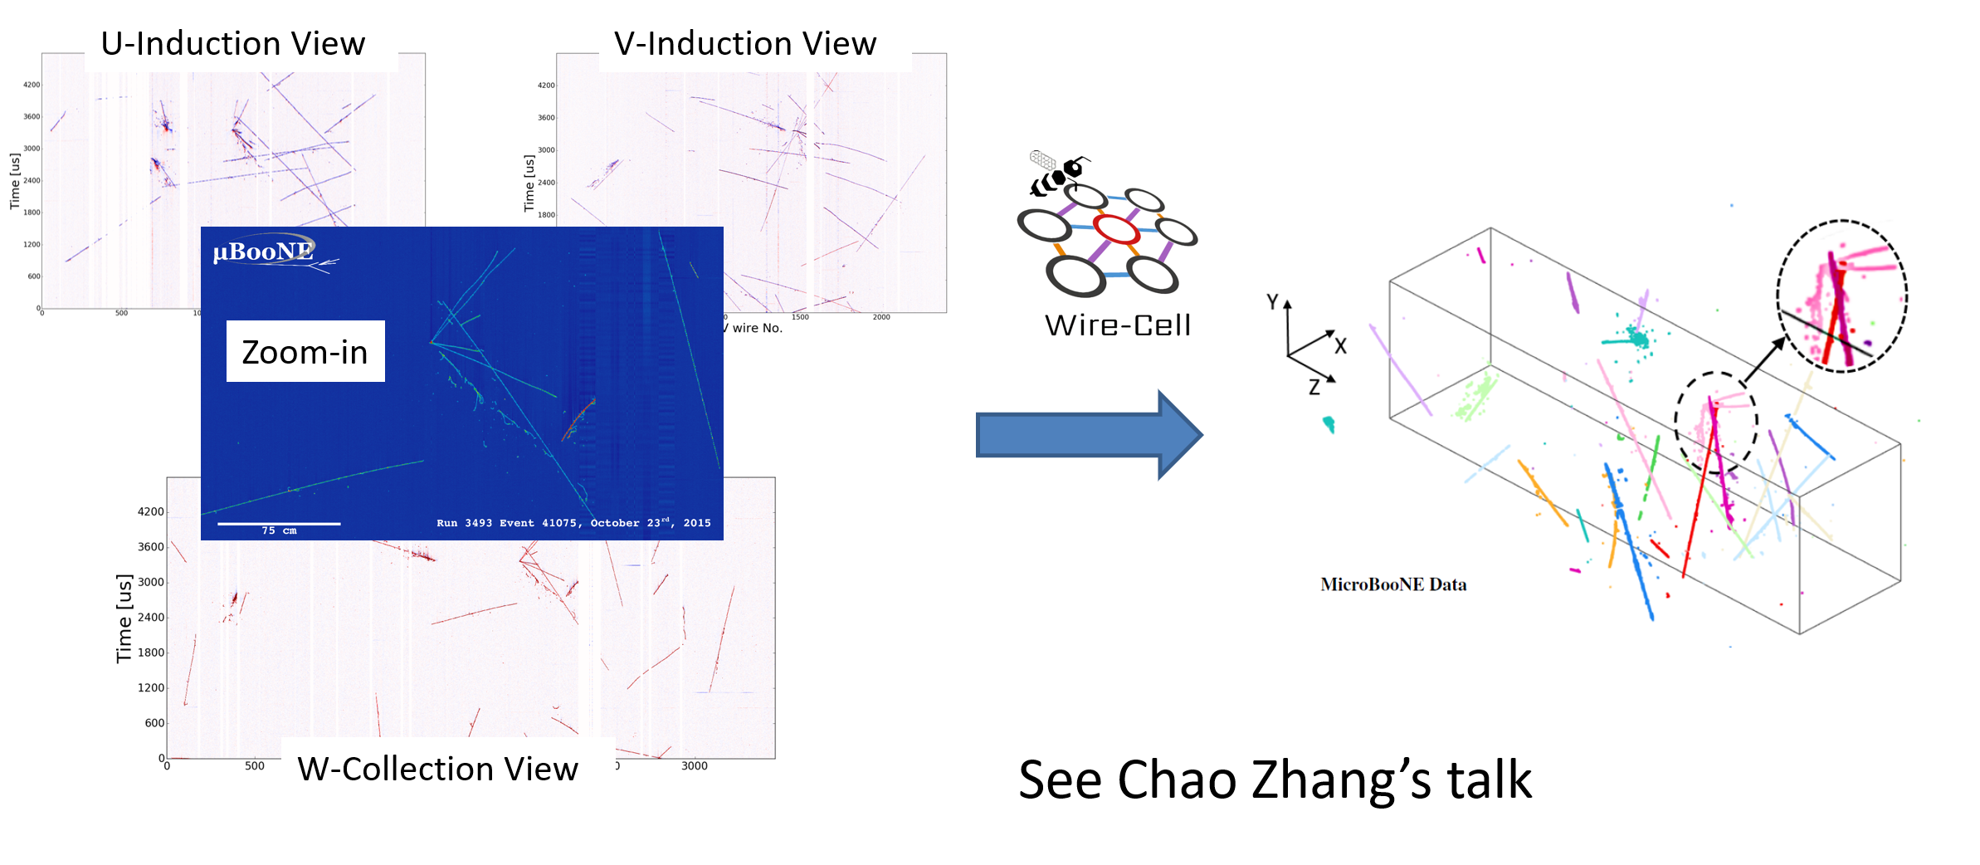
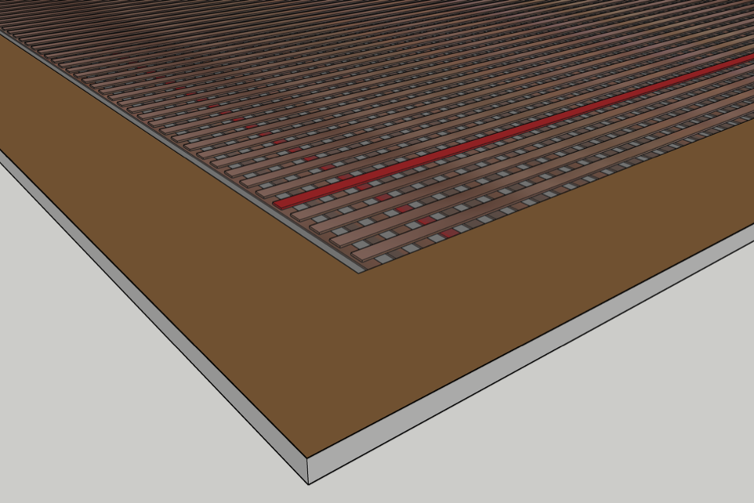
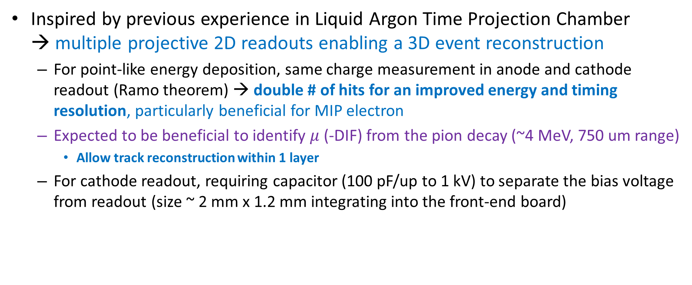
An Improved Design with 2-sided Readout
Inspired by previous experience in Liquid Argon Time Projection Chamber
→ multiple projective 2D readouts enabling a 3D event reconstruction
  For point-like energy deposition, same charge measurement in anode and cathode readout (Ramo theorem) → double # of hits for an improved energy and timing resolution, particularly beneficial for MIP electron
  Expected to be beneficial to identify $μ$ (-DIF) from the pion decay (~4 MeV, 750 um range)
    Allow track reconstruction within 1 layer
  For cathode readout, requiring capacitor (100 pF/up to 1 kV) to separate the bias voltage from readout (size ~ 2 mm x 1.2 mm integrating into the front-end board)

Slide 5
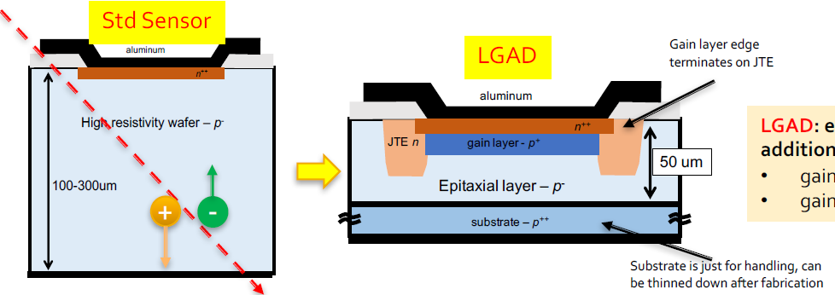
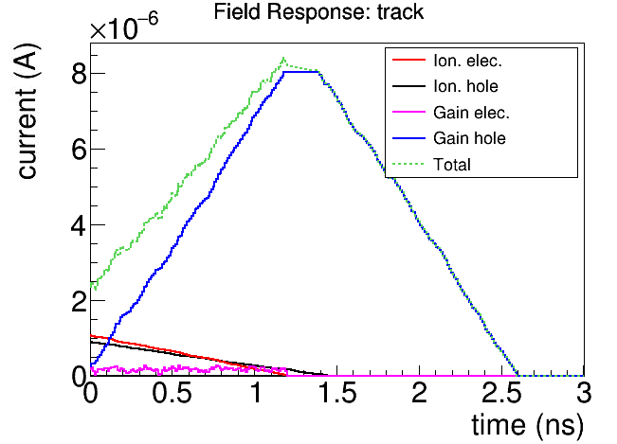
Alternative Design with a PIN Device
Just like the Calorimeter (LXe vs. Crystal), it is desired to have an alternative design for the ATAR
  Given the existing studies on simulations, a natural candidate for the alternative design is a PIN device
  Compared to LGAD, PIN does not have the GAIN mechanism
PIN device

Slide 6
Pros and Cons for PIN-based 120 um-thick ATAR
Pros
Cons
PIN is known to be linear in energy response to energy deposition from 1 to 100 MIP
  Excellent stopping π/µ separation
With the charge collection signal, much easier to calibrate the energy response (uniform, stable and topology independent)
A single 12-bit (4096) digitizer is sufficient to cover the entire dynamic range
Need a working design of pre-amp electronics to achieve > 9:1 signal-to-noise ratio for MIP signal, which requires more power
  With FAST, the S/N ~ 5:1 for MIP signal
  Also have impact in timing resolution (to be elaborated in details)
Additional considerations for the alternative design
  Keep the current geometry, possible to expand to 3x3 cm² with more channels
  Given stopping π/µ ~ 10-35 MIP,
    Good T0 timing resolution is expected
      Handle 300 kHz rate (e) and rejecting beam background (for π ID)
    Good 2-hits separation should be expected, but depending on electronics
      π/µ separation for hits separated by 1.5 ns

Slide 7
Requirement of Electronics
The (minimal) most probable value (MPV) charge for a MIP track in a 120-um thick Si is about 7800 electrons (1.25 fC)
  To reach a 9:1 S/N ratio, the equivalent noise charge (ENC) should be smaller than 860 electrons
6 e- /pF@ 1 us shaping @ room temperature
  "Signal Processing for Particle Detectors" Veljko Radeka
  @ 10 pF, 5 ns shaping time gives us 850 electrons
  At LXe temperature (~4 e/pF), ENC ~ 570
~ 5 mW/ch
Better than 1%
integrated linearity
up to 100 MIP
200 um pitch, 100 um width | N-type strip (2 cm) | P-type strip (2 cm)
Interstrip capacitance | 0.1 fF/um → 4 pF | 0.04 fF/um → 1.6 pF
Back capacitance | 0.08 fF/um → 3.2 pF | 0.08 fF/um → 3.2 pF
FLEX cable | 50-60 pF/m → 2.5 – 3 pF
Total | ~ 10 pF | ~ 8 pF

Slide 8
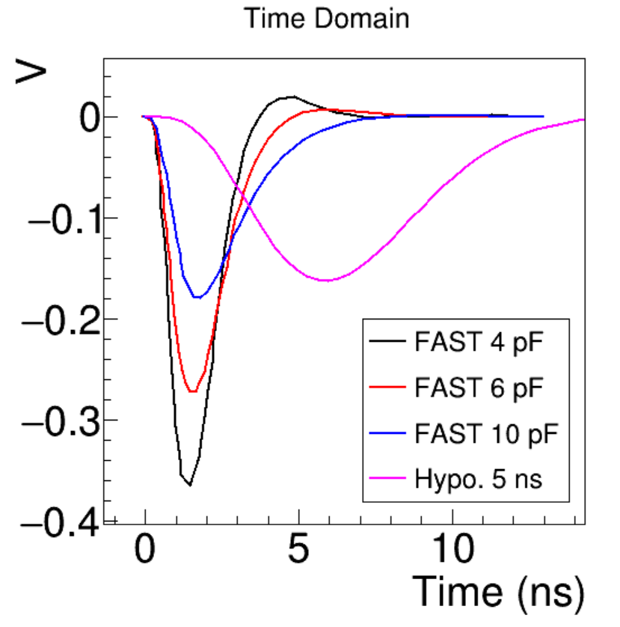
Demonstration of the ATAR Performance with 5 ns Shaping
Based on existing studies
  Simulation: db-98
  T0 timing resolution: db-104
  Two-peak separation: db-106
  Charge resolution: db-105
Simulation:
  Signal fluctuation +
  Random Electronics Noise
Reconstruction assuming known electronics response function
  Deconvolution with FFT
  Compressed sensing with L1 regularization
Hypothetical electronics response with 5 ns shaping utilized the functional form of LArASIC

Slide 9
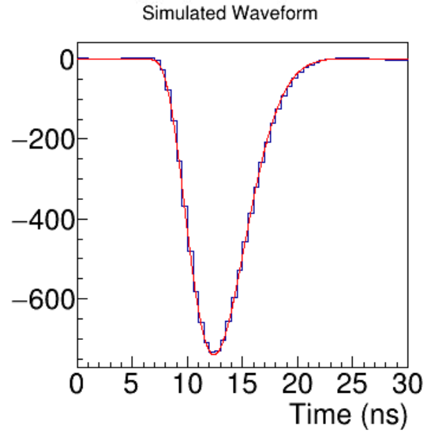
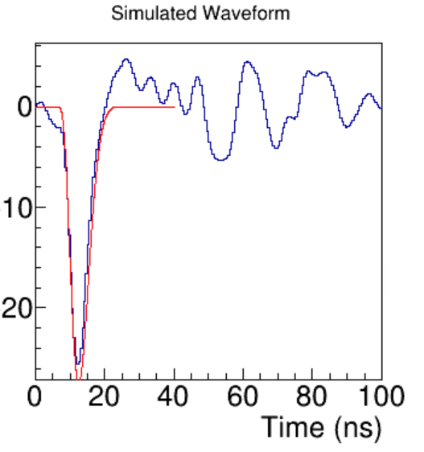
Example of Simulated Waveform with Noise
@ 2 GHz digitization
30xMIP ~ stopping pions/muons
MIP ~ electrons
ENC ~ 850 electrons
Simulated waveform
Truth

Slide 10
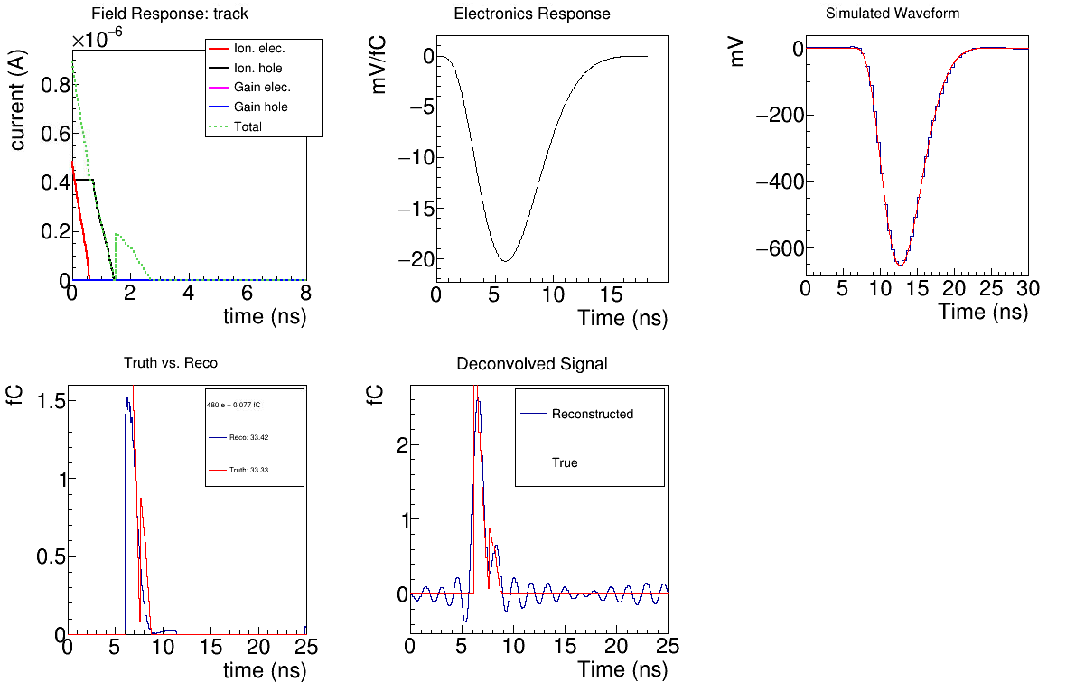
2-peak Separation π (47 MIP)-µ (9 MIP) @ 60-60 um + 1.5 ns)
π
µ
Filter can be further optimized

Slide 11
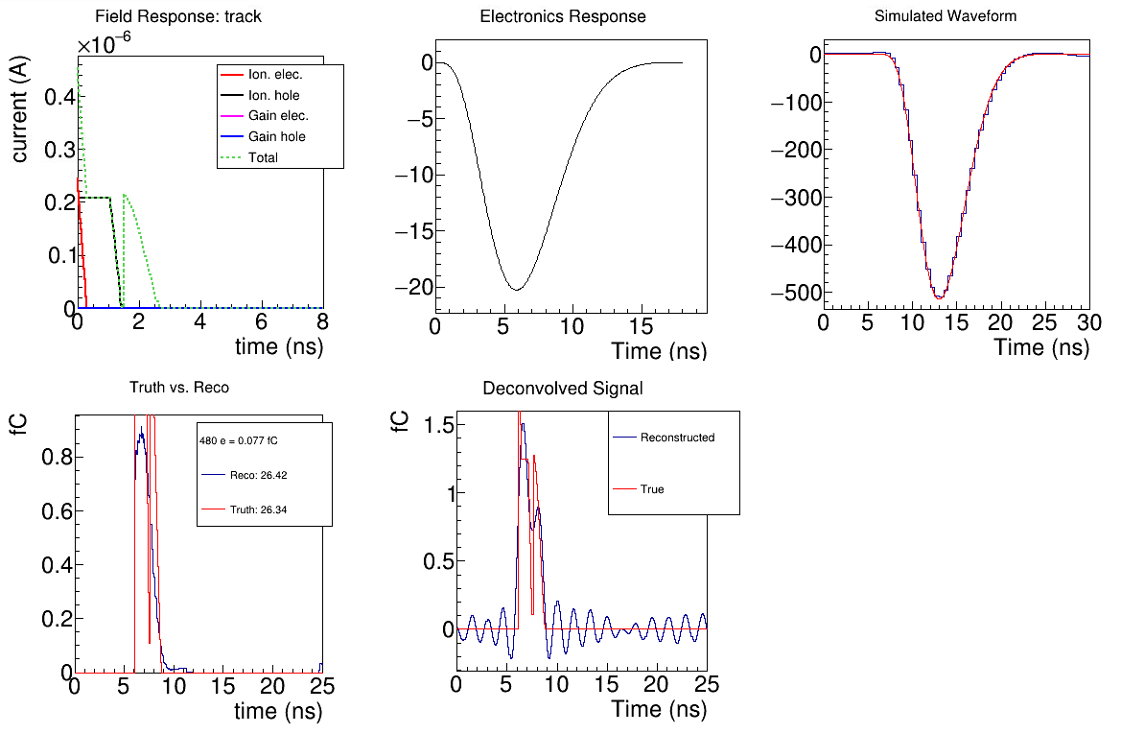
π
µ
2-peak Separation
π (60 MIP)-µ (9 MIP) @ 30-90 um + 1.5 ns)

Slide 12
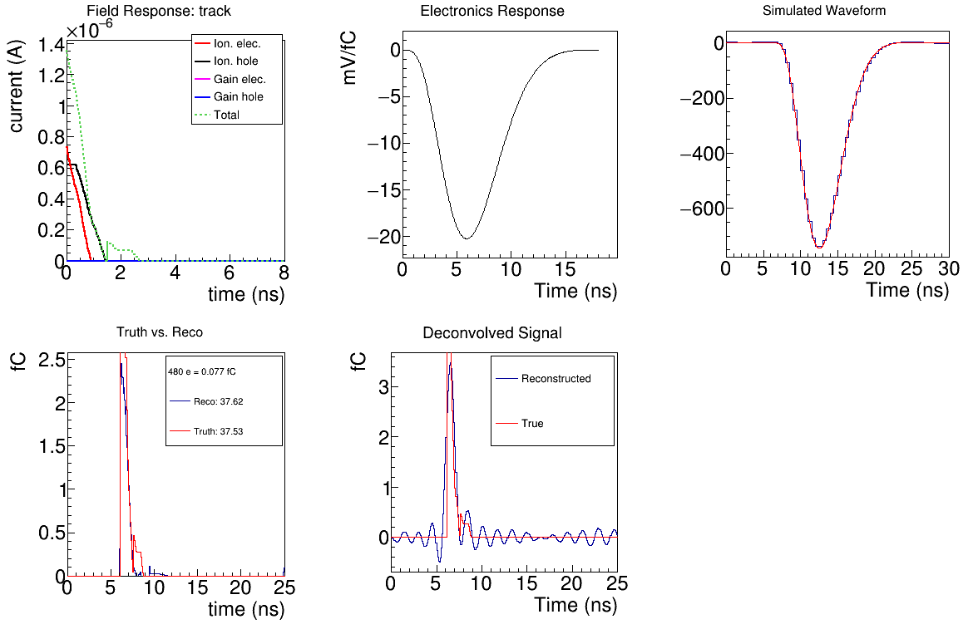
π
µ
2-peak Separation
π (39 MIP)-µ (9 MIP) @ 90-30 um + 1.5 ns)
2-sided readout limits the ambiguities a single 3D point in the decay layer

Slide 13
Summary of Timing and Charge Resolution
 | MIP hit | MIP track (50 hits assumed with 2-sided readout) | 10xMIP hit | 30xMIP hit
T0 resolution | 408 ps | 408/sqrt(50) = 58 ps | 103 ps | 74 ps
Charge resolution (1024 e in 7 ns) | <13.1% | 13.1%/sqrt(50) = 1.9% | <1.31 % | <0.44%
2-peak separation @ 3D point of the decay layer | N/A | N/A | Good with 1.5 ns separation, when delayed hit charge is not too small
PIONEER physics requirements satisfied!
120 um PIN device, a 5 ns shaping time preamplifier + S/N ~ 10:1

Slide 14
Discussions and R&D path
Sensor and electronics design are related:
  Thicker than 120 um ATAR PIN layer will allow for shorter (than 5 ns) shaping time
Development of a new low-noise preamp electronics with shaping time ~ 5 ns
  Can also be used for SiPM readout for PIONEER calorimeter
  We may explore a readout scheme with E0, T0, and TOT instead of full digitization → simplified readout chain with a big saving on electronics power
Demonstration of 2-sided PIN/LGAD fabrication (BNL LDRD scope, see Volodya and Gabriele’s talks)
Engineering Design with proper cooling
  Electronics Noise can be significantly reduced if using cold electronics (LXe temperature)

Slide 15
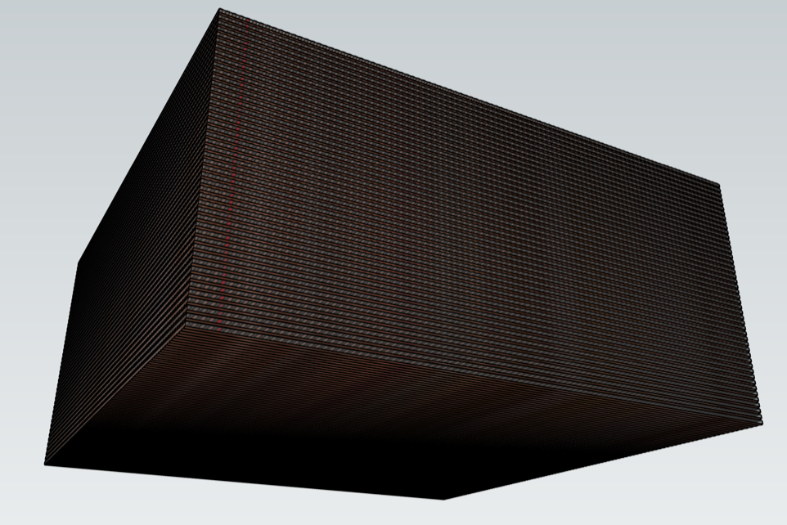
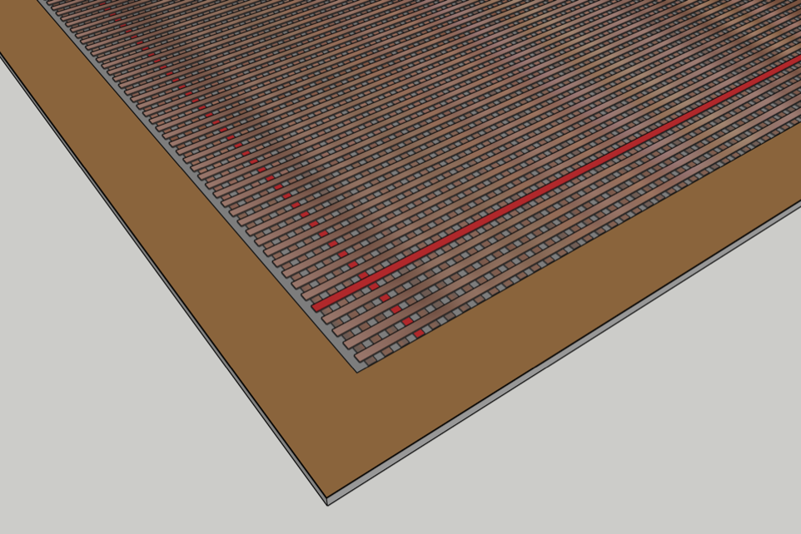
Summary
We propose a 2-sided PIN-based ATAR for PIONEER
With a 5-ns shaping time preamplifier, this alternative design enables
  Excellent energy resolution (π/µ separation, electron energy)
  Excellent timing resolution (<100 ps for stopping π/µ)
  Excellent position resolution for precise 3D topology reconstruction (identify short muon even within one layer)
R&D goals:
  2-sided 120 um PIN/LGAD fabrication (BNL LDRD)
  Development of a new low-noise preamp electronics with a shaping time ~ 5 ns

Slide 17
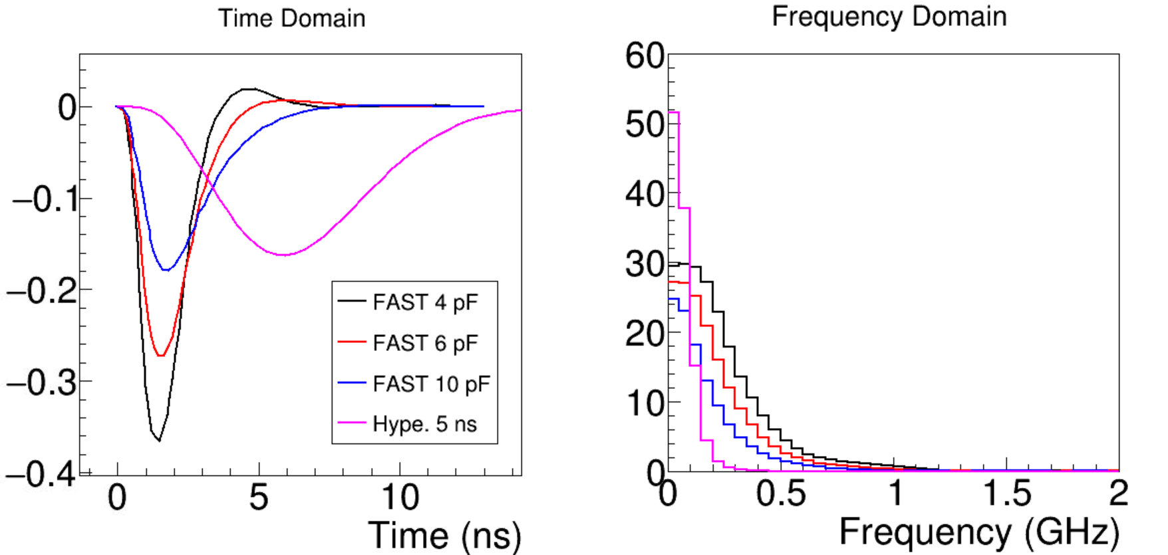

Slide 18
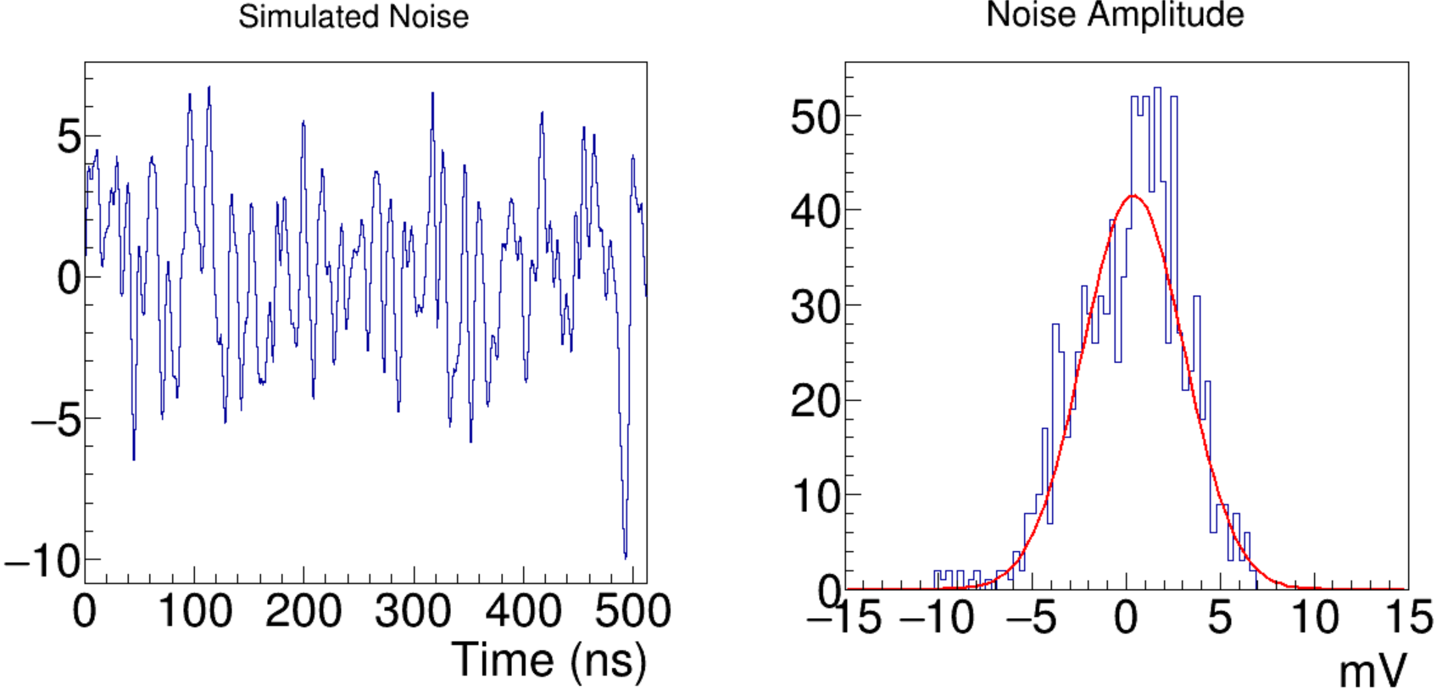
Simulated Noise (ENC ~ 860 e-)

Slide 19
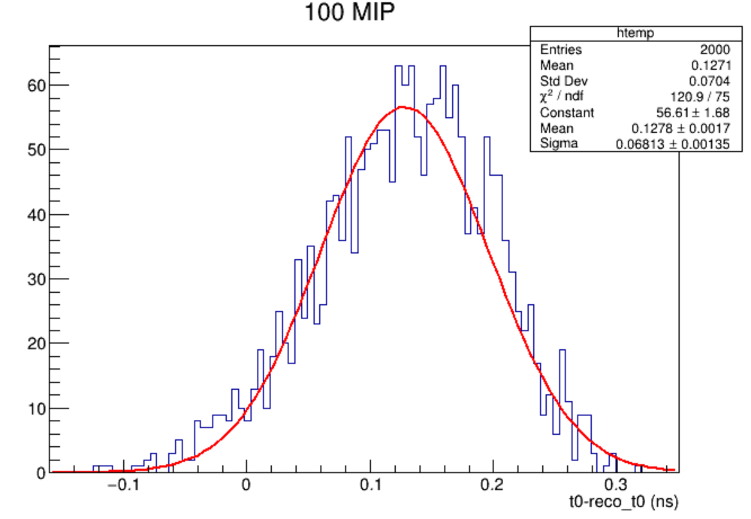
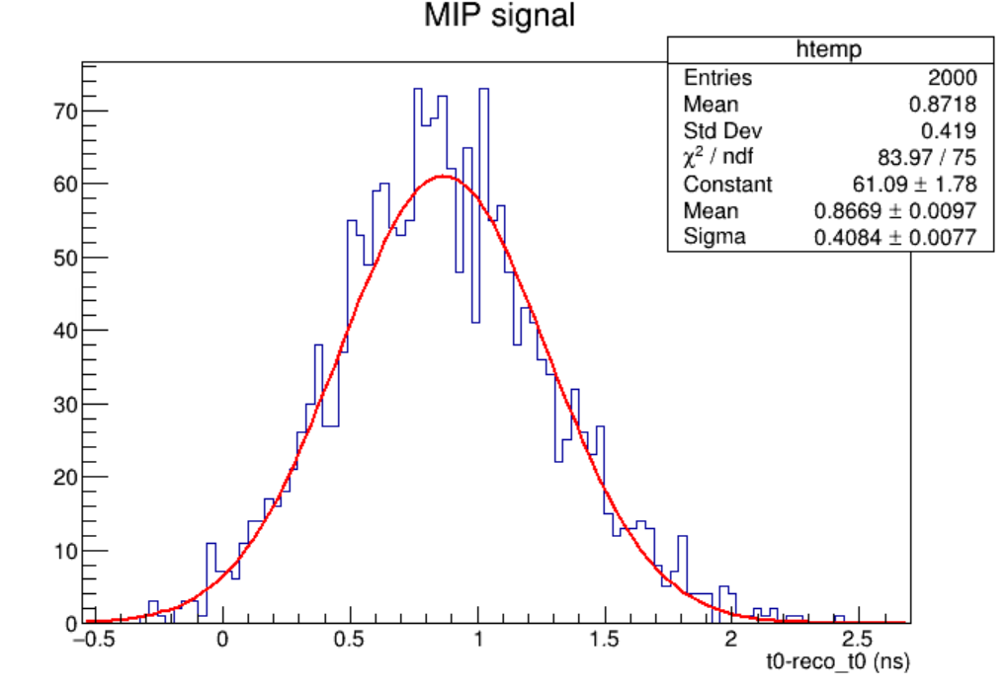
T0 resolution
100x MIP
MIP

Slide 20
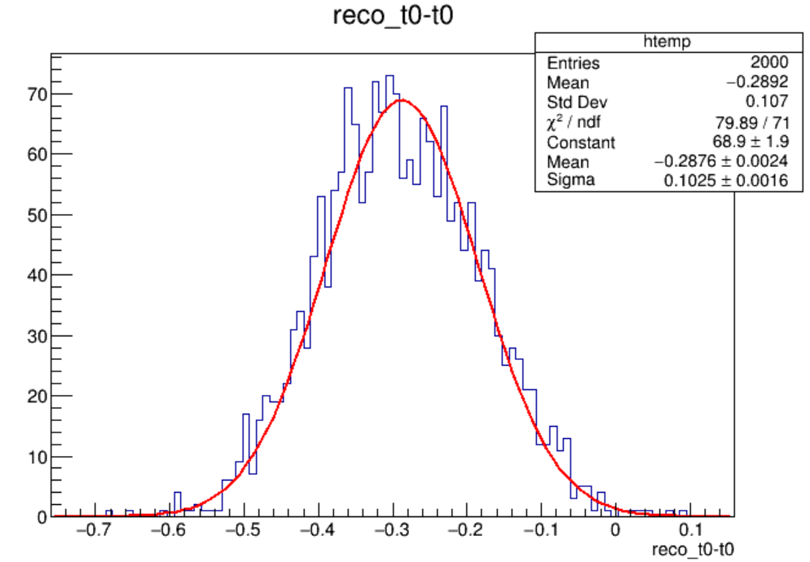
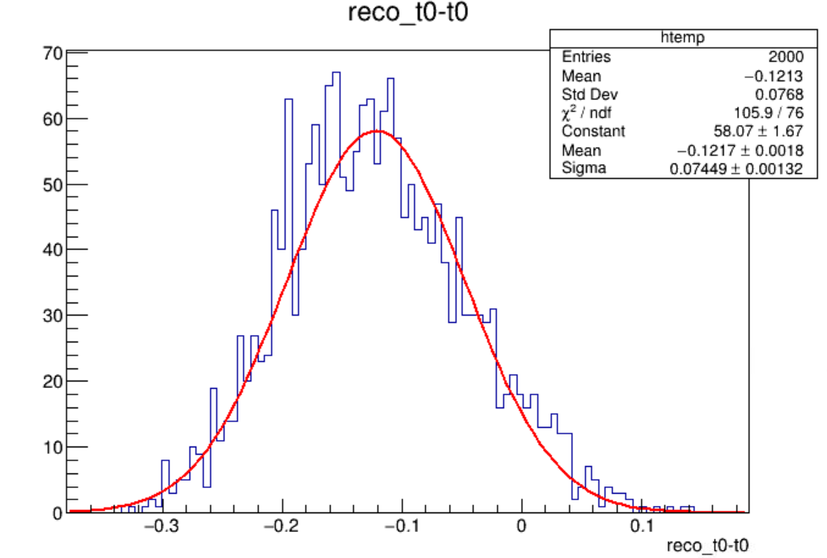
T0 resolution
10 MIP
30 MIP

Slide 21
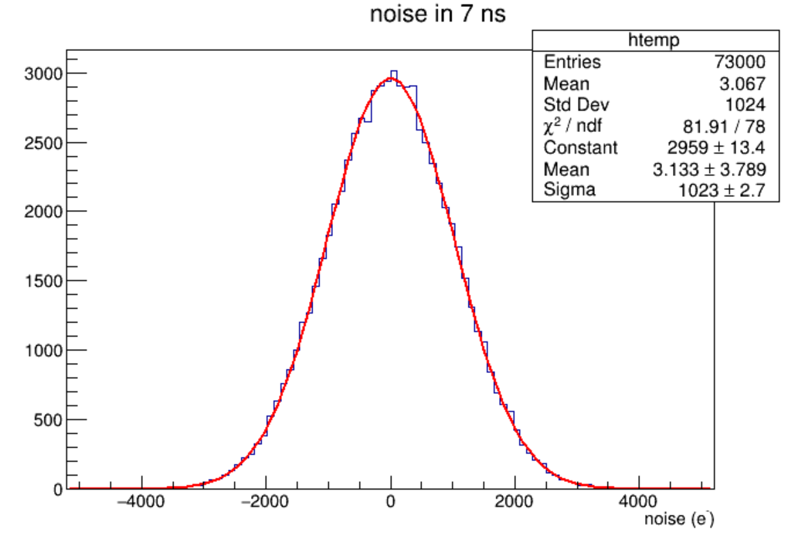
Charge Resolution (7-ns window)
MIP
  13.1%
MIP track with 50 hits
  1.85%
MIPx100
  0.13%

Slide 22
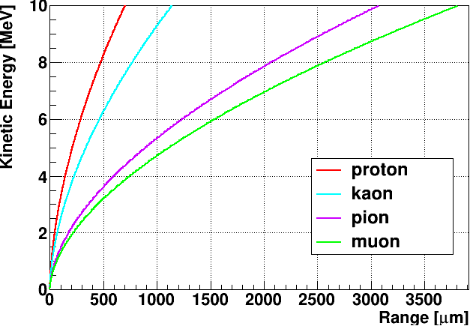
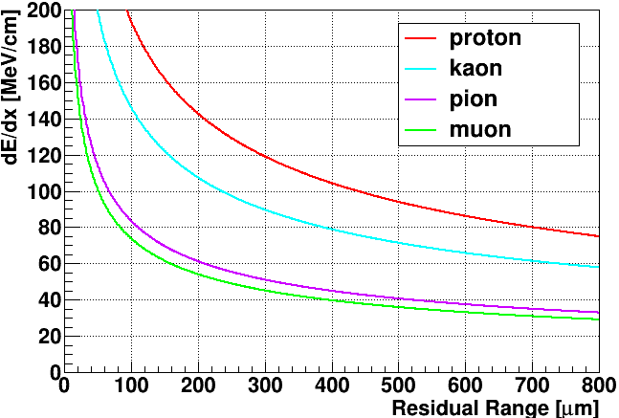

Slide 23
HV
FRONT side
BACK side
E-Field
Strip
Strip
Strip
2 mm
……….
……….
h
e
2 mm
2 mm
100x strips
Strip
……….
……….
100 um
100 um
substrate
Readout strips on
both sides of the substrate
Readout
Chip
Flex
120 um
Readout
Chip
Flex

