Slide 1
Management eines Departments am Beispiel von PH
Daniel Merten
Laura Doerr

Slide 2
Organisationsstruktur
CERN
RC
BE
TE
AI
FP
AT
EN
GS
HR
IT
PH
PS
AGS
Notes:
RC Research and Computing
AT Accelerators and Technology
AI Administration and General Infrastructure
PH Physics
IT Information Technology
BE Beams
TE Technology
EN Engineering
HR Human resources
FP Finance and Procurement
GS General Infrastructure Services
AGS Administration and General Services
PS Planning & Support

Slide 3
AIS
Administrative Information Services
SIR – Safety Information Registration
HRT – Human Resources Toolkit
EDH – Electronic Documents Handling

Slide 4
Service Level Agreement
Cooling and Ventilation
ATLAS
CMS
Power Distribution
ATLAS
ALICE
CMS
LHCB

Slide 5
Vergleich Budget requests
Category A | 2012 Estimates (15/07/2010) | 2012 preliminary budget | Difference
Detector related costs
Secretariat
Communications
Off-line computing
On-line computing
Test beams & calibration facilities
Laboratory operations
General services
Total without power
Power
Grand Total

Slide 6
LHC RRB Scrutiny Group Spring Meeting 2011
Montag, 16/05/2011
14:00 Introduction
15:00 Coffee
15:30 Preparation of experiments scrutiny
17:00 Discussion with RRB Chairman

Slide 7
LHC RRB Scrutiny Group Spring Meeting 2011
Dienstag, 17/05/2011
Closed pre-discussion, ATLAS
Closed pre-discussion, TOTEM
Closed pre-discussion, CMS
Closed pre-discussion, LHCb
SG Dinner

Slide 8
LHC RRB Scrutiny Group Spring Meeting 2011
Mittwoch, 18/05/2011
Closed pre-discussion, ALICE
Closed session, final discussion

Slide 9
Diverse kleinere Aufgaben
Praktikumszeugnis
Tender fuer das Feuerwehrfunksystem
Erstellung eines Programms fuer Herr Schroeder

Slide 10

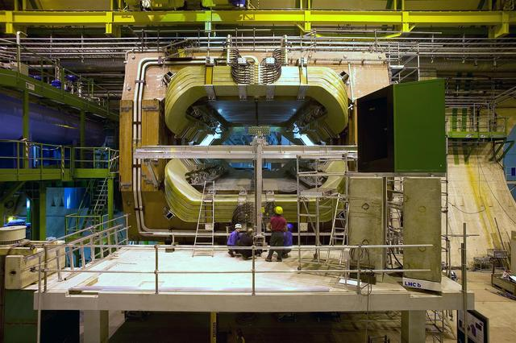
LHCb

Slide 11
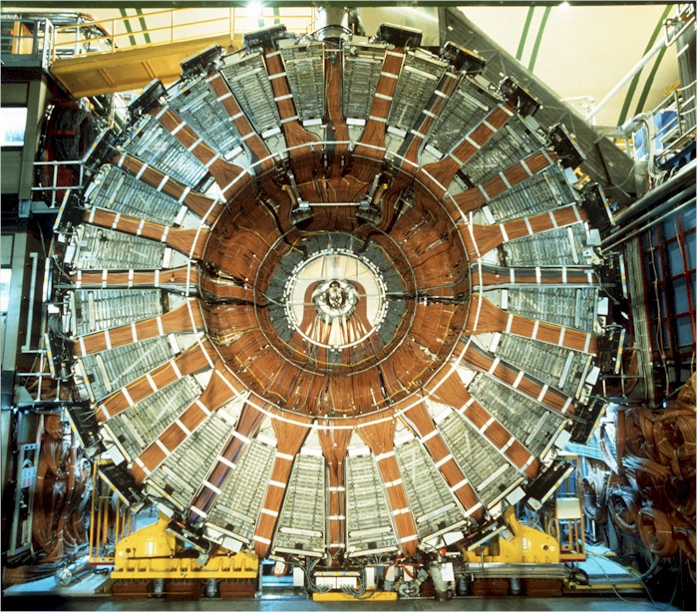
Delphi

Slide 12
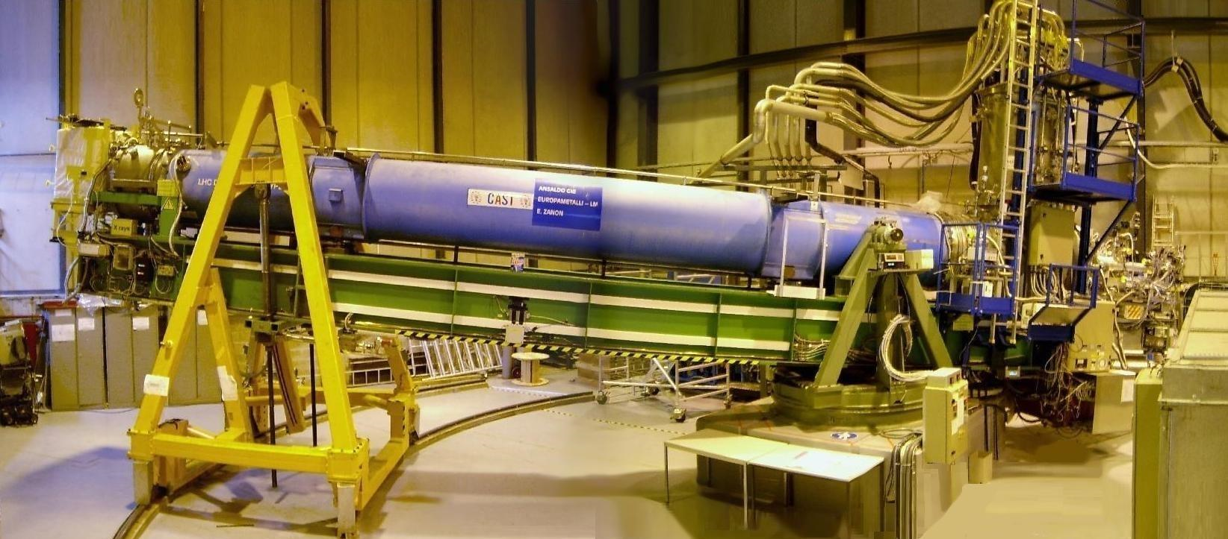
CAST

Slide 13
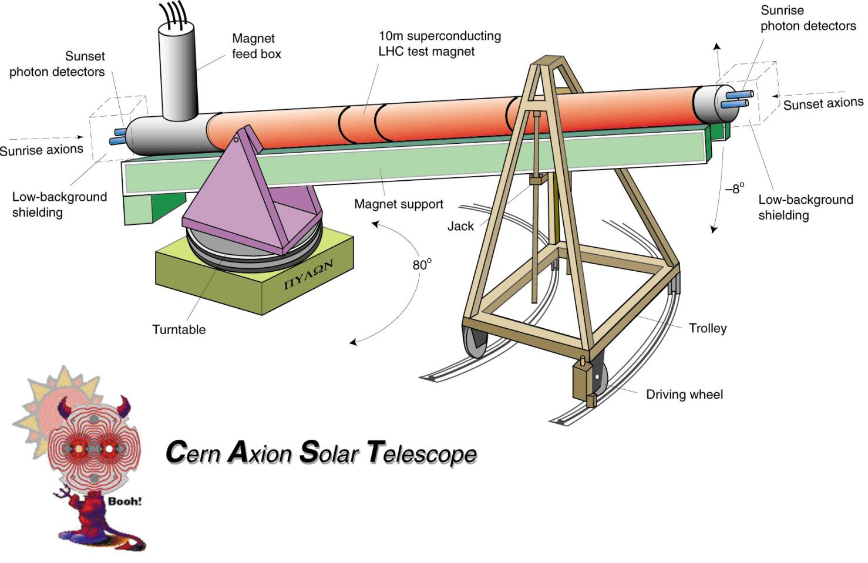

Slide 14
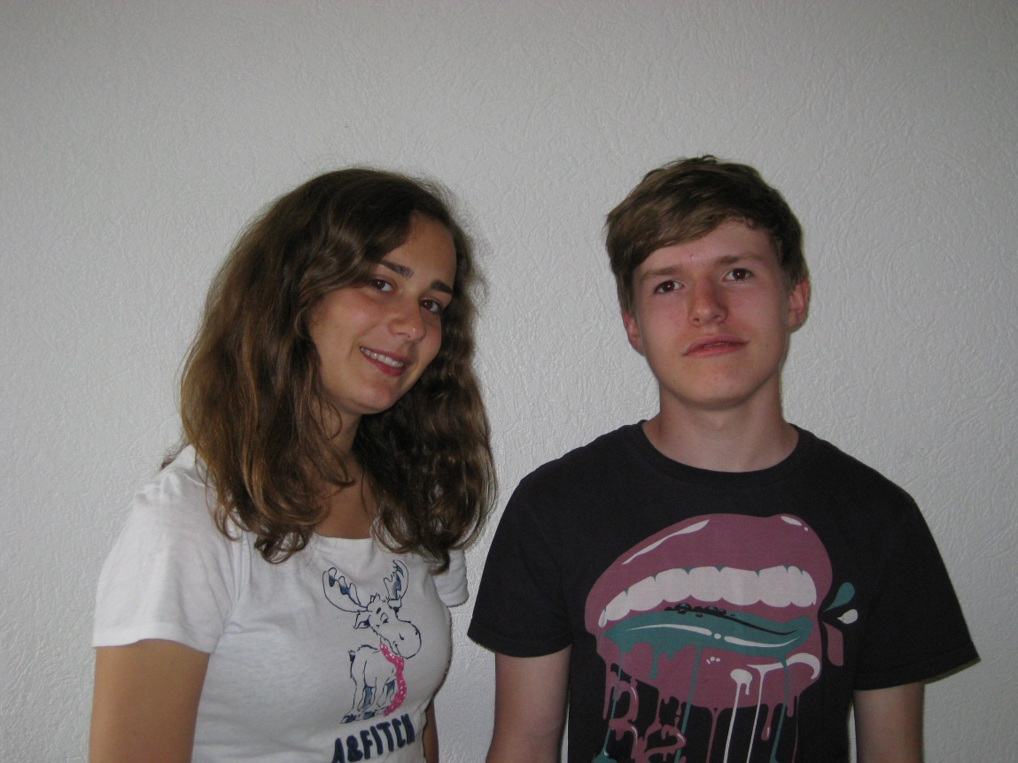
Vielen Dank Herr Schmeling fuer Ihre Muehe und Ihr Engagement!

Slide 15
Danke fuer eure Aufmerksamkeit!

