Slide 1
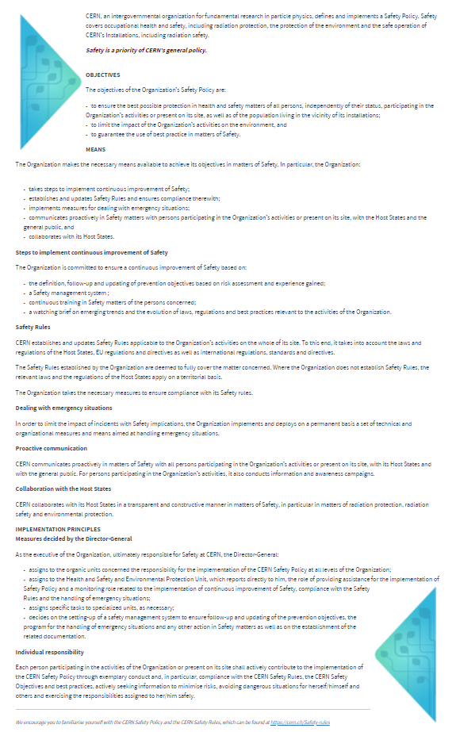
CERN Safety Policy
Extract from CERN Safety Policy
Safety is a priority of CERN’s general policy.
The objectives of the Organization’s Safety Policy are:
  to ensure the best possible protection in health and safety matters of all persons, independently of their status, participating in the Organization’s activities or present on its site, as well as of the population living in the vicinity of its installations;
  to limit the impact of the Organization’s activities on the environment, and
  to guarantee the use of best practice in matters of Safety.
The Organization makes the necessary means available to achieve its objectives in matters of Safety.
CERN collaborates with its Host States in a transparent and constructive manner in matters of Safety, in particular in matters of radiation protection, radiation safety and environmental protection.

Slide 2
Safety responsibilities @ CERN
Extract from CERN Safety Policy
As the executive of the Organization, ultimately responsible for Safety at CERN, the Director-General:
  assigns to the organic units concerned the responsibility for the implementation of the CERN Safety Policy at all levels of the Organization;
  assigns to the Health and Safety and Environmental Protection Unit, which reports directly to him, the role of providing assistance for the implementation of Safety Policy and a monitoring role related to the implementation of continuous improvement of Safety, Safety Policy compliance with the Safety Rules and the handling of emergency situations;
  assigns specific tasks to specialized units, as necessary;
  decides on the setting-up of a safety management system to ensure follow-up and updating of the prevention objectives, the program for the handling of emergency situations and any other action in Safety matters as well as on the establishment of the related documentation.
Individual responsibility
  Each person participating in the activities of the Organization or present on its site shall actively contribute to the implementation of the CERN Safety Policy through exemplary conduct and, in particular, compliance with the CERN Safety Rules,

Slide 3
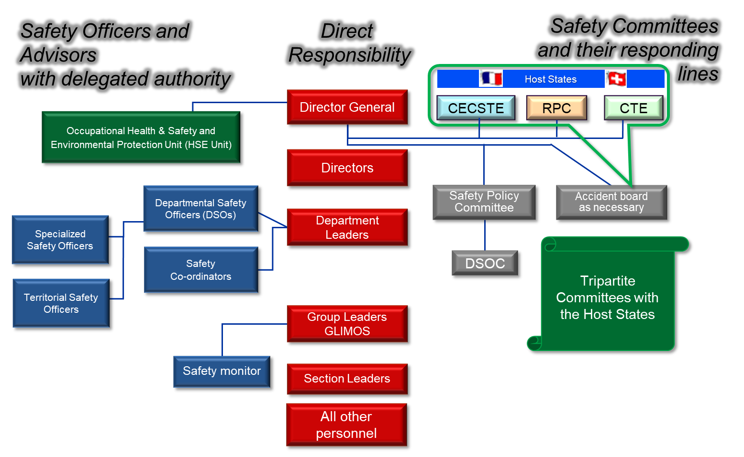
Safety responsibilities @ CERN
Changes ahead

Slide 4
The HSE Unit
B. Delille | HSE 2021 @ Directorate
EDMS 2453511

Slide 5
Mandate of the HSE Unit
Expert advice and services in matters of
Occupational Health and Safety & Environment
Establishes and updates Safety Rules as required for the proper functioning of the Organization
Grant authorizations (clearance) for installations, equipment, activities and projects with major Safety implications
Support
Authorizations
Safety rules
Monitors the environmental impact of the Organization’s activities
  Responsible for
  Radiation Protection
RP
Environmental monitoring
HSE
Mission
Responsible for Fire and Rescue and Emergency response
  Responsible for Occupational Medicine
Fire & rescue service
Occupational Medicine
The HSE Unit reports directly to the DG

Slide 6

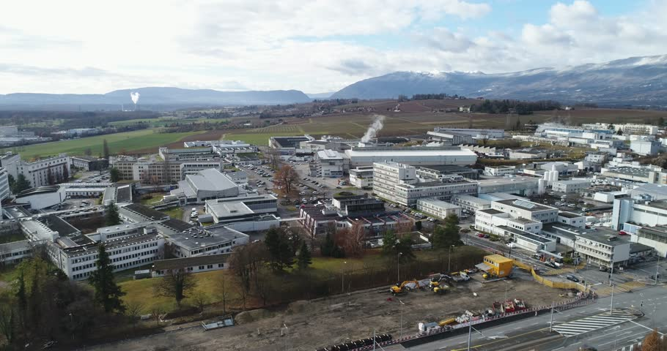
Stakeholders
Support
Authorizations
Safety rules
Host States Authorities in Matters of Radiation Protection and Radiation Safety
Local Authorities in matters of Environmental Protection
Fire and Rescue Services in France and Switzerland
ALL CERN Units and Departments, including their partners (institutes etc)
For the safe operation of CERN’s accelerators, experiments and premises
RP
Environmental monitoring
HSE
Mission
Occupational Medicine
Fire & rescue service

Slide 7
HSE Unit - 2021 Structure
HSE
Occupational Health & Safety and Environmental Protection Unit
DH: B. Delille / DDH: S. Roesler
HSE-ENV
Environment
HSE-OHS
Occupational Health & Safety
HSE-RP
Radiation Protection
HSE-TS
Transversal Services
HSE-FRS
CERN Fire & Rescue Service
GL: S. Kleiner /
DGL: L. Ulrici
GL: Y. Loertscher /
DGL: S. La Mendola
GL: S. Roesler /
DGL: H. Vincke
GL: P. Bonnal /
DGL: O. Deschamps –
S. Gunning - M. Nas
GL: A. Goehring-Crinon /
DGL: C. Delamare
DG
Workforce [FTEs]
Staff: 160
Fellows: 35
MPAs: 17
Reports to
MPEs: 195

Slide 8
HSE 2021 – Transversal Services Group
Workforce [FTEs]
Staff: 10
Fellows: 6
MPAs: 2
HSE-TS
Transversal Services
GL: A. Goehring-Crinon/
DGL: C. Delamare
HSE-TS-LC
Legal Support & Communication
HSE-TS-AS
Administrative Services
HSE-TS-ST
Safety Training
HSE-TS-SPP Special Projects & Processes
HSE-TS-CS
Computing Support
SL: A. Goehring-Crinon
SL: U. Tihinen
SL: C. Balle
SL: G. Segura
SL: C. Delamare
From DI
Centralized
From TC
From CEN
New

Slide 9
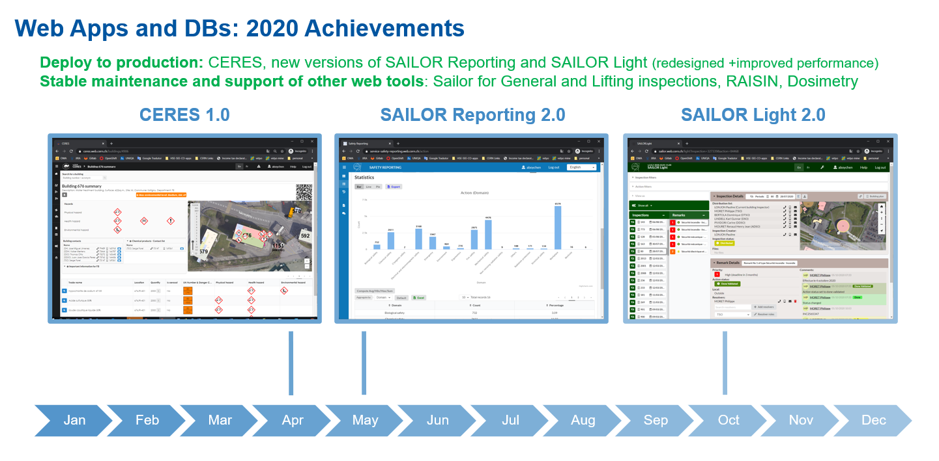
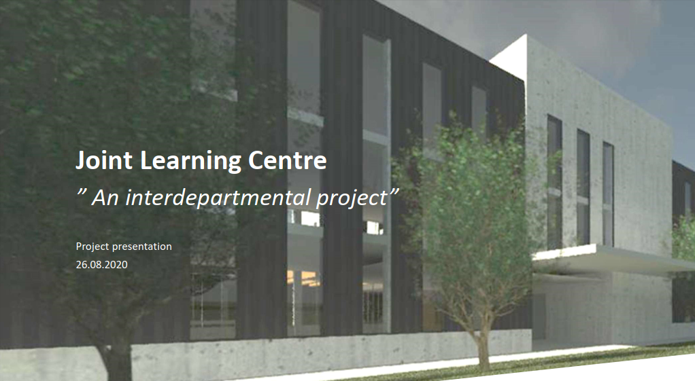
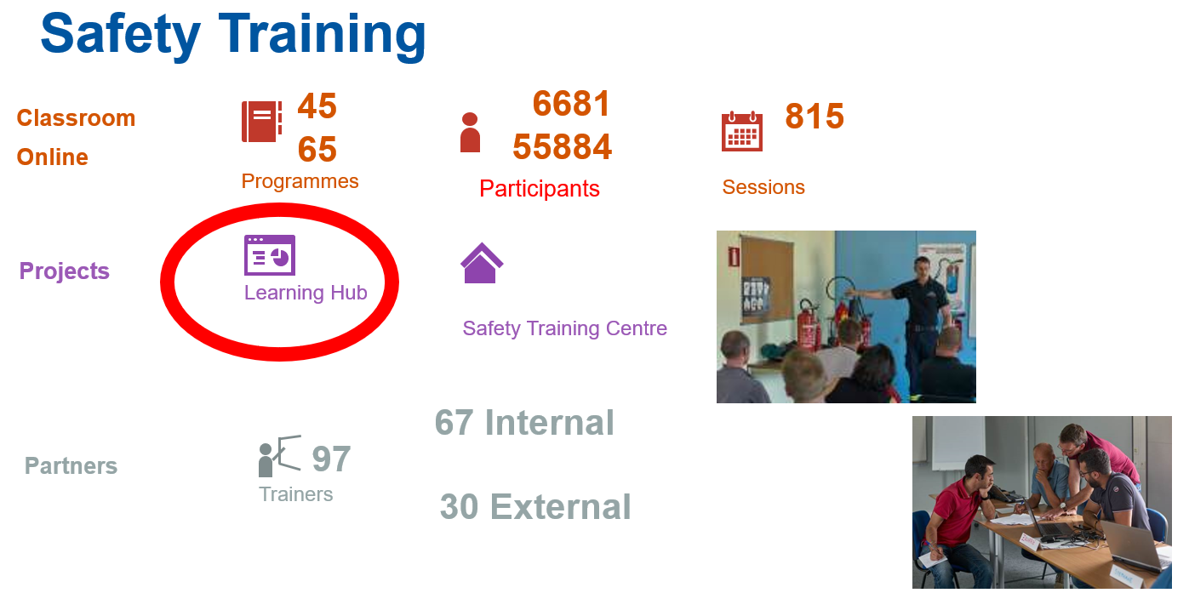
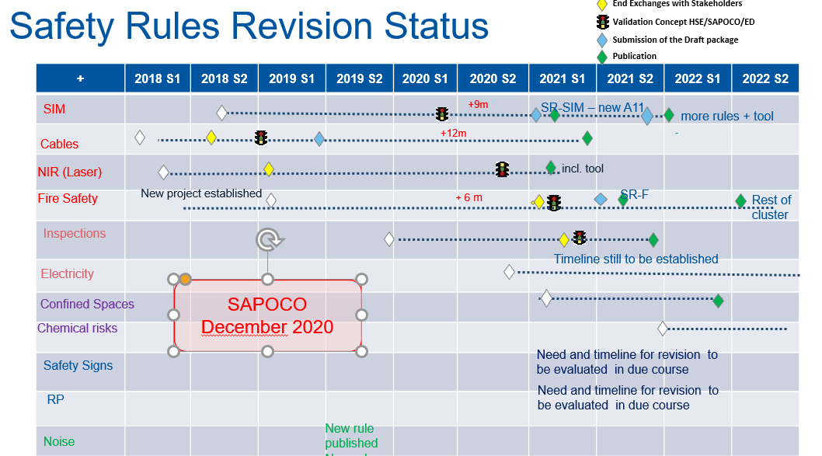
HSE 2021 – Transversal Services Group

Slide 10
HSE 2021 – Environment Group
Workforce [FTEs]
Staff: 8
Fellows: 2
MPA: 1
HSE-ENV
Environment
GL: S. Kleiner/
DGL: L. Ulrici
HSE-ENV-EP
Environmental Prevention
HSE-ENV-EM
Environmental Monitoring
SL: S. Schadegg
SL: A. Dziewa
Safety Computing
Noise

Slide 11

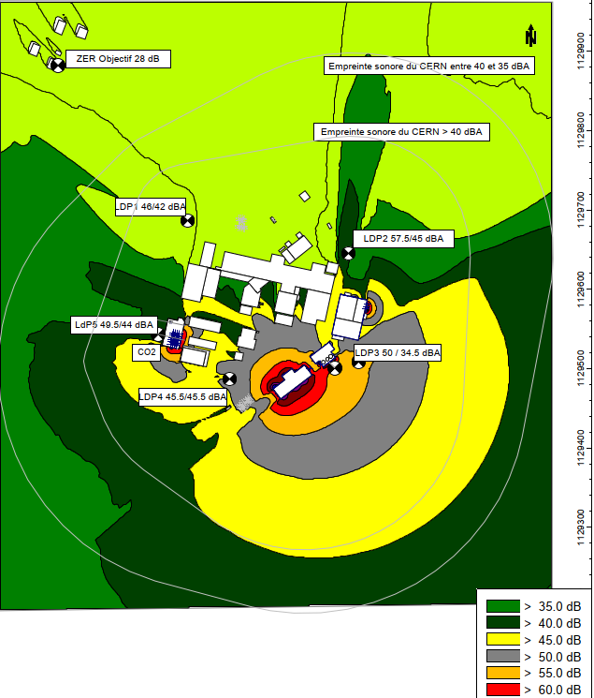
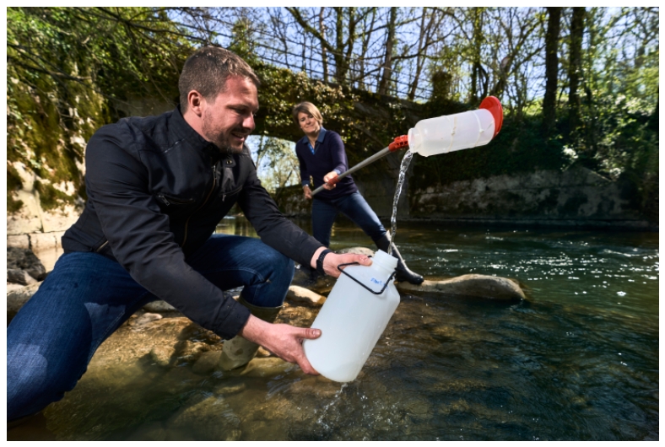
HSE 2021 – Environment Group

Slide 12
HSE 2021 – Radiation Protection Group
Workforce [FTEs]
Staff: 47
Fellows: 20
MPAs: 11
HSE- RP
Radiation Protection
GL: S. Roesler/
DGL: H. Vincke
HSE-RP-AS
Accelerators & Sites
HSE-RP-CS
Characterisation & Services
HSE-RP-DC
Dosimetry & Calibration
HSE-RP-RWM
Radioactive Waste Management
HSE-RP-IL
Instrumentation & Logistics
SL: H. Vincke
SL: C. Theis
SL: P. Carbonez
SL: D. Perrin
SL: G. Dumont
HSE-RP-SP
Special Projects
SL: M. Silari

Slide 13
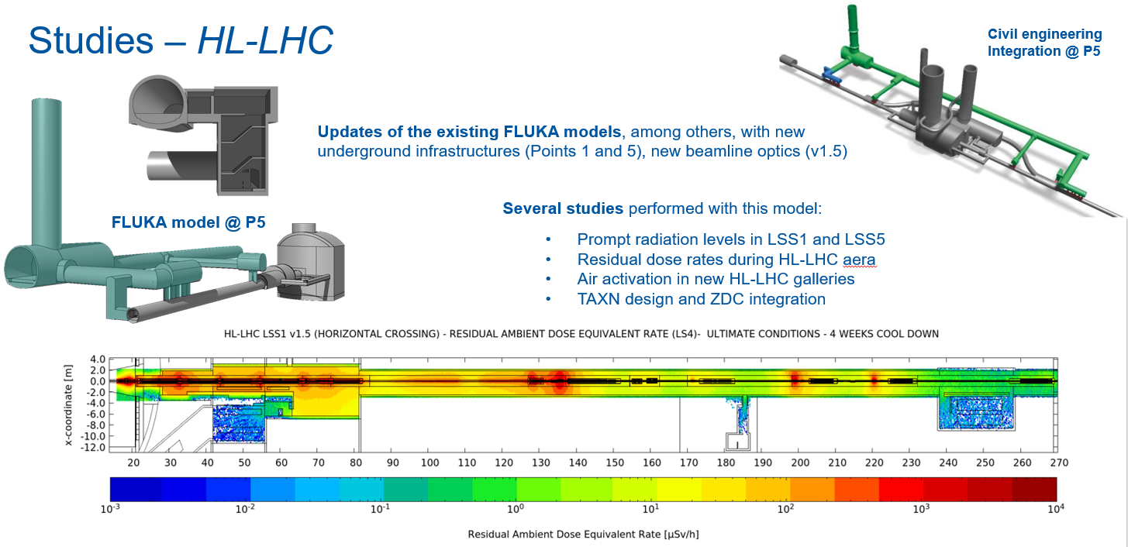
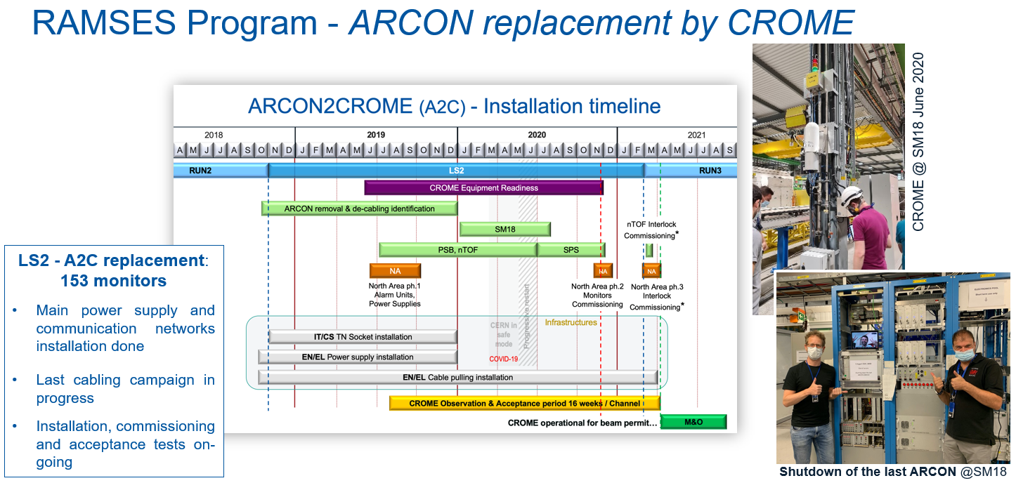
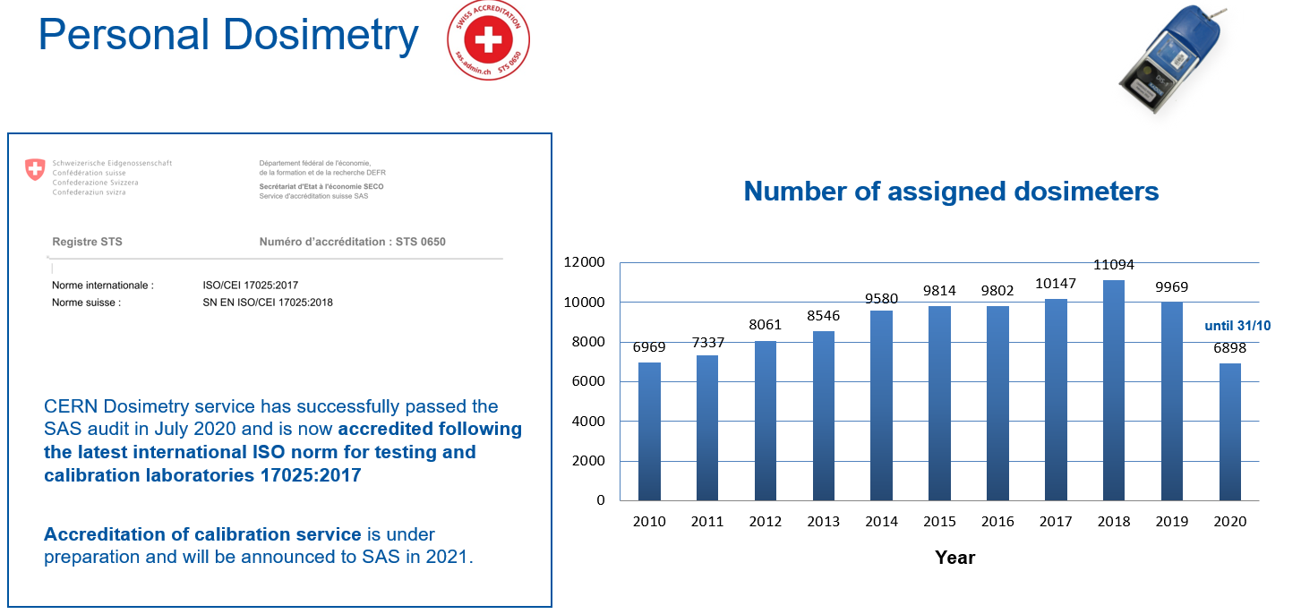
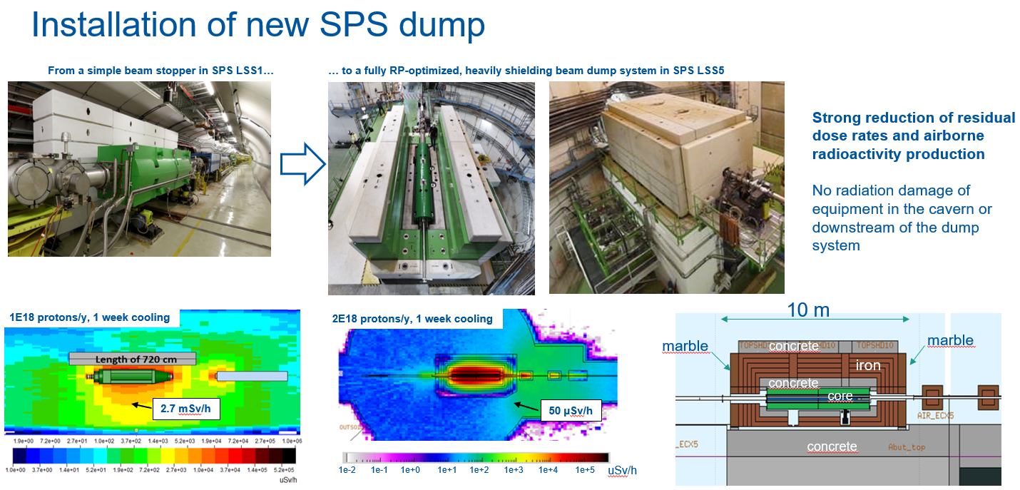
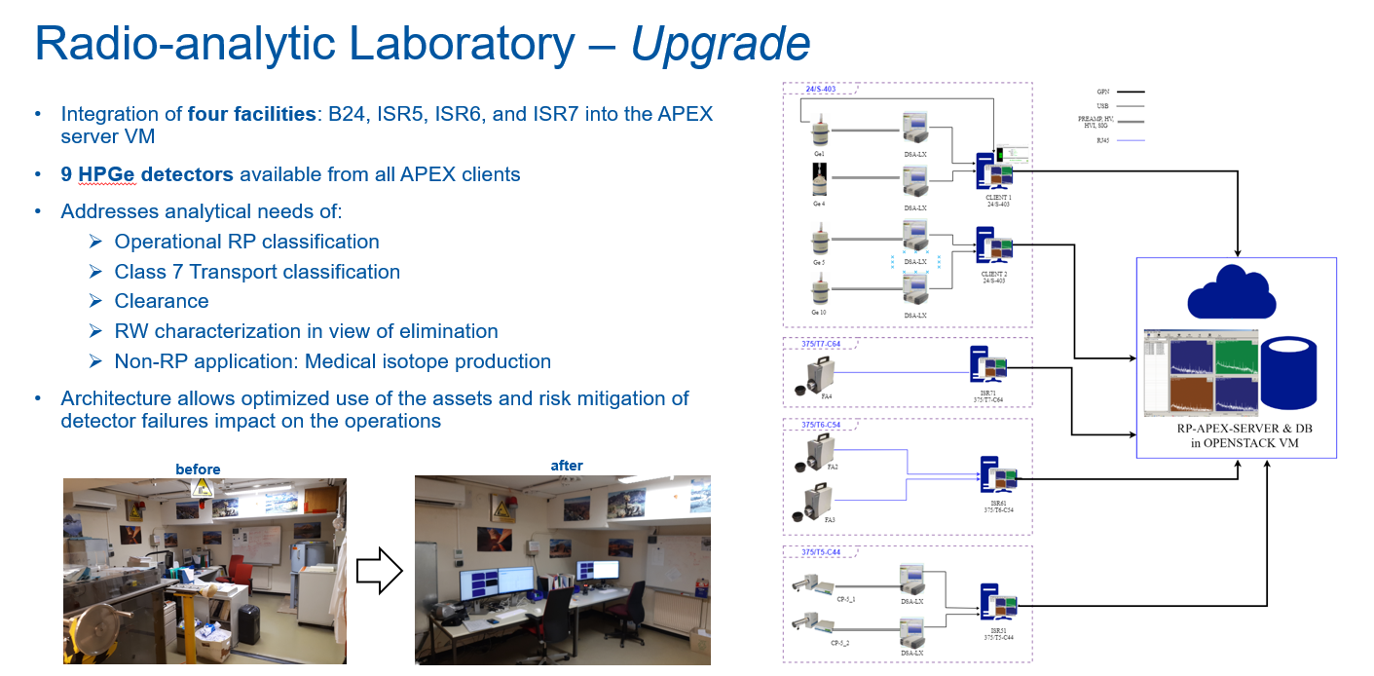
HSE 2021 – Radiation Protection Group

Slide 14
HSE 2021 – Occupational Health & Safety Group
Workforce [FTEs]
Staff: 31
Fellows: 6
MPAs: 3
HSE-OHS
Occupational Health & Safety
GL: Y. Loertscher/
DGL: S. La Mendola
HSE-OHS-PE
Process Engineering & General Safety Services
HSE-OHS-IB
Infrastructure & Building Safety Engineering
HSE-OHS-ME
Medical Service
SL: S. Marsh
SL: S. La Mendola
SL: B. Delille
(ad interim)
Noise

Slide 15
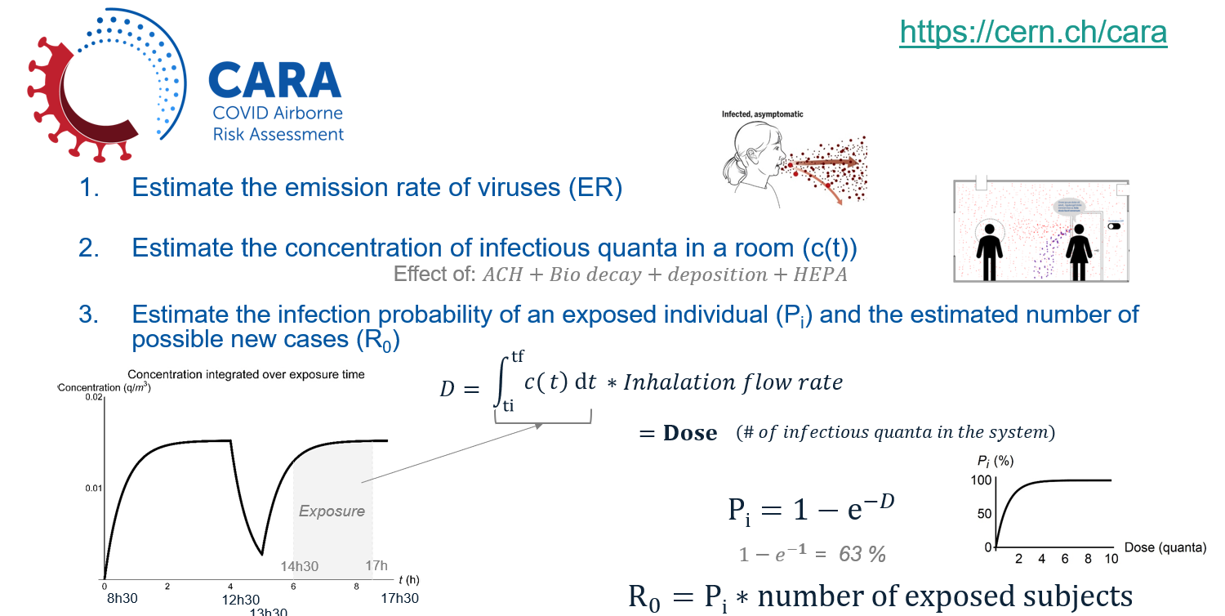
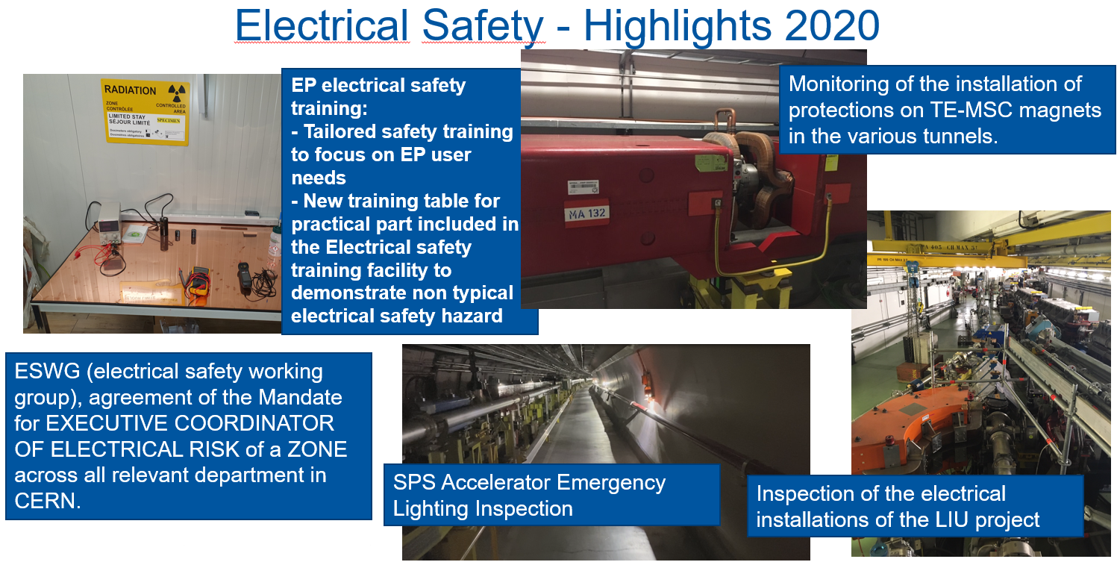
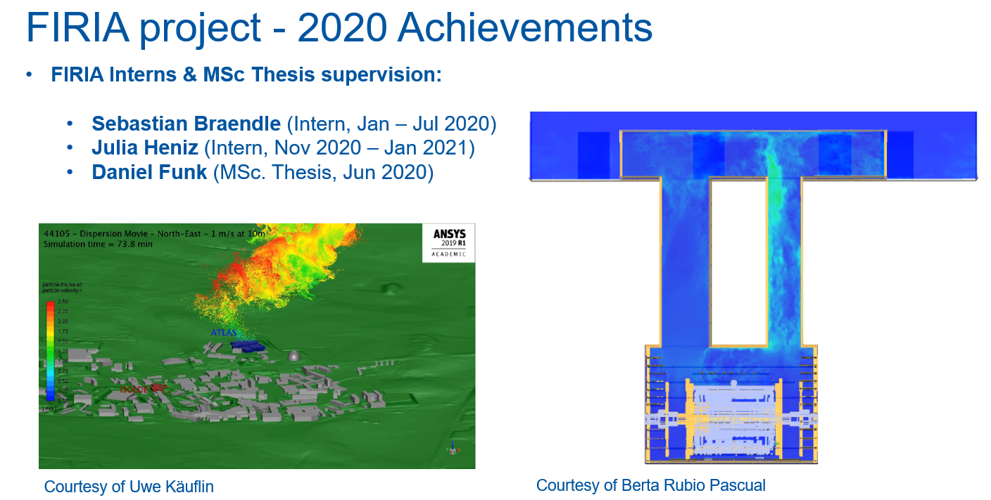
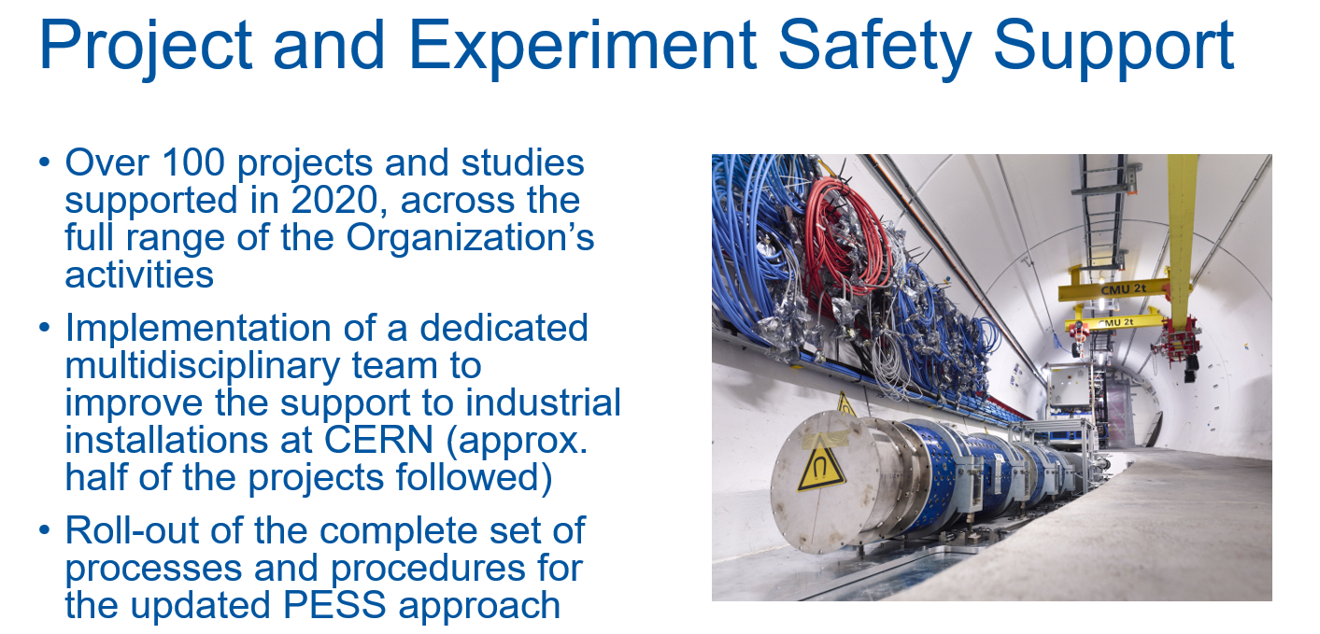
HSE 2021 – Occupational Health & Safety Group

Slide 16
HSE 2021 – Fire & Rescue Service Group
Workforce [FTEs]
Staff: 58
HSE-FRS
Fire & Rescue Service
GL: P. Bonnal / DGL: O. Deschamps,
S. Gunning, M. Nas
HSE-FRS-CI
Incident
Command
HSE-FRS-OP
Operations & Planning
HSE-FRS-SI
Systems & Information
SL: M. Nas
SL: O. Deschamps
SL: S. Gunning

Slide 17
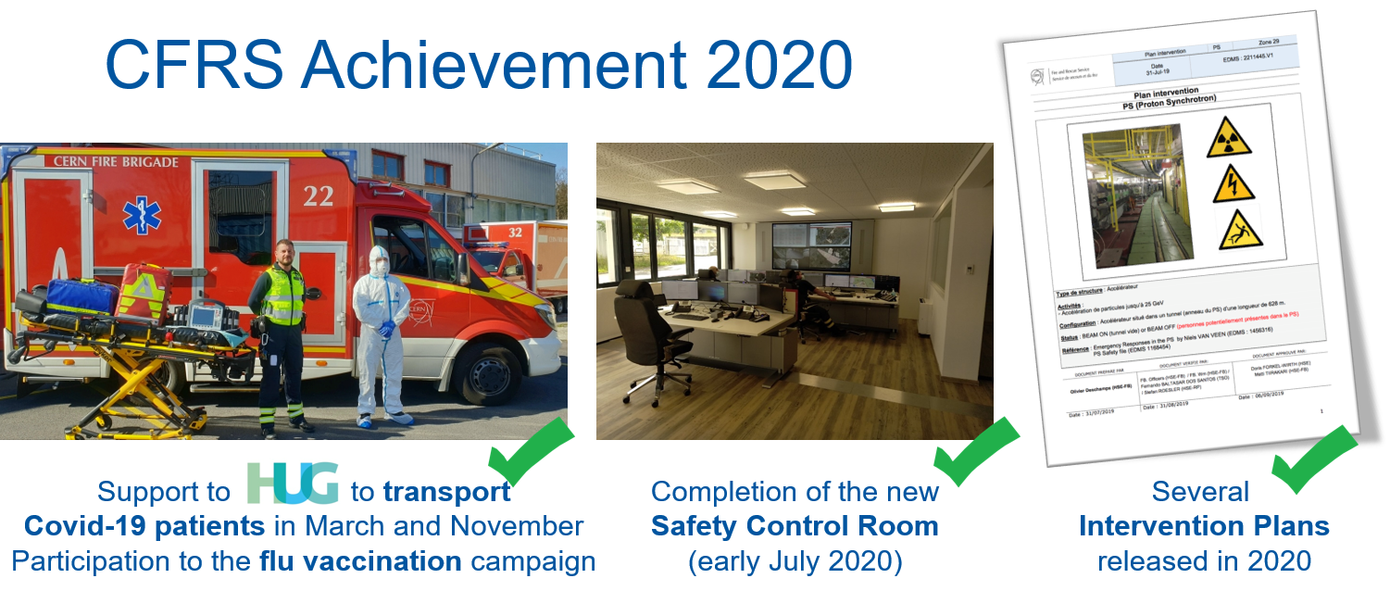
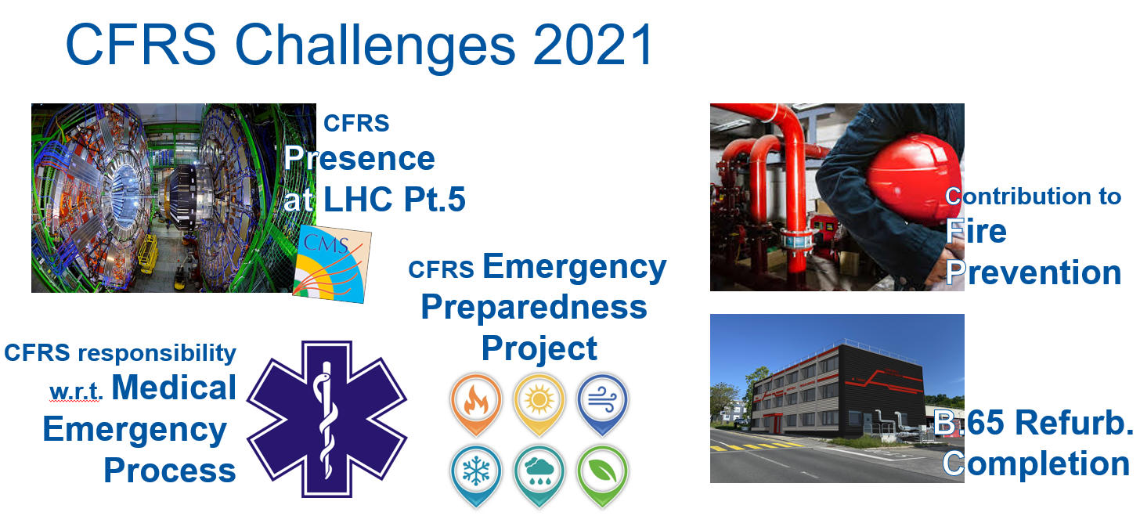
HSE 2021 – Fire & Rescue Service Group

Slide 18

HSE 2021/2025 – A 5-Yr Vision
An integrated HSE Unit that
- is recognized as the advisory, inspection and authoritative body in matters of Safety at CERN.
- provides a well-defined level of operational and emergency response.
Ready to face challenges of Run3/LS3 and future major accelerator project(s).
The Management and Technical Management Boards (MB & TMB) will ensure the sharing of managerial and technical information to allow the appropriate decisions to be taken. These are the managerial & operational bodies of the Unit.

Slide 19

HSE 2021/2025 – Priorities (1/4)
Environment
  Deliver and monitor objectives defined in CERN Environmental reports, for both conventional and radiological environmental aspects. Assess and document the long-term radiological environmental impact for homologation with the Host States Authorities.
  Develop, with CEPS, the strategy and implementation plan for 2021-2025. (Proposal to Directorate members that DHs participate in CEPS, the original participation -2016- was DHs of BE, EN, TE, EP, SMB, HSE, IR + SY– to be discussed ofc).
  Strengthen relations with both inside partners (FCC) & outside partners (external stakeholders, EC).
The strategy and implementation plan shall cover three main aspects: Raise awareness of our impact on the environment, propose the implementation of projects for CERN in the HiLumi Era, study with partners like FCC the environmental impact of PP activities

Slide 20
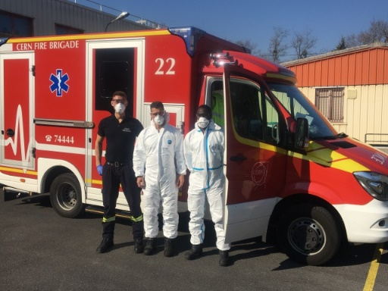
HSE 2021/2025 – Priorities (2/4)
HSE operational and emergency response: the definition and implementation of
  Emergency Preparedness Plan
  Occupational Health Management Plan
  Safety Reviews Plan, i.e. revised Inspection plan (name to be agreed)
The development of these plans will require the identification of the HSE operational & emergency response level - according to risks and retour d’expérience, a gap analysis to compare with the currently developed response level, an implementation plan and the identification of situations needing the intervention of outside partners.
Note: The Occupational Health Management Plan will include the required evolution towards a risk based health surveillance at CERN. Before launching a project on the evolution of the Medical Service, the priority for 2021 will still be to manage the COVID-19 situation.

Slide 21
HSE 2021/2025 – Priorities (3/4)
HSE as advisory body and support to departmental activities
  Implement support to Projects, Studies, Experiments and Departments’ activities transversally across HSE, delivering a proactive and pragmatic approach in providing guidance and training in all Safety domains within the scope of the HSE Unit.
This project concerns all HSE groups and technical safety domains. The goal is that HSE provides advice as a Unit, and not as a combination of groups working in silo.

Slide 22
HSE 2021/2025 – Priorities (4/4)
Lessons learnt from LS2 and readiness for Run3/LS3
  For all Safety aspects, team up with Departments and Experiments to understand the safety issues raised during LS2 and how these could develop during LS3. This priority is wide and includes many aspects such as: the definition of clear guidelines for interventions of non-electrical nature in the vicinity of electrical equipment, works and services supervisor, safety coordination depending on the category of works, closure of all LS2 ALARA Level 3 works, document lessons-learnt and agree on actions to be taken for LS3. Review together with LHC Experiments the RP follow-up during LS2 upgrade works and integrate into LS3 preparation
Safety rules
  Delivering well-coordinated efforts towards a consistent framework of rules in support of operational activities.

